Slide 1

Rotary Peace Conference with Marva Wisdom & Crista Renner January 14, 2026

Slide 2
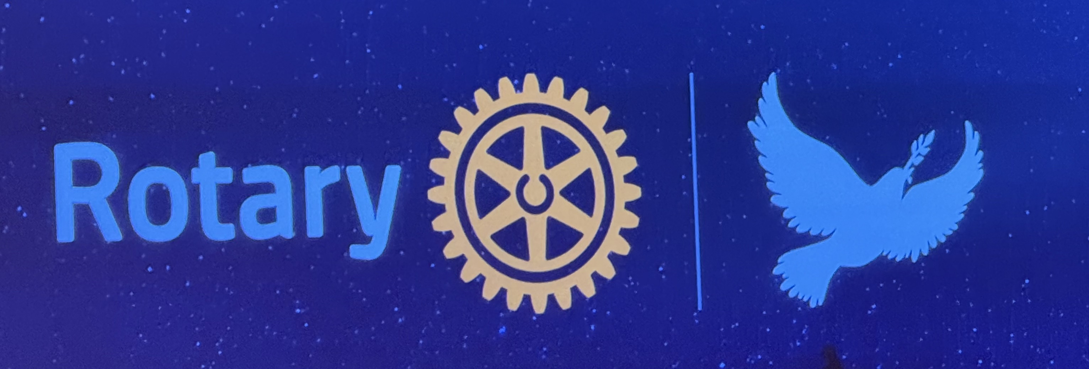
What we will talk about today
Our Experience
What we learned, Key Messages
What we can do as Rotarians
Your Questions

Slide 3
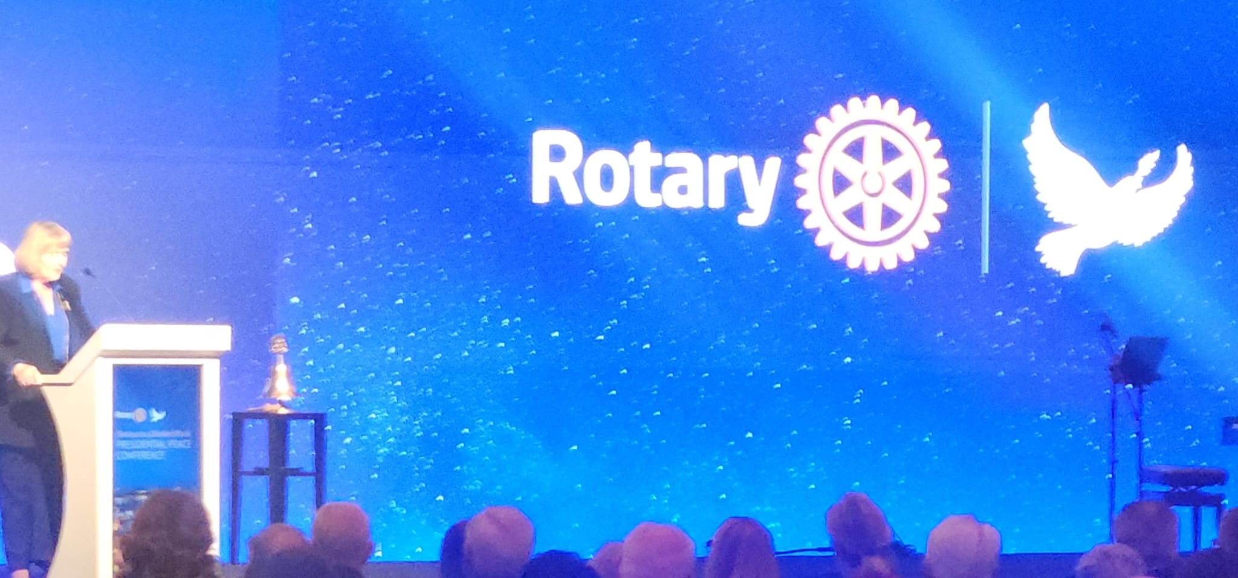
Purpose as understood and threaded throughout conference
Rotary chose Istanbul because it stands as the city that bridges the world:
straddling continents, old meeting the new, its peoples, culture and religious diversity
The conference is a platform for dialogue
Leaders re-stated that "diversity is our strength"
Conversations focused on economic, social and environmental justice
Did you know?
"Indigenous people make up 5% of the world's population, yet they protect 80% of the world's biodiversity." United Nations

Slide 4
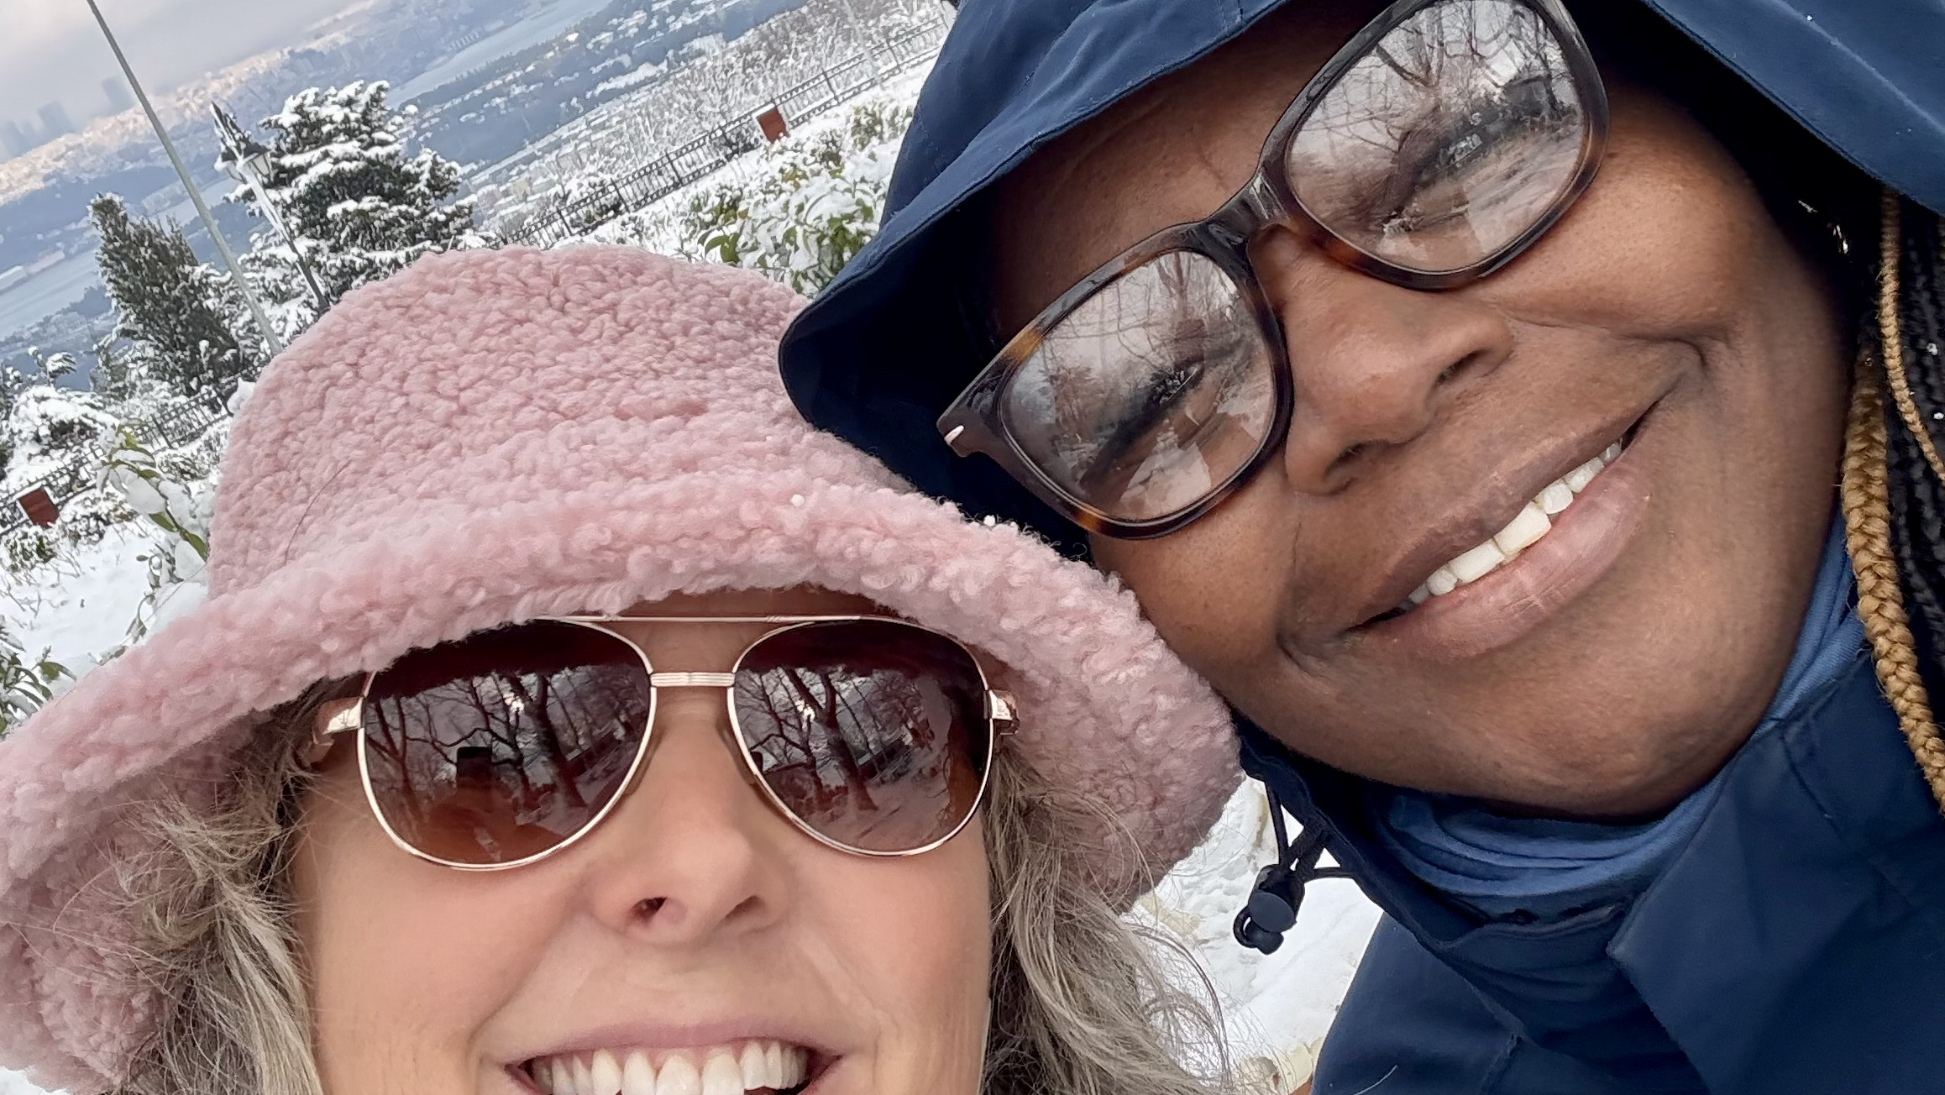
Our Experience
Our overall feelings and take-aways.
What stood out and continues to stand out most for each of us?

Slide 5
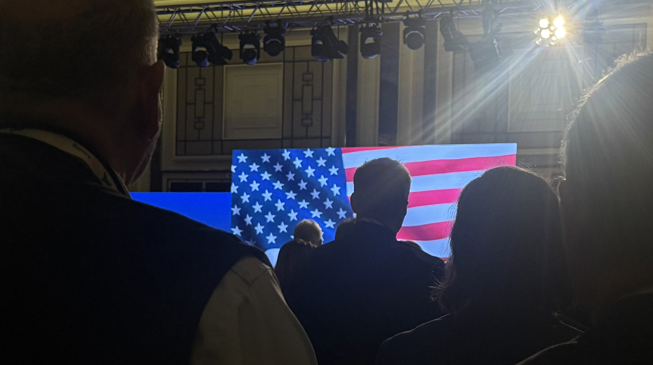
What we learned
Key Messages from the Conference

Slide 6
What the UN Acknowledges
The United Nations need a transformation in Global Governance to meet today's challenges (UN Assistant Secretary)
Greater use of the UN Charter
$2.4 trillion spent on war and pittance spend on peace and prevention of war
Peaceable countries have higher GDP
The more $$$'s on military spending the less available for education, health, infrastructure, food, housing (basic necessities

Slide 7
Key Takeaways
Information Warfare - Epidemic of misinformation, a greater need for education
Trust deficit between state & citizens: as a result of the misinformation
Invisible threads of conflict: processes & systems playing in the background
The perception of polarization is stronger than the polarization

Slide 8
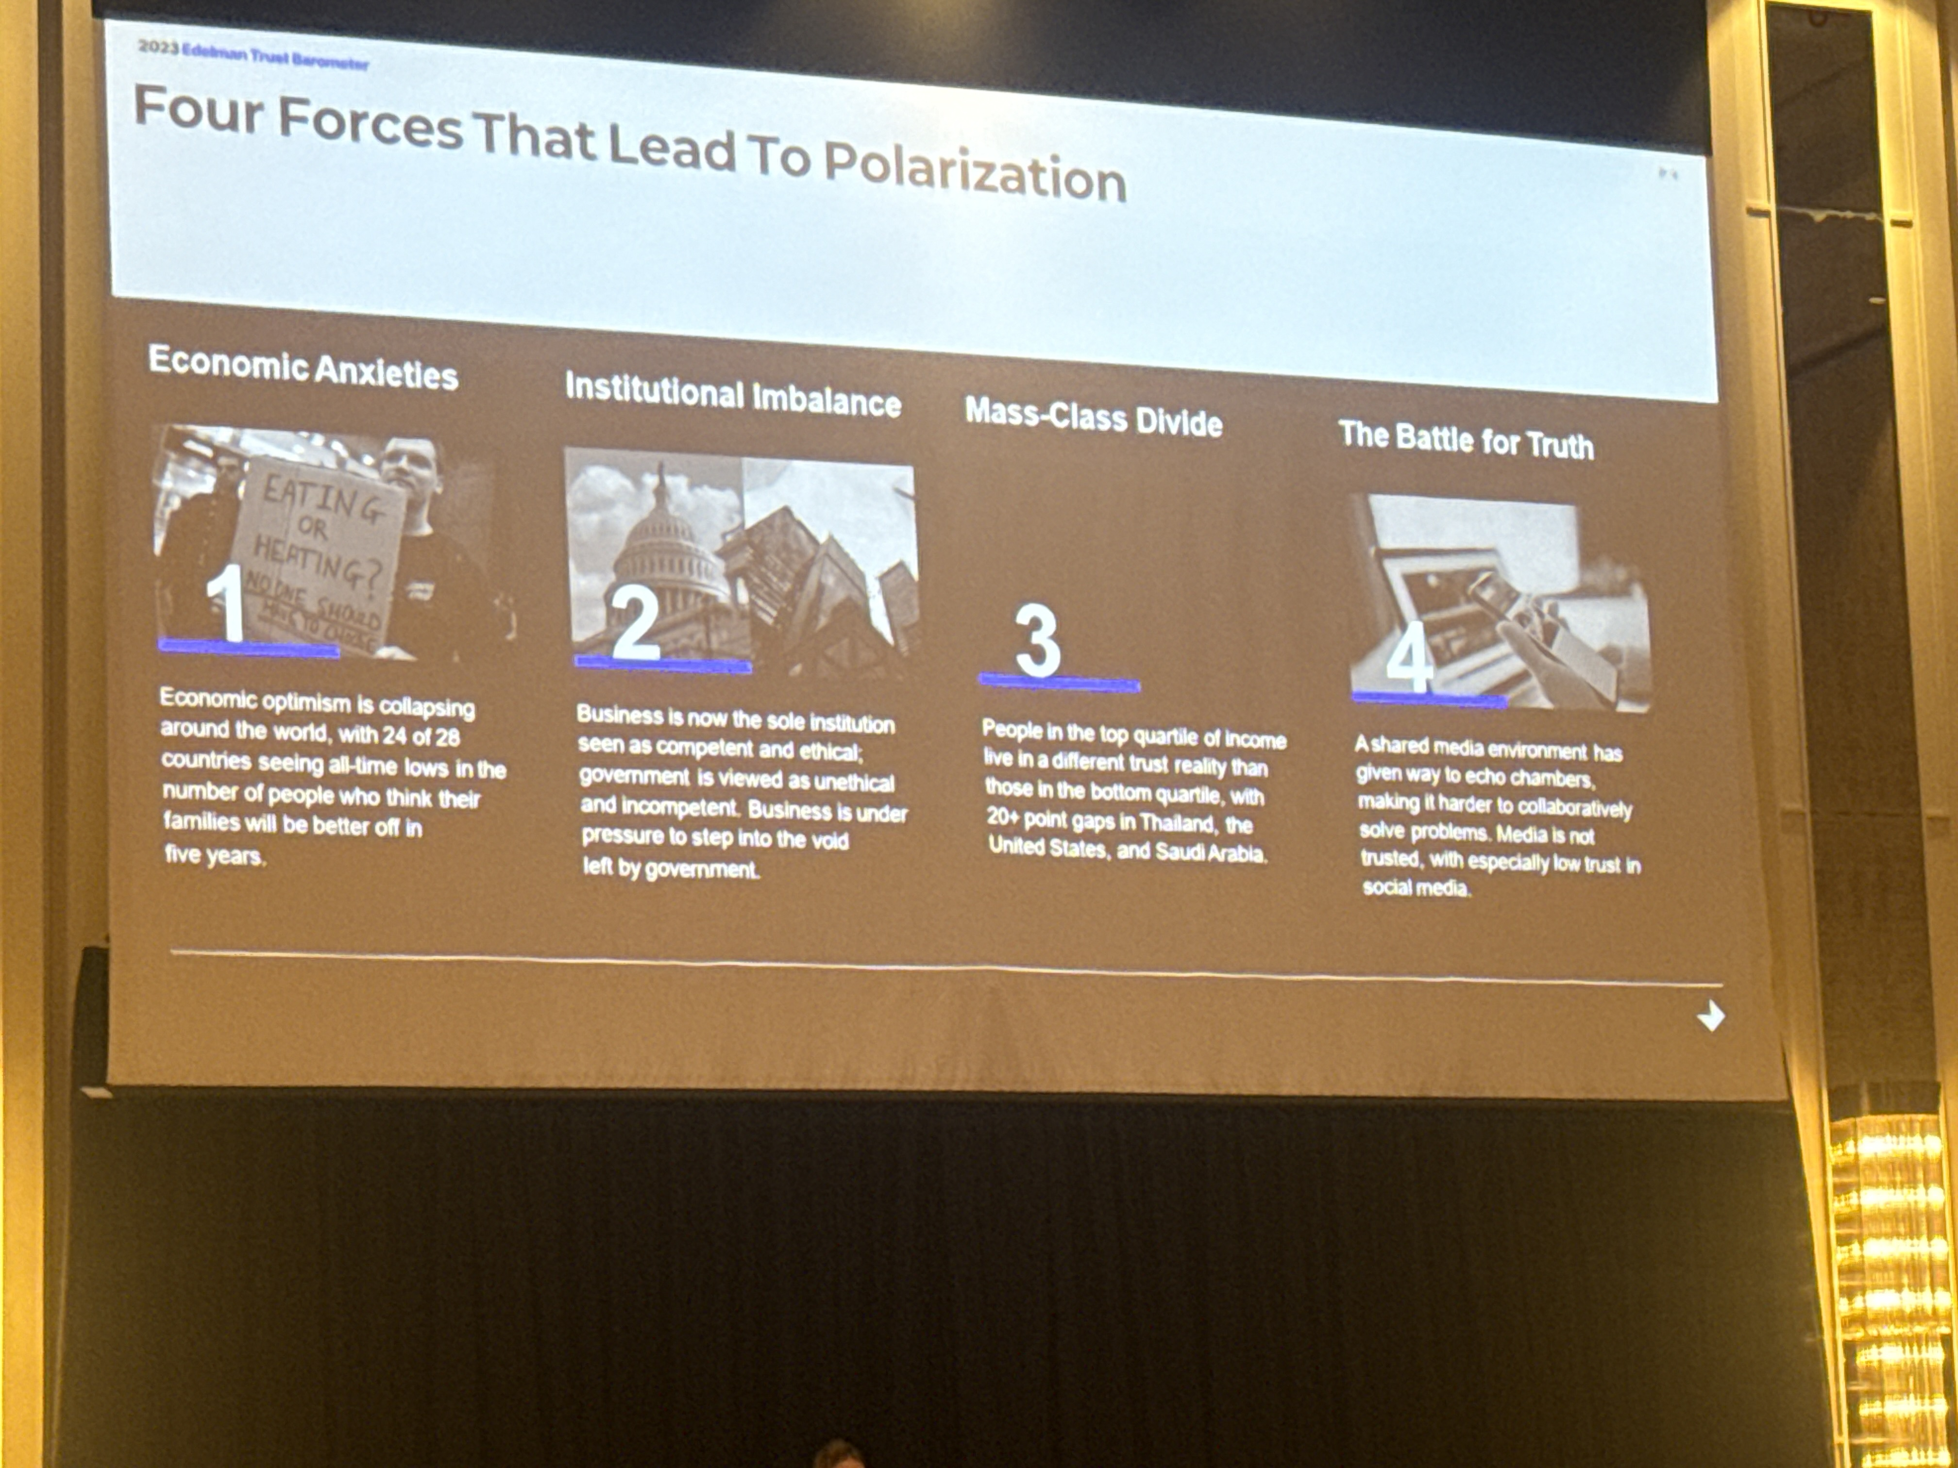
Polarization
REMEMBER: THIS CONFERENCE WAS
ALMOST ONE YEAR AGO.

Slide 9
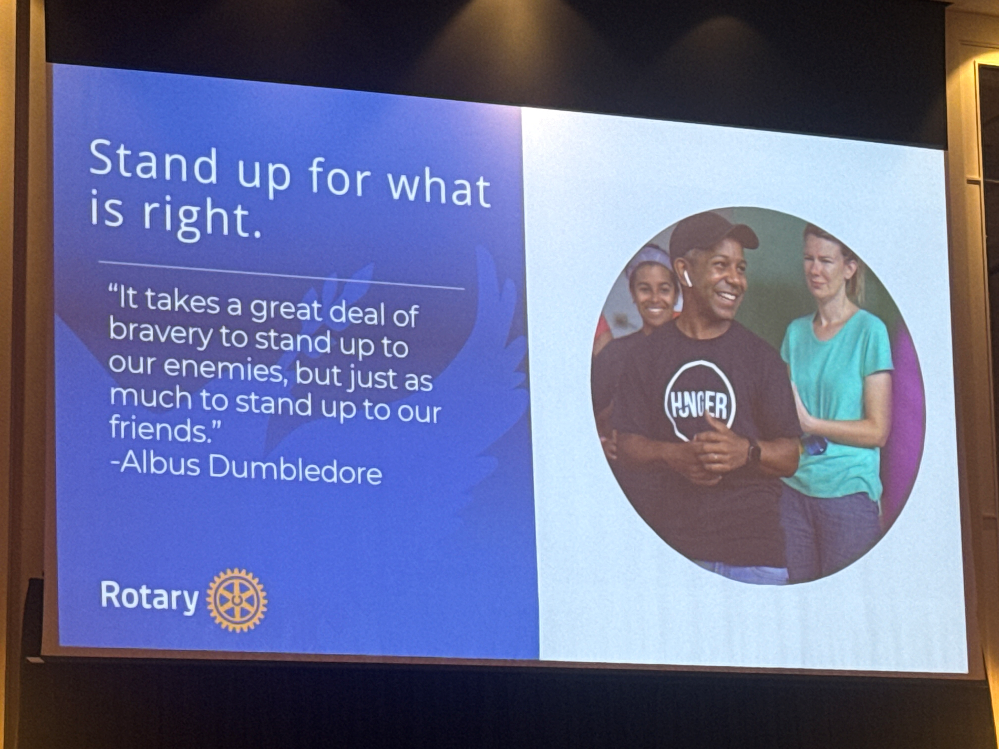
What we can do as Rotarians?

Slide 10
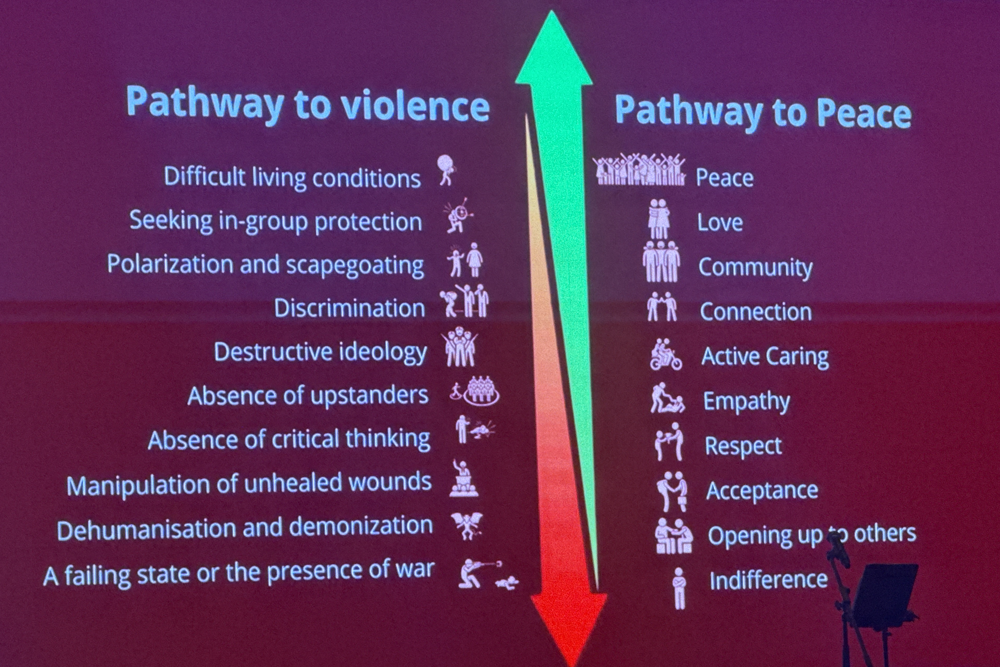

Slide 11
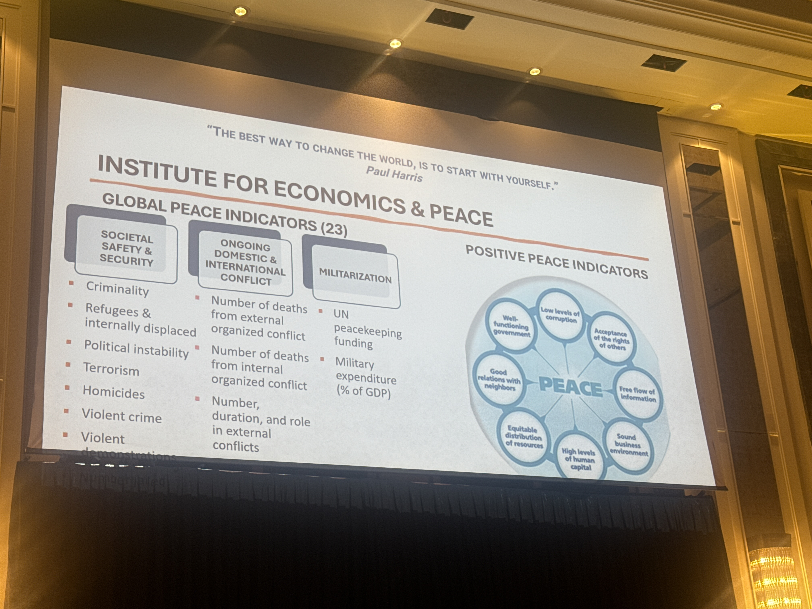

Slide 12
8 Pillars: Positive Peace
Well-Functioning Government
Equitable Distribution of Resources
Free Flow of Information
Good Relations with Neighbours
High Levels of Human Capital
Acceptance of the Rights of Others
Low Levels of Corruption
Sound Business Environment

Slide 13
Actions we can take to heal in a divided world
Be the best version of yourself
Engage with and encourage others to have difficult conversations. This requires quiet courage. Without these conversations, we contribute to the invisible threads of conflict.
Engage in conversations with the heart and mind of a "good host".
As Rotarians, fight aggressively for peace as those who want to wage war.
Questions: How did you come to care about...
Peace requires more than hope.
Get youth involved. (interact)
As Rotarians, we do things that matter. Now, more than ever, what we do matters.
Foster inclusion
Focus on mental health and psycho-social healing

Slide 14

Your Questions?

Slide 15
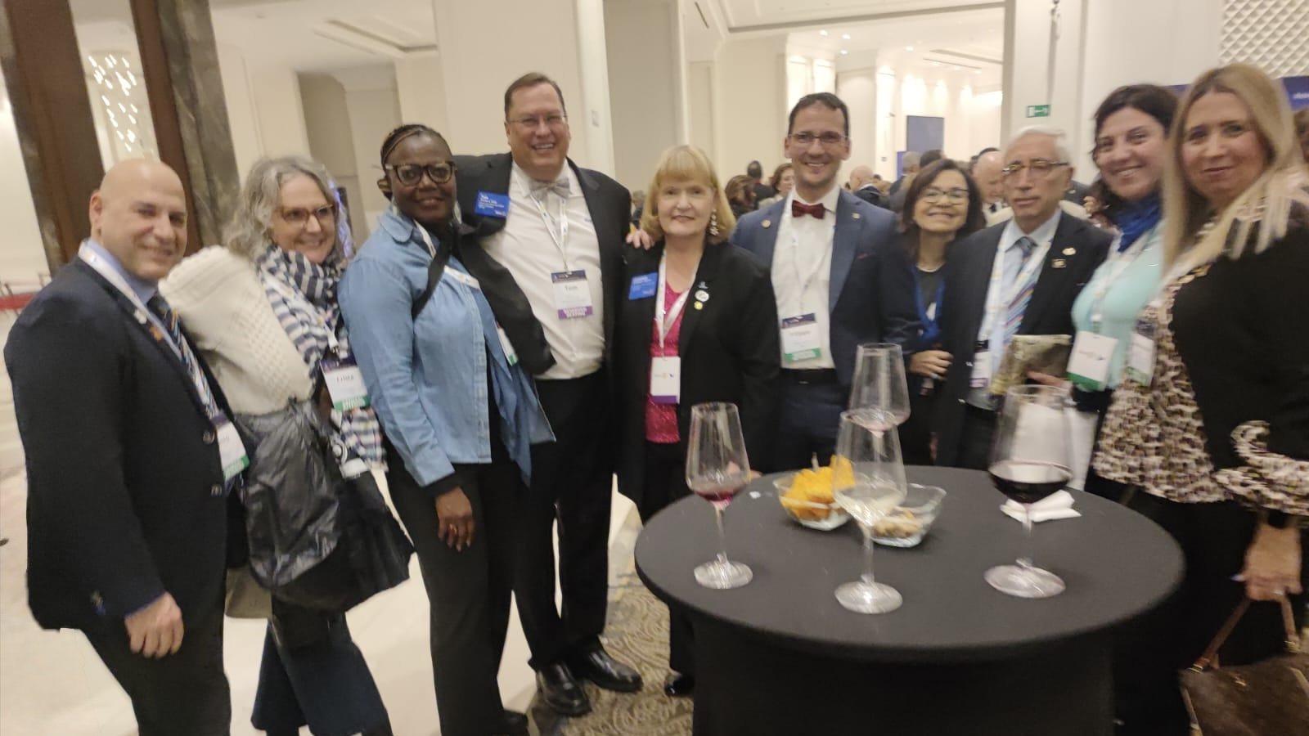
Thank you!
Marva, Crista and 1.4 Million other Rotarians

