Slide 1


NEW Guidelines and Application Process

Slide 2

The Paul Harris Fellow Award
An honour given to recognize an individual’s significant, above and beyond, contributions to Rotary and the community.
Can be given to Rotarians, community members, or posthumously
Recipients exemplify the qualities and ideals of Rotary, “Service Above Self”, be active in community affairs and be known as someone who lives the “Four-Way Test”.

Slide 3
History of the Award
Our club has given out over 130 PHF Awards since 2000
As a sustaining club we contribute $100 per member annually to the Rotary Foundation
This gives us the capacity to give out many more awards

Slide 4

New Application Form

Slide 5
Questions
Why should the nominee receive a PHF Award? (Describe their contributions to Rotary and the community. Include examples of leadership, service and impact that demonstrate commitment to Rotary’s values and ideals)
What are some examples of the positive impact of the nominee’s volunteer service and/or professional accomplishments that support this nomination?

Slide 6
Questions
Provide examples of how the nominee demonstrates the Four-Way Test
What are some other things we should know about the nominee? (Additional facts or stories that add interest or value that are relevant to the nomination)

Slide 7
When to Submit nominations To dmbuchan@gmail.com
By May 1st
And anytime!!!

Slide 8
We can Help. And we will review applications and make recommendations to the Board
Awards Committee
Donna B. Donna G.
Jon Maneesh
Patsy Tara
Jannette

Slide 9
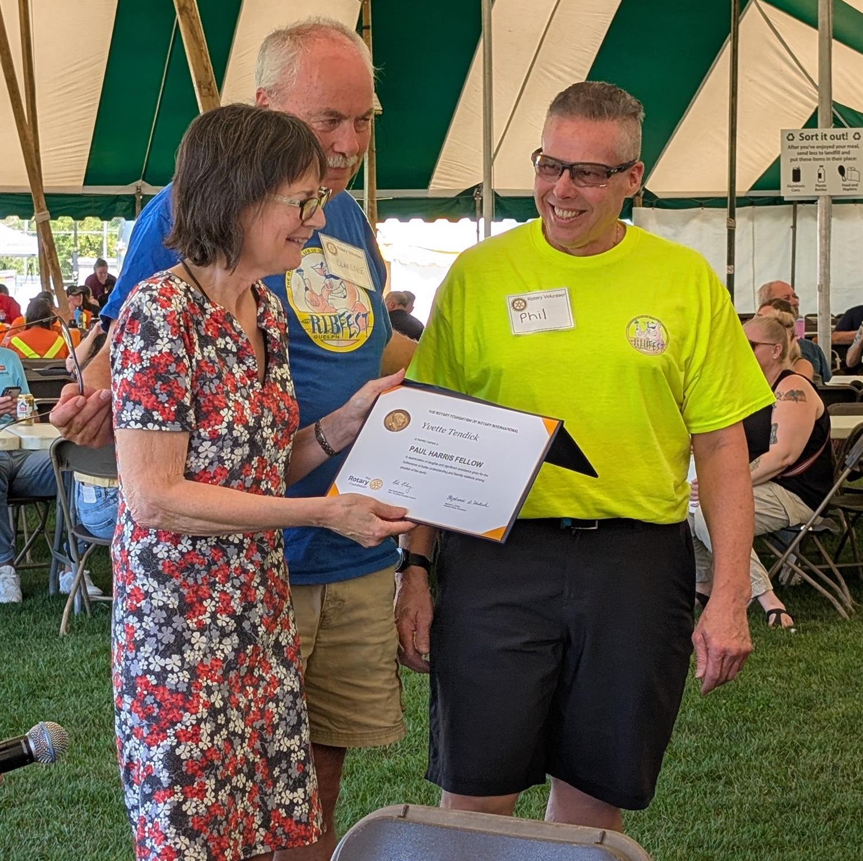
Never an expectation, always an honour.
Who do you think is deserving?
Nomination form on ClubRunner
(Members only/Club Info/Documents/Paul Harris Fellow)

