Slide 1
Global Grants
7080 Presidents’ Meeting
September 23rd, 2013

Slide 2
3 Types of Grants
District Grants
Global Grants
Packaged Grants
Short-term projects/activities
Local or International
Funded by Clubs and District
Administered by District
Large scale projects/activities
International
$30,000 minimum budget
Funded by Clubs, District and TRF
Administered by TRF
Work with RI strategic partners on predesigned activities (i.e. Aga Khan University)
Fully funded by World Fund & strategic partner
Notes:
District grants align with the mission of TRF.
Global Grants align with one or more areas of focus.
Additional Information if required.
RI Strategic Partners
Rotary’s relationship with the following partners opens the door for Rotarians to work with them directly:
ShelterBox for disaster relief
Global Food Banking Network for hunger
Dollywood Foundation's Imagination Library for literacy
International Reading Association for literacy
Goodwill Industries International for vocational training
YSA (Youth Service America) for youth involvement
RI works with their strategic partners to design packaged grants for large-scale, sustainable projects that support the areas of focus. To work with these partners, apply for a packaged grant.
Aga Khan University supports health educators training and nursing scholarships
Mercy Ships supports vocational training and medical service
UNESCO-IHE Institute for Water Education supports water and sanitation scholarships

Slide 3
Global Grants…
...fund large scale projects and activities (minimum budget of $30,000 US) that:
Align with one or more areas of focus
Are sustainable
Are measurable
Are host community-driven
Actively involve Rotarians/community members
Meet eligibility requirements
Have impact on many people*
Notes:
Meet the eligibility requirements in the grants terms and conditions.
*The last point is not a written requirement, but is a TRF consideration.

Slide 4
Areas of focus
Peace and conflict prevention/resolution
Disease prevention and treatment
Water and sanitation
Maternal and child health
Basic education and literacy
Economic and community development

Slide 5
Why apply?
4 clubs invest $2,500 each = $ 10,000
District (DDF) matches 100% = $ 10,000
Subtotal $ 20,000
TRF matches 50% of cash = $ 5,000 (of Clubs’ $10,000)
TRF matches 100% of DDF = $10,000 (of District’s $10,000)
TOTAL $35,000
Note: Foundation’s World Fund provides a minimum of $15,000 and maximum of $200,000
Notes:
Answer: Just need to do the math!

Slide 6
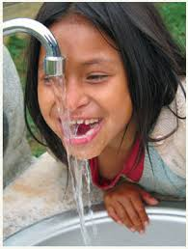
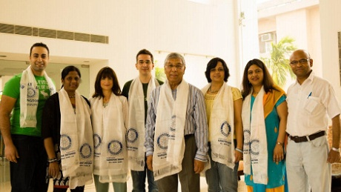
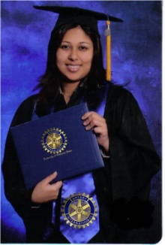
Global grants can be used to fund:
Humanitarian Projects
that support one or more areas of focus
Vocational Training Teams
teams travelling abroad to learn more about their profession or teach local professionals
Scholarships
for graduate-level academic studies in areas of focus

Slide 7
Sponsor Requirements
Primary Host Sponsor
Club/District
Primary International Sponsor Club/District
Notes:
Host = country where the project will take place.

Slide 8
Additional Requirements
Qualification (MOU) – District(s) and Club(s), Host & International
Must be in good standing with TRF
Host Club must open and maintain an exclusive bank account until completion of project
100% administered by Rotarians
No secondary grants permitted to other organizations
Active participation of Rotarians
Notes:
Additional Information if required.
Cooperating Organizations
Cooperating organizations are reputable non-Rotary organizations or academic institutions that provide expertise, infrastructure, advocacy, training, education, or other support for the grant.
Cooperating organizations must agree to comply with all reporting and auditing activities required by The Rotary Foundation and provide receipts and proof of purchase as required.
No more than five global grants may be approved in one Rotary year for projects involving a single cooperating organization. Universities hosting scholars are not considered a cooperating organization.

Slide 9
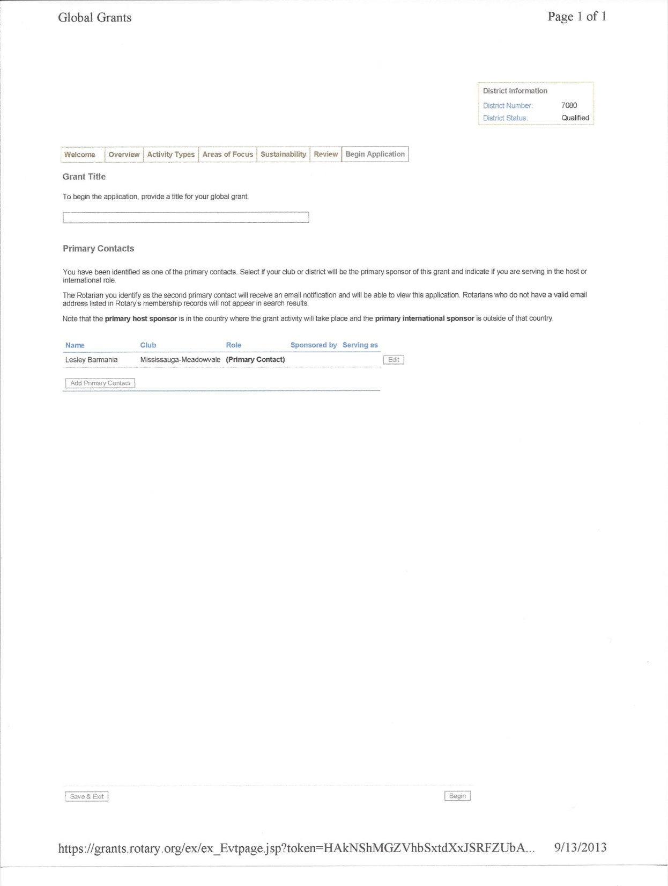
On-line Application

Slide 10
Application Components
Community Assessment
Project Plan
Project Committees (3 each from Host & International)
Sustainable Solutions
Measurable Outcomes
Financial Management Plan (Budget/Bank account)
Notes:
Plus reporting and auditing requirements outlined in section IX in the Grants Terms & Conditions.

Slide 11
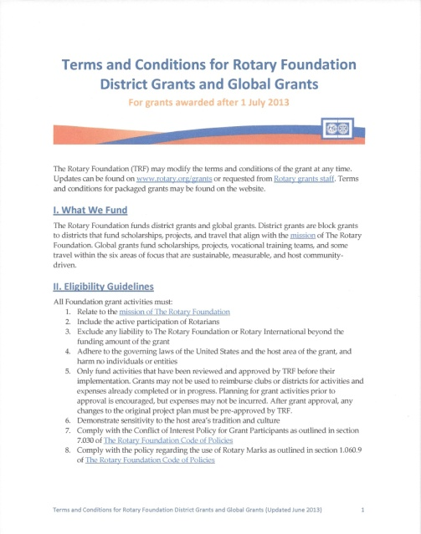
Support
http://www.rotary.org/en/global-grants
Terms and Conditions document
District – Bob Palmateer
Next workshop – October date TBA
Notes:
Terms and conditions document can be found at above website.

Slide 12
Questions
Notes:
When acting as a primary sponsor, each district and each club is limited to 10 open grants at a time.

