Slide 1

ACTION PLAN – Mississauga Meadowvale
Approved by the Board on
Monday October 20, 2025

Slide 2

Thank you / Acknowledgement
Research & Intel provided by

Slide 3
Process
Facilitated sessions
August 23, 2025: Mary Brady, Director, D 7080 Learning Committee, Scott Herbert, D 7080 Membership Chair and PDG Kathi Dick, Chair, D 7080 Peace Committee.
  Club members present: Francis, Narciso, Lesley, Magan, Muhammad, Nita, Brad, Rohit, Marcelle, Meera, Vinay
September 10, 2025: Scott Herbert, D 7080 Membership Chair
    Club members present: Francis, Narciso, Lesley, Magan, Muhammad, Marcelle, Meera, Vinay
Club Internal Discussions
Club Assembly: October 17, 2025
Board Approval: October 20, 2025

Slide 4
GOALS
Mission, Vision, Values
A Final Action Plan with Goals & Objectives
Process for Tracking
NEXT STEPS
Commitment from entire Mississauga Meadowvale Rotary Club membership
Presentation to Club Assembly
Board approval

Slide 5
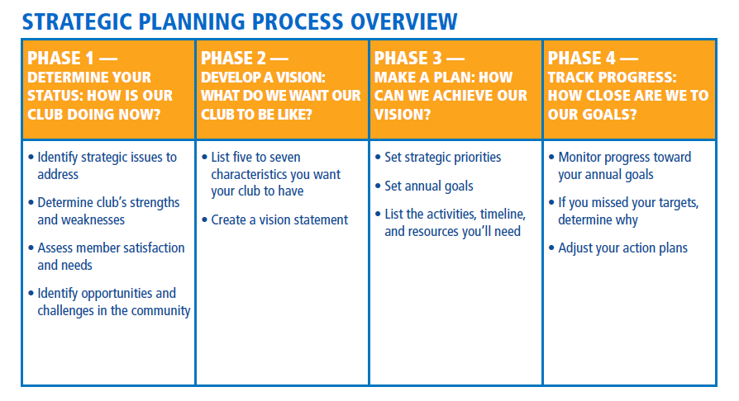

Slide 6
Identify Strategic Issues to Address
Other Strategic Issues
  Membership
  Succession Planning
  Ongoing fundraising & sponsorship
  Public image

Slide 7

Draft Action Plan
5 Sep. 2025
First Draft Action Plan
10 Sep. 2025
Second Draft Action Plan
17 Oct. 2025
Third Draft Action Plan/Club assembly
20 Oct. 2025
Final Board Approval

Slide 8
Vision
We are a vibrant and diverse group of fun and passionate people of action, committed to solving issues and addressing community needs in Meadowvale Mississauga, in a sustainable manner, making lasting contributions and impacts, to local and global communities.

Slide 9
Mission
We provide service to others, promote integrity, and advance world understanding, goodwill, and peace through our network of business, professional, and community leaders.

Slide 10

Characteristics/Values
Our club will be known by the following characteristics:
We serve with purpose
We build lasting friendships
We are diverse and inclusive
We act with integrity
We lead to create change

Slide 11
SWOT Analysis
Strengths
Weaknesses
Responsiveness from members
Risk of burnout (fundraising & committees)
Public image (including social media, ClubRunner)
Size
Formal committees & meeting
Cluster meetings (all Mississauga clubs)
Club founded 1979
Punching above our weight
Attract diverse members
“Friendliest club in town”
Committed and skilled members
Club’s community reputation of Rotary club financial resources
Constantly innovating and, growing
Passionate, action-orientated

Slide 12
SWOT Analysis
Opportunities
Threats (Challenges)
Member Engagement, Attraction and Retention
Maximizing our impact through a small handful of high-impact projects
Identify “signature project” for our club that will set us apart from other Rotary clubs (e.g. Comedy Night)
Smaller membership limits our ability to respond to community needs and new projects
Potential increase in dues (as club grows – venue may add costs)
Membership opportunities in a growing community
Interact & Rotaract (and link)
EarlyAct Club
Re-launch cluster project
Corporate sponsorships & memberships
Community visibility, reachability & branding
Partnerships with community agencies, municipal government, Salvation Army, United Way and Chamber of Commerce.
Grants Committee (Rotary & external grants)
Continue to connect with former Rotarians and Rotary alumni (Alumni - 57 former members to return) – consider Friends of Rotary & Community Corps
Fellowship & Social Opportunities
Co-Chairs for Committees (for continuity)

Slide 13

Elevator Speech
Rotary Mississauga Meadowvale members are people of action. We make a difference in our community and the world. We are leaders committed to helping people, and our motto is "service above self".
We meet on the 1st and 3rd Friday of each month at 12:00 noon to socialize, plan service projects, discuss local and international issues and hear interesting guest speakers.
Briefly put, we are good people, doing great things in our community and across the globe.

Slide 14
Assess Membership Satisfaction
Rotary Club Health Check Survey
Member Experience Survey (from District 7080 - Survey Monkey) – Rod McLachlan/Jacob Lumgair

Slide 15
Rotary Club Health Check Survey - 1
RATING SCALE:  = Positive  = Neutral  = Negative
Rating | Dimension of Experience
 | I look forward to attending club meetings.
 | Our club meeting programs are relevant, interesting, and varied.
 | We have a greeter or greeters who welcome members and visitors to meetings.
● | Our meetings are organized and run professionally.
 | Members make an effort to meet and talk with different people at each meeting.

Slide 16
Rotary Club Health Check Survey - 2
RATING SCALE:  = Positive  = Neutral  = Negative
Rating | Dimension of Experience
 | I’ve made several new friends in the club.
● | Our club tries new things (activities, meeting practices and formats, service, socials, etc.) to enrich members’ experience.
 | We are inclusive in who we invite to our club, how we welcome guests, the topics we discuss, and the service we focus on.
 | Members other than club leaders participate in Rotary events at the district or international level.
 | Most members are aware of Rotary’s Avenues of Service and areas of focus, take part in projects, and feel proud to be a part of the club.

Slide 17
Rotary Club Health Check Survey - 3
RATING SCALE:  = Positive  = Neutral  = Negative
Rating | Dimension of Experience
 | We raise funds in a way that allows members to contribute what they wish.
 | We recognize members’ service, engagement, and donations by nominating them for and presenting them with awards.
● | I have made international connections through Rotary.
 | Guests are asked to introduce themselves and are invited back.
 | We provide members with flexible meeting opportunities (attending virtually or in person or watching recordings if they miss a meeting).

Slide 18

ACTION PLAN PRIORITY 1:
INCREASE OUR IMPACT

Slide 19
Action 1 – Increase our Impact
Goal | Action to Take | Resources Needed & Timeline | Who Leads the Effort
Develop & sustain meaningful partnerships (ongoing) | Develop directory of top employers Develop social service agency directory & other NGOs (City and local community) Develop inventory of international partners & NGOs | 2025-26 2026-27 2025-26 | Service Project Committee (Marcelle/Magan/Brad) Service Project Committee (Marcelle/Meera/Vinaye/Brad) Service Project Committee (Magan)
Complete 1 community clean-up every spring with City councillor partners | Develop plan Recruit & Execute | Spring 2026 | Service Project Committee (Discuss with Councillor Martin (Brad/Marilyn)
Completed 1 tree planting project | Develop plan Recruit & Execute | Fall/Spring- 2025/26 | Service Project Committee (Discuss with Councillor Martin (Brad/Marilyn)
Reach a membership of 30 Rotarians by 2030 | Profile of local employers Membership events Open House/ Business Networking | 2025/26 - 18; 2026/27 - 21; 2027/28 - 24; 2028/29 - 27; 2029/30 - 30. | Membership Committee

Slide 20

ACTION PLAN PRIORITY 2:
EXPAND OUR REACH

Slide 21
Action 2 – Expand our reach
Goal | Action to Take | Resources Needed & Timeline | Who Leads the Effort
Ensure visible social media presence | Committee Plan Co-Chairs | 2025-26 2025-26 | Public Relations Committee/Magan/Vinaye
Host business network meetings | Plan for 6 in first year Evaluate & modify as needed | 2025-26 | Public Relations Committee (Magan/Marcelle/Francis/Narciso/Vinaye). First Event February 2026
Invite guest speakers that include special skills and careers (e.g. cybercrime) | Invitation to all members re: speakers (Calendar of Events) Develop a 6-month plan Survey of members | 2025-26 | Club Service Committee/ Public Relations Committee/All members/Francis to email members
Collaborate with other service clubs in our community | Connect with AG Rajeev/Nelly | 2025-26 | President with the Assistant Governor (and other Cluster Presidents)/Francis

Slide 22

ACTION PLAN PRIORITY 3:
ENHANCE PARTICIPANT ENGAGEMENT

Slide 23
Action 3 – Enhance participant engagement
Goal | Action to Take | Resources Needed & Timeline | Who Leads the Effort
Ensure each committee has multiple committee members | Host Club Assembly with Matrix of roles/opportunities | 1st Club Assembly | President and Directors
Involve all new members on a committee of their passion (6 -month mentorship) | Application form review Mentorship Program & Checklist | 2025-26 | Membership Committee
Actively engage Rotaract & Interact in our projects | Develop a plan – opportunities to engage with youth Opportunities for participation | 2025-26 | Youth Service/Meera Service Committee/Marcelle
Transition program for Interact/Rotaract to join Rotary | Identify all youth that were sponsored Database of Alumni | 2025-26 | Youth Service/Marcelle/Meera/Vinaye Membership Committee
Formal recognition for every donation club provides (Guidelines for recognition requirements) | Develop guidelines Include guidelines with all donations | 2025-26 | President/Board Public Relations

Slide 24

ACTION PLAN PRIORITY 4:
INCREASE OUR ABILITY TO ADAPT

Slide 25
Action 4 – Increase our Ability to Adapt
Goal | Action to Take | Resources Needed & Timeline | Who Leads the Effort
Recite the 4-Way Test at every meeting | Recruit a FUN Sergeant-At-Arms Display 4WT Roller Banner at each meeting | 2025-26 | President/FUN Sergeant-At-Arms
Appoint a dedicated chair for Youth Services | To designate | 2025-26 | President/Board/Nita to consider
Appoint an Environment Committee & Chair (consider subcommittee of Service) | Review “Club Leadership Plan” | 2026-27 | President/Board
Ensure all Presidents are graduates of the Rotary Leadership Institute (RLI) | Share with Club Develop Succession Plan | Ongoing | Board
Maintain Strategic Plan/Action Plan (ongoing) | Share with members Finalize Strategic Plan Monitor at Club Assembly |  | Monitoring by Muhammad/Club Service Committee/Monthly update at Board level Quarterly Club Update Yearly Update/Club Assembly

Slide 26
Next Steps
Share the results with the entire Club
Ensure Committees are formed to carry out the Action Plan
Develop a 3-year Succession Plan (President, Committee Chairs)
RECOMMENDED MONITORING
Monthly Board monitoring/Muhammad
Quarterly and Annual Review – Club Assembly

Slide 27
Monitoring - example

Slide 28
Monitoring - example
Goal | Objective | Indicator | RAG Status (Red, Amber, Green)
Goal # 1: to increase our membership to 18 net members by June 2026 | Net increase in our membership by 4 members for 2025/26 | 1 new member every quarter
 | One business networking event every quarter | 1 new member recruited every business networking event
 | Two open houses every year | 1 new member recruited every open house event
 | One visitors’ day (club meeting with external guest speaker) every quarter | I new member every visitors’ day

Slide 29
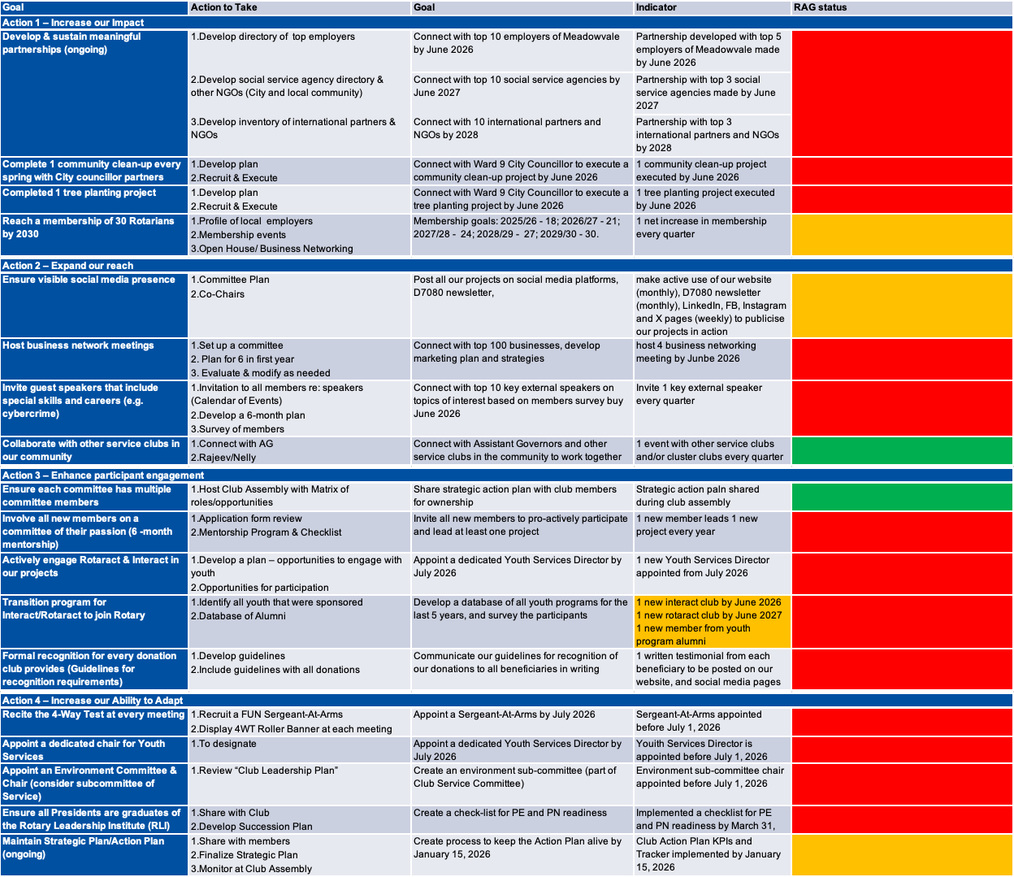
KPIs and Monitoring Tool (draft)

Slide 30
Did we achieve our Goal?
Mission, Vision, Values
Club Assessment
A Final Action Plan with Goals & Objectives
Process for Tracking
NEXT STEPS:
Commitment from entire Mississauga Meadowvale Rotary Club members
Yes
Yes
Yes
Yes
Yes

Slide 31

THANK YOU!

