Slide 1

Foundation Dinner Nov 27th, 2025
Patterson Kaye Lodge

Slide 2
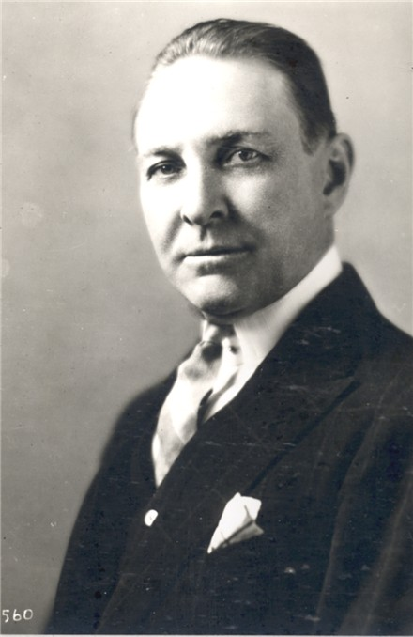
What is The Rotary Foundation?
Charitable arm of Rotary International
Founded in 1917 by Arch Klumph
Top-rated global charity for impact & transparency
Notes:
The Foundation began with just $26.50. Today it funds humanitarian and educational programmes worldwide.

Slide 3

Our Mission & Vision
The Rotary Foundation enables Rotarians to advance world understanding, goodwill, and peace through the improvement of health, the support of education, and the alleviation of poverty.

Slide 4

How It Works: The Cycle of Giving
1. We Give:
2. The Foundation Manages:
3. Clubs & Districts Apply for Grants:
4. Impact is Created:
5. The Cycle Repeats:

Slide 5
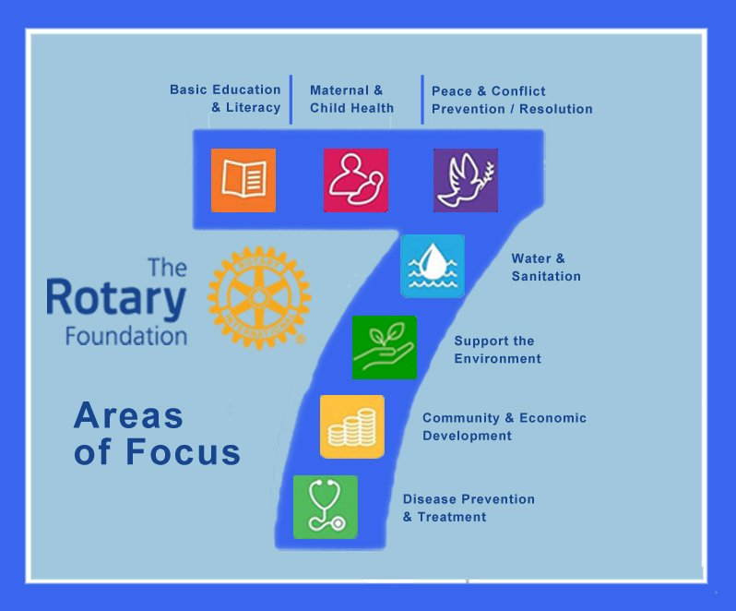
Seven Areas of Focus
Peacebuilding & Conflict Prevention
Disease Prevention & Treatment
Water, Sanitation & Hygiene
Maternal & Child Health
Basic Education & Literacy
Community Economic Development
Environment
Notes:
These seven areas guide Rotary's work to create long-term sustainable change.

Slide 6

Global Impact: PolioPlus
"When we talk about the Foundation's impact, we have to start with PolioPlus. This is Rotary's flagship program and arguably one of the greatest public health achievements in history”

Slide 7
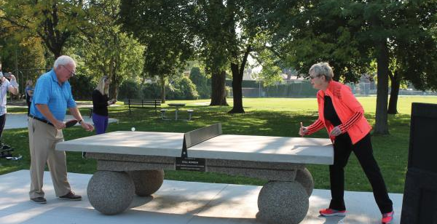
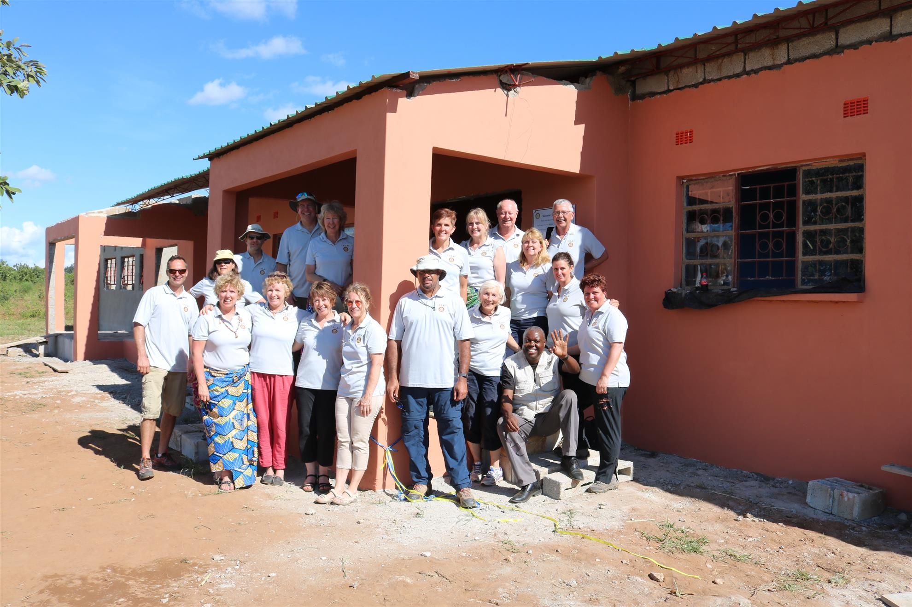
Types Of Grants
District & Global
District Grants – Local & flexible projects
Global Grants – Large-scale sustainable projects
Notes:
Rotary grants allow clubs like ours to have greater local and international impact.

Slide 8
How is the Money Spent?
Source: Rotary Club of Canmore 2018

Slide 9

Every Rotarian, Every Year (EREY)
Encourages $25–$100+ annual giving
Funds are invested for 3 years
50% returns to our District as DDF
Notes:
EREY participation helps fund both global and local Rotary projects.

Slide 10

More Than Money: Your Participation
Volunteer
Identify Needs
Serve on a Committee
Be an Advocate
"The money provides the fuel, but we, the Rotarians, are the drivers."

Slide 11
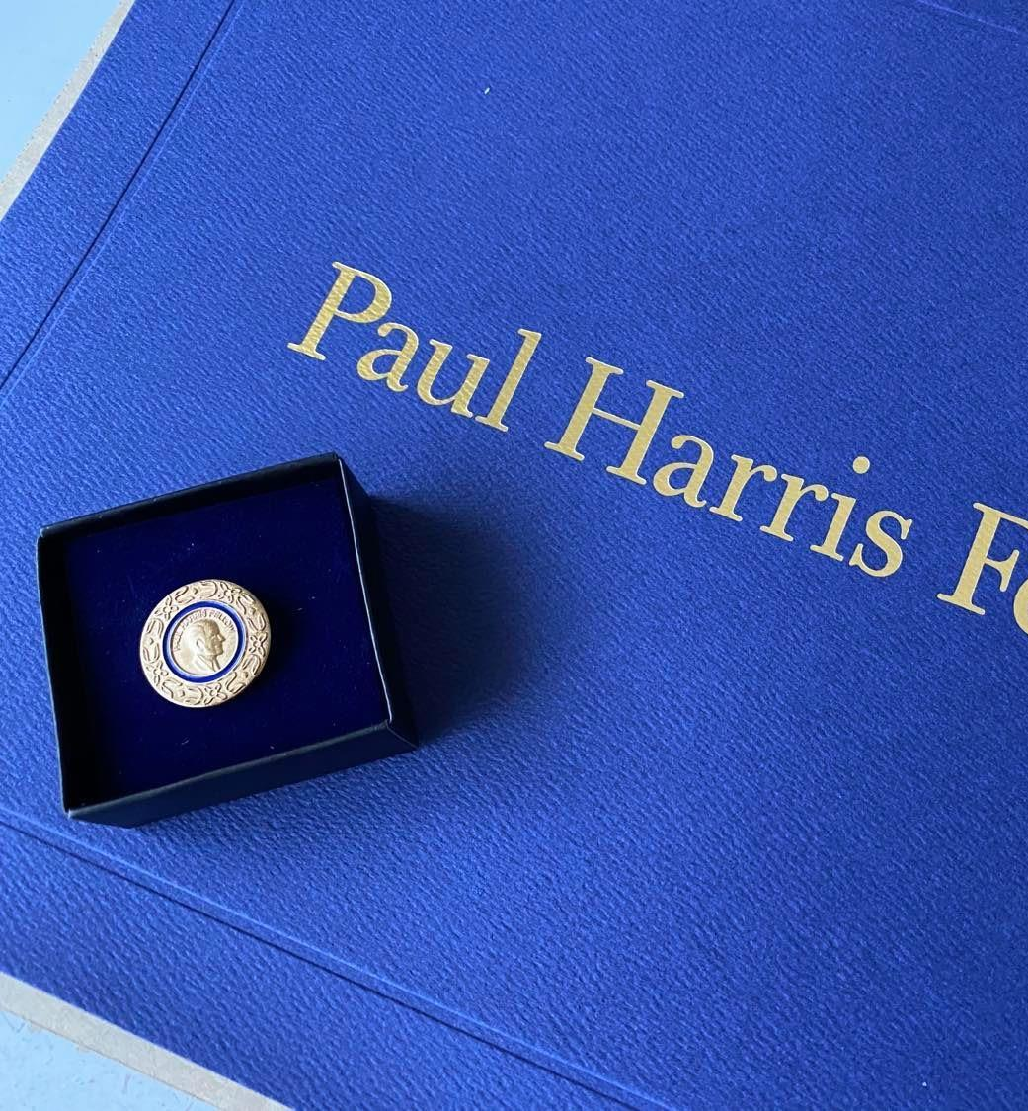
Donor Recognition
Paul Harris Fellow – $1,000
Paul Harris Society – $1,000/year
Major Donor – $10,000+
Arch C. Klumph Society: For leadership-level gifts of $250,000 or more –
Bequest Society – Legacy gifts
Notes:
Recognition celebrates generosity and encourages giving.

Slide 12

Summary: Why It Matters
· It's our vehicle for creating lasting change.
· It magnifies our individual contributions into a global force for good.
· It's efficient and trusted, with a proven track record.
· It allows us to act both locally and globally.
· It is the practical application of our motto, 'Service Above Self.'"

Slide 13
Call to Action
Support
Support Foundation giving through Every Rotarian Every Year (EREY)
Consider
Consider becoming a Paul Harris Fellow or Society member
Continue
Continue 'Doing Good in the World' in 2025–26
Notes:
End your presentation by motivating members to participate and contribute.

Slide 14
A Final Thought
"Arch C. Klumph said back in 1917, 'It seems eminently proper that we should accept endowments for the purpose of doing good in the world.'
"Every time we contribute—whether it's our time, our expertise, or our money—we are adding to that endowment. We are choosing to do good in the world. We are creating a legacy of peace, health, and hope for generations to come."

Slide 15

Thank you
www.rotary.org/en/about-rotary/rotary-foundation

