Slide 1

North Bay Nurse Practitioner-Led Clinic
April 27, 2015
Terri MacDougall, Clinical Director

Slide 2
Objectives
What is a Nurse Practitioner?
Why a Nurse Practitioner-Led Clinic?
Describe North Bay Nurse Practitioner-Led Clinic
Who we are, and what we do
Questions?

Slide 3
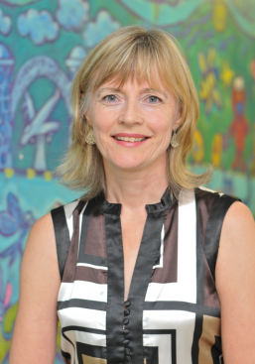
Nurse Practitioners
Advanced practice nurses who have completed formal education beyond that of an RN
Diagnose, prescribe medications, order diagnostic tests and treat illness
Focus on health promotion, wellness and prevention of illness
Work collaboratively with other health care providers
http://www.youtube.com/watch?v=IJ9YAtEtKhw

Slide 4
Brief History
NPs have been working in Ontario since the early 1970s
Historical barriers to implementation of NPs throughout the health care system:
Education, Legislative Authority, Funding

Slide 5


Education
    Primary Health Care NP program was cancelled in early 80’s….
    Primary Health Care NP Program was re-introduced in 1995, consortium of 9 universities (certificate program)
    Ruth Grier was Minister of Health (NDP)
    Masters Acute Care Nurse Practitioner Program started at U of T, McMaster in 1994

Slide 6
Legislative Authority
    Until 1998, NPs worked under medical directives, our work was hidden
    1998, Nursing Act was amended to expand our legal scope of practice, diagnose, order tests, prescribe
    Elizabeth Witmer was Minister of Health (PC)
    Since then there have been major changes to legal scope in keeping with our experience to provide safe independent care
    Ontario Hospital Act has been amended to allow Acute Care NPs to work independently within hospitals

Slide 7

Funding
    The fee for service primary health care system was a barrier to full implementation of the NP Role
    Community Health Centres , NP roles remained alive, due to salaried positions, Not every community has a CHC
    Remote Nursing Stations in First Nations, the role stayed alive
    Family Health Teams facilitated role implementation, FHTs… widespread reform to the way doctors are paid
    Newest model: Nurse Practitioner Led Clinic (2007) Sudbury first NPLC.

Slide 8
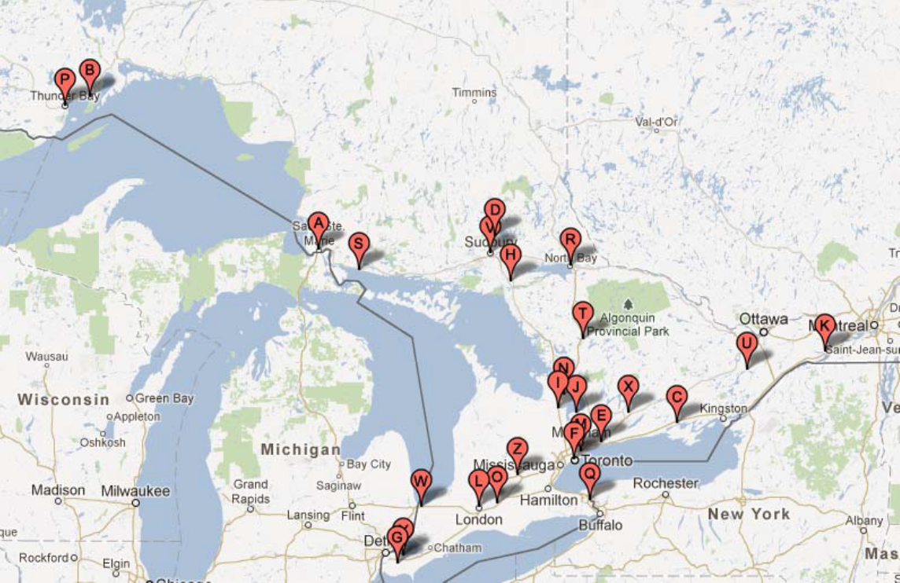
25 Nurse Practitioner-Led Clinics

Slide 9
Nurse Practitioner – Led Clinics
Consistency with Government Priorities
Improves access for consumers
Provides a viable alternative (rather than MD’s) to consumers who need access to primary health care
Provides for a more consumer and family directed service as per the MOHLTC Ten Year strategy
Re-directs efficiencies back into the system in order to address gaps in services.
Builds a strong critical mass of services that will help to recruit and retain skilled professionals.
Provides after hour options for consumers and their families thereby decreasing frequent visits to the ED.

Slide 10
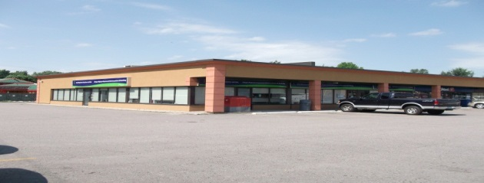
North Bay Nurse Practitioner- Led Clinic http://www.nbnplc.com
In 2008, the Liberal government promised to fund an additional 25 NP-Led Clinics
3 Waves of Requests for Proposals for Clinics were initiated
North Bay NP-Led Clinic was funded in the third wave
The Board of Directors started working on setting up the clinic in September 2010

Slide 11
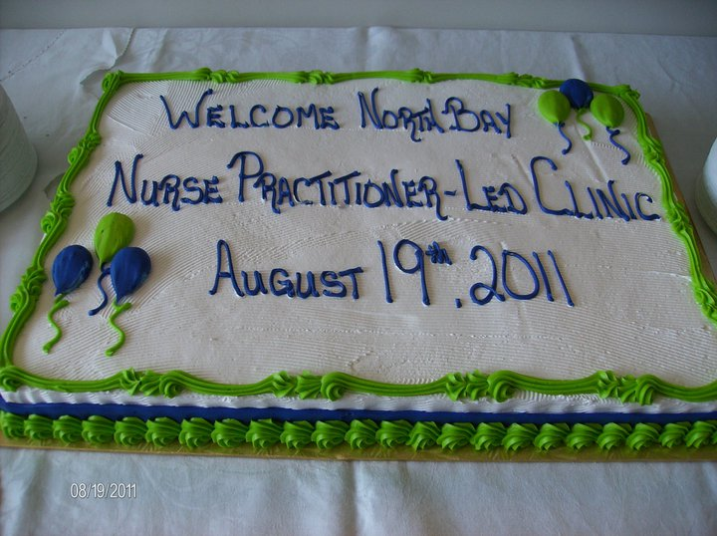

Slide 12
North Bay Nurse Practitioner-Led Clinic
Vision
To enhance primary health care services in North Bay
Mission
The NBNPLC through the provision of primary health care services promotes optimal health for those living with chronic disease and for families with young children
Values
Collaboration Holistic
Innovation Respect
Participation Integrity

Slide 13
Who are we?
Team of Interprofessionals:
Four NPs
One RN, One Clinical Tech
Collaborative Physician, 3 hours a week
One full time Social Worker
Part time Dietitian
Part time Pharmacist
Reception and Admin staff

Slide 14
Hours of Operation
Monday & Wed 8 to 4 pm
Friday 8 to noon
Two extended Days, Tuesday and Thursday, Open 8 to 8 pm
Same Day Appointments

Slide 16
RNAO Best Practice Spotlight Organization – Candidacy
In March 2012, the North Bay NP-Led Clinic was granted Best Practice Spotlight Organization (BPSO) Candidacy
Quality care framework, to standardize care
We have promised to implement six best practice guidelines.

Slide 17
Questions??

