Slide 1
Paul Takala, Chief Librarian/CEO November 2021
Hamilton Public Library – Beyond COVID-19
Paul Takala, Chief Librarian/CEO November 2021
HPL BEYOND COVID-19
Notes:
PRESENTATION NOTES

Slide 2
Paul Takala, Chief Librarian/CEO November 2021
During the Pandemic HPL’s highest priority has been to:
Protect staff and the public
Support the emergency response
Provide as much service as we safely can
Post-COVID Strategy
Use the reset to make structural changes
Move to more strategic partnership
Return to normal order of decision making
HPL BEYOND COVID-19
Notes:
PRESENTATION NOTES

Slide 3
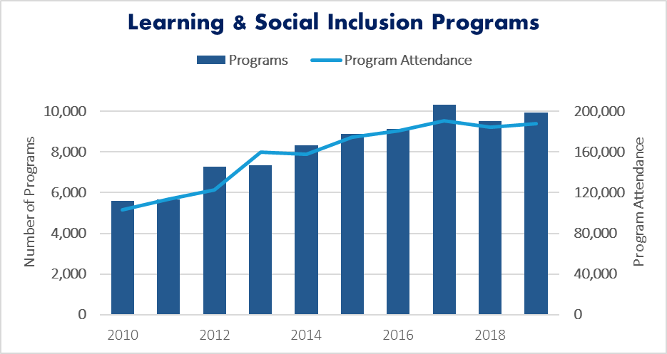
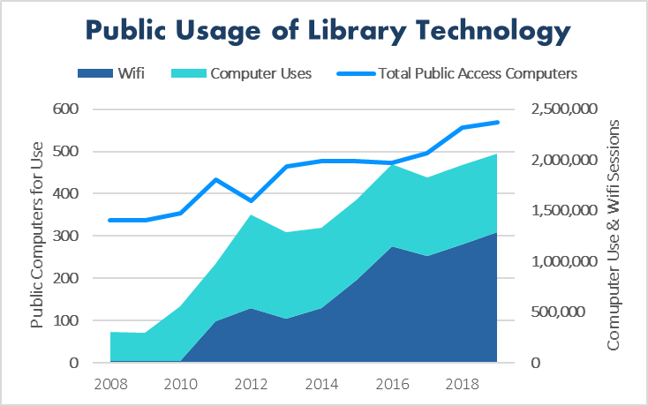
Paul Takala, Chief Librarian/CEO November 2021
Decade Before COVID-19 Usage stable, Growth in digital, Shift to value added activities
HPL BEYOND COVID-19
Notes:
PRESENTATION NOTES

Slide 4
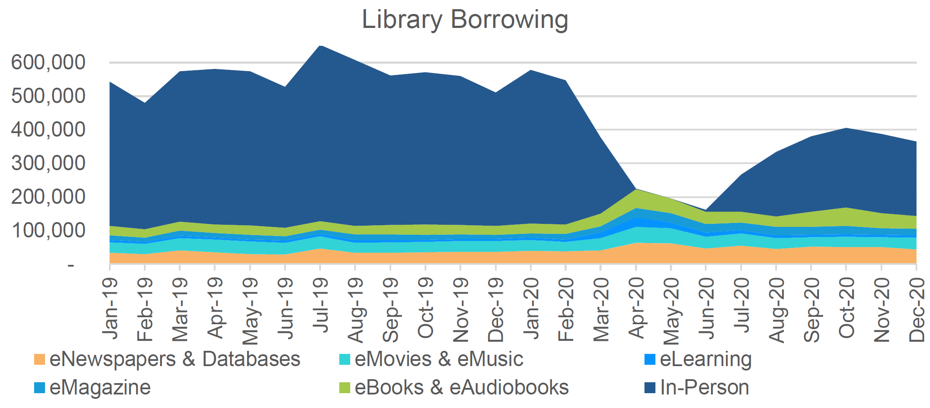
Paul Takala, Chief Librarian/CEO November 2021
Library Collections Acceleration to digital but physical books not going away
HPL BEYOND COVID-19
Notes:
PRESENTATION NOTES

Slide 5
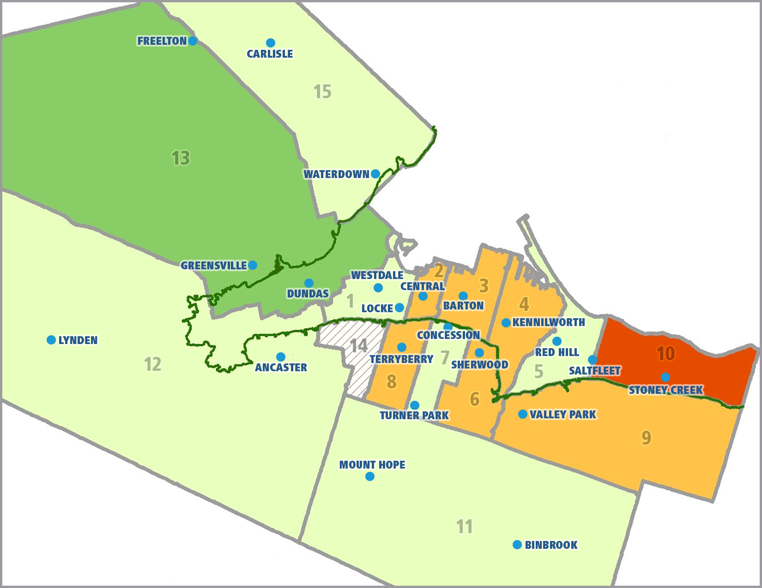
Paul Takala, Chief Librarian/CEO November 2021
NEW BUILDS AND MAJOR CAPITAL IMPROVEMENTS
Since 2020
2010 to 2019
Prior to 2010
New Building
Facility Renewal 1 branch not up to current accessibility standards
PARKDALE
HPL BEYOND COVID-19
Notes:
PRESENTATION NOTES

Slide 6
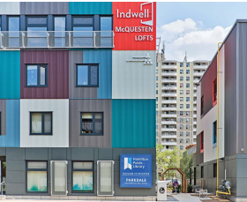
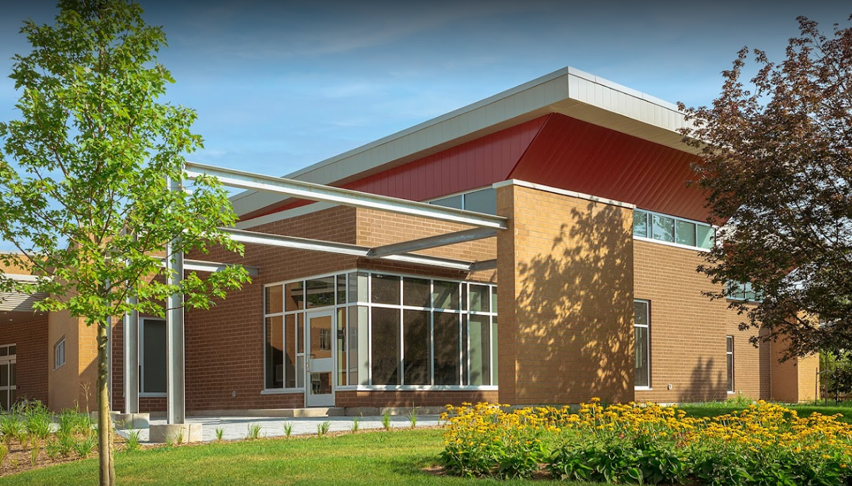
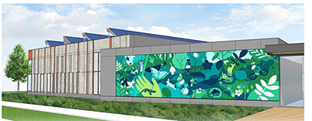
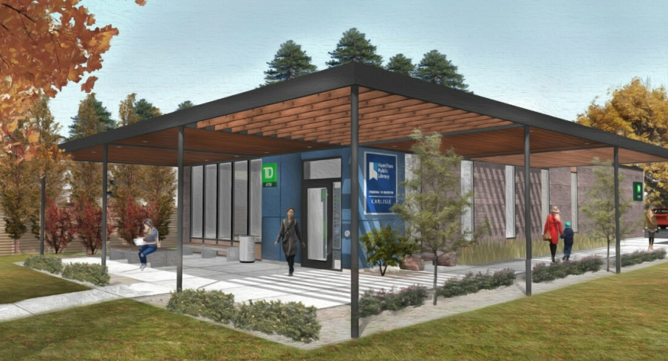
Paul Takala, Chief Librarian/CEO November 2021
PARKDALE
Most Recent Projects
GREENSVILLE
VALLEY PARK
CARLISLE
HPL BEYOND COVID-19
Notes:
PRESENTATION NOTES

Slide 7
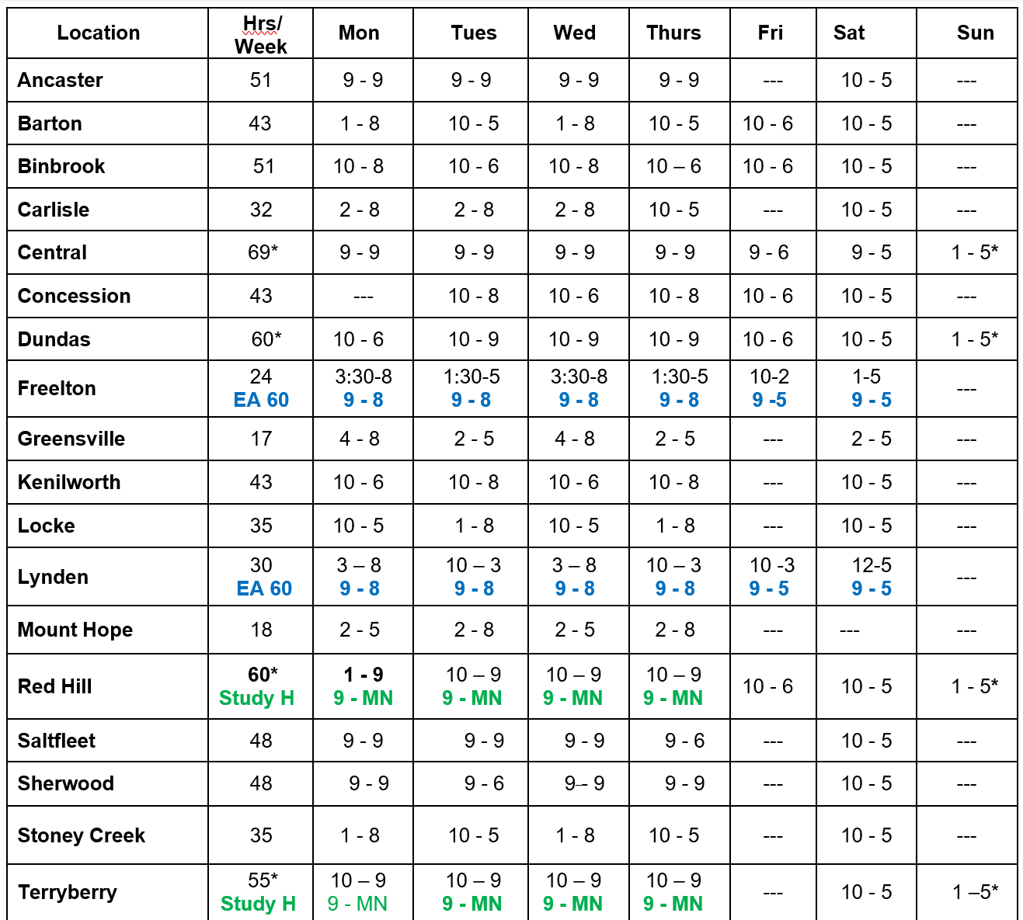
November 2021
Service Hours Pre-COVID Rural Extended Access (EA) Study Halls (Study H) Some Hours Added Inconsistent Hours Closed Days
HPL BEYOND COVID-19
Notes:
PRESENTATION NOTES

Slide 8
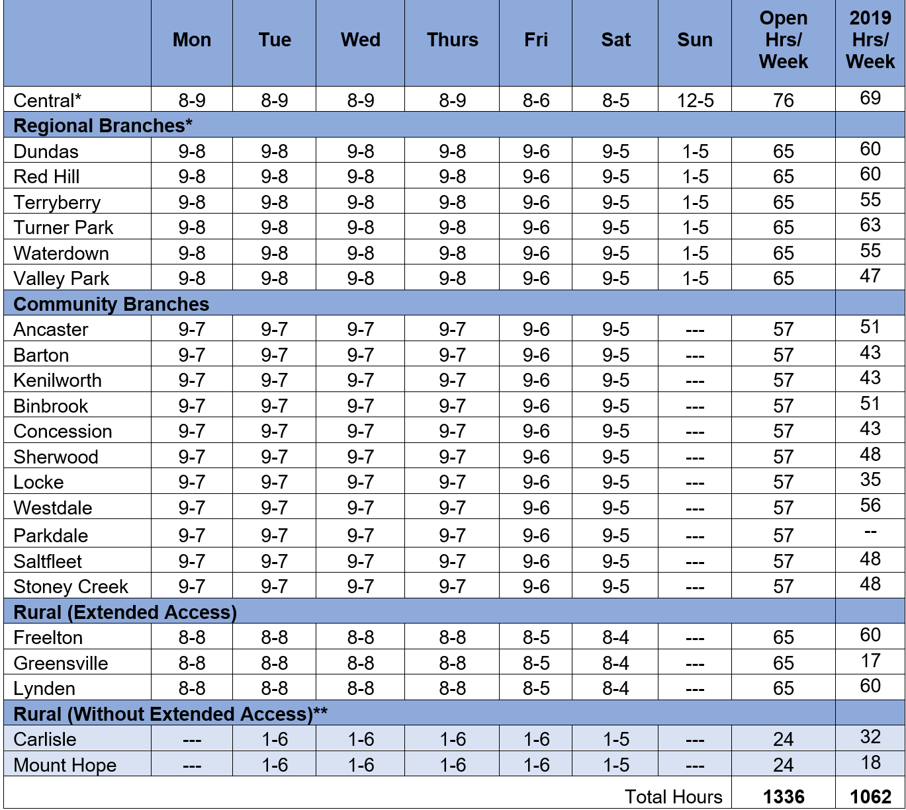
Chief Librarian/CEO November 2021
Service Hours Post-COVID Rural Extended Access Study Halls Consistency
Regional Branches to have Evening Study Halls (8 pm-12 am)
Central to open at 8 am
Expand Rural Extended Access
Pending Library Board Approval
HPL BEYOND COVID-19
Notes:
PRESENTATION NOTES

Slide 9
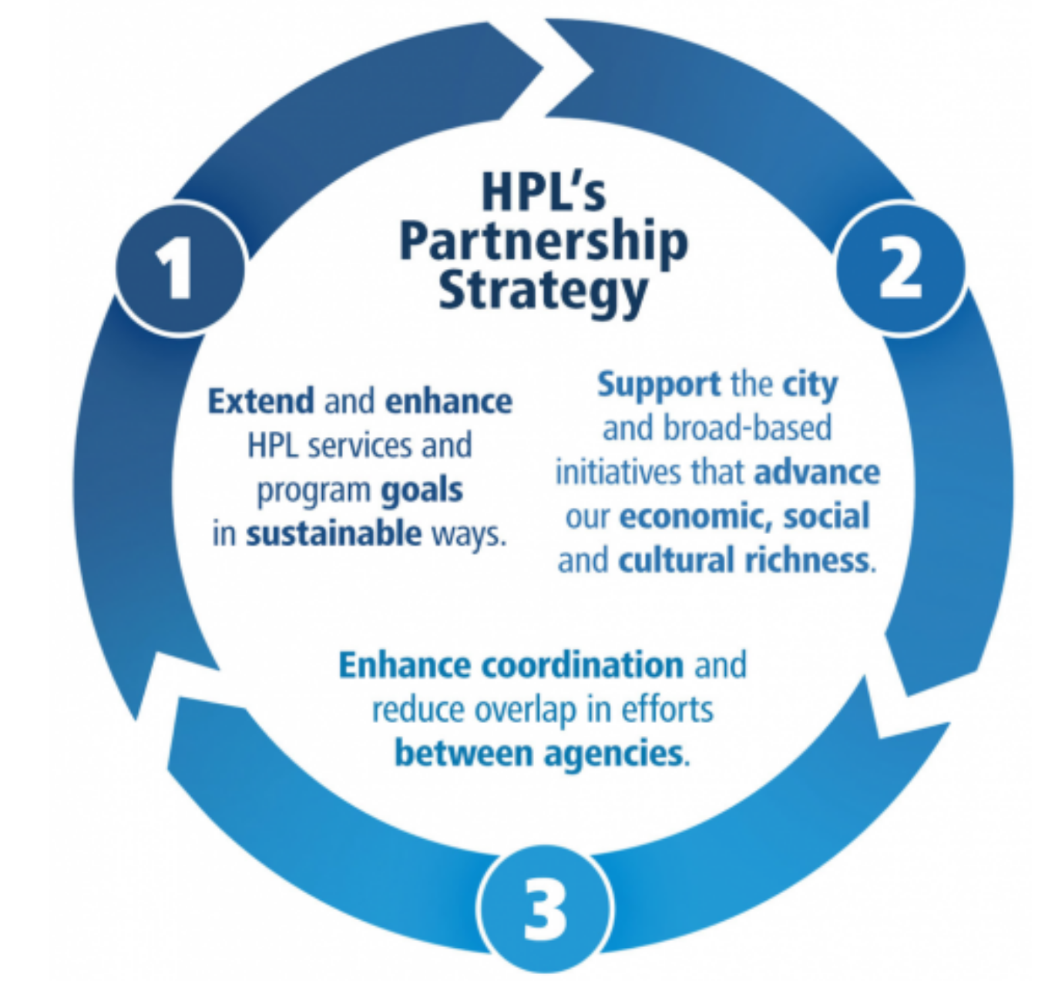
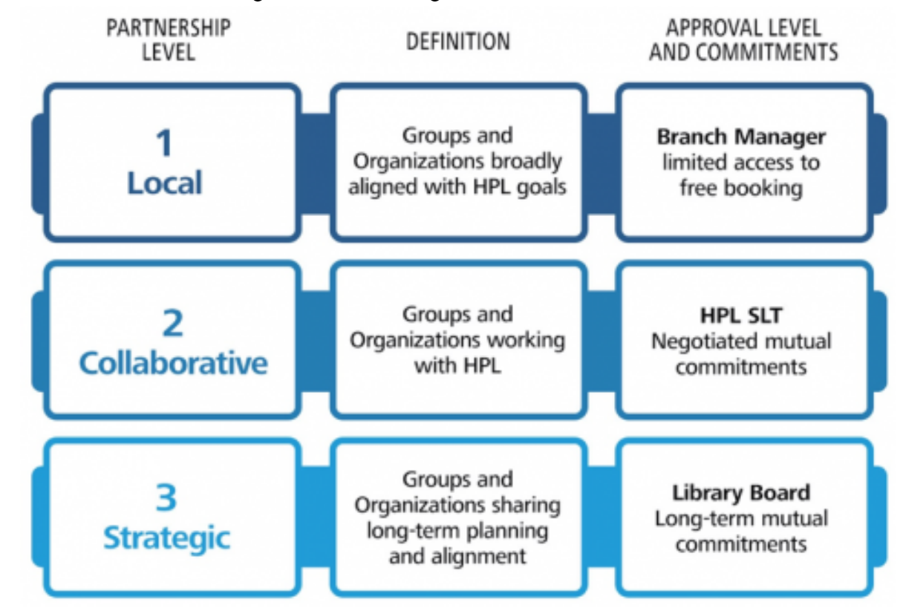
Paul Takala, Chief Librarian/CEO November 2021
Working with Us Policy on Partnerships, Programs, Space
HPL BEYOND COVID-19
Notes:
PRESENTATION NOTES

Slide 10
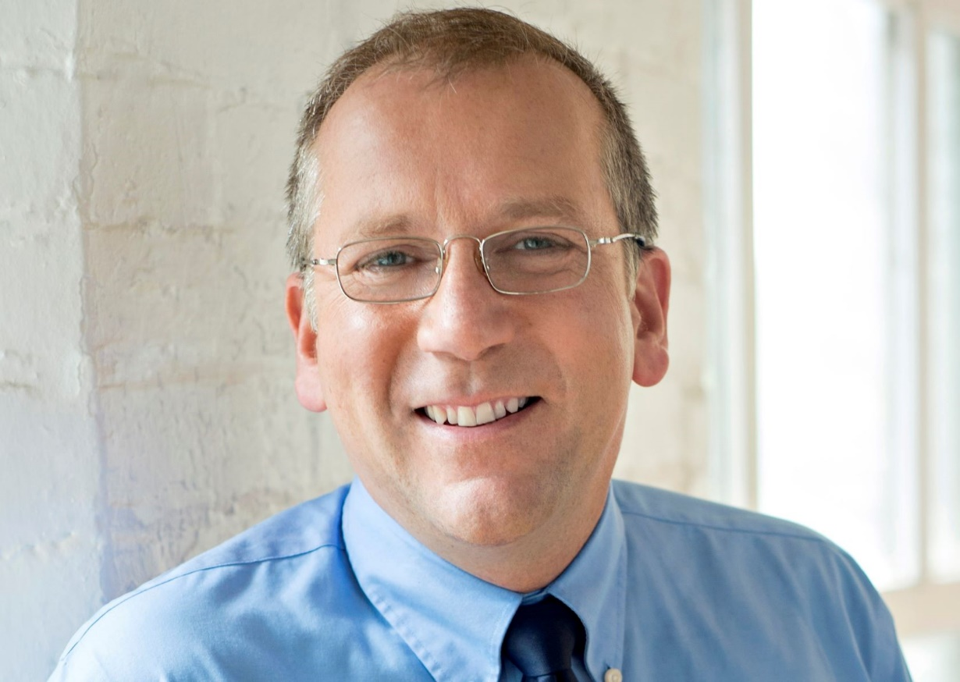
Paul Takala, Chief Librarian/CEO November 2021
Discussion & Questions?
Paul Takala Chief Librarian/CEO Hamilton Public Library T: 905-546-3215 | M: 905-979-4818 ptakala@hpl.ca | www.hpl.ca
HPL BEYOND COVID-19
Notes:
PRESENTATION NOTES

