Slide 1
Ideas to Attract
&
Engage
Value
Marketing
Notes:
ICA Presentation PJS 2021-01-27
For Hamilton AM Rotary Club, D7090
Slide 1: Ideas to Attract & Engage (1:15 / Start 10:00)
Good morning! There is so much that can be said about ideas for Attracting & Engaging members to our Rotary Clubs! Indeed, we have all been in many sessions discussing these important membership realities. So today I’m going to quickly run through a few ideas that come down in my mind to two things:
(1) Value: Value is really the whole story! If a person sees the value in being a member of your club they will join, and they will stay! Studies show that Rotarians leave (or never join) for time or money. Most clubs meet over a meal. If we say ~$20 per meeting for the meal & a few happy bucks, then with typical club dues the cost is maybe ~$1200 per year. But if the value is there, that is NO PROBLEM! Even millennials and Gen-Z (my kids – under 40) will upgrade their cell phone every year or indulge in their daily Starbucks – each one of those running similar amounts of money!
(2) Then Marketing: We've got to get better at telling the world what we have to offer!

Slide 2
Helping Rotarians to Grow Rotary!
Notes:
Slide 2: Innovative Club Advocates (0:20 / Start 8:45)
I am one of 11 Innovative Club Advocates currently in Zones 28+32. We are all here to help you find innovative new ways to Grow Rotary, and later in this presentation I will show you where to look on the Zone website to find contact information and other resources I will be referring to.

Slide 3
Add New Members
Keep the Members you Have
Start New Clubs
Notes:
Slide 3: 3-Ways to Grow Rotary (0:55 / Start 8:25)
So to grow Rotary there are primarily only 3 ways: The first is to add new members, the second is to engage the members we have and keep them in the club, and the third is to start new clubs.
Today we're primarily interested in the first two but note that the easiest way to grow Rotary is the 3rd one! Many clubs are building cause-based Satellite clubs to complement their Rotary options and gain membership. To add or retain our members in our existing clubs we often have to carefully examine who and what we are. Sometimes we have to accept that we may need to change our culture, and this can be hard! To start new clubs, we just have to identify & accept the culture of the new group, and this is generally a lot easier! So now, let's get on with looking at ideas for 1 & 2.

Slide 4
Notes:
Slide 4: What Do Your Members Want? (0:50 / Start 7:30)
The first step in ensuring there is value in our Rotary Club is making sure we know who we are. Review at least once every year or more often. How do you want your meetings to run? Are there meals, do you do a pledge or anthem, is there a Sergeant-at-Arms issuing fines? And are any of those things attractive to the "new" members you hope to attract? Are the presentations interesting? Are there too many? Are they too long? Do we want a focus for our club (the environment? Peace? Literacy?)
Regular club assemblies & visioning exercises can help keep you on track. Here's a tip that might be new: Look up "Open Space Technology", this is a great way to explore a group's interests and come to actionable & achievable goals.

Slide 5
Notes:
Slide 5: Rotary's Core Values (0:45 / Start 6:40)
I like to encourage clubs to become "Chapter 1 Clubs". This refers to Chapter 1 of our Rotary Manual of Procedure titled “Guiding Principles", which is everything that is important to a successful club:
Our motto "Service above Self"
The 4-way test, the Object of Rotary, the Avenues of Service... and more.
And in my view, the underlying values that make us who we are, our CORE VALUES: Fellowship, Service, Integrity, Leadership, Diversity. As long as we serve our community and our world with integrity & fellowship, as long as Rotary is FUN... your new club will be a success! All other details about Rotary clubs are negotiable.

Slide 6
Are your
Meetings
Fun!??!
Notes:
Slide 6: Are Your Meetings Fun? (0:40 / Start 5:55)
So are your club meetings fun?
Do you have greeters welcome guests & members?
Do you ask guests and visitors about their experience?
Do you have a club "Innovation Chair" and committee? This can be a huge benefit for your club!
What about a mid-meeting activity or "event"? I was a professor for my career, and learning theory teaches us that a typical attention span is no more than 20 minutes. Jim Marggraff, a keynote speaker at the Toronto International Convention told me that he uses what he calls "ICB's" (Increased Cognition Break) all the time, including at a TED talk he once gave virtually to over 10,000 attendees! There are lots of creative options, ask me later if you want some ideas.
Note for Questions: Ideas could include:
University of Michigan's "Fitness Dice", each number associated with a different activity like squats, arm circles, lunges, etc.
Laughter coaching (Google ideas)
PETS activity: 3 20-sec music clips, random pick volunteer to do dance moves & they pick the next one. In 2-3 minutes gets the group going!

Slide 7
Zoom!!
Notes:
Slide 7: Zoom! (0:25 / Start 5:05)
As long as our meetings are mostly virtual, there are a few differences. But not all are bad! Some clubs in my District are staying virtual, and many more are planning to be hybrid.
We can invite speakers from anywhere!
We can meet without a meal purchase.
And it is easier to invite guests via Zoom than it is to get them to walk through the door.

Slide 8
Engage
Your Members
Projects for their passion
Regular meetings
Service as opportunity for social
HANDS ON every month!
Socials every month
Notes:
Slide 8: Engage Your Members (0:50 / Start 4:40)
Now your club meetings are fun, what about the rest of the Rotary experience? Encourage your members to recommend projects that THEY are passionate about. I heard of 1 club that gives every new member budget ($1K? $2K?). Use service projects & fundraisers as an opportunity for social interaction. Remember those core values: Fellowship & Service! And speaking of service projects, try to have at least one that is HANDS ON every month! They don't need to be big flashy projects, get a group together and help at the food bank or donate blood together. Don't forget to invite the family or friends to these hands-on events. This is where you will find new & younger members, they want to be involved!

Slide 9
Notes:
Slide 9: Social Media (0:30 / Start 3:50)
So now we've made sure the VALUE is in the product! Let's sell it. It is not news to anybody I'm sure that by far the greatest return for your marketing dollar is digital. You cannot afford to have a poor website, and you definitely need to use social media to get the word out. Make sure you have a committee in your club that focusses on your digital face and use Rotary's Brand guidelines that you can find on rotary.org.

Slide 10
Host a Business Mixer After-Hours
Notes:
Slide 10: Host a Business Mixer (0:20 / Start 3:20)
Host a business mixer after hours. Your local Chamber of Commerce has been doing this for years. Make sure you have some well-designed displays or videos to improve the community awareness of Rotary and possibly attract new members. Get sponsors for food or drink, maybe even a door prize.

Slide 11
Hallmarks of an
Innovative Club
LEADING YOUR CLUB TO TOMORROW
Notes:
Slide 11: Hallmarks of an Innovative Club (1:15 / Start 3:00)
We have a downloadable document on the Zone website summarizing some basic hallmarks of an innovative club. Some of these like appointing an innovation chair, having a diversity of meetings or having an exciting and accurate web presence we already talked about today.

Slide 12
Notes:
Slide 12: Zone Website (0:30 / Start 2:45)
Our Zones 28 & 32 share a ClubRunner website, most easily found by Google. On that site go to the Resources page using the tab at the top, then select the image to take you to the Innovative Club Advocate page. We are starting to load some useful materials there, such as the presentation we did last week on how to start a new Environmentally Based Rotary club, or the Hallmarks document I just talked about.

Slide 13
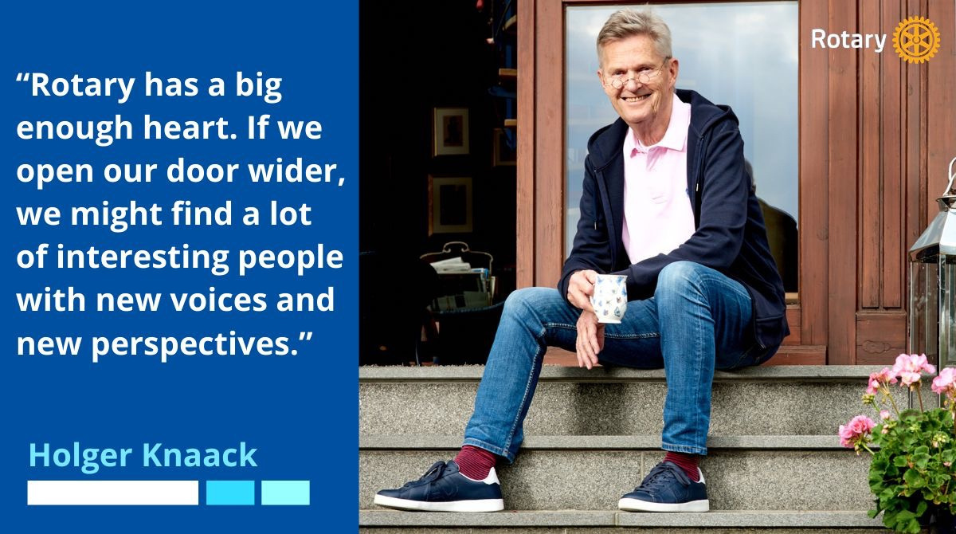
Bold discussions!
Notes:
Slide 13: Bold Discussions (0:15 / Start 2:15)
We will conclude with the words of our President Holger Knaack: "Rotary has a big enough heart. If we open our door wider we might find a lot of interesting people with new voices and new perspectives."

Slide 14
Thanks!
Notes:
Slide 14: Thank you! (0:15 / Start 2:00)
So, I want to thank you for your attention today and for your service to Rotary! If there is time on your agenda I can try to answer any questions you may have.

