Slide 1
Interact 101
A primer
Notes:
Thank you for the invitation
We really don’t have a lot of time….
I want to give you a “PRIMER” Interact 101.
Your take away will be … Doing this right means that there is a lot involved here BUT it looks worth it.

Slide 2
Agenda
What is Interact?
What is your Investment?
What is your ROI?
What does an Interact Club do?
Types of Interact Club?
How to start and Interact Club?
Bridge to the Future?
Risk Mgt.
Notes:
Always told to have an agenda…. But no one ever remembers it.

Slide 3
The Definition of Interact….
Dictionary.com: (Verb)
to act one upon another:
to communicate, work, or participate in an activity with someone
RI says that Interact is short for “International Action”
Notes:
Even though retired I teach 1 class a term …. This term my class is almost completely international students So defining word become a way to ensure all are on track.
Interact is a Verb…. A verb is a word that shows action
Read…. It is action between groups or members
Click and see RI definition (from some source unknown)

Slide 4
What is Interact?
Watch this and decide:
WHO is Interacting!
HOW are they Interacting!
WHY are they Interacting
Notes:
Read present video but before READ

Slide 5
What is Interact?
What is Interact?? https://youtu.be/Gmgwtst4O-k

Slide 6
https://youtu.be/Gmgwtst4O-k

Slide 7
What is Interact?
12 to 18
Your Decision:
WHO is Interacting!
HOW are they Interacting!
WHY are they Interacting
Young People
Being Active!
Because it’s Fun!

Slide 8
A little History
Interact was started in 1962 in Melbourne FL
Today there is 14,911 clubs
Located in over 145 countries
With 342,953 members
Ave: 23 members / Club
Notes:
Today there is 14,911 clubs
Located in over 145 countries
With 342,953 members
Average 23 m/c

Slide 9
The Goal of Interact
Gives young people an opportunity to participate in fun, meaningful service projects while developing leadership skills and meeting new friends

Slide 10
Interactors Self Discovery
Developing leadership skills with personal integrity;
Demonstrating helpfulness and respect for others;
Advances international understanding and goodwill.
Notes:
So
Leadership
Respect
Understanding
I would have great Pride if I had anything to do with an organization that yielded these three characteristics in young people

Slide 11
2 Types of Interact Club
High School
Community
Only 1 High School
Requires authorization and Faculty Advisor
Meets on school property during school time
Activities approved by school
Open to all High School aged persons
Generally associated with Community Youth Council
More management required by Sponsoring Rotary Club

Slide 12
What is your Club Investment?
Time
Mentorship
Guidance
Sponsorship $
Pizza
Notes:
Time
Pizza Lunch hour meeting at a HS… How else would you encourage attendance
Sponsorship$ usually small amounts of seed funds for a project / Bell and Banner t Shirts
Guidance… how to run a meeting…. How to run a fundraiser
Mentorship Leadership by example

Slide 13
What is your Club’s ROI?
Community Connection
Satisfaction of Accomplishment
Fun
Pride in seeing Young People Grow
Notes:
Community Connection for club
Satisfaction of Accomplishment
Pride Seeing Young People Grow.
FUN ! Fun!

Slide 14
What is an Interact Club required to do?
RI specifies that each Interact Club must annually do:
At Least one Community or School Service Project
At least one Service Project that Furthers International Understanding
Notes:
READ

Slide 15
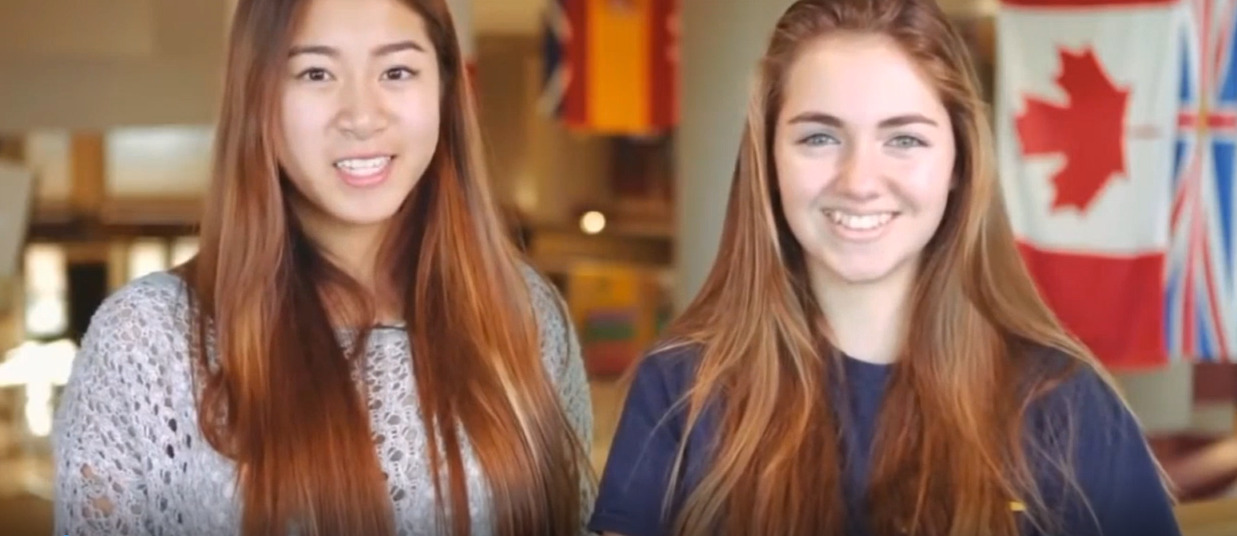
Does it Work? “My Best Day in Interact”

Slide 16
Does it Work? “My Best Day in Interact”
Best Day in Interact https://youtu.be/u1_cubPlZmQ

Slide 17
So….. Does it work??
You saw:
Young People
Being Active
Having Fun
Creating Meaningful Change in Communities and Themselves!
Notes:
Read and click after Fun Read …. IT WORKS!!!!

Slide 18
8 Steps to Start an Interact Club
Sell to your Club
Sell to the Principal (Community Youth Comm)
Sell to Faculty Advisor
Invite Seed Members
Informational Meeting
Organizational Meeting
Obtain RI Certification
Inaugural Ceremony
Notes:
8 Steps and considerations

Slide 19
8 Steps to Start an Interact Club
Sell to your Club
Sell to the Principal (Community Youth Comm)
Sell to Faculty Advisor
Invite Seed Members
Informational Meeting
Organizational Meeting
Obtain RI Certification
Inaugural Ceremony
Notes:
Need Support with your club’s Member participation
Must Recognize Challenges and Risks

Slide 20
8 Steps to Start an Interact Club
Sell to your Club
Sell to the Principal (Community Youth Comm)
Sell to Faculty Advisor
Invite Seed Members
Informational Meeting
Organizational Meeting
Obtain RI Certification
Inaugural Ceremony
Notes:
Domed to fail without Administration Support.
You want them to recognize the value to the students and the community
You need their support in selecting the most important Faculty Advisor

Slide 21
8 Steps to Start an Interact Club
Sell to your Club
Sell to the Principal (Community Youth Comm)
Sell to Faculty Advisor
Invite Seed Members
Informational Meeting
Organizational Meeting
Obtain RI Certification
Inaugural Ceremony
Notes:
This is the most important selection you will make. It is the Faculty Advisor that
Makes sure meetings as run Smoothly
Coordinates leadership Training
Guides execution of Projects
Knows what can be done and what would be impossible
Is the connection with school administration
Guides all to success

Slide 22
8 Steps to Start an Interact Club
Sell to your Club
Sell to the Principal (Community Youth Comm)
Sell to Faculty Advisor
Invite Seed Members
Informational Meeting
Organizational Meeting
Obtain RI Certification
Inaugural Ceremony
Notes:
I call them “seed” members as first members that will BELIEVE!
Have the Faculty Advisor invite them

Slide 23
8 Steps to Start an Interact Club
Sell to your Club
Sell to the Principal (Community Youth Comm)
Sell to Faculty Advisor
Invite Seed Members
Informational Meeting
Organizational Meeting
Obtain RI Certification
Inaugural Ceremony
Notes:
Market it to all Have Pizza

Slide 24
8 Steps to Start an Interact Club
Sell to your Club
Sell to the Principal (Community Youth Comm)
Sell to Faculty Advisor
Invite Seed Members
Informational Meeting
Organizational Meeting
Obtain RI Certification
Inaugural Ceremony
Notes:
Time to let the students work at developing
Constitution, Election of BoD, Ideas to Fundraisers,

Slide 25
8 Steps to Start an Interact Club
Sell to your Club
Sell to the Principal (Community Youth Comm)
Sell to Faculty Advisor
Invite Seed Members
Informational Meeting
Organizational Meeting
Obtain RI Certification
Inaugural Ceremony
Notes:
Paperwork.
s/b say 12 members to start but not specified by RI

Slide 26
8 Steps to Start an Interact Club
Sell to your Club
Sell to the Principal (Community Youth Comm)
Sell to Faculty Advisor
Invite Seed Members
Informational Meeting
Organizational Meeting
Obtain RI Certification
Inaugural Ceremony
Notes:
Time for party
Present Gavel and Bell / Banner
Have your club members present.

Slide 27
How to Sell Interact to Students!
Interact will sell itself to a certain percentage of student, But others will need to see what is in it for themselves…….
Add to the Community Volunteer Hours
It will be Fun with Friends
Resume Builder
Outcomes to demonstrate taking Initiative, Team Organizing, Community Action and Leadership Training
Notes:
What's in it for students
READ

Slide 28
Building a Bridge to the Future
Slapshot
RYLA
Rotoract
International Student Exchange
Future Rotarians?
Notes:
Note there is more to Interact beyond the HS Walls
Slapshot
RYLA
Rotoact
International Student Exchang
Yes and perhaps future Rotary Club members (in 10 Years)

Slide 29
Risk Management
Risks = injury, illness and Physical / Sexual and Emotional Abuse.
All actions to prevent and mitigate
“If You Fail to Plan, You Are Planning to Fail”
Must have Policies and Procedure with Code of Conduct for activities involving Youth
Notes:
School ….student death swimming …. Teacher charged

Slide 30
Follow Rotary’s youth protection policies
•Ensure adult supervision for meetings, activities, and service projects.
•Screen (PVSC) all adults who have significant unsupervised contact with Interactors. This includes Rotarian and faculty advisers, mentors, and chaperones.
•Follow local guidelines for youth participation in online activities, such as e-meetings and the use of social media.
•Follow Rotary’s youth travel policies for travel outside the local community.

Slide 31
Policies and Codes of Conducts
Sexual Harassment
Cultural Sensitivity
Emotional Abuse / Harassment
Individual Injury
Inappropriate Behaviour
Natural Disaster during Program
Liability Insurance

Slide 32
Screen All Youth supervisors!
All persons must have a Police Vulnerable Sector Check…. $20 for Volunteers
This is needed for all persons advising, mentoring and even transporting students

Slide 33
Questions
References:
Rotary Basics: A guide to Members
Interact Handbook
Interact Guide to Rotary Club Sponsors and Advisors (RI 654en)
Rotary Youth protection Guide
Notes:
Guide on Rotary Policies 4878 Pages

