Slide 1
Rotary Club of Westfield-Mayville PolioPlus Challenge
A presentation by Jim Wakeman
Club Foundation Chair
September 27, 2016
Email: jimwakeman67@gmail.com Cell: (814) 450-1866

Slide 2
Rotary Club of Westfield-Mayville PolioPlus Challenge
Our Opportunity:
To receive $10,000 in matching funds to be donated by an anonymous foundation to PolioPlus.
Our Task:
To raise $10,000 to qualify for these matching funds.

Slide 3
Background
In August of this year we received a letter from a foundation stating that it was interested in partnering with our club to raise money to help eradicate polio.
Later that month Tom Berkhouse and I met with one of the founders of this foundation. At this meeting we were presented with a tentative offer of between $5,000 and $10,000 in matching funds to be donated to PolioPlus, based on certain criteria.
These criteria were:
The Rotary Club of Westfield-Mayville would engage in new fundraising activities to generate funds specific to this effort.
These fundraising activities would help to increase enthusiasm and engagement of our club members.
Each fundraising activity will be an opportunity to educate about polio and polio eradication efforts.
Funds are not to be redirected from the budget nor come from donations not part of a fundraiser.

Slide 4
Upon hearing this exciting news, the reaction might be…

Slide 5
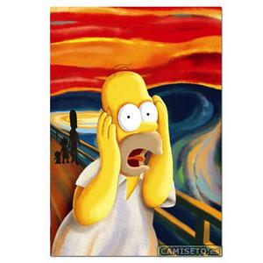
How in the %&*@! are we going to raise that kind of money?!

Slide 6
Raising $10,000 all at once could be difficult.

Slide 7
Raising $2,500? Much easier.

Slide 8
Here is the multiplying effect on our dollars from the two available matches.
Each $1 we raise is matched by one from this foundation up to $10,000.
$1 (our club’s contribution) + $1 (from the 1:1 foundation match) = $2
Each dollar donated to The Rotary Foundation’s PolioPlus Fund may be matched 2:1 up to $35,000,000 per year by the Bill and Melinda Gates Foundation.
Each of the $2 from us and the local foundation generates $2 for a total of a $4 dollar match. So….
$2 + $4 = $6. The end result is that each of our club’s dollars may become $6!

Slide 9
We will accomplish our task by doing multiple fundraisers over an extended period of time.

Slide 10
The overall timetable is to complete this challenge by the end of April 2018. My goal is to compete it by fall of 2017.
A suggested schedule is:
A first small fundraising activity would be held in the January to March period of 2017.
A second one in summer 2017
A third in fall 2017
A large fundraising project, also in summer 2017
The Interact and Rotaract Clubs will each do one as their schedules permit.

Slide 11
From the PolioPlus Challenge fundraising activities of the Brocton and Chautauqua Lake Interact Clubs and the Fredonia Rotaract Club, we would expect only a small monetary contribution. This could be $50 from each of the Interact Clubs and $100 from the Rotaract Club. For these clubs this challenge would be more about polio education and their personal service towards polio eradication efforts.

Slide 12
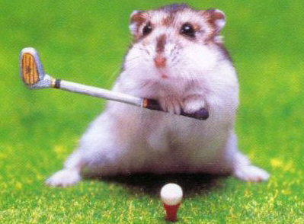
The goal of the one large fundraising activity to be held in summer 2017 is to raise at least $4,000. What about a “Putt an End to Polio” miniature golf tournament?

Slide 13
If each of the three smaller fundraising efforts were to raise $2,000, we will have met our fundraising goal!

Slide 14
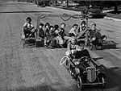
We will need ALL members to be involved in some way. One of the conditions of the foundation’s generous offer is that club member enthusiasm and engagement be a goal of this challenge. We also need everyone to help so as to share the work required to meet the goal of this PolioPlus Challenge.

Slide 15
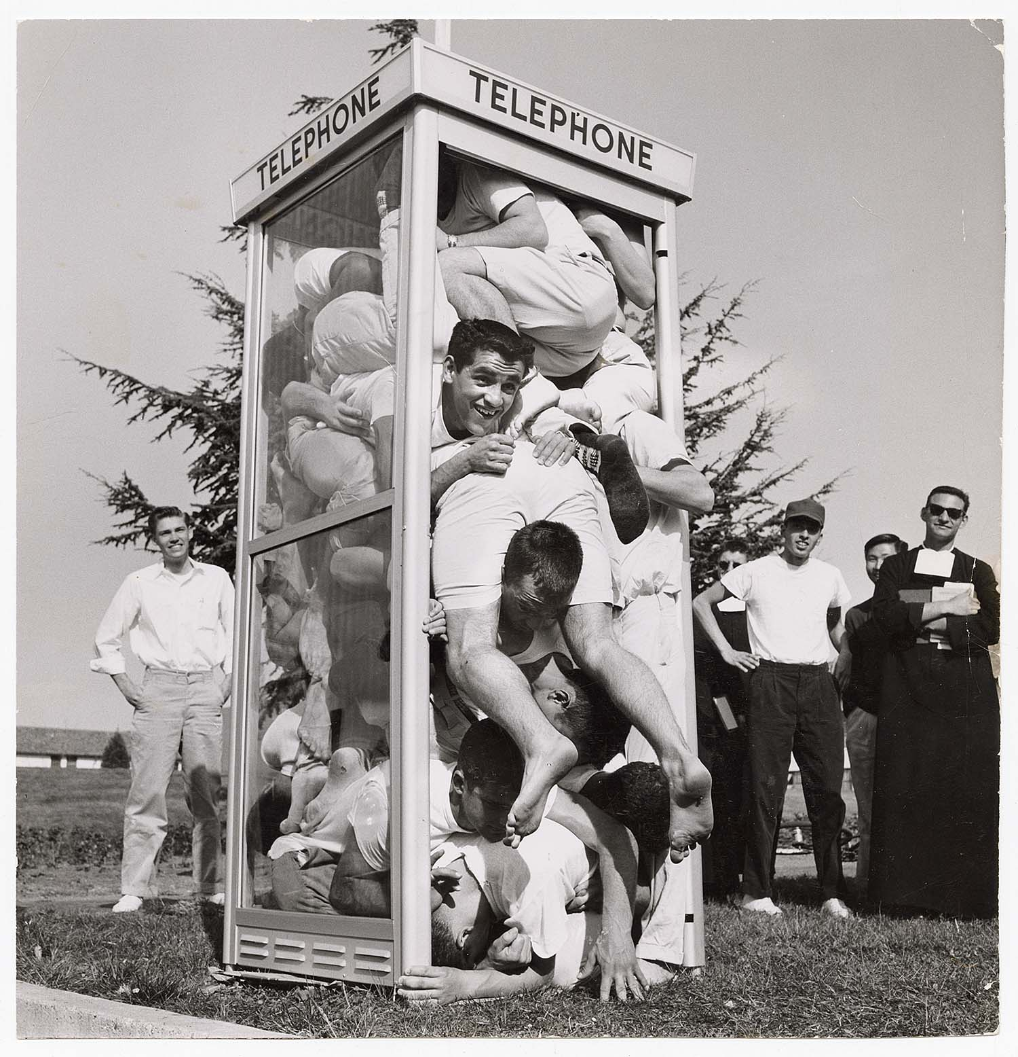
To generate enthusiasm we need to put the FUN back into FUNdraising!
Here are some creative ideas for your consideration. Other suggestions are welcome!

Slide 16
Putt an End to Polio – Mini outdoor golf tournament w/ teams; sponsors for holes; refreshments &, awards; weather dependent; (Option: indoor holes at area bars during inclement weather)
Pies for Polio #1 – Sales of half & whole “homemade” pies; advance orders/sales
Pies for Polio #2 – With much advance publicity of local “celebrities” & “dignitaries” who are willing to take “pies” (whipped cream in foil pans) in their faces for the cause for a suggested donation; have 1 or more local photographers & videographers who are willing & able to donate their time & talents to snap photos (“Photos for Polio”) & take video for additional sales.
Pies & Wine for Polio – Sales of event tickets & donations to event held at local winery w/slices of pie & scoops of vanilla ice cream; perhaps additional partial proceeds of sales from bottles (not glasses) of wines of one or more of the winery’s choice(s)
Poker Run for Polio – Summer poker run for motorcycle riders to designated area bars; legal beverages for purchase; some refreshments for discounted purchase or gratis; winning hand(s) receive prizes
Snowmobile Poker Run for Polio – Winter poker run for snowmobilers (see above); weather dependent
Paint for Polio – “Cocktails & Color” painting on canvas or on wine glasses with advance reservations & including refreshments; est. participant fee is $30 for instructor, materials & polio donation

Slide 19
Next Steps:
Establish 4 subcommittees for 4 fundraisers.
Determine fundraisers.
Name chairpersons of these.
Recruit members.
Establish action plan & time table.
Implement.
Pat yourselves on the back for a job well done!

Slide 20
That is our PolioPlus Challenge.
Where are YOU in in our club’s effort?

