Slide 1
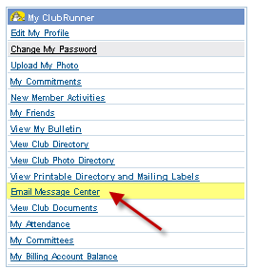
Message Center
ClubRunner simplifies the way club members communicate via email—whether it be within their club, to prospective members, club directors or special groups and committees.
In addition, email addresses are centralized. This means that if a member changes his/her address, it is reflected everywhere, in all distribution lists, without the need to notify others.
1-877-4MY-CLUB

Slide 2
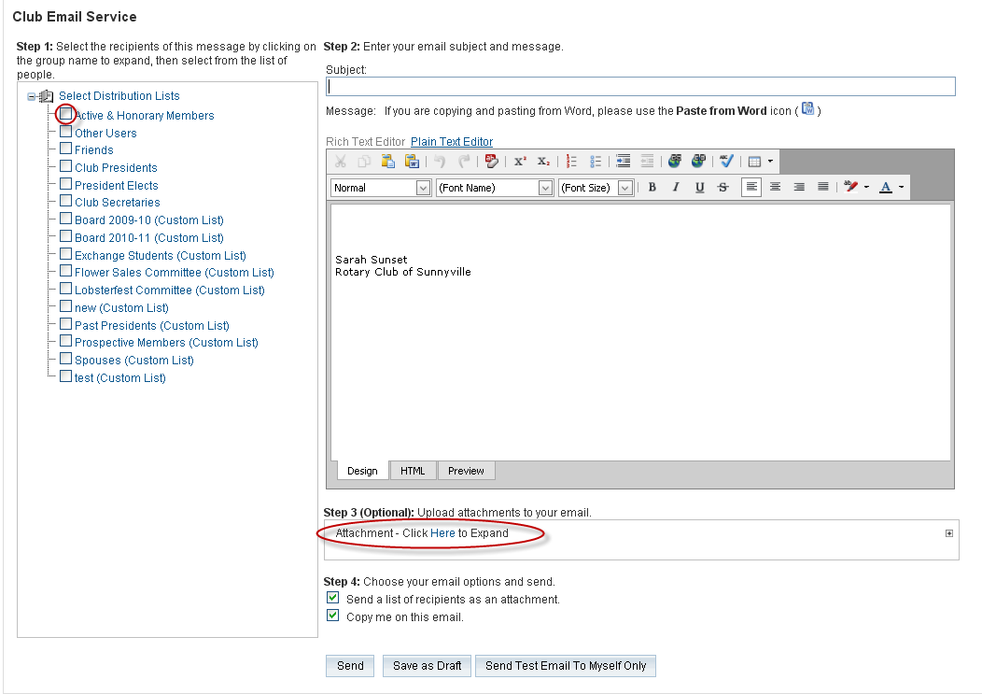
Message Center
email
Since your site has all the club members’ email addresses, sending a broadcast message to all or selected members is easy.
Club executives and directors can also broadcast messages to selected executives in all or selected clubs within the district with just one click.
1-877-4MY-CLUB

Slide 3
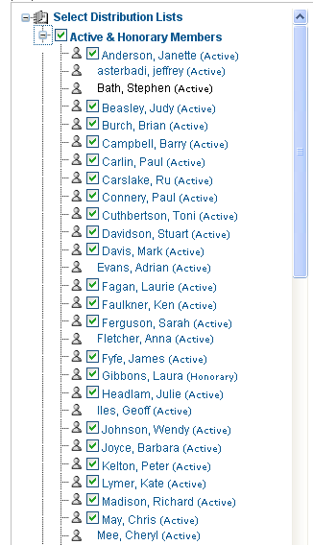
Message Center
You can also create as many custom distribution lists as you wish.
Custom Distribution
lists are great for:
Board of Directors
Committees
Projects
Messages arrive individually, personalized with the member’s name and club along with the sender, so they are not interpreted as spam.
1-877-4MY-CLUB

