Slide 2
What is it…?
Opportunity to study abroad for a year
Opportunity to learn a new culture and language
Opportunity to make friends for a lifetime
It’s a year of adventure
Our returned students call it… “The best year of my life”

Slide 3
Quick Overview
School year (11-12 months)
Both cultural and academic
You will learn the language and culture
You will attend school
Credits are decided by home school
Hosted by 3 families (normally)
Supported by Rotary club and Rotary counselor in country

Slide 4
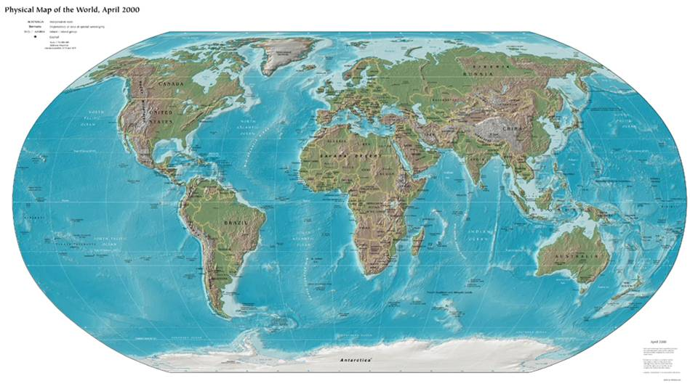
Where can I go…?

Slide 5
35+ Countries
Australia
Japan
Thailand
India
France
Brazil
Spain
Germany
Sweden
Mexico
Belgium
Argentina
South Africa
Poland
Finland
plus others…

Slide 6
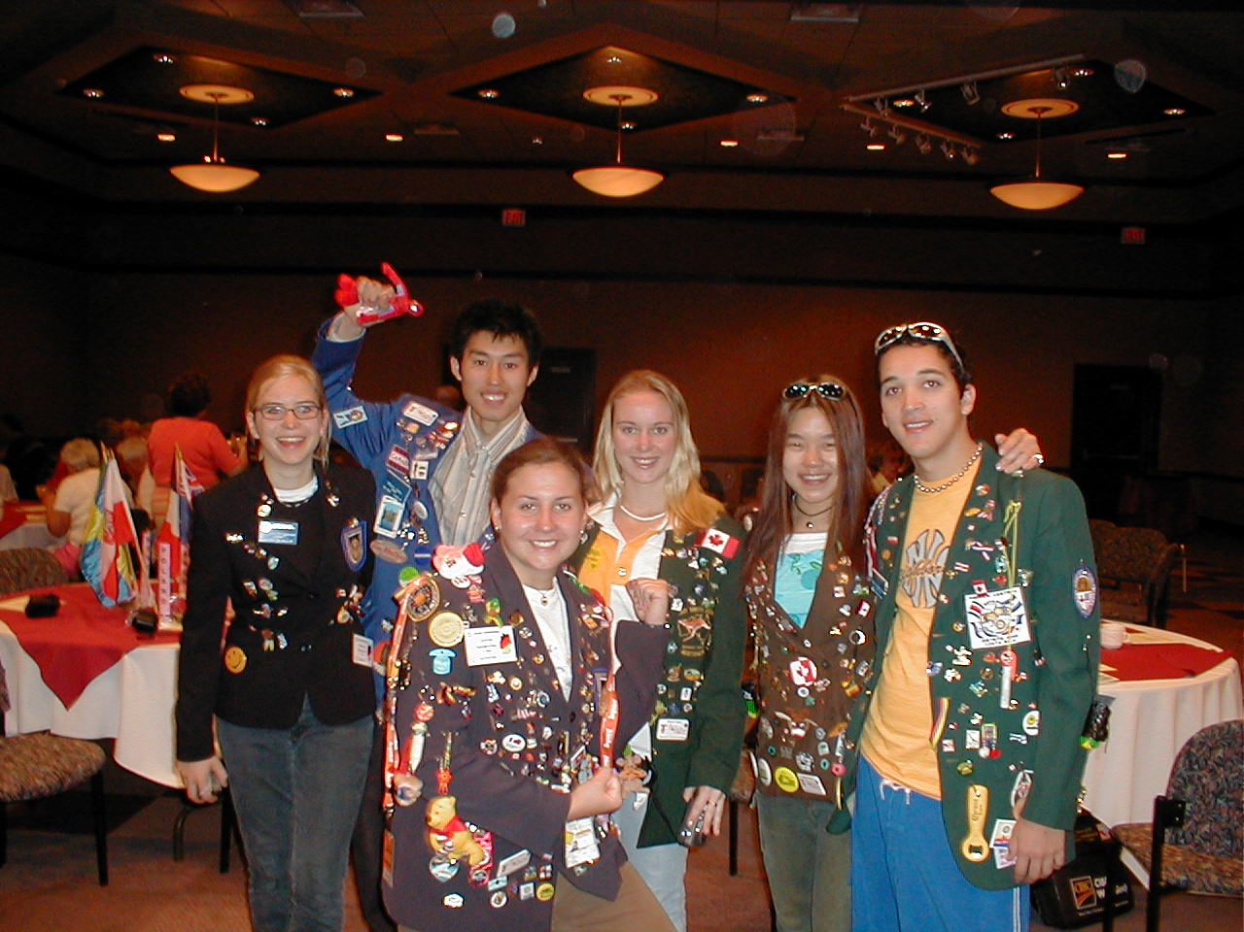
“Real Life Students”
(Fortunately they bear no resemblance to any Exchange students on TV or in the movies…)

Slide 7
Why Rotary…?
Thorough selection and orientation/training process before you leave
Hosted by a Rotary Club and Host Families
Activities with Rotary/Rotarians
Support network overseas and at home
Much lower cost than other study abroad options

Slide 8
Qualifications…
Good student (top half of class)
Between 15½ and 18½ years old and not have graduated on Aug 1, 2017 (with some exceptions)
Sense of adventure
Willingness to learn language and culture
Initiative to get involved in activities

Slide 9
Other Qualifications…
Applicants should have pleasant personality and must:
be able to adjust to a new and different culture/country
be willing live apart from their families
be open to new and different experiences
Despite the name not a true “exchange” (your family does not have to host but we appreciate help in finding host families)
Families of both non-Rotarians and Rotarians are eligible

Slide 10
What does it cost…?
Rotary Scholarship provides:
room and board
tuition
monthly stipend (and normally lots of extras)
Student is responsible for:
air fare (depends on country)
health insurance (cost depends on country)
program fee
possibly language school
any additional spending money
Student cost is usually $6,000 - $8,000
does not include what your parents save while you are gone (food, car insurance, other activities etc.)

Slide 11
If this interests you…
Email:
Youthexchange@rotarylondon.org
Or visit:
facebook.com/RYELondon

