Slide 1
Edmonton’s Economic Outlook
<Details>
September 10, 2018
John Rose
Chief Economist
Financial and Corporate Services

Slide 2
Agenda
The Context
International Context
Energy Prices
Regional & Local Current Indicators
Long-Term Outlook
Edmonton, the Region and Alberta
Risks to the Outlook
2
| Financial Strategies and Budget| Financial and Corporate Services | Edmonton’s Economic Outlook |

Slide 3
Global Context
While very prolonged, global recovery is gaining momentum
Forecast growth rates in most regions have been raised
Euro zone countries finally showing sustained growth
Global financial markets remain fragile – large capital outflows from emerging markets
2018 will be a slightly better year globally, slowing growth in China is problematic due to its increasing share of global output
Source: International Monetary Fund
3
| Financial Strategies and Budget| Financial and Corporate Services | Edmonton’s Economic Outlook |

Slide 4
Oil Prices West Texas Intermediate
US$/bbl
Source: U.S. Energy Information Administration
4
| Financial Strategies and Budget| Financial and Corporate Services | Edmonton’s Economic Outlook |

Slide 5
Some Oil Prices are Improving
US$/bbl
Source: Bloomberg
5
| Financial Strategies and Budget| Financial and Corporate Services | Edmonton’s Economic Outlook |

Slide 6
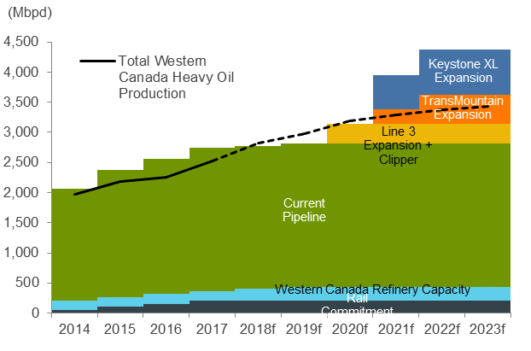
Alberta oil export capacity
Source: Alberta Energy
6
| Financial Strategies and Budget| Financial and Corporate Services | Edmonton’s Economic Outlook |

Slide 7
Natural gas prices Henry Hub
US$/mmBtu
Source: U.S. Energy Information Administration
7
| Financial Strategies and Budget| Financial and Corporate Services | Edmonton’s Economic Outlook |

Slide 8
Alberta Capital Expenditures
CDN $, million
Source: Statistics Canada
8
| Financial Strategies and Budget| Financial and Corporate Services | Edmonton’s Economic Outlook |

Slide 9
Unemployment moving lower
Higher unemployment in Edmonton is driven largely by labour force growth.
A recent shift away from part-time job gains will support consumer spending over the next 12 to 18 months.
Unemployment in the Edmonton region will drift down slowly from the 6.4% range over 2018.
Source: Statistics Canada
9
| Financial Strategies and Budget| Financial and Corporate Services | Edmonton’s Economic Outlook |

Slide 10
Employment in the Edmonton CMA
,000s
%
Source: Statistics Canada
10
| Financial Strategies and Budget| Financial and Corporate Services | Edmonton’s Economic Outlook |

Slide 11
Change in Employment July 2017 to July 2018 Three-month moving average
Job Gains |  | Job Losses
Alberta (36,900)
Construction | 12,600 | Accommodation and Food Services | -5,800
Primary | 9,800 | Agriculture | -4,800
Educational Services | 8,900 | Health Care | -4,300
Manufacturing | 7,900 | FIRE | -4,000
Edmonton CMA (23,500)
Public Administration | 12,600 | Logistics | -9,400
Construction | 11,700 | Other services | -5,700
Educational Services | 10,700 | Accommodation and Food Services | -4,500
Health Care | 8,300 | Utilities | -4,500
Source: Statistics Canada
11
| Financial Strategies and Budget | Financial and Corporate Services | Alberta’s Economic Outlook |
Notes:
Province: Statistics Canada, Table 14-10-0091-01 (formerly CANSIM 282-0124)
CMA: Statistics Canada, Table 14-10-0097-01 (formerly CANSIM 282-0130)

Slide 12
Consumer inflation moving up
The region’s year-over-year inflation rate slowed sharply in 2016 and then began to accelerate
Energy prices have been a key driver of inflation with natural gas, electricity and gasoline highly volatile
Forecast is for inflation to remain slightly above 2.5% then gradually move back to the 2% range for 2019
Higher inflation will erode real incomes for Edmonton residents as average weekly wages rising at a rate slightly below CPI
Year-over-Year % Change in CPI
Source: Statistics Canada
12
| Financial Strategies and Budget| Financial and Corporate Services | Edmonton’s Economic Outlook |

Slide 13
City of Edmonton housing starts
Source: CMHC
13
| Financial Strategies and Budget| Financial and Corporate Services | Edmonton’s Economic Outlook |

Slide 14
Non-Residential Investment in the Edmonton Region
Source: Statistics Canada
| Financial Strategies and Budget| Financial and Corporate Services | Edmonton’s Economic Outlook |

Slide 15
Value of building permits Edmonton CMA
$, millions
Source: Statistics Canada
15
| Financial Strategies and Budget| Financial and Corporate Services | Edmonton’s Economic Outlook |

Slide 16
Growth moderates in the longer term
Real GDP Growth
The City of Edmonton experienced a sharp slow down in mid-2016.
City and region made a clear recovery to faster growth in 2017 along with the province
Continuing in-migration will allow the City and the region to grow more rapidly than Alberta and Canada in the final years of the outlook.
Source: City of Edmonton, Conference Board of Canada
16
| Financial Strategies and Budget| Financial and Corporate Services | Edmonton’s Economic Outlook |

Slide 17
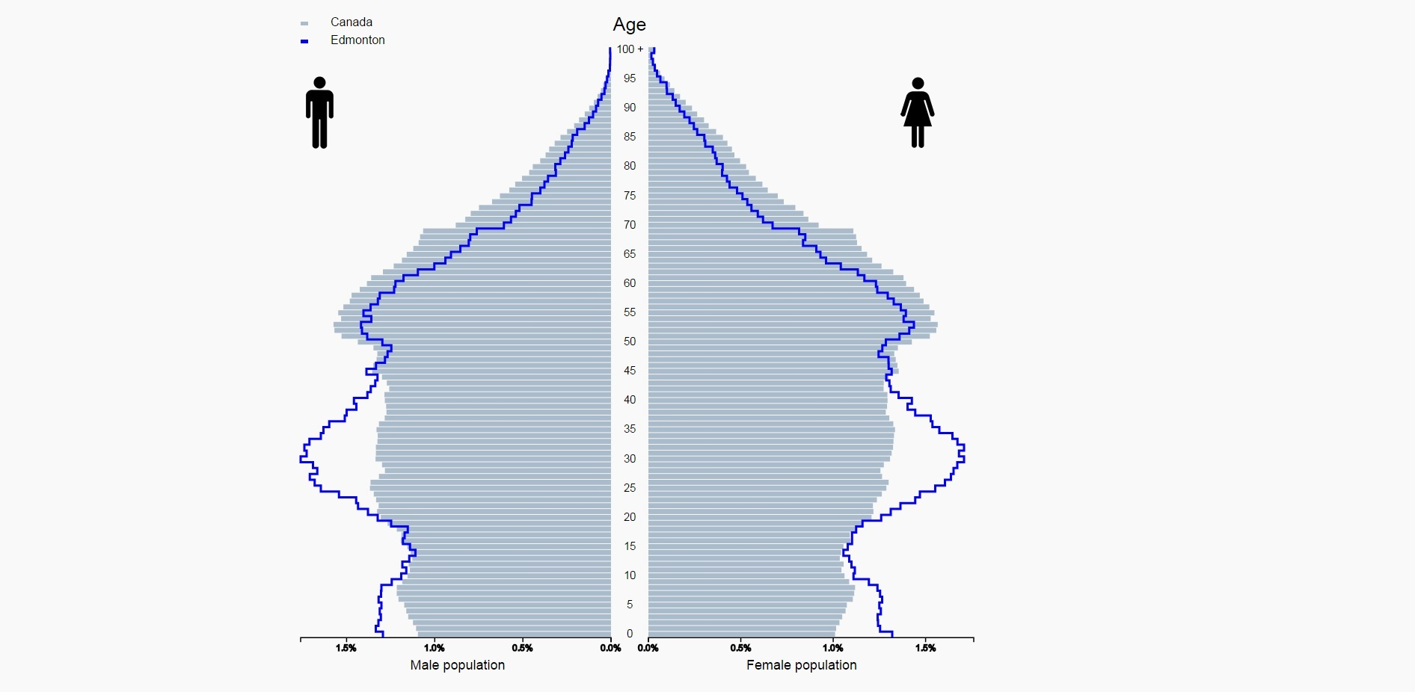
Edmonton’s demographic advantage
Average Age
Canada 41.0
Alberta 37.8
City of Edmonton 37.7
Source: Statistics Canada
17
| Financial Strategies and Budget| Financial and Corporate Services | Edmonton’s Economic Outlook |

Slide 18
Risks to the Edmonton Outlook
Downside
Oil prices fall through 2018 and 2019 causing severe slump in energy investment and provincial government spending
Consumer confidence falters with concerns growing over housing, debt, rising interest rates, and inflation
Conclusion of a number of major construction projects leads to further contraction in the building sector
Stricter controls on carbon emissions and opposition to energy investments constrain longer term growth
Growing international trade conflicts limit global growth and depress commodity prices
Upside
U.S. recovery gains additional momentum with recent tax cuts and infrastructure spending
Canadian economy could to perform better than currently forecast
OPEC and other major oil producers agree to continue and enforce additional production cuts
Euro Zone and Emerging Market countries succeed in stimulating more rapid growth boosting trade and energy prices
18
| Financial Strategies and Budget| Financial and Corporate Services | Edmonton’s Economic Outlook |

Slide 19
Subscribe for monthly updates on
Edmonton’s economy
edmonton.ca/EconomicNews
Upcoming events
ESNA.CA
Chief Economist
Financial and Corporate Services

Slide 20
Thank you!
<Details>
John Rose
Chief Economist
Financial and Corporate Services
780-496-6070
john.rose@edmonton.ca
20
| Financial Strategies and Budget| Financial and Corporate Services | Edmonton’s Economic Outlook |

