Slide 1
This year’s theme is fitting. When Ashleigh and I asked ourselves what is it that inspires us as Rotarians? We had the same answer. You! You! You! You inspire us!
Border City Rotary Club of Lloydminster 2018-2019

Slide 2
Keith Weinbender
Keith is the kindest, most sincere person in the world!
His vocational still resonates and inspires members of our club
Keith is always quick to extend the hand of Rotary to newcomers and guests
He is a dedicated Rotary member, and one of our anchors
He is a wise, calming force

Slide 3
Glenn McCaw
Glenn is compassion in motion
He inspires us because he is someone you can always rely on; he really is ‘the last guy in town to let you down’
Winner of the ‘best husband’ award
Glenn is easy going with a great sense of humor (for a funeral director)
Nothing ruffles him, even though Doreen tries

Slide 4
Paul Klassen
When we think of Paul we immediately inspired by his generosity and kindness
Paul supports everything in the community on some level
He is a great example to all and is always quick to lend support to those in need
Paul is quiet, easy going, personable, always humble, and someone we aspire to be more like

Slide 5
Doreen McCaw
Doreen is an extremely dedicated wife to Glenn; she thinks about him and his needs constantly
She has a great sense of humor; and is a great mentor
You can see so much kindness in those big brown eyes of hers
Doreen inspires with her value-based leadership within our community and region

Slide 6
Teressa Kruekel
Teressa is a soft-hearted, approachable, easy going mother of 3 and community leader
She is empathetic and has a heart for helping others
Teressa has a great sense of humour, and we clearly see a bit of mischief in those eyes
Teressa, you are a lovely person and we are so happy that you are a member of our club

Slide 7
Susan Drever
We are inspired by Susan’s very organized and ‘let’s get it done’ approach
Susan is passionate about her family, her work and her community involvement
It is also clear that Susan is a fantastic mother and grandmother
Susan is energized, and always a light in the room

Slide 8
Ed Anderson
Ed is a kind, gentle man who is devoted to his family and to local causes – particularly healthcare
Ed’s kindness overflows and we see that he loves babies . . . watch him make funny faces at Jill’s baby during meetings
Ed is always very welcoming to new members
He has stories to tell and loads of wisdom to share

Slide 9
Michelle Benning
Michelle is one of the most down to earth people on the planet
She is passionate, loyal, adventurous and organized
Michelle has taken on big roles within our club in the past such as; IPN Chair, and Treasurer. Truly inspirational!
Michelle is a Great mom! If you would like a glimpse of true love, watch Michelle when she’s looking at her boys

Slide 10
Evan Stephens
We love Evan! He has such a quiet, non assuming nature; however, Ashleigh and I are not fooled. We see a bit of mischief here too
Evan has a quiet strength, a calm presence, quick wit and a great sense of humour
Of course, you are also our club’s Bitcoin guru
We are inspired by your easy going nature and willingness to lead our club as president next year

Slide 11
Maria Kokonas
Maria is the member who has made us all believe in the true magic and wonder of birthdays
Maria is a very generous member with a soft heart, and passion for life
She is welcoming and friendly with a smile that lights up a room
Maria is always interested in learning about new ways Rotary can serve our community

Slide 12
Ashleigh Jarvis
Ashleigh has success written all over her future
She has this natural sparkle that makes you wonder what she’s up to
Ashleigh has incredible values that align perfectly with Rotary
I am inspired by Ashleigh’s intelligence, innovation, and her ‘whatever it takes’ attitude toward leadership

Slide 13
Jill Kelly
Okay, we need to say this first, even if we didn’t know anything else about Jill we are so incredibly inspired by her dedication to bring Lauren to Rotary every Tuesday. Wow!
Jill is the true essence of calm. Amazing! We trust that you have enviably low blood pressure?
We are so inspired by Jill’s creativity, innovation and interest in serving others in our community

Slide 14
Nekky Jamal
What inspires us about Nekky, except everything?
His presence is like Divinity walking into the room
Nekky is humble, kind to the core, personable, and takes service above self to a whole new level
Great smile! You should consider dentistry as a profession
Lloydminster’s 2018 Citizen of the Year
An inspiration to all

Slide 15
Dave Evans
We are inspired by Dave’s warm and open approach
We love his sense of humour; Dave is never short of funny stories and has a contagious laugh
Dave has taken on the Youth Programs role within our club and we are so inspired by his dedication to serve youth and up and coming young leaders in our community

Slide 16
Tom Hnatko
If this photo doesn’t say ‘Ahoy Matey’ I just stole your hippo I don’t know what does
We are continually inspired by Tom’s gentle, caring nature
He is a family focused ex-pirate who never forgets his wife’s birthday or anniversary
Tom is much too humble to tell you this but he was instrumental in saving a young woman’s life years ago just by being kind

Slide 17
Chris Leibel
This is the man to call if you ever need help
Chris is always smiling, easy going, and would give you the shirt off his back if you were in need
We are inspired by his work ethic, common sense decision making and commitment to Rotary
Chris has served as Rotary president, IPN Co-Chair, and many other important Rotary roles

Slide 18
Dave McLennan
Dave is great parent, a loving husband, and a great friend to many
Having spent years as an educator Dave has this deep teacher’s voice, when we hear him we all quit talking, sit up and listen
Dave always gives careful thought to Rotary questions and helps our club make good, logical decisions

Slide 19
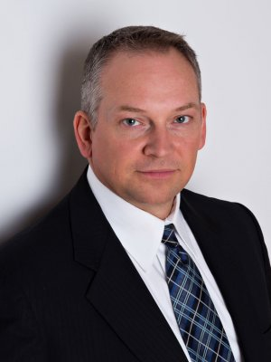
Les Hanson
Les is definitely one of the best dressed guys in town! PS Check out his socks
Les has served on NPO Boards advocating for vulnerable, at-risk youth and marginalized individuals for the past 20 years
We are inspired by his dedication to youth and those in need
Les is a past president of our Rotary club and has also served on a variety of committees
He is also our resident poultry expert

Slide 20
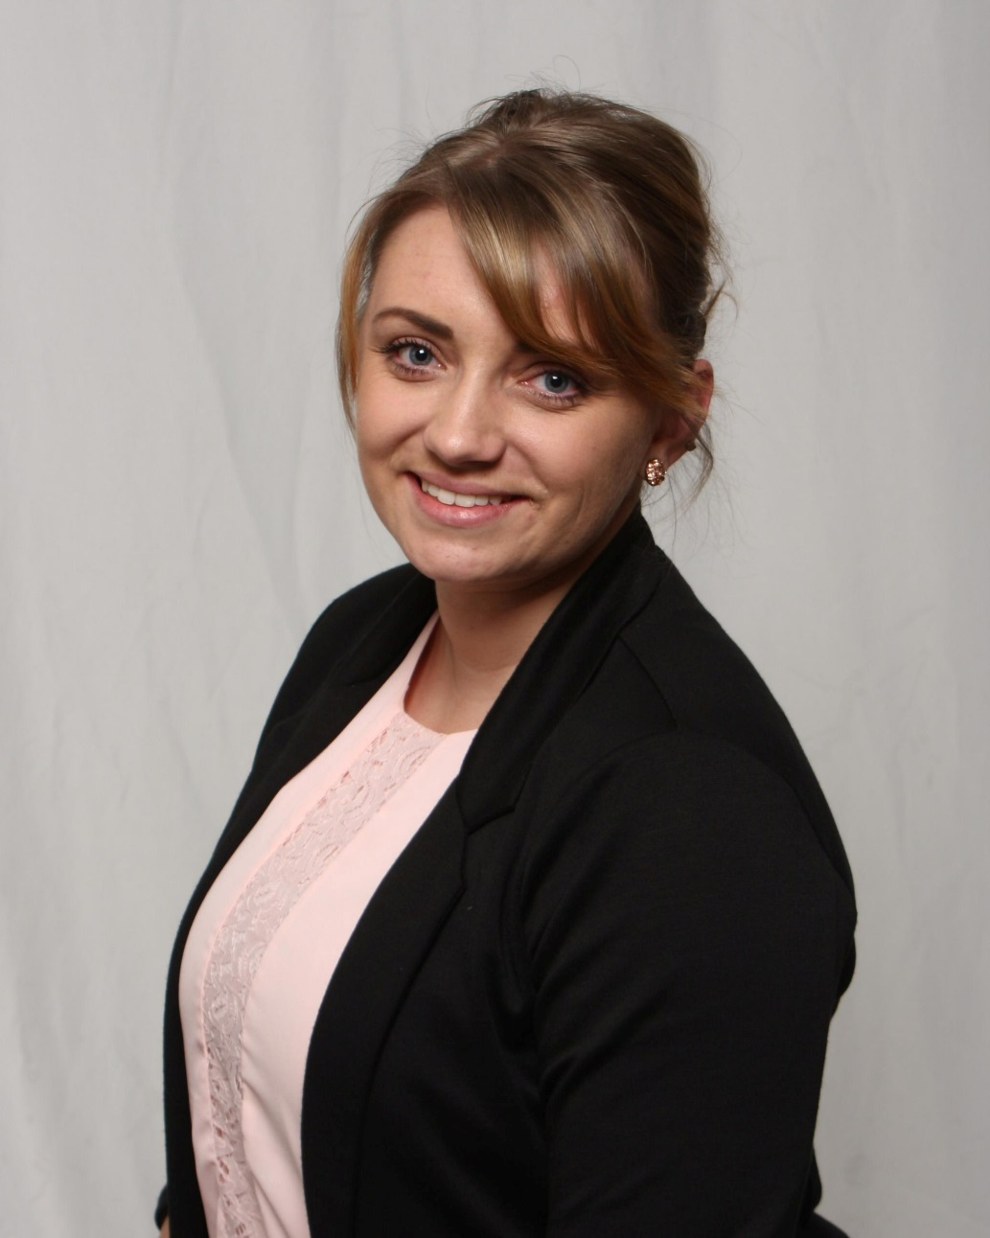
Mel Granger
Mel is our fearless female member
She is also the type of person you want to be your friend – we think we will re-name her Miss Rotary Friendship
Mel puts her heart into any everything she enjoys doing
We are inspired by Mel’s commitment to our biggest fundraiser of the year – Irish Pub Night! She will be leading the way this year with Ashleigh’s help
Mel, we are so happy that you are a part of our club

Slide 21
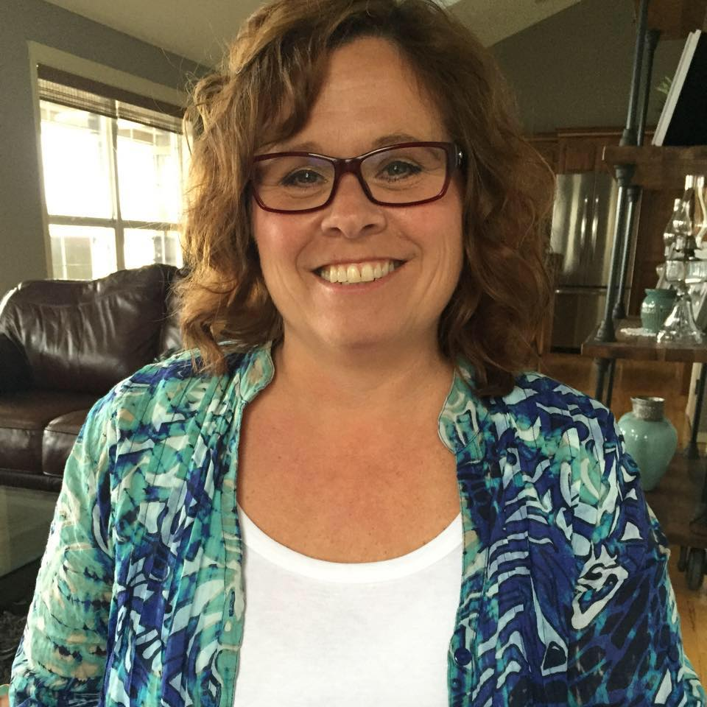
Jackie Jarvis
We are inspired by Jackie’s quiet compassion and strength
Jackie is a gentle, down to earth soul that you can sit down and speak to about anything
But, trust me you don’t want to tangle with her either – love Ash
Jackie will be leading the Club Service Committee this year and hosting a summer barbeque for our members in August

Slide 22
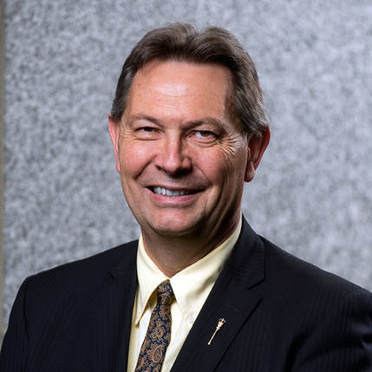
Richard Starke
Richard is our club politician . . . but we love him anyway
We are inspired by Richard’s willingness to step into the political arena and to serve in this capacity
I am personally inspired by Richard and Allison’s willingness to care for a former Rotary exchange student from Germany who was living in the USA when she was diagnosed with cancer - Doreen

Slide 23
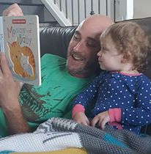
Carlo Monette
Carlo is one of our newest members and we are inspired by his mere willingness to hang out with us
Carlo is another one of our club’s – go to guys should you ever need help
He has a great sense of humour! He is a great dad and a great husband
Carlo, thank you for being a member of our club and for dedicating your time and talents to serving our community

Slide 24
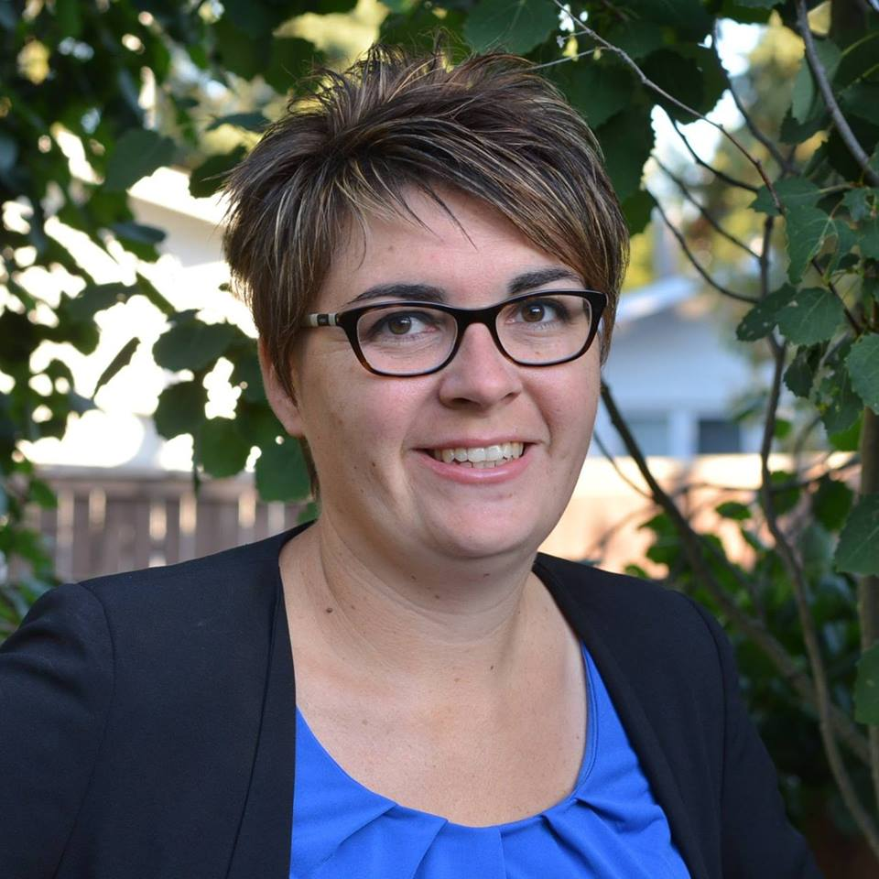
Leanne Wildeman
We are inspired by Leanne’s exceptional work ethic!
She is not only a member of our club but she is also our resident SK. Telemiracle and Kinette Club Queen
Leanne is a very sincere individual with a quiet strength.
She possesses a wonderful willingness to help with whatever needs doing
Leanne helps with our club’s public awareness needs and we are so happy that she chose our club for membership

Slide 25
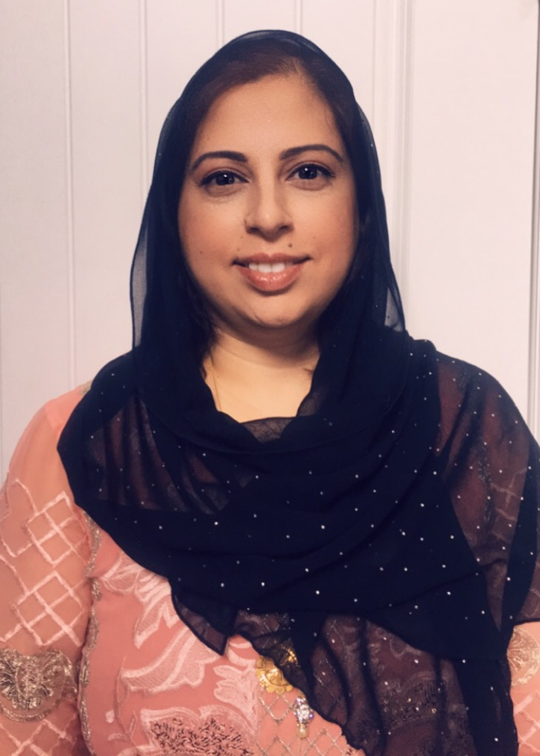
Arshi Mizra
Arshi is a committed wife and mother of three
We are inspired by Arshi’s amazing sense of style and class and her smile that lights up the room at 7:00am Tuesday mornings
As a new member of our club we look forward to getting to know you better. We are thrilled that you chose the Border City Rotary Club as a way to make a difference in your community

Slide 26
Pam Armstrong
Pam, you have been a god-send to our club
Your organizational skill, and administrative/financial knowledge inspires us to look ahead, focusing on other Rotary matters because of our confidence in you
Thank you for your down to earth, open and honest approach
We love your smile and warm greeting every Tuesday morning

Slide 27
Abigail Jurgens
About Abigail

