Slide 1


Logging Into Zoom With Different Devices
STEP BY STEP ILLUSTRATIONS

Slide 2
Using Zoom On Different Platforms
Many of you are skilled users but some Rotarians are not
Although it is still Zoom, Zoom can look and feel different on different platforms
Because members may attend a meeting with different devices, this document shows what logins look like and how to use them
Using pictures this presentation covers …
  PCs using Microsoft utilities … Slide 3
  iPhones … Slide 13
  iPads … Slide 24
Pardon my unprofessional photographs ☺

Slide 3
PCs Using Microsoft Outlook

Slide 4
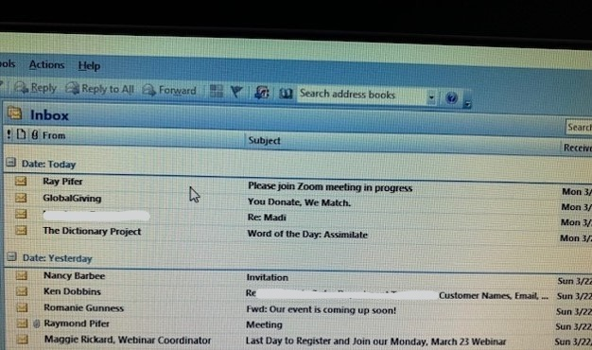
Zoom generated email “Subject”

Slide 5
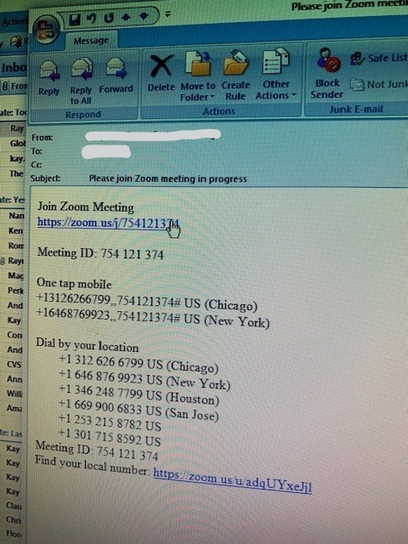
Open email. Click on the URL

Slide 6
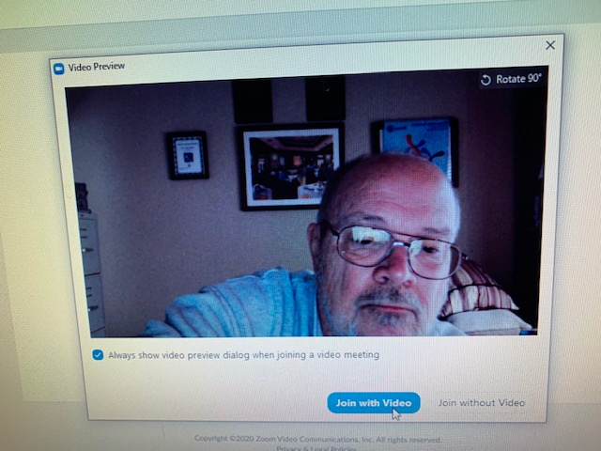
Click “Join with Video”

Slide 7
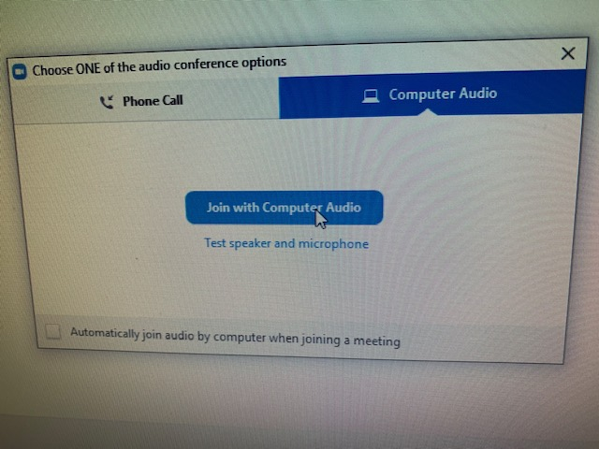
Click “Join with Computer Audio”

Slide 8
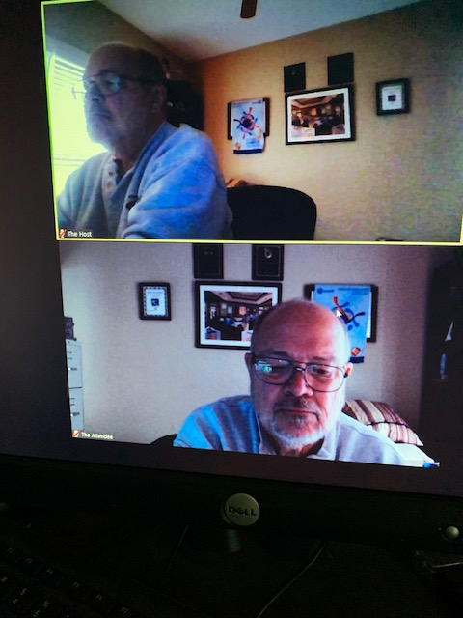
Host and One Attendee

Slide 9
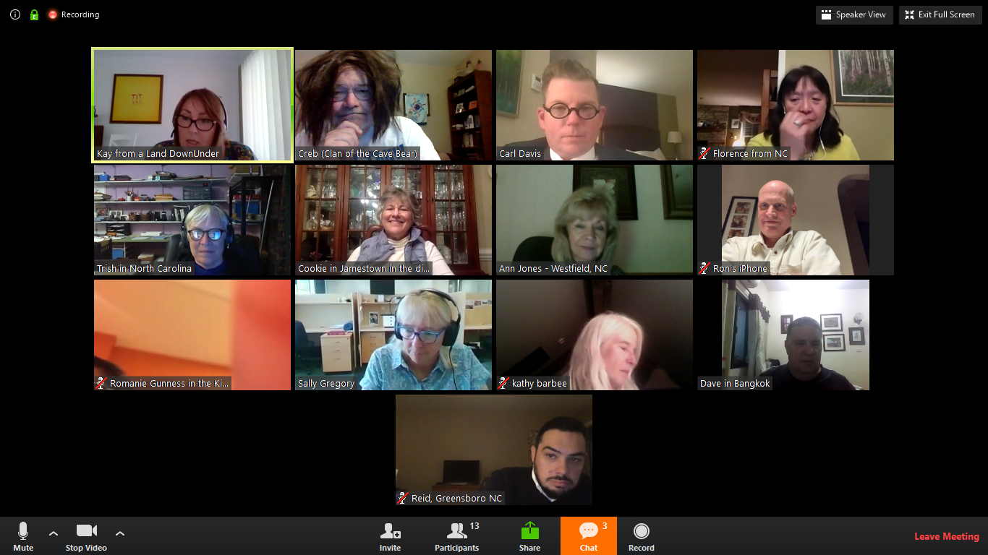
It should read as “Speaker View” in right hand corner
When it reads “Speaker View” you are in fact in “Gallery View”

Slide 10
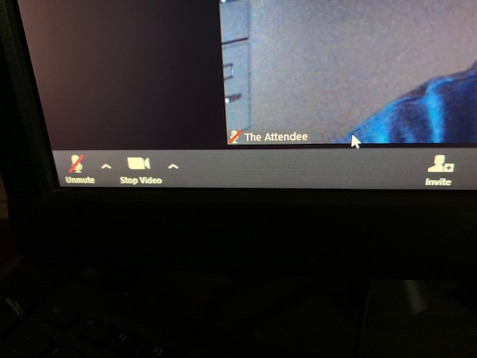
Toggle Switches: Microphone & Video

Slide 11
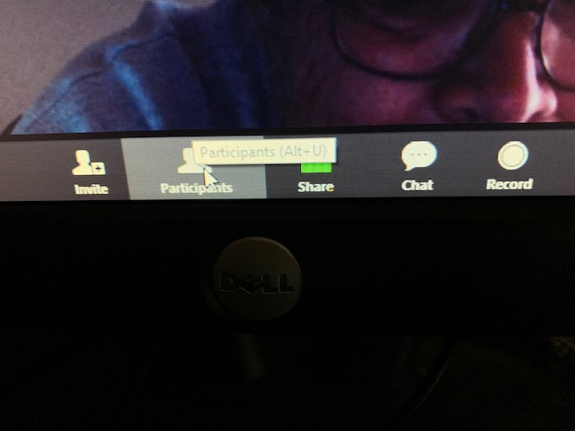
Can change name by clicking “participants”
Can “Chat” to Everyone or just a single person
“Share” is for the Guest Speaker. Record is for the Host

Slide 12
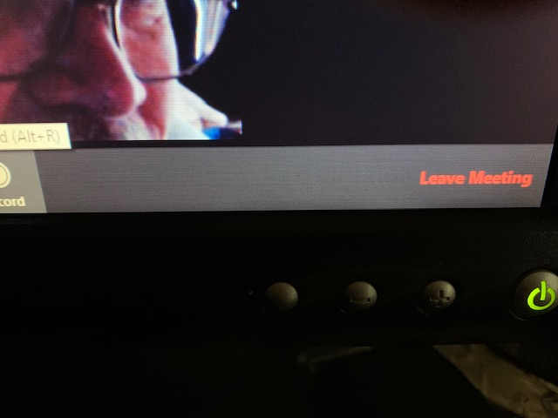
Leave Meeting on lower right hand side

Slide 13
iPhones

Slide 14
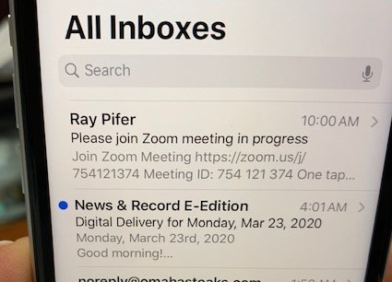
Mail received

Slide 15
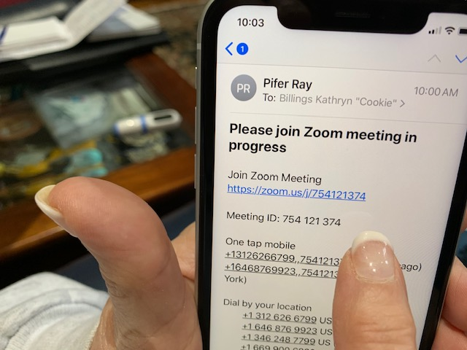
Click on URL

Slide 16
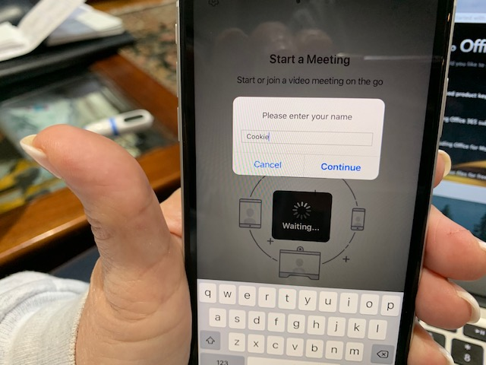
Enter your name as it will appear to others

Slide 17
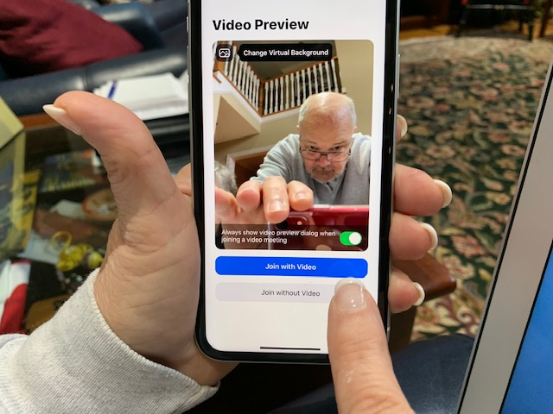
Join with Video

Slide 18
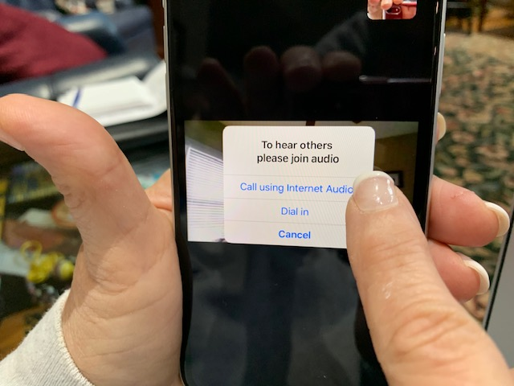
Call using Internet Audio

Slide 19
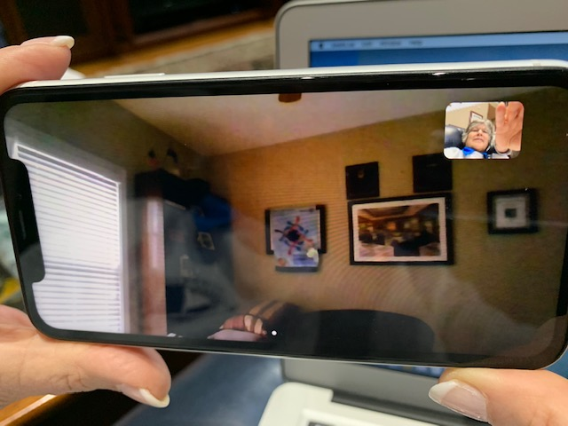
Hold iPhone “horizontally”
Little picture of you … rest of screen for some of the others

Slide 20
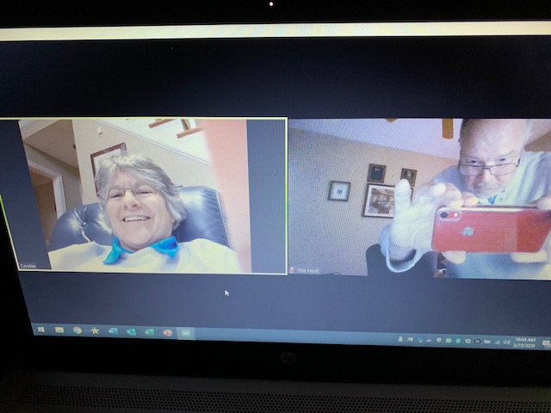
Cookie is what an iPhone user looks like to others when holding iPhone “horizontally”

Slide 21
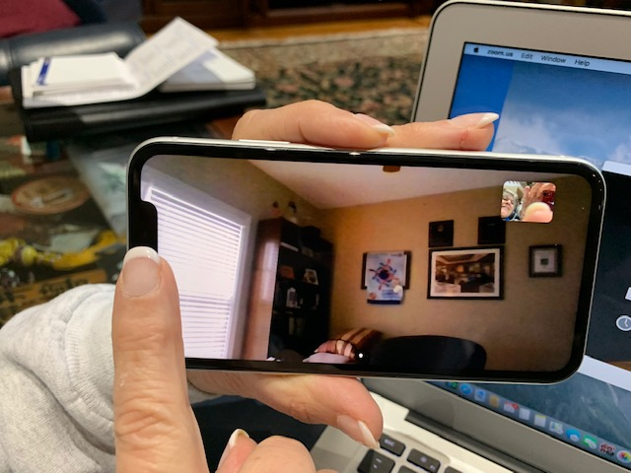
Getting ready to scroll to the right to see system controls

Slide 22
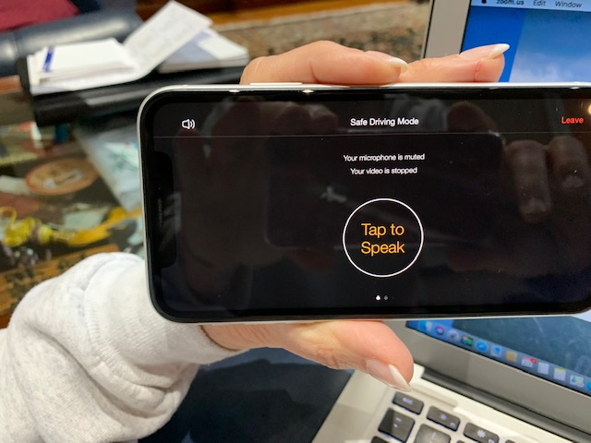
System controls

Slide 23
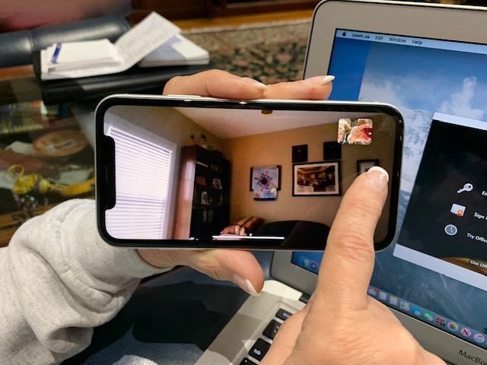
Getting ready to scroll to left to see other participants

Slide 24
iPads
Please load the Zoom App before attempting to log into a Zoom video conference

Slide 25
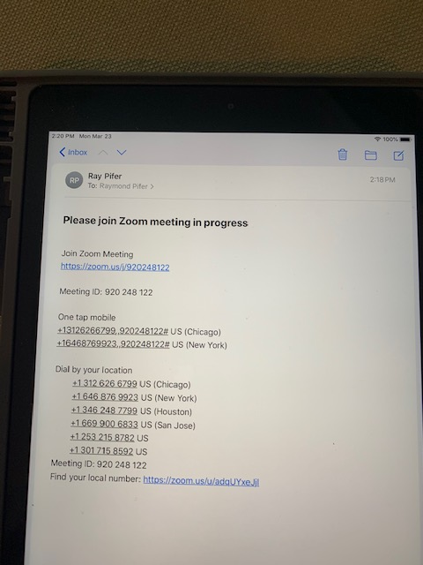
Receive email and click on URL

Slide 26
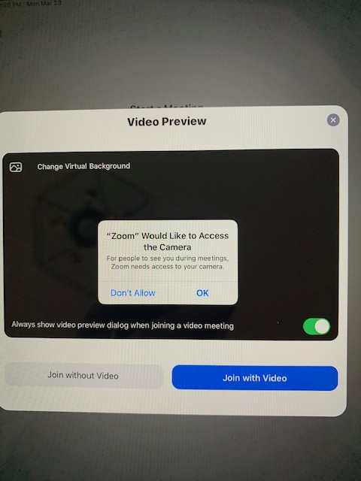
“OK” to Access Camera

Slide 27
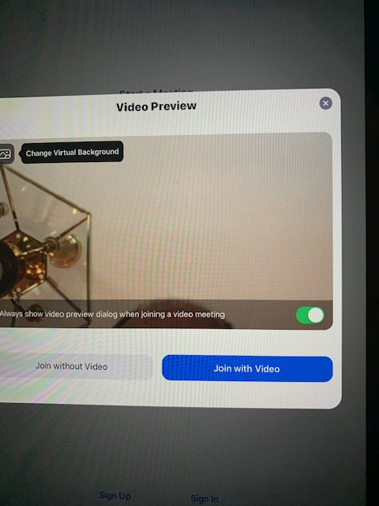
Click “Join with Video”

Slide 28
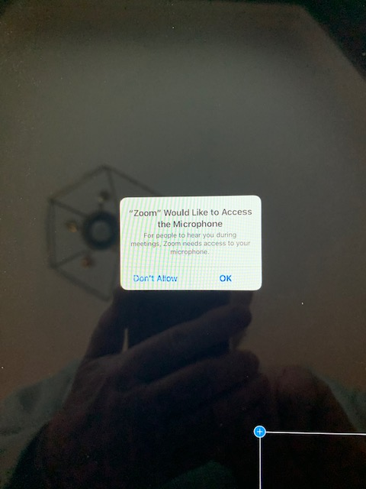
OK to “Access Microphone”

Slide 29
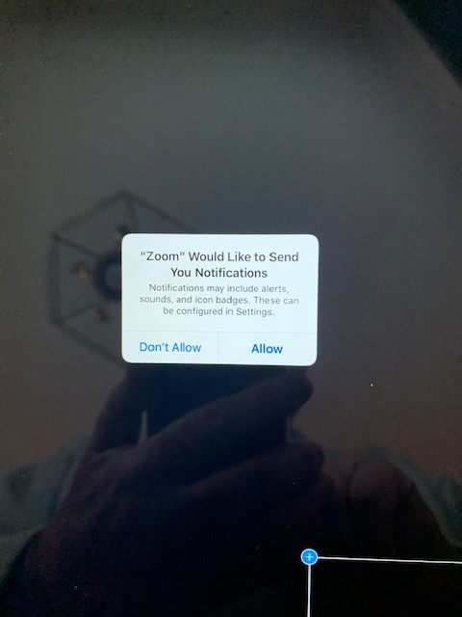
“Allow” Zoom to send Notifications

Slide 30
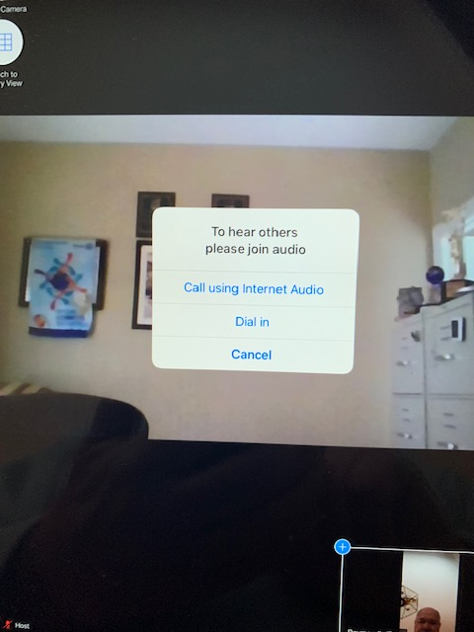
Call using Internet Audio

Slide 31
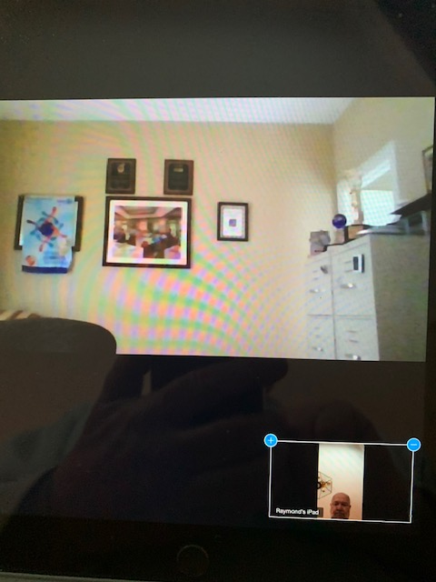
Initial window … not best way for club meeting

Slide 32
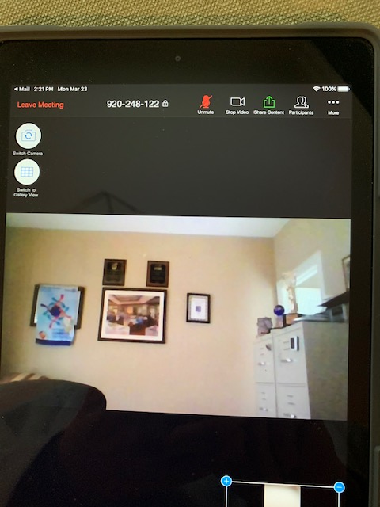
Big Button on left: “Switch To Gallery View”

Slide 33
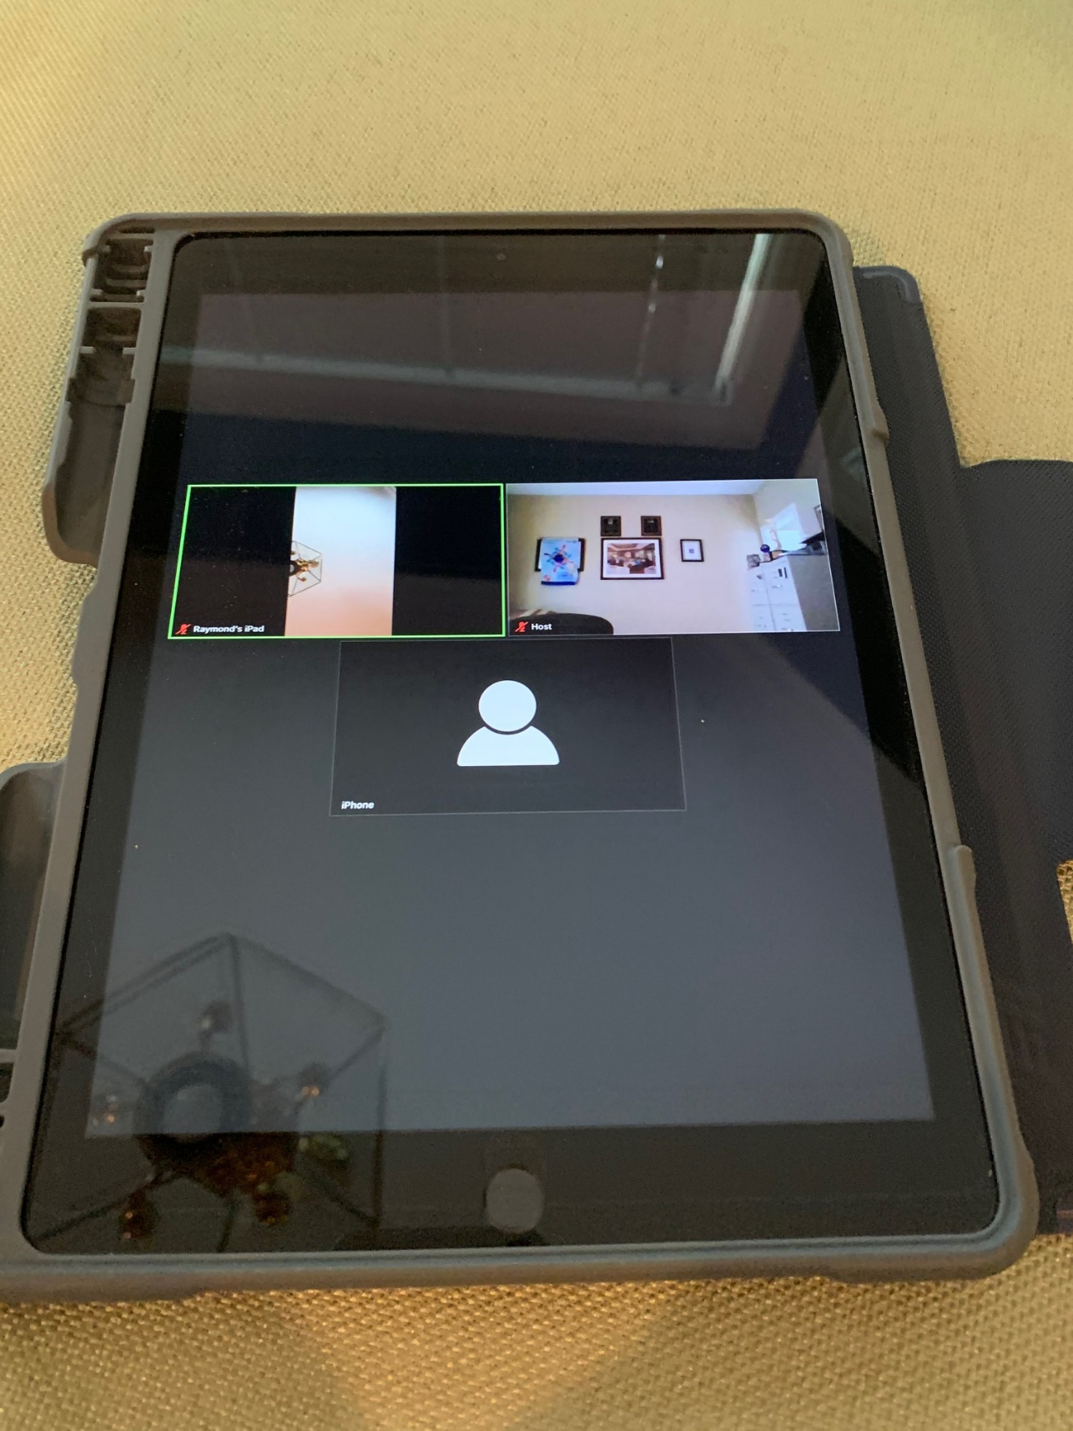
In “Gallery View” see lots of people all at once

Slide 34
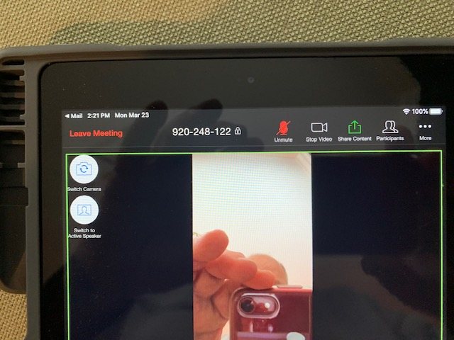
Controls are at top

Slide 35
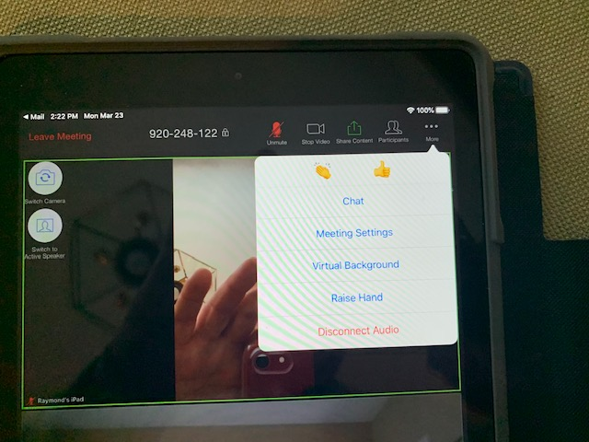
“More” controls

Slide 36

Live Long And Prosper

