Slide 1
Rotary Club of Ann Arbor North Foundation
Report for May 28, 2020 Club Meeting

Slide 2
Sources of Funds for Year Ending June 30,2020
2019 Golf Outing
Mad Hatter Fundraising Dinner
Watershed III Profits
Carry-over from 2018-2019 Rotary Year

Slide 3
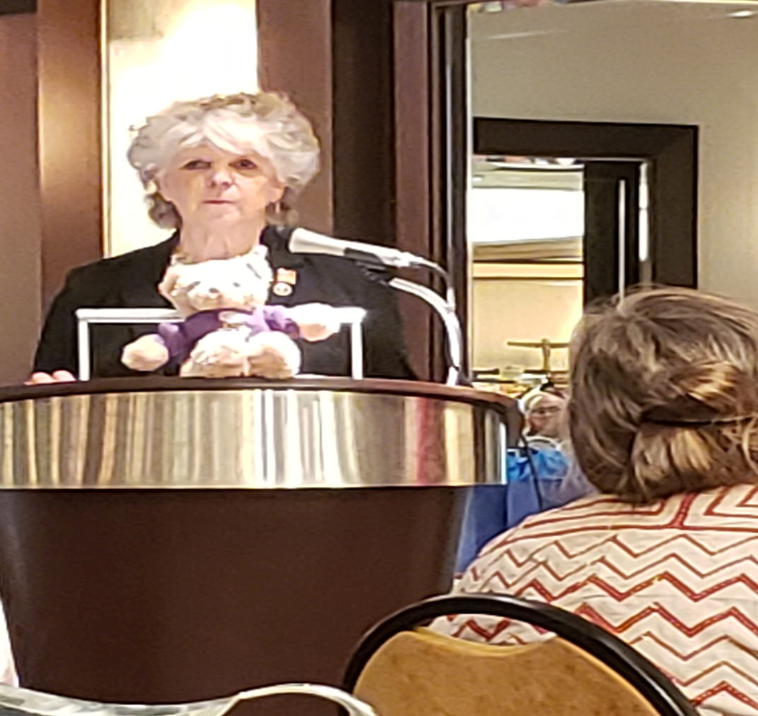
July
$1,000 to Breakfast at St. Andrew’s
In Honor of Virginia Nordby
$250 to Down’s Syndrome Support Team
Sponsor for the 15th Annual Buddy Walk
$200 for Ann Arbor Rotary Club Polio Luncheon
Lunch at Weber’s on October 23, 2019

Slide 4
August and September
$250 Community Action Network
Donation for School Supplies,
in addition to what individual club members contributed
$1,000 Michigan Works! SE
Sponsorship for Youth Program

Slide 5
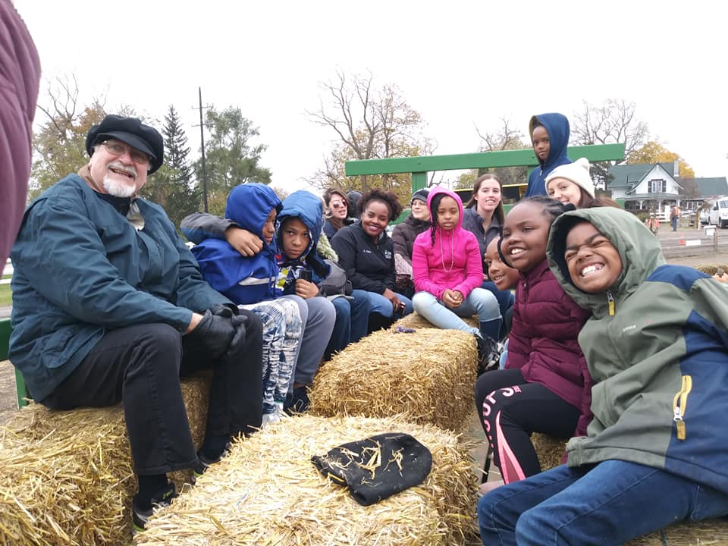
October and November
$1,200 Girl Scouts Heart of Michigan
Donation sufficient to support 1 troop
$148 Three Cedar Farms
Cost for Annual Trip to Pumpkin/Corn Maze/Donuts with
Children from Green Baxter Court
Heart of Michigan

Slide 6
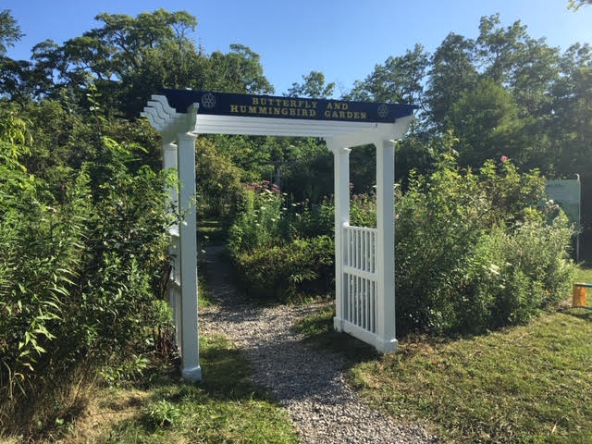
December
$2,100 Plantwise
Butterfly Garden Clean Up and Planting
$79.35 Diane Sheffrey
Reimbursement for Youth Exchange Students Holiday Event
Diane provided lunches for the students

Slide 7
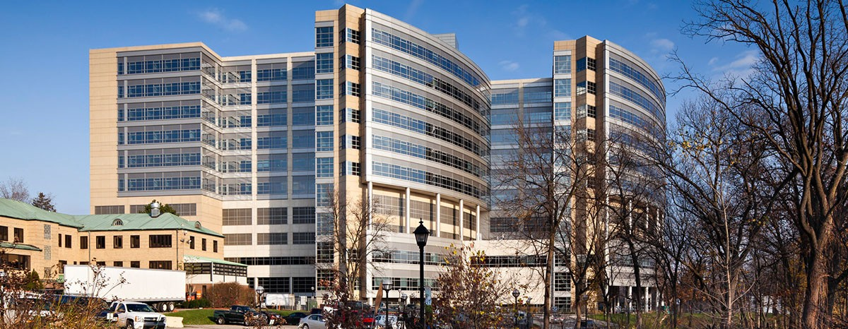
January
$1,000 U of M Rogel Cancer Center
Donation Request from John/Erika Copeland
For Patient and Family Support Services
$1,000 S Mott Children’s Hospital
Donation Request from John/Erika Copeland
For Child and Family Life Program
Patient & Family Services
Child & Family Life Program

Slide 8
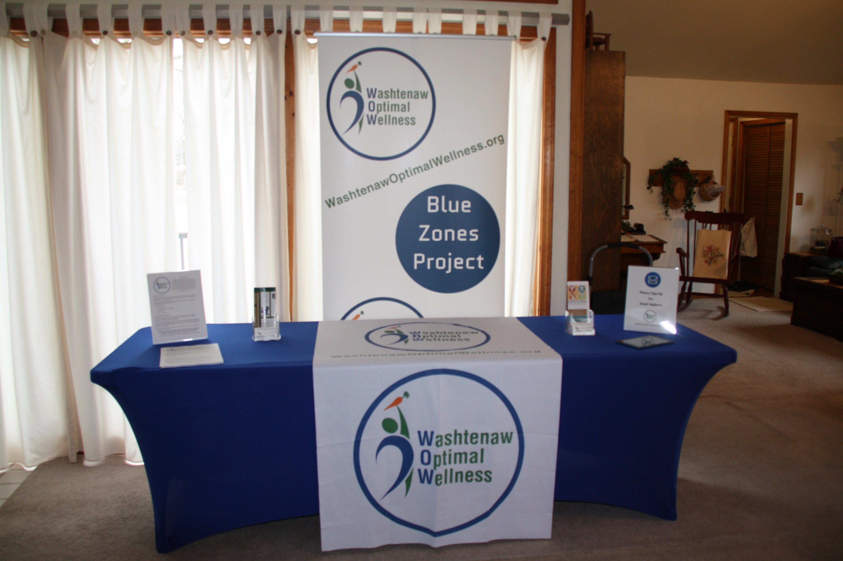
February
$500 BSA Southern Shores Field Office
Donation Request by Erika Copeland
Donation for Women is Scouting Program
$665 Washtenaw Optimal Wellness
Donation for Durable Marketing Items
$1,200 The Holly Institute
Donation Request by Bryan Schindel
Donation to Cover Cost of 1 Family
Southern Shores Field Service Council- Boy Scouts of America

Slide 9
March and April
$167.54 Diane Sheffrey
Reimbursement for Ronald McDonald Dinner Expenses
$1,200 BSA Southern Shores Field Office
Donation to Cover Cost of Handbooks for the Boys
$1,000 SOS Community Services
Donation in Wake of Covid 19 Outbreak
Southern Shores Field Service Council- Boy Scouts of America

Slide 10
April Continued
$1,000 Meals on Wheels
Donation in Wake of Covid 19 Outbreak
$1,000 Food Gatherers
Donation in Wake of Covid 19 Outbreak
$1,000 Rotary District 6380
Donation to Mask Challenge
To bring N95 Masks to Hospitals in Need in Our District

Slide 11
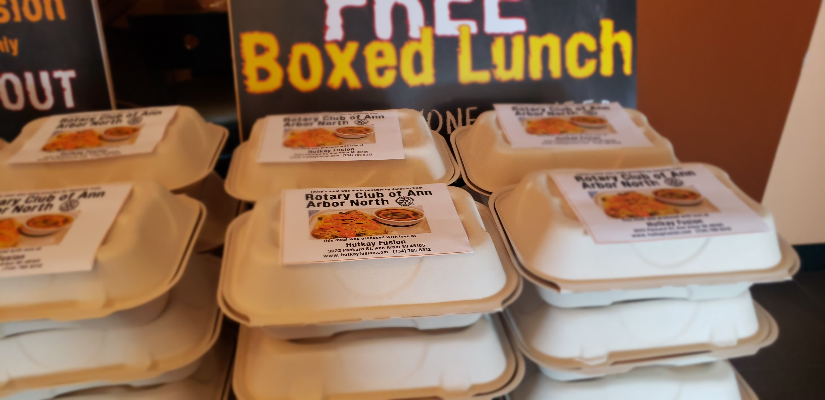
April and May
$550 to Hut-K Fusion
Donations to Provide Meals to those in Need
For Pick Up, Delonis Center, Safe House
In Wake of Covid 19 Outbreak
$1,000 Habitat for Humanity
Mortgage Payment Relief Program
In Wake of Covid 19 Outbreak

Slide 12
May Continued
$500 Fisher House Michigan
Heros Helping Heros Meals Program
In Wake of COVID 19 Outbreak
$1000 Rotary Club of Ann Arbor
Disaster Response Committee
COVID-19
COVID-19 Crisis

Slide 13
Investment Side
Edward Jones Account Balances
As of April 30, 2020 $31,561.19
Stocks and Mutual Funds

Slide 14
Life Insurance Policies
Jeff Crause
Manish Mehta
Stephen Modell
Steve Pierce
Vic Pooler

