Slide 1


Rotary Club of Ann Arbor North
Notes:
Name Thank you fun (laughing and game) engaging (ask what do you know about UW, informational

Slide 2
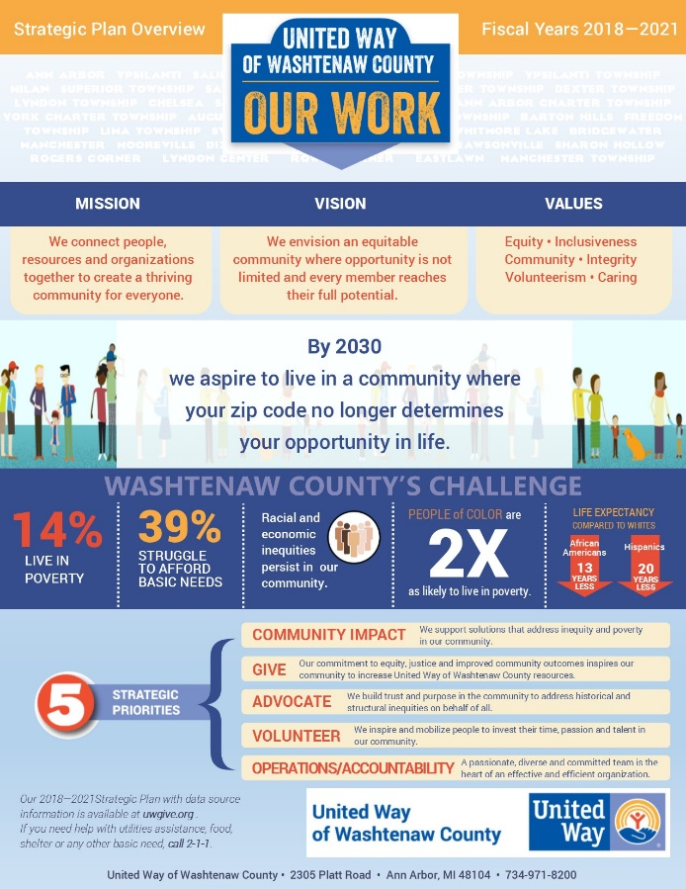

2018-2021
Strategic
Plan
2017 Campaign Kickoff

Slide 3
Our Work
2-1-1: Community Help & Referral Line
  Staffed 24/7
  Online chat, email or database search also available
FamilyWize: Discount Rx Program for all
Volunteer Center: www.VolunteerWashtenaw.org
Mobile Financial Resource Team:
VITA: Volunteer Income Tax Assistance for families & individuals earning $54,000 a year or less
2017 Campaign Kickoff

Slide 4
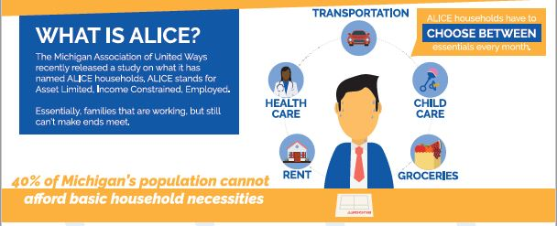

Slide 5
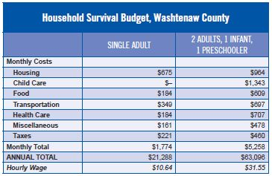
Monthly Costs for a
single adult = $21,288
$10.64 per hour
Monthly Costs for a
family of 4 with
young children = $63,096
$31.55 per hour

Slide 6

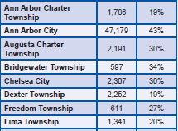
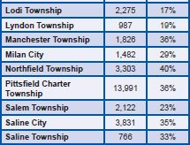
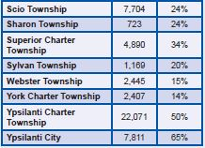
Washtenaw County – 2015 ALICE and Poverty %’s
Lowest
← 14%
Highest
65%

Slide 7
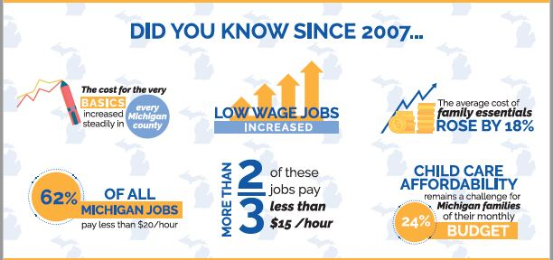
Did you know?

Slide 8
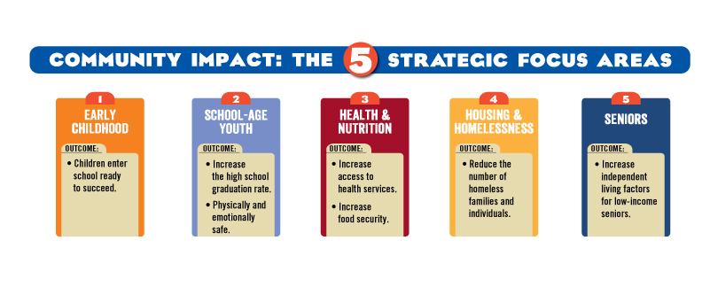
Our Work

Slide 9

Funding Decisions
Most grants are awarded via a competitive application process.
Agencies are screened to ensure core sound practices in place.
Grants are reviewed and disbursed by community volunteers.
Unique participation in Washtenaw Coordinated Funders

Slide 10
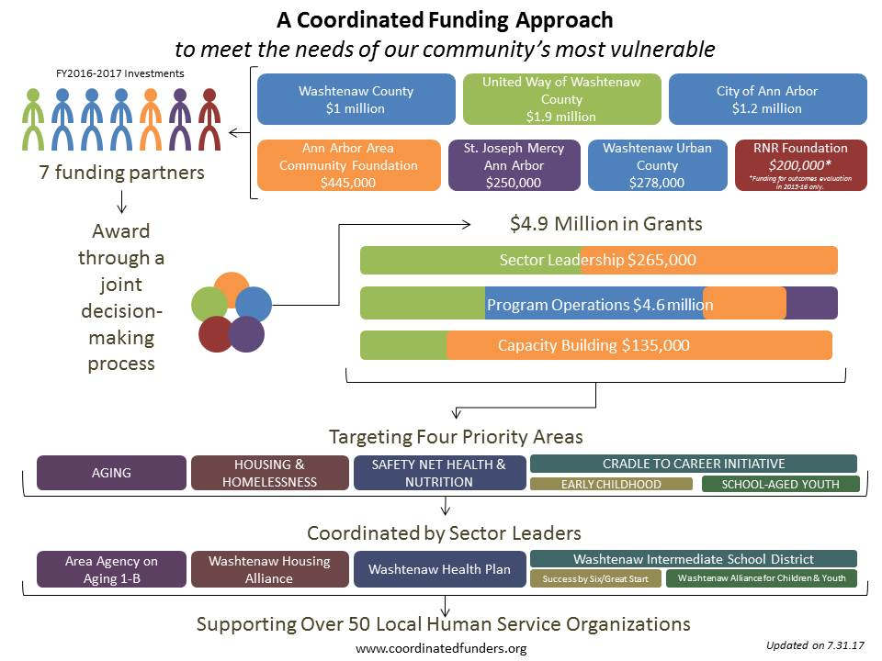
2017 Campaign Kickoff
Notes:
Washtenaw Urban County is a partnership between the Washtenaw County Board of Commissioners and the cities, townships and villages who have agreed to jointly participate in federally funded programs

Slide 11

Early Childhood
  85% of brain development happens before kindergarten.
  Nearly 1 in 6 children are in poverty in our county
  When children receive quality early childhood education, they are more likely to read at grade level by 3rd grade
  Early childhood education programs can save society $17
  for every dollar invested—as a result of savings in
  education and social expenditures, combined with
  gains in productivity
Our Goal: Children enter school ready to succeed.
Notes:
Amanda
*Strategy of Detroit’s United Way-investing almost all of their funds into Early childhood

Slide 12
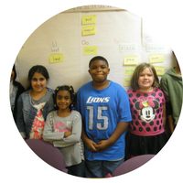
School-Aged Youth
1 in 3 students in Washtenaw County are economically disadvantaged
Overall Graduation Rate: 87.3%
Economically disadvantaged Grad Rate: 71.9%
Only 53% of economically disadvantaged 3rd graders
are proficient readers
Our Goal: Increase the high school graduation rate.
Our Goal: Youth feel physically and emotionally safe in their homes, schools, and communities.
Notes:
Amanda
"A student who can't read on grade level by 3rd grade is four times less likely to graduate by age 19 than a child who does read proficiently by that time. Add poverty to the mix, and a student is 13 times less likely to graduate on time than his or her proficient, wealthier peer,"
"about one in every 10 young male high school dropouts is in jail or juvenile detention, compared with one in 35 young male high school graduates."

Slide 13
Housing & Homelessness
In Washtenaw County a person earning minimum wage ($8.50 per hour) would need to work 92 hours in a week to afford a modest 2 bedroom apartment.
On a given night in 2017 there were 260 people in emergency shelter or transitional housing. 40 people went unsheltered.
    16% of the people counted were homeless for more than 2 years
    85 reported serious mental illness
Our Goal: Reduce the number of people experiencing homelessness.
Notes:
Katie
The longer someone stays homeless and in crisis the worse ALL of their outcomes are.

Slide 14
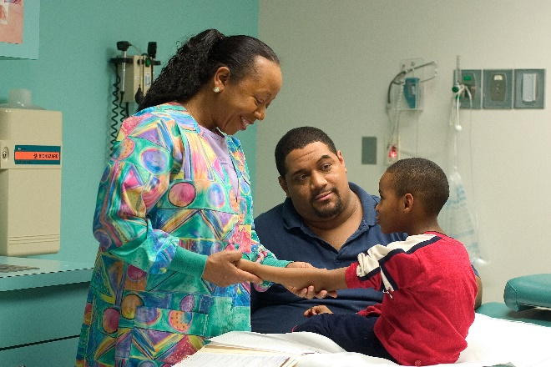
Safety Net Health & Nutrition
1 in 7 people in Washtenaw County
are food insecure.
Life expectancy:
  Chelsea: 85
  Ypsilanti Township: 66
Our Goal: Increase access to health services.
Our Goal: Decrease food insecurity.
Notes:
Katie
Ask if anyone can give a definition of food insecurity: not having reliable access to a sufficient quantity of affordable, nutritious food

Slide 15
Aging
Over half of seniors in our county live alone
47% of seniors report not having someone they could borrow $100 from in an emergency
Studies show that being isolated is just as bad for seniors as smoking and is worse than being obese.
Our Goal: Increase independent living factors for low-income seniors.
Notes:
Katie

Slide 16
Financial Stability
37% of our neighbors in Washtenaw County struggle to meet basic needs
A “Household Survival Budget” does not include any savings or enrichment activities
Our Goal: Move people towards greater economic self-sufficiency and away from safety-net services needed during crisis situations.
Notes:
Katie

Slide 17
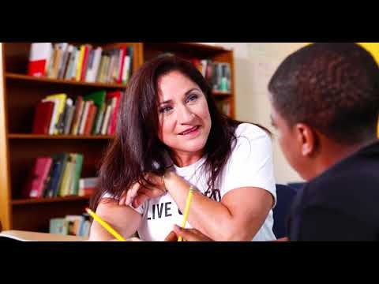
2017 Campaign Kickoff

Slide 18
Only 22% of economically-disadvantaged 8th graders are proficient at grade-level math.
African American babies (0-12 months) die at almost twice the rate of
white babies in Washtenaw County
52% of seniors in Washtenaw County live alone with limited outside support. Isolated seniors have much higher rates of chronic disease.
28% of economically disadvantaged youth in Washtenaw County do not graduate high school.
14% of Washtenaw County live in poverty, another 25% struggle to make ends meet

Slide 19
Upcoming Events!
Power of the Purse March 14th 5:30-730
at The Kensington Hotel, Ann Arbor
VITA Volunteer Income Tax Assistance
June National Day of Action
Notes:
Katie

