Slide 1


Welcome
Strathcona
Sunrise
Rotary Club

Slide 2


Rotary International
Countries: 200 +
Clubs: 46,000+
Members: 1,400,000+

Slide 3
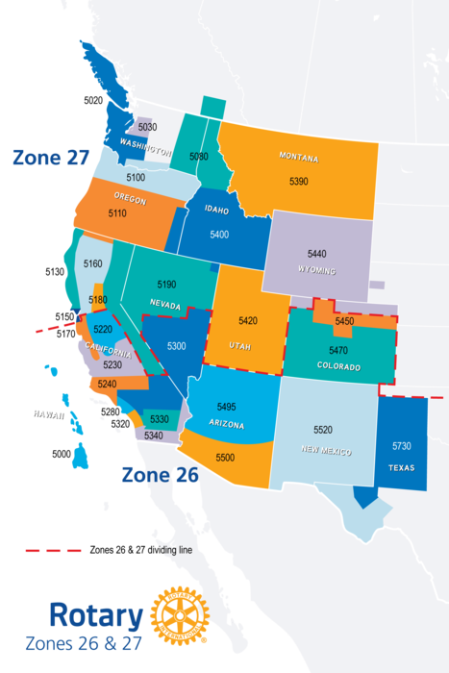

535 Rotary Districts
34 Rotary Zones
Zones 26 and 27 are partnered

Slide 4
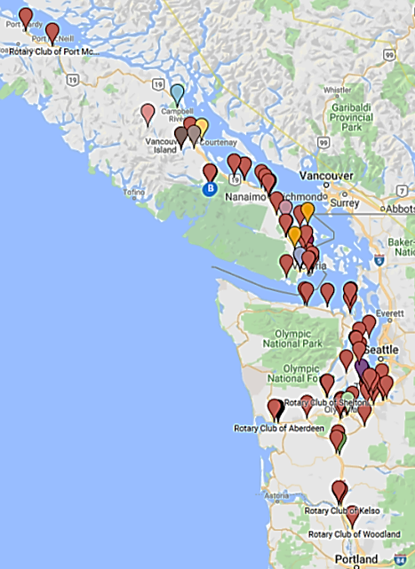

4,971 4,056 Rotarians
77 92 Rotary Clubs
11 18 Areas
Area 20:
Strathcona Sunrise(59) 31
Comox (50 ) 44, Courtenay (101) 63,
Cumberland (----) 18, Comox Valley (----) 43,
(210) 199 Rotarians

Slide 5

World’s Greatest Partnership
TRF MISSION:
“Advance world understanding, goodwill & peace through improvements in health, support of education and alleviation of poverty”

Slide 6

?
?
Why?
?
Begin with
the end in mind!

Slide 7
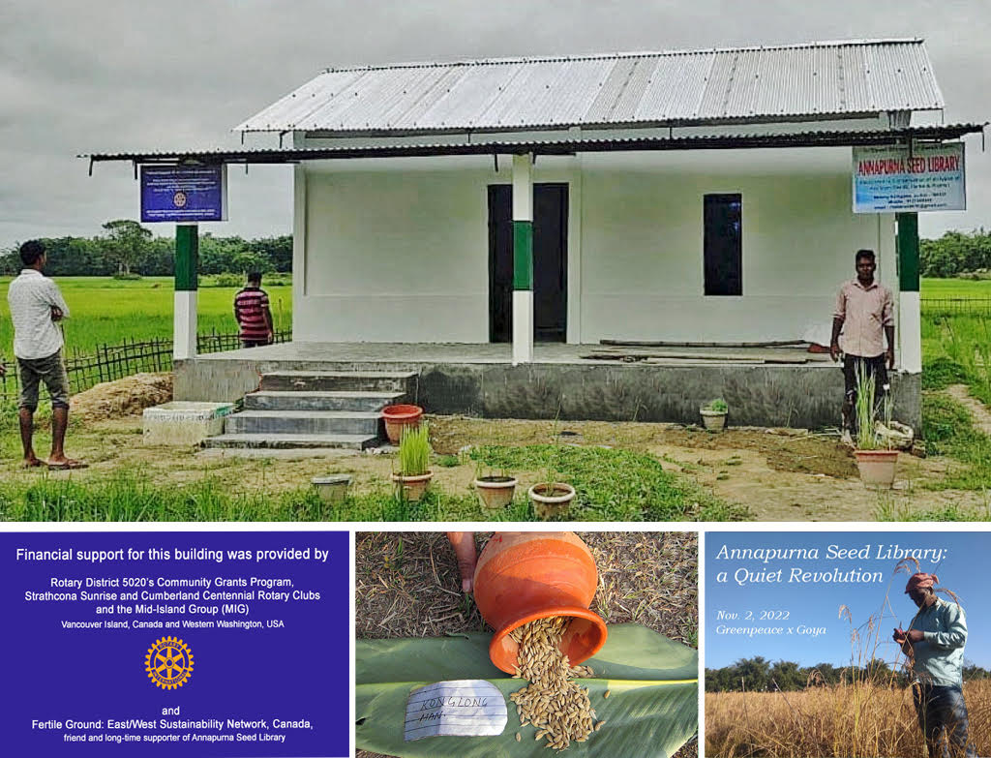

Partnerships:
“People of Action….
Making a Difference!”

Slide 8
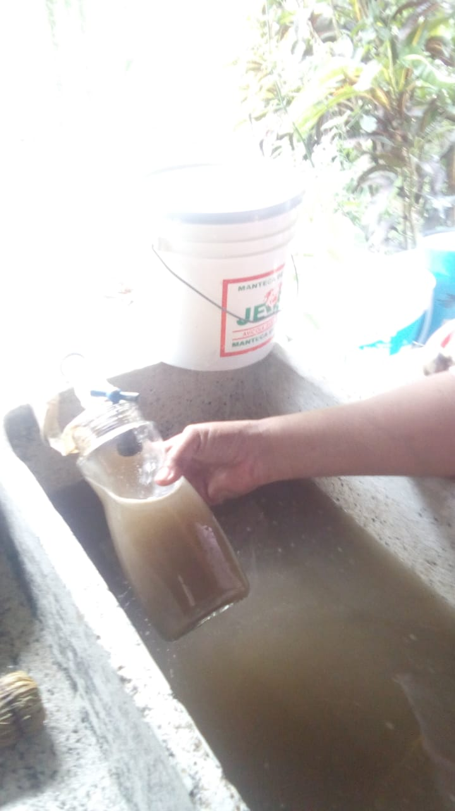
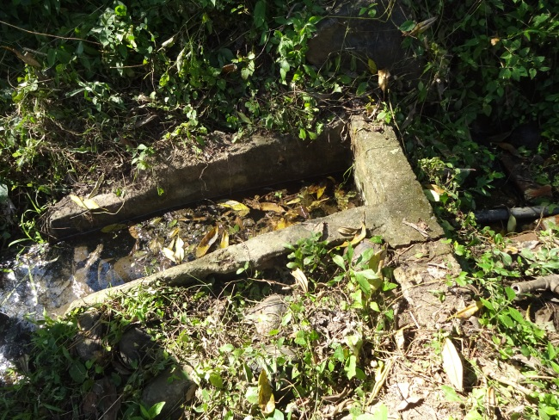
Water Projects---- $160,000

Slide 9
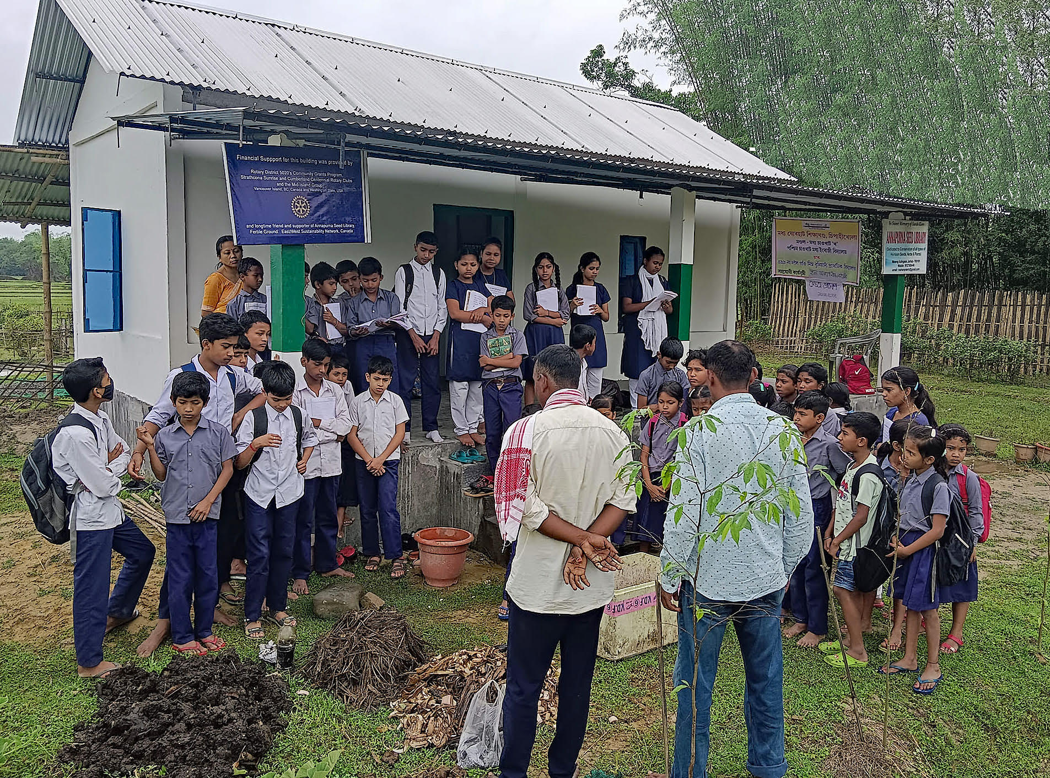
Supporting
Student
Learning
Youth:
The
Future

Slide 10
        STRATHCONA SUNRISE ROTARY:
        Is it the Truth?
1. Dollars contributed through the Annual Fund (project funds) AND
Polio Plus (polio eradication funds) earn a Paul Harris Fellow
2. Strathcpna Sunrise Rotary’s Annual Fund goal is $11,000 US this year.
3. To earn an EREY (Every Rotarian Every Year) ‘Banner’ every club member donates
at least 35 CAD to the Annual Fund.
4. Strathcona Sunrise earned an EREY Banner last year.
5. Strathcona Sunrise Rotarians could earn an EREY Banner this year.
6. Polio Plus Society members donate at least $100 US yearly until world polio eradication.
7. Strathcona Sunrise has donated over $500,000 CAD to Annual Fund since chartering.
8. Strathcona Sunrise Rotarians are generous and caring people!
True =
Hands Up
False =
Hands Down

Slide 11



The Rotary Foundation
Endowment
Fund
PolioPlus
Annual Fund

Slide 12
The Rotary Foundation
Endowment
Fund
GOAL:
2.025 billion by 2025
Benefactor
Bequest Society

Slide 13
The Rotary Foundation
850,000 (1988) wild polio cases
30 (2022) wild polio cases
99.9% reduction of world polio cases
$2,600,000,000 spent to date ….. for immunization
20,000,000 walking today …. due to polio eradication efforts
PolioPlus
Dollars spent
annually for Polio Eradication

Slide 14
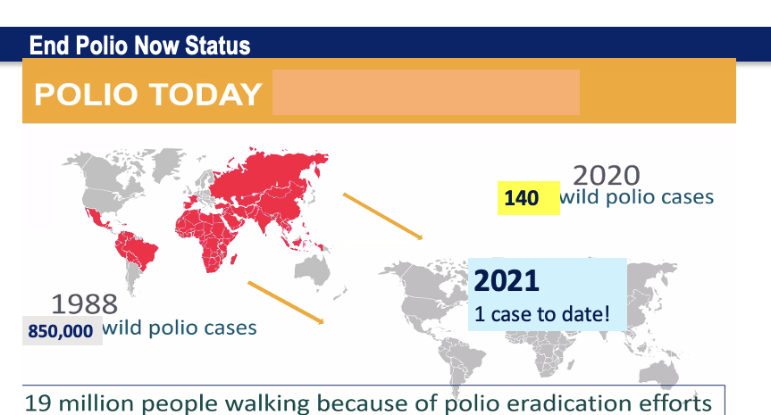
End Polio Now Status
ww.endpolio.org
2022
30 wild polio cases!
2 Afghanistan
8 Mozambique
20 Pakistan
2021
6 wild polio cases!
850,000
As of 5/15/20

Slide 15


NEW POLIO ERADICATION STRATEGY
Goal one: Permanently interrupt transmission of all poliovirus in Afghanistan and Pakistan.
Goal two: Stop transmission of circulating vaccine-derived poliovirus type 2 and prevent outbreaks in polio-free regions.
Notes:
In June 2021, the Global Polio Eradication Initiative, of which Rotary is a founding member, launched a new strategic plan covering the years 2022-2026. The new plan builds on our progress to date and addresses the remaining hurdles to polio eradication. The title of the strategy is “Delivering on a Promise.” The strategy has two goals: 1) interrupt transmission of all poliovirus in Afghanistan and Pakistan (that means both wild and circulating vaccine-derived poliovirus) and 2) stop transmission of circulating vaccine-derived poliovirus type 2 outside of the endemic countries and prevent outbreaks in polio-free regions. For both goals two important milestones are stopping transmission by end 2023 and certifying the world wild poliovirus free and validating the absence of circulating vaccine-derived poliovirus by end 2026.
We are confident that this strategy will deliver on OUR promise to children everywhere that they will soon live in a world free from the threat of all types of polio.

Slide 16
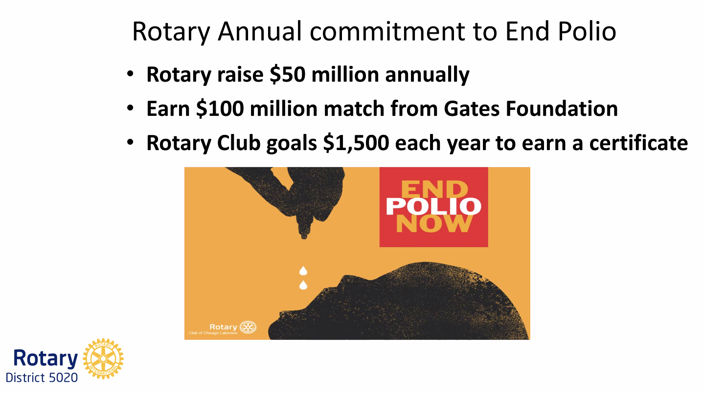


Slide 17


D5020 Polio Plus Society

Slide 18
The Rotary Foundation
7 Focus Areas:
Peace and Conflict Resolution
Disease Prevention and Treatment
Water and Sanitation
Maternal and Child Health
Basic Education and Literacy
Economic and Community Development
Supporting the Environment
Annual
Fund

Slide 19
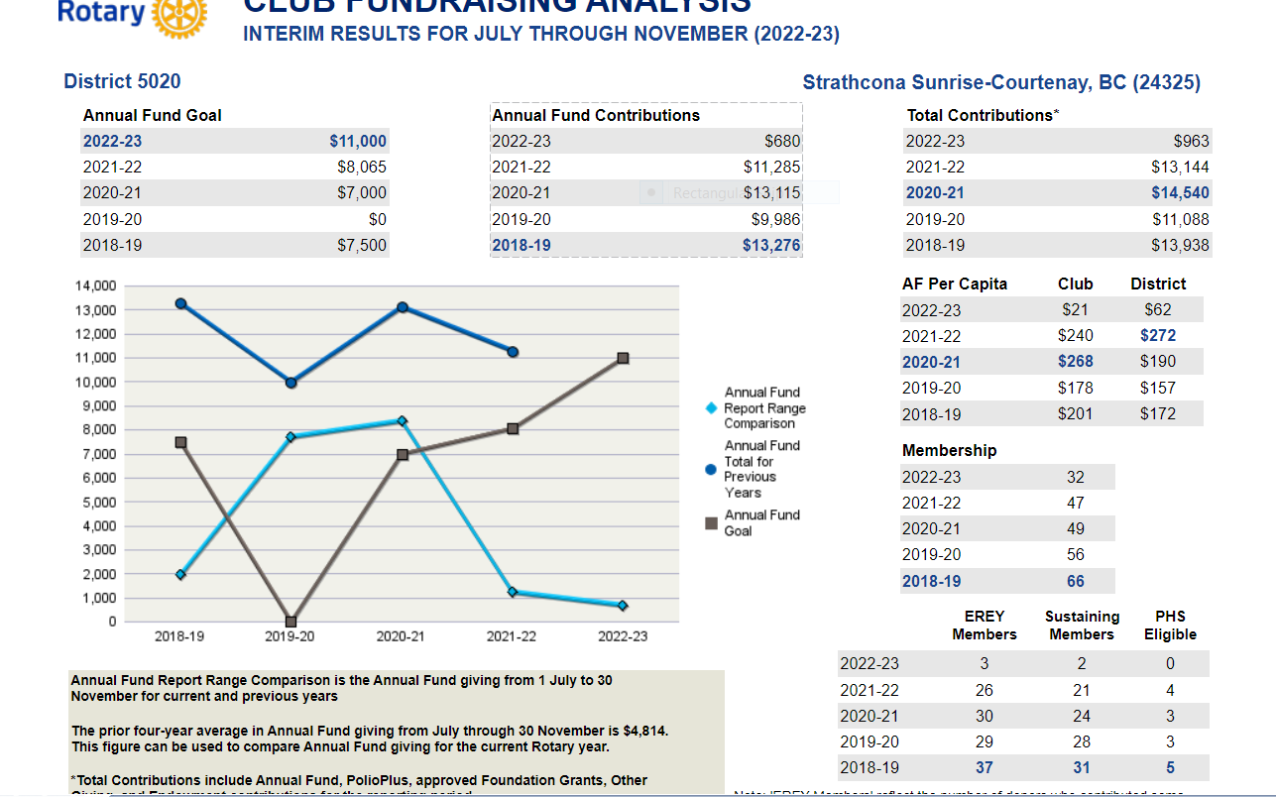

Slide 20
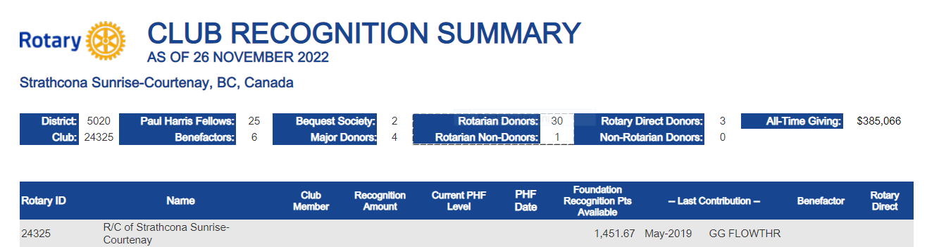
Paul Harris Fellows: 25
Major Donors: 4
Rotary Direct Donors: 3 (9 %)
All-Time Giving: $ 386,066 USD (511,705.59) CAD
32
members

Slide 21
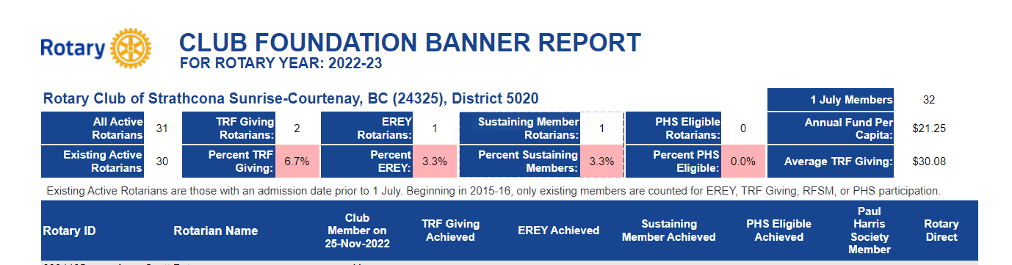
2022 – 2023 Contributions
EREY (Every Rotarian Every Year: Annual Fund)): 1 (3%)
Annual Fund / Per Capita: $ 21.25 USD
TRF / Per Capita (Annual Fund plus Polio +): $ 30.08 USD
32
members

Slide 22
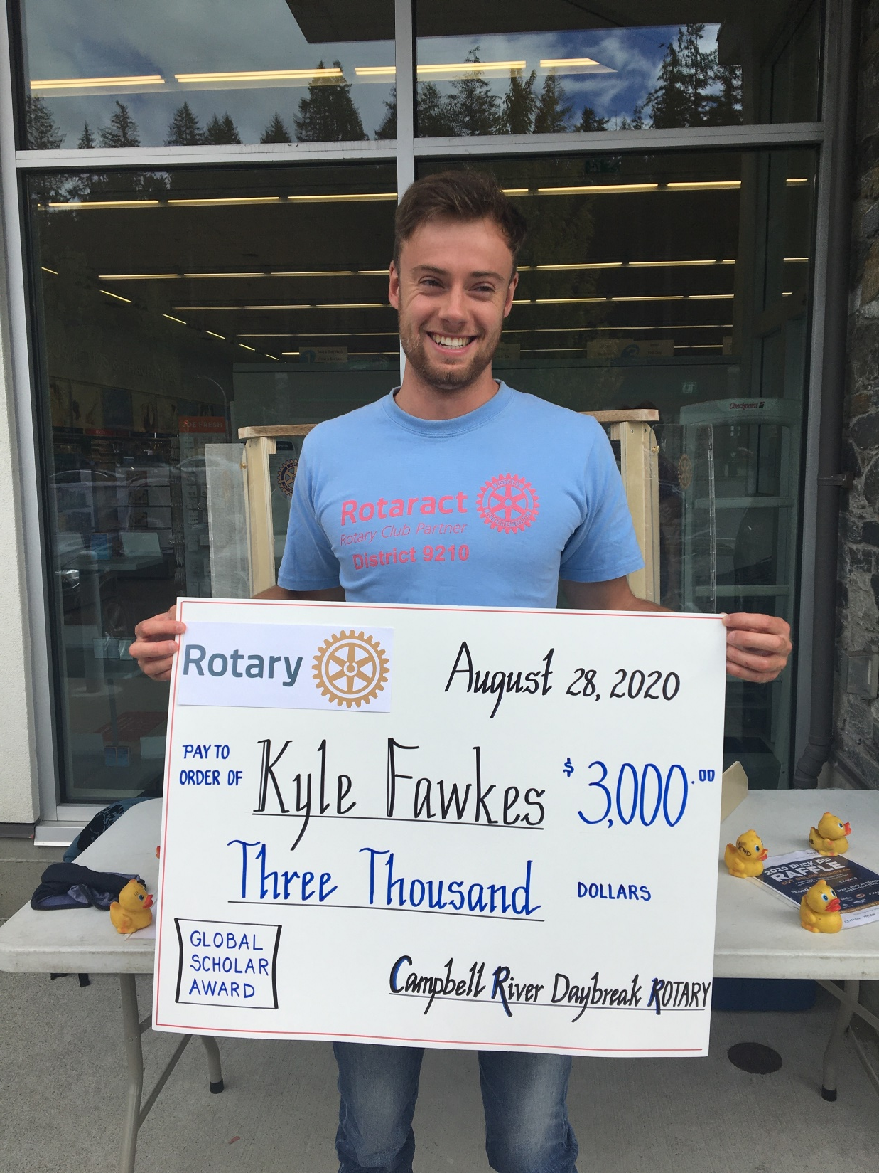
Kyle Fawkes
Global Scholar
Sponsored by
Campbell River
Daybreak Rotary
Rotary District 5020

Slide 23
Global Grant Example
GG1635506 Joy of Sound
Areas of Focus: Basic education and literacy
Club Strathcona Sunrise-Courtenay / Host Club Chennai Kilpauk India
To help young children/students with profound hearing impairment to overcome their disability
Total Budget $65K
Club Cash $ 12,500 ($6,250 each club)
+ D5020 DDF $ 12,500
+ D3230 DDF $ 11,000
+ World fund $ 29,000
$ 65,000

Slide 24
Supporting The Rotary Foundation
Every Rotarian Every Year (EREY)
Paul Harris Fellow
Paul Harris Society
Benefactor
Bequest Society
Major Donor
Notes:
Ask participants what the different ways are to support the Rotary Foundation and ask them to explain each one – see below for explanation.
Every Rotarian Every Year Rotary ( Clubs that achieve Annual Fund giving of $100 per capita during a Rotary year and each club member contributes $25US to the Annual Fund)
Foundation Sustaining Member (a contribution of a minimum of $100US each year)
Paul Harris Fellow (contributed in cash and recognition points a total of $1000US)
Paul Harris Society Member (commitment to donate a minimum of $1000 US per year – not binding)
Benefactor (commit $1,000US or more in estate plan)
Bequest Society Member (commit at least $10,000US in estate plan)
Major Donor (cumulative donations of cash reach $10,000US)*
Arch Klumph Society (cumulative donations of cash reach $250,000US)*
*Not including Foundation recognition points.

Slide 25
District 5020 2022-2023 Incentives
District Community Grant (DCG) size based on prior year Annual Fund Contributions per capita
    Per capita Less than $100 ---DCG $2,000
    Per capita $100 to $199.00 ---DCG $3,500
    Per capita $200 or more --- DCG $5,000

Slide 26
DG Dale’s ASK:
EREY – contribute at least $35 to Annual Fund
Rotary Direct – sign up for Rotary Direct
Notes:
100% Paul Harris Fellow Club: clubs in which all dues-paying members are Paul Harris Fellows..
100% Paul Harris Society Club: clubs in which every dues-paying member contributes a minimum of $1,000 to the Annual Fund, PolioPlus, or global grants within a Rotary year
100% Foundation Giving Club clubs that achieve an average of $100 in per capita ng and 100 percent participation, with every dues-paying member contributing at least $25 Every Rotarian, Every Year Club: For clubs that achieve a minimum Annual Fund contribution of $100 per capita during the Rotary year, and every dues-paying member must personally contribute at least $25 to the Annual Fund during the year.
Top Three Per Capita in Annual Fund Giving: the three clubs in district 5020 that give the most, per capita, to the Annual Fund.

Slide 27
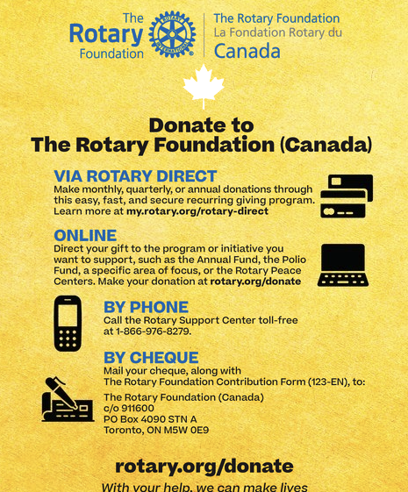
rotary.org/donate

Slide 28
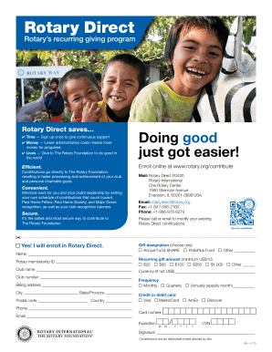
Rotary HELP DESK
866 976 8279

Slide 29

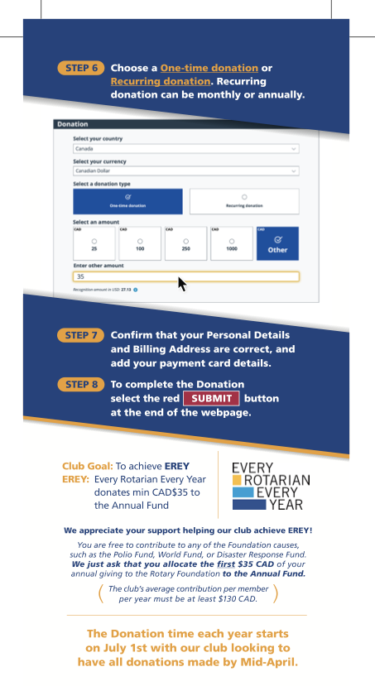
Step by Step
Donations
and
Rotary Direct

Slide 30
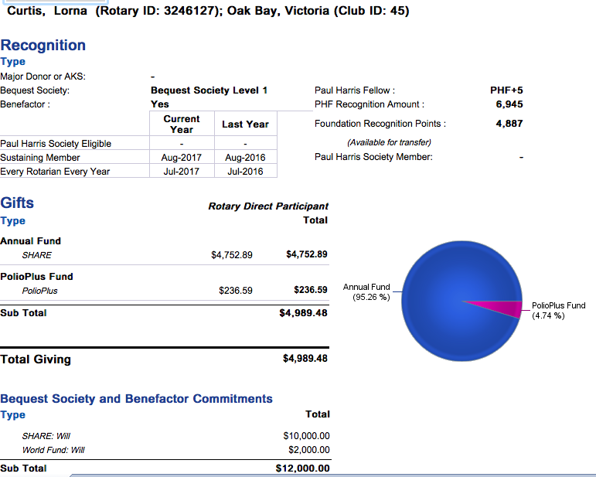
DONOR HISTORY
Notes:
DONOR HISTORY ( only individual Rotarian can access their own donor history information)
-Under individual reports – Donor History
-Click on View Report
-click on Donor History Report
This report includes:
Rotary ID
Club ID
Bequest Society
Benefactor
Paul Harris Society
Sustaining Member
Every Rotarian Every Year
Foundation $ donated
Foundation Recognition Points
What fund $ are being directed to

Slide 31


Slide 33
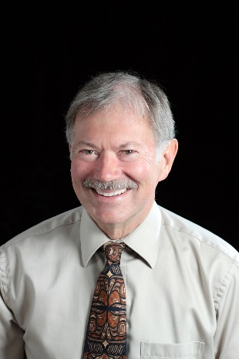

Thank You!
Together we can and will
continue to make a difference
as we “IMAGINE Rotary”!
Questions?
craiggillis10@gmail.com

