Slide 1
Sequim Sunrise Rotary Club
Youth Services (New Generations)
Youth Service 2018/19 budget summary
Interact & WE Day | $ 1,900,00
RYLA | $ 1,100.00 (3-students at $325 each + travel)
Safe & Sober Senior Party | $ 500.00
Student of the month | $ 500.00
Sequim Options School (formerly Alt HS) | $ 1,000.00
Business Week | $ 1,500.00
Discretionary Fund | $ 851.00
Sequim Education Foundation | $ 2,000.00
Total Youth Service Foundation | $ 9,351.00
Scholarships | $ TBD

Slide 2
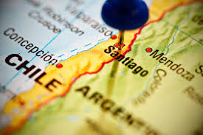
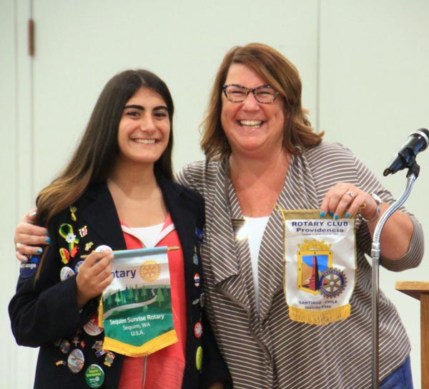
Rotary Youth Exchange – Belen’
10+ Months
4 – Host Families
Ron & Andrea Gilles
Tom & Ann Flack
Eric & Christine Danielson
Jon & Candyce Jack
Lots of fun, lots of learning, many friendships!

Slide 5
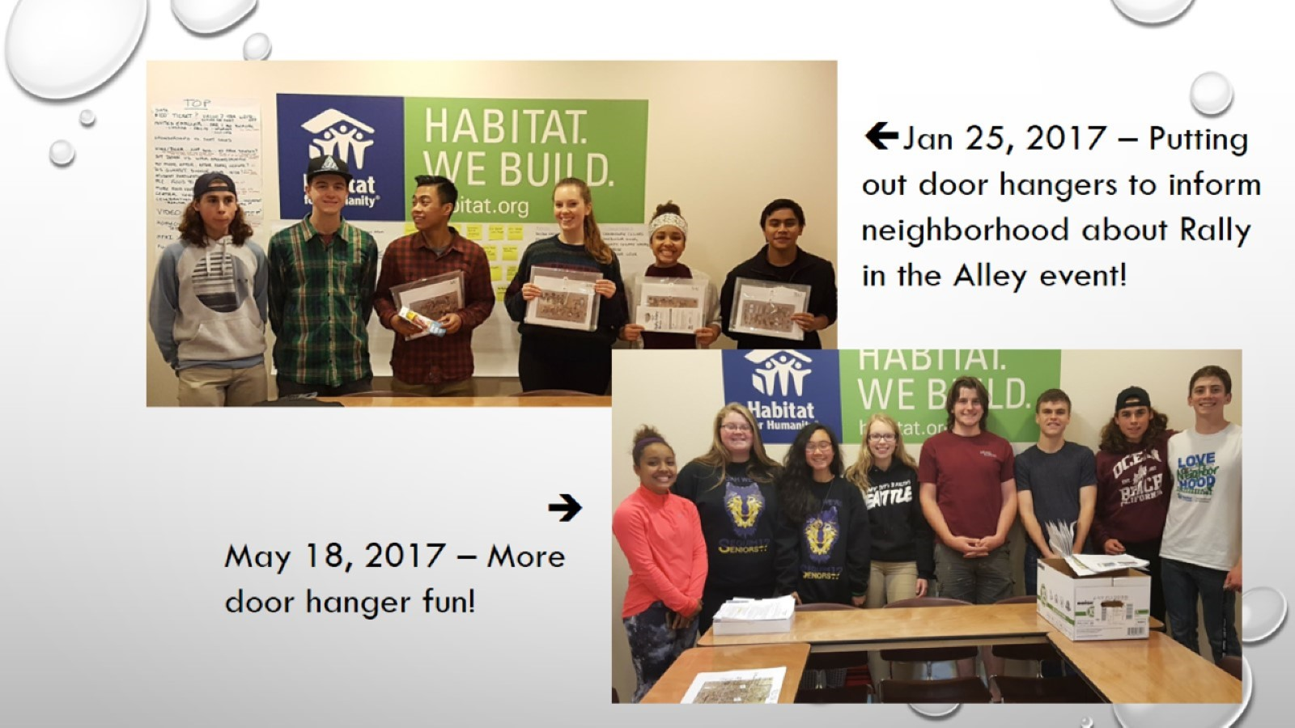

Slide 6
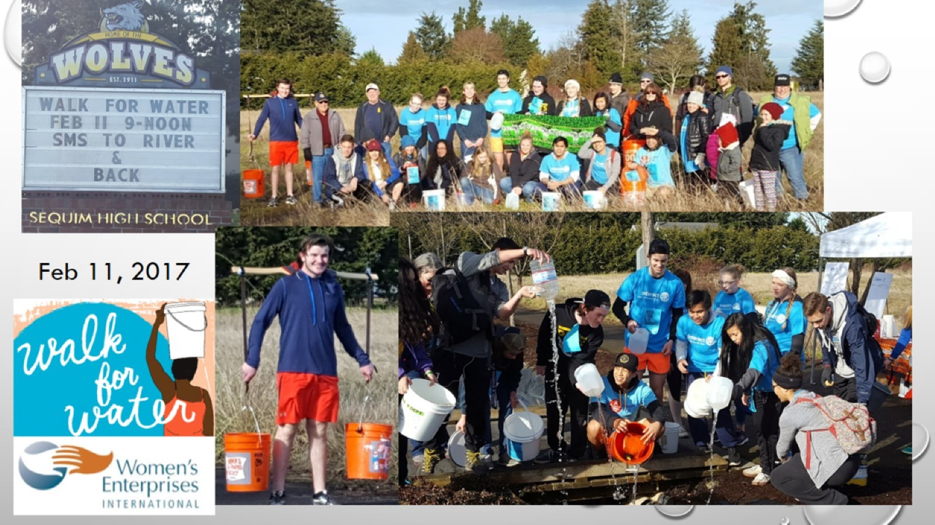

Slide 7
Saturday, April 21, 2018

Slide 8
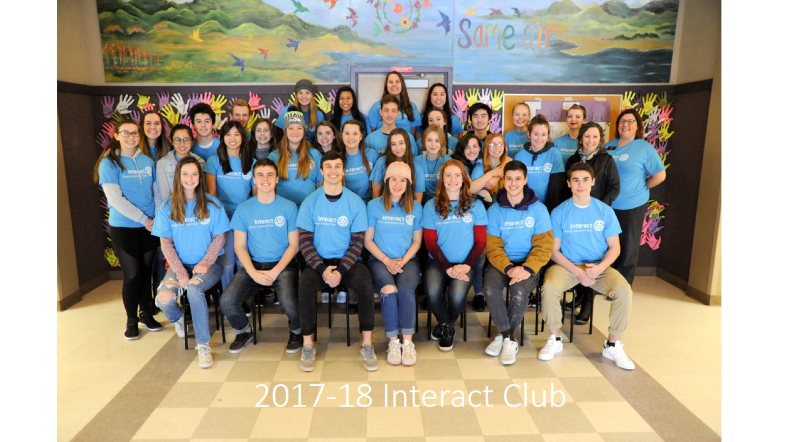
2017-18 Interact Club

Slide 12
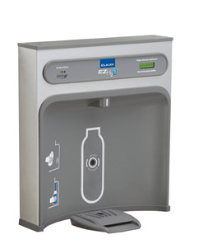
Acting Locally
Interact/Be the Change Club raised money to have two Water Bottle Refill stations installed at Sequim High School. One in the Cafeteria Building and one in the H-Building – that is ADA accessible.
This project was very important to the students – from a “green” perspective and serving their local community – Sequim High School

Slide 13
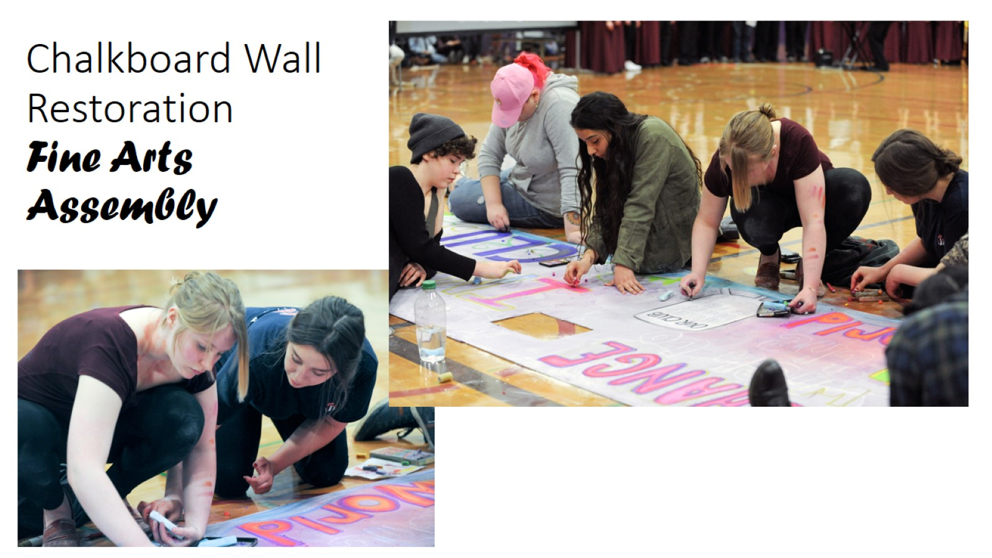
Chalkboard Wall Restoration Fine Arts Assembly

Slide 14
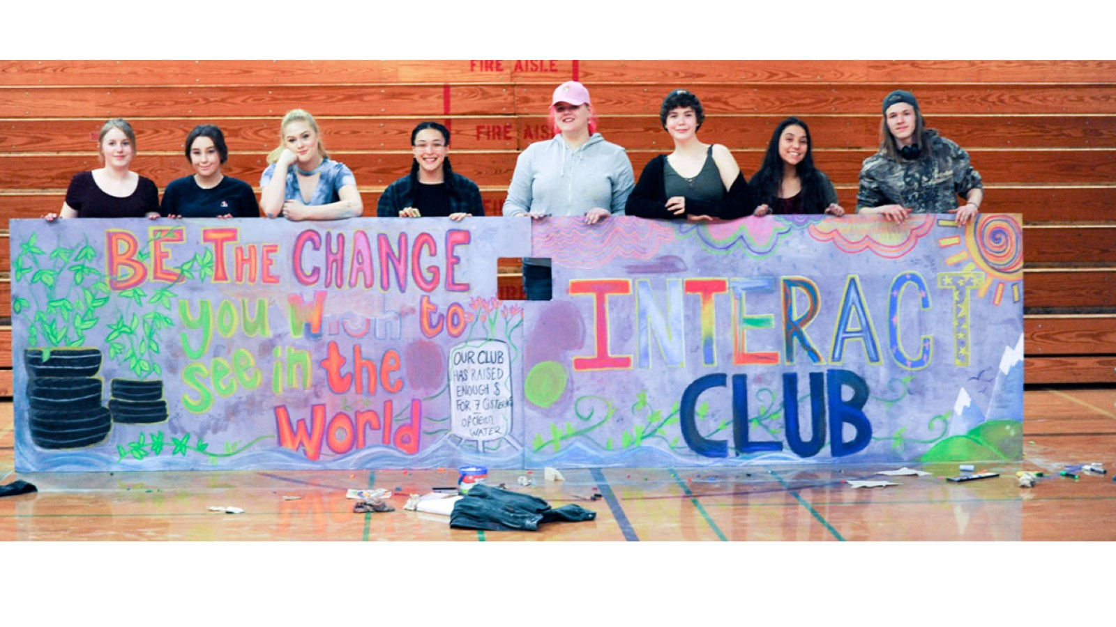

Slide 15
Scholarships
2018 Sequim Sunrise Rotary Scholarships - 1 Year
Award Winner | Award Amt. | University | NOTES
Sarah Shea | $2,500.00 | Western Washington University
Teya Nop | $2,500.00 | University of Washington | Interact Club Member
Grace Tolberd | $2,500.00 | Pacific University Oregon
2018 Sequim Sunrise Rotary Vocational Scholarships - 2 Year
Award Winner | Award Amt. | University | NOTES
Jilian Hutchison-Blouin | $5,000.00 | Peninsula College | 2-year VoTech ($2,500 each year) Interact Club Member
2018 Sequim Sunrise Rotary James and Agnes Williams STEM - 1 year
Award Winner | Award Amt. | University | NOTES
Andrew Hanstead | $4,000.00 | Washington State University | 2016/2017 – Interact Club Member
Total Scholarships Awarded | $16,500.00

Slide 16
Sequim Education Foundation = $2,000
Sequim High School
Safe & Sober Senior Party = $500
The Sequim Education Foundation’s latest round of teaching grants — totaling $31,575 to 14 educators across the Sequim School District — helps provide funding for science projects, supplies such as headphones and chairs, fields trips and more.
http://www.sequimgazette.com/news/sequim-education-foundation-teacher-grants-give-local-teachers-a-boost/
The party is open to any graduating high school seniors in the Sequim area. It includes music, contests, food, raffles, give-aways, games and more. The party was designed to keep graduating seniors safe and alcohol- and substance-free on their graduation day.

Slide 17
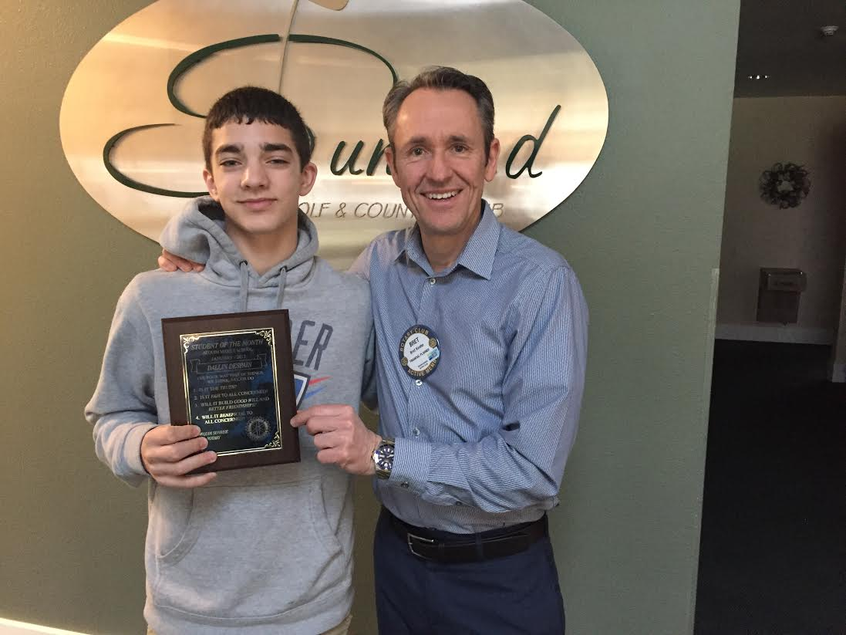
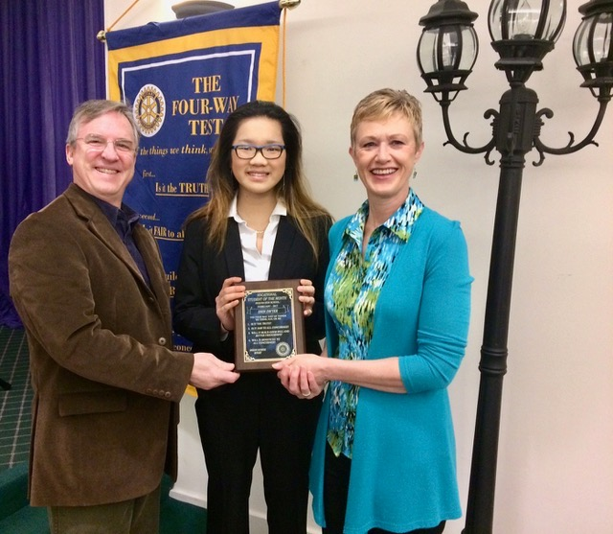
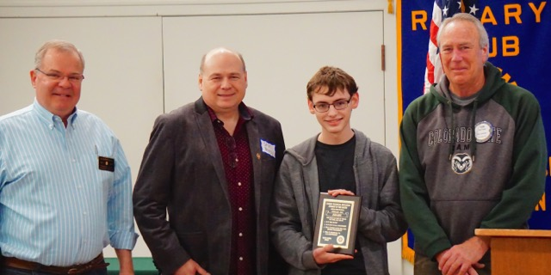
Student of the Month
Sequim Middle School – Coordinator
Bret Keen
Sequim High School – Coordinator(s)
For many years – Nell Clausen
2017/2018 – Tom Flack
2018/2019 – Shenna Younger

Slide 18
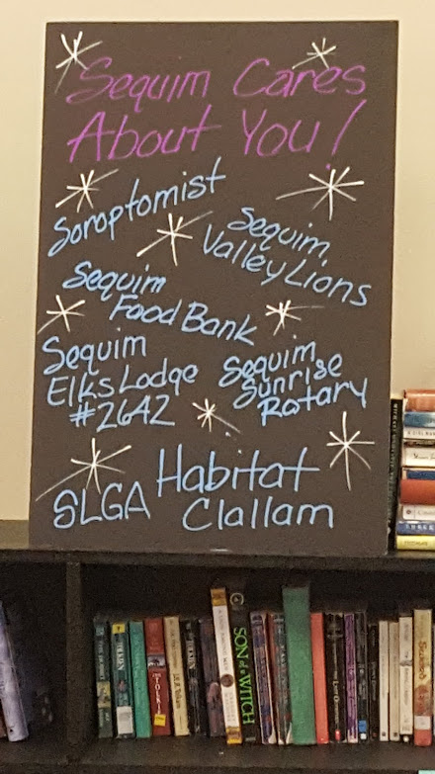
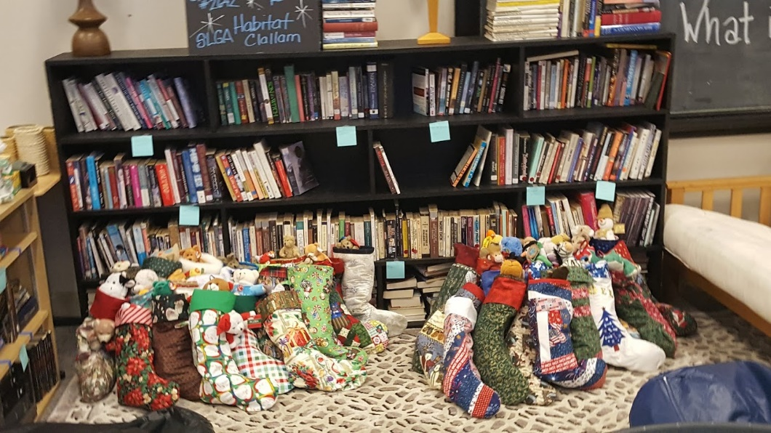
SHS – Sequim Options School
Coordinator
Julia McKenna-Blessing
Julia surveys the students to find out their interest and then coordinates community members in those industries to come and present to the students.
We have also provide – Christmas Stockings in collaboration with other service groups.
SSR also gave assisted with materials needed for the reading area.

Slide 19
