Slide 1

DOING GOOD IN THE WORLD

Slide 2
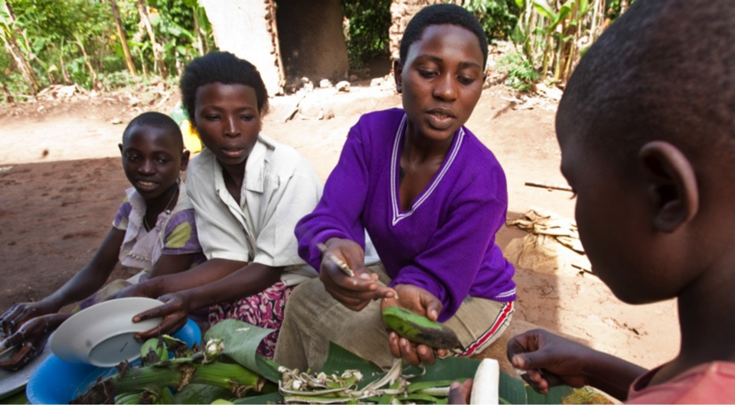
OUR MISSION
World Understanding • Goodwill • Peace
Notes:
“The mission of The Rotary Foundation is to enable Rotarians to advance, World Understanding, Goodwill and Peace through the Improvement of health, the support of education and the alleviation of poverty.”
We accomplish this by using the expertise and compassion of Rotarians who foster effective and sustainable projects around the world. We are looking to the future and incorporating projects within the 6 areas of focus bringing us closer to our mission while supporting the amazing work of Rotarians. Through OUR Foundation, we reach out to both our local and international communities enriching the lives of millions.

Slide 3
AREAS OF FOCUS – THE ROTARY FOUNDATION
Peace and Conflict Prevention/Resolution
Disease Prevention and Treatment
Water and Sanitation
Maternal and Child Health
Basic Education and Literacy
Economic and Community Development
Notes:
Whether it’s eradicating polio in India, digging water wells in the Philippines, providing dictionaries to a local elementary school, or educating a scholar in peace and conflict resolution, Rotary creates the environment and circumstances to promote peace throughout the world.
So I ask you, what makes Rotary special?
[Encourage Audience Participation]
The Rotary Foundation
-Addresses all of the greatest educational and humanitarian needs
-Its world reach is greater than the United Nations
-We can go where politicians and religious groups cannot
Thank you for your comments. I encourage you to share your stories with your fellow Rotarians, and with The Rotary Foundation – so we may share them with the world.

Slide 4
BECAUSE OF YOU – THE ROTARY FOUNDATION
Video: https://vimeo.com/220802306
Notes:
Whether it’s eradicating polio in India, digging water wells in the Philippines, providing dictionaries to a local elementary school, or educating a scholar in peace and conflict resolution, Rotary creates the environment and circumstances to promote peace throughout the world.
So I ask you, what makes Rotary special?
[Encourage Audience Participation]
The Rotary Foundation
-Addresses all of the greatest educational and humanitarian needs
-Its world reach is greater than the United Nations
-We can go where politicians and religious groups cannot
Thank you for your comments. I encourage you to share your stories with your fellow Rotarians, and with The Rotary Foundation – so we may share them with the world.

Slide 5
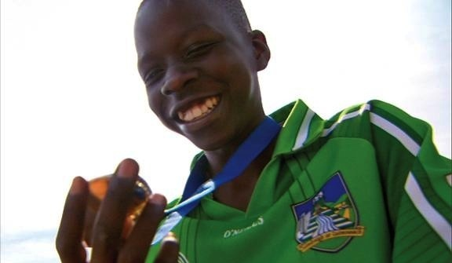

Build Peace
Notes:
The world needs Rotary and The Rotary Foundation to help with Peace and Conflict Resolution!
IMAGE: War has displaced over 22,000 Sudanese to Australia. A program created by Rotary Peace Centers alumni uses soccer to help displaced youth make a new life. Your contribution helps the Foundation strengthen local peace efforts and train peacebuilders worldwide.
(optional additional information)
Conflict is a normal part of the experience of states, communities and individuals and cannot be eliminated; what can be changed is whether the resolution of conflict is peaceful or violent. Institutions often focus their projects on one of three phases of conflict: prevention, mediation and resolution, or post-conflict stabilization.
The Rotary Foundation promotes the practice of peace and conflict prevention/resolution by:
Strengthening local peace efforts
Training local leaders to prevent and mediate conflict
Supporting long-term peace building in areas affected by conflict
Assisting vulnerable populations affected by conflict, particularly children and youth
Supporting studies related to peace and conflict resolution
Projects in this area can be both locally and internationally focused.

Slide 6
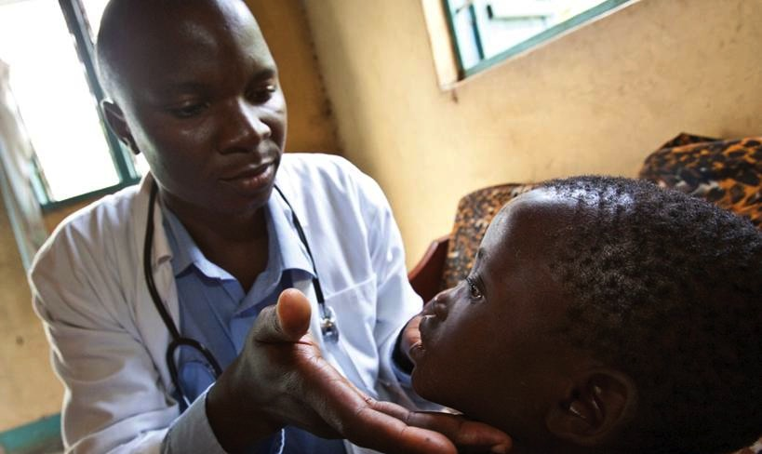
Fight disease
Notes:
Infectious diseases are the leading killers of people living in poverty. Sub-Saharan Africa has 24% of the global disease burden but only 3% of the world’s healthcare. Nearly all of the 14-17 million children and adults who die each year from an infectious disease live in developing countries.
IMAGE: Over 1.2 million children have been orphaned in Uganda due to HIV/AIDS. Support The Rotary Foundation and its partners to help children and orphans receive the medical treatment that they deserve. Despite the fact that their parents died from this disease, they wish to have the life that we all have.
The Rotary Foundation reduces the causes and effects of disease by
Improving the capacity of local health care professionals
Combating the spread of HIV/AIDS, malaria, and other major diseases
Enhancing the health infrastructure of local communities
Educating and mobilizing communities to help prevent the spread of major diseases
Supporting studies related to disease prevention and treatment
(project ideas)
Rotarians can help by designing projects that focus on these goals. Projects like purchasing HIV/AIDS screening supplies for local clinics, training the staff at the clinic, and then organizing an education campaign about HIV/AIDS prevention would fulfill the sustainability goal of TRF and help prevent the spread of a deadly infectious disease.

Slide 7
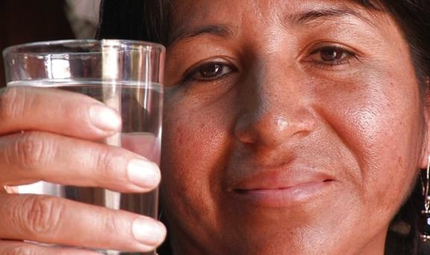
Provide clean water
Notes:
Worldwide, 2.6 billion people — 72% in Southern Asia — lack access to improved sanitation facilities, and 884 million — 37% in sub-Saharan Africa — do not use improved sources of drinking water. (WHO/UNICEF). This year, 2.2 million children will die from diarrhea and related diseases. (Rehydration Project).
The dual focus of clean water and sanitation must be taken on together by Rotarians. When people have access to clean water they have better health; sanitation facilities lead to less spread of diseases; hygiene education leads to disease prevention.
IMAGE: The Rotary Foundation and its partners supplied water filters to 5,000 families in Lima, where over 70 percent of their drinking water comes from the polluted, Rimac River. “They are not just giving us a concrete box. They are giving us health and our children a better quality of life.”
The Rotary Foundation ensures that people have sustainable access to water and sanitation by
increasing equitable community access to safe drinking water and basic sanitation
Strengthening the ability of communities to develop and maintain sustainable water and sanitation systems
Educating communities about safe water, sanitation, and hygiene
Supporting studies related to water and sanitation

Slide 8
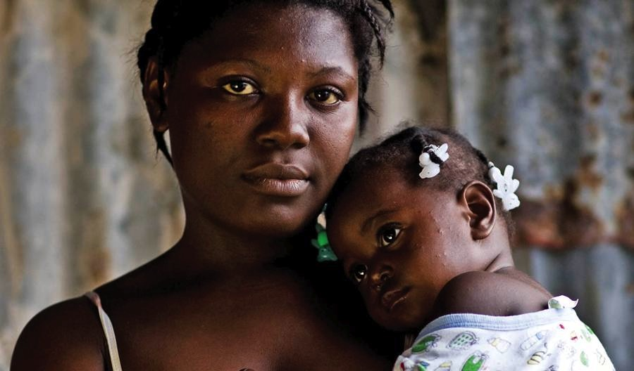
Support Mothers and Children
Notes:
536,000 women and girls die every year as a result of complications during pregnancy, childbirth, or the six weeks following delivery, a rate of more than one per minute. For every woman who dies, an additional 20 to 30 will have short- and long-term disabilities. Pregnancy and childbirth are the leading cause of death and disability for women in developing countries. (WHO)
IMAGE: Haiti has the highest infant and maternal mortality rates in the Western Hemisphere. To help prenatal care providers reach remote areas of the country, The Rotary Foundation provided a fully-equipped medical jeep that can carry 11 volunteers anywhere they are needed in the country.
The Rotary Foundation improves the lives of mothers and their children by
Reducing the mortality rate for children under the age of five
Reducing the maternal mortality rate
Improving access to essential medical services and trained health care providers for mothers and their children
Supporting studies related to maternal and child health

Slide 9
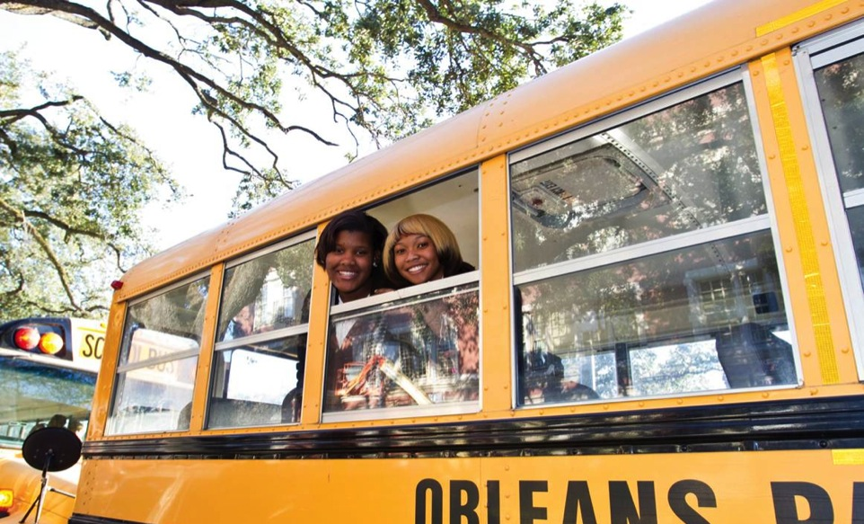
Promote Education
Notes:
Worldwide, 75 million children — 41 million of them girls — do not have access to basic education. (World Bank) It is not just children who are held back by lack of access to basic education and literacy. More than 1 in 4 adults cannot read or write, 66% of them women. (End Poverty 2015 Millennium Campaign)
Education is one of the basic human rights. However, access to that right is severely limited for many children and adults by factors that are out of their control. Factors such as geographical location, gender, ethnicity, societal standing, and language all contribute to children’s and adults access to education.
IMAGE: In August 2005, Hurricane Katrina flooded 80% of the city of New Orleans, Louisiana. The storm destroyed 110 public schools, displacing nearly 400,000 students. With help from The Rotary Foundation and volunteer labor, everybody collaborated to rebuild the schools and the city, supplying momentum to others that wanted to come back.
The Rotary Foundation promotes education and literacy for all by
Ensuring that children have access to quality basic education
Reducing gender disparity in education
Increasing adult literacy
Strengthening the capacity of communities to support basic education and literacy
Supporting studies related to basic education and literacy

Slide 10
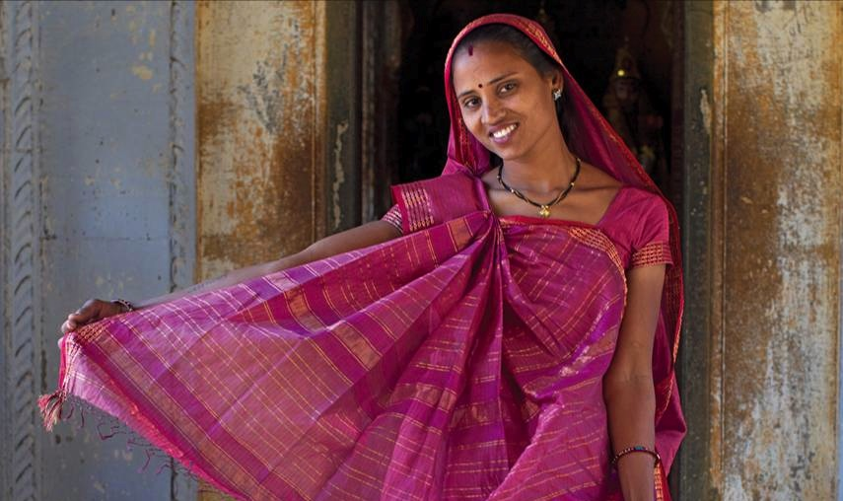
Grow local economies
Notes:
Worldwide, 1.4 billion people live in poverty (less than $1.25 a day). It is anticipated that with the onset of the current economic crisis an additional 55 million to 90 million more people will be living in extreme poverty.
IMAGE: Jhoole, a non-profit social enterprise, was created in India to help women create brighter futures for themselves, their families and their communities
(optional information)
Rotary is committed to alleviating poverty through microfinance institutions and vocational training programs. These types of development will elevate the daily life of individuals by building a better infrastructure. An individual who receives a microfinance loan may be able to build up their own rug weaving business much like a person who participates in a vocational training program for nursing will be able to better serve their community while supporting themselves.
The Rotary Foundation invests in people to create measurable and enduring economic improvement in their lives and communities by
Strengthening the development of local entrepreneurs and community leaders, particularly women, in impoverished communities
Developing opportunities for decent and productive work, particularly for youth
Building the capacity of local organizations and community networks to support economic development
Supporting studies related to economic and community development

Slide 11

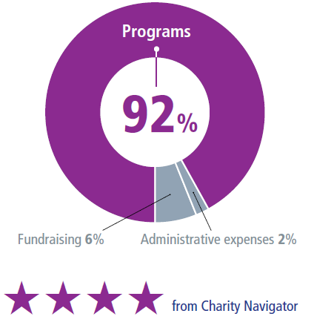
MAKING A DIFFERENCE
THE ROTARY FOUNDATION’S EXPENDITURES GO TO...
Notes:
Rotary’s unique funding model strengthens our future by building on a stellar record of efficient use and stewardship of the financial resources entrusted to us. For example, when we look at our annual expenditures over the last 10 years, we’ve minimized our fundraising and administrative expenses and dedicated 88 to 89 percent of our total spending to programs.
The Foundation’s sound financial management and its commitment to accountability and transparency are also recognized as exceptional, year after year, by independent evaluators of not-for-profits. Rotary’s website provides detailed information on the Foundation’s finances.
In fiscal year 2013-14, only 2 percent of Foundation expenditures went to administrative expenses and 6 percent to fundraising. The Foundation directed 92 percent of its spending to programs, far exceeding the benchmarks that independent charity-rating services view as a measure of high efficiency.
The recent recession demonstrated to the philanthropic community that maintaining a strong financial base that includes operating reserves is necessary in order to weather increased volatility in financial markets.
Beginning 1 July 2015, five percent of contributions to the Annual Fund are earmarked for operating expenses or to build the operating reserve to three times annual operating expenses, when needed.
This change will have no impact on District Designated Funds, but will provide a more predictable level of financial support for programs and the operating expenses it takes to make them successful.
With a solid financial base and restored reserves, we’ll have an organization that is able to support the good work that Rotarians do in the world — even as the economic and financial environment remains unpredictable.

Slide 12
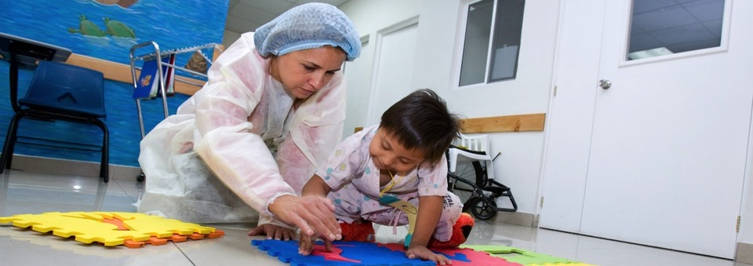
MAKE ROTARY YOUR CHARITY OF CHOICE!
Needs identified and implemented by Rotarians
Global network of
compassionate volunteers
Rotarian driven
Local and international activities
Diligent oversight of funds
Notes:
The Rotary Foundation is YOUR Foundation – make it your charity of choice!
Rotarian driven projects— projects are created at the local level by Rotarians who live and see the needs of the community every day.!
Diligent Oversight of Funds: Rotary funding is monitored on many different levels. Funds are overseen by Rotarians, clubs, districts and Rotary staff. Larger projects are even reviewed and audited by Rotarian professionals that work within the area of focus and can give expert guidance and evaluations. Rotarian auditors sometimes perform audits to ensure spending is being used correctly. All of these measures ensure that the funds YOU give to The Rotary Foundation Do Good In The World.
Local and International Projects- Rotary helps people in need throughout the world. The SHARE system and grant model allow for projects to take place in your backyard or across the globe. The international component and ability to help those in need around the world is unique and Rotarians have made their Foundation extraordinary in its capacity to focus on needs in developed and developing countries!
Rotarians = Service above Self
Rotarians are The Rotary Foundation. Contributing to The Rotary Foundation each and every year is demonstrating your commitment to “Service above Self” and a commitment to helping those in need. Let’s take a look at what your contributions can do…

Slide 13

Notes:
These are some examples of what your annual contributions can help provide.
Fourteen anti-retroviral drugs to prevent the transmission of HIV from infected mothers to their babies in Liberia
One bicycle to play sports for youth with disabilities in France
Sexual assault and domestic abuse education for young women in Texas, USA

Slide 14
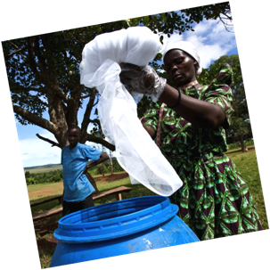
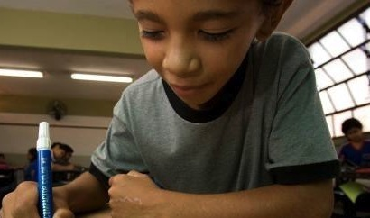
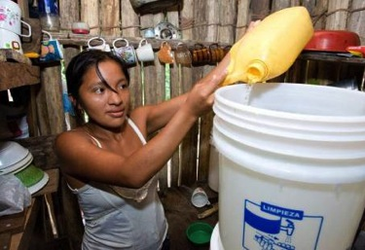
$100 HELPS PROVIDE
School supplies
Malaria tests
Water-hygiene training
Notes:
Here are some examples of what your annual contributions can help provide:
Three backpacks filled with school supplies for primary school children in Honduras
Fifty malaria diagnostic tests to prevent, diagnose and treat malaria in Mali
One biosand filter and water hygiene training for a family in Peru

Slide 15
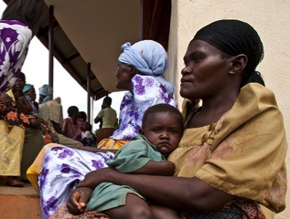
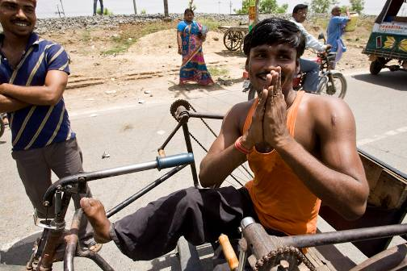
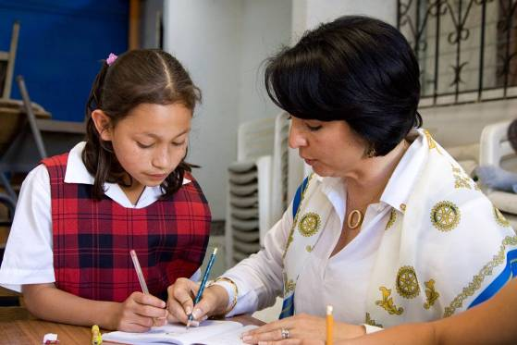
$1,000 HELPS PROVIDE
HIV antiretroviral drugs
Mobility for disabled youth
Domestic abuse education
Notes:
These are some examples of what your annual contributions can help provide.
Fourteen anti-retroviral drugs to prevent the transmission of HIV from infected mothers to their babies in Liberia
One bicycle to play sports for youth with disabilities in France
Sexual assault and domestic abuse education for young women in Texas, USA

Slide 16
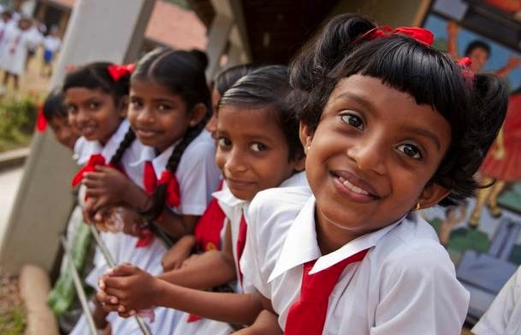
EVERY ROTARIAN, EVERY YEAR
100% Member Participation
Notes:
The Annual Fund is the primary source of funding for the programs of The Rotary Foundation. The Annual Fund is the cornerstone for these programs; for the beneficiaries, and why we give. It is for the stories these programs permit us to tell.
For us to continue doing so much good in the world, it is necessary for Every Rotarian to participate in the programs and to support our Foundation Every Year.
If Rotary is to be there to:
Teach children to read, build wells, feed the hungry, care for the sick, shelter the poor; then Every Rotarian is invited to support the Annual Fund with a personal contribution, Every Year.
Check if your Rotary club has a club fundraising goal for the Annual Fund this year, and help achieve it with your personal gift.
(Optional information)
The 2014-15 worldwide Annual Fund goal is US$123 million.
Rotarians and friends of Rotary can also direct Annual Fund contributions to any of the Foundation’s six areas of focus. These additional opportunities are intended to attract new donors, including non-Rotarians and other organizations; Contributions directed to any of the six areas of focus are included toward a club’s annual giving goal and per capita calculations. Likewise, they are eligible for all APF recognition opportunities.
Areas of focus designated contributions are not included in a district’s SHARE calculation and do not generate any DDF.

Slide 17

Are You Wearing a Rotary Pin Today?

