Slide 1
Sharing Food, Building Community
PNW Rotary Food Project

Slide 2
1 In 7 Americans Struggle With Hunger
Watch this https://www.youtube.com/watch?v=mYCVbuyv840
The PNW Rotary Food Project is an innovative, new way to fight hunger in our community.
You want to help. We make it easy

Slide 3
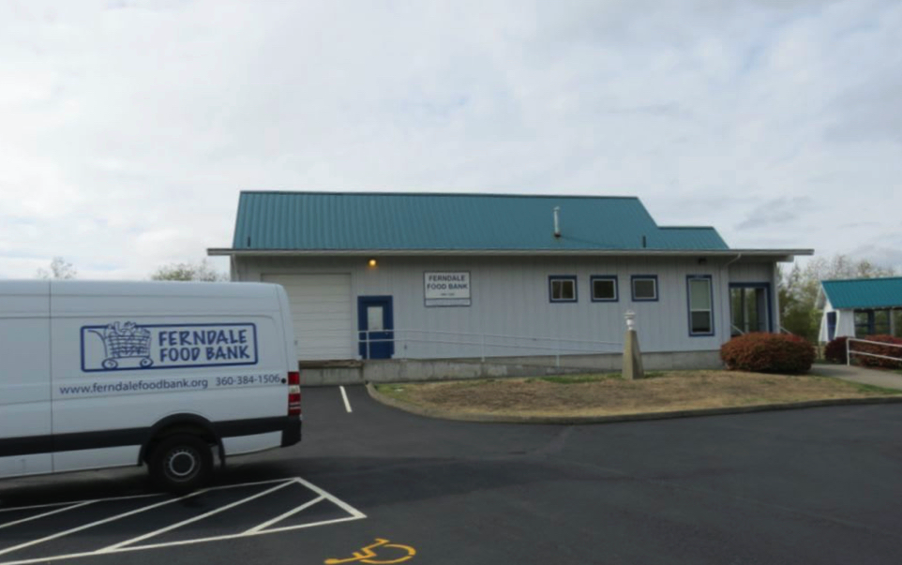
Our Story
The PNW Rotary Food Project was started by a small group of Rotarians from the Rotary Club of Ferndale and the Rotary Club of Pacific Northwest Passport who wanted make it easy for people to donate food to our local food bank.
They realized that many of their neighbors wanted to help fight hunger in their community too, but for one reason or another, never get around to it. So, they adopted a simple, door-to-door food collection system to enable people to pitch in.

Slide 4
They had three goals:
To provide a regular supply of food to hungry neighbors
To create new neighborhood connections and strengthen the community
To serve as a model for other communities

Slide 5
What did it take to get started
Contributions from the two Rotary Clubs plus individual members ($2550 initially)
District 5050 Matching Grant ($2500)
Bought Bags, lots of bags, printing supplies, website & software expenses and People of Action T-shirts
Donated Seed funds to Snohomish Rotaract Club (2022)
And of course LOTS of time, effort and energy from the original Steering Committee:
  Allen Stockbridge, Julie Johansen, Char Hart, Laurie Lloyd, Rollo VanSlyke, Dakota White (Rotaract), Jill Greer, Maureen Sextant, Deb Wiggs, Tim & Pati Villhauer, Sharon Robinson and Matt & Julie Roth.
  Zoom meetings galore!! Trying to figure out how to get this done in the middle of a Pandemic

Slide 6
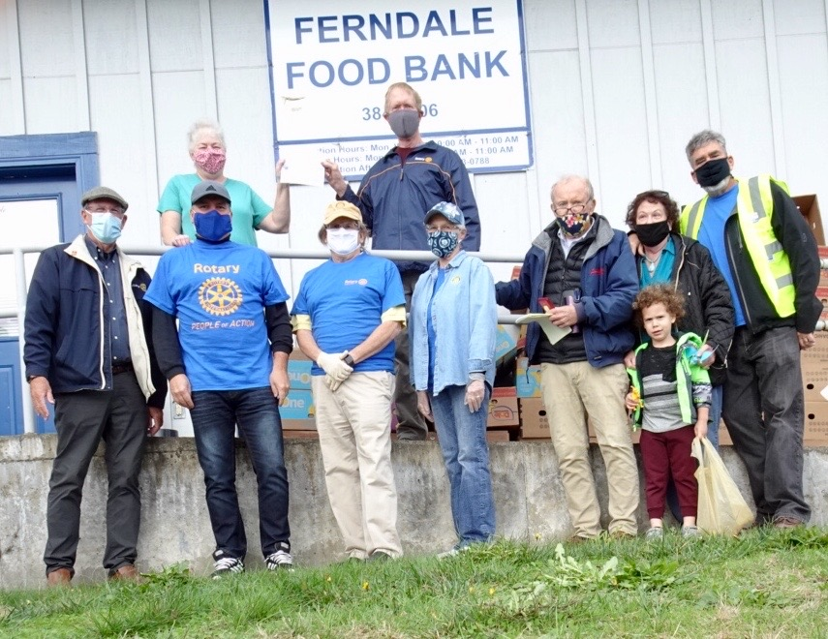
And so it began……..
The PNW Rotary Food Project’s first collection was October 10th, 2020. Five Neighborhood Coordinators picked up green bags from nearly 50 families in the Ferndale Service Area and delivered approximately 750 pounds to the Ferndale Food Bank.

Slide 7
We were just getting started
First full year (2021) 8,485 lbs
Second full year (2022) 7,657 lbs
And remember those 2 years were the depths of Covid so there were no public events to spread the word and sign up new donors..
Third year (2023) 10,849 lbs
Public events returned. Lots of new donors
Fourth year (2024) More new donors 12,274 lbs
Fifth year (2025) A few more donors 15,732 lbs
GRAND TOTAL from beginning thru 12/31/25 57,349 lbs

Slide 8
So here’s how it works:
Rotary Food Project volunteers invite their friends and neighbors to participate, plus we have tables at public events where we explain the program to community visitors.
Whenever people sign up to become Donors, the volunteers suggest that they buy just one extra nonperishable food item each week, and store it at home in a Green Bag that we provide.
The volunteers then stop by the donors’ homes every two months, pick up the Green Bags, leave an empty one behind, and take the Green Bag with donated food directly to the Ferndale Food Bank.

Slide 9
More Room to Grow – the need continues
Ferndale Food Bank Highlights - 2025
8,000 Individuals Served
70,000 Visits
900,000 Meals Served
757,000 Pounds of Food Rescued
14,211 Volunteer Hours

Slide 10
Here’s how you can help if you are in our area
Join Us
Sign up as a donor. We’ll bring you a green bag to get you started
Donate funds to keep the project going.
Or become a Neighborhood Coordinator and work with our volunteers
As shown before, Passport Club has been a valuable partner from the beginning donating funds whenever needed for ongoing project costs (i.e. bags & website expenses). And Julie and Bob are always there on pickup day to load up their SUV to the gills!!
Get in touch and let us know you want to donate food, become a Neighborhood Coordinator (aka pickup driver) or donate funds to cover project costs.
https://pnwrotarygreenbags.org/
laurietherider@gmail.com
360-319-9419 (Laurie Lloyd)
OR…..

Slide 11
Another way to help
…contact us if you want to start a food project in your area. We’d be glad to share our experience.

Slide 12
QUESTIONS?

