Slide 1
Ellensburg Morning Rotary Club
2015 - 16

Slide 2
A glimpse into 2015 - 16

Slide 3
Your Board
President: John Graf
Past President: Steven Weidenbach
President Elect: Jeri Epperson
Vice President: Sarah Keith
Treasurer: Karen Grigg
Secretary: Lindsay Thorn
Membership Chair: Sadie Thayer
Director Jack Carpenter
Director Tara Truax
Director: Jerry Alldredge
Director: Karen Shaw
Director: Clayton Myers
Pending Directorship: Paul Malinski
Pending Satellite Club Rep: Bob Hansen

Slide 4
Your Thursday morning list ☺
Wake up early
Get ready
Skip Breakfast
Leave for the Palace Café
Say hello to your fellow Rotarians
Find Terri – order breakfast
Cont.

Slide 5
Your Thursday morning list ☺
6:45 Social time with Rotarians
7:00 Bell/Invocation/Pledge
7:03 Introduce Guests
7:05 Introduce Program
7:06 Program followed by Q and A
7:25 Announcements and Committee Reports
7:30 Vocational Minute(s)
7:35 Sargent of Arms and Split the Pot
7:45 Do Good

Slide 6
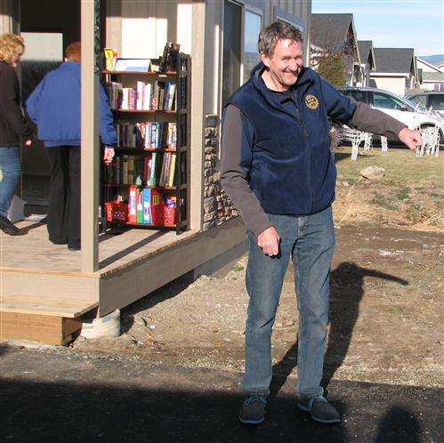
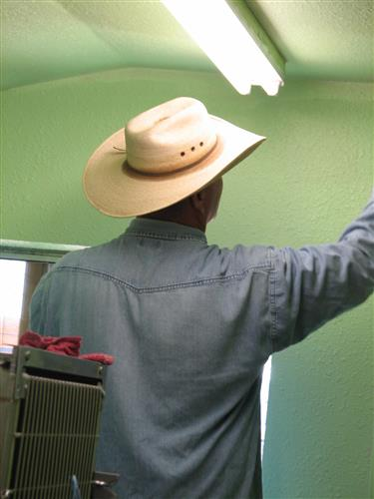
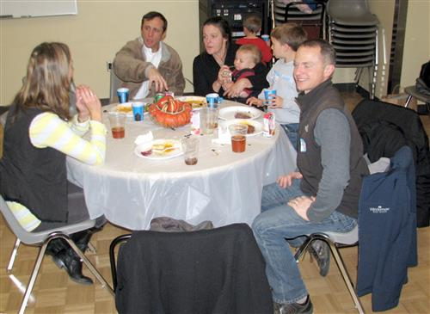
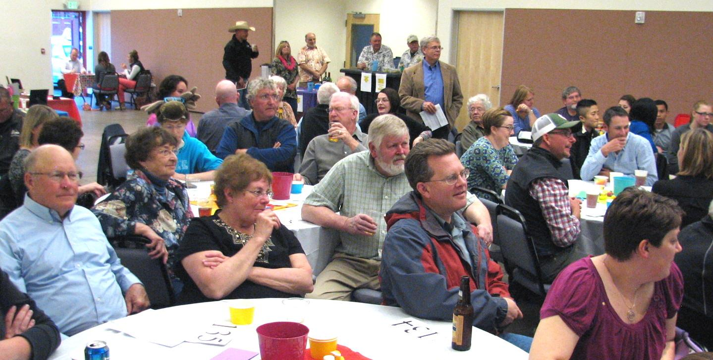
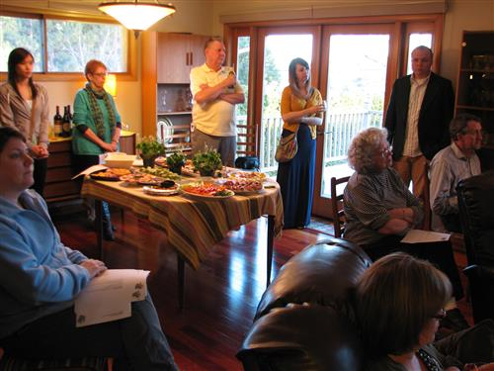
We have Good People

Slide 7
We will CELEBRATE each other

Slide 8
My Core Belief
Our relationships are the LIFEBLOOD of this Organization

Slide 9
Growth

Slide 10
Membership
We will set records this year with membership
Special thanks to:
Steve Weidenbach
Bob Hansen
Karen Grigg
Sadie Thayer
For their vision, commitment, and follow through with our Satellite Club

Slide 11
Let me tell you a little about you

Slide 12
You are a leader in our community
You connect with people
You want to improve the lives of others
You are the change you want to see in this world
You are a Rotarian

Slide 13
Leadership
Leadership allows influence

Slide 14
Leadership
If your actions inspire others to dream more, learn more, and become more, you are a leader.”
John Quincy Adams

Slide 15
Membership: Our growth depends on you

Slide 16
Emerging Leadership: Our young leaders depend on you.
Early Act
Lincoln Elementary School
Interact
Morgan Middle School – Both Campuses
Rotaract
Central Washington University and Young Business Leaders

Slide 17
Bridges

Slide 18
Second Chance
Second Thursday of every month
Bruce’s Place
5:00 – 6:30
Monthly Social
BYOBAF

Slide 19
Presidential Barbeque

Slide 20
Presidential Barbecue
Wednesday, July 22nd
6:00 PM
North Alder Park
Family Friendly
All Kittitas County Clubs are invited to attend

Slide 21
Rotary Night at the Orchard
July 29th
509-575-HITS (4487)
1301 S Fair Ave, Yakima, WA 98901
http://yp1.glitnirticketing.com/ypticket/web/ev_list.php
EBURG ROTARY

Slide 22
Collaborative Projects
Because…..

Slide 23
Collaborative Projects support the:

Slide 24
Projects

Slide 25
Projects
North Alder Splash Park

Slide 26
Projects
Circle the City

Slide 27
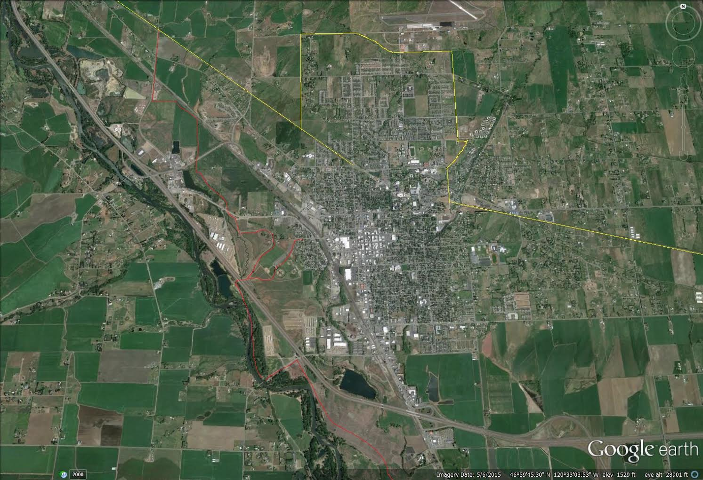

Slide 28
Projects: Circle the City
Do the things that we do the best
Embrace our Youth
Literacy
Community Engagement

Slide 29
Projects: Circle the City
What if the trail at Irene Rinehart Park allowed children and their families to interact with a children’s story, commissioned by us, illustrated by a local artist, containing local lore, and preserved along the trail?

Slide 30
Projects: International

Slide 31
Do Good

