Slide 1
This presentation is intended to:
Give you a flavor of three distinct ideas
They are different in:
Scope
Cost
Time
Community Impact

Slide 2
This presentation is intended to:
Help us make a decision for our future
Help us Do Good
Engage our Members
Justify Fundraising
Leave a Mark

Slide 3
This work:
Started with our visioning several years ago

Slide 4
We Know our Club DNA is:
Fun
Flexible
Responsive
Courageous
Diverse

Slide 5
Our club is ripe for the “NEXT” thing
So let’s jump into to learning more…

Slide 6
Project #1
Homeless Shelter

Slide 8
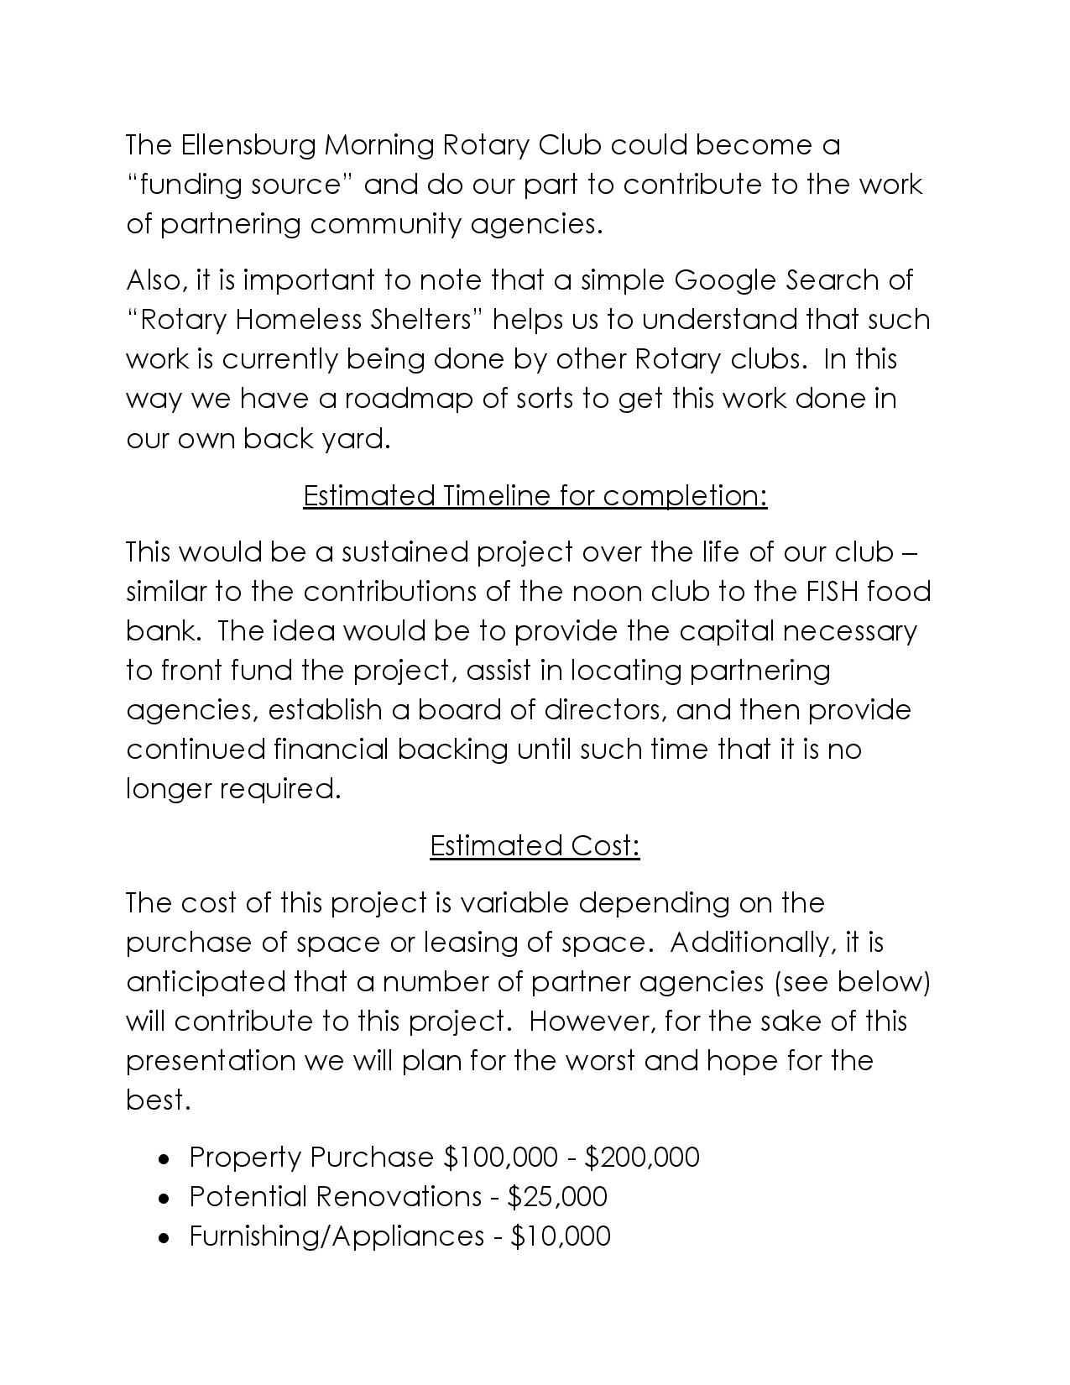

Slide 9
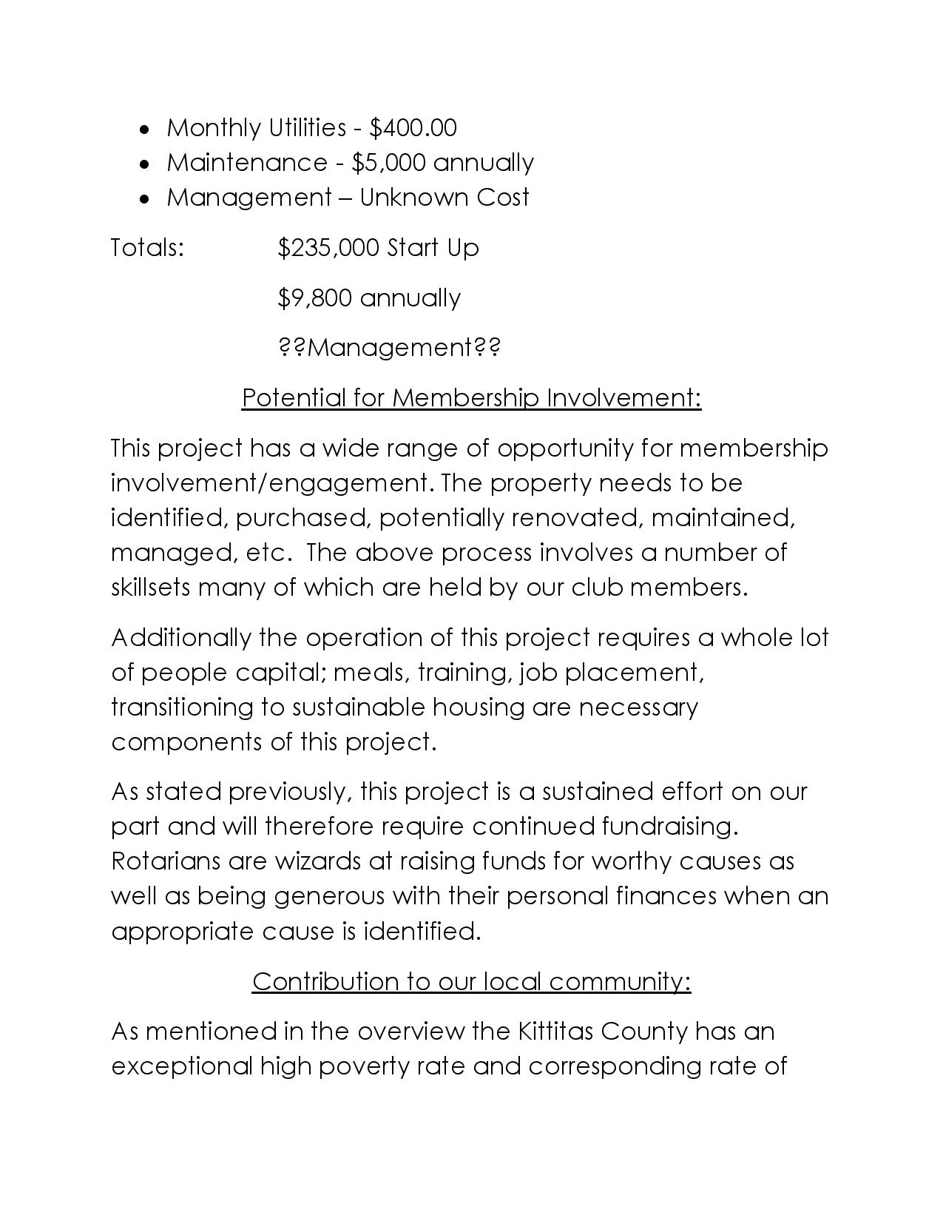

Slide 10
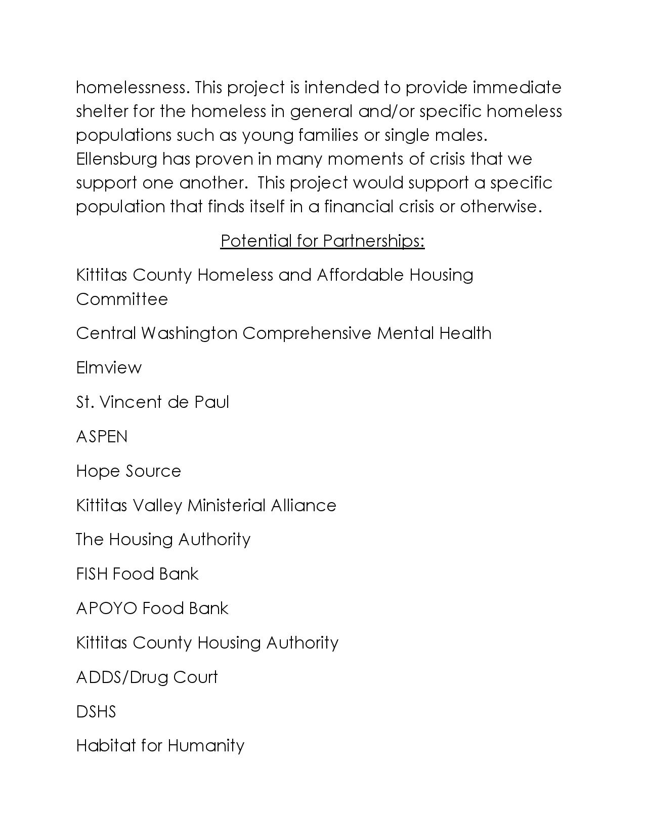

Slide 11
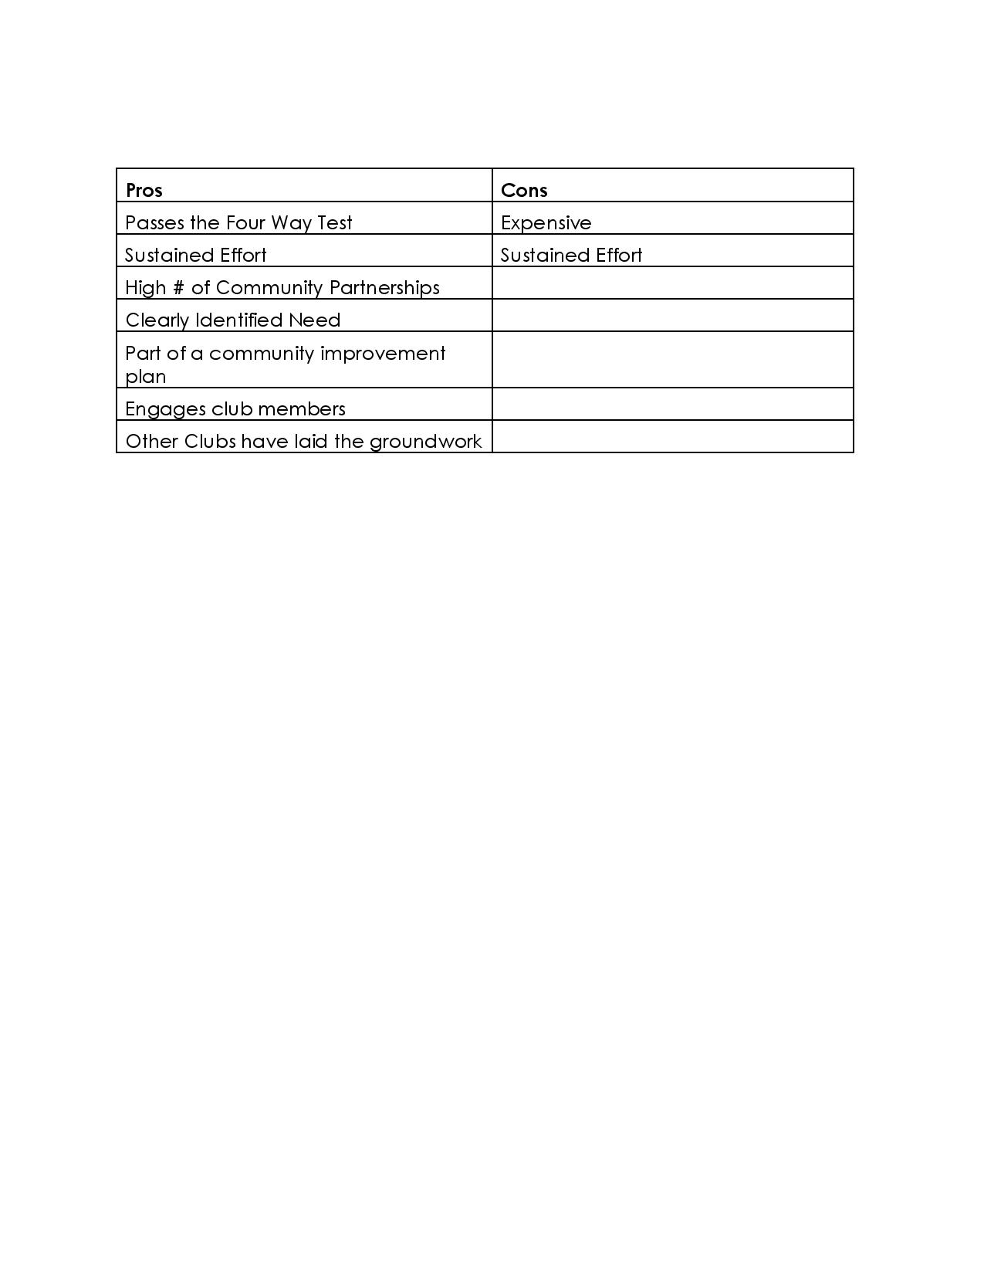

Slide 12
Project #2
Circle the City

Slide 13
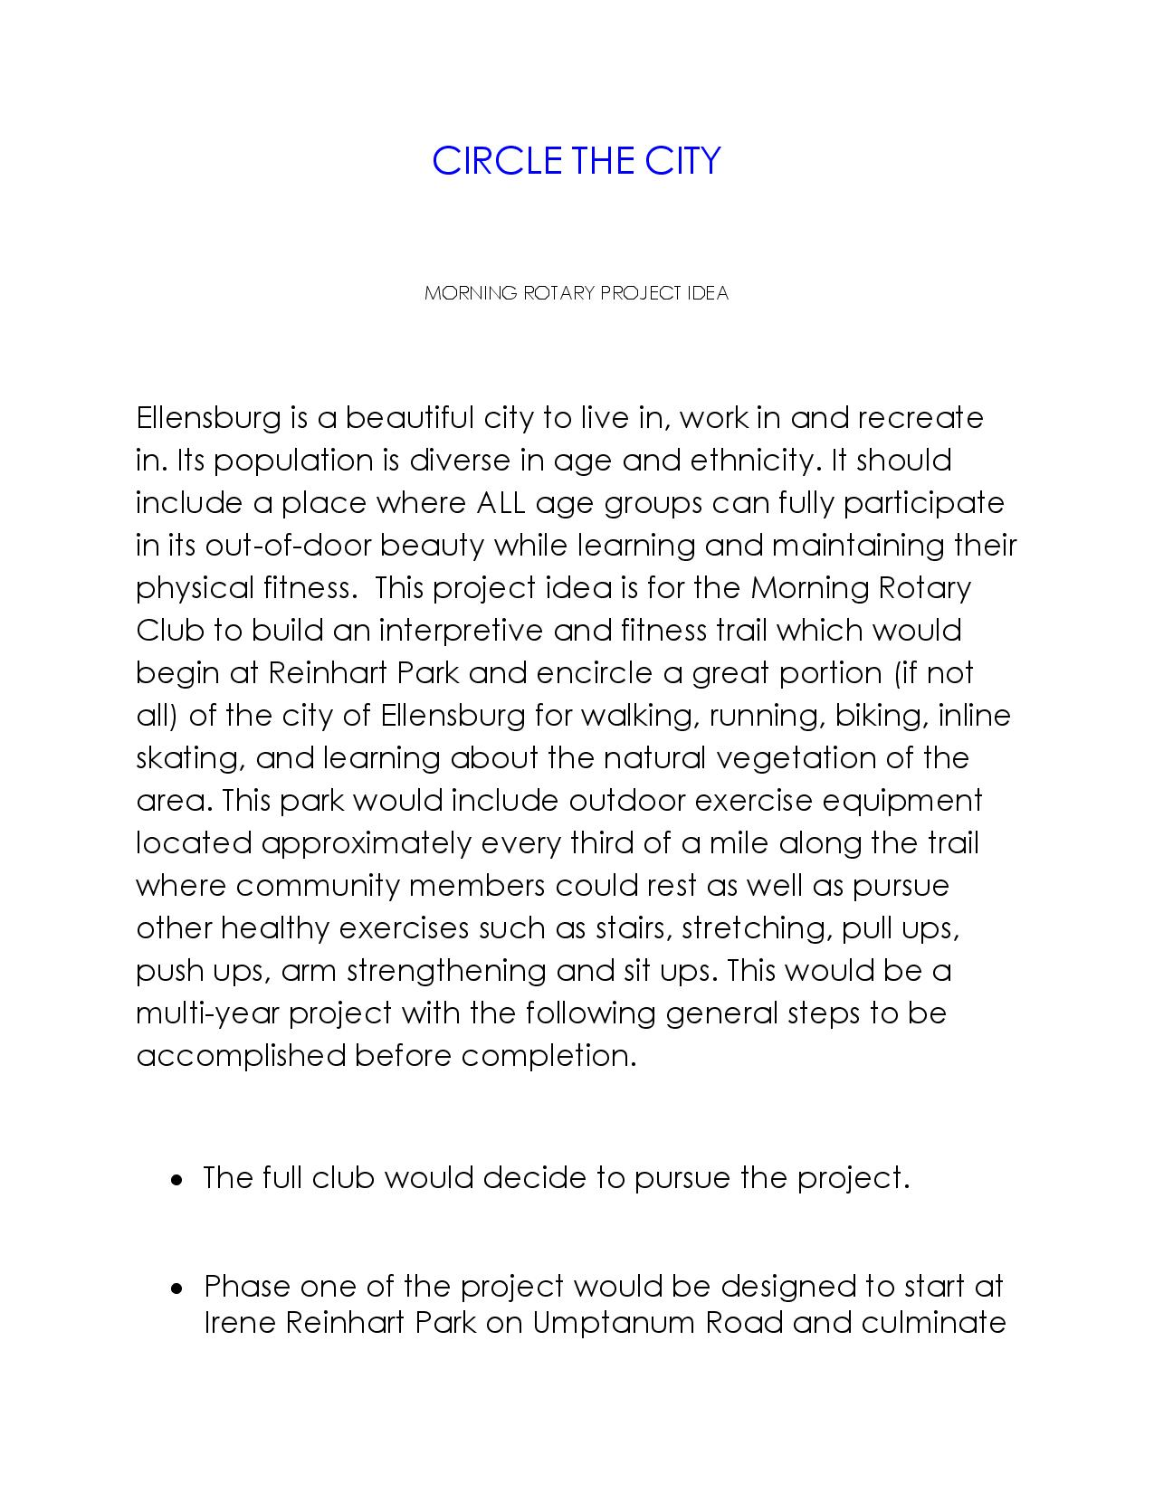

Slide 15
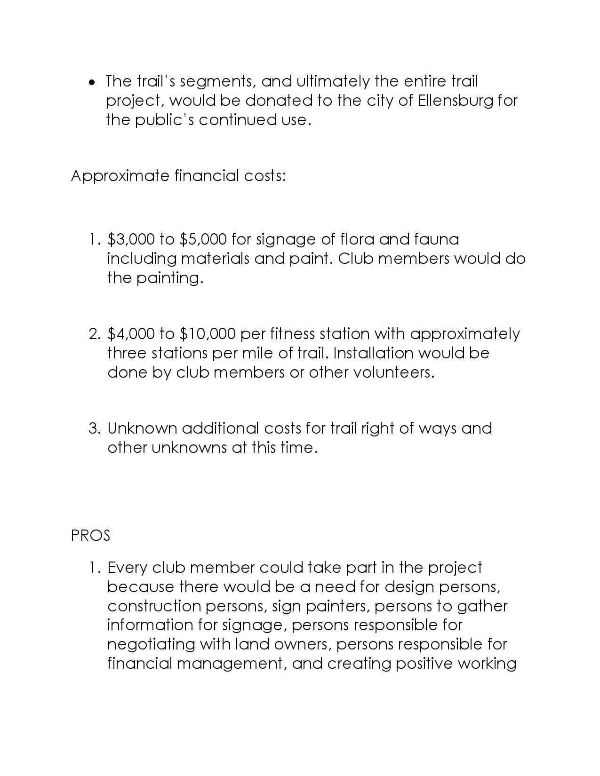

Slide 16
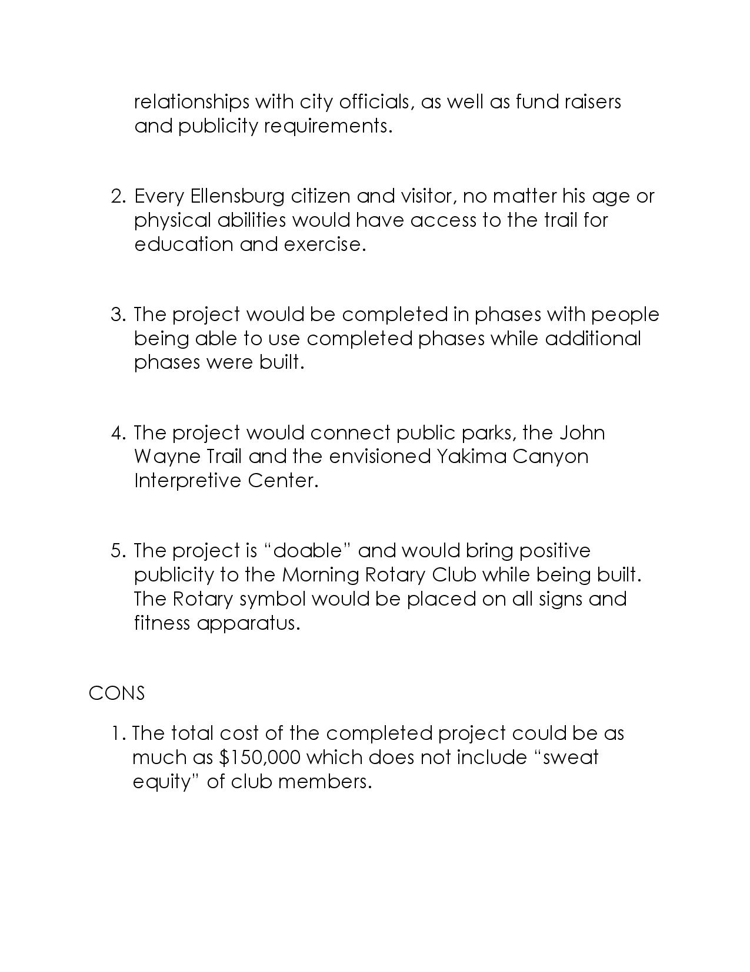

Slide 17
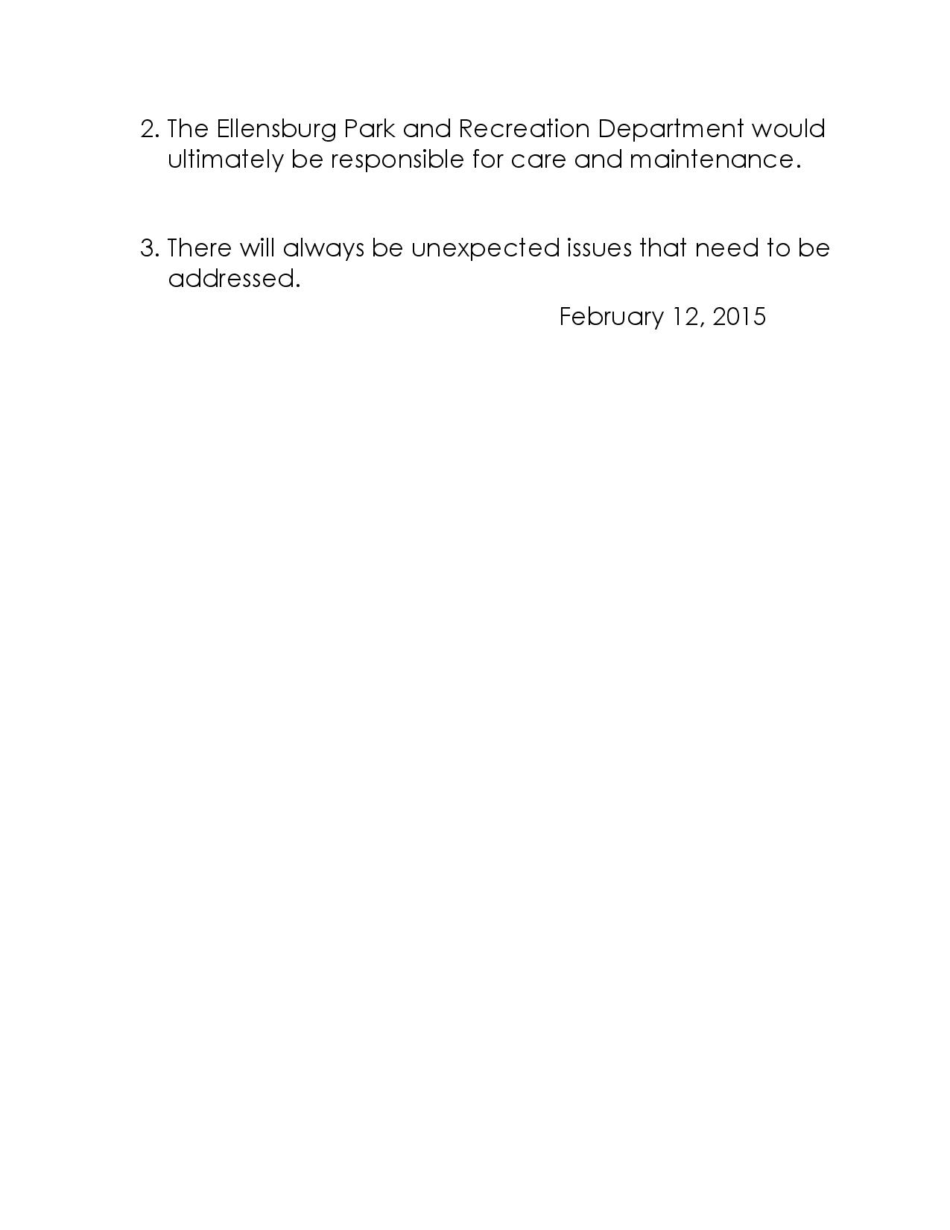

Slide 18
Project #3
Splash Pad

Slide 19
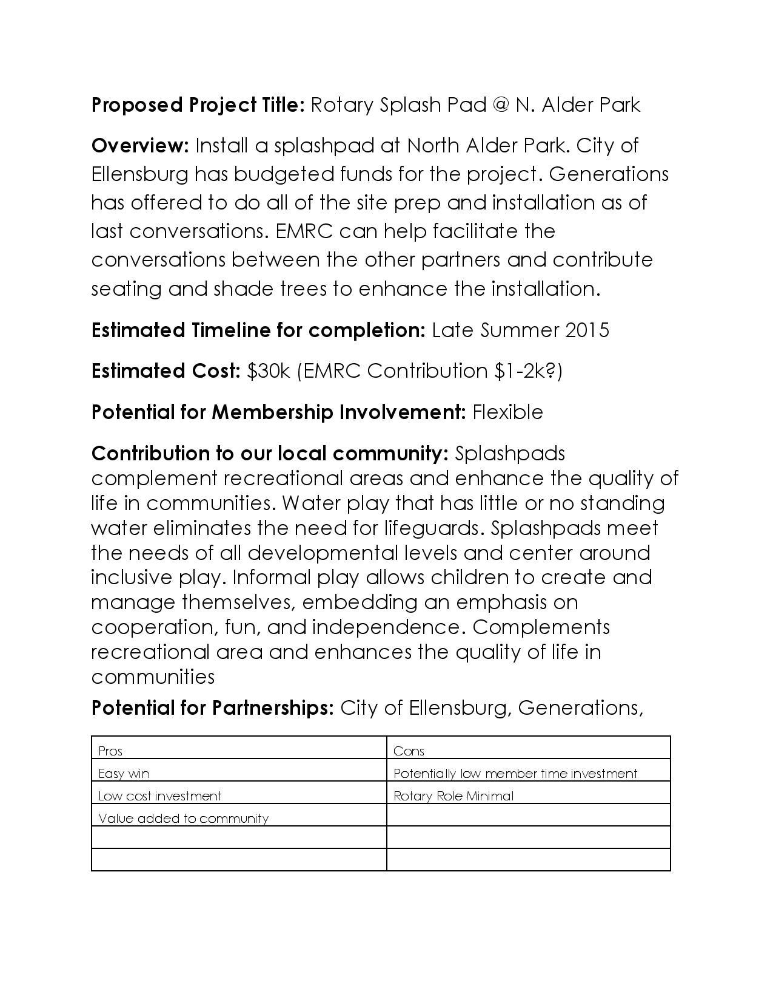

Slide 20
Three Big Projects
Questions

