Slide 1
WESSA EDUCATION CENTRES
WESSA
The Wildlife and Environment Society of South Africa

Slide 2
Our Vision and Mission
Our vision is to be a highly effective and well-supported champion of the environment.
Our mission is to implement high impact environmental and conservation projects which promote participation in caring for the Earth.
Where we operate
We have both professional staff and passionate members working across South Africa.
As a UNESCO partner, we are also supporting education for sustainable development across the Southern African region.
We have four environmental education centres located in KZN, Limpopo and the Northern Cape.

Slide 3
The WESSA Ecosystem
WESSA SCHOOLS &
YOUTH PROGRAMMES
WESSA EDUCATION CENTRES
Our Schools
programmes support and improve school curricula,
equipping children and teachers to live sustainably in the future.
WESSA offers year long learnerships & provides
training to unemployed,
disadvantaged youth
We provide a unique
and diverse variety of outdoor educational experiences using the WESSA e-STEAM curriculum framework & subject-specific fieldwork programmes
linked to environmental education.
Effective
accredited and non-accredited training, education & skills development
programmes designed
to address the critical scarcity of the skills
that are required
to drive the green
& blue economy
THE WESSA
ECOSYSTEM
WESSA TRAINING
Our members
initiate environmental
projects & organise events
in their local
Communities. There are regions, branches, friend’s groups and People caring
for the Earth
throughout
South Africa
WESSA MEMBERSHIP
Through our Environmental Awards, we incentivise and verify sustainable tourism initiatives . Our projects provide youth training and critical work experience in the Green and Blue economy.
WESSA SUSTAINABLE TOURISM

Slide 4
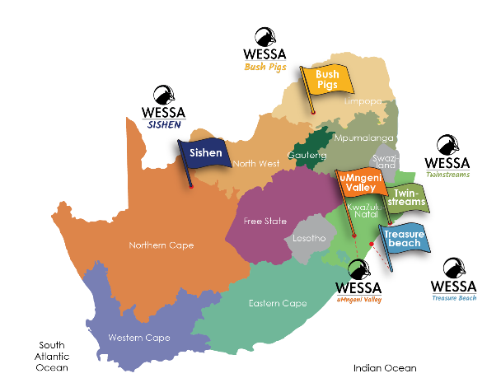
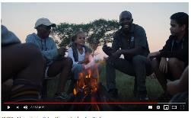
WESSA Education Centres
Click on the videos below to enter our world of learning and adventure
Browse through the programme options found at our 5 unique WESSA education centres. Click on the brochure
Click on the map below to visit our WESSA Education Centre’s Website
WESSA Treasure Beach
WESSA uMngeni Valley

Slide 5
WESSA e-STEAM Curriculum Framework

Slide 6
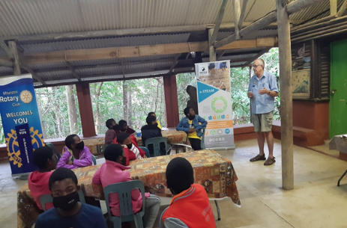
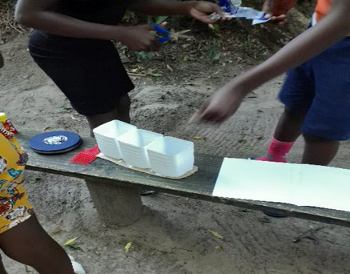
WESSA e-STEAM PROJECT
OVERVIEW OF PROJECT – 9 MONTHS OF IMPLEMENTATION

Slide 7
OBJECTIVES OF THE PROJECT
To enable school learners to explore environmental issues and engage in problem solving using e-STEAM and take action to improve the environment.
a) Everyone has the right to environment which is not harmful to their health or wellbeing
To expose learners to protection of the environment using e-STEAM as section 24 of the constitution state that:
b) Everyone has the right to have the environment protected for the benefit of present and future generations.
To impart knowledge about the principles required for the conservation and utilization of natural resources for the existence of mankind through environmental education.

Slide 8
PROJECT IMPACT SO FAR
1. WESSA ON WHEELS SCHOOL VISITS = 10 SCHOOLS
- Introduce project to principals and teachers
- Run 2 hour workshops for Grade 6 pupils
- Plan the first visit to Twinstreams
3. TEACHER TRAINING PROGRAMME = 4 SCHOOLS
-21 Teachers
- Support for curriculum and lesson planning
2. TWINSTREAMS e-STEAM WORKSHOP = 7 SCHOOLS
- 90 Pupils
- 3 Days / 2 Nights Camp at the centre
- e-STEAM workshops + team-building + environmental education + forest study
- Supported by Rotary Mtunzini Team

Slide 9
SCHOOLS SELECTED
10 Schools under uMlalazi local municipality were selected.
These were the lucky schools:
Zenzeleni mashamase Technical school (Attended camp)
Prince Zithume High School (Attended camp)
Isinyabusi Technical (Attended camp)
Hlakaniphani Senior Secondary (Attended camp)
Uphindo high school (Attended camp)
Emoyeni High School (Attended camp)
Nzuza Secondary School (Attended camp)
Mtonokudla Secondary School
Zinqobela High School
Matigulu High School

Slide 10
CURRENT NEW DEVELOPMENTS
HILTON EFFECT project in Karkloof – with the adoption of Thembelihle Primary School as an e-STEAM School
Partnership between WESSA; University of Kwazulu-Natal; CASME (Centre for the advancement of Science and Maths Education) and the ESKOM Science Expo to run e-STEAM Teacher training in primary schools around Mtunzini.
Endorsement of e-STEAM by the e3 Department of Basic Education entrepreneurship programme

Slide 11
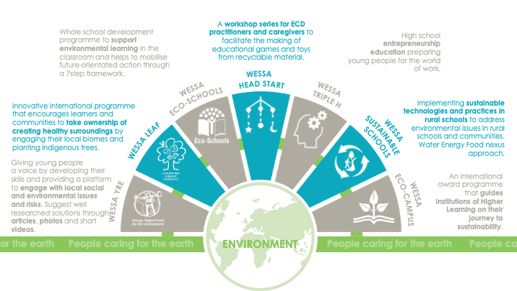
Schools & Youth

Slide 12
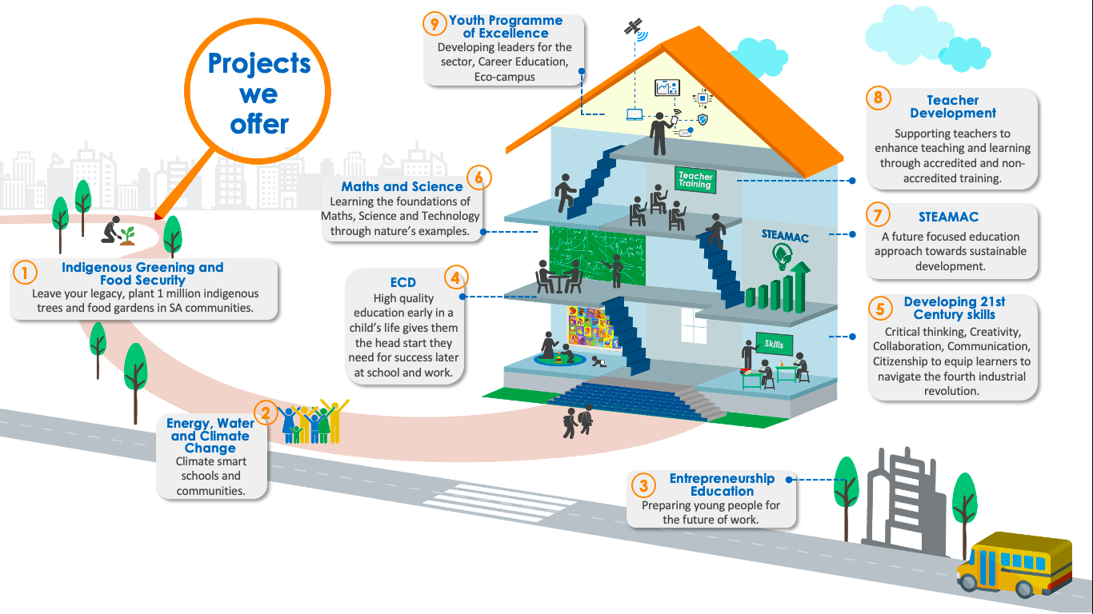
Schools & Youth

Slide 13
Schools & Youth

Slide 14
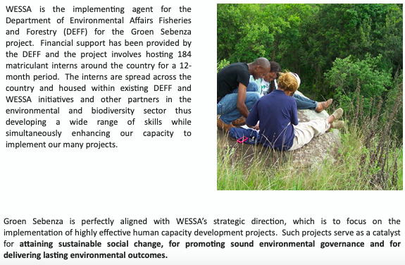
Schools & Youth

Slide 15
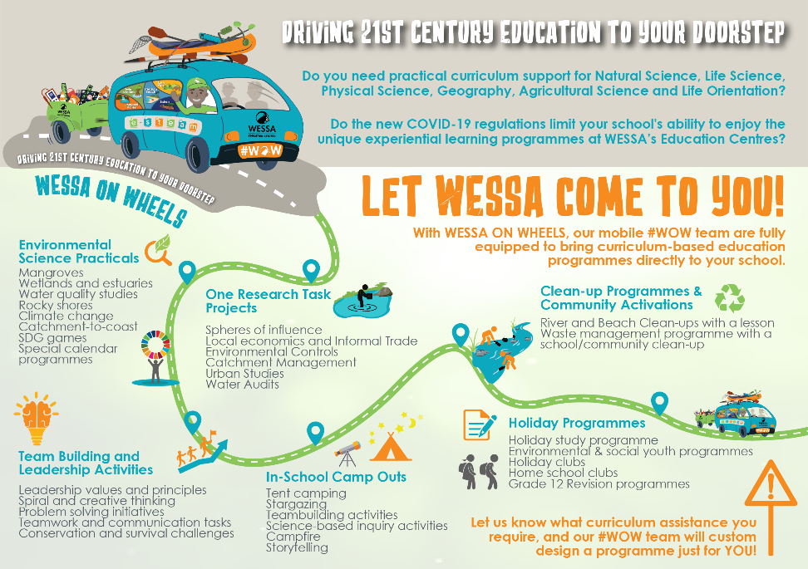
WESSA Education Centres

Slide 16
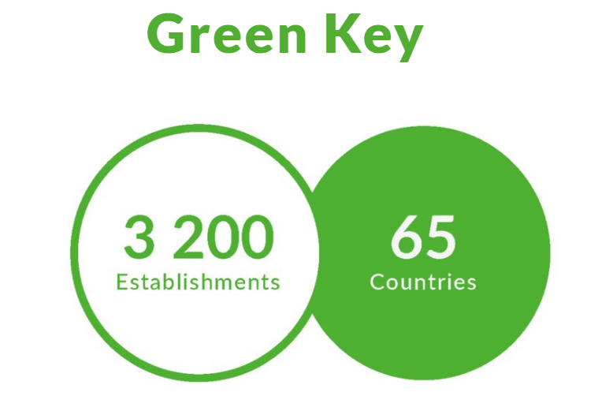
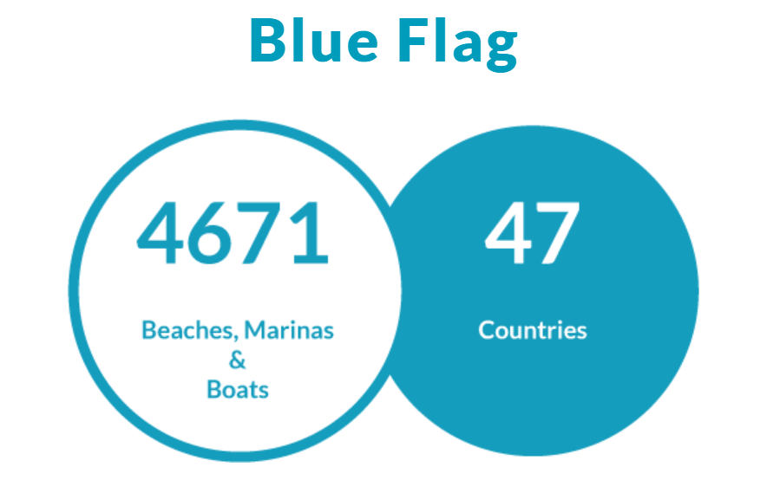
WESSA Sustainable Tourism
WESSA is the South African Green Key implementer.
The Green Key award is the leading standard for excellence in the field of environmental responsibility and sustainable operation within the tourism industry. This prestigious eco-label represents a commitment by businesses that their premises adhere to the strict criteria set by the Foundation for Environmental Education.
WESSA is the South African Blue Flag implementer.
The iconic Blue Flag is one of the world’s most recognised voluntary awards for beaches, marinas, and sustainable boating tourism operators. In order to qualify for the Blue Flag, a series of stringent environmental, educational, safety, and accessibility criteria must be met and maintained.
A WESSA developed environmental award for sensitive coastal sites in South Africa. The Green Coast award verifies good environmental management at these sites and offers opportunities for local communities and residents to partner with municipalities to manage and rejuvenate sensitive coastal species, habitats and cultural heritage sites.

Slide 17
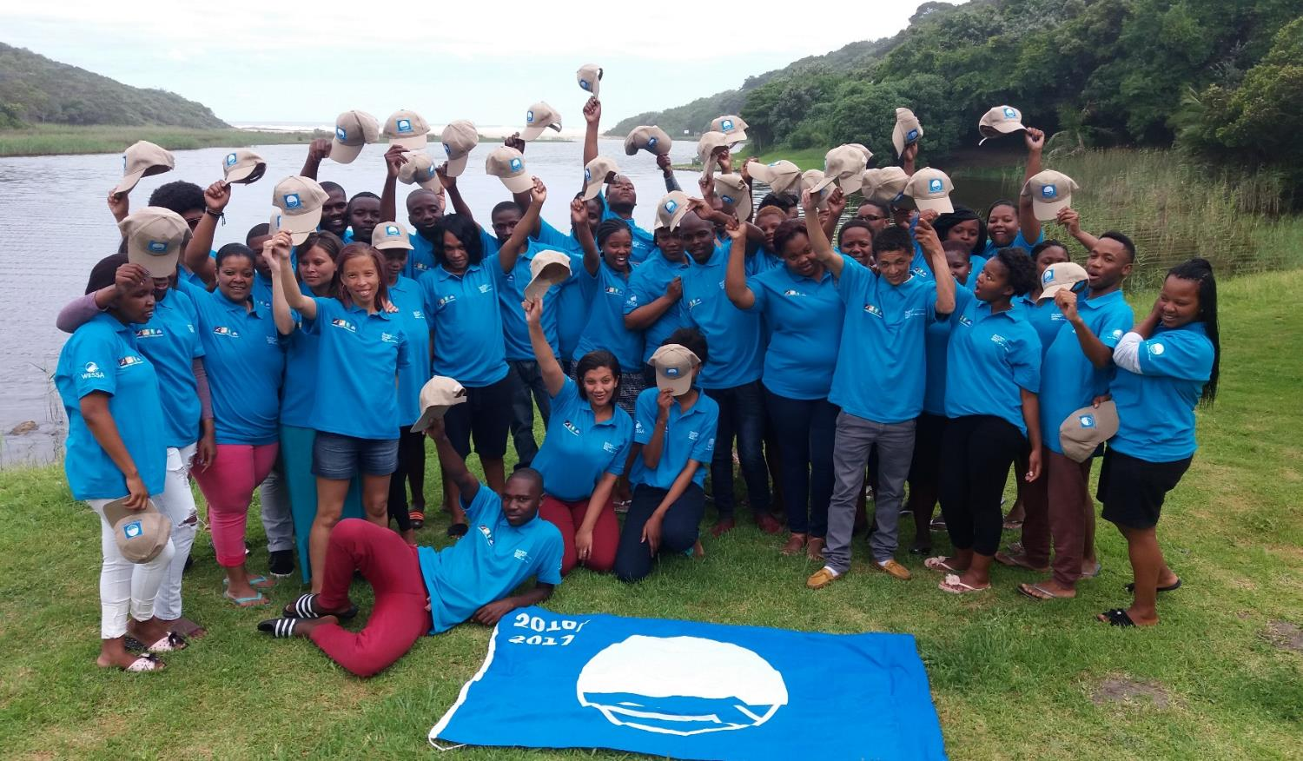
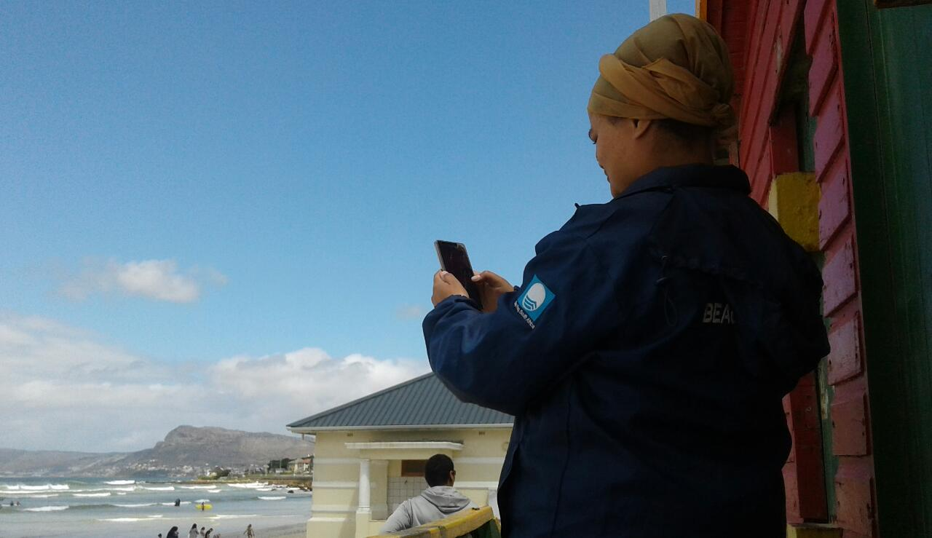
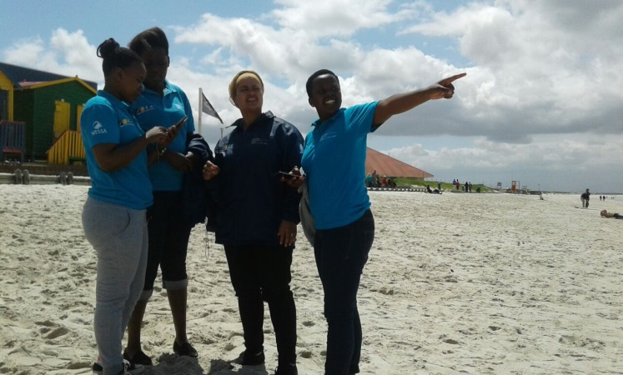
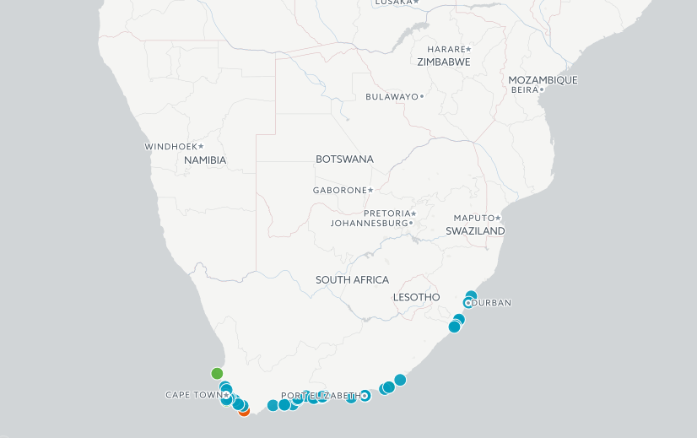
WESSA Sustainable Tourism
The Sustainable Tourism unit aims to incentivise local governments and tourism businesses to operate more sustainably through our Blue Flag and Green Key environmental awards.
Through our internally developed Green Coast award, we promote public participation in the protection of our sensitive coastline.
Environmental Award Sites
With our awards endorsed by the National Department of Tourism, our programmes are all underpinned by national youth development programmes which offer accredited training and work experience in the Blue and Green economy to unemployed youth.

Slide 18
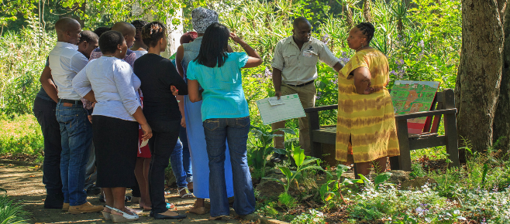
WESSA Training
Our extensive range of accredited and WESSA-certified courses are designed to address the critical scarcity of skills required to drive a green and blue economy in South Africa.
The courses place emphasis on developing hands-on, practical skills, towards promising career paths and a sustainable society.
WESSA is accredited for 3 full qualifications and numerous short skills courses. Our training offering includes more than 500 credits across 6 SETA’s (including ETDP-SETA, LGSETA,CATHSSETA, SERVICES SETA and FP&MSETA). WESSA is also registered with the Department of Higher Education and Training as is now required of all accredited training providers. Our training materials can be contextualized for the specific needs of the client and learner. We partner effectively with corporates, helping them meet their CSI goals by delivering training on their behalf.
WESSA specialises in training for careers in the green and blue economy.
Leaners are guided through our training to become stewards for our planet.
‘Empowering industry, communities and people to care for the Earth through education and training.’

Slide 19
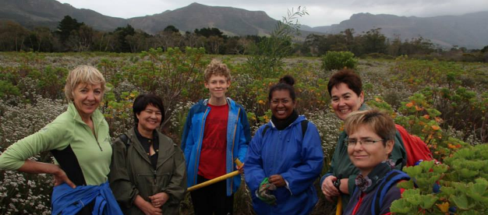
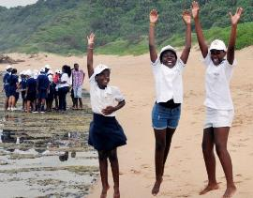
WESSA Membership
We’ve been a membership organisation since 1926. Our strong presence on the ground today is strengthened by thousands of members, friend’s groups and branches throughout South Africa who share our commitment to caring for the Earth.
The WESSA Youth Volunteer programme is a new type of commitment amongst young people through Volunteerism. To achieve this, the WESSA Youth Volunteer programme is focusing on providing appropriate coordinated support that builds on the strengths of young people through volunteerism in order to facilitate personal growth, and accountability.
Volunteers can provide their services either by volunteering at WESSA community projects that are being activated on the UN special days calendar, WESSA Education centres and WESSA National Corporate and Governmental Programmes. The WESSA Youth Volunteer Programme assists youth to identify and understand the 17 Sustainable Development Goals. The programme gives youth the confidence to positively contribute towards localizing the SDG’s and the 2030 agenda.
WESSA is a
membership-based organisation and, throughout South Africa, our members initiate environmental projects and organise educational events and activities in their local communities.

Slide 20
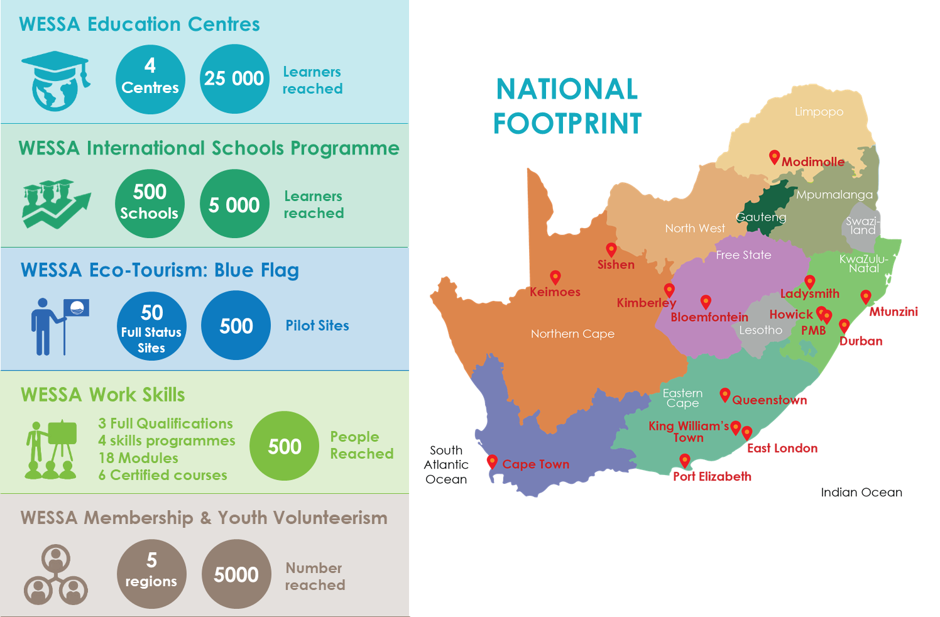
WESSA operates across South Africa

Slide 21
Thank you
Matthew Cocks
General Manager – Education Centres
+27 64 752 0439
www.wessa.org.za
matthew@wessa.co.za

