Slide 1

Overdiagnosis: Causing Harm in the Pursuit of Health
May 25, 2022
@EddyLang1
Eddy Lang MDCM CCFP(EM)
Professor Department Head Emergency Medicine
Cumming School of Medicine
University of Calgary, Alberta Health Services

Slide 2


Faculty/Presenter Disclosure
Faculty: Eddy Lang
Financial affiliations:
No relevant disclosures
Intellectual disclosure:
Chair of the 2022 Preventing Overdiagnosis Conference in Calgary
Member of the Canadian Task Force on Preventive Health Care
Notes:
Instructions:
This slide must be visually presented to the audience AND talked through by the speaker.
Where a faculty/presenter has no relationships to disclose, simply indicate ‘‘Not Applicable’’ under the heading ‘‘Financial affiliations’’.
Speakers must indicate direct financial relationships with both for-profit groups (e.g., relationships with industry, or communications firms) and not-for-profit groups (e.g., charitable organizations, government, patient advocacy groups, research groups, etc.) and any other relationship which could be perceived by a reasonable, well informed participant as having the potential to influence the content of the educational event.

Slide 3
Learning Objectives
Describe overdiagnosis and its relationship to the concepts of over-detection, shifting disease definition thresholds, disease mongering, low-value care and diagnostic test accuracy
Identify the myriad of complex drivers of overdiagnosis and consider feasible, re-searchable and measurable mitigating strategies
Summarize academic and participation opportunities for the upcoming overdiagnosis conference in Calgary

Slide 4
Question to consider – answer in text
Is it possible for a citizen / patient to be harmed by undergoing a test with very good performance characteristics or simply receive an accurate diagnostic label? If yes, please give an example?

Slide 5

Alfred
65 year old male unhappily divorced – lonely despondent
Problems started with after complications of prostate cancer surgery
3 years prior – “routine PSA”
Biopsy
Low grade tumor
Opted for prostatectomy
Erectile dysfunction

Slide 6

Pamela
Severe anxiety in a 27 yo female – unable to complete studies
Problem dates to abnormal finding on CT / MRI
Imaging performed for migraine evaluation
Potential malignancy
Lesion not amenable to biopsy
No progression after 3 years likely normal variant – incidental finding

Slide 7

Sam
24 yo male on / off ADHD medications for years
Struggled with schoolwork in his teens
Referred to a psychologist for testing – ADD without hyperactivity
Prescribed medications with excellent early effect
Later developed, anorexia, anxiety and depression with medication cessation

Slide 8

Overdiagnosis defined
“The labeling of a person with a disease or abnormal condition that would not have caused the person harm if left undiscovered, creating new diagnoses by medicalizing ordinary life experiences, or expanding existing diagnoses by lowering thresholds or widening criteria without evidence of improved outcomes. Individuals derive no clinical benefit from overdiagnosis, although they may experience physical, psychological, or financial harm.”

Slide 9
Overdiagnosis confessions of an Emergency MD
Over-investigation of low-risk PE and subsegmental clot
CT angiography for neurologic complaints and incidental findings
Allergic reactions with hyperventilation / anxiety labeled anaphylaxis
Low risk chest pain, provocative testing in follow-up and premature labeling with heart disease

Slide 10
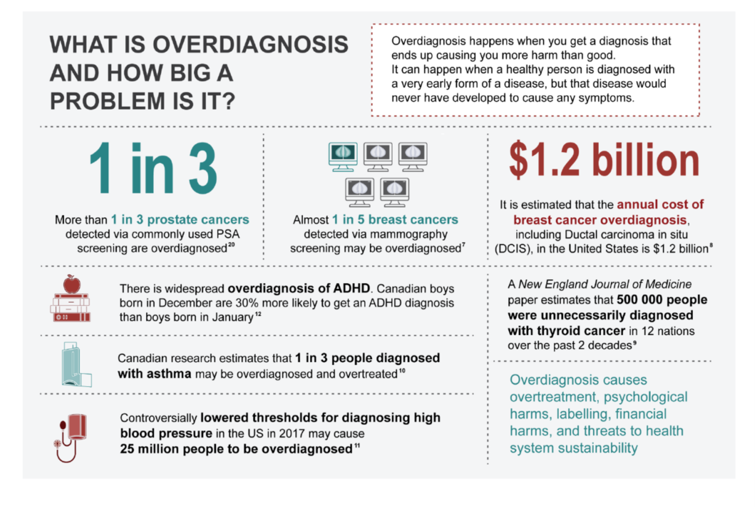

Slide 11
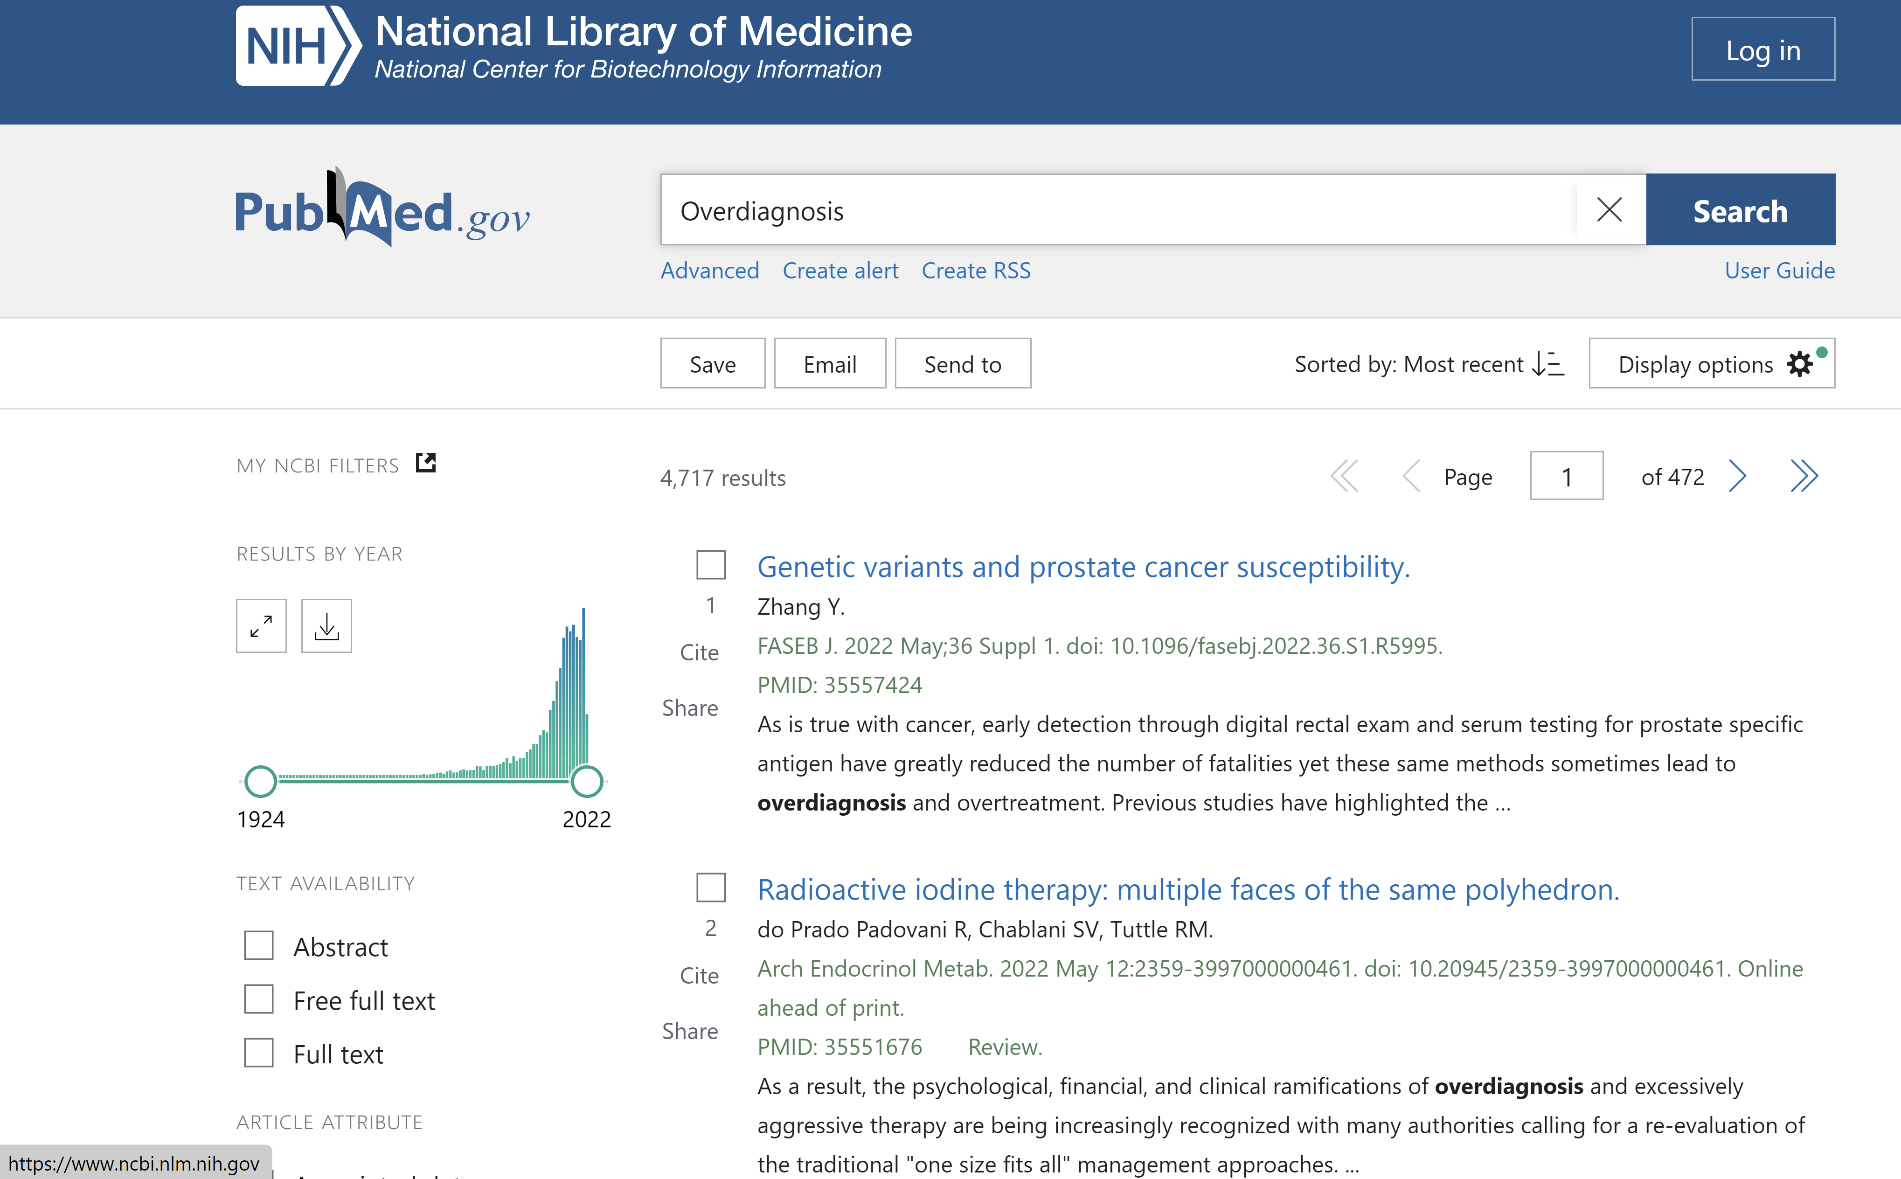
An emerging scientific field
New MeSH term
4 700 citations
Most published in the last 10 years
Related to but distinct from overuse, low-value care, Choosing Wisely
Not test performance
Not misdiagnosis

Slide 12
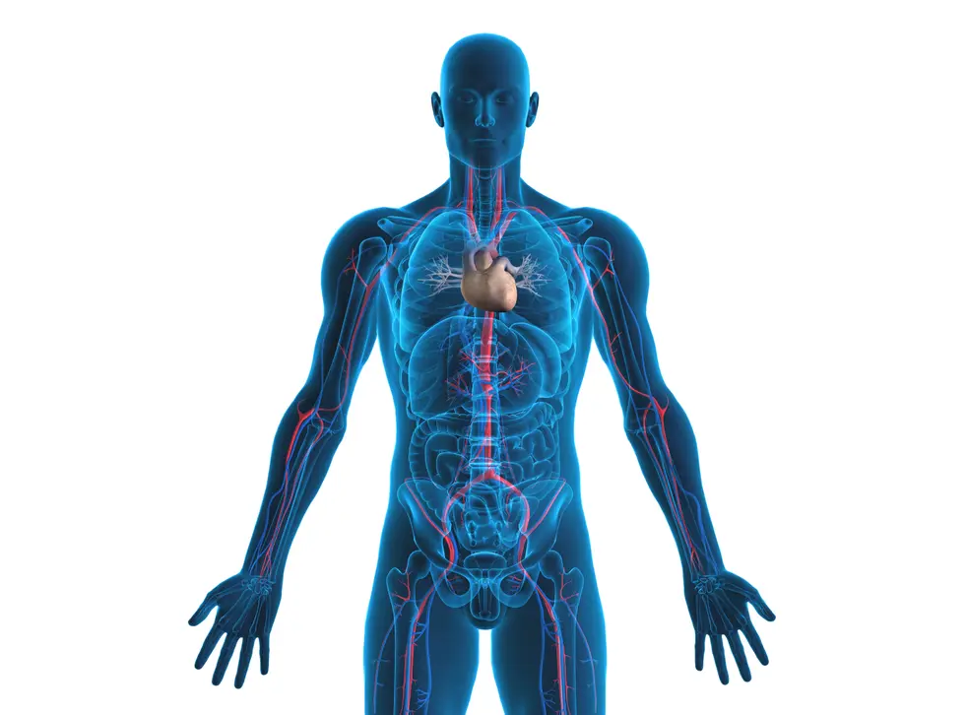
Incidental findings neuroimaging
Depression
ADHD
Ductal Carcinoma in Situ
Screening for lung cancer in
Young Taiwanese women –
non-smokers
Thyroid cancer
Inferior MI on routine EKG
Lower thresholds for HTN
Screening for atrial fib
Non-alcoholic fatty
liver disease
More CTs –
fewer kidneys
Unjustified threshold
for CKD
Melanoma epidemic
revealed
Prostate cancer
Polycystic ovary

Slide 13
Drivers and Impacts

Slide 14
1000-person graphic CTFPHC

Slide 15
PSA testing
PSA – early and accurate prostate cancer detection – simple blood test
RCT evidence in > 10K men
> 98% sensitivity; 18% false +ve
Detects 100 prostate cancers in 1000 screened – 33 indolent, asymptomatic, ODx
In those treated - incontinence and erectile dysfunction – 12-18%
Disease specific mortality – NNScreen = 1000 – prevent 1 PC death
All cause mortality benefit – zero
Do citizens proceed with informed consent?
Should the public purse pay for this test?

Slide 16
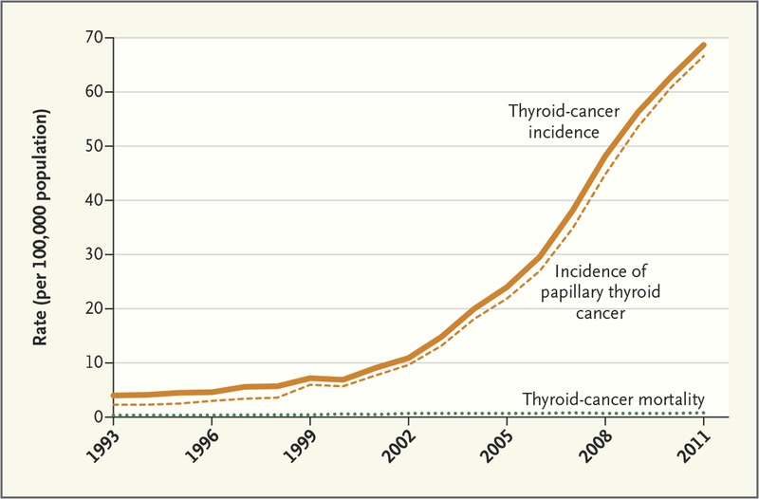
The overdiagnosis epidemiologic signature
South Korea’s Thyroid-Cancer “Epidemic” — Turning the Tide; NEJM December 2015

Slide 17
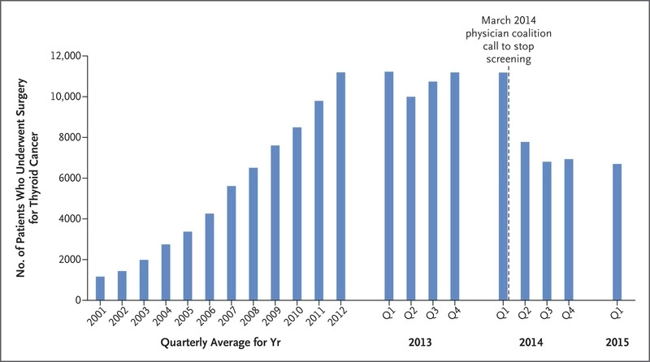
South Korea’s Thyroid-Cancer “Epidemic” — Turning the Tide; NEJM December 2015

Slide 18
Choosing Wisely and Overdiagnosis
Minimal alignment between areas of concern for overdiagnosis and Choosing Wisely
Different methods for achieving topic focus?
How often does “what are the downsides?” “what if I do nothing” speak to overdiagnosis?
How likely is will I be better off not knowing?

Slide 19
Closing thoughts
Addressing overdiagnosis does not minimize or counter the problem of underdiagnosis
Important healthcare harm but seemingly little known or understood
Widespread, rampant and insidious source of waste and harm
Medicine’s dirty secret?
Can be addressed through funding policies and informed consent for testing at high risk for overdiagnosis

Slide 20
