Slide 1

MEMBER SURVEY 2017
Calgary Centennial
Calgary Centennial
Rotary Club of Calgary Centennial
Spring 2017

Slide 2


Navigation
INTRODUCTION
REASONS FOR MEMBERSHIP
ENGAGEMENT
CLUB
PERFORMANCE
FUNDRAISING
DISTRICT PERFORMANCE
Methodology
Reasons for Joining
Rotary Roles
Club Performance Ratings
Types of Fundraising
Your Club’s Request
for District Assistance
Response By Club
Reasons for When Joined
Engagement - District
Preferred
Areas of Service
Preferred Amount
District Ratings –
Fundamentals
Demographics
Reasons for Staying
Engagement - Club
Preferred
Rotary Programs
Club Fundraising Limitations
District Fundamentals
Ranked Importance
Preferred Engagement
Other Issues
Open End
Fundraising Attitudes
District Performance Ratings
Self Assessment of
Role in the Club
Request District Assistance
NAVIGATING THE REPORT
In SLIDESHOW VIEW, click on any button above to navigate to the section.
Use the icons in each slide footer for convenient navigation and quick access to more information:
NAVIGATION
Click to return to this report navigation slide.
DETAILED DATA
Escape from Slideshow View to NORMAL VIEW; then click to open a worksheet with detailed data.
INFORMATION
Click for a pop-up that explains the slide. Click again to hide.
Notes:
In SLIDESHOW VIEW, click on any button above to navigate to the section.
Use the icons in each slide footer for convenient navigation and quick access to more information.

Slide 3
Methodology
QUESTIONNAIRE
The study questionnaire was developed in consultation with District leadership and programmed by Dimark Research.
The finished on-line survey was tested for accuracy. Aggregated anonymous data from the first 27 respondents was reviewed to ensure the survey was functioning properly.
FIELDING
Email invitations were distributed to 1,842 District 5360 Rotarians for which the district has valid email addresses (43 members excluded due to lack of email address). Emails were sent February 3 and repeated at six day intervals to anyone who had not yet completed the survey.
Each Rotarian was emailed a unique link to the online survey to ensure valid responses and no duplications.
The report is based on the first 759 responses (40.3% of members) received between February 3 and March 8, 2017.
ANALYSIS
Respondent data was checked to confirm valid responses.
Survey results were tabulated in total and across several other categorizations, including:
  Respondent’s gender, age, role in their club and district, time in Rotary, level of engagement, areas of interest (reasons for staying in Rotary) and assessment of their club’s overall health.
  Respondent’s Club characteristics such as size, locale, average service, age distribution and gender mix.
Over 5,000 open-end comments were reviewed and categorized according to theme.
Confidential reports will be produced for each club with more than six respondents.
COST
The survey was completed at a total cost of $1,518.
Cost was $2/survey, due to donation of time from Dimark Research and Stratus Research.
Standard cost of a professional survey of this scope would be >$30,000.

Slide 4
Methodology
MEMBER CONFIDENTIALITY
The survey is being managed by a professional group (Dimark Research). They must always protect the privacy of survey participants and this is standard procedure.
District 5360 provided a list of Rotarians by club.
Each Rotarian was assigned a random number and names were then disconnected from the remainder of the process.
Each Rotarian was emailed a unique link to the survey. That link enabled Dimark to control responses so that there is only one per Rotarian. The survey data remains linked to the Rotarians code.
Each club was assigned a random number and the code numbers of club members were connected to the club code.
A data person at Dimark Research tabulated the results, using the Rotarian’s code to link their answers (survey data) to their club. No one had access to their answers (survey data) and their name in the same place.
A Rotarian who specializes in market research prepared the reports. He only received aggregated data and comments, with no Rotarian or club names.

Slide 5
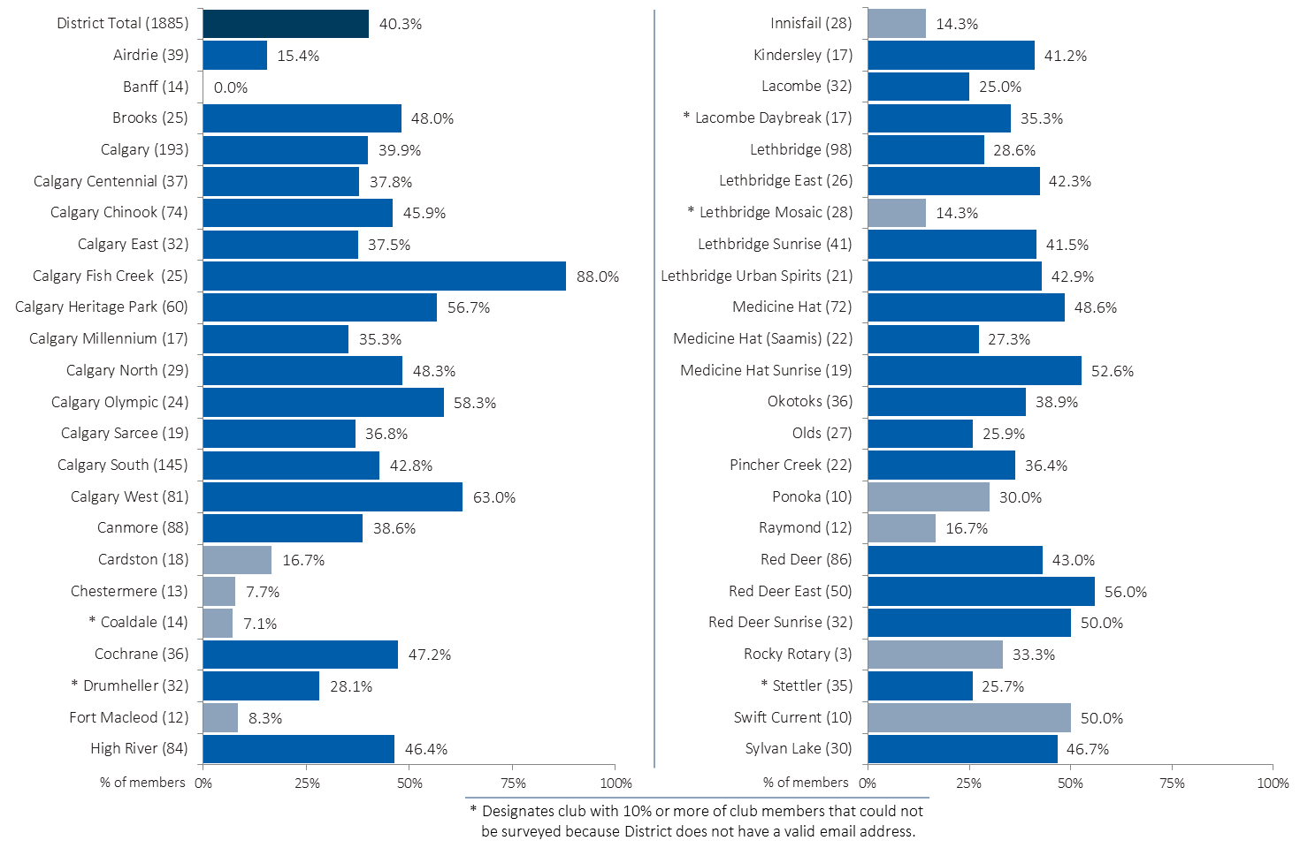
Responses by Club
Base = (members)
40.3% of Rotarians responded.
Base = (members)
14 of 37 members
36 of 47 clubs qualify for a club report (6+ responses).

Slide 6
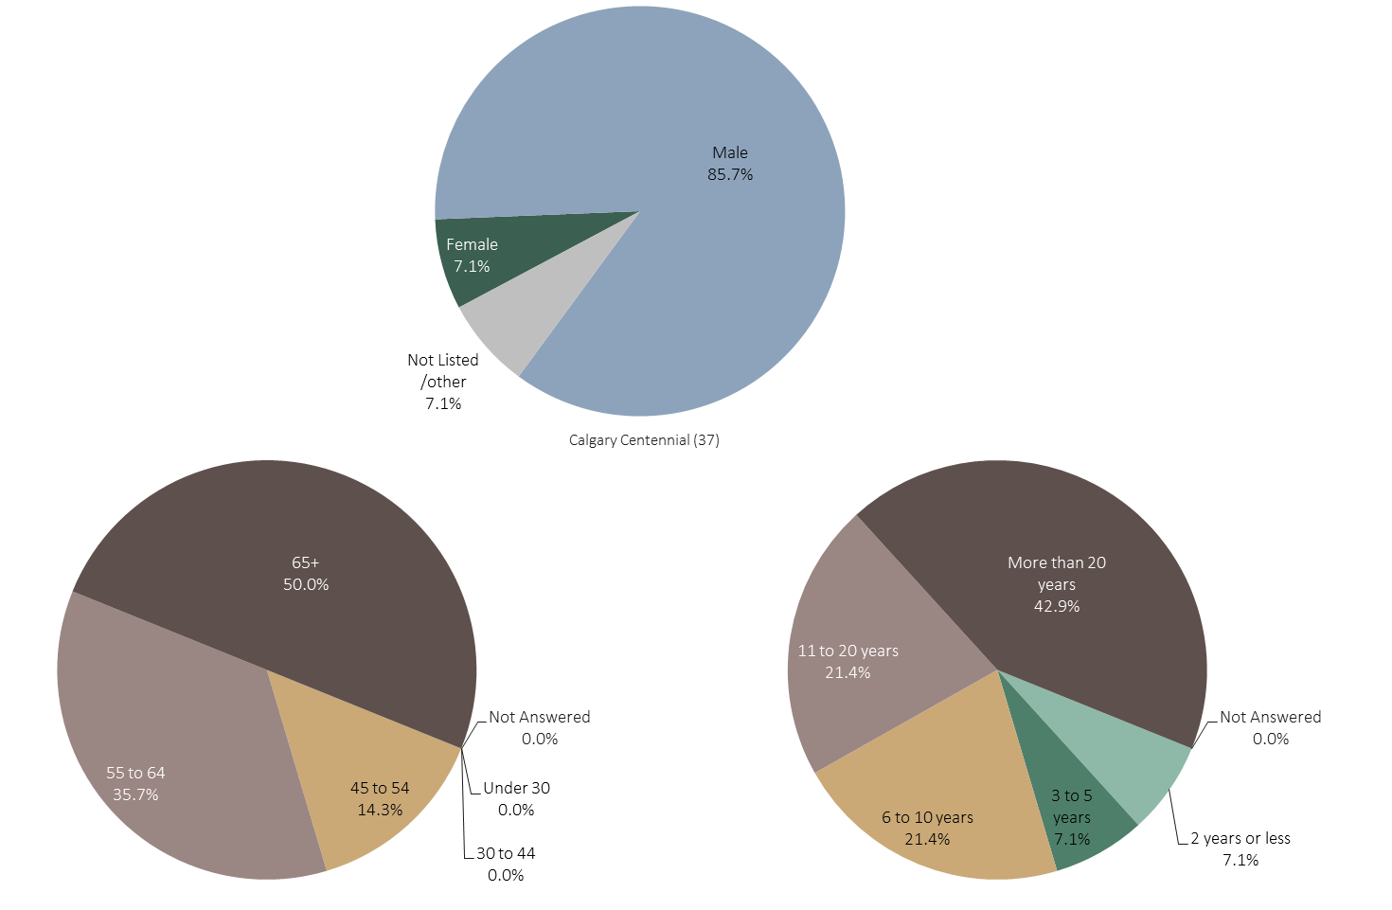
Demographics – Club Survey Respondents
MORE
AGE
TIME IN ROTARY
GENDER
For your club, the chart shows the percent of respondents of each gender, age and years in Rotary, compared to the total district and to groups of similar clubs.
Respondents were asked the following questions:
  “Remembering your answers are confidential, it will help us to analyze the results by knowing…
  To which of the following age groups do you belong?
  What is your gender?”
  How long have you been a member of Rotary (including all clubs and locations)?”
Further analysis across a range of categories can be seen by clicking on the Excel icon while in PowerPoint Normal View (not SlideShow view).
Notes:
For your club, the chart shows the percent of respondents of each gender, age and years in Rotary, compared to the total district and to groups of similar clubs.
Respondents were asked the following questions:
“Remembering your answers are confidential, it will help us to analyze the results by knowing…
To which of the following age groups do you belong?
What is your gender?”
How long have you been a member of Rotary (including all clubs and locations)?
Further analysis across a range of categories can be seen by clicking on the Excel icon while in PowerPoint Normal View (not SlideShow view).

Slide 7
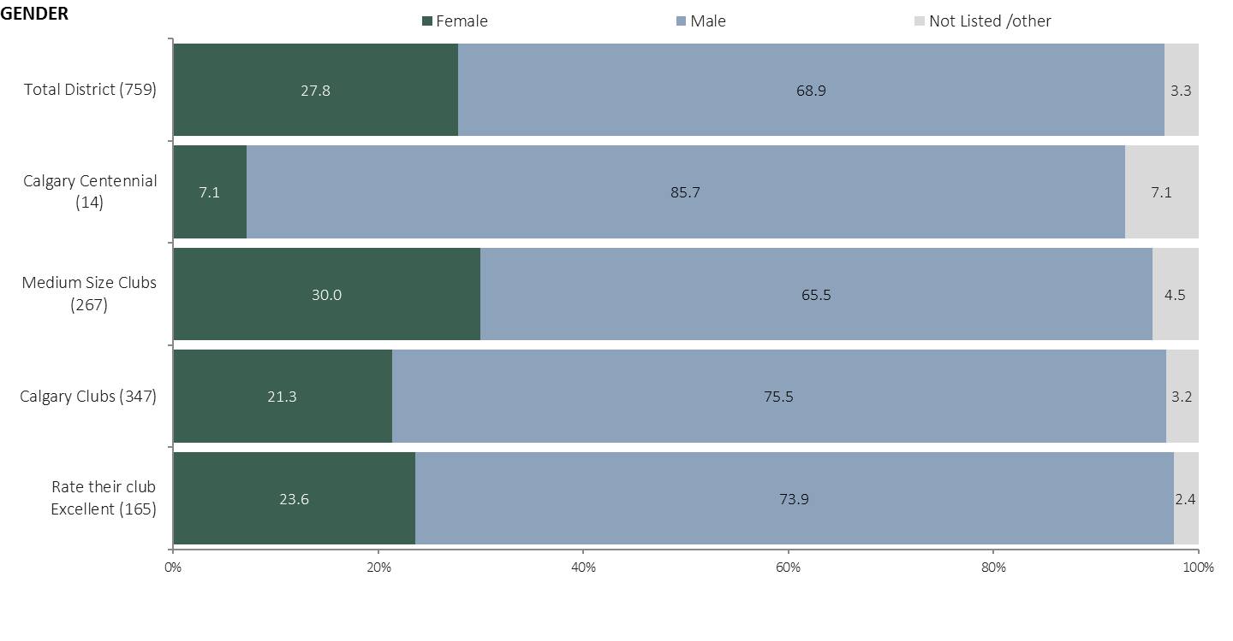
Gender - Compared
MORE
The chart shows the percent of respondents of each gender in your club, compared to the total district and to groups of similar clubs.
Respondents were asked the following questions:
  “Remembering your answers are confidential, it will help us to analyze the results by knowing…
  To which of the following age groups do you belong?
  What is your gender?”
  How long have you been a member of Rotary (including all clubs and locations)?”
Further analysis across a range of categories can be seen by clicking on the Excel icon while in PowerPoint Normal View (not SlideShow view).
Notes:
The chart shows the percent of respondents of each gender in your club, compared to the total district and to groups of similar clubs.
Respondents were asked the following questions:
“Remembering your answers are confidential, it will help us to analyze the results by knowing…
To which of the following age groups do you belong?
What is your gender?”
How long have you been a member of Rotary (including all clubs and locations)?
Further analysis across a range of categories can be seen by clicking on the Excel icon while in PowerPoint Normal View (not SlideShow view).

Slide 8
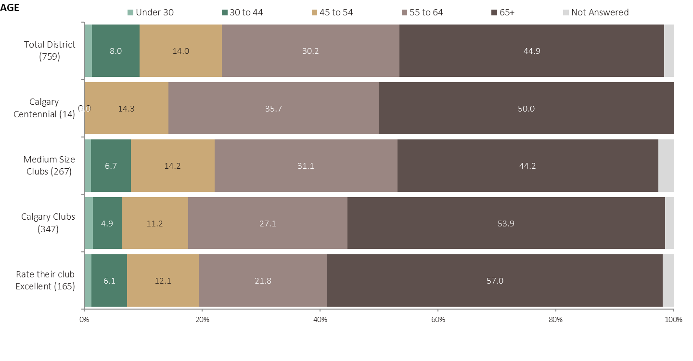
Age - Compared
MORE
Those who rate their club excellent are more likely to be over 65, less likely to be 55-64.
The chart illustrates the percent of respondents from your club in each age category, compared to the total district and to groups of similar clubs.
Respondents were asked the following questions:
  “Remembering your answers are confidential, it will help us to analyze the results by knowing…
  To which of the following age groups do you belong?
  What is your gender?”
  How long have you been a member of Rotary (including all clubs and locations)?”
Further analysis across a range of categories can be seen by clicking on the Excel icon while in PowerPoint Normal View (not SlideShow view).
Notes:
The chart illustrates the percent of respondents from your club in each age category, compared to the total district and to groups of similar clubs.
Respondents were asked the following questions:
“Remembering your answers are confidential, it will help us to analyze the results by knowing…
To which of the following age groups do you belong?
What is your gender?”
How long have you been a member of Rotary (including all clubs and locations)?
Further analysis across a range of categories can be seen by clicking on the Excel icon while in PowerPoint Normal View (not SlideShow view).

Slide 9
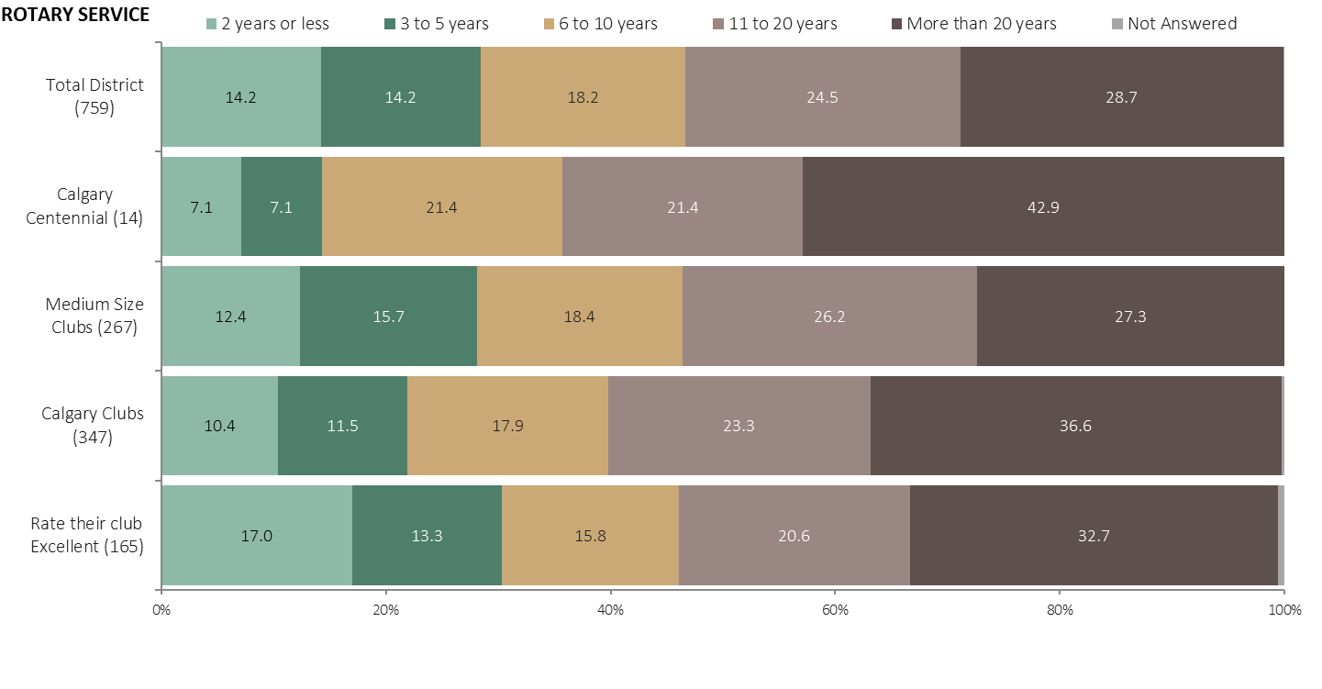
Years of Rotary Service - Compared
The chart illustrates the percent of respondents from your club in each category of Rotary service, compared to the total district and to groups of similar clubs
Respondents were asked the following questions:
  “Remembering your answers are confidential, it will help us to analyze the results by knowing…
  To which of the following age groups do you belong?
  What is your gender?”
  How long have you been a member of Rotary (including all clubs and locations)?”
Further analysis across a range of categories can be seen by clicking on the Excel icon while in PowerPoint Normal View (not SlideShow view).
Notes:
The chart illustrates the percent of respondents from your club in each category of Rotary service, compared to the total district and to groups of similar clubs
Respondents were asked the following questions:
“Remembering your answers are confidential, it will help us to analyze the results by knowing…
To which of the following age groups do you belong?
What is your gender?”
How long have you been a member of Rotary (including all clubs and locations)?
Further analysis across a range of categories can be seen by clicking on the Excel icon while in PowerPoint Normal View (not SlideShow view).

Slide 10
REASONS FOR MEMBERSHIP
Reasons for Joining
Reasons for When Joined
Reasons for Staying

Slide 11
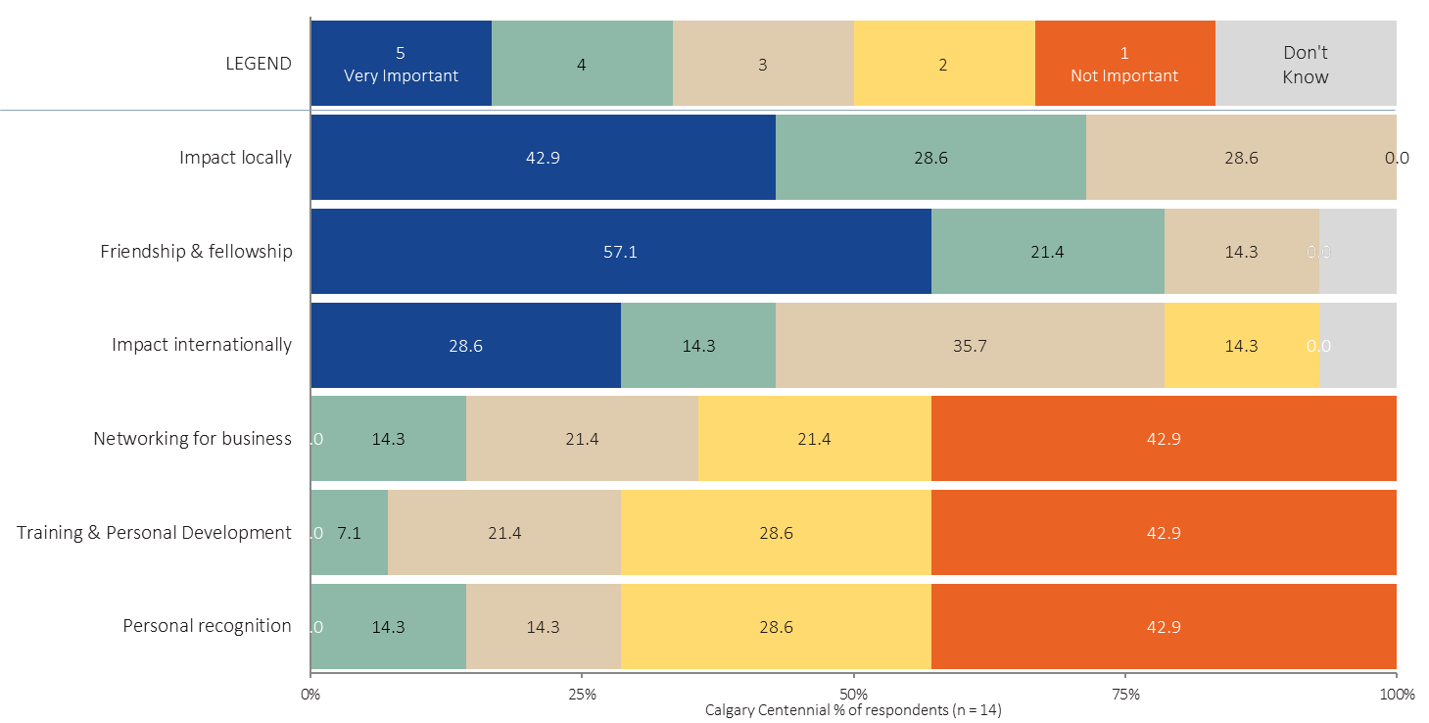
Main Reason for Joining Rotary – Club
MORE
Click to see comments from club members.
For your club, the chart illustrates the importance of six different reasons to join Rotary.
Respondents were asked the following question:
  Using a 5 point scale where 5 means very important and 1 means not important at all, how important were each of the following reasons in your decision to join your first Rotary club?
      Friendship & fellowship
      Impact internationally
      Impact locally
      Networking for business
      Personal recognition
      Training & Personal Development
Further analysis across a range of categories can be seen by clicking on the Excel icon while in PowerPoint Normal View (not SlideShow view).
Notes:
For your club, the chart illustrates the importance of six different reasons to join Rotary.
Respondents were asked the following question:
Using a 5 point scale where 5 means very important and 1 means not important at all, how important were each of the following reasons in your decision to join your first Rotary club?
Friendship & fellowship
Impact internationally
Impact locally
Networking for business
Personal recognition
Training & Personal Development
Further analysis across a range of categories can be seen by clicking on the Excel icon while in PowerPoint Normal View (not SlideShow view).

Slide 12
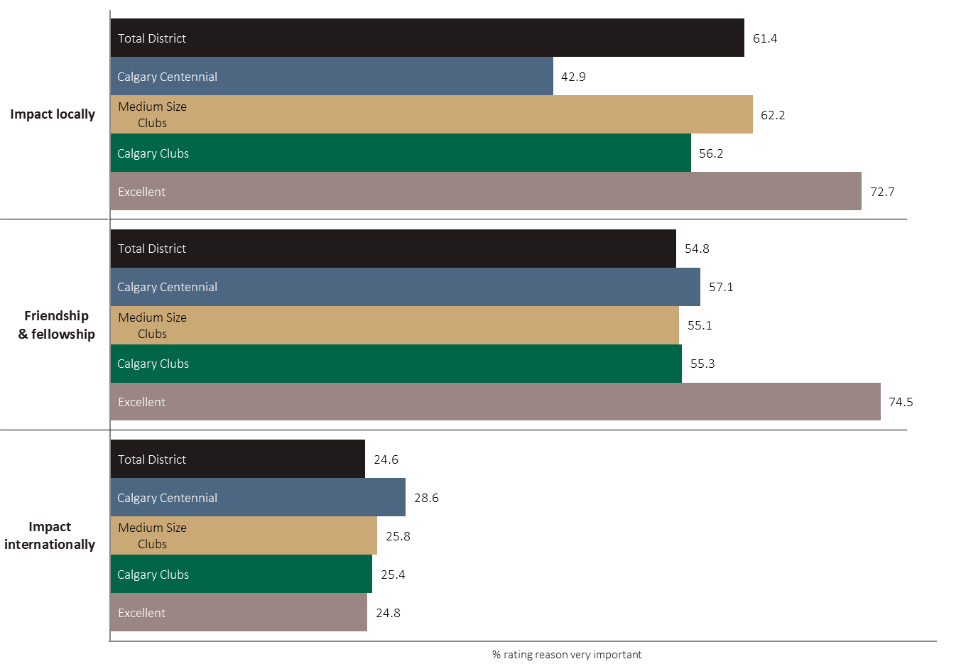
Main Reason for Joining Rotary – Compared
For each of the top reasons for joining Rotary, the chart illustrates the percent rating the reason as very important; comparing your club to the total district and groups of clubs similar to yours.
Respondents were asked the following question:
  Using a 5 point scale where 5 means very important and 1 means not important at all, how important were each of the following reasons in your decision to join your first Rotary club?
      Friendship & fellowship
      Impact internationally
      Impact locally
      Networking for business
      Personal recognition
      Training & Personal Development
Further analysis across a range of categories can be seen by clicking on the Excel icon while in PowerPoint Normal View (not SlideShow view).
Notes:
For each of the top reasons for joining Rotary, the chart illustrates the percent rating the reason as very important; comparing your club to the total district and groups of clubs similar to yours.
Respondents were asked the following question:
Using a 5 point scale where 5 means very important and 1 means not important at all, how important were each of the following reasons in your decision to join your first Rotary club?
Friendship & fellowship
Impact internationally
Impact locally
Networking for business
Personal recognition
Training & Personal Development
Further analysis across a range of categories can be seen by clicking on the Excel icon while in PowerPoint Normal View (not SlideShow view).

Slide 13
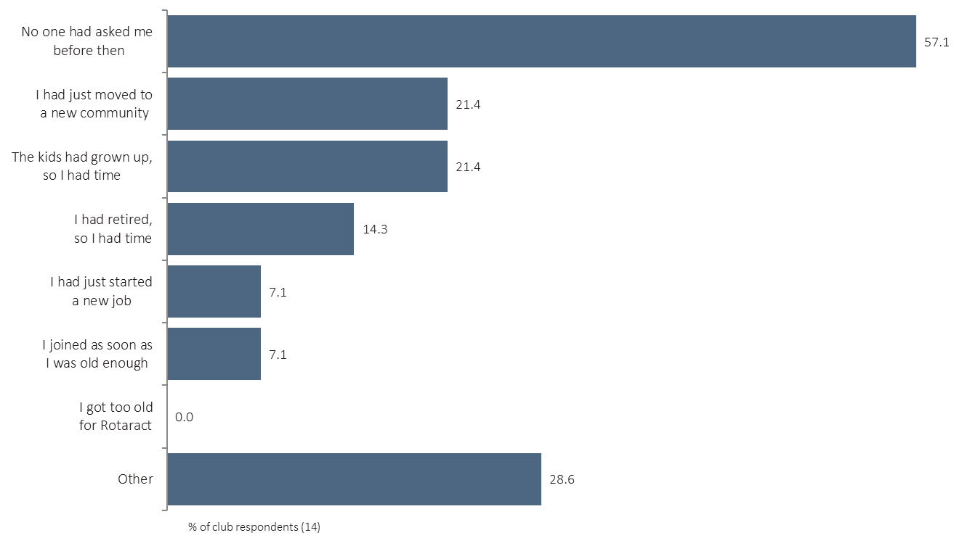
Reasons for Joining Rotary at that time - Club
MORE
Click to see comments from club members.
The chart illustrates why your club’s Rotarians joined when they did.
Respondents were asked the following question:
  Still thinking back to when you first joined a Rotary club, what were the reasons that you joined THEN instead of earlier in your life?
  Please check all that apply.
      I joined as soon as I was old enough
      I got too old for Rotaract
      I had just started a new job
      I had just moved to a new community
      The kids had grown up, so I had time
      I had retired, so I had time
      No one had asked me before then
      Other
Further analysis across a range of categories can be seen by clicking on the Excel icon while in PowerPoint Normal View (not SlideShow view).
Additional comments from club members can be seen by clicking on the Excel icon while in PowerPoint Normal View (not SlideShow view).
Notes:
The chart illustrates why your club’s Rotarians joined when they did.
Respondents were asked the following question:
Still thinking back to when you first joined a Rotary club, what were the reasons that you joined THEN instead of earlier in your life?
Please check all that apply.
I joined as soon as I was old enough
I got too old for Rotaract
I had just started a new job
I had just moved to a new community
The kids had grown up, so I had time
I had retired, so I had time
No one had asked me before then
Other
Further analysis across a range of categories can be seen by clicking on the Excel icon while in PowerPoint Normal View (not SlideShow view).
Additional comments from club members can be seen by clicking on the Excel icon while in PowerPoint Normal View (not SlideShow view).

Slide 14
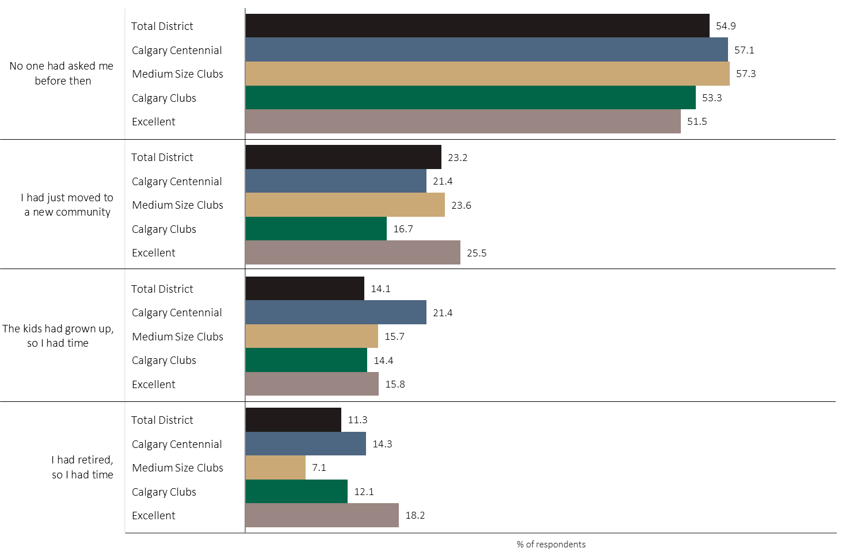
Reasons for Joining Rotary at that time - Compared
The chart illustrates why Rotarians joined when they did, comparing your club to the total district and to similar clubs.
Respondents were asked the following question:
  Still thinking back to when you first joined a Rotary club, what were the reasons that you joined THEN instead of earlier in your life?
  Please check all that apply.
      I joined as soon as I was old enough
      I got too old for Rotaract
      I had just started a new job
      I had just moved to a new community
      The kids had grown up, so I had time
      I had retired, so I had time
      No one had asked me before then
      Other
Further analysis across a range of categories can be seen by clicking on the Excel icon while in PowerPoint Normal View (not SlideShow view).
Notes:
The chart illustrates why Rotarians joined when they did.
Respondents were asked the following question:
Still thinking back to when you first joined a Rotary club, what were the reasons that you joined THEN instead of earlier in your life?
Please check all that apply.
I joined as soon as I was old enough
I got too old for Rotaract
I had just started a new job
I had just moved to a new community
The kids had grown up, so I had time
I had retired, so I had time
No one had asked me before then
Other
Further analysis across a range of categories can be seen by clicking on the Excel icon while in PowerPoint Normal View (not SlideShow view).

Slide 15
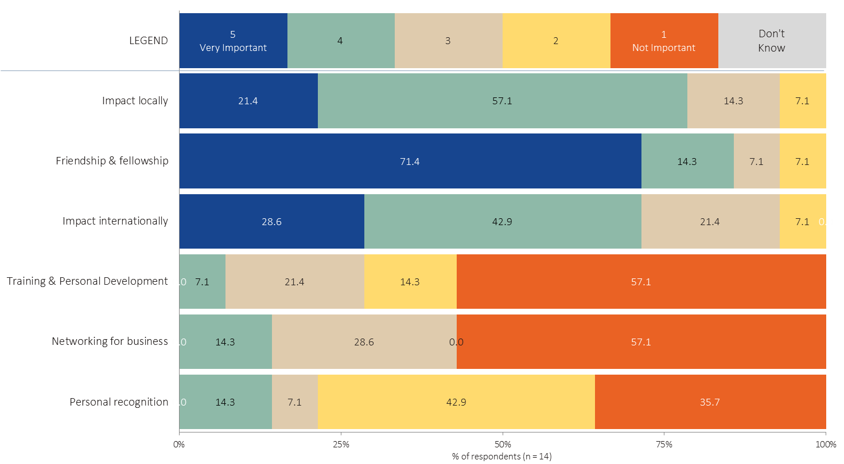
Main Reason for Staying in Rotary – Club
MORE
Click to see comments from club members.
For your club, the chart illustrates the importance of six different reasons for staying in Rotary.
Respondents were asked the following question:
  Using a 5 point scale where 5 means very important and 1 means not important at all, how important are each of the following reasons you stay in Rotary?
      Friendship & fellowship
      Impact internationally
      Impact locally
      Networking for business
      Personal recognition
      Training & Personal Development
Further analysis across a range of categories can be seen by clicking on the Excel icon while in PowerPoint Normal View (not SlideShow view).
Additional comments from club members can be seen by clicking on the Excel icon while in PowerPoint Normal View (not SlideShow view).
Notes:
For your club, the chart illustrates the importance of six different reasons for staying in Rotary.
Respondents were asked the following question:
Using a 5 point scale where 5 means very important and 1 means not important at all, how important are each of the following reasons you stay in Rotary?
Friendship & fellowship
Impact internationally
Impact locally
Networking for business
Personal recognition
Training & Personal Development
Further analysis across a range of categories can be seen by clicking on the Excel icon while in PowerPoint Normal View (not SlideShow view).
Additional comments from club members can be seen by clicking on the Excel icon while in PowerPoint Normal View (not SlideShow view).

Slide 16
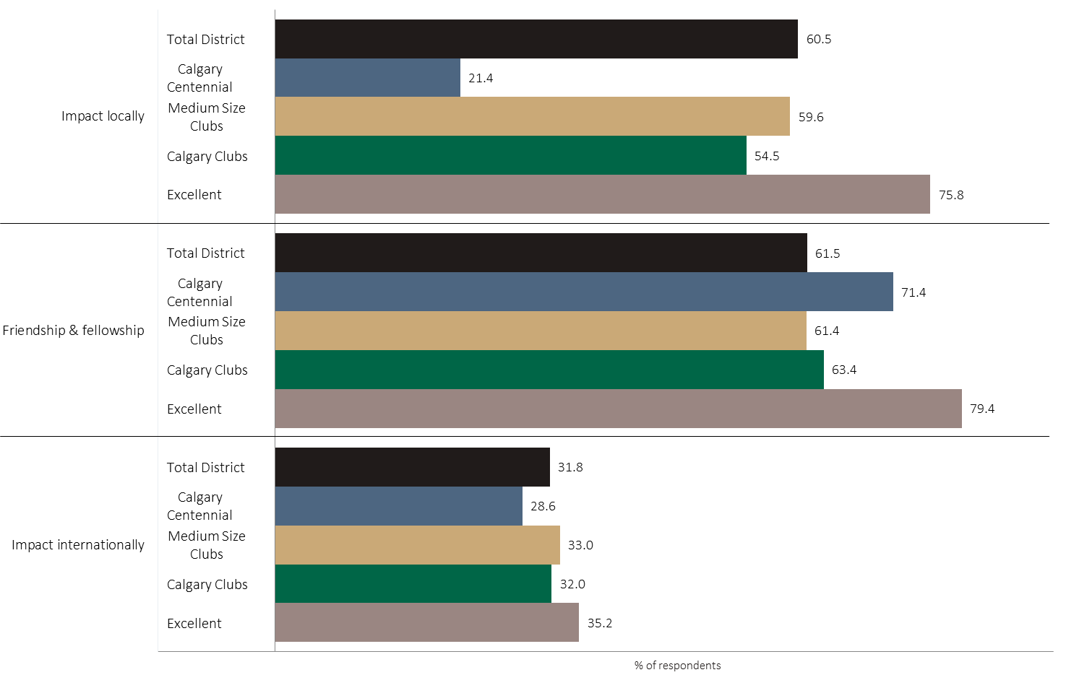
Main Reason for Staying in Rotary - Compared
MORE
For your club, the chart illustrates the importance of six different reasons for staying in Rotary.
Respondents were asked the following question:
  Using a 5 point scale where 5 means very important and 1 means not important at all, how important are each of the following reasons you stay in Rotary?
      Friendship & fellowship
      Impact internationally
      Impact locally
      Networking for business
      Personal recognition
      Training & Personal Development
Further analysis across a range of categories can be seen by clicking on the Excel icon while in PowerPoint Normal View (not SlideShow view).
Notes:
For your club, the chart illustrates the importance of six different reasons for staying in Rotary.
Respondents were asked the following question:
Using a 5 point scale where 5 means very important and 1 means not important at all, how important are each of the following reasons you stay in Rotary?
Friendship & fellowship
Impact internationally
Impact locally
Networking for business
Personal recognition
Training & Personal Development
Further analysis across a range of categories can be seen by clicking on the Excel icon while in PowerPoint Normal View (not SlideShow view).

Slide 17
ENGAGEMENT
Rotary Roles
Engagement - District
Engagement - Club
Preferred Engagement
Self Assessment of
Role in the Club

Slide 18
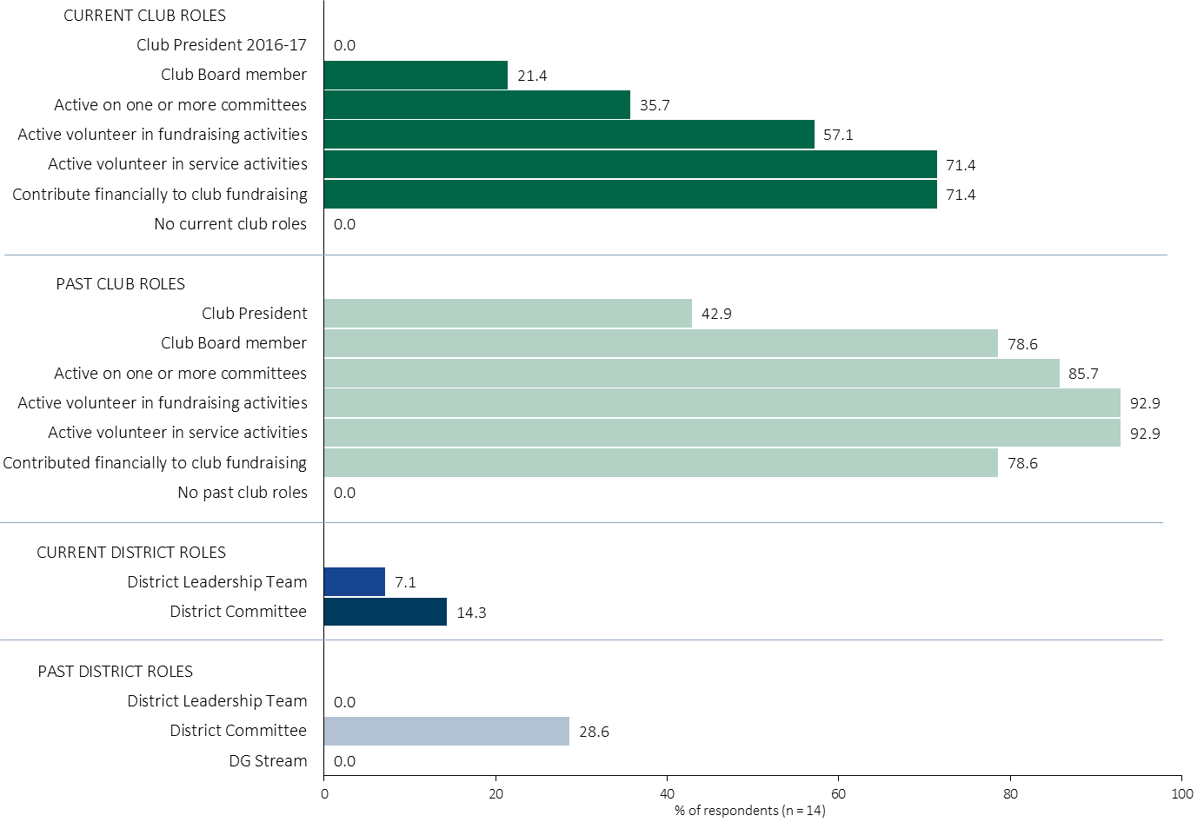
Rotary Roles - Club
For your club, the chart illustrates the percent of total respondents in each type of Rotary role: club and district, current and past.
Respondents were asked the following questions:
  What roles, if any, do you CURRENTLY hold in your Rotary club? Please check all that apply.
  What roles, if any, have you EVER held in any Rotary club? Please check all that apply.
      Club President
      President Elect
      Club Board member
      Active on one or more committees
      Active volunteer in fundraising activities
      Active volunteer in service activities
      Contribute financially to club fundraising
  What roles, if any, do you CURRENTLY hold at the DISTRICT level? Please check all that apply.
      District Leadership Team (District Chairperson or AG)
      District committee member
  What roles, if any, have you EVER held at the DISTRICT level? Please check all that apply.
      District Leadership Team (District Chairperson or AG)
      District committee member
      District Governor stream (DG, PDG, DGE, DGN, DGND)
Further analysis across a range of categories can be seen by clicking on the Excel icon while in PowerPoint Normal View (not SlideShow view).
Notes:
For your club, the chart illustrates the percent of total respondents in each type of Rotary role: club and district, current and past.
Respondents were asked the following questions:
What roles, if any, do you CURRENTLY hold in your Rotary club? Please check all that apply.
What roles, if any, have you EVER held in any Rotary club? Please check all that apply.
Club President
President Elect
Club Board member
Active on one or more committees
Active volunteer in fundraising activities
Active volunteer in service activities
Contribute financially to club fundraising
What roles, if any, do you CURRENTLY hold at the DISTRICT level? Please check all that apply.
District Leadership Team (District Chairperson or AG)
District committee member
What roles, if any, have you EVER held at the DISTRICT level? Please check all that apply.
District Leadership Team (District Chairperson or AG)
District committee member
District Governor stream (DG, PDG, DGE, DGN, DGND)
Further analysis across a range of categories can be seen by clicking on the Excel icon while in PowerPoint Normal View (not SlideShow view).

Slide 19
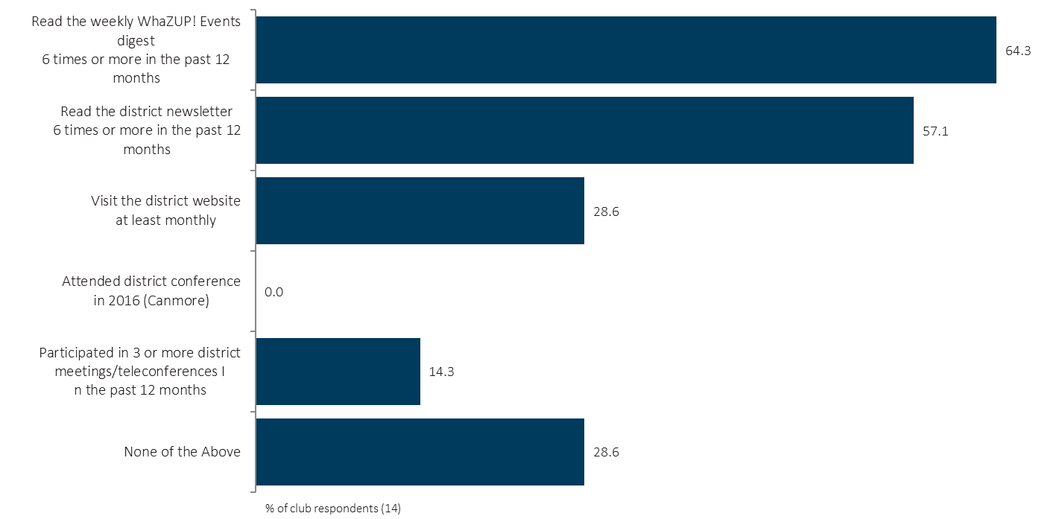
Engagement in District Initiatives – Club
MORE
The chart illustrates the percent of club respondents who participated in each type of district initiative.
Respondents were asked the following question:
    Which of the following apply to you? Please check all that apply.
    Have you -
      Attended district assembly/conference in 2016 (Canmore)
      Participated in 3 or more district meetings/teleconferences in the past 12 months
      Read the district newsletter 6 times or more in the past 12 months
      Read the weekly WhaZUP! Events digest 6 times or more in the past 12 months
      Visit the district website at least monthly
Further analysis across a range of categories can be seen by clicking on the Excel icon while in PowerPoint Normal View (not SlideShow view).
Notes:
The chart illustrates the percent of club respondents who participated in each type of district initiative.
Respondents were asked the following question:
Which of the following apply to you? Please check all that apply.
Have You -
Attended district assembly/conference in 2016 (Canmore)
Participated in 3 or more district meetings/teleconferences in the past 12 months
Read the district newsletter 6 times or more in the past 12 months
Read the weekly WhaZUP! Events digest 6 times or more in the past 12 months
Visit the district website at least monthly
Further analysis across a range of categories can be seen by clicking on the Excel icon while in PowerPoint Normal View (not SlideShow view).

Slide 20
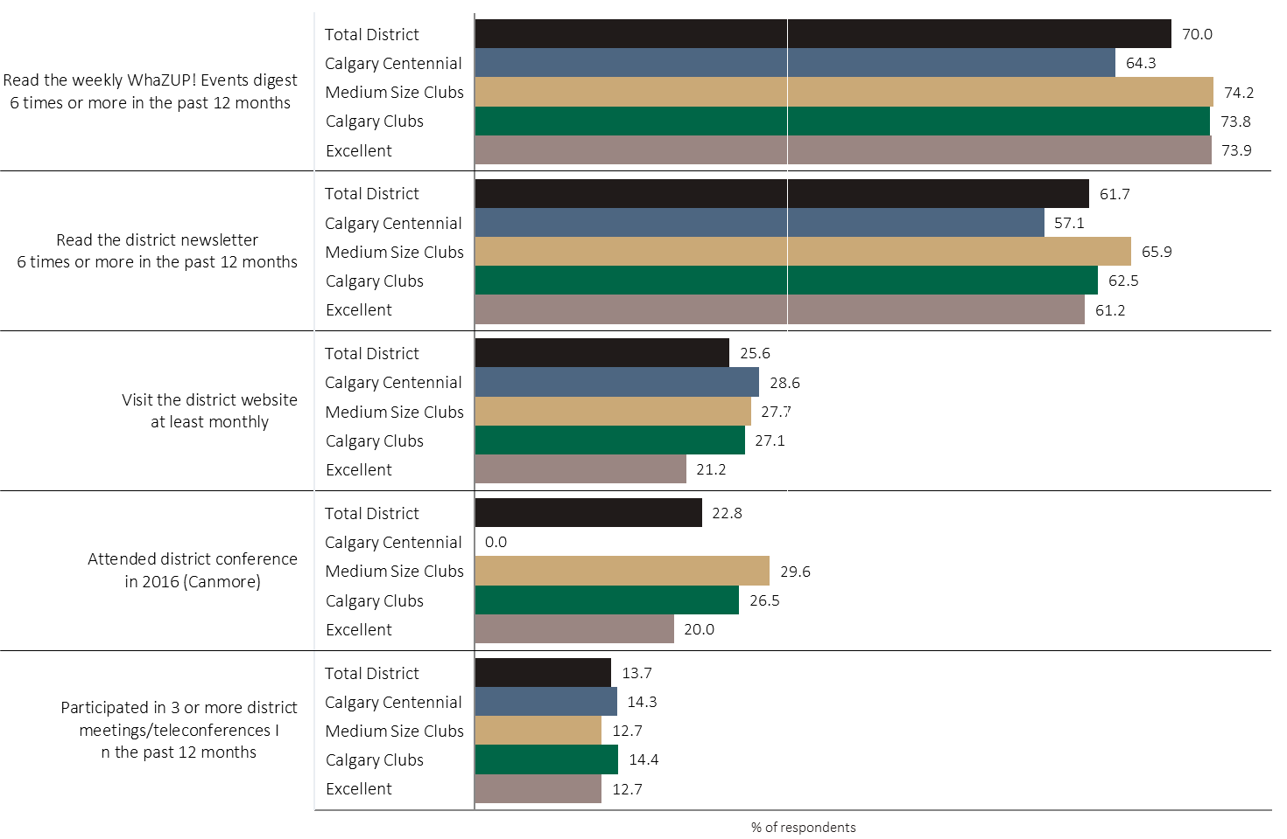
Engagement in District Initiatives - Compared
The chart illustrates the percent of club respondents who participated in each type of district initiative, in comparison to the district average and other club groups.
Respondents were asked the following question:
    Which of the following apply to you? Please check all that apply.
    Have you -
      Attended district assembly/conference in 2016 (Canmore)
      Participated in 3 or more district meetings/teleconferences in the past 12 months
      Read the district newsletter 6 times or more in the past 12 months
      Read the weekly WhaZUP! Events digest 6 times or more in the past 12 months
      Visit the district website at least monthly
Further analysis across a range of categories can be seen by clicking on the Excel icon while in PowerPoint Normal View (not SlideShow view).
Notes:
The chart illustrates the percent of club respondents who participated in each type of district initiative, in comparison to the district average and other club groups.
Respondents were asked the following question:
Which of the following apply to you? Please check all that apply.
Have You -
Attended district assembly/conference in 2016 (Canmore)
Participated in 3 or more district meetings/teleconferences in the past 12 months
Read the district newsletter 6 times or more in the past 12 months
Read the weekly WhaZUP! Events digest 6 times or more in the past 12 months
Visit the district website at least monthly
Further analysis across a range of categories can be seen by clicking on the Excel icon while in PowerPoint Normal View (not SlideShow view).

Slide 21
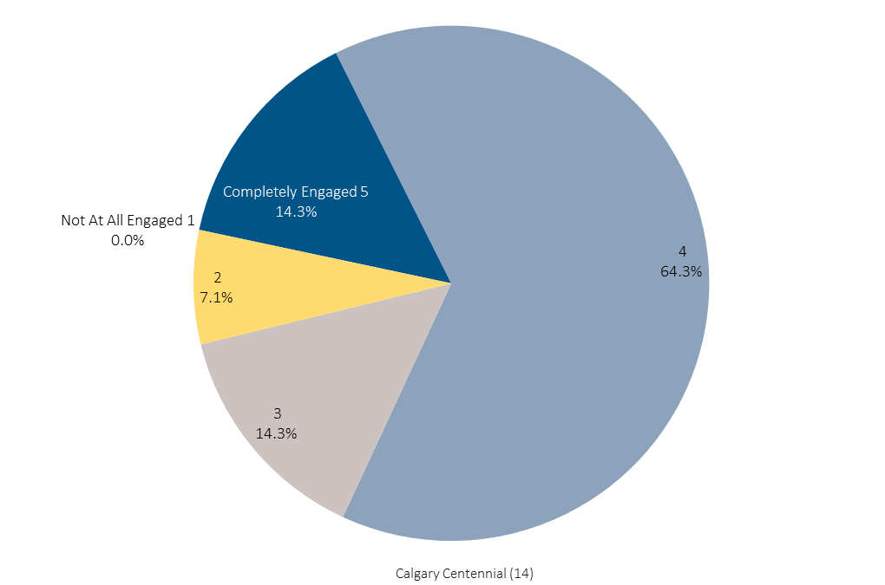
Engagement in Club Activities & Work – Club
MORE
The chart illustrates the level of engagement among Rotarians.
Respondents were asked the following question:
    Using a 5 point scale where 5 means completely engaged and 1 means not engaged at all, how would you rate your level of engagement in the activities and work of your Rotary club?
      5 – Completely Engaged
      4
      3
      2
      1 – Not Engaged At All
      Don’t Know
Further analysis across a range of categories can be seen by clicking on the Excel icon while in PowerPoint Normal View (not SlideShow view).
Notes:
The chart illustrates the level of engagement among Rotarians.
Respondents were asked the following question:
Using a 5 point scale where 5 means completely engaged and 1 means not engaged at all, how would you rate your level of engagement in the activities and work of your Rotary club?
5 – Completely Engaged
4
3
2
1 – Not Engaged At All
Don’t Know
Further analysis across a range of categories can be seen by clicking on the Excel icon while in PowerPoint Normal View (not SlideShow view).

Slide 22
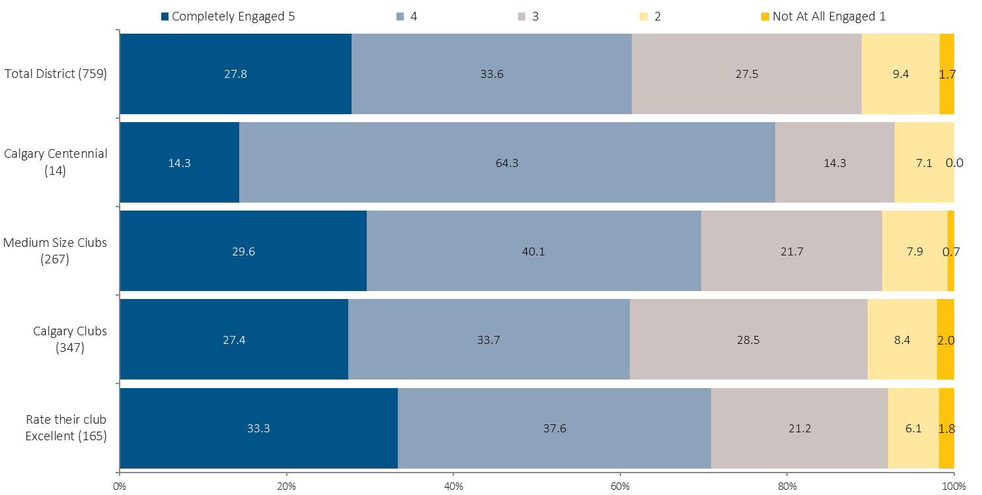
Engagement in Club Activities & Work - Compared
The chart illustrates the level of engagement among Rotarians.
Respondents were asked the following question:
    Using a 5 point scale where 5 means completely engaged and 1 means not engaged at all, how would you rate your level of engagement in the activities and work of your Rotary club?
      5 – Completely Engaged
      4
      3
      2
      1 – Not Engaged At All
      Don’t Know
Further analysis across a range of categories can be seen by clicking on the Excel icon while in PowerPoint Normal View (not SlideShow view).
Notes:
The chart illustrates the level of engagement among Rotarians.
Respondents were asked the following question:
Using a 5 point scale where 5 means completely engaged and 1 means not engaged at all, how would you rate your level of engagement in the activities and work of your Rotary club?
5 – Completely Engaged
4
3
2
1 – Not Engaged At All
Don’t Know
Further analysis across a range of categories can be seen by clicking on the Excel icon while in PowerPoint Normal View (not SlideShow view).

Slide 23
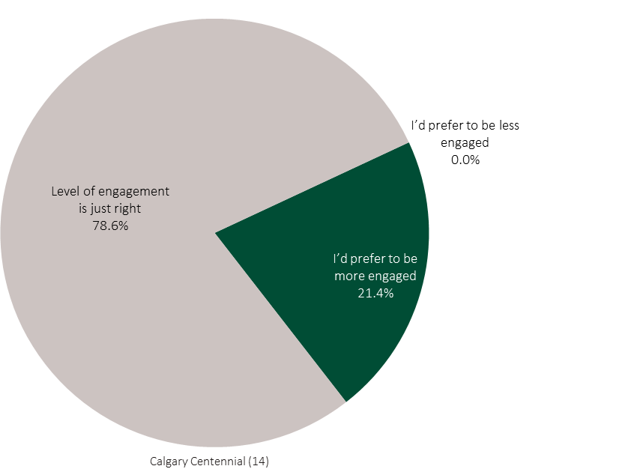
Preference for Level of Engagement – Club
MORE
Click to see comments
from club members.
The chart illustrates the preferred level of engagement among Rotarians, compared to their current engagement.
Respondents were asked the following question:
    Is your level of engagement in your club’s activities and work less than you’d prefer, more than you’d prefer, or just right for you right now? Check one.
      5 – Completely Engaged
      4
      3
      2
      1 – Not Engaged At All
      Don’t Know
Further analysis across a range of categories can be seen by clicking on the Excel icon while in PowerPoint Normal View (not SlideShow view).
Notes:
The chart illustrates the preferred level of engagement among Rotarians, compared to their current engagement.
Respondents were asked the following question:
Is your level of engagement in your club’s activities and work less than you’d prefer, more than you’d prefer, or just right for you right now? Check one.
5 – Completely Engaged
4
3
2
1 – Not Engaged At All
Don’t Know
Further analysis across a range of categories can be seen by clicking on the Excel icon while in PowerPoint Normal View (not SlideShow view).

Slide 24
Preference for Level of Engagement - Compared
The chart illustrates the preferred level of engagement among Rotarians, compared to their current engagement.
Respondents were asked the following question:
    Is your level of engagement in your club’s activities and work less than you’d prefer, more than you’d prefer, or just right for you right now? Check one.
      5 – Completely Engaged
      4
      3
      2
      1 – Not Engaged At All
      Don’t Know
Further analysis across a range of categories can be seen by clicking on the Excel icon while in PowerPoint Normal View (not SlideShow view).
Notes:
The chart illustrates the preferred level of engagement among Rotarians, compared to their current engagement.
Respondents were asked the following question:
Is your level of engagement in your club’s activities and work less than you’d prefer, more than you’d prefer, or just right for you right now? Check one.
5 – Completely Engaged
4
3
2
1 – Not Engaged At All
Don’t Know
Further analysis across a range of categories can be seen by clicking on the Excel icon while in PowerPoint Normal View (not SlideShow view).

Slide 25
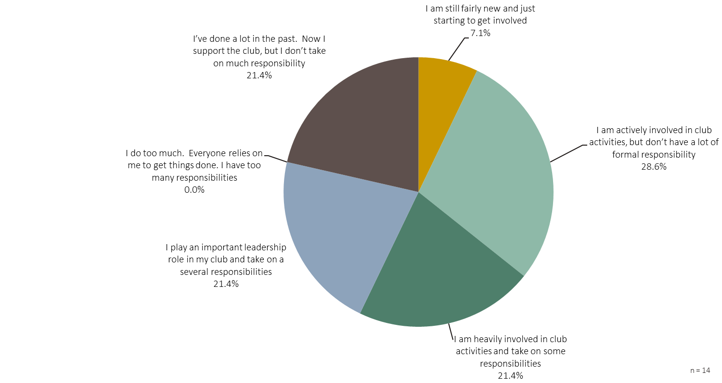
Self Assessment of Role in Club – Club
MORE
29%
PASSIVE
21%
LEADERS
50%
DOERS
The chart illustrates the Rotarian’s self assessment of the role they play in their club.
Respondents were asked the following question:
    Regardless of what positions you may hold, please choose which statement best fits how you see your CURRENT role in your club. Please select one statement.
      I am still fairly new and just starting to get involved
      I am actively involved in club activities, but don’t have a lot of formal responsibility
      I am heavily involved in club activities and take on some responsibilities
      I play an important leadership role in my club and take on a several responsibilities
      I do too much. Everyone relies on me to get things done. I have too many responsibilities
      I’ve done a lot in the past. Now I support the club, but I don’t take on much responsibility
Further analysis across a range of categories can be seen by clicking on the Excel icon while in PowerPoint Normal View (not SlideShow view).
Notes:
The chart illustrates the Rotarian’s self assessment of the role they play in their club.
Respondents were asked the following question:
Regardless of what positions you may hold, please choose which statement best fits how you see your CURRENT role in your club. Please select one statement.
I am still fairly new and just starting to get involved
I am actively involved in club activities, but don’t have a lot of formal responsibility
I am heavily involved in club activities and take on some responsibilities
I play an important leadership role in my club and take on a several responsibilities
I do too much. Everyone relies on me to get things done. I have too many responsibilities
I’ve done a lot in the past. Now I support the club, but I don’t take on much responsibility
Further analysis across a range of categories can be seen by clicking on the Excel icon while in PowerPoint Normal View (not SlideShow view).

Slide 26
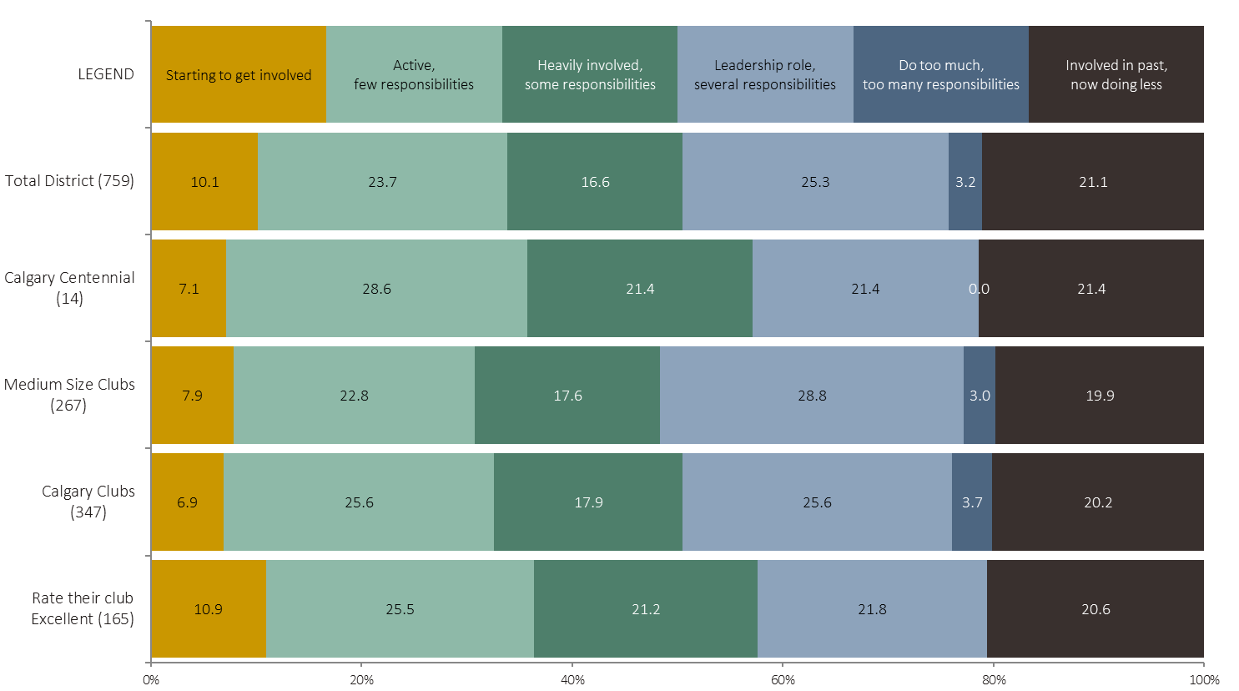
Self Assessment of Role in Club - Compared
PASSIVE
DOERS
LEADERS
PASSIVE
The chart illustrates the Rotarian’s self assessment of the role they play in their club.
Respondents were asked the following question:
    Regardless of what positions you may hold, please choose which statement best fits how you see your CURRENT role in your club. Please select one statement.
      I am still fairly new and just starting to get involved
      I am actively involved in club activities, but don’t have a lot of formal responsibility
      I am heavily involved in club activities and take on some responsibilities
      I play an important leadership role in my club and take on a several responsibilities
      I do too much. Everyone relies on me to get things done. I have too many responsibilities
      I’ve done a lot in the past. Now I support the club, but I don’t take on much responsibility
Further analysis across a range of categories can be seen by clicking on the Excel icon while in PowerPoint Normal View (not SlideShow view).
Notes:
The chart illustrates the Rotarian’s self assessment of the role they play in their club.
Respondents were asked the following question:
Regardless of what positions you may hold, please choose which statement best fits how you see your CURRENT role in your club. Please select one statement.
I am still fairly new and just starting to get involved
I am actively involved in club activities, but don’t have a lot of formal responsibility
I am heavily involved in club activities and take on some responsibilities
I play an important leadership role in my club and take on a several responsibilities
I do too much. Everyone relies on me to get things done. I have too many responsibilities
I’ve done a lot in the past. Now I support the club, but I don’t take on much responsibility
Further analysis across a range of categories can be seen by clicking on the Excel icon while in PowerPoint Normal View (not SlideShow view).

Slide 27
CLUB PERFORMANCE
Club Performance Ratings
Preferred
Areas of Service
Preferred
Rotary Programs
Other Issues
Open End

Slide 28
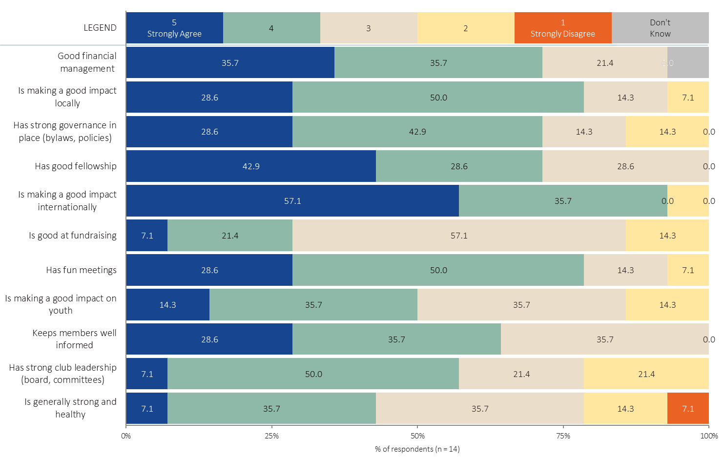
Club Performance Ratings
MORE
The chart illustrates how Rotarians rate their clubs across many different criteria. Items are sorted from the highest to lowest rated overall.
Respondents were asked the following question:
  Using a 5 point scale where 5 means Strongly Agree and 1 means Strongly Disagree, please rate your club on the following:
    23 statements were presented, divided across three screens to be more manageable.
Further analysis across a range of categories can be seen by clicking on the Excel icon while in PowerPoint Normal View (not SlideShow view).
Notes:
The chart illustrates how Rotarians rate their clubs across many different criteria. Items are sorted from the highest to lowest rated overall.
Respondents were asked the following question:
Using a 5 point scale where 5 means Strongly Agree and 1 means Strongly Disagree, please rate your club on the following:
23 statements were presented, divided across three screens to be more manageable.
Further analysis across a range of categories can be seen by clicking on the Excel icon while in PowerPoint Normal View (not SlideShow view).

Slide 29
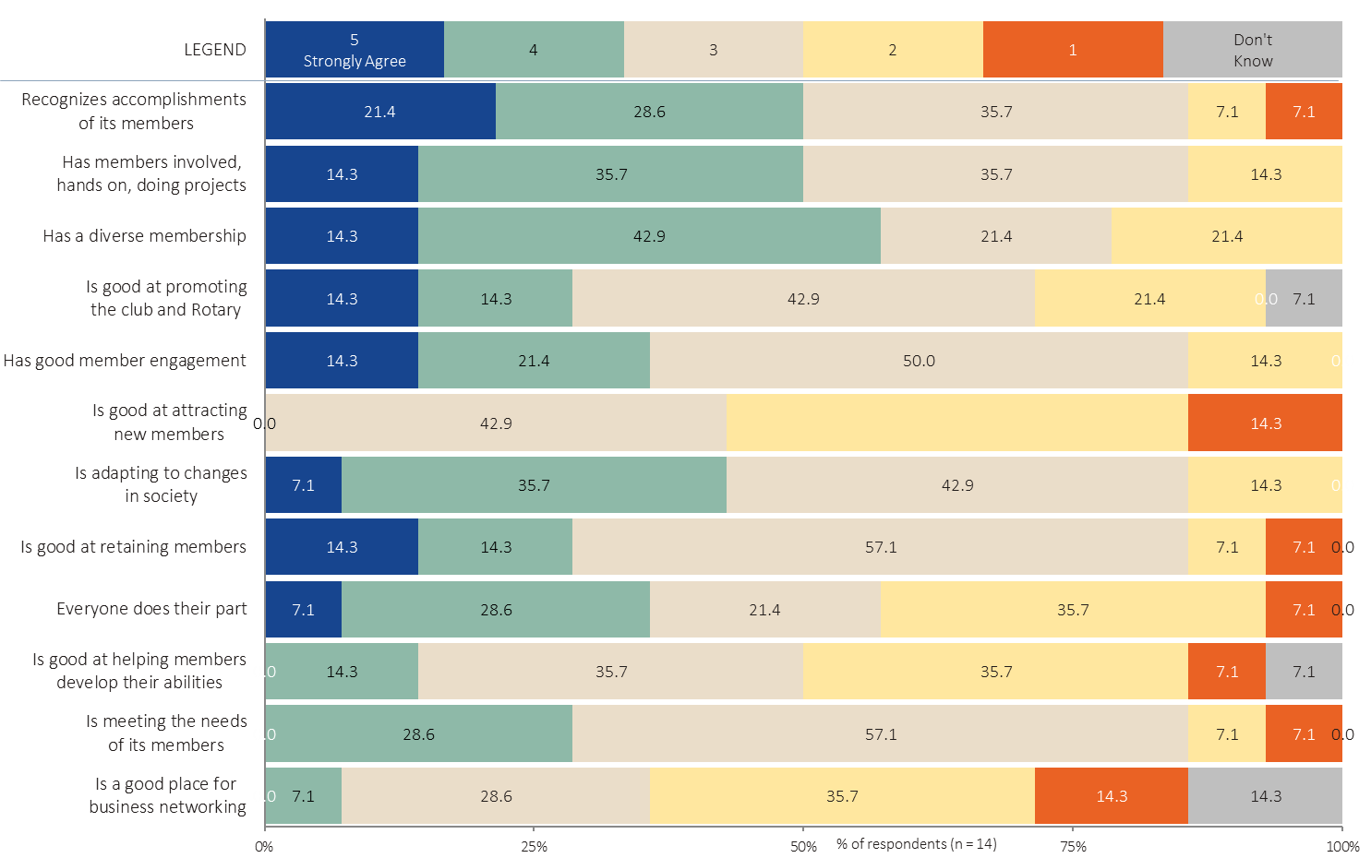
Club Performance Ratings
Click to see comments from club members:
The chart illustrates how Rotarians rate their clubs across many different criteria. Items are sorted from the highest to lowest rated overall.
Respondents were asked the following question:
  Using a 5 point scale where 5 means Strongly Agree and 1 means Strongly Disagree, please rate your club on the following:
    23 statements were presented, divided across three screens to be more manageable.
Further analysis across a range of categories can be seen by clicking on the Excel icon while in PowerPoint Normal View (not SlideShow view).
Notes:
The chart illustrates how Rotarians rate their clubs across many different criteria. Items are sorted from the highest to lowest rated overall.
Respondents were asked the following question:
Using a 5 point scale where 5 means Strongly Agree and 1 means Strongly Disagree, please rate your club on the following:
23 statements were presented, divided across three screens to be more manageable.
Further analysis across a range of categories can be seen by clicking on the Excel icon while in PowerPoint Normal View (not SlideShow view).

Slide 30
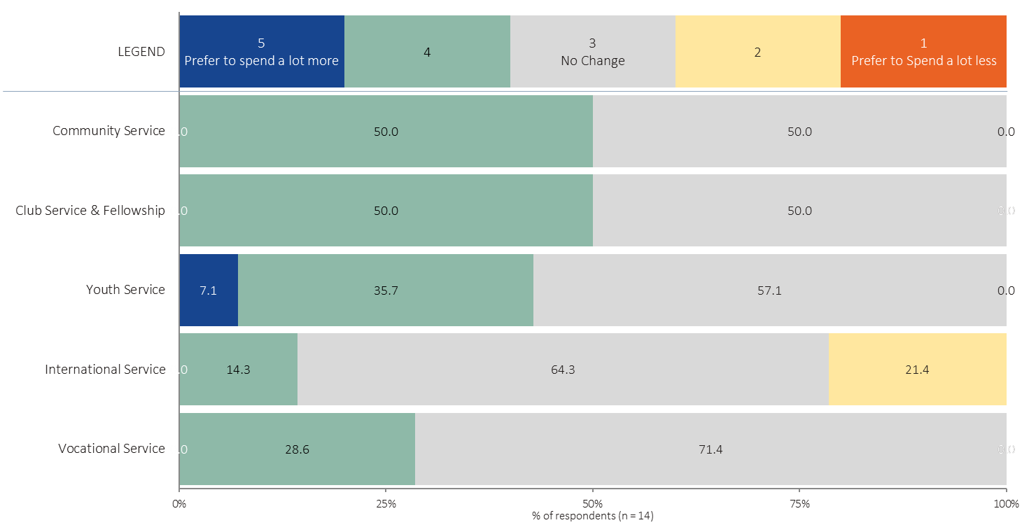
Preferred Club Spending by Area of Service
The chart illustrates preference for club spending by area of service.
Respondents were asked the following question:
  Without getting into the specific numbers, but comparing to your sense of what the club is doing, for each of the following areas of Rotary service, would you prefer your club spend more or less than they are this year?
  Of course, we’d all like to spend more on everything, but for the purpose of understanding how your preferences align with the club, please assume the total amount of spending is fixed.
  If you are fine with the club’s spending priorities, or if you don’t know, select “No Change”.
For each of five areas of service they could choose to “Prefer to spend a lot more”, “Prefer to spend a little more”, “No Change”, “Prefer to spend a little less” or “Prefer to spend a lot less”.
Further analysis across a range of categories can be seen by clicking on the Excel icon while in PowerPoint Normal View (not SlideShow view).
Notes:
The chart illustrates preference for club spending by area of service.
Respondents were asked the following question:
Without getting into the specific numbers, but comparing to your sense of what the club is doing, for each of the following areas of Rotary service, would you prefer your club spend more or less than they are this year?
Of course, we’d all like to spend more on everything, but for the purpose of understanding how your preferences align with the club, please assume the total amount of spending is fixed.
If you are fine with the club’s spending priorities, or if you don’t know, select “No Change”.
For each of five areas of service they could choose to “Prefer to spend a lot more”, “Prefer to spend a little more”, “No Change”, “Prefer to spend a little less” or “Prefer to spend a lot less”.
Further analysis across a range of categories can be seen by clicking on the Excel icon while in PowerPoint Normal View (not SlideShow view).

Slide 31
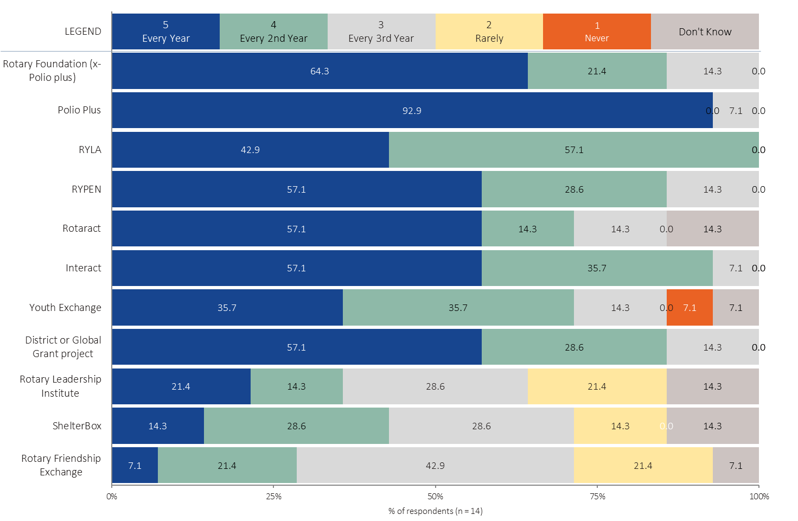
Preferred Club Support/Participation – Rotary Programs
The chart illustrates preference for club support/participation in Rotary programs.
Respondents were asked the following question:
    There are several programs available to all clubs in Rotary. Using a 5 point scale, where 5 means you believe your club should support the program every year, and 1 means you believe your club should never support the program, please rate the following:
Eleven Rotary programs were listed, with the option to prefer club participation every year, every 2nd year, every 3rd year, rarely or never.
Further analysis across a range of categories can be seen by clicking on the Excel icon while in PowerPoint Normal View (not SlideShow view).
Notes:
The chart illustrates preference for club support/participation in Rotary programs.
Respondents were asked the following question:
There are several programs available to all clubs in Rotary. Using a 5 point scale, where 5 means you believe your club should support the program every year, and 1 means you believe your club should never support the program, please rate the following:
Eleven Rotary programs were listed, with the option to prefer club participation every year, every 2nd year, every 3rd year, rarely or never.
Further analysis across a range of categories can be seen by clicking on the Excel icon while in PowerPoint Normal View (not SlideShow view).

Slide 32
Other Comments from your club – Open End
MORE
Have we missed any issues that you believe are important to the future of Rotary?
What do you consider to be the biggest challenge(s) facing your Rotary club in the next three years?
What do you see as the most important thing District 5360 leadership can do to help you and/or your club?
Any final comments?

Slide 33
CLUB FUNDRAISING
Types
Preferred Amount
Club Limitations
Fundraising Attitudes

Slide 34
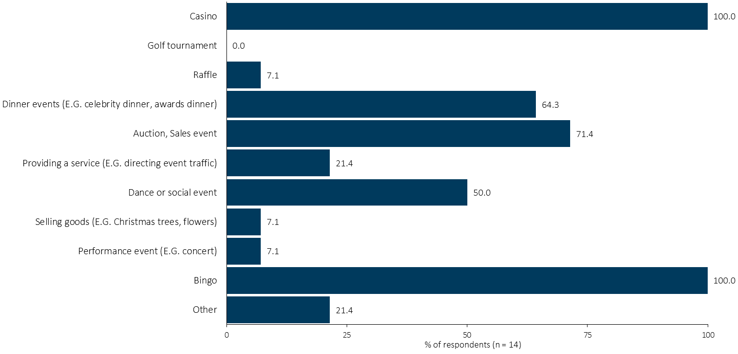
Types of Club Fundraising
The chart illustrates the types of fundraising that clubs do.
Respondents were asked the following question:
  What types of fundraising does your club do most years? Please check all that apply.
  10 types were listed and respondents could make additions under “Other”.
Further analysis across a range of categories can be seen by clicking on the Excel icon while in PowerPoint Normal View (not SlideShow view).
Notes:
The chart illustrates the types of fundraising that clubs do.
Respondents were asked the following question:
What types of fundraising does your club do most years? Please check all that apply.
10 types were listed and respondents could make additions under “Other”.
Further analysis across a range of categories can be seen by clicking on the Excel icon while in PowerPoint Normal View (not SlideShow view).

Slide 35
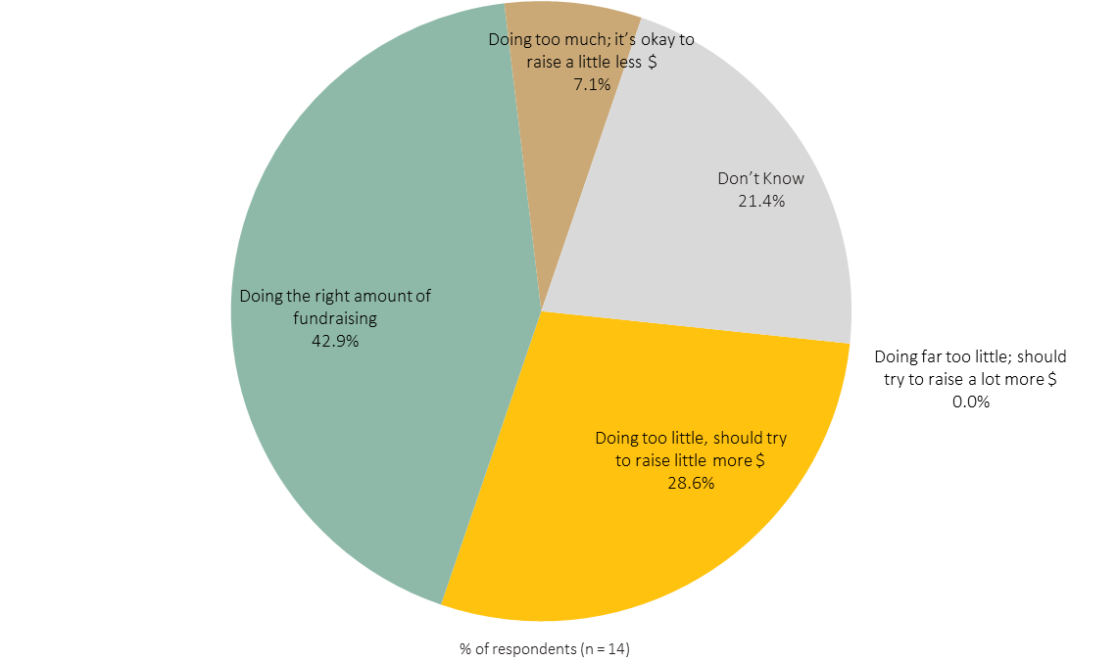
Amount of Club Fundraising
Many are content with current fundraising
The chart illustrates the how Rotarians rate the amount of fundraising their clubs do.
Respondents were asked the following question:
    In this Rotary year, is your club doing what it should to raise funds? Should it be trying to do more? Or is the club trying to do too much? Please check one.
        Doing far too little; should try to raise a lot more $
        Doing too little, should try to raise little more $
        Doing the right amount of fundraising
        Doing too much; it’s okay to raise a little less $
        Doing far too much; it’s okay to raise a lot less $
        Don’t Know
Further analysis across a range of categories can be seen by clicking on the Excel icon while in PowerPoint Normal View (not SlideShow view).
Notes:
The chart illustrates the how Rotarians rate the amount of fundraising their clubs do.
Respondents were asked the following question:
In this Rotary year, is your club doing what it should to raise funds? Should it be trying to do more? Or is the club trying to do too much? Please check one.
Doing far too little; should try to raise a lot more $
Doing too little, should try to raise little more $
Doing the right amount of fundraising
Doing too much; it’s okay to raise a little less $
Doing far too much; it’s okay to raise a lot less $
Don’t Know
Further analysis across a range of categories can be seen by clicking on the Excel icon while in PowerPoint Normal View (not SlideShow view).

Slide 36
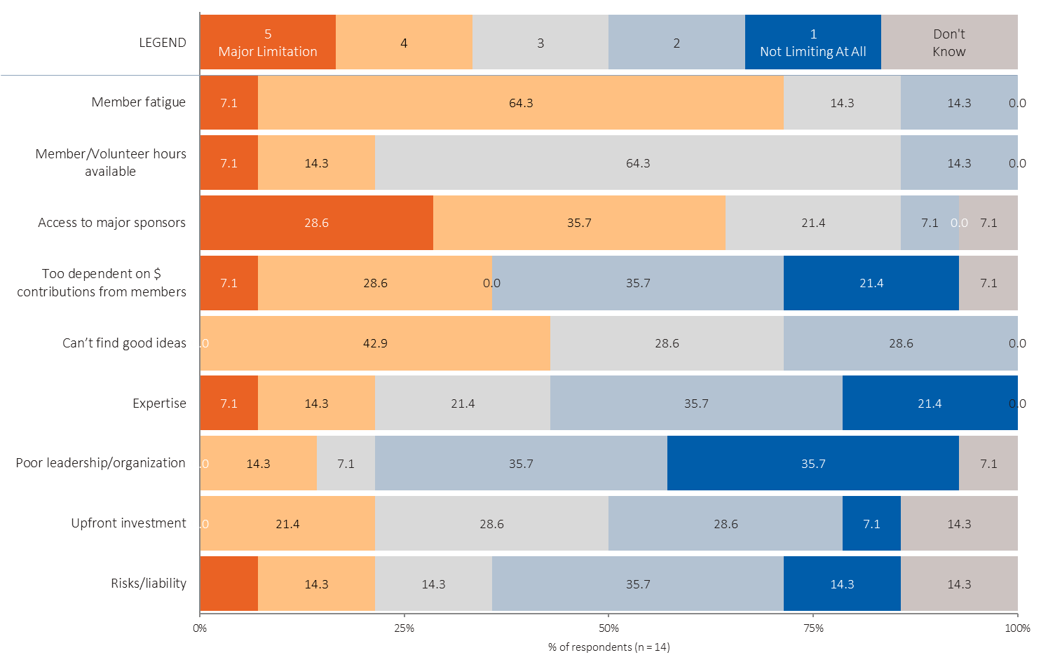
Club Fundraising Limitations
The chart illustrates limitations to club fundraising.
Respondents were asked the following question:
    Using a 5 point scale, where 5 is a major limitation and 1 is not limiting at all, please rate the factors that are limiting your club’s ability to raise funds.
        Expertise
        Member fatigue
        Member/Volunteer hours available
        Upfront investment
        Risks/liability
        Poor leadership/organization
        Access to major sponsors
        Can’t find good ideas
        Too dependent on $ contributions from members
Further analysis across a range of categories can be seen by clicking on the Excel icon while in PowerPoint Normal View (not SlideShow view).
Notes:
The chart illustrates limitations to club fundraising.
Respondents were asked the following question:
Using a 5 point scale, where 5 is a major limitation and 1 is not limiting at all, please rate the factors that are limiting your club’s ability to raise funds.
Expertise
Member fatigue
Member/Volunteer hours available
Upfront investment
Risks/liability
Poor leadership/organization
Access to major sponsors
Can’t find good ideas
Too dependent on $ contributions from members
Further analysis across a range of categories can be seen by clicking on the Excel icon while in PowerPoint Normal View (not SlideShow view).

Slide 37
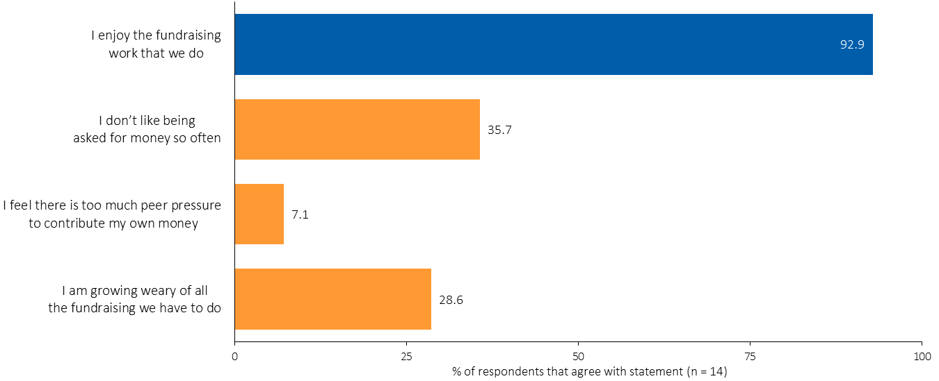
Club Fundraising Attitudes
The chart illustrates attitudes about club fundraising.
Respondents were asked the following question:
    Do you agree or disagree with each of the following statements? Please check.
        I enjoy the fundraising work that we do
        I am growing weary of all the fundraising we have to do
        I don’t like being asked for money so often
        I feel there is too much peer pressure to contribute my own money
Further analysis across a range of categories can be seen by clicking on the Excel icon while in PowerPoint Normal View (not SlideShow view).
Notes:
The chart illustrates attitudes about club fundraising.
Respondents were asked the following question:
Do you agree or disagree with each of the following statements? Please check.
I enjoy the fundraising work that we do
I am growing weary of all the fundraising we have to do
I don’t like being asked for money so often
I feel there is too much peer pressure to contribute my own money
Further analysis across a range of categories can be seen by clicking on the Excel icon while in PowerPoint Normal View (not SlideShow view).

Slide 38
DISTRICT PERFORMANCE
Your Club’s Request
for District Assistance
District Ratings –
Fundamentals
District Fundamentals
Ranked Importance
District Performance Ratings
Request District Assistance

Slide 39
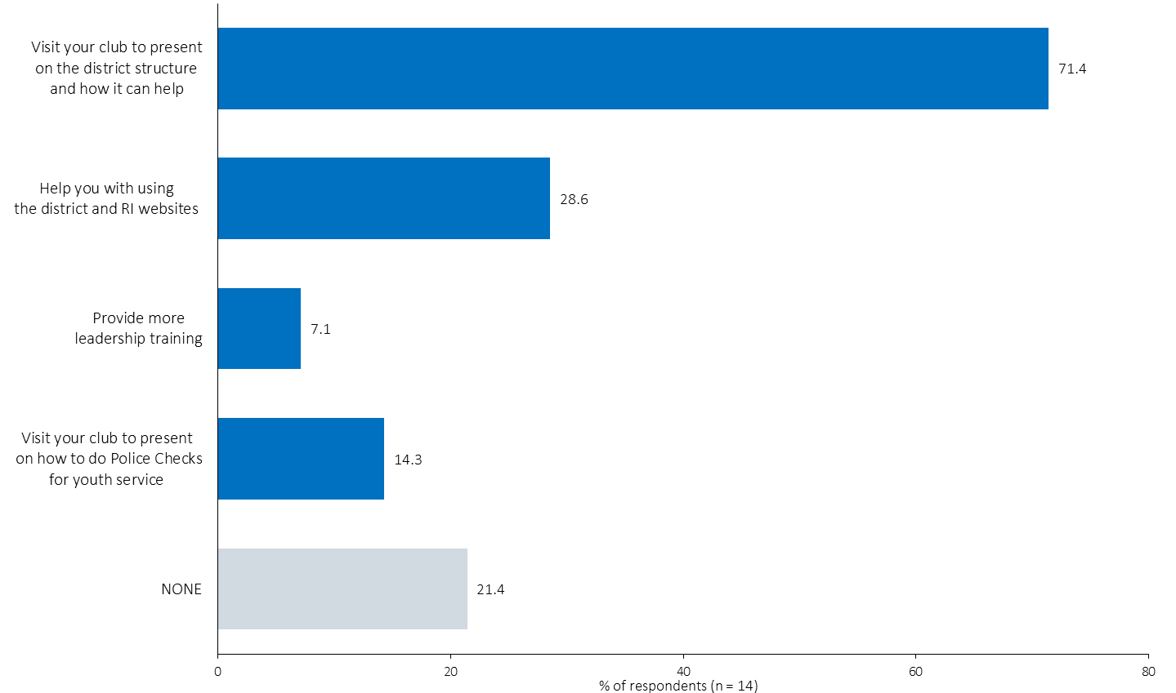
Your Club’s Request for District Assistance
The chart illustrates the percent of total respondents who would like the district to help in each way.
Respondents were asked the following question:
    Which of the following would you like to see District 5360 do? Please check all that apply.
      Visit your club to present on how to do Police Checks for youth service
      Visit your club to present on the district structure and how it can help
      Help you with using the district and RI websites
      Provide more leadership training
Further analysis across a range of categories can be seen by clicking on the Excel icon while in PowerPoint Normal View (not SlideShow view).
Notes:
The chart illustrates the percent of total respondents who would like the district to help in each way.
Respondents were asked the following question:
Which of the following would you like to see District 5360 do? Please check all that apply.
Visit your club to present on how to do Police Checks for youth service
Visit your club to present on the district structure and how it can help
Help you with using the district and RI websites
Provide more leadership training
Further analysis across a range of categories can be seen by clicking on the Excel icon while in PowerPoint Normal View (not SlideShow view).

Slide 40
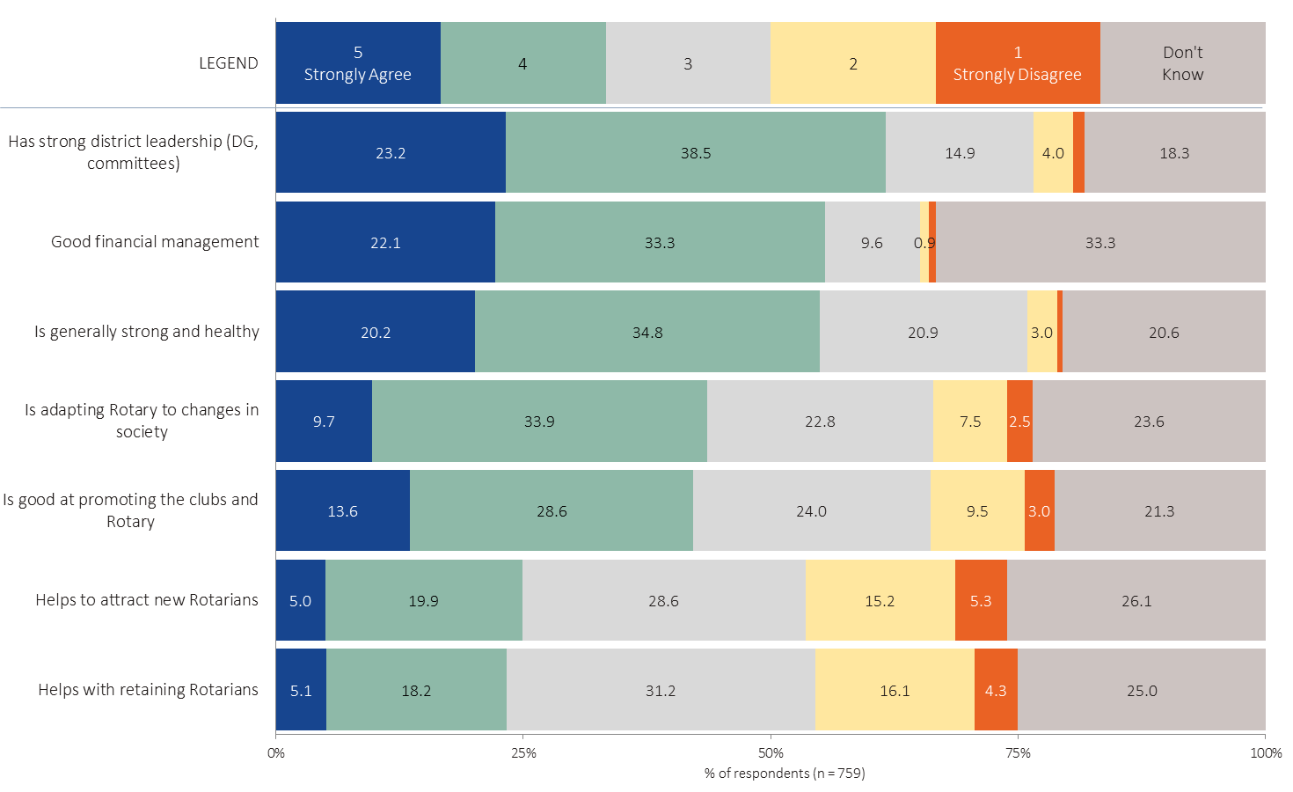
District Ratings - Fundamentals
MORE
Many don’t know how the district is doing.
Few see the district as strong at membership.
The chart illustrates how Rotarians rate the district across key factors. Items are sorted from the highest to lowest rated overall.
Respondents were asked the following question:
  The next questions are about District 5360 and what it does to support Rotarians and their clubs.
  Using a 5 point scale where 5 means Strongly Agree and 1 means Strongly Disagree, please rate District 5360 on the following:
          7 statements were presented.
Further analysis across a range of categories can be seen by clicking on the Excel icon while in PowerPoint Normal View (not SlideShow view).
Notes:
The chart illustrates how Rotarians rate the district across key factors. Items are sorted from the highest to lowest rated overall.
Respondents were asked the following question:
The next questions are about District 5360 and what it does to support Rotarians and their clubs.
Using a 5 point scale where 5 means Strongly Agree and 1 means Strongly Disagree, please rate District 5360 on the following:
7 statements were presented.
Further analysis across a range of categories can be seen by clicking on the Excel icon while in PowerPoint Normal View (not SlideShow view).

Slide 41
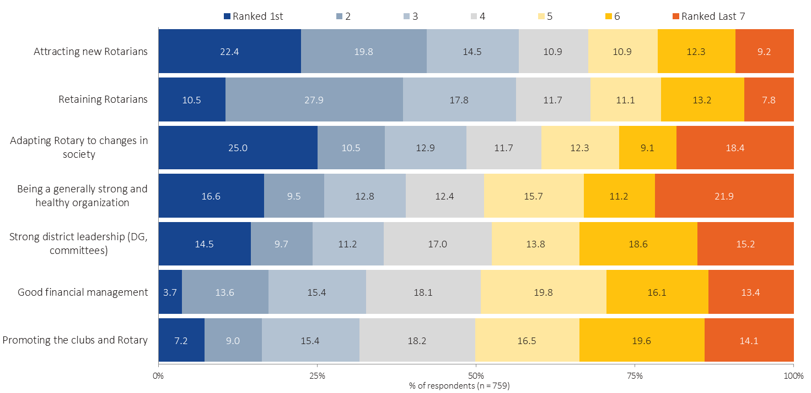
District Fundamentals – Ranked Importance
The chart illustrates how Rotarians rank the importance of factors. Items are sorted from the highest to lowest mean ranking.
Respondents were asked the following question:
    Please rank how you see the importance of the following items to the long term success of our district. In other words, what should be the highest priority?
    Click on each item in order, from the most important issue to the least important issue. Click again to change the order.
    7 statements were presented.
Further analysis across a range of categories can be seen by clicking on the Excel icon while in PowerPoint Normal View (not SlideShow view).
Notes:
The chart illustrates how Rotarians rank the importance of factors. Items are sorted from the highest to lowest mean ranking.
Respondents were asked the following question:
Please rank how you see the importance of the following items to the long term success of our district. In other words, what should be the highest priority?
Click on each item in order, from the most important issue to the least important issue. Click again to change the order.
7 statements were presented.
Further analysis across a range of categories can be seen by clicking on the Excel icon while in PowerPoint Normal View (not SlideShow view).

Slide 42
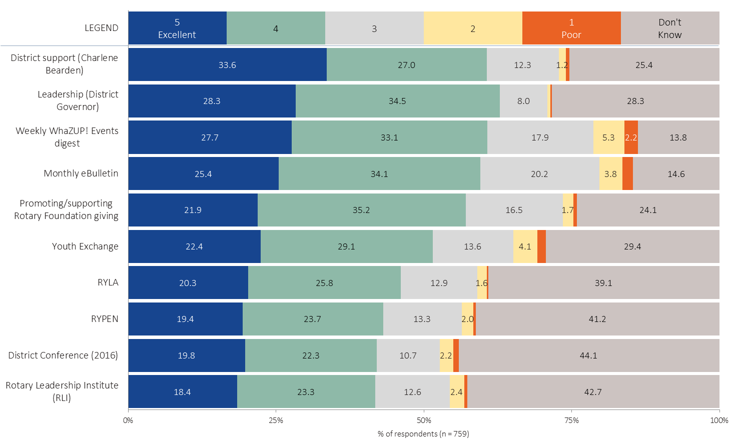
District Performance Ratings
MORE
The chart illustrates how Rotarians rate District 5360 across many different criteria. Items are sorted from the highest to lowest rated overall.
Respondents were asked the following question:
  Using a 5 point scale where 5 means Excellent and 1 means Poor, please rate the performance of District 5360 on the following:
    20 statements were presented, divided across two screens to be more manageable.
Further analysis across a range of categories can be seen by clicking on the Excel icon while in PowerPoint Normal View (not SlideShow view).
Notes:
The chart illustrates how Rotarians rate District 5360 across many different criteria. Items are sorted from the highest to lowest rated overall.
Respondents were asked the following question:
Using a 5 point scale where 5 means Excellent and 1 means Poor, please rate the performance of District 5360 on the following:
20 statements were presented, divided across two screens to be more manageable.
Further analysis across a range of categories can be seen by clicking on the Excel icon while in PowerPoint Normal View (not SlideShow view).

Slide 43
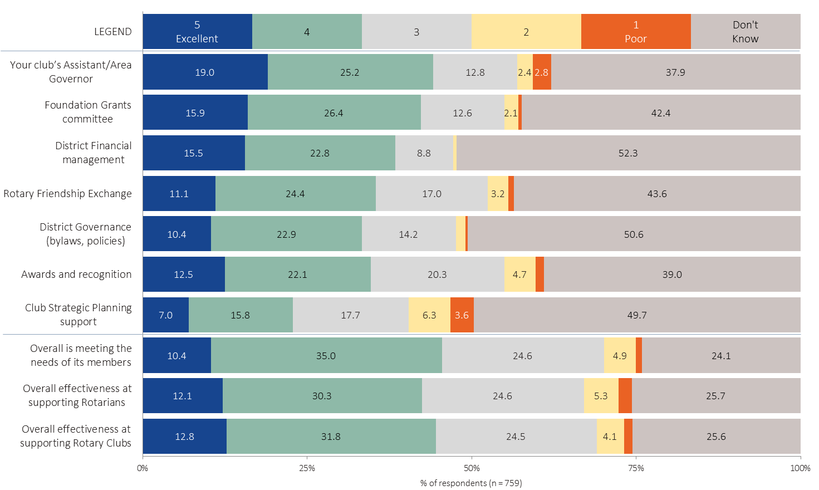
District Performance Ratings
MORE
The chart illustrates how Rotarians rate District 5360 across many different criteria. Items are sorted from the highest to lowest mean rating.
Respondents were asked the following question:
    Using a 5 point scale where 5 means Excellent and 1 means Poor, please rate the performance of District 5360 on the following:
    20 statements were presented, divided across two screens to be more manageable.
Further analysis across a range of categories can be seen by clicking on the Excel icon while in PowerPoint Normal View (not SlideShow view).
Notes:
The chart illustrates how Rotarians rate District 5360 across many different criteria. Items are sorted from the highest to lowest rated overall.
Respondents were asked the following question:
Using a 5 point scale where 5 means Excellent and 1 means Poor, please rate the performance of District 5360 on the following:
20 statements were presented, divided across two screens to be more manageable.
Further analysis across a range of categories can be seen by clicking on the Excel icon while in PowerPoint Normal View (not SlideShow view).

Slide 44
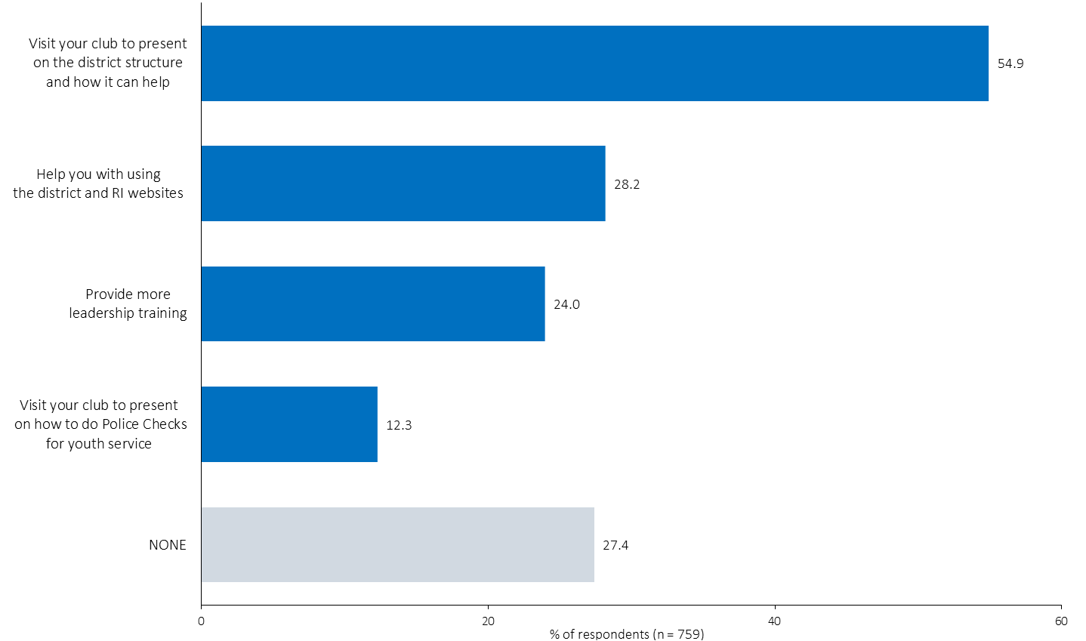
Request District Assistance
The chart illustrates the percent of total respondents who would like the district to help in each way.
Respondents were asked the following question:
    Which of the following would you like to see District 5360 do? Please check all that apply.
      Visit your club to present on how to do Police Checks for youth service
      Visit your club to present on the district structure and how it can help
      Help you with using the district and RI websites
      Provide more leadership training
Further analysis across a range of categories can be seen by clicking on the Excel icon while in PowerPoint Normal View (not SlideShow view).
Notes:
The chart illustrates the percent of total respondents who would like the district to help in each way.
Respondents were asked the following question:
Which of the following would you like to see District 5360 do? Please check all that apply.
Visit your club to present on how to do Police Checks for youth service
Visit your club to present on the district structure and how it can help
Help you with using the district and RI websites
Provide more leadership training
Further analysis across a range of categories can be seen by clicking on the Excel icon while in PowerPoint Normal View (not SlideShow view).

Slide 45
MEMBER SURVEY 2017

