Slide 1
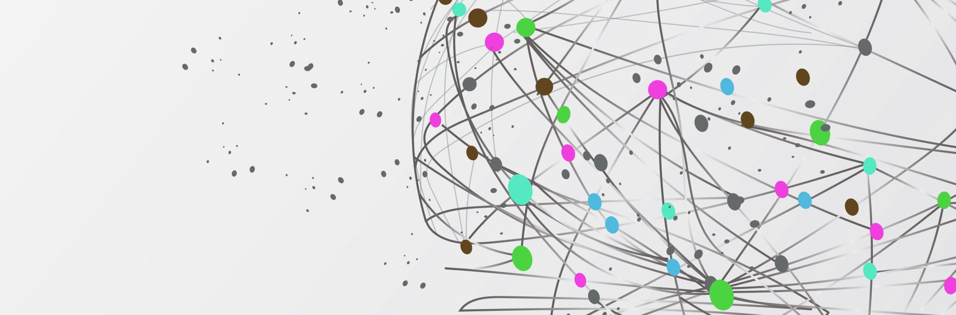
Kiva Micro Credit

Slide 2
What is Kiva?
More than 1.7 billion people around the world are unbanked and can’t access the financial services they need. Kiva is an international non-profit, founded in 2005 in San Francisco, with a mission to expand financial access to help underserved communities thrive.
Kiva does this by crowdfunding loans and unlocking capital for the underserved, improving the quality and cost of financial services, and addressing the underlying barriers to financial access around the world.
Kiva by the Numbers
  4.6 million borrowers
  80 Countries
  2.2 Million lenders
  1.86 Billion Loans funded through Kiva
  96.3% Repayment rate
  450 Volunteers
  4,356 Field partners and trustees
  110 employees
  81% of Borrowers are women

Slide 3
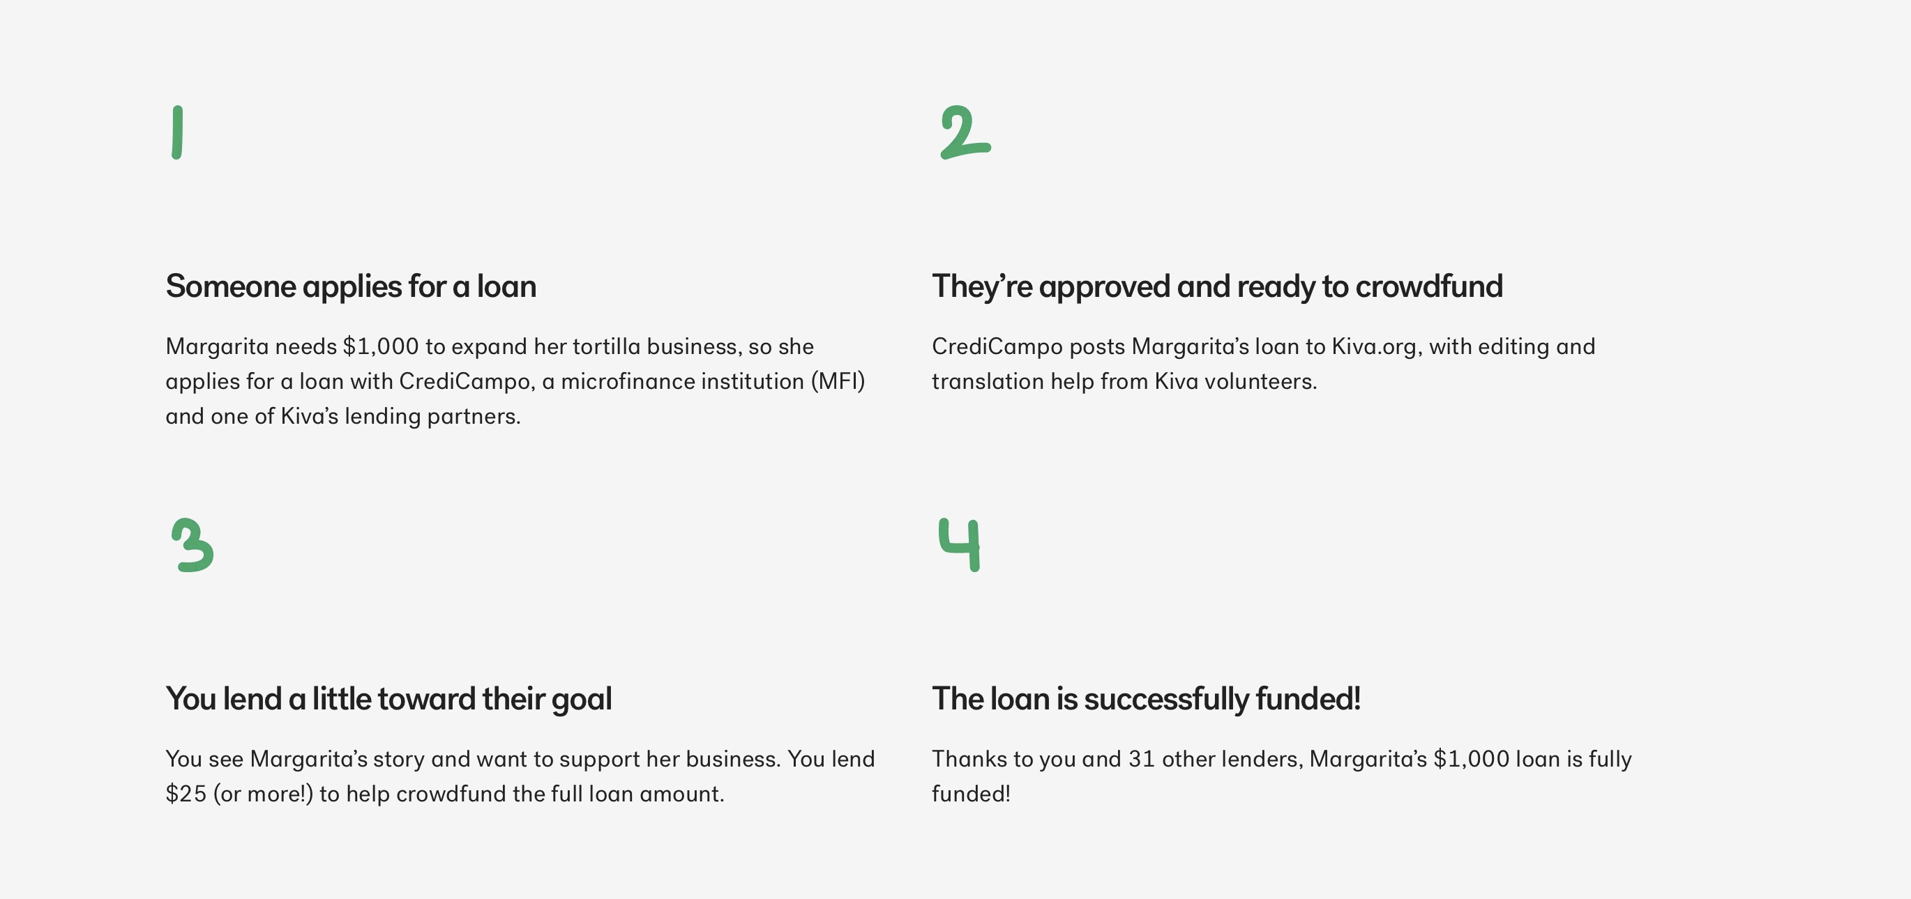
How does it work

Slide 4
Rotary club of Calgary Centennial
Involvement
In 2011 deposited $2500 CAD into Kiva and started making loans
Total deposits to date are $12,881USD
Have made 1891 loans in 69 countries
Have lent out a total of $85,590 USD
47 loans have defaulted - $1,101.52 USD

Slide 5
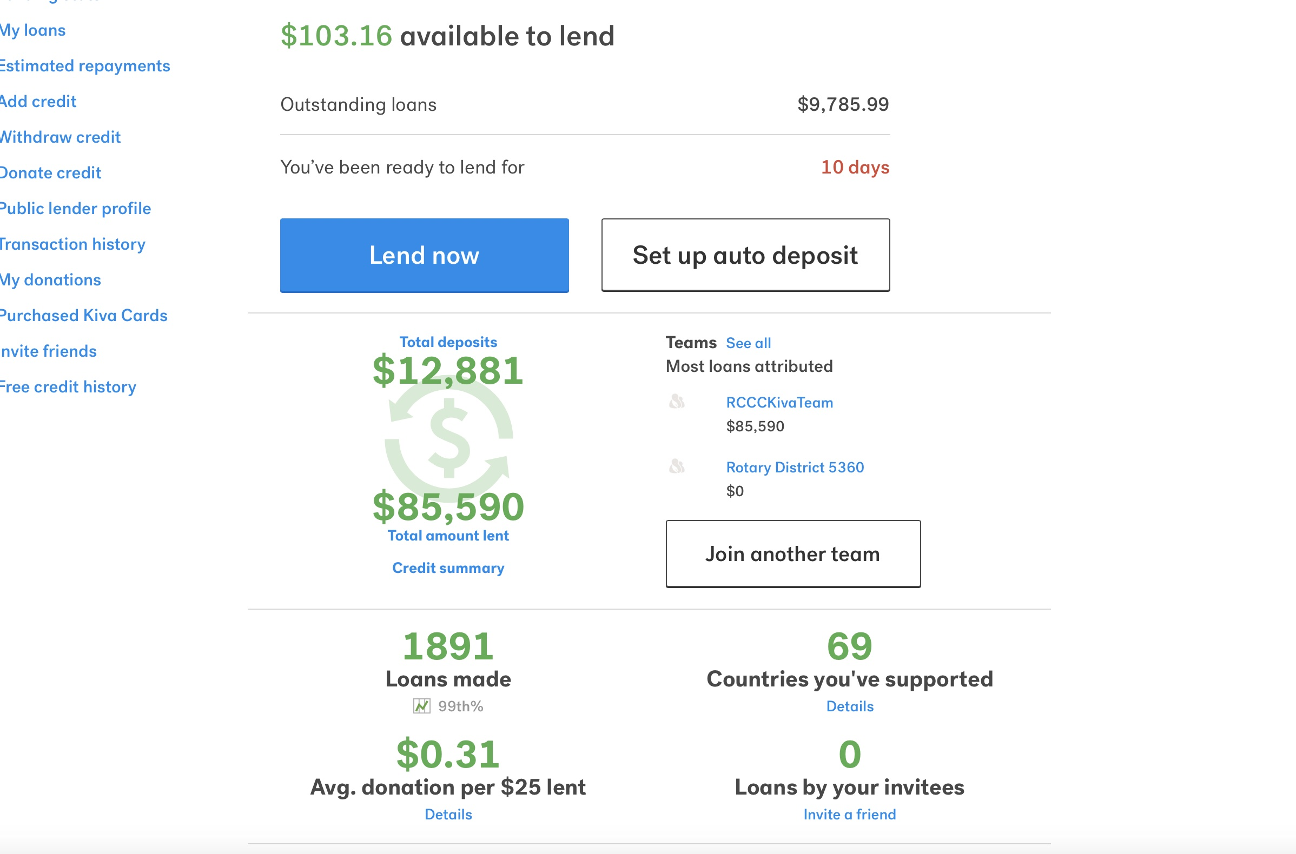
After logging into Kiva screen shows amount available to lend

Slide 6
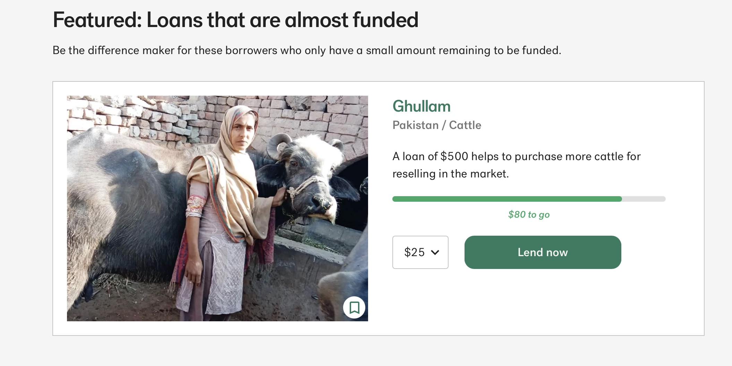
After pressing the lend button – taken to screen that shows loans that are almost funded

Slide 7
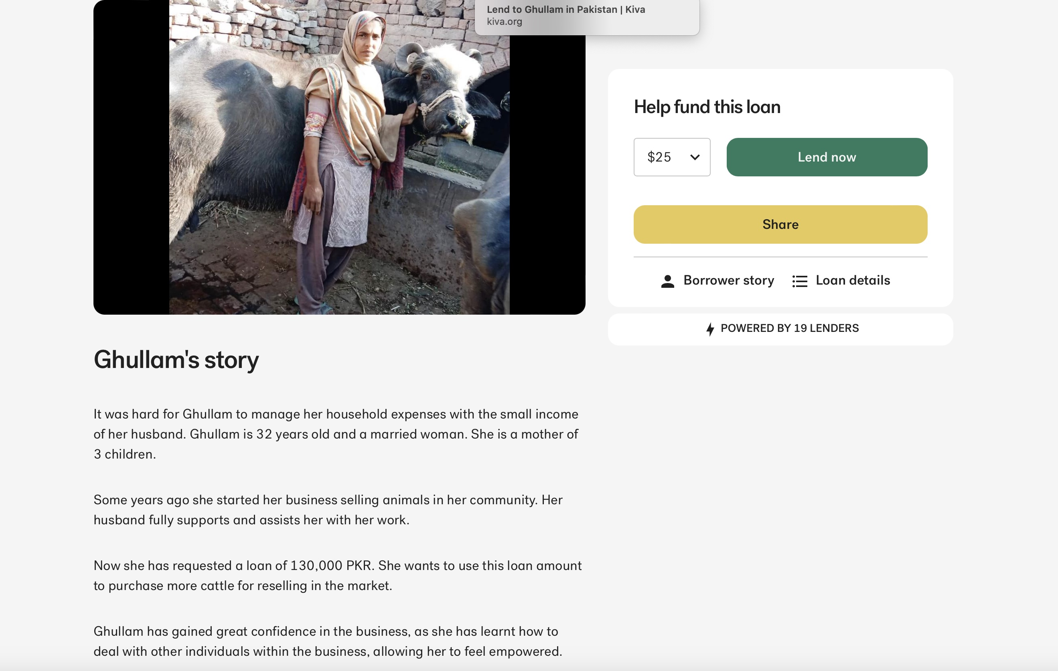
Click on the borrower’s name and their story appears

Slide 8
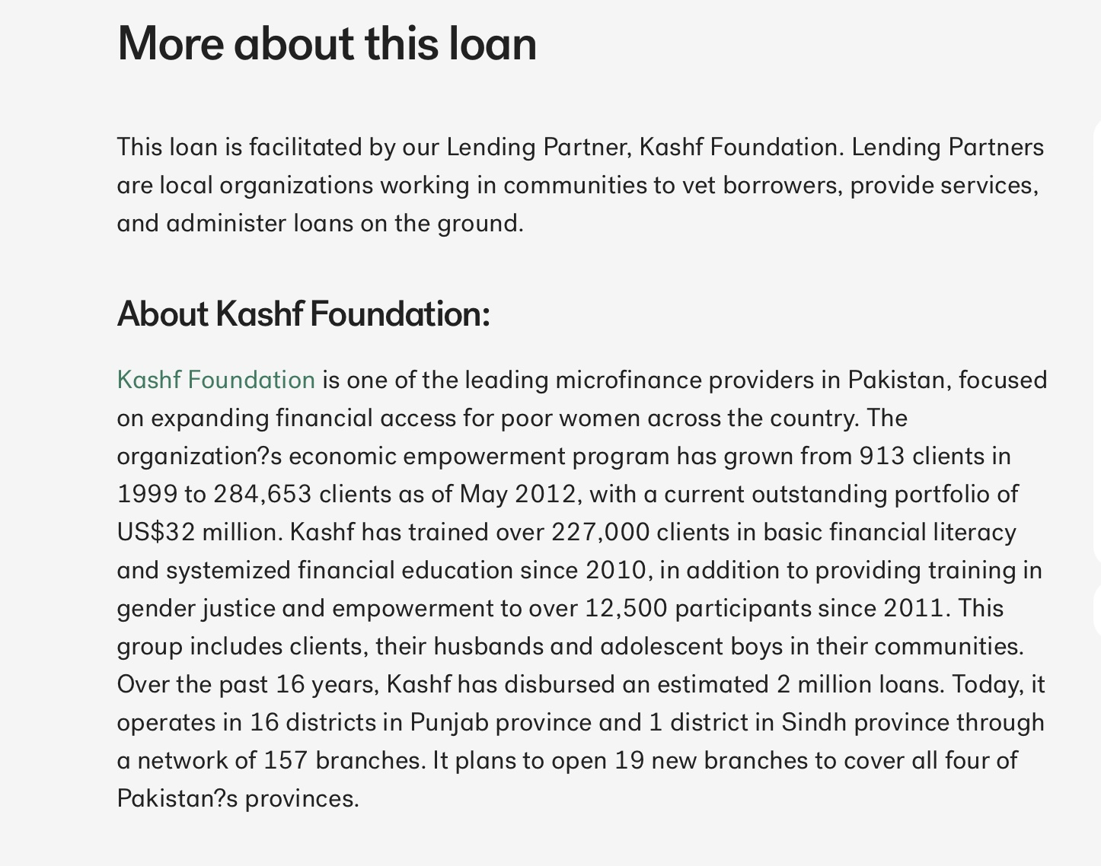
Scrolling down will display information about the lending organization

Slide 9
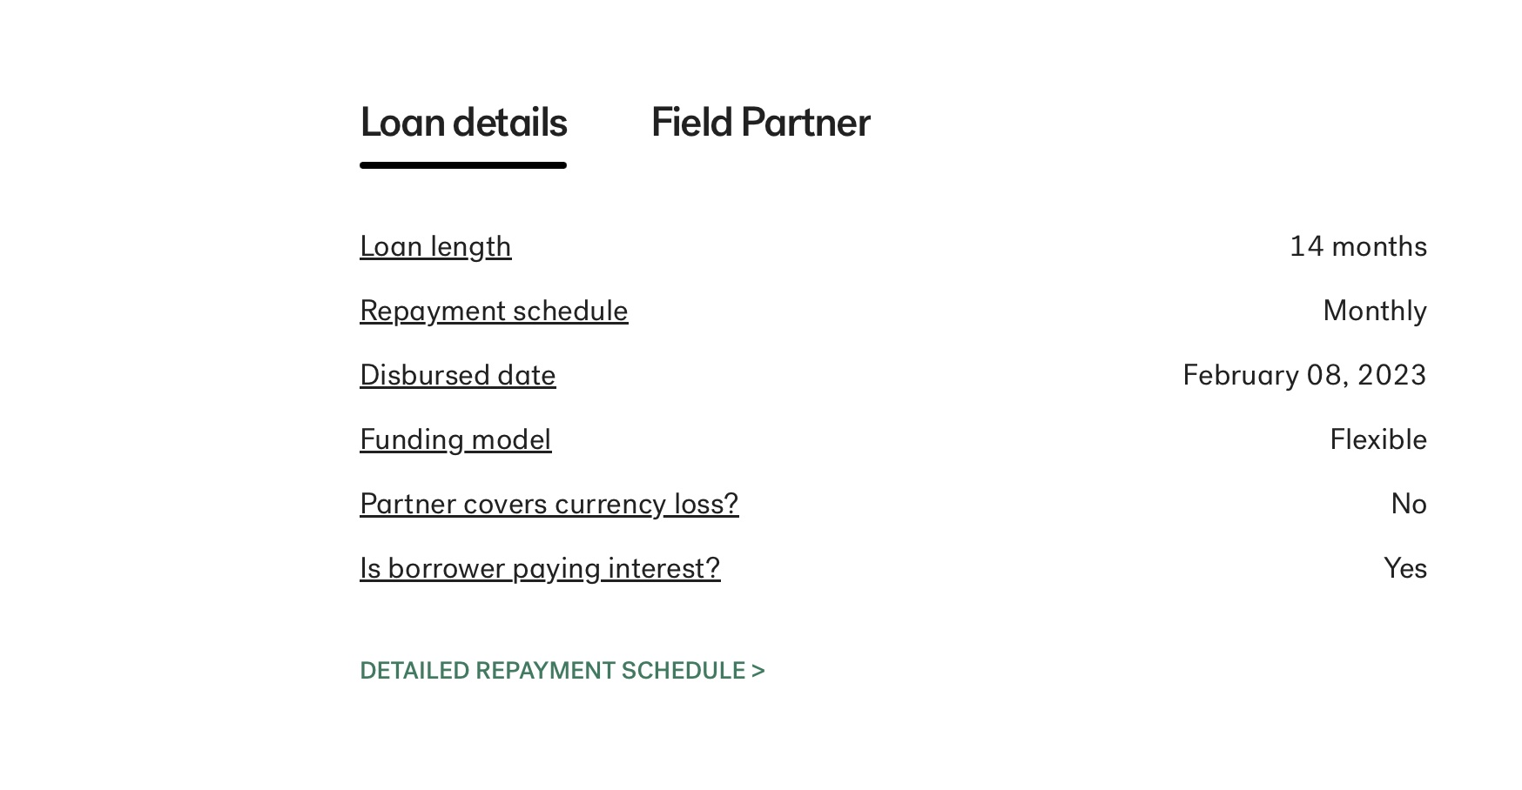
Scroll down to loan details

Slide 10
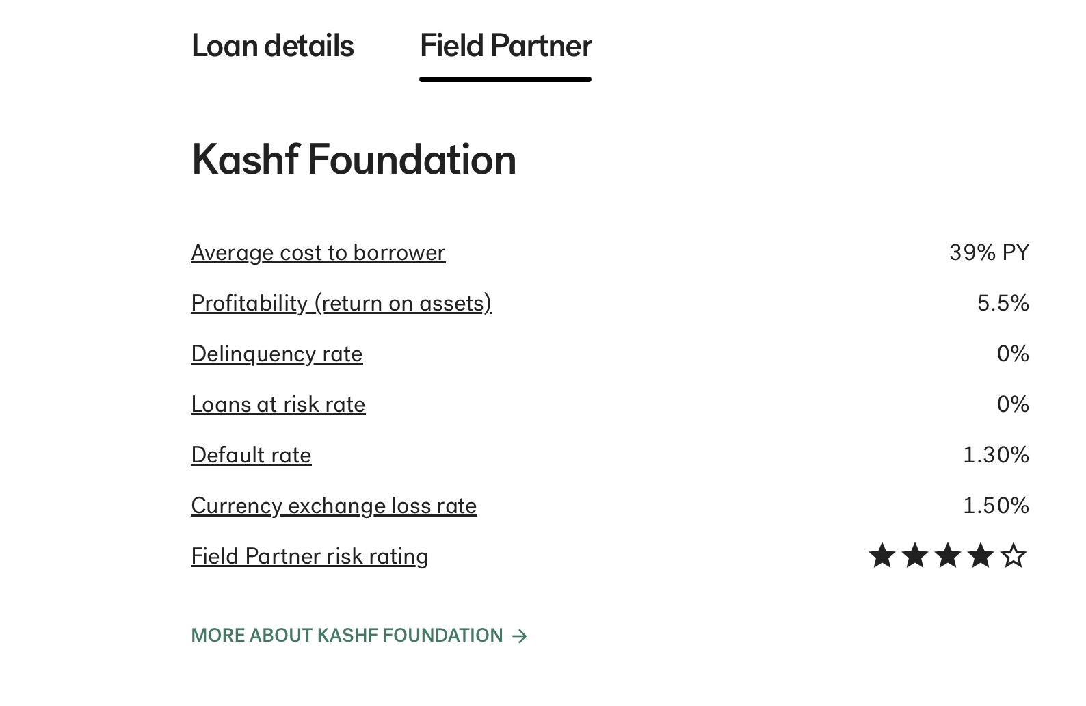
Click on Field Partner

Slide 11
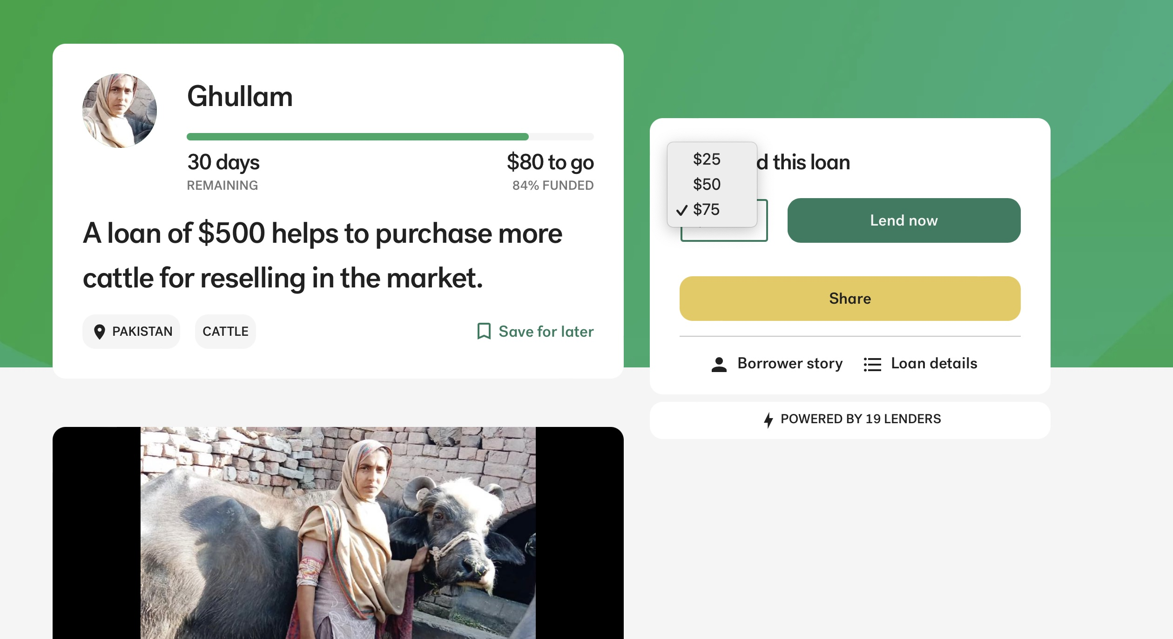
Select loan amount and press loan now

