Slide 1

Rotary Centennial
Ranchmen’s Club
February 18, 2026
THE ELEPHANT IN THE ROOM
Normalizing the conversation about death and dying

Slide 2
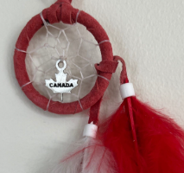
Canadian land acknowledgement
I am the great grand-daughter of the uninvited guests to these lands and acknowledge the traditional ancestral unceded territories on which we all learn, work, play, live and die. Recognizing the land is an act of reconciliation and gratitude to the traditional owners, elders and wisdom keepers.

Slide 3

Agenda
Introduction
Challenges around the conversation
Normalize the process
Knowledge and information
Fill in the gaps for your life
Emily Levine : a story
Closing and moving forward
Questions

Slide 4
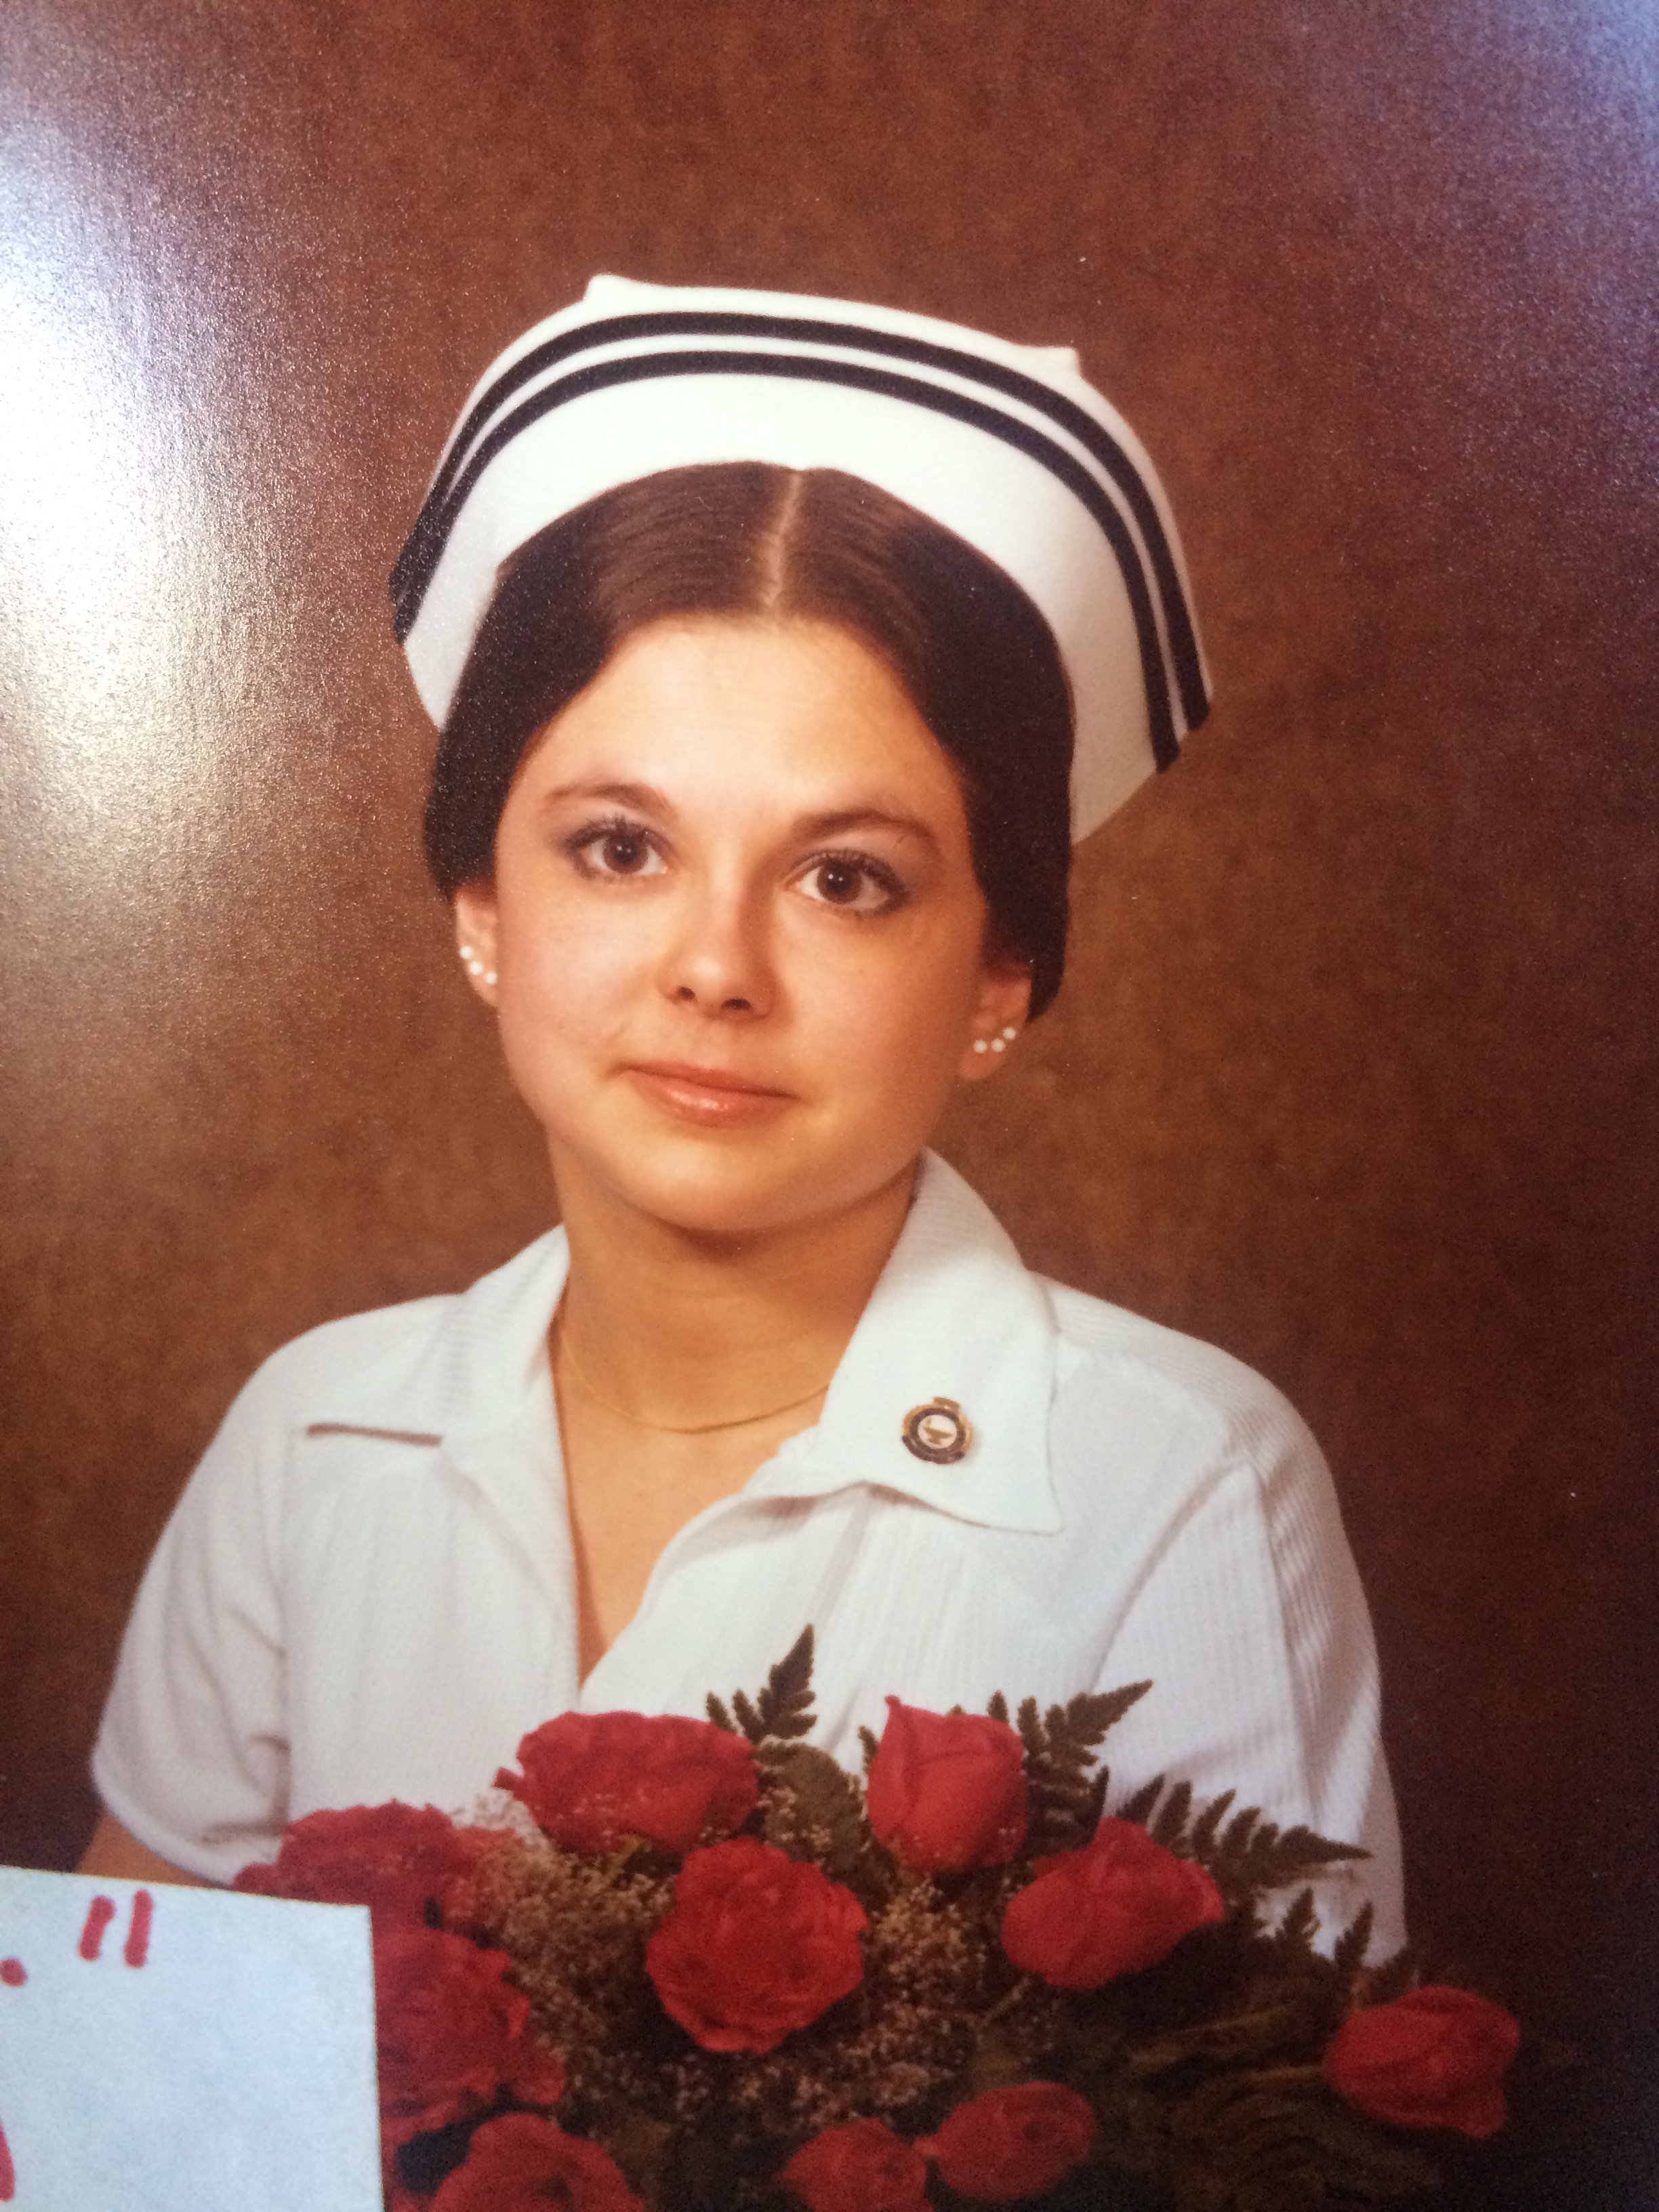
My lived experience as a Canadian Registered Nurse ………
Traditional, old-school, hands-on, hospital-based bedside training, beginning in 1978.
Caring for sick and dying adults in Saskatchewan and Alberta a full twenty years before “Dr. Google”.
From a western medicine and health care lens, within an environment where patients were older or seniors, primarily English speaking, Caucasian, ETHNOCENTRIC delivery of medicalized treatment, most people living independently and proud to be doing so.
None were concerned about how to pay for the treatment or hospital stay (Canadian model)
Nursing practice over last half century includes med-surg, home care, palliative home care, racetrack (NO practice in northern Canadian communities, research, neonate, paediatric, psychiatry, OH/industrial, remand, forensics, cruise ships, etc.) Full bio on deathmaven.ca.
.

Slide 5

Human bodies are all similar, made of the same parts, organic material and function within a narrow balance of normal. Our medical system has focused on and perfected keeping our bodies cured and fixed. That’s what it is supposed to do. This is an incredible success.
There is some consideration about personhood but, especially in an emergency or crisis, this is not doctors’ prime focus. Fixing the body is the common denominator. Because of the beautiful variety of personhoods, individualizing the intervention to the person’s soul is not the goal. The goal is to fix the problem, cure the body and save a life.
Does the individual person who comes into ER KNOW this …?

Slide 6
Barriers to conversation
Othering
Talking will bring it on sooner
Most fearsome when most remote
Not allowed to be seen as weak
Spiritual and religious factors
Our own discomfort with the conversation
People have the right to NOT know (RNTK)
Declining health means failure
Focus is on the fight
.

Slide 7
There will never be a perfect way to approach the conversation. The desire to speak about it is engrained, however “now is not the time”. We feel deprived of rituals, of community, of conversation.
In the UofA Alumni magazine, New Trail (issue 134), one writer points out that we, in western society, may see death and illness as a failure and we are not accustomed to “failing”. There is a mentality of refusing “loss” in our society that prioritizes and focuses so much on winning that we don’t know how to process loss.
We are built on values like growth, abundance and opportunity, and when there is a problem, it can be fixed… but we can’t fix death.
Our health care system is focused on treatments that provide cures and extending life. Life is precious, is extended at all cost and the miraculous advances in medicine have given countless people a second or third chance to pack more life into their years. Death is still seen as a failure to fix what ails us.
How did we get to a place where we are afraid…?

Slide 8
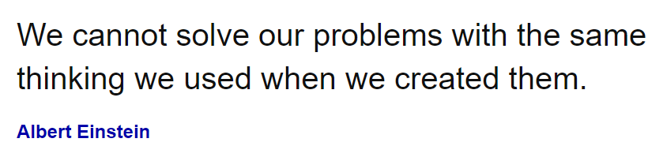
.

Slide 9
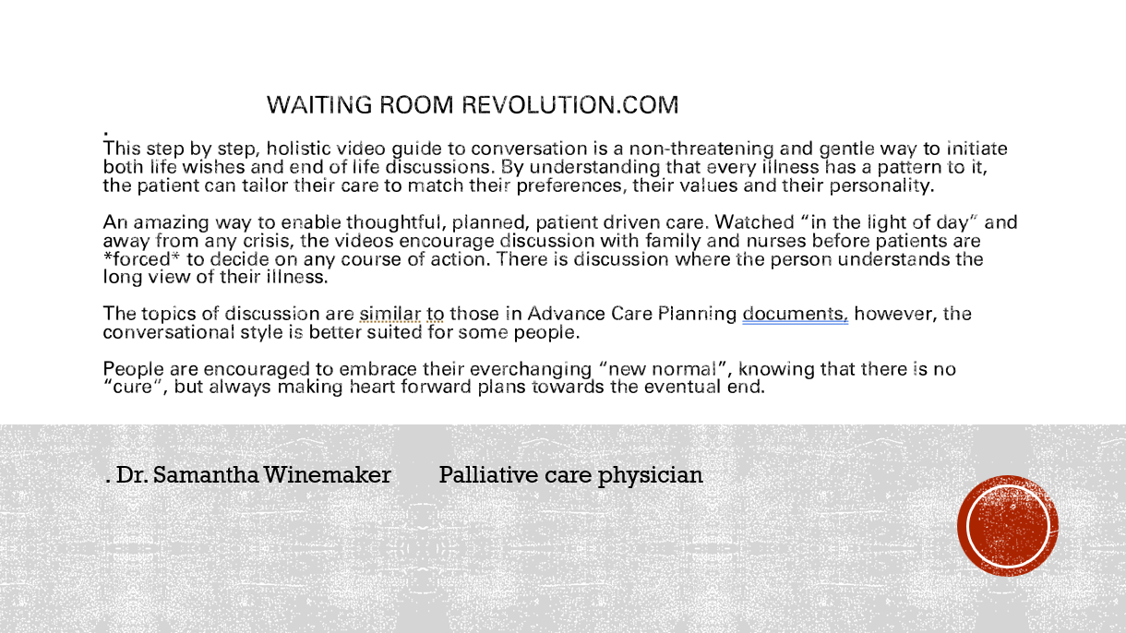

Slide 10


Slide 11
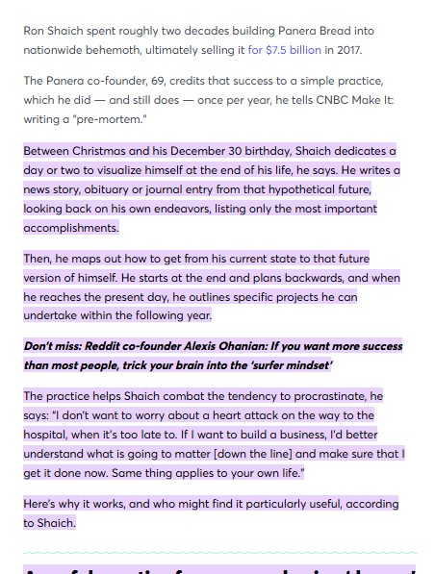
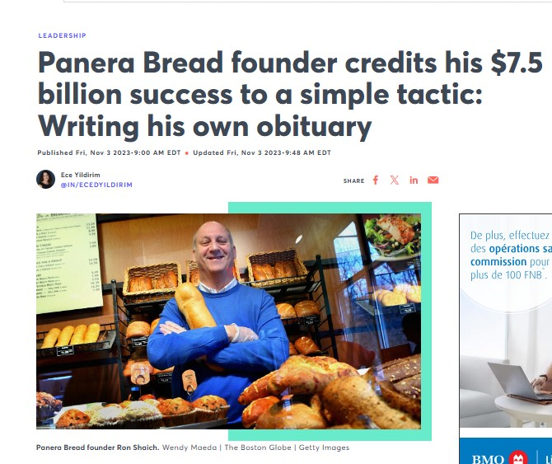
Steven Covey #2 in practice : ”begin with the end in mind”

Slide 12
Emily Levine : her story

Slide 13
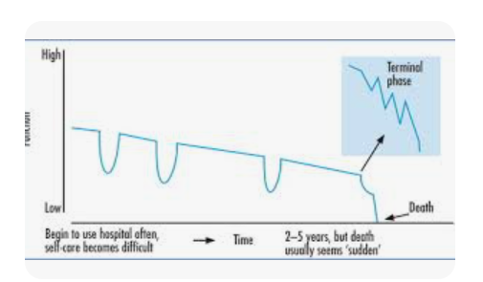
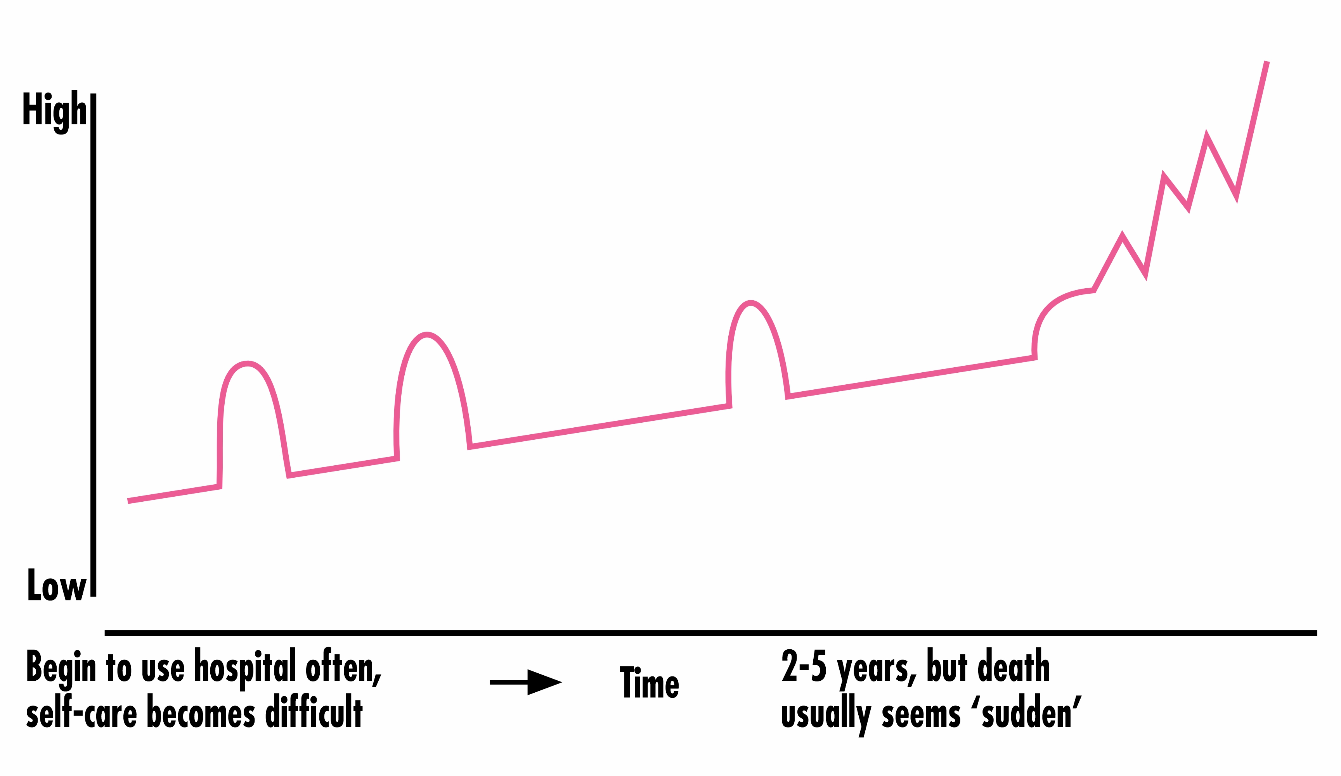
Flip the script, change the narrative, normalize the conversation

Slide 14
content supported under following legislation :
Canadian Nurses Association code of ethics, specifically those regarding Justice and Value of Choice
CRNA continuing competence indicators and practice standards 1.2, 1.4, 2.1, 2.2, 2.3, 2.8, 3.3, 3.5, 4.1 and 4.2
Health Professions Act of Alberta Schedule 24 “Profession of Registered Nurses” Practice points 3 (a) i , ii, iv, v and vii

Slide 15
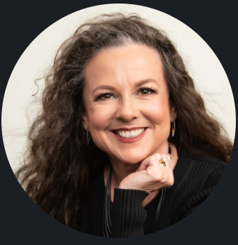
DEATH MAVEN LTD* live.a.life.worth.dying.for@gmail.com www.deathmaven.ca
Marilyn Moldowan RN, BScN
PO Box 94077
Elbow River RPO
Calgary T2S 0S4 phone 403-919-1683
CRNA registration #46877
*”Death Maven” and “Madame Maven Publishing” are divisions of 706889 Alberta LTD.

Slide 16

Thank you
Questions please . . . . . .. . . . . . . . . . . . . . . . . . . . . . . . . . . . . . . . . . . . . . . . . . . . . . . .

Slide 18

The power of communication

Slide 19

Overcoming nervousness
Confidence-building strategies

Slide 20

Engaging the audience
Make eye contact with your audience to create a sense of intimacy and involvement
Weave relatable stories into your presentation using narratives that make your message memorable and impactful
Encourage questions and provide thoughtful responses to enhance audience participation
Use live polls or surveys to gather audience opinions, promoting engagement and making sure the audience feel involved

Slide 21
Selecting visual aids
Enhancing your presentation

Slide 22
Effective delivery techniques
This is a powerful tool in public speaking. It involves varying pitch, tone, and volume to convey emotion, emphasize points, and maintain interest.
  Pitch variation
  Tone inflection
  Volume control
Effective body language enhances your message, making it more impactful and memorable.
  Meaningful eye contact
  Purposeful gestures
  Maintain good posture
  Control your expressions

Slide 23
Navigating Q&A sessions
Know your material in advance
Anticipate common questions
Rehearse your responses
Maintaining composure during the Q&A session is essential for projecting confidence and authority. Consider the following tips for staying composed:
Stay calm
Actively listen
Pause and reflect
Maintain eye contact

Slide 24
Speaking impact
Your ability to communicate effectively will leave a lasting impact on your audience
Effectively communicating involves not only delivering a message but also resonating with the experiences, values, and emotions of those listening

Slide 25
Dynamic delivery
Learn to infuse energy into your delivery to leave a lasting impression
One of the goals of effective communication is to motivate your audience
Metric | Measurement | Target | Actual
Audience attendance | # of attendees | 150 | 120
Engagement duration | Minutes | 60 | 75
Q&A interaction | # of questions | 10 | 15
Positive feedback | Percentage (%) | 90 | 95
Rate of information retention | Percentage (%) | 80 | 85

Slide 26
Final tips & takeaways
Consistent rehearsal
  Strengthen your familiarity
Refine delivery style
  Pacing, tone, and emphasis
Timing and transitions
  Aim for seamless, professional delivery
Practice audience
  Enlist colleagues to listen & provide feedback
Seek feedback
Reflect on performance
Explore new techniques
Set personal goals
Iterate and adapt

Slide 27
Speaking engagement metrics
Impact factor | Measurement | Target | Achieved
Audience interaction | Percentage (%) | 85 | 88
Knowledge retention | Percentage (%) | 75 | 80
Post-presentation surveys | Average rating | 4.2 | 4.5
Referral rate | Percentage (%) | 10 | 12
Collaboration opportunities | # of opportunities | 8 | 10

