Slide 1
Revolutioning Rotary Through The Power of Youth
Kamil Kanji

Slide 2
KEY MESSAGES
1. Empowering youth to take on leadership roles within Rotary will not only bring great short term benefit through the introduction of new ideas, perspectives and passions but will also build the lifelong Rotarians that will serve as the foundational legacy of this incredible organization.

Slide 3
KEY MESSAGES
2. Youth are already transforming Rotary at a club level, district level and zone level. In order to continue expanding this organization we must support the work of youth and contribute to their success, because when young people succeed the entire organization succeeds.

Slide 4
KEY MESSAGES
3. Rotary is on the cusp of revolutionary change where youth come to the forefront of representation, leadership and most importantly; service. Rotarians must not only support but act in this era of change if the organization hopes to grow even more at all levels, in all aspects.

Slide 5
HOW MANY INTERACT CLUBS ARE THERE AROUND THE WORLD?
15,000 - 20,000

Slide 6
HOW MANY INTERACTORS ARE THERE AROUND THE WORLD?
350,000 - 500,000

Slide 7
HOW LONG HAS INTERACT EXISTED?
59 YEARS

Slide 8
CLUB WIDE YOUTH IMPACT
Interact Multi-Club Collaboration Project
Interact Club of Lethbridge Malawi Project
Interact Club of Medicine Hat Pediatric Wing Renovation

Slide 9
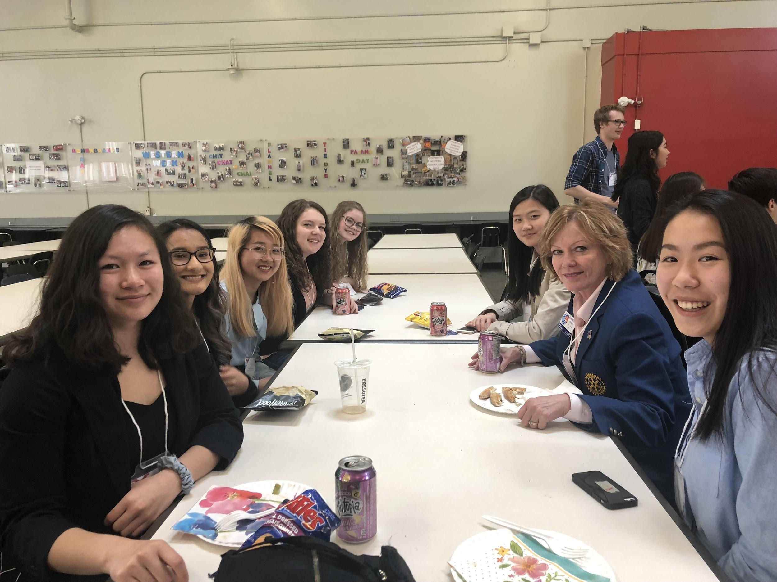
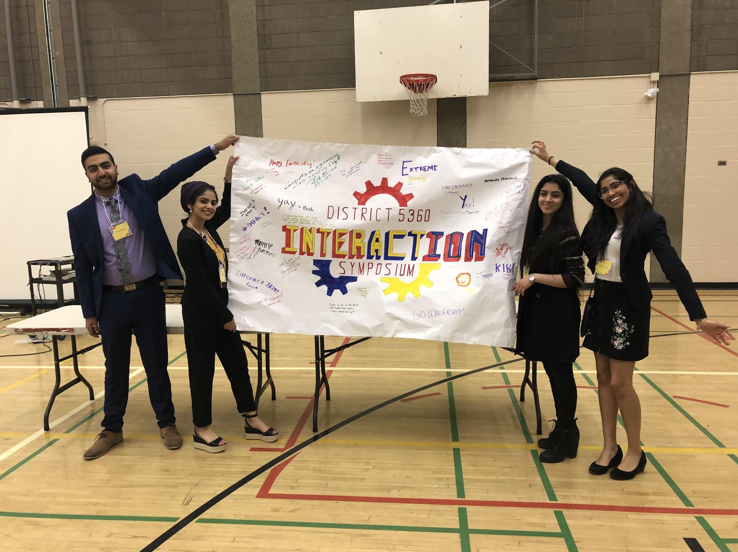
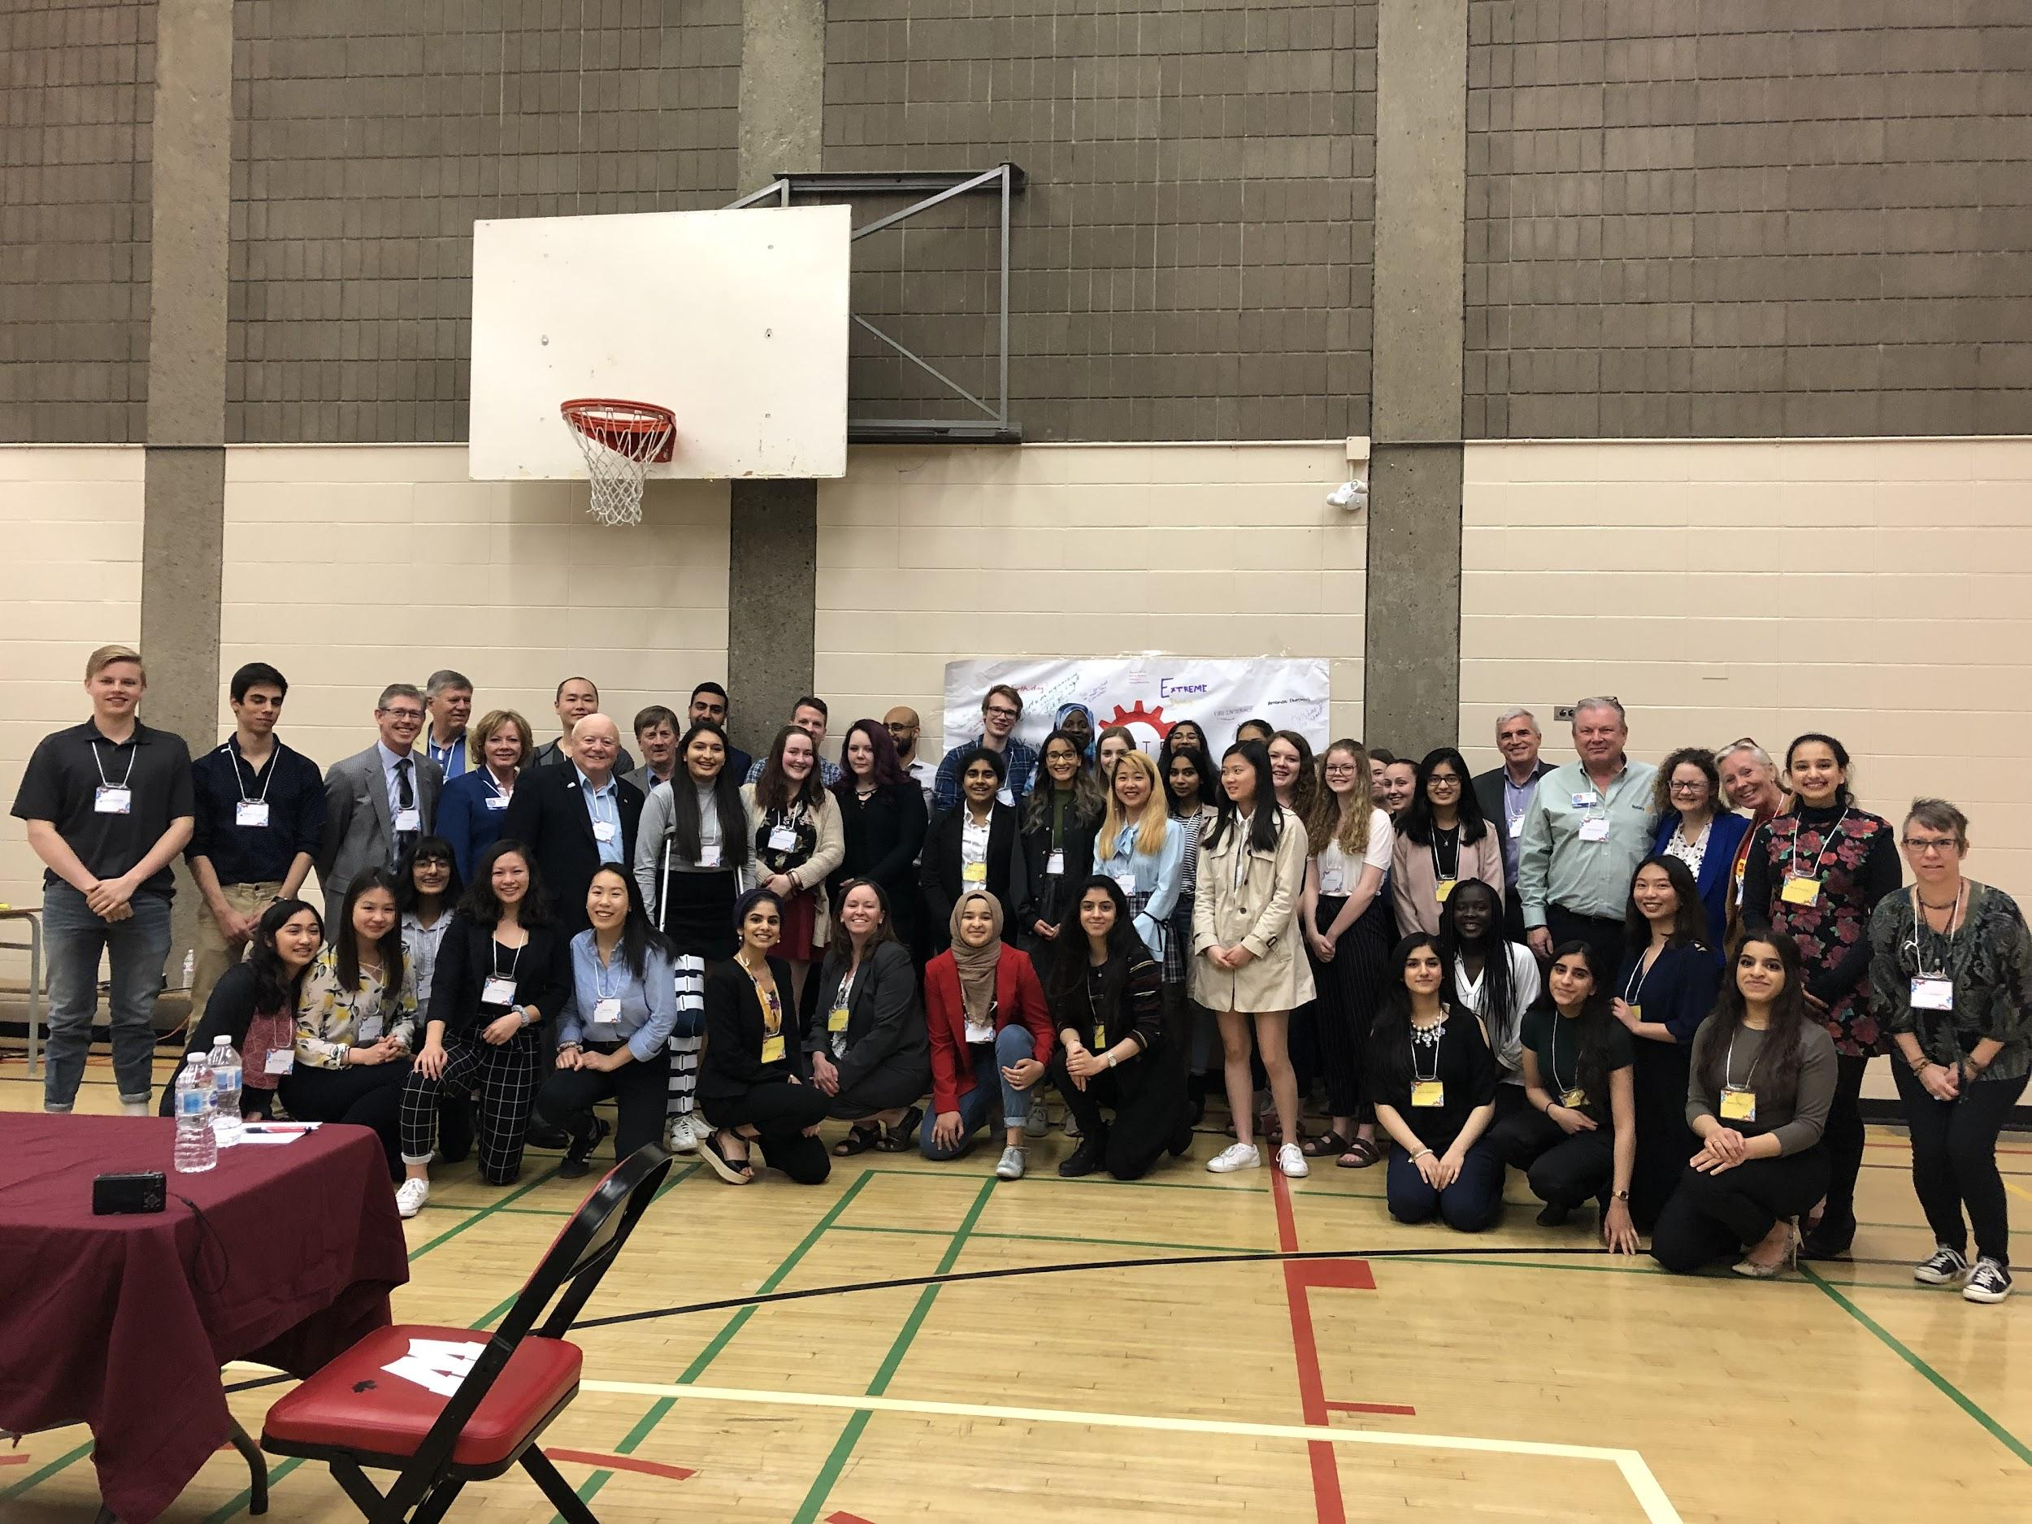
DISTRICT WIDE YOUTH IMPACT
The District 5360 Interaction Symposium

Slide 10
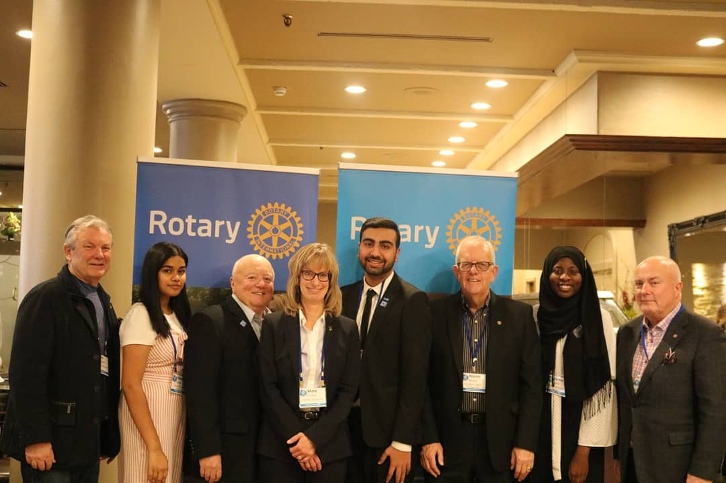
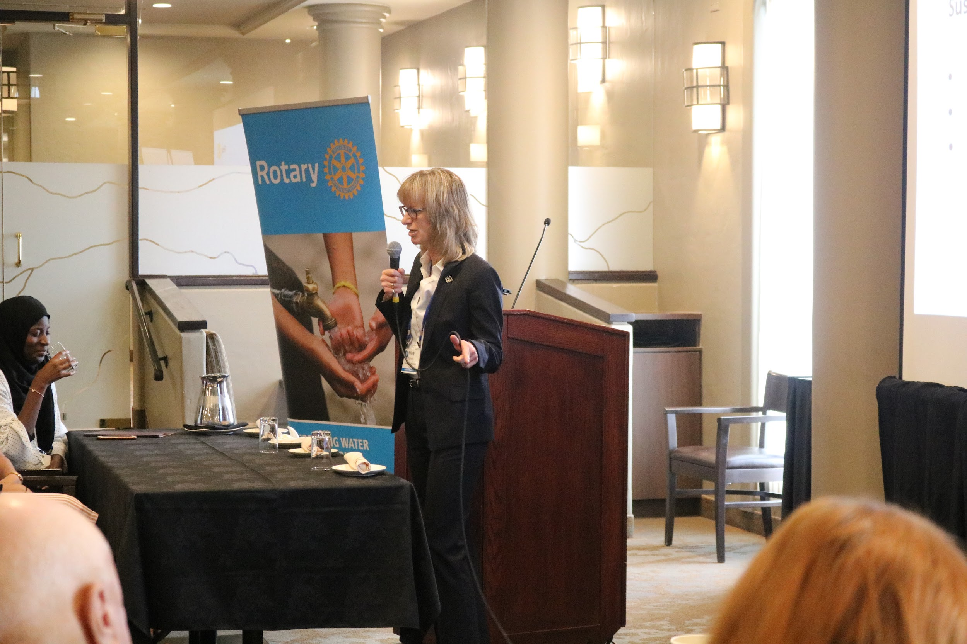
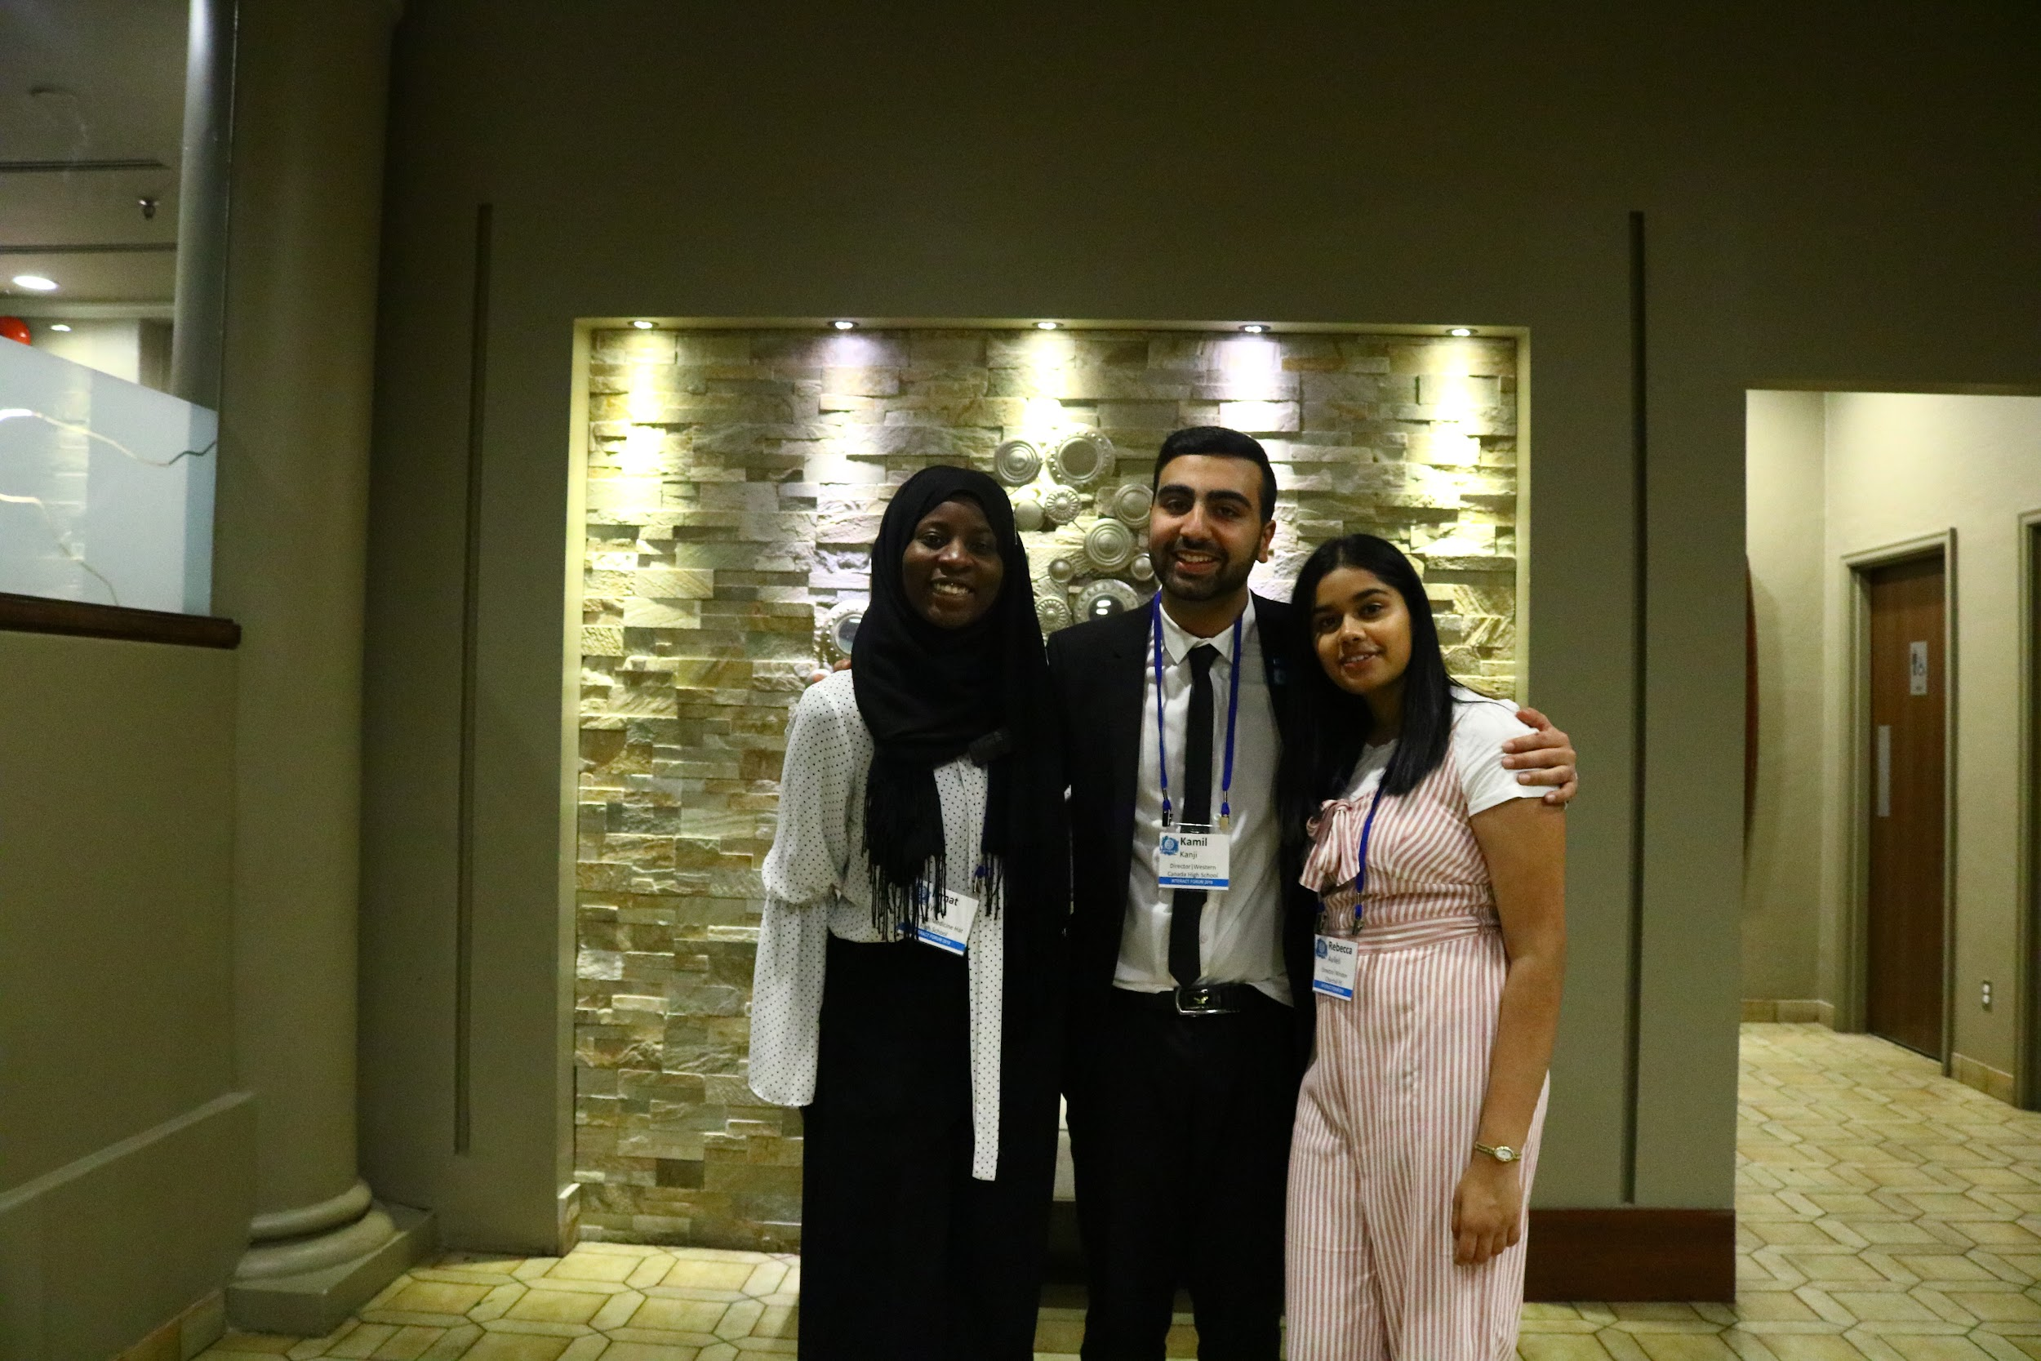
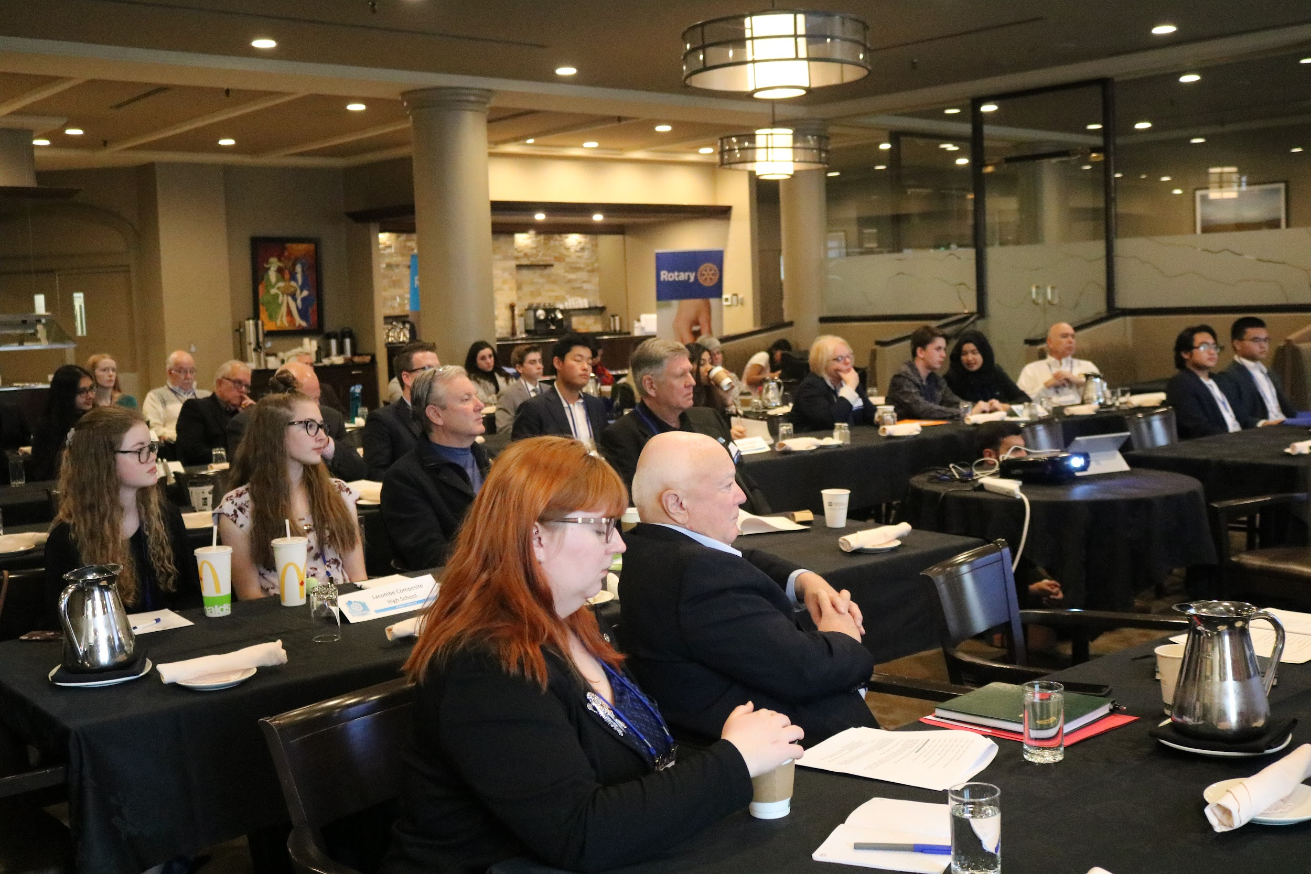
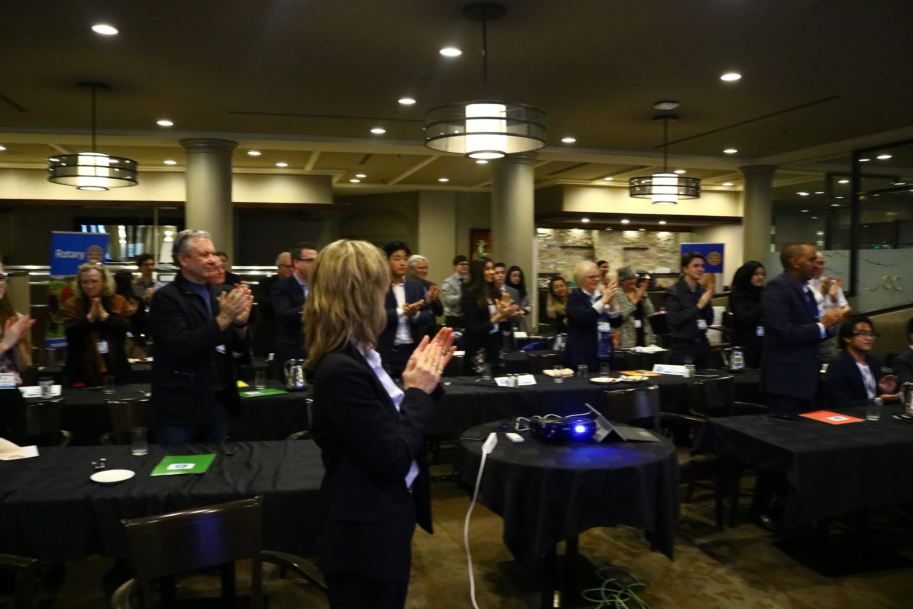
DISTRICT WIDE YOUTH IMPACT
The District 5360 All Interact Presidents Forum

Slide 11
DISTRICT WIDE YOUTH IMPACT
Interact age representation on the following committees: Diversity, Equity and Inclusion, New Clubs, Learning and Development and various District Conference Planning Committees
Paul Harris Fellowships to several Interact age students
Youngest Interact age committee appointments and Chair positions in District history
District 5360 Youth Impact Achievements

Slide 12
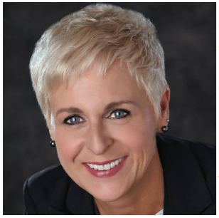
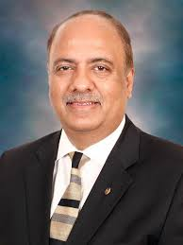
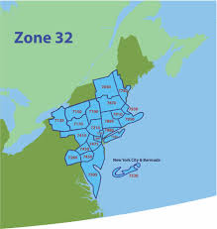
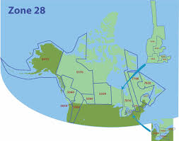
INTERNATIONAL YOUTH IMPACT
First ever international conference for Interact students in Canada, the USA, Bermuda and France
The event is to be hosted in the year 2022 in Calgary, AB
A weekend of inspiration, empowerment and leadership skill development
Zone 28 and 32 Interact Convention

Slide 13
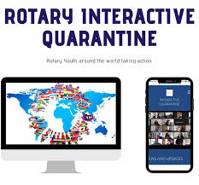
INTERNATIONAL YOUTH IMPACT
International coalition of youth exchange and Interact students working to share different projects and ways to stay Rotary productive during COVID-19
Comprised of students from several countries such as Venezuela, the USA, Canada, Columbia and other European nations
Rotary Interactive Quarantine

Slide 14
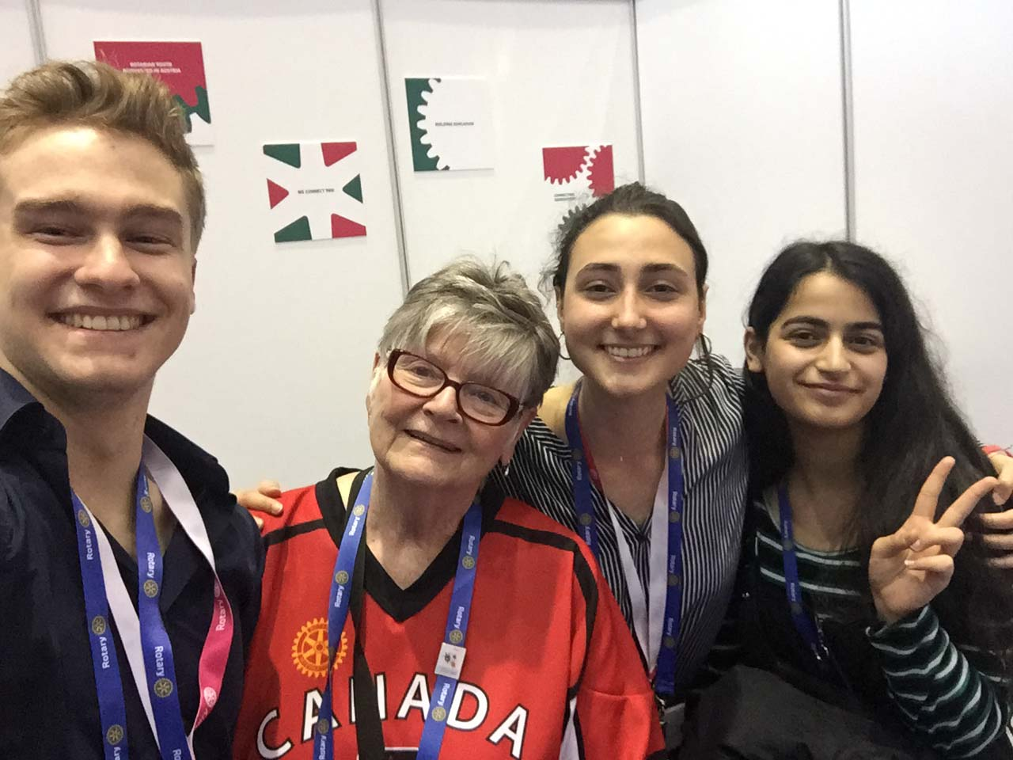
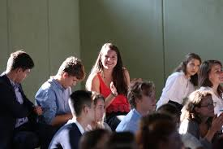
INTERNATIONAL YOUTH IMPACT
A Interact network that connects young people around the world to make universal primary education possible
They have given over 5,000 children access to education, have organized events in over ten countries, and were invited to the UN General Assembly 2018
Initiative Interchange

Slide 15
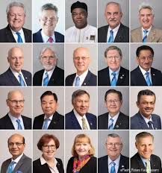
INTERNATIONAL YOUTH IMPACT
A proposal submitted to the RI Board in regards to creating an action oriented advisory group comprised of past and present Interactors has been accepted
This body advises the RI board and President on how to take action in elevating, empowering and supporting Interact around the world in various ways
Rotary International Interact Advisory Council

Slide 16
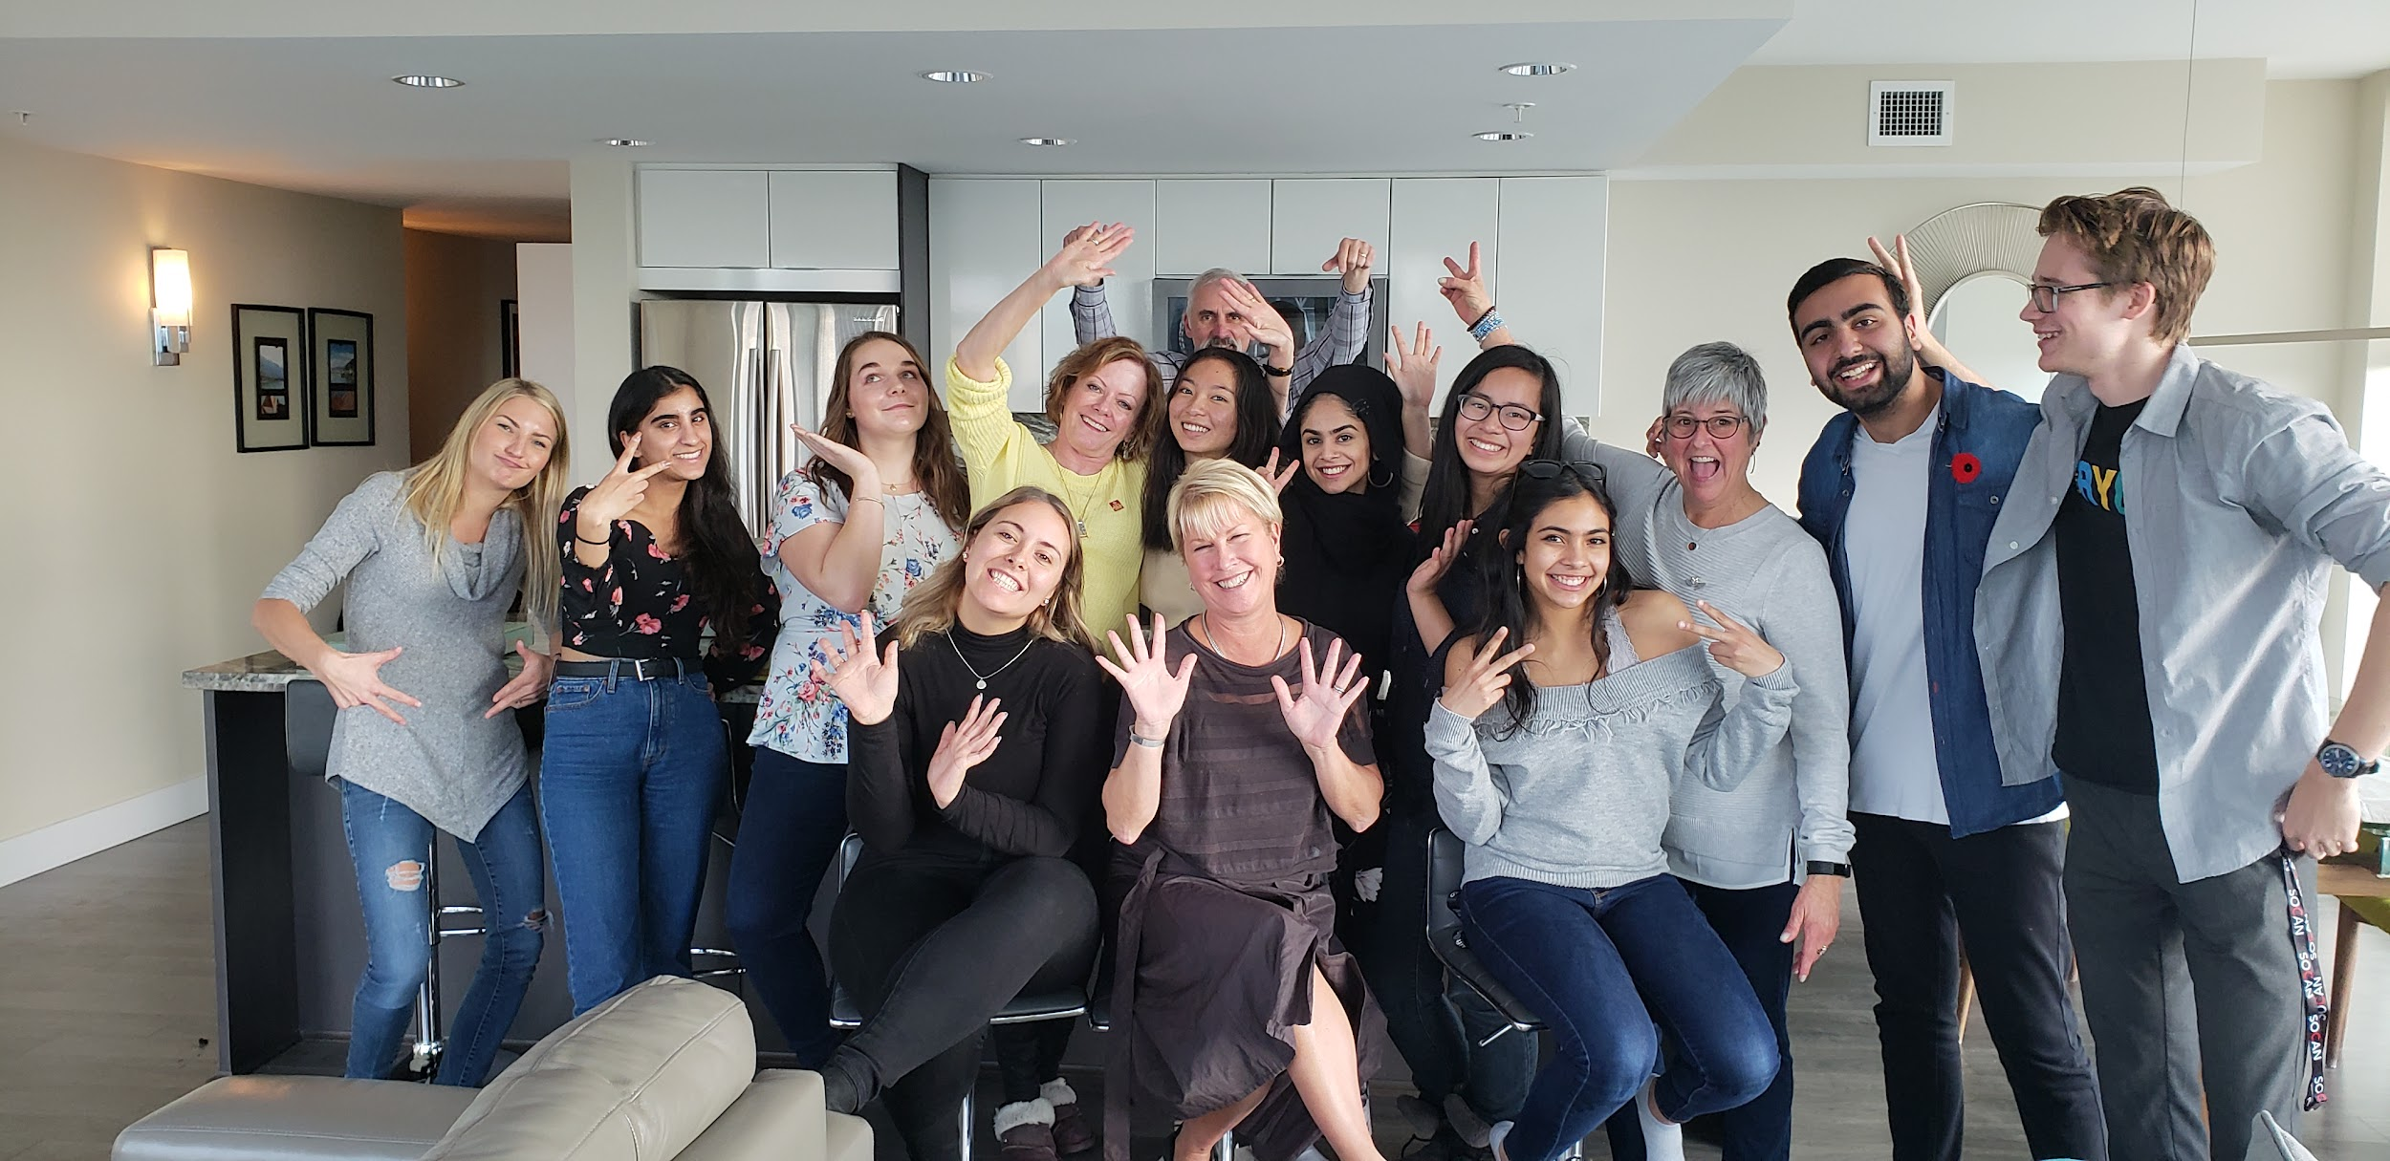
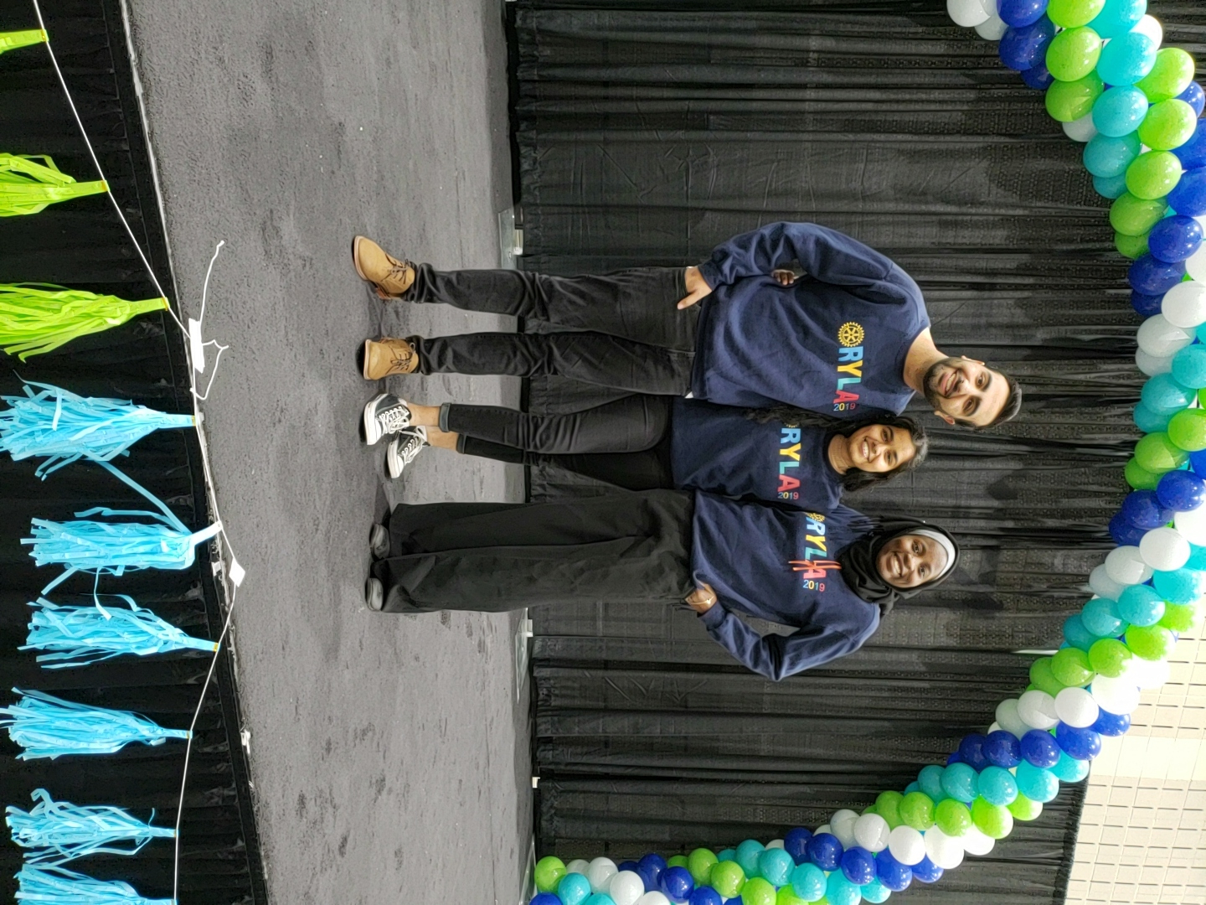
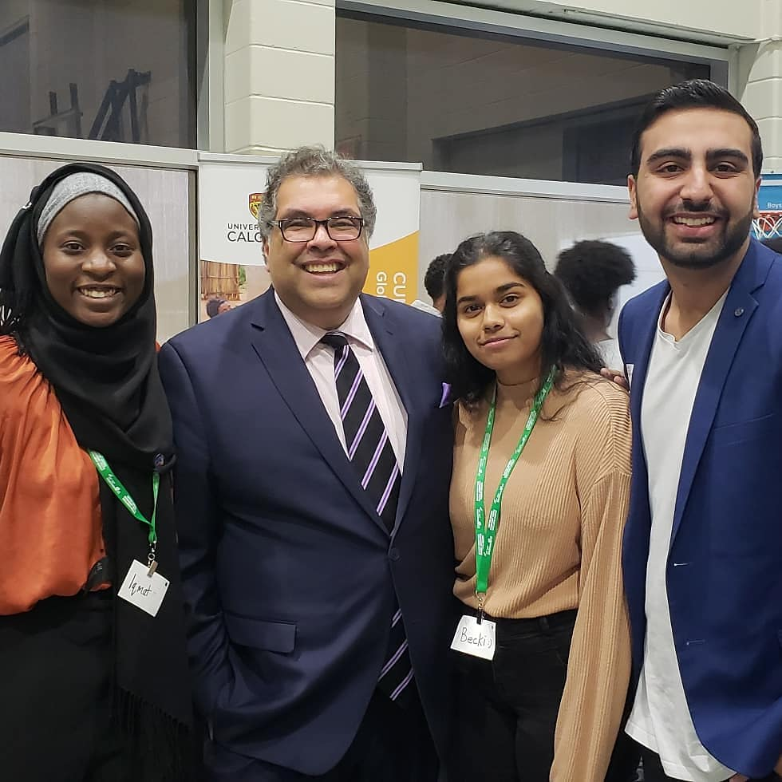
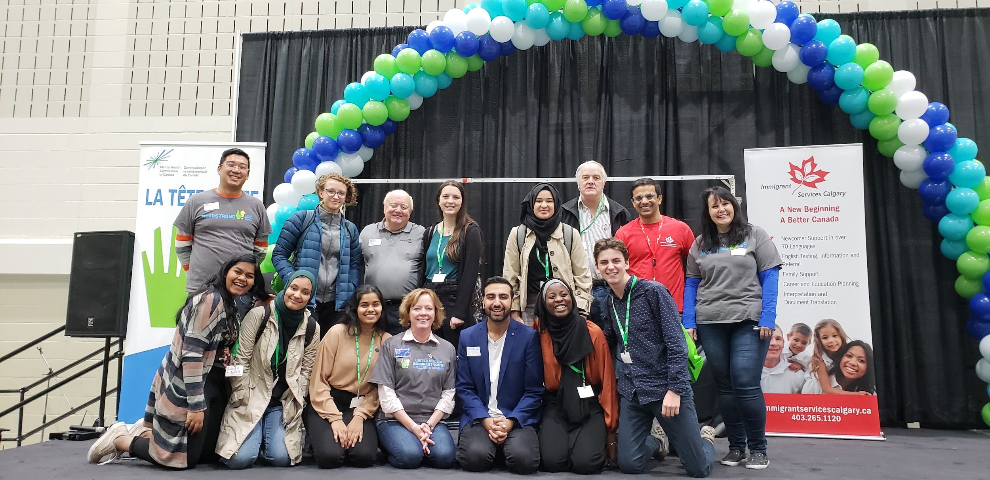
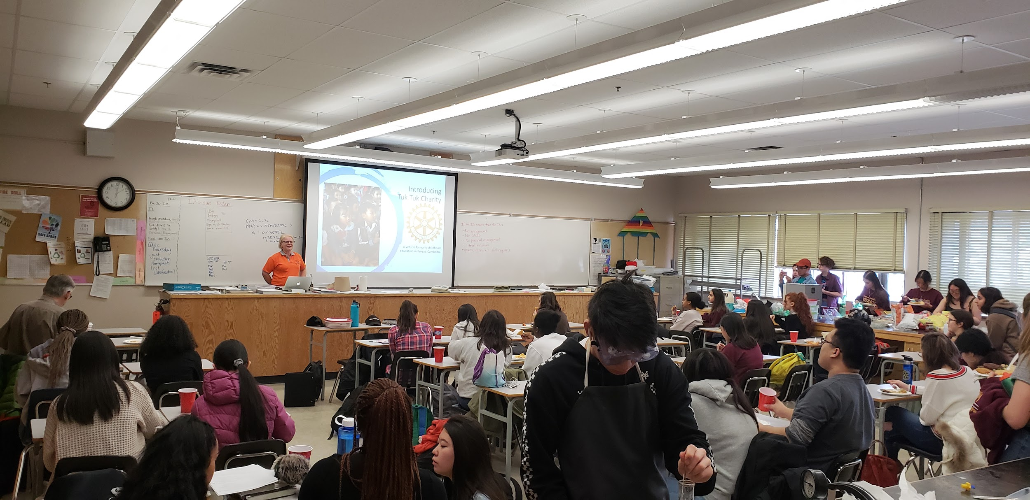
OVERALL IMPACT

Slide 17
HOW CAN YOU SUPPORT YOUTH IN ROTARY
Listen to what the needs of youth are
Take action in supporting our endeavours in whatever way you can
Contribute your sage advice and wisdom to the work youth are doing, we are on the shoulders of the amazing Rotarians that came before us
Mentor youth and guide our passions through the proper channels so that we can achieve maximum impact

Slide 18
THANK YOU
QUESTIONS?

