Slide 1
Our Transforming Grid
A Conversation with the Rotary Stampede Park Club
February 15, 2024
Public

Slide 2
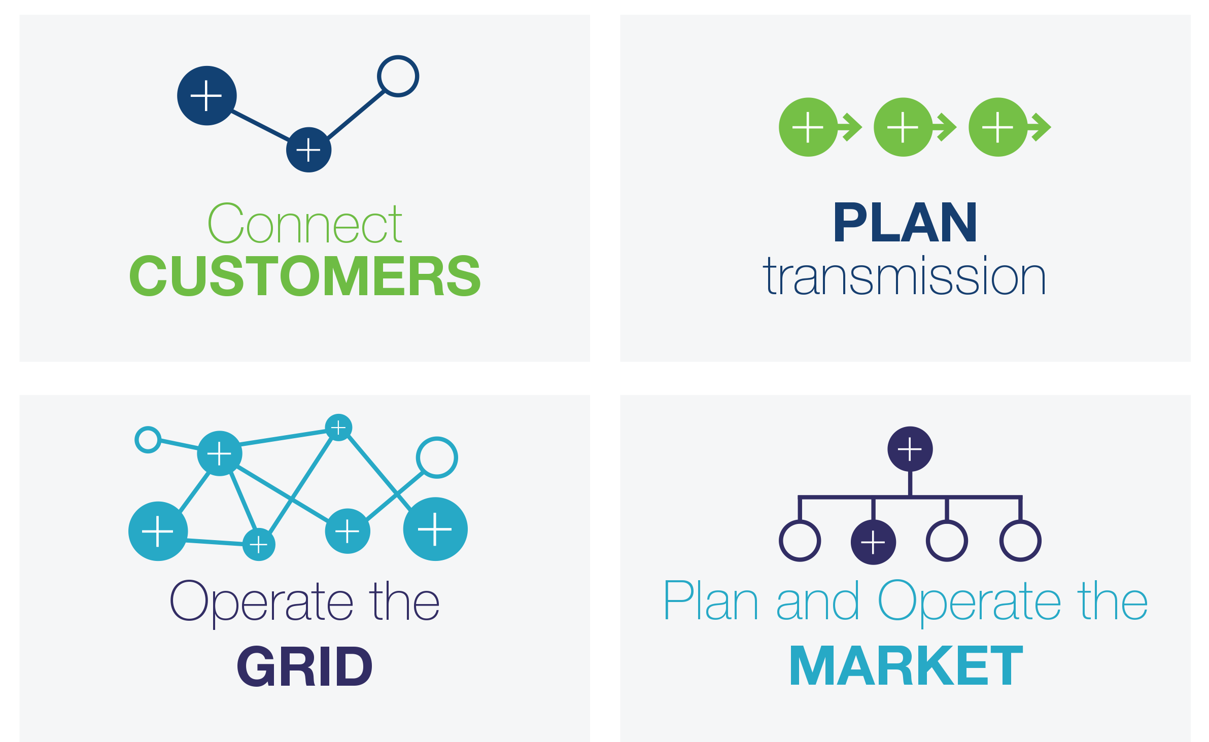
Our Public Interest Mandate
Public

Slide 3
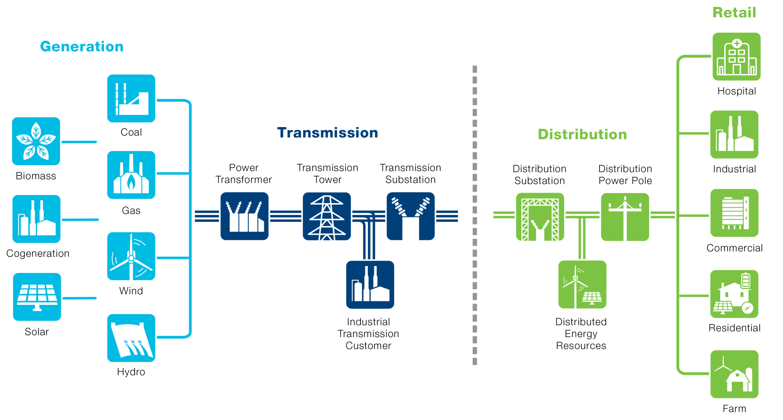
How the System Works
Public

Slide 4
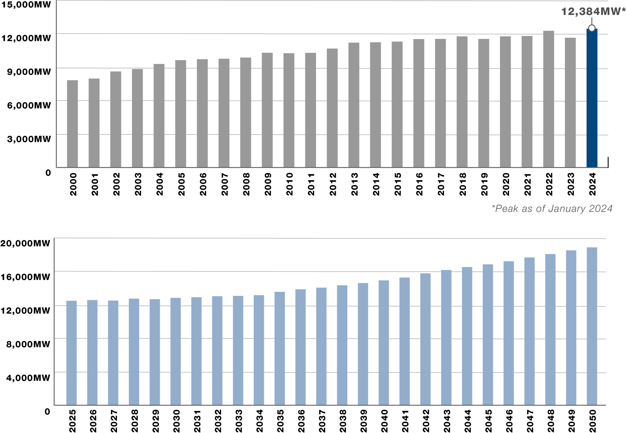
Alberta Power System Growth
Public

Slide 5
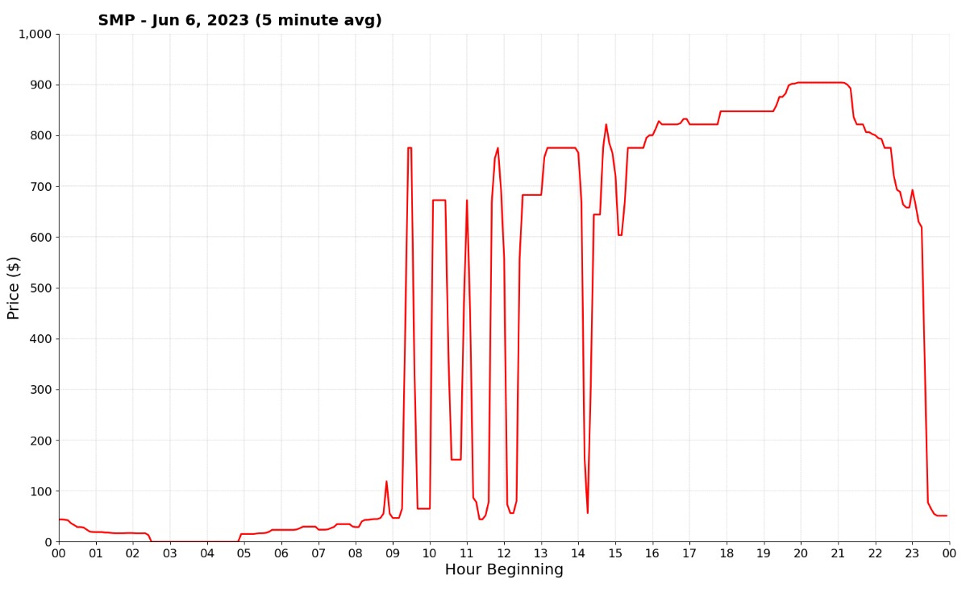
An Eventful Time
“For Alberta, this is the first year that renewables generation has provided more generation than coal on an annual basis” AESO 2022 Annual Market Statistics
Public

Slide 6
January 13, 2024: A Close Call – Albertans Respond
Between January 12 and 15, the AESO experienced four Grid Alerts.
Alberta’s all-time peak load of 12,384MW was set on Thursday, January 11.
An Emergency Alert was issued on Saturday the 13th – Albertans reduced load by 200MW.
Key reasons help explain what caused the Emergency Alert:
Extreme cold – high demand
Low wind and no solar – expected and forecast
Neighbouring jurisdictions under strain
Some natural gas generation outages
Emergency reserves, batteries and imports usage
Significant equipment malfunction concern
Life and Property at risk if something went wrong with rotating outages.
Low availability of imports
Outages
Low wind
High demand
Public

Slide 7
Coal Transition and Emissions
Alberta’s transition away from coal generation has created a meaningful reduction in electricity sector emissions.
The pace of transition has also increased prices in the past few years.
Public

Slide 8
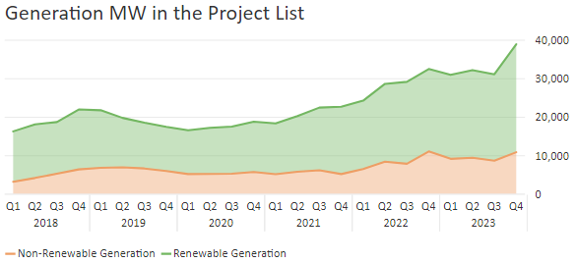
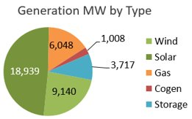
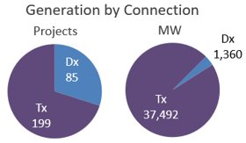
Significant Volume of Generation in the Connection Project List
28.1 GW
10.8 GW
Public

Slide 9
Renewables Growth
By 2035, AESO’s preliminary assessments indicate approximately 35-40% of our domestic Alberta generation will be provided by renewables, including hydro and biomass.
Public

Slide 10
Leading the Industry Forward
Public

Slide 11
What We Are Trying To Accomplish
Affordable Electricity for Consumers
A Reliable Electric Grid
Decarbonization by 2050 and Related Policy Objectives
Reasonable and Realistic Implementation
Public

Slide 12
Option Value of 2050 vs 2035
Less reliance on “first-of-kind” technologies (costs, operations risks)
Time to develop regulatory processes (i.e., brownfield vs greenfield SMRs)
Adequate time to develop infrastructure (i.e., fuel supply, storage and potentially interties)
Creates optionality to choose between second or third-generation technologies (i.e., hydrogen vs CCUS vs SMR)
2035
2050
Avoids significant cost escalation (i.e., scarce resources) by attempting to complete multiple projects simultaneously
Public

Slide 13
2035 vs 2050 Decarbonization
Emissions are expected to reduce to less than 10 Mt per annum before 2030 without any changes as proposed in the Clean Electricity Regulation.
The expected emissions difference between the decarbonization by 2035 and the decarbonization by 2050 scenario is negligible and amounts to 22 Mt between 2023 and 2050.
Assumes carbon pricing of $170 by 2030 in each scenario
Assumes supports including the Investment Tax Credits
Public

Slide 14
What’s Ahead
A carbon neutral future is certain – timelines are up for debate.
The ideal path forward will achieve it within reasonable timelines, while ensuring reliability and affordability.
All generation types are required for success.
AESO is working closely with government and stakeholders to ensure a safe, affordable and reliable grid, now and in the future.
Reports, Recommendations and Policy Direction.
Public

Slide 15
The Floor is Open!
Public

Slide 16
Contact the AESO
X: @theAESO
Email: info@aeso.ca
Website: www.aeso.ca
Subscribe to our stakeholder newsletter
Public

Slide 17
Thank you
Public

