Slide 1

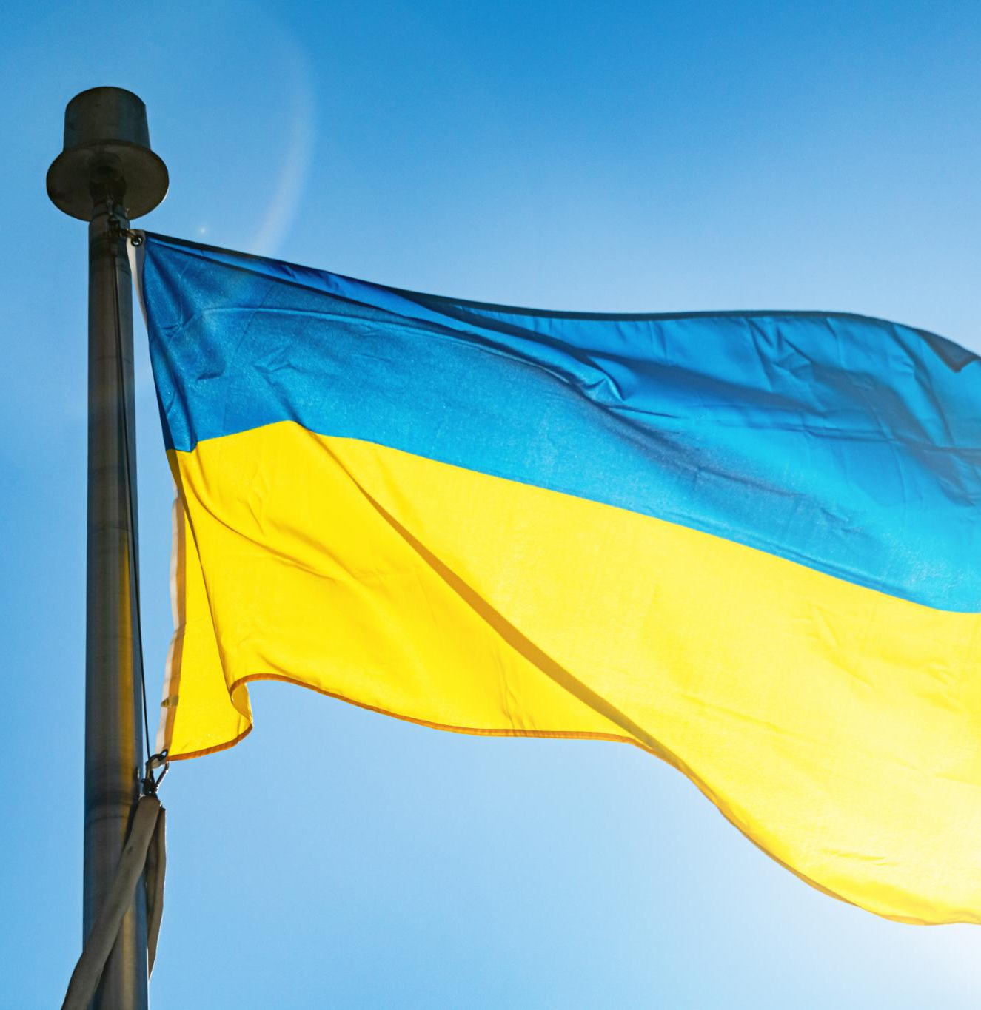
CONTRIBUTIONS OUR CLUB MADE TO AID
UKRAINIAN EVACUEES
Rotary's Impactful Initiatives
Raised $492,000 — And So Much More
Monetary aid, housing help, job support, and warm welcomes for those in need.
Notes:
---
This presentation will explore the historical background of the Ukrainian flag and the significance of its colors, as well as the impactful initiatives undertaken by the Rotary Club to support Ukrainian refugees. We will delve into the outcomes of these efforts, the challenges faced, and future plans for continued support.

Slide 2

Symbolism
  The Ukrainian flag is a symbol of national pride and unity, reflecting the country’s struggles for independence. It serves as a reminder of the sacrifices made throughout history to achieve freedom and self-determination.
Cultural Significance
  Together, blue and yellow embody the spirit and resilience of the Ukrainian people, symbolizing hope and strength.
Notes:
The blue color represents peace and the sky, while the yellow symbolizes prosperity and the golden wheat fields. Together, they embody the spirit and resilience of the Ukrainian people.

Slide 3
Symbolism of the Blue and Yellow Colors
  BLUE symbolizes peace and tranquility, reflecting the vastness of the sky.
  YELLOW represents prosperity and abundance, often associated with the golden fields of wheat.
Notes:
The blue color represents peace and the sky, while the yellow symbolizes prosperity and the golden wheat fields. Together, they embody the spirit and resilience of the Ukrainian people.

Slide 4


SUPPORT FOR UKRAINIAN EVACUEES TO ALBERTA!
Nearly 250,000 new Ukrainians in Canada
More than 70,000 came to Alberta
33,000 have come to Calgary since the 2014 invasion of Ukraine
Canada has the 3rd largest population of Ukrainians in the world
Notes:
We will begin with the historical background of the Ukrainian flag, including its origins, the symbolism of its blue and yellow colors, and its cultural significance. Next, we will highlight the Rotary Club's initiatives aimed at supporting Ukrainian refugees, followed by an analysis of the impact of these efforts and future plans.

Slide 5
SUPPORT FOR UKRAINIAN EVACUEES TO ALBERTA!
The Rotary Club of Calgary at Stampede Park
  Ribbons for Peace Fundraiser
  Help new evacuees settle into their homes in Calgary
Notes:
We will begin with the historical background of the Ukrainian flag, including its origins, the symbolism of its blue and yellow colors, and its cultural significance. Next, we will highlight the Rotary Club's initiatives aimed at supporting Ukrainian refugees, followed by an analysis of the impact of these efforts and future plans.

Slide 6
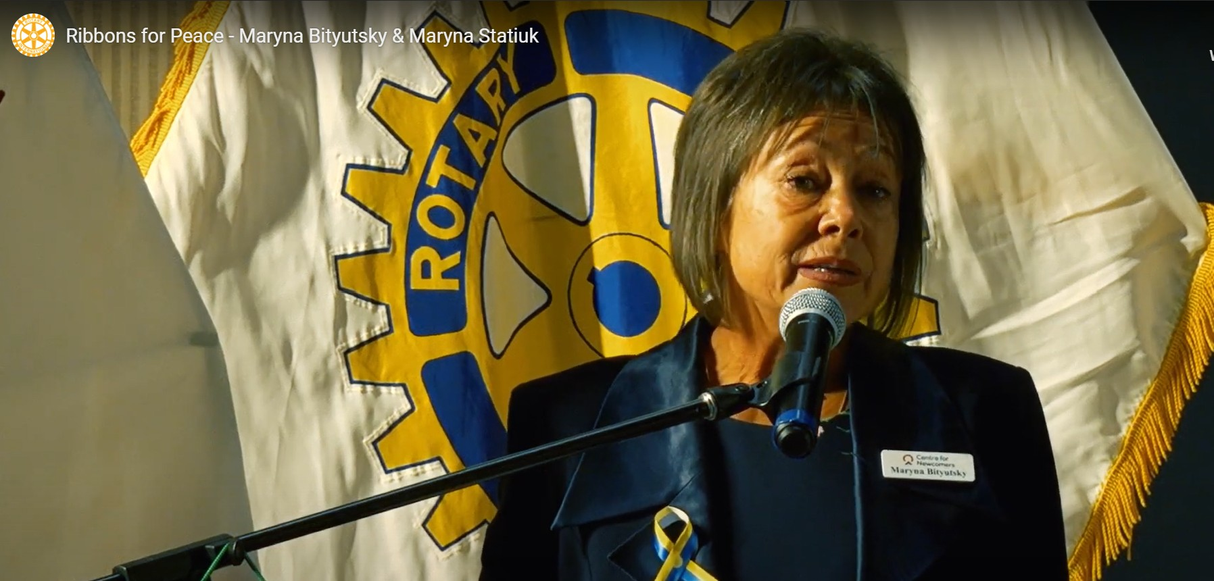
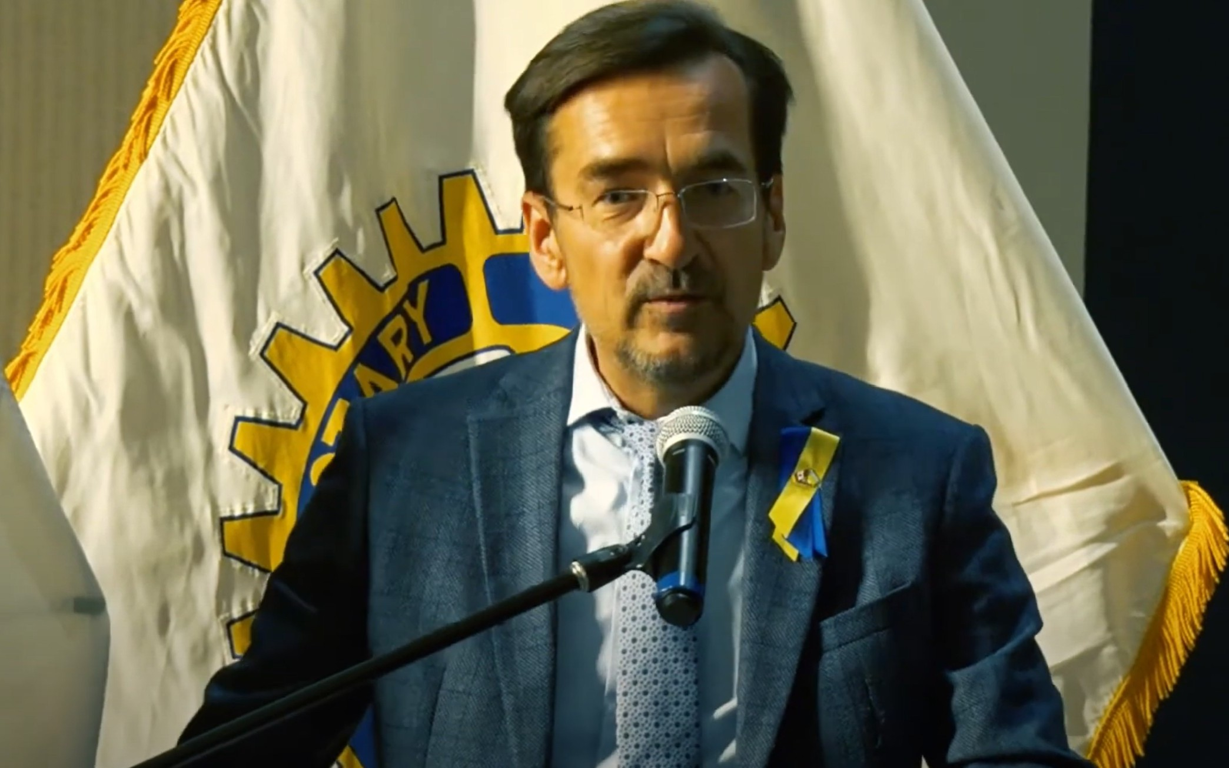
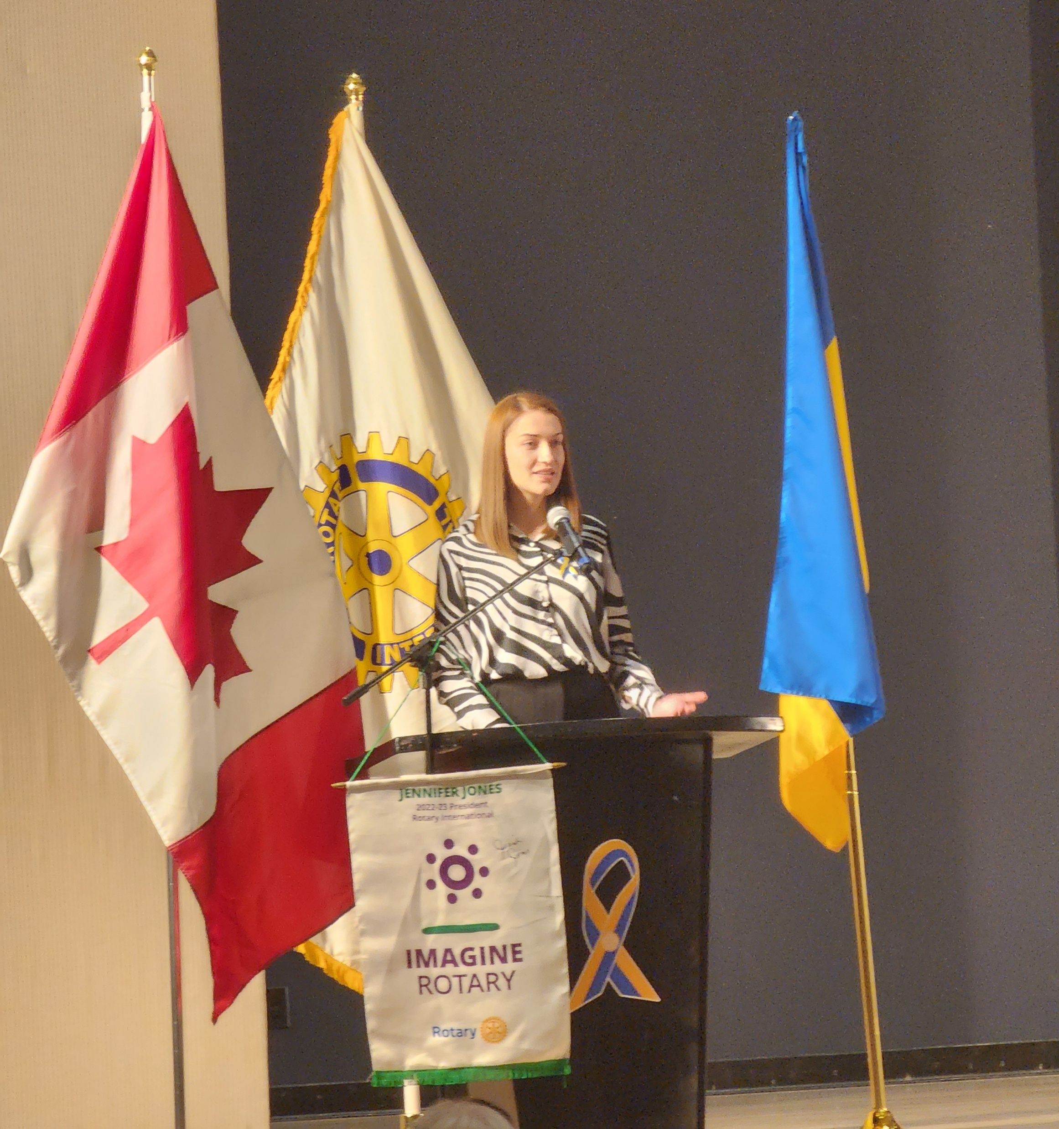
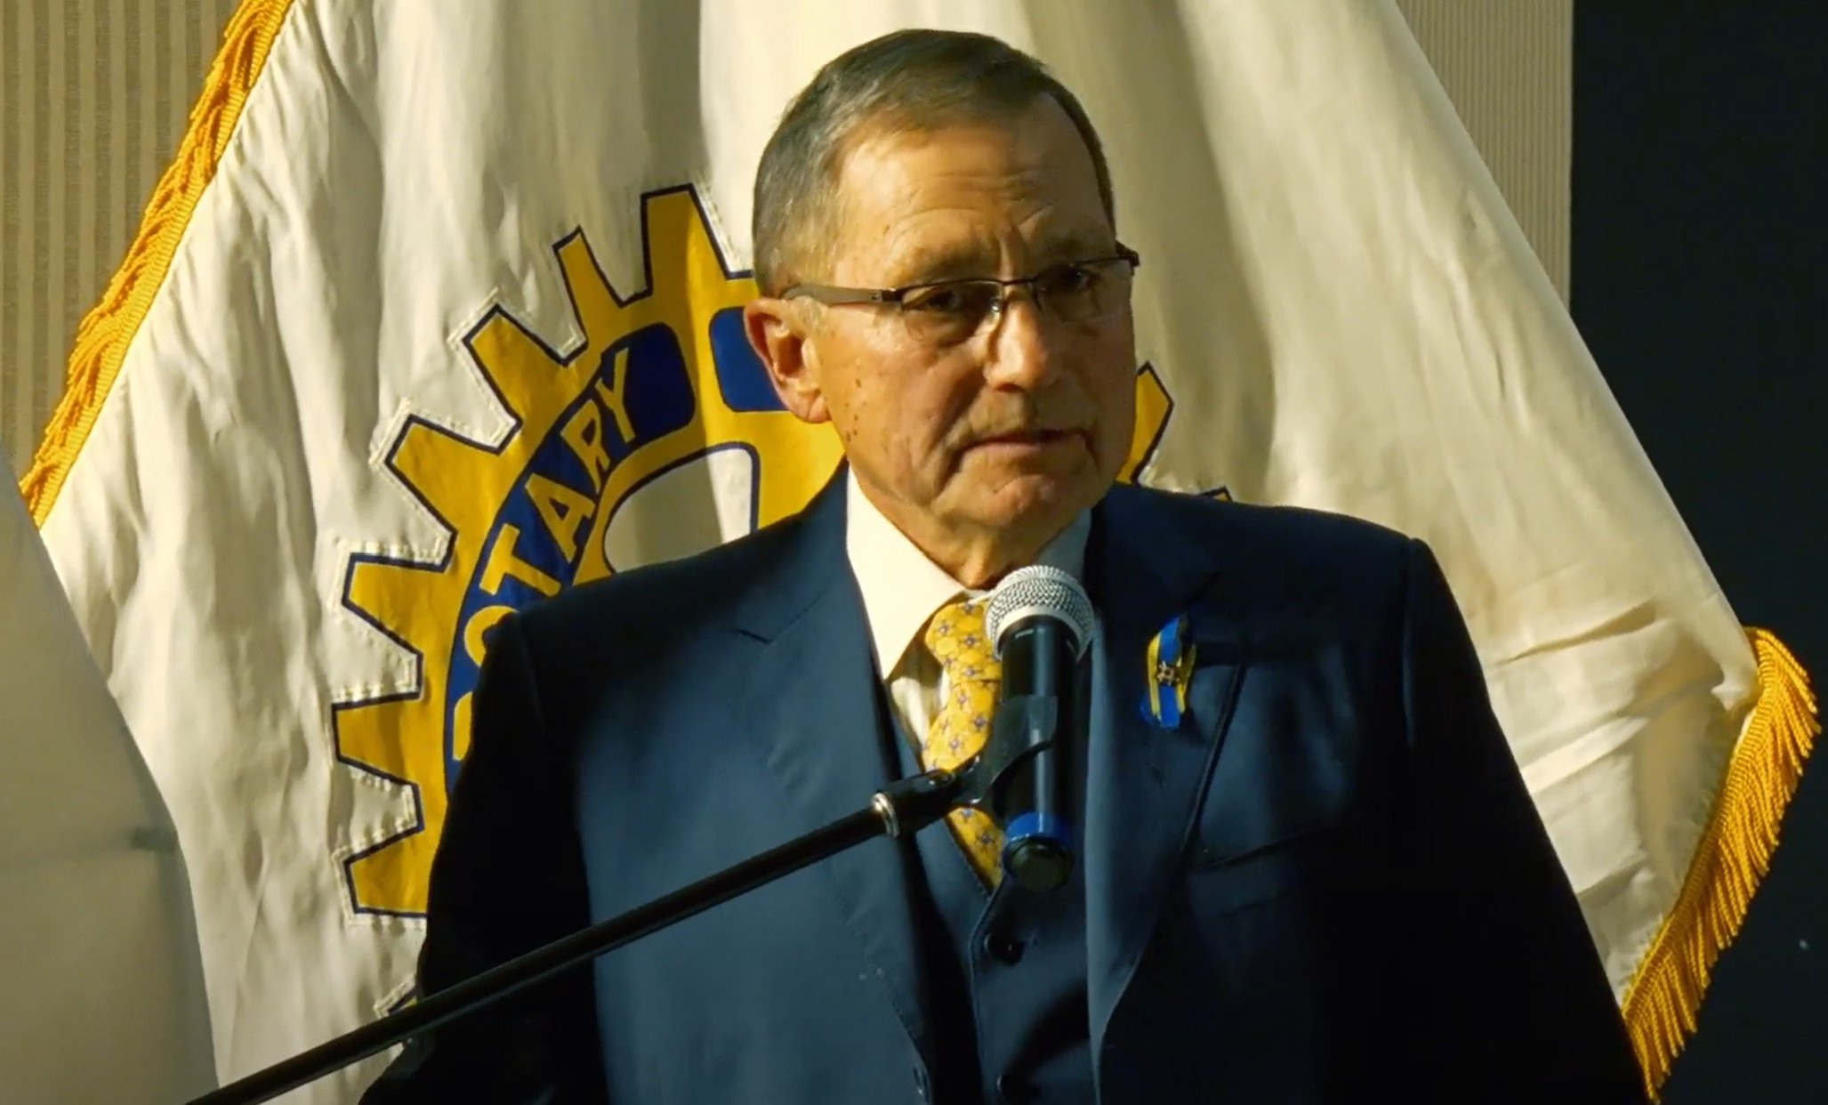
Our Speakers
Maryna Bityutsky – CFO – Calgary Centre for Newcomers
Oleksander Danyleiko
Consul General of Ukraine in Edmonton
Maryna Stetsiuk – ESL Instructor
Hon. Ed Stelmach - Former Premier of Alberta
Notes:
The Ukrainian flag has a deep historical context, reflecting the nation's identity and aspirations. Understanding its origins and the meaning behind its colors helps to appreciate its significance in both Ukrainian culture and history.

Slide 7
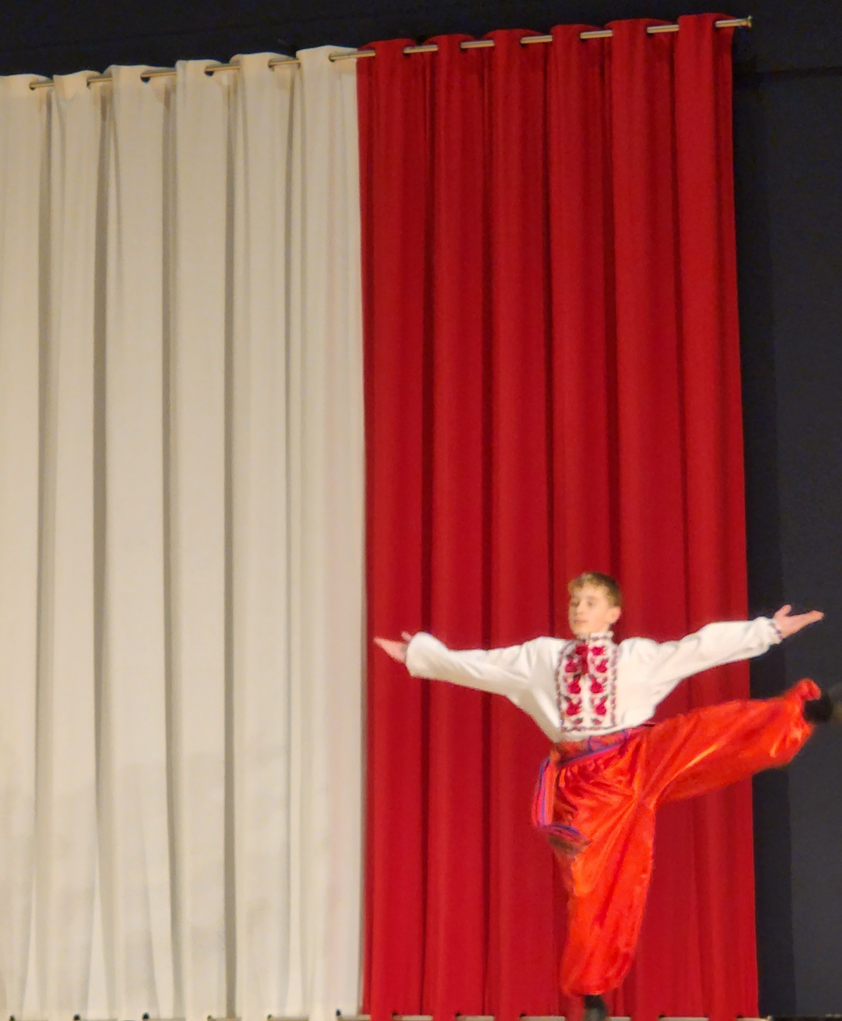
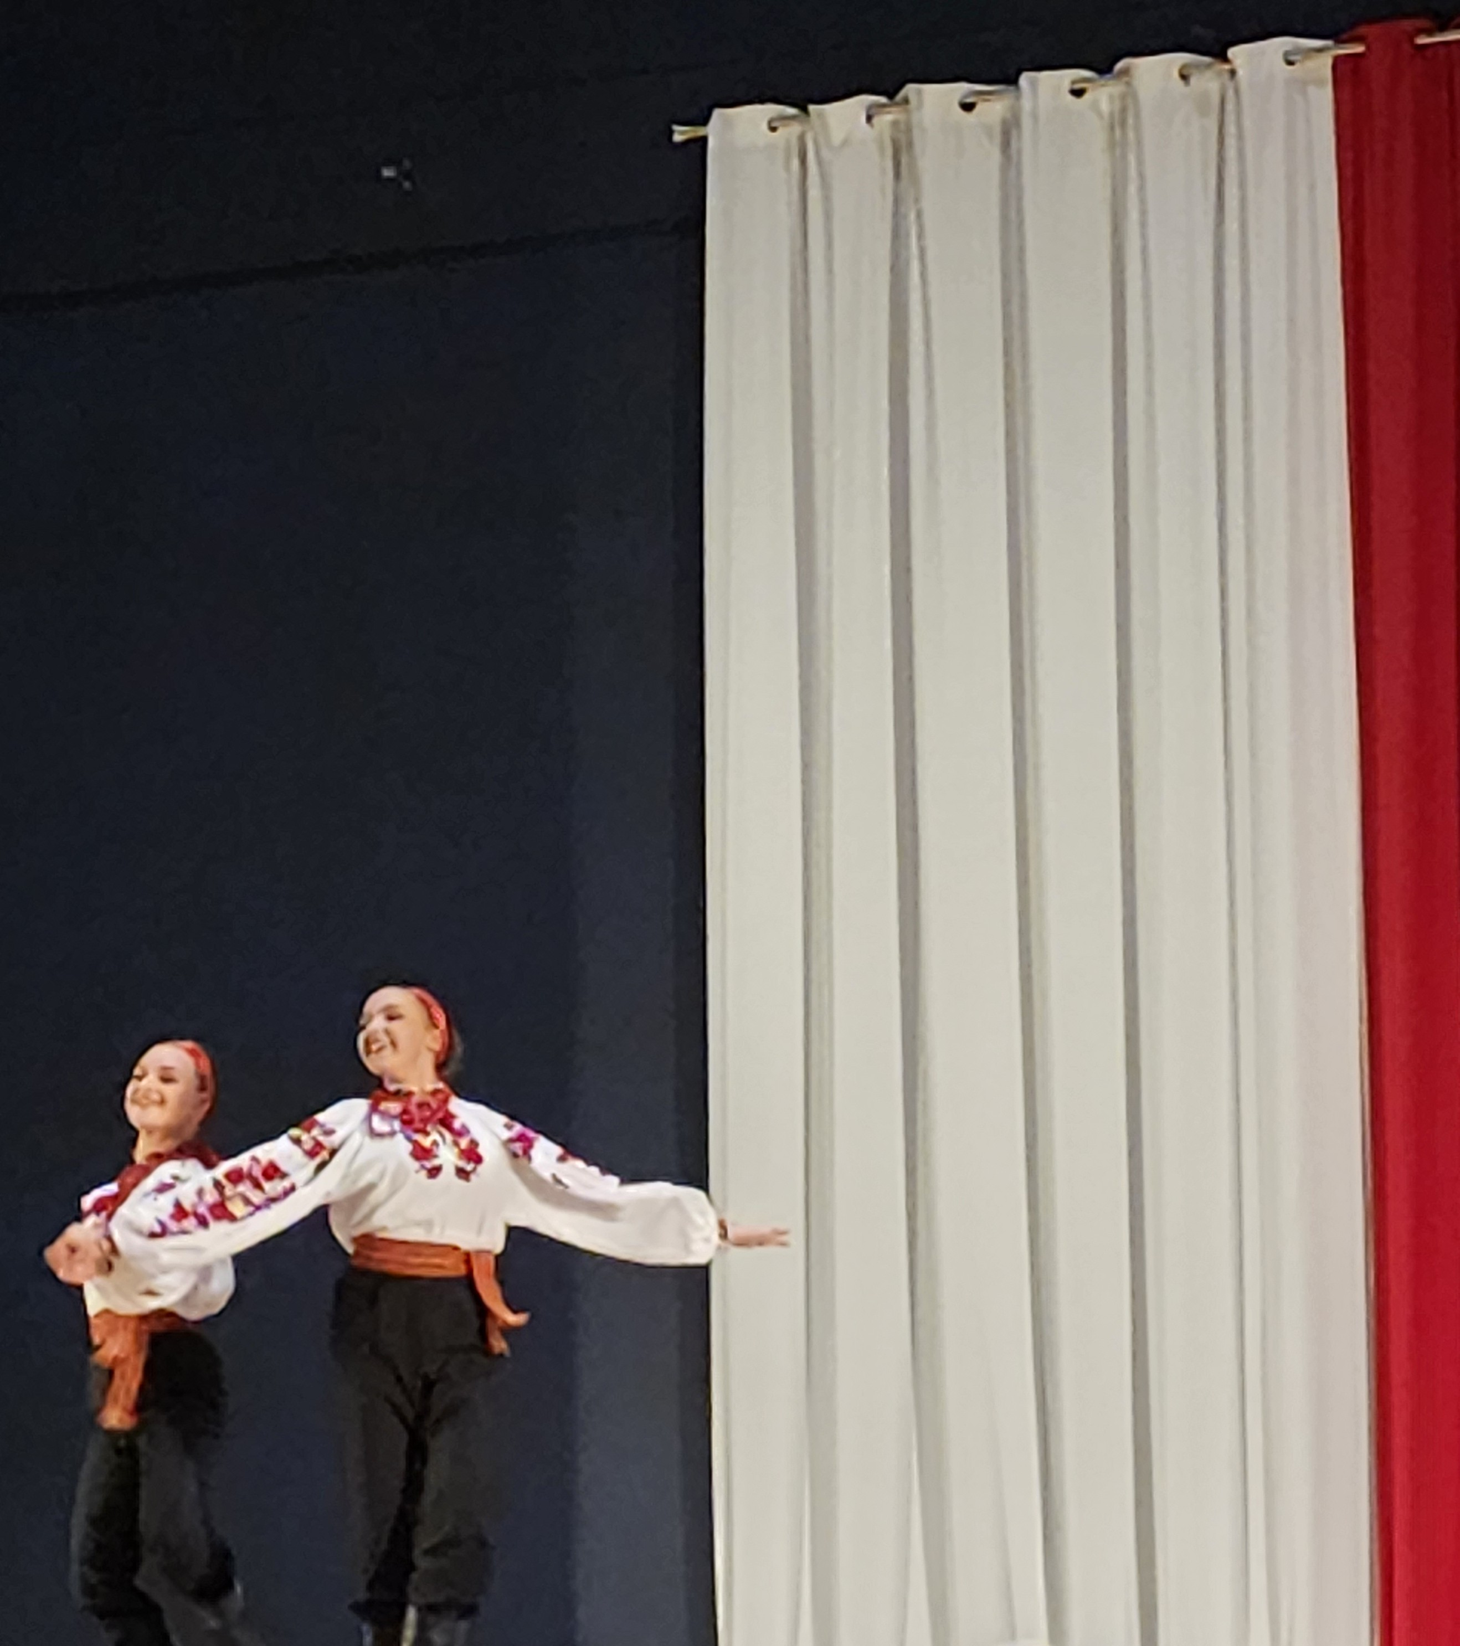
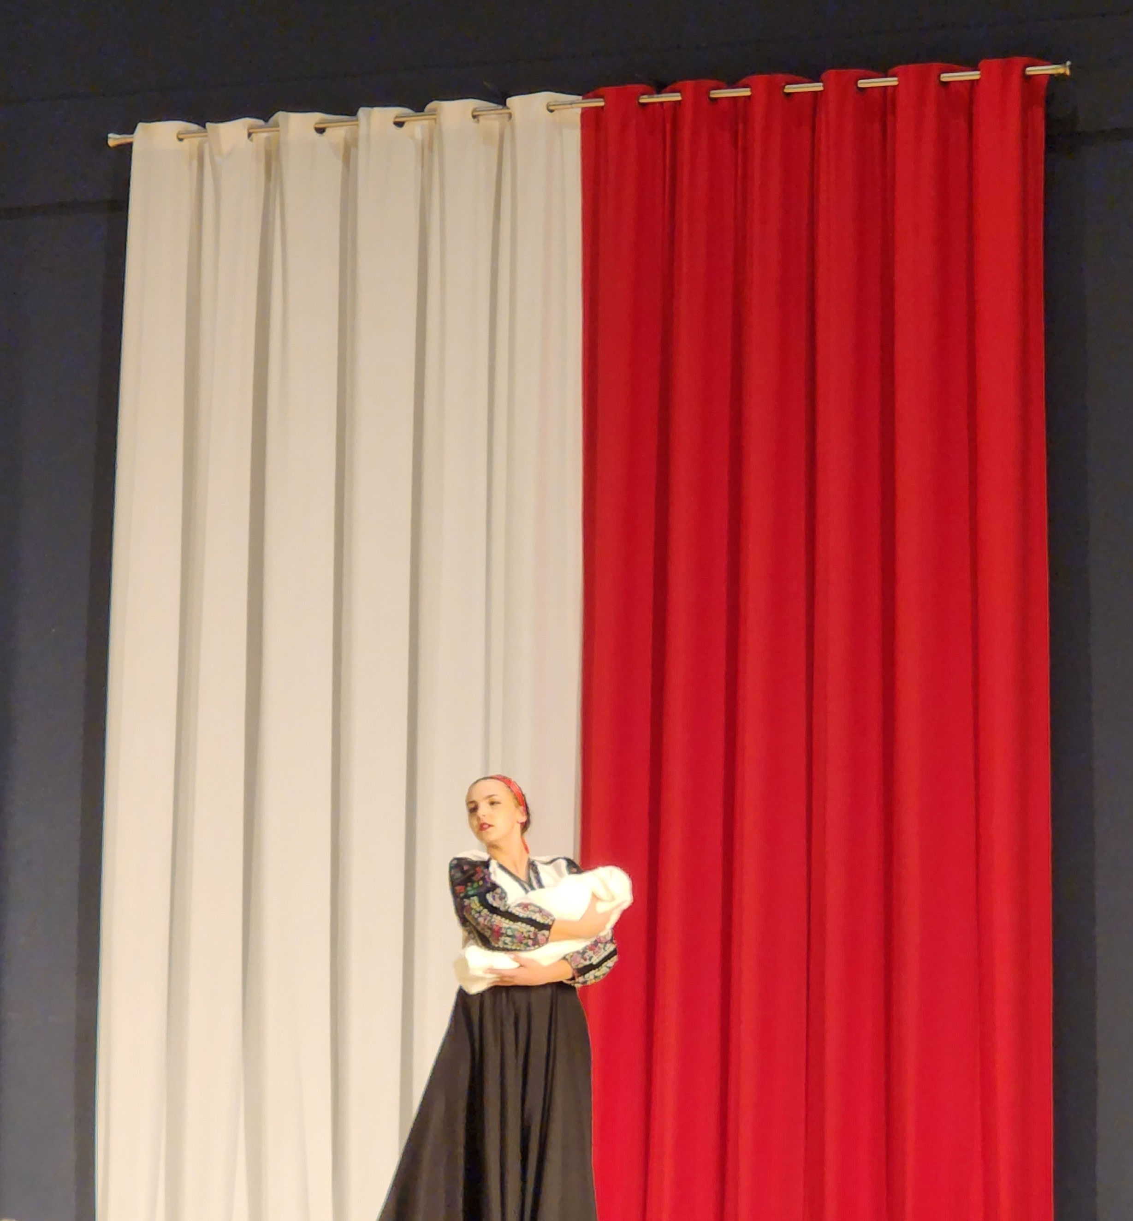
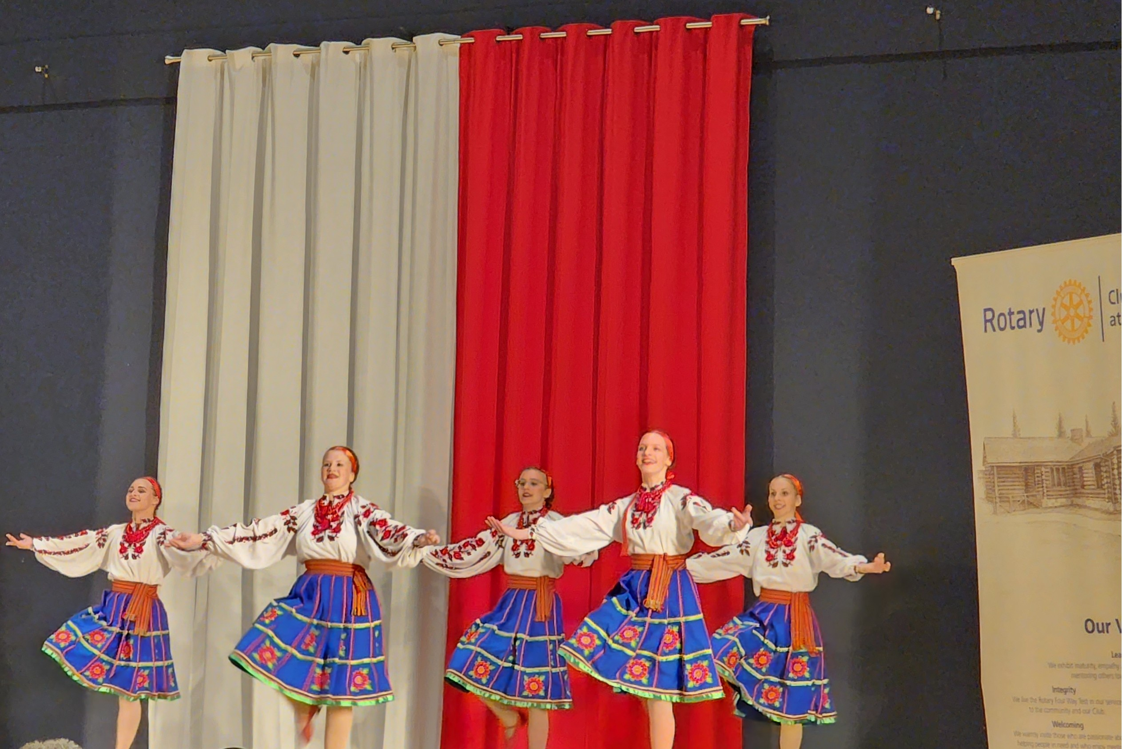
Cultural entertainment
Vykrutas Ukrainian Dance Society
Notes:
The Ukrainian flag's blue and yellow colors have been used for centuries, representing the sky and wheat fields of Ukraine. It was officially adopted in 1918, symbolizing national identity and independence.

Slide 8
Most arrive with nothing
Often single mothers with children—with urgent needs:
🏠 Temporary housing
📑 Immigration paperwork
🩺 Health coverage
🎒 School registration
🚗 Transportation and essentials
"Financial support gives a hand up—not a handout," 💛 Everyone deserves a chance to live in peace.
Notes:
The Rotary Club has taken significant steps to assist Ukrainian refugees through various initiatives, aligning with its mission to promote humanitarian service and community support.

Slide 9
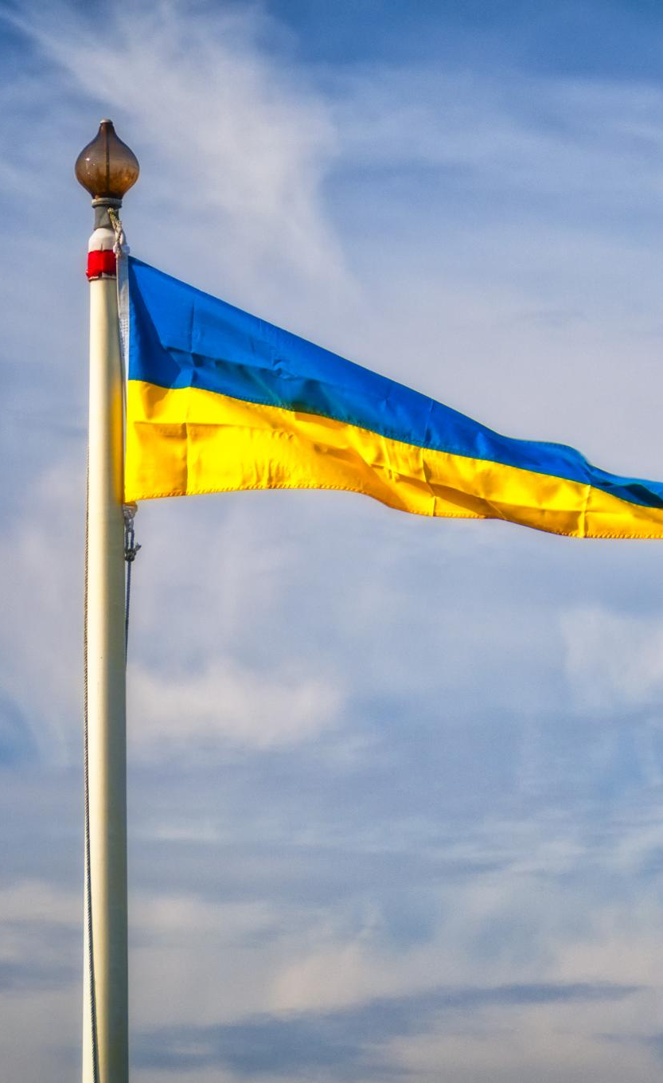

With overwhelming support through tickets, auctions, and donations…proudly raised
$172,000
Notes:
The Ukrainian flag is a symbol of national pride and unity, reflecting the country’s struggles for independence. It serves as a reminder of the sacrifices made throughout history to achieve freedom and self-determination.

Slide 10
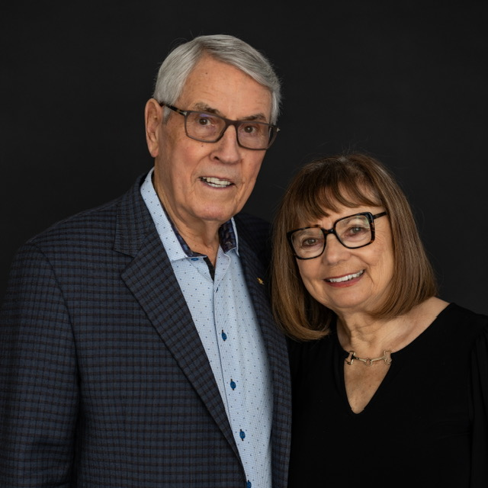
an additional
$100,000 was donated
By Glen and Jeanette Richardson in honour of Jeanette’s parents and her brother.
This brought our “RIBBONS FOR PEACE” fundraising total to
$272,000
Glen and Jeanette Richardson

Slide 11
Glen and Jeanette donated an additional $100,000 to the Rotary International RELIEF FUND FOR Ukrainians
“In honour of my parents who immigrated to Canada from Ukraine in 1930, Glen and I wanted to give back to the country and community that welcomed them.”
— Jeanette Richardson
Jeanette Richardson, a proud first-generation Canadian, and her husband Glen, a devoted member of the Rotary Club of Calgary at Stampede Park for 48 years, donated an additional $100,000 to the Rotary International Relief Fund for Ukrainians.
A tribute to family, heritage, and the power of giving.

Slide 12
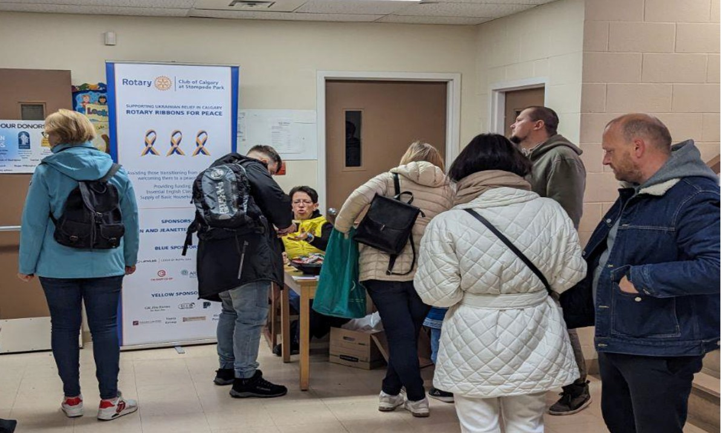
How was the money spent?
Partnering for Impact
Our club partnered with St. Vladimir’s Parish to put the $272,000 raised toward essential support for nearly 6,000 Ukrainian evacuees.
ARRIVAL PACKAGES - $99,000:
pillows, bedsheets, blankets, towel, toiletries, basic dishes, pots and pans.
Together, we provided not just supplies—but stability, dignity, and a warm welcome.

Slide 13
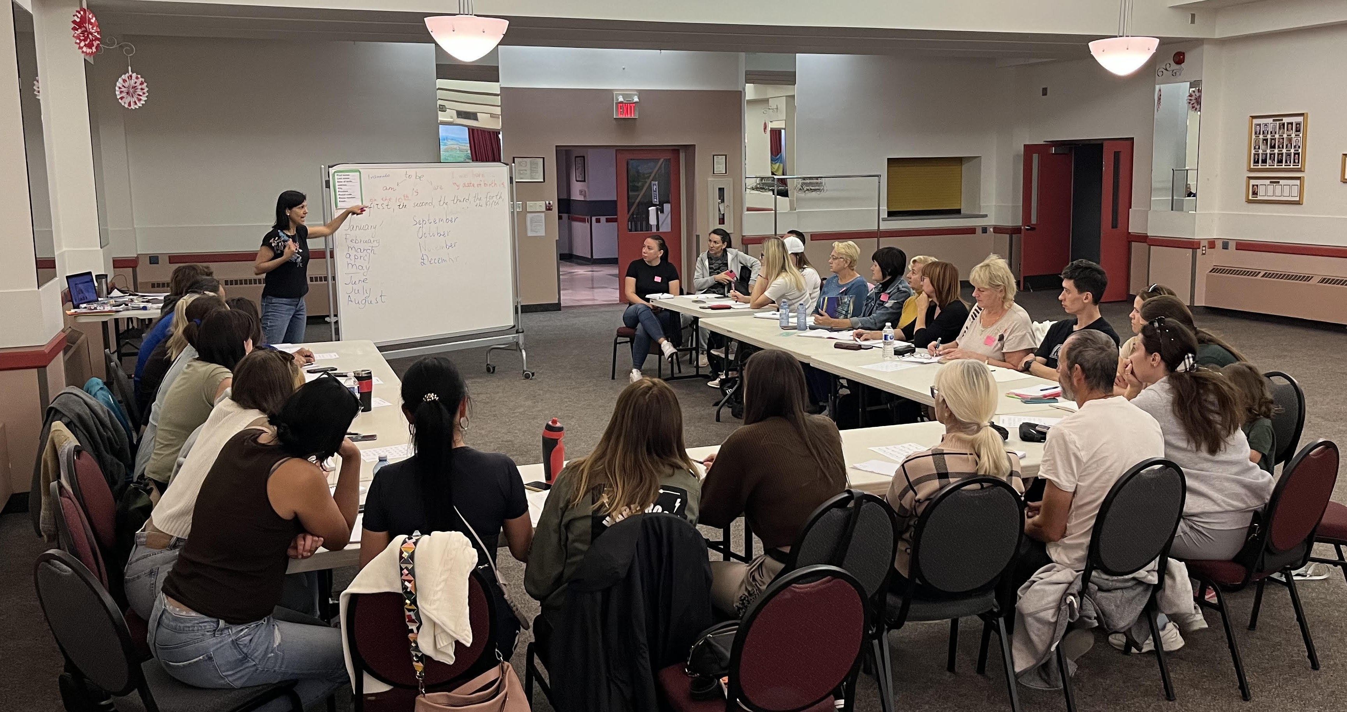
How was the money spent?
SURVIVAL ENGLISH CLASSES
$134,000 for 2,300 students
10-day intensive Mon.-Fri.
Faced with a six-month wait for government English classes, St. Vladimir’s Parish—supported by our club—opened its doors to evacuees, offering immediate language lessons.
Breaking Language Barriers
We provided English language support to help evacuees build everyday communication skills—empowering them to secure jobs, find housing, and confidently navigate life in an English-speaking environment.

Slide 14
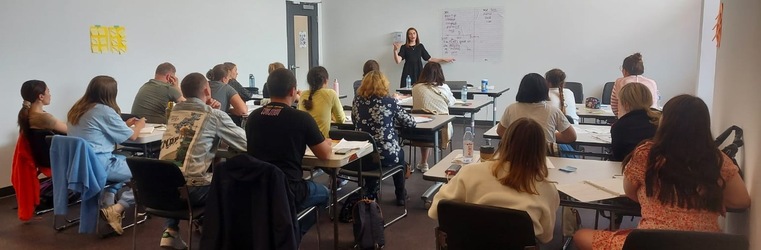
How was the money allocated?
SURVIVAL ENGLISH CLASSES
Student Testimonial
  ‘The classes helped me to start a conversation, not be afraid to talk about different topics, such as work and resume writing, shopping, weather, to discuss various moments that were in our lives, and the opportunity to dream about our new life in Canada.’ Yuliia Fedai

Slide 15
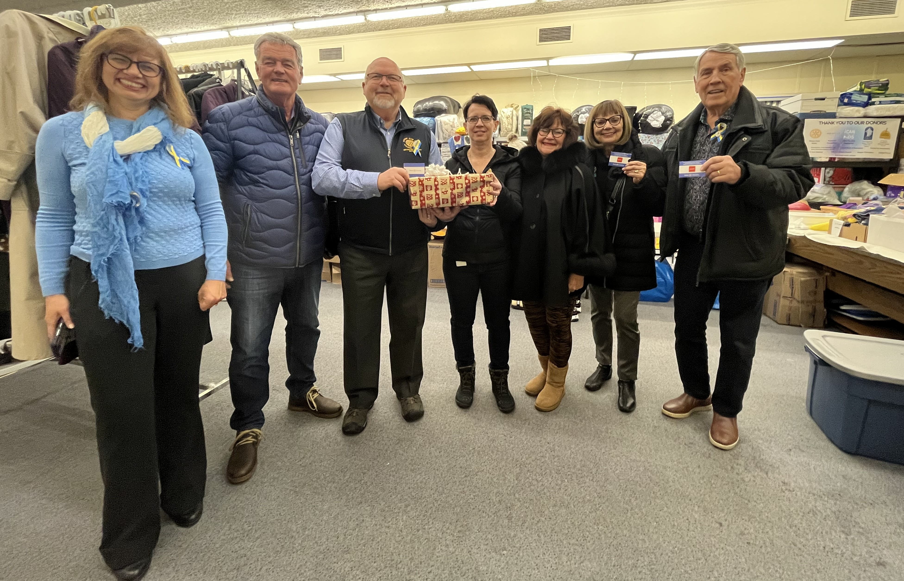
How was the money spent?
FOOD SECURITY
Matched $10,000 Calgary Co-Op to fund $100 gift cards for 200 families just before Christmas

Slide 16

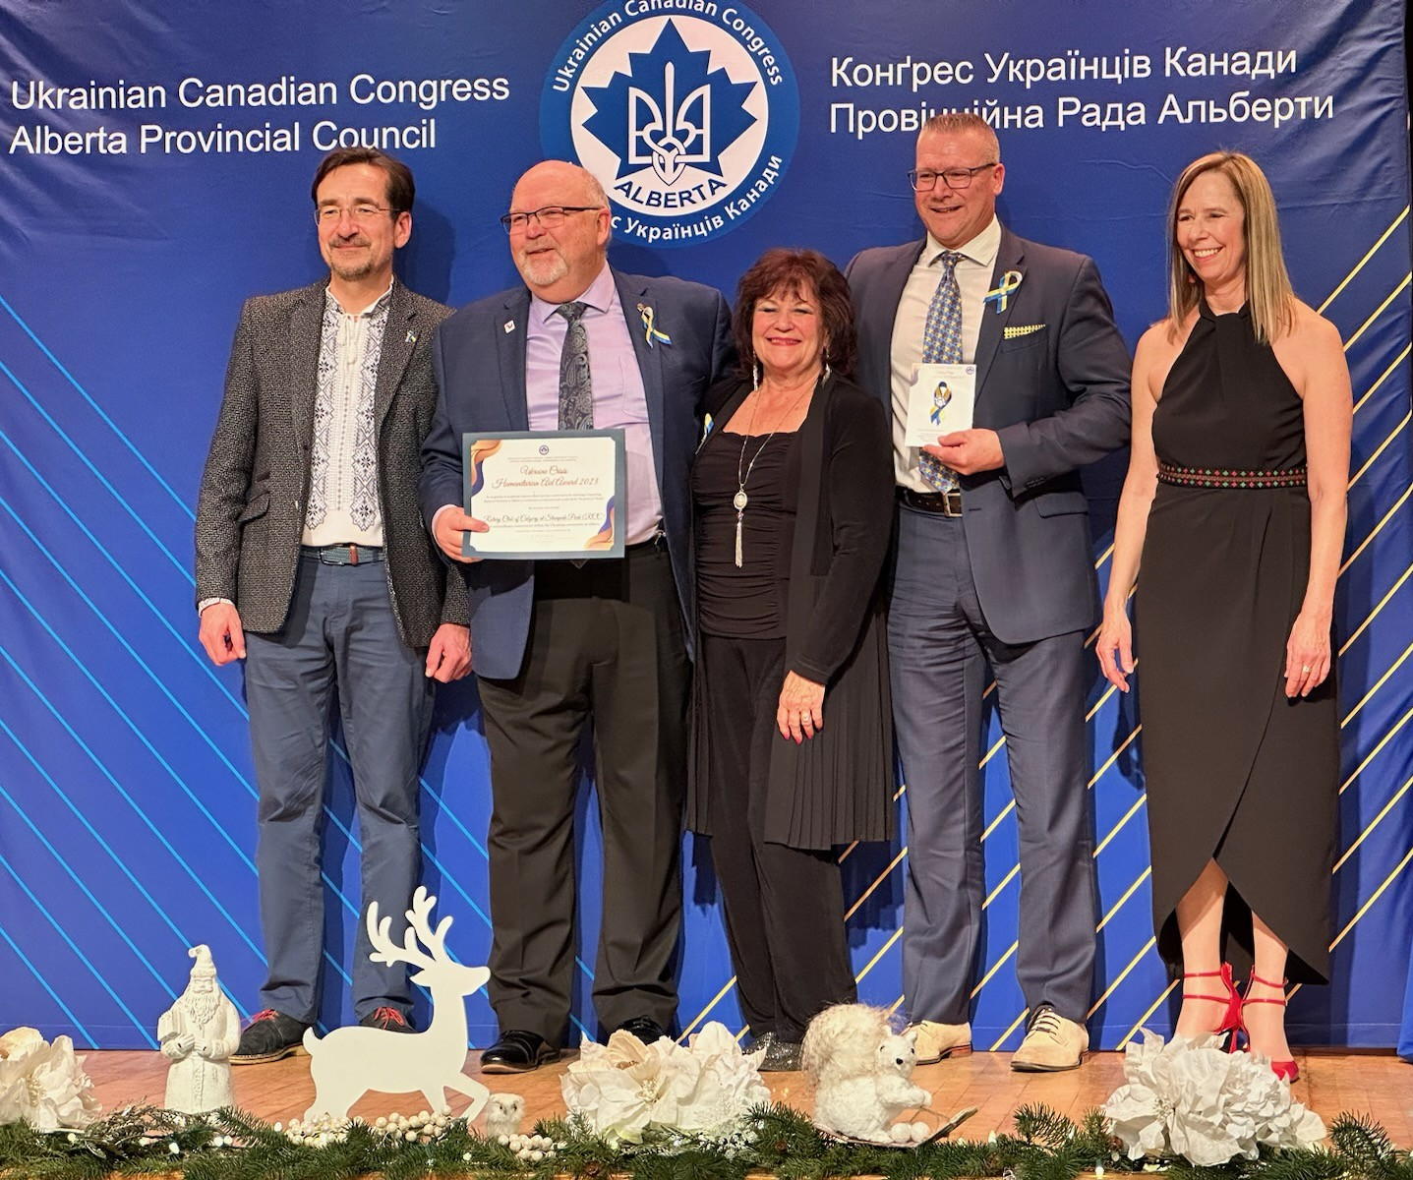
IN 2023, Rotary Club of CALGARY AT stampede Park’s “Ribbons for Peace” fundraising efforts receive
Hetman Humanitarian Aid Award recognizing club IMPACT ON support of Ukrainian evacuee settlement services in Calgary
THE HETMAN HUMANITARIAN AID AWARD

Slide 17
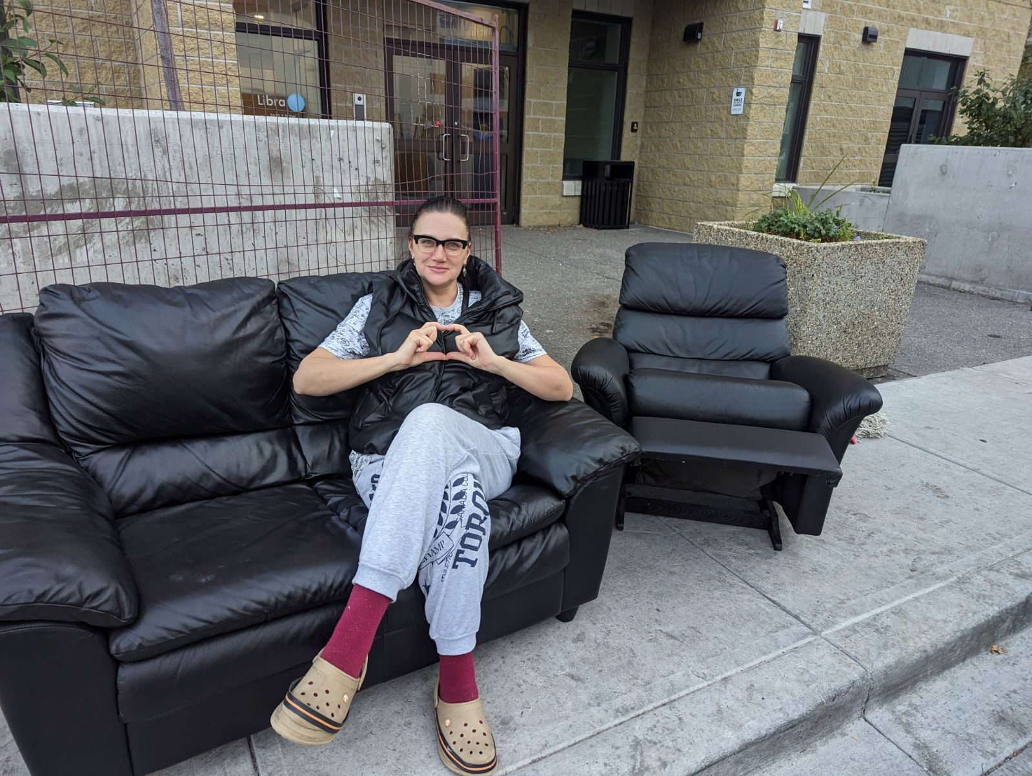
Furniture project initiated and spearheaded by Rotarian john Fitzsimmons
Rotarians rallied support from friends and family, collecting truckloads of furniture, clothing and toys, delivering it to the Ukrainian Donation Centre—helping newcomers settle into their new homes with dignity and comfort.
Notes:
Rotary Clubs have launched specific projects such as providing shelter, food, and medical care to Ukrainian refugees. These initiatives focus on immediate assistance and long-term support.

Slide 18
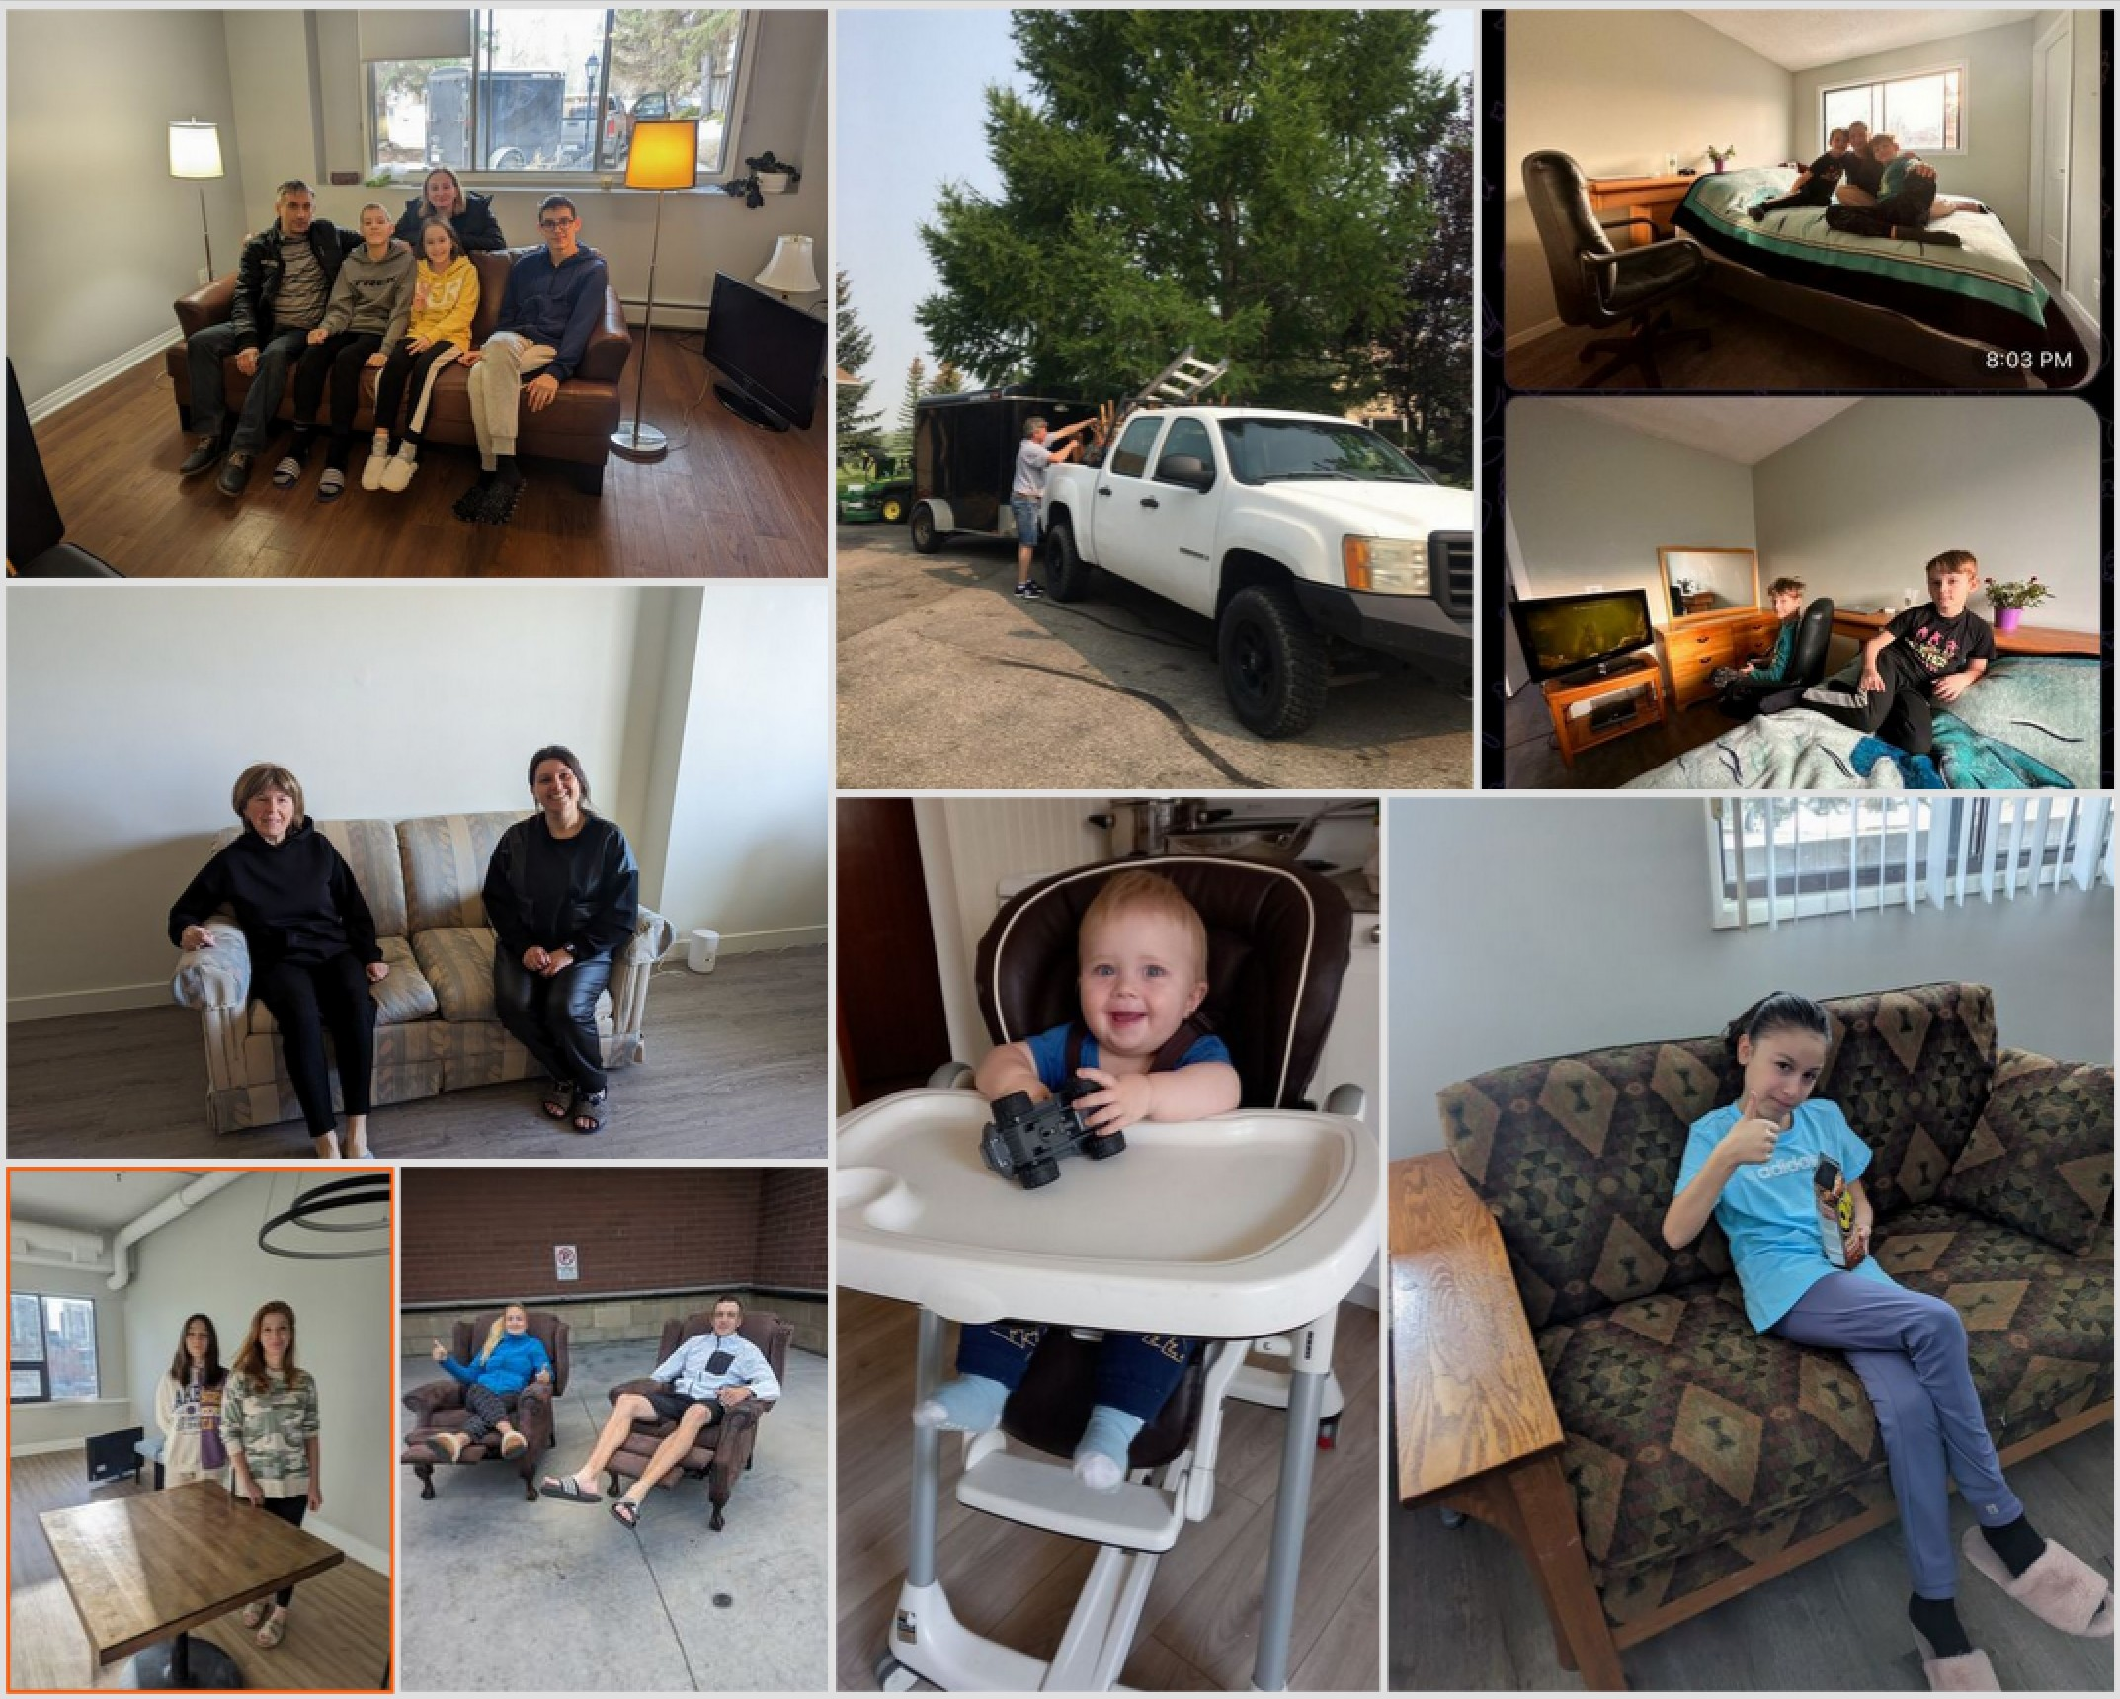
Collecting items involved many volunteer hours to lug heavy furniture up or down stairs, load trucks and unload again at Ukrainian Donation Centre.
Many smiling faces show how efforts were appreciated.

Slide 19

All this furniture found appreciative home, and, changed a fearful, time into a chance to build a comfortable home far away from home.

Slide 20
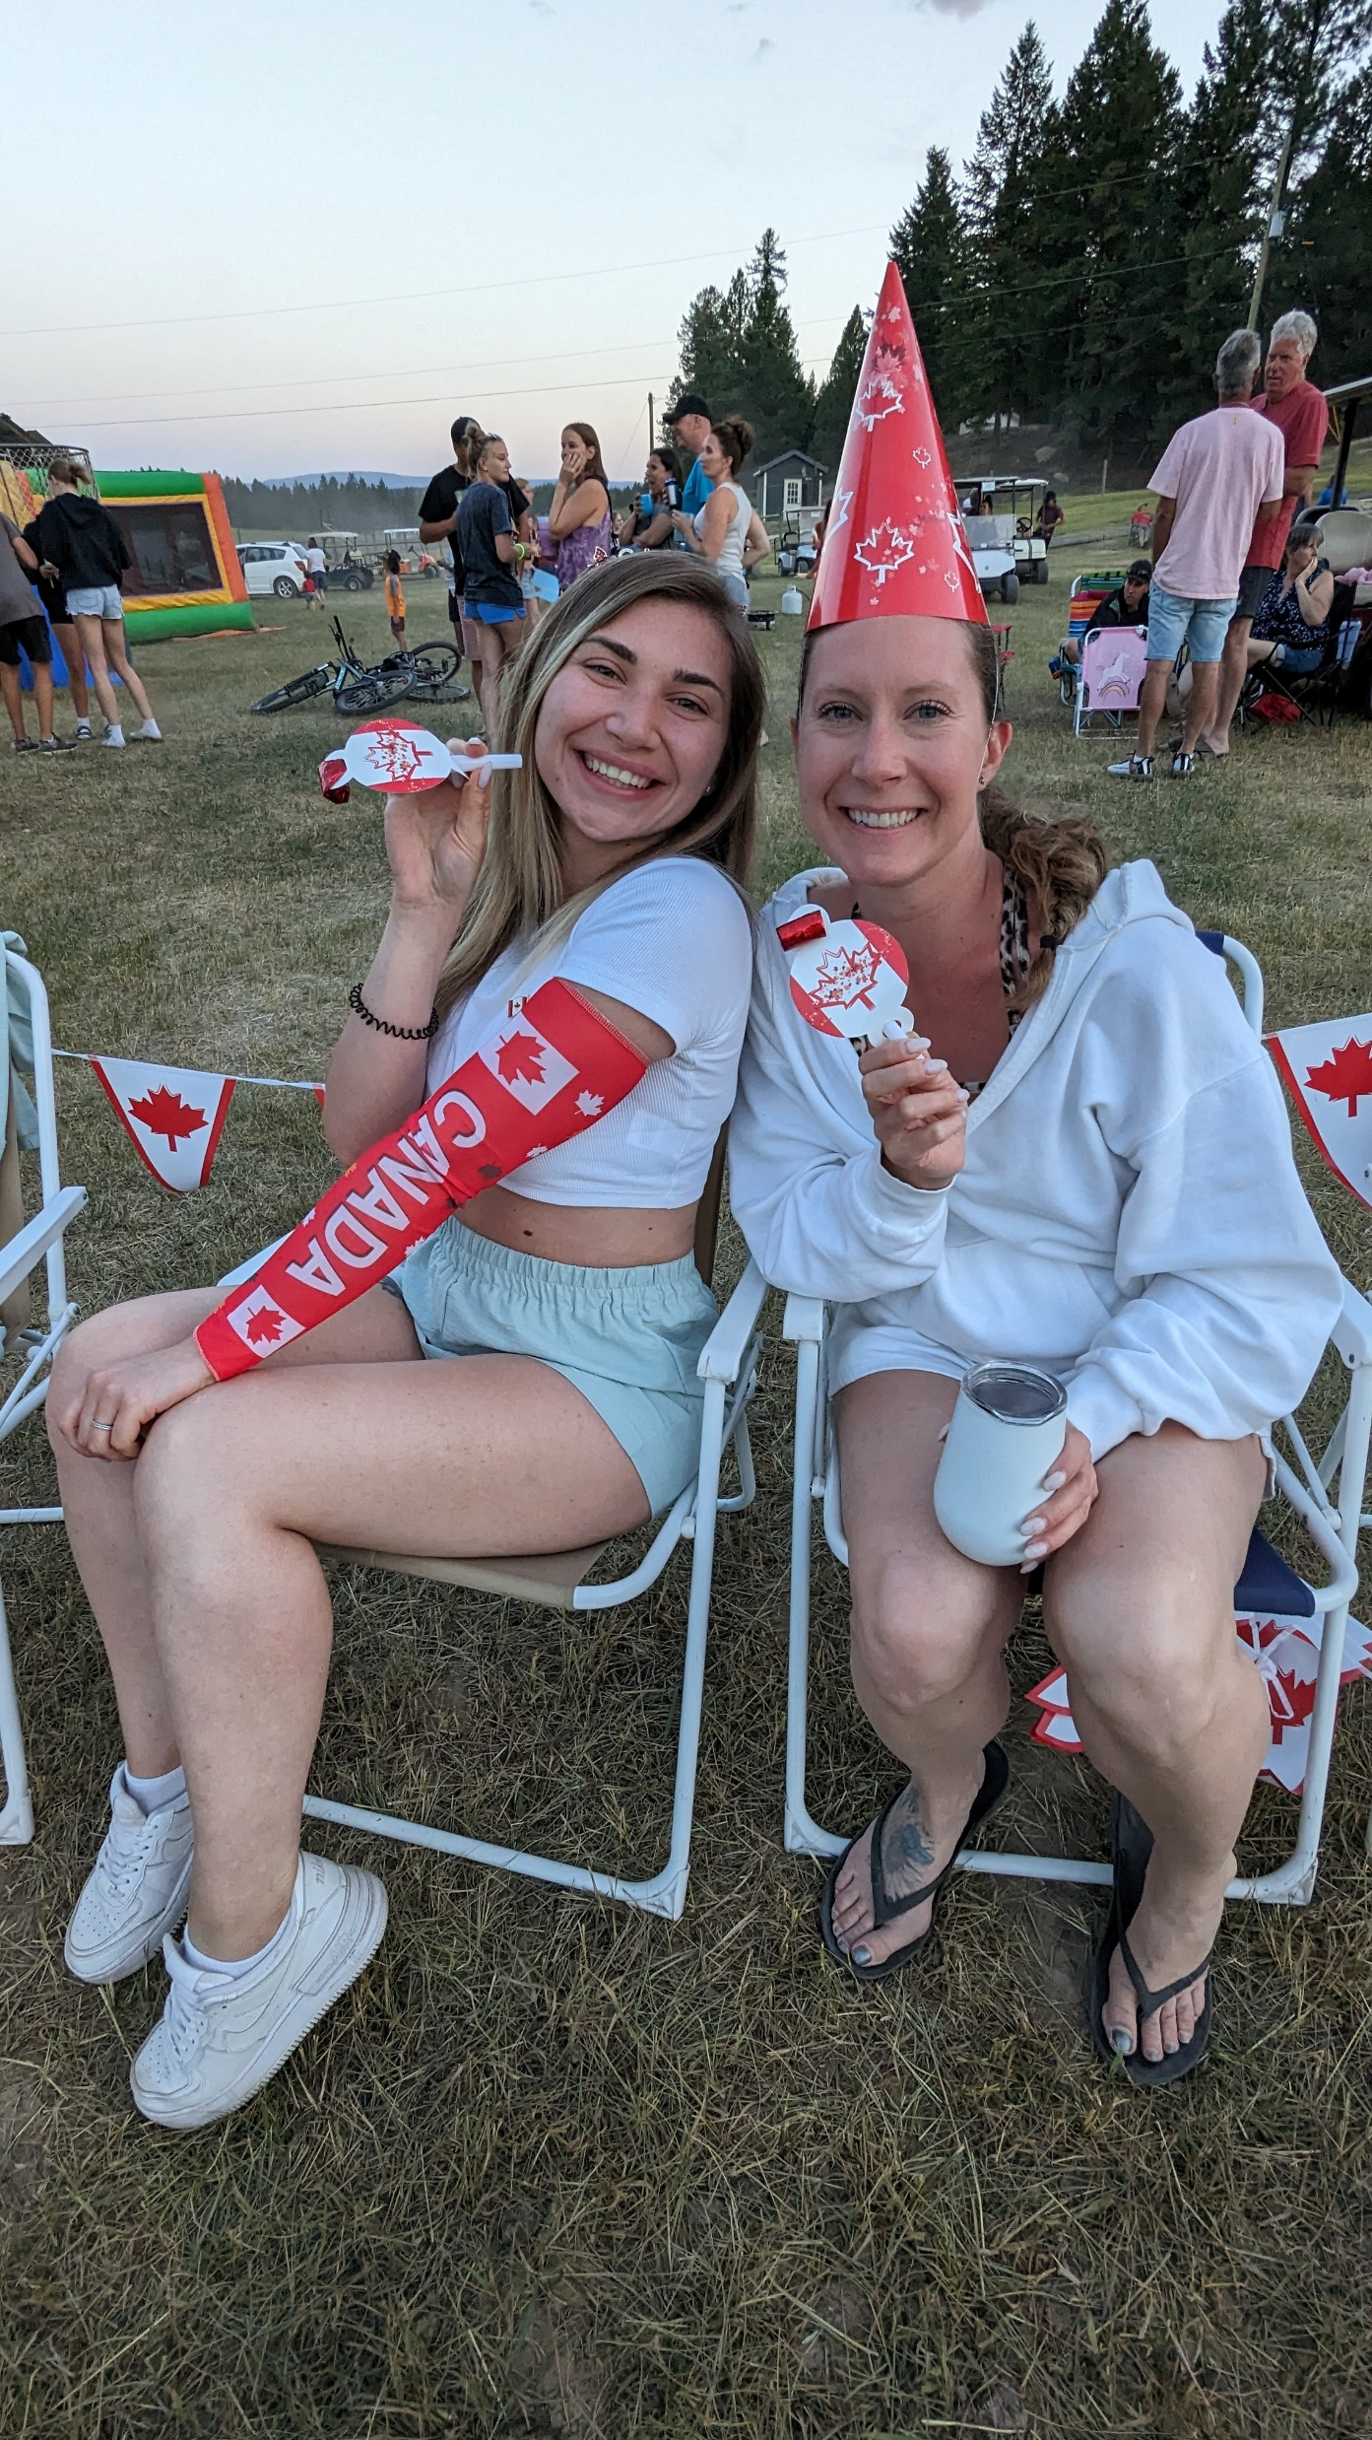

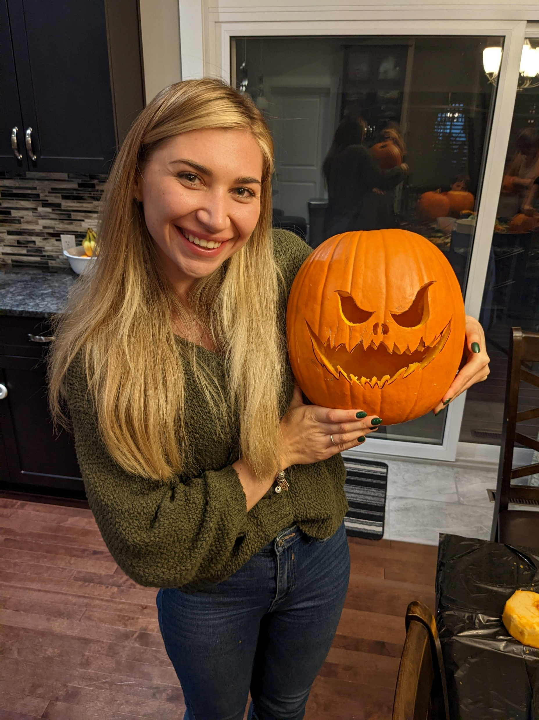

Rotarian Kathy Demorest hostS newcomer Viktoriia in CalgarY
Hosting a young Ukrainian evacuee has been nothing short of inspiring. She’s working full time, building a business, and embracing life in Canada—all thanks to her drive and the support of our community and the Rotary family.
This is what happens when kindness meets opportunity.
Viktoriia’s first Canada Day
Host Kathy and Viktoriia
Viktoriia’s first Halloween

Slide 21
Other ways we helped
Donated $100,000 towards a $750,000 Global Grant to build rehabilitation centres in two Ukrainian hospitals to aid those with catastrophic injuries
Donated two cars to Ukrainian newcomers
    One of Rotarian donated a 2001 Nissan Pathfinder to a family who arrived in Calgary in January 2023. Parents now employed; car helped them get established
    A friend of a Rotarian donated his car to a woman who was commuting 2.5 hours each way to her new teaching job.
    We paid for her car insurance and provided a $500 gas card.
Notes:
Rotary Clubs have launched specific projects such as providing shelter, food, and medical care to Ukrainian refugees. These initiatives focus on immediate assistance and long-term support.

Slide 22
Other ways we helped
  ASSISTANCE IN GETTING JOBS
    Rotarians helped new arrivals get jobs and made referrals to employers so newcomers could start earning an income and become self-sufficient.
Notes:
Rotary Clubs have launched specific projects such as providing shelter, food, and medical care to Ukrainian refugees. These initiatives focus on immediate assistance and long-term support.

Slide 23
Other ways we helped
Through our club’s World Community Service committee, we provided:
$10,000 - Mental Health for School Kids - Psychological Assistance was donated for psychological help for refugee children suffering from PTSD. The project provides mental health support for 200 distressed Ukrainian refugee children. These children have been forced from their homes, schools, friends and normal life which has had a tremendous impact on their mental health and development in general.
$10,000 - Medical Supplies were donated to the Rotary Club of Warsaw for purchasing medical supplies for a Ukrainian hospital.
Notes:
Rotary Clubs have launched specific projects such as providing shelter, food, and medical care to Ukrainian refugees. These initiatives focus on immediate assistance and long-term support.

Slide 24
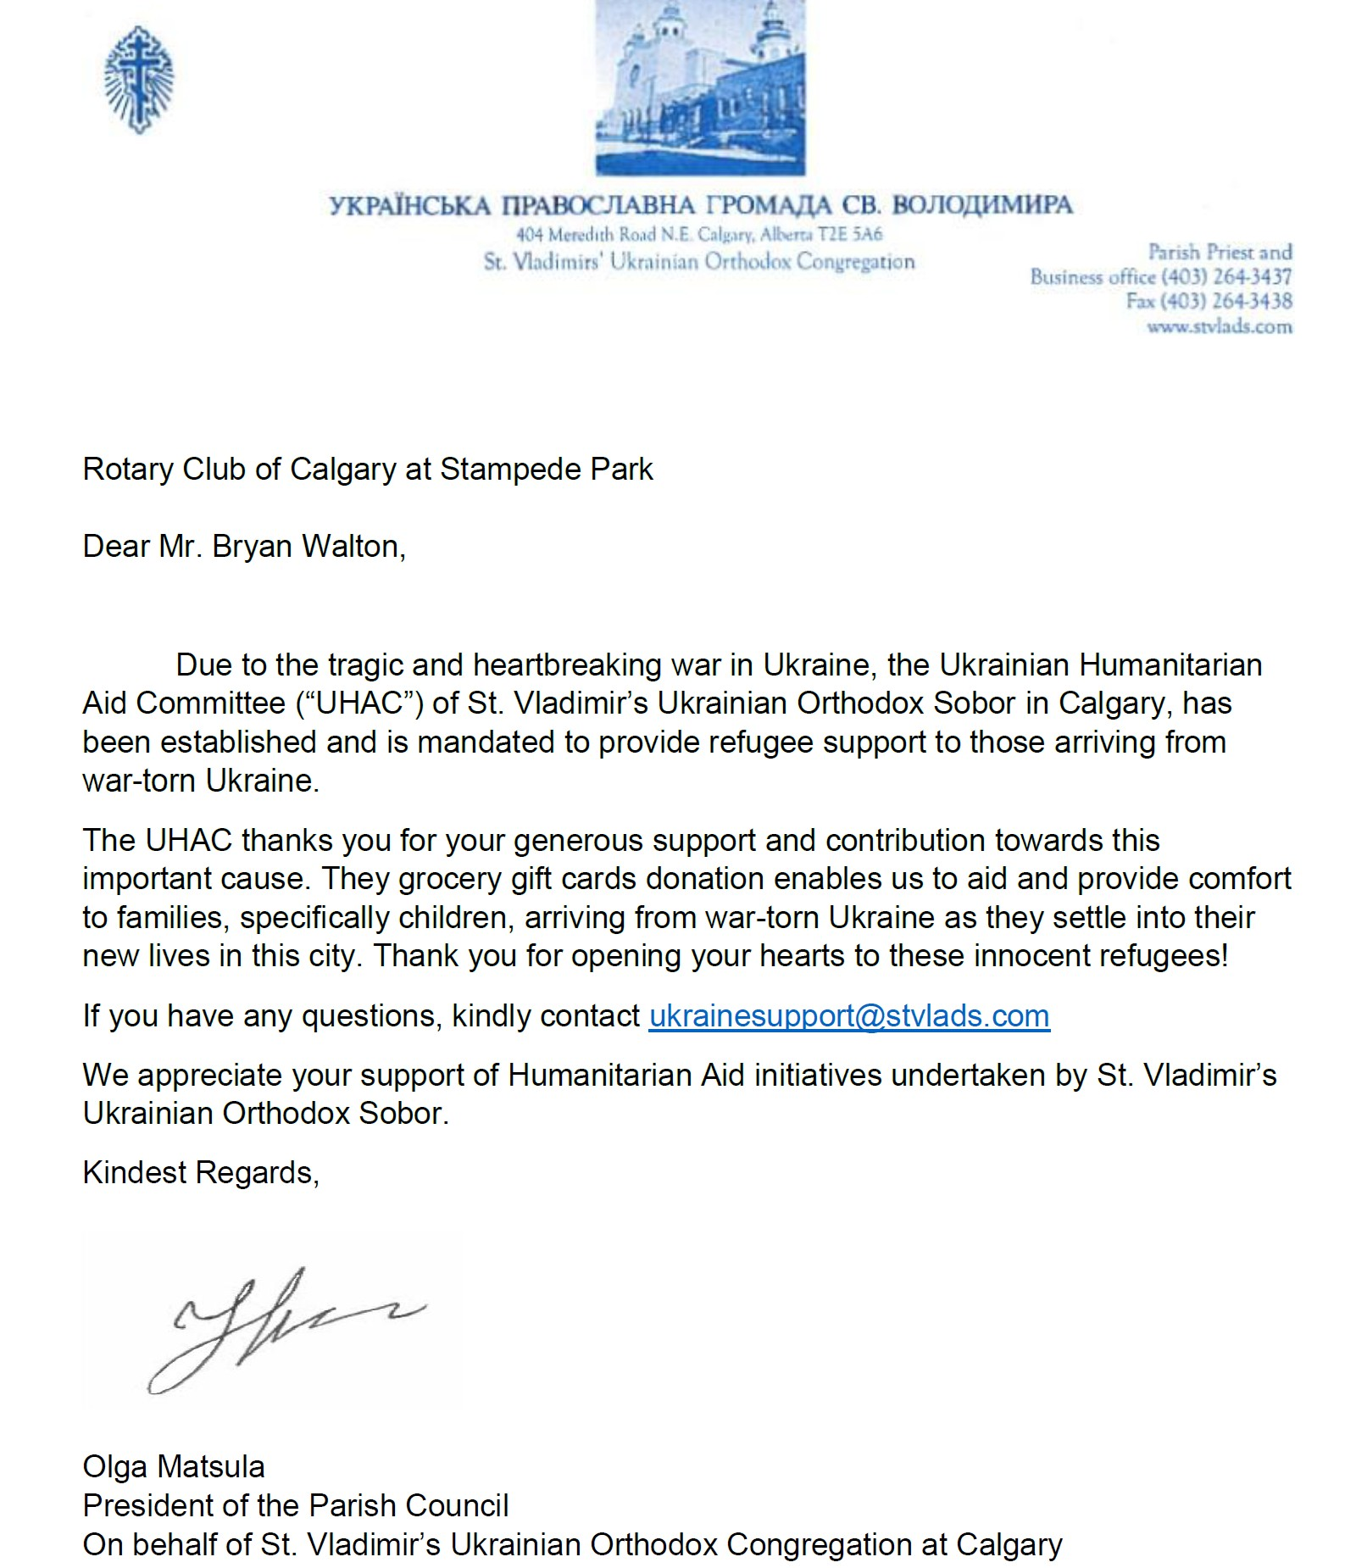
Refugee Gratitude
St. Vladimir’s Parish extends sincere appreciation to the Rotary Club of Calgary at Stampede Park for their help and support during difficult periods.
Impact on the Community
The assistance provided by the Rotary Club of Calgary at Stampede Park has fostered a positive ripple effect, benefiting the entire community.
Notes:
Many refugees have shared their stories of gratitude towards the Rotary Club's assistance. These testimonials highlight the positive changes in their lives as a result of these efforts.

Slide 25
Conclusion:
Reflecting Rotary’s commitment to service
The Rotary Club of Calgary at Stampede Park stood with Ukrainian newcomers to provide:
💙 $492,000 donated by our club and its members
🏠 Homes opened, jobs and cars secured
🛋️ Furniture collected and delivered
🤝 Warm, heartfelt welcomes to thousands of evacuees
A powerful example of Rotary in action—compassion, commitment, and community.

