Slide 1
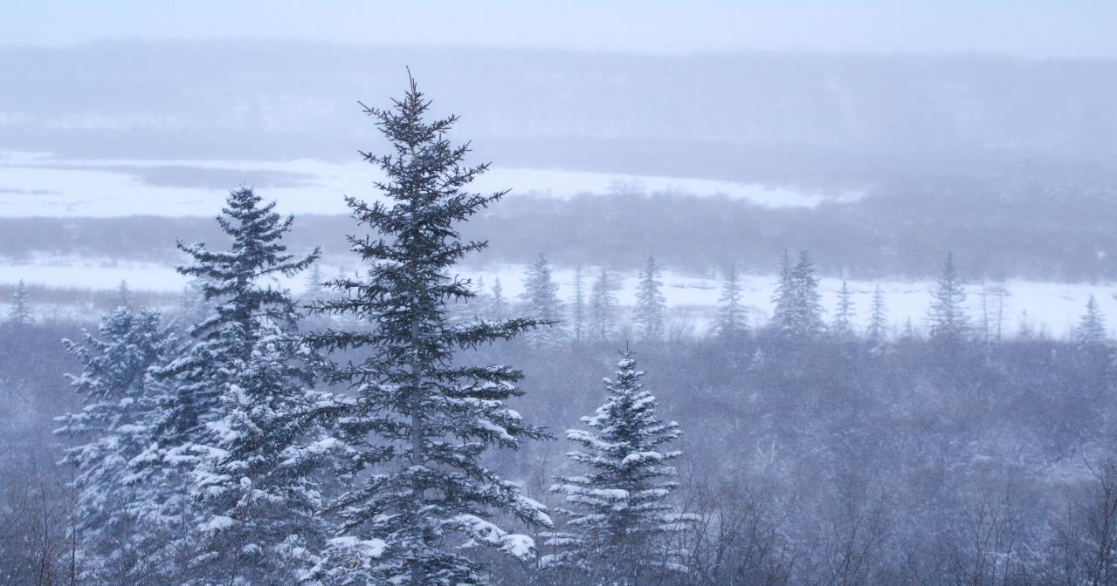
WELCOME
- WE ARE GLAD YOU ARE HERE -

Slide 2
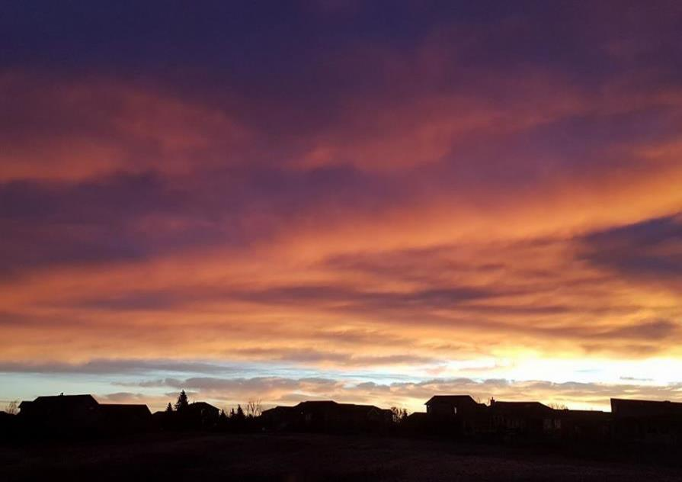
Rotary Club of Lethbridge
SUNRISE
Breakfast meetings are held
7:00-8:00 am every Thursday at
Nord-Bridge Seniors Centre
1904-13 Avenue North, Lethbridge
Photograph by Pat Lowell- Used with Permission

Slide 5
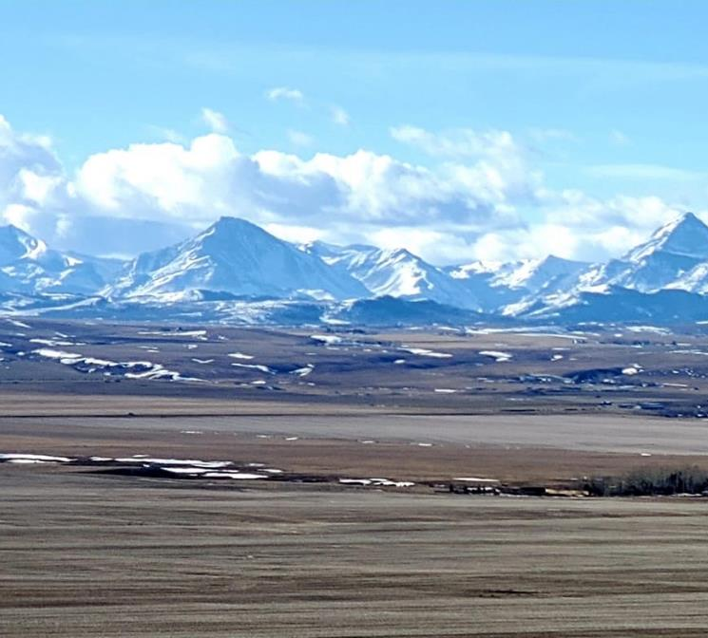
MARCH
Member Birthday
March 11 Judi Reed
March 13 Daryn Wenaas
Member Anniversaries
March 6 Anita & Kevin Wickersham
Date Joined Rotary
March 1, 1994 Brian Treadwell
March 8, 2012 Greg Tiffin

Slide 6
Bring Your Family To DisCon 2020
And Celebrate Rotary!
Join Us
Friday May 1st- Sunday May 3rd
REGISTER TODAY AT: http://discon5360.ca
DisCon 2020 is such an opportunity. Innovative in how we approach membership, forging wider and deeper connections to our communities, and attracting more and diverse members. This year, we even have an award-winning daycare to ensure that young, busy families can still participate in our activities.
Let’s make this another How Rotary Connects the World event! Building connections that allow talented, thoughtful, and generous people to unite and take meaningful action through Rotary service.

Slide 7
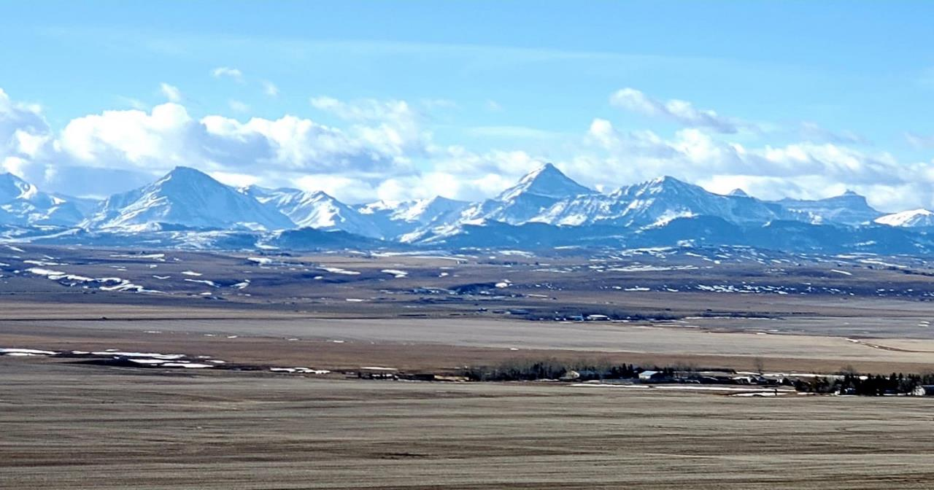
March 19: No Breakfast Meeting - Evening with Rotaract
March 28: Peace Workshop in Calgary
April 2: No Breakfast Meeting
April 4: 2020 Vision for Sunrise
SUNRISE
FUTURE DATES & EVENTS

Slide 8
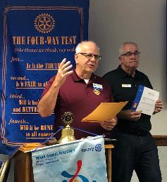
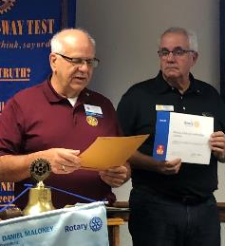
December 5, 2019
Assistant Governor, Barrie Orich presents Lethbridge Sunrise with a certificate of appreciation from Rotary Foundation,
for its financial support of
END POLIO NOW

Slide 9
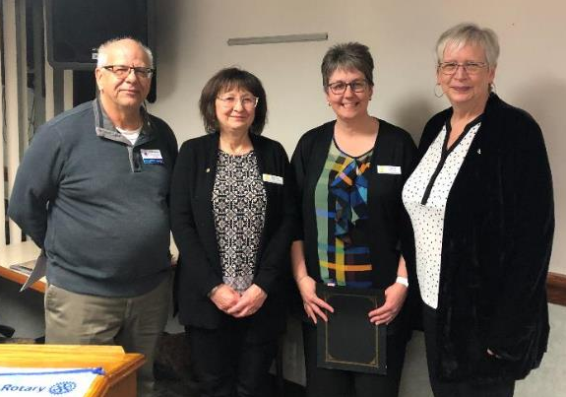
January 23, 2020
WELCOME
Carol Haayema
New Member
Rotary Club of Lethbridge
Sunrise
L-R Barrie Orich, Myrna Procinsky-Longair,
Carol Haayema, Berga Moen

Slide 10
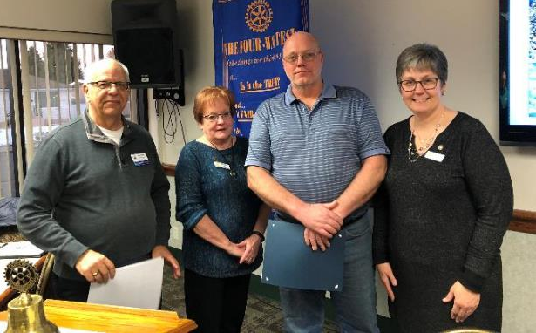
February 27, 2020
WELCOME
Brian Haayema
New Member
Rotary Club of Lethbridge
Sunrise
L-R Barrie Orich, Carolyn Clark,
Brian Haayema, Carol Haayema

Slide 12
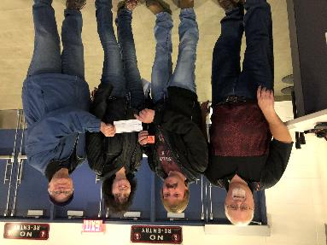
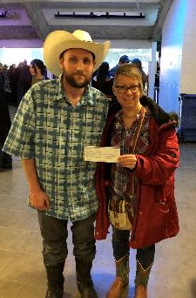
50/50 DRAW WINNERS
Friday
Jason Poole
$3,722
Way to Go
VOLUNTEERS
We raised over $10,000!
THANK YOU
FOR YOUR GREAT WORK!
Saturday
Matthew Battey
$7,100

Slide 13
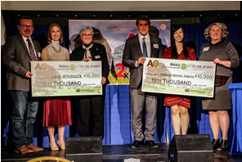
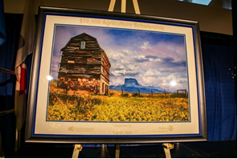
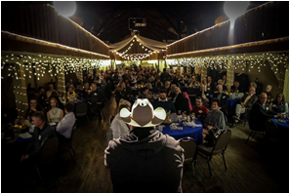
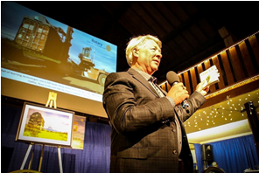
AG Scholarships 2020 - Rotary Club of Lethbridge East and Lethbridge Exhibition Park
Thursday, February 27, 2020 – Scholarship Recipients – Mallory Adam and Geni Witdouck
Scholarship Presentations: L to R: Rudy Friesen (CEO Exhibition Park), Geni Witdouck, Fran Leggett (Rotary Club of Lethbridge East), Steve Leavitt (Rotary District 5360), Mallory Adams, Bev Lanz (Director Exhibition Park)
The original painting by Rotarian Lynn Gregson which sold by auction to Cor Van Raay.
Robert Saik was guest speaker and he did a great job of inspiring the young adults in the crowd to consider a career in agriculture.
Auctioneer Justin Perlich kept the sell out crowd in Heritage Hall bidding on the Lynn Gregson original.

Slide 15
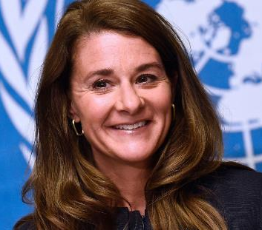
INTERNATIONAL WOMEN’S DAY
March 8, 2020
“I was in my 40s before I started thinking critically about gender equality. The data is unequivocal: No matter where in the world you are born, your life will be harder if you are a girl.....it is still overwhelmingly men making decisions, controlling resources, and shaping policies and perspectives.”
Melinda Gates

Slide 17
Club members are encouraged to participate in one or more committees.
Get in touch with the committee chair for more information.
SUNRISE COMMITTEES
NAME
Membership
Community Service
International Service
Los Amigos Project
Club Service
Foundation
Youth
Fundraising
Public Relations
CHAIR
Myrna Procinsky-Longair
Diane Randell
Berga Moen
Karl Samuels
Julie Smith
Carol Kundrik
Felipe Guerra
Ron Bunton & Udo Hanebaum
Matthew Hatch
Service Above Self

Slide 18
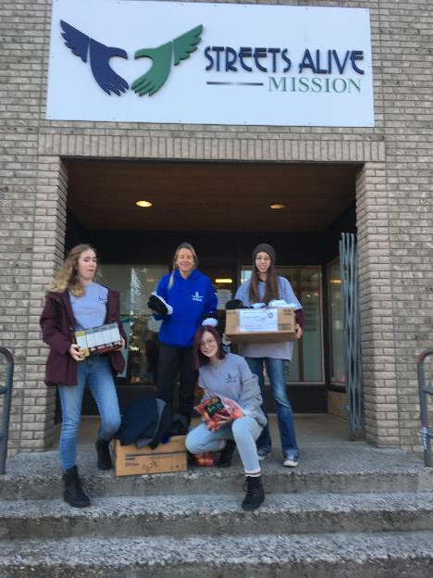
Random Acts of Kindness

Slide 19
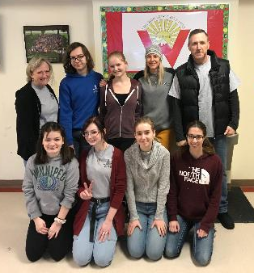
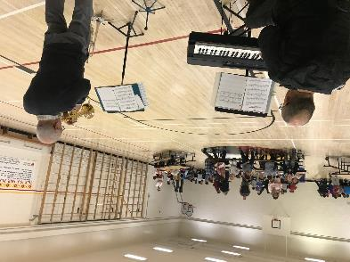
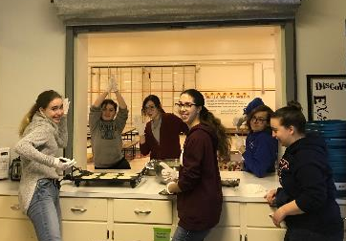
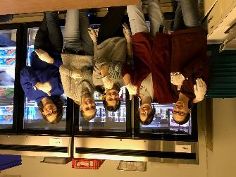
Pancake Breakfast at Westminster School

Slide 21
GUEST SPEAKERS
March 12 Samantha Lenci
Lethbridge College Update
March 19 Breakfast Meeting Cancelled
Rotaract Fun-Facts-Fellowship Evening
6:00-8:30 pm, Room 1035, Markin Hall, U of L
Cost $15 per Rotarian – Includes Pizza & Salad Supper

Slide 22
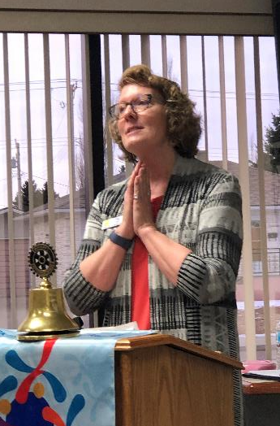
GUEST SPEAKER – MARCH 5, 2020
Pat Lowell
GALAPAGOS & PERU
Best Trip Ever!

Slide 23
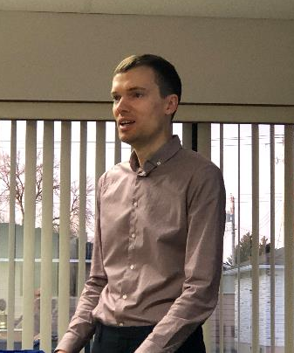
Guest Speaker
February 27, 2020
Ross Kilgour
Senior Community Planner
City of Lethbridge
Managing Urban Development

Slide 24
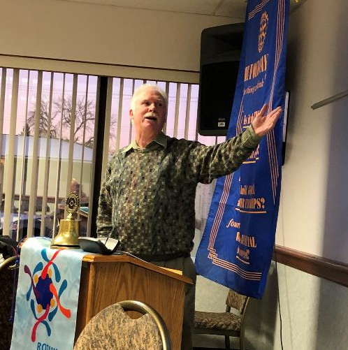
Guest Speaker
February 20, 2020
Ken Kellett
Electric Car Ownership
in Lethbridge

Slide 25
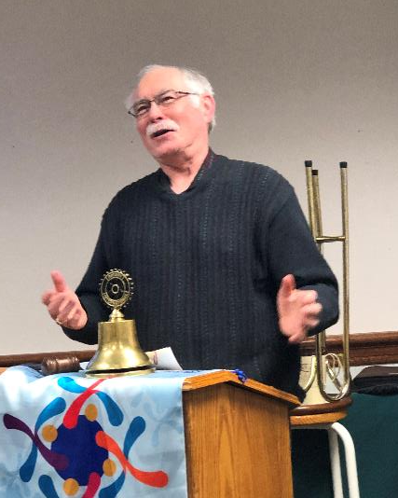
Guest Speaker - February 13, 2020
Michael Cormican
Syrians in
Lethbridge Update

Slide 26
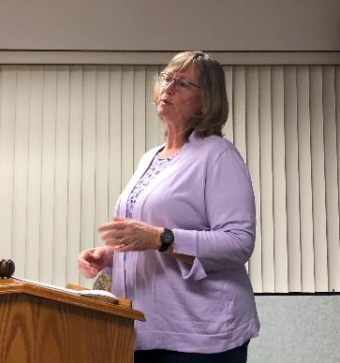
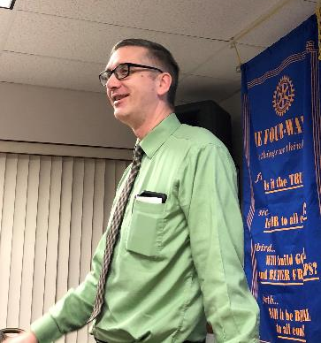
Guest Speakers - February 6, 2020
Mary Dyck and Matthew Hatch
Meeting Diverse Needs in Recreation Programs

Slide 27
Guest Speaker – January 30, 2020
Imogen Pohl
Previous Scholarship Recipient
Life & Activities Update

Slide 28
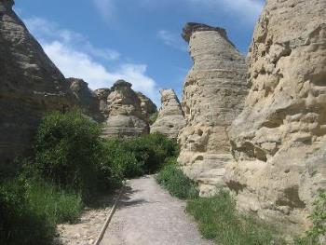
Guest Speaker – January 23, 2020
Aaron Domes
Writing on Stone Provincial Park

Slide 29
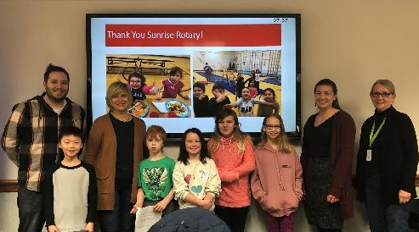
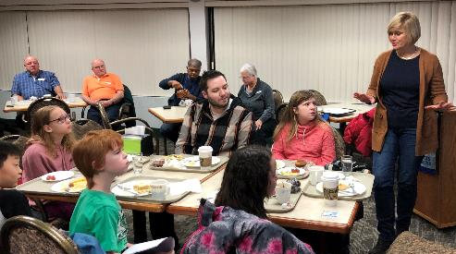
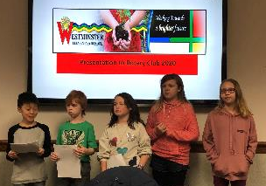
Guest Speaker – January 16, 2020
Angela Wilde, Principal
Westminster Elementary School
ROTARY BREAKFAST PROGRAM
& EARLY ACT PROJECT

Slide 30
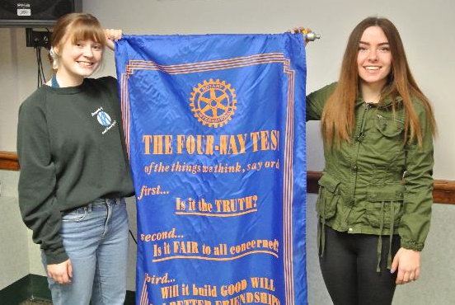
Guest Speakers
January 9, 2020
RYPEN STUDENTS
L-R Haven & Leigh

Slide 31
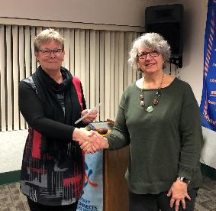
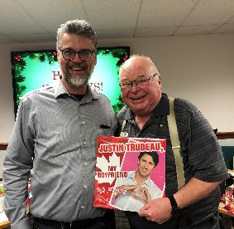
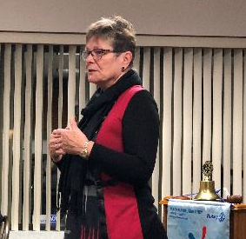
December 19, 2019
Christmas Social
Ho-Ho-Ho
Hosted by Cathy Moen
Guest Speaker – Hazel Mitchell, FASD Fetal Alcohol Syndrome Disorder
Party Auction - Justin Trudeau “My Boyfriend” Record

Slide 32
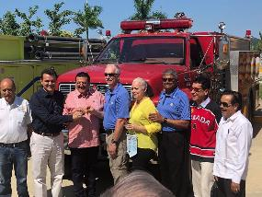
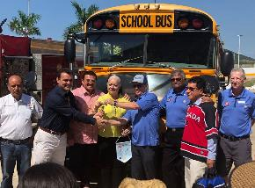
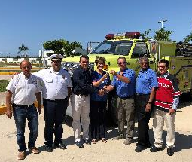
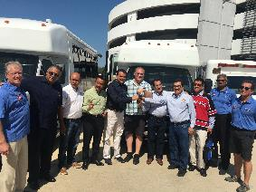
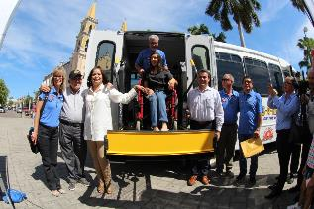
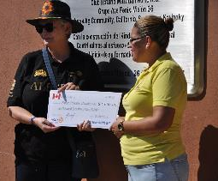
Guest speaker - December 12, 2019
Karl Samuels - Los Amigos

Slide 33
December 5, 2019
Sunrise Rotary Club
AGM
Annual General Meeting

Slide 34
ROTARY BREAKFAST PROGRAM
WESTMINSTER SCHOOL
ADVERTISEMENT
JANUARY 16, 2020

Slide 35
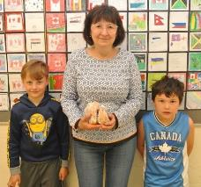
ROTARY BREAKFAST PROGRAM
New Volunteers are Welcome
JOIN US April 1st
Bear hugs to our
generous sponsor!

Slide 37
THE FOUR-WAY TEST
OF ALL THE THINGS WE THINK, SAY OR DO
IS IT THE TRUTH?
IS IT FAIR TO ALL
CONCERNED?
WILL IT BUILD GOODWILL &
BETTER FRIENDSHIPS?
WILL IT BE BENEFICIAL TO ALL CONCERNED?

