Slide 1
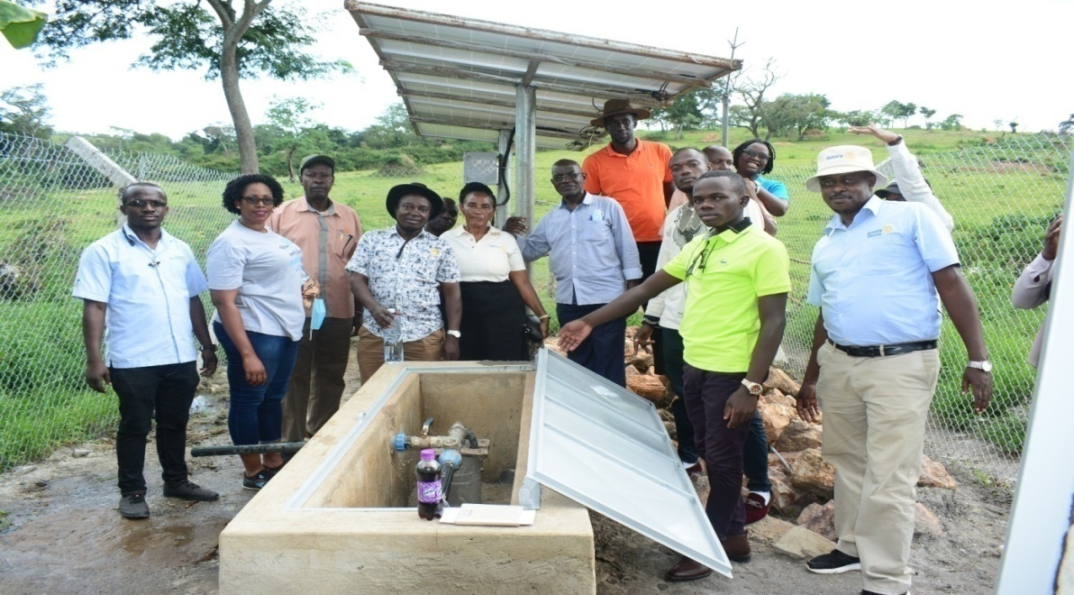
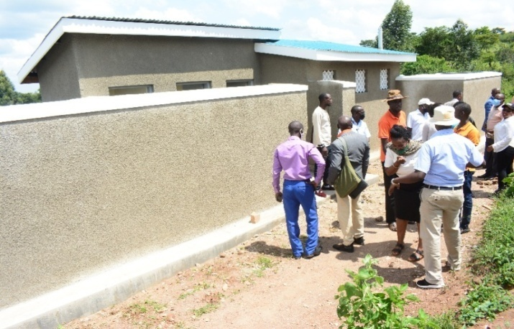
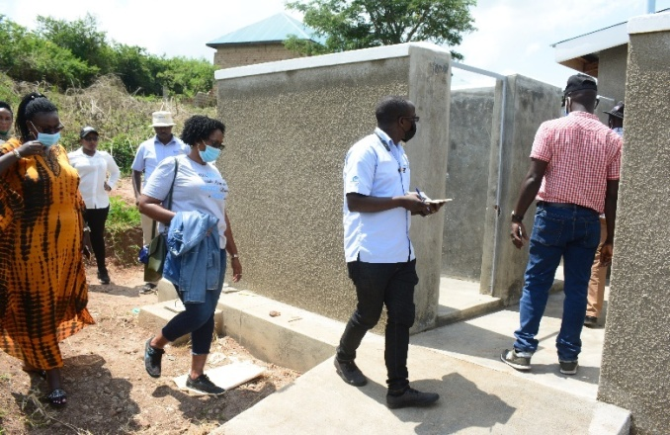
REPORT ON JOY’S HOLISTIC HEALTH PROJECT (GG1863241) FUNDED BY: ROTARY INTERNATIONAL, DISTRICT 5550,GOV’T OF CANADA AND ALL THE CLUBS IN SASKATOON
dd
Rotarians, Rotaractors and other project stakeholders at the water source during the project handover to the beneficiaries.
VIP Latrines have also been constructed with bathrooms with running water

Slide 2
h
Introduction
The host club (Rotary Club of Mbarara) with the community and Joy’s centre worked together to implement “Joy’s Holistic Health Project (GG1863241)" in Kijooha, Buremba, Kazo District and 90% of the work has been completed. This report specifically presents the overall project achievements.
2. Project main Objectives:
The main objectives of the Project are;
To improve the quality of life of orphans and vulnerable children by providing basic education and provision of safe drinking water
To empower the surrounding communities through basic livelihood skills.
3. Project Location:
The project site is located in Kijooha, Buremba, Kazo District found in Uganda. Uganda is landlocked and lies 800 kilometers inland from the Indian Ocean. And
its a landlocked country located in East Africa covering an area of 241,550 sq. km. It has a growing population of 39 million people.
It has the fourth highest population growth rate in the World (3.6%) and the second highest birth rate (1) (47 births/1000 population).

Slide 3
Project location continue…
Half of Uganda’s population is below the age of 15.
It is estimated that 87% of Uganda’s population lives in rural areas.
The country retains close cultural and ethnic ties with its neighboring countries of South Sudan, Kenya, Tanzania, Rwanda, and the Democratic Republic of Congo.
The landscape is both mountainous and tropical, crossed by the equator, and blessed with lakes, rivers, forests, wetlands, prairies, snow-capped mountains, and volcanoes.
Uganda borders the World’s second largest lake by surface area in Lake Victoria, and has the origins of the longest river in the World, the Nile. With Uganda’s abundant wildlife, resources, and geography, it is said to have every piece of Africa in its country.
4. Socio Economic Condition
The project is now benefiting at least 1532 people including school community and Kijooha population from 300 households.
The population comprises 55.8 % female and 44.22% male. The livelihoods of the Kijooha people depend on agriculture.

Slide 4
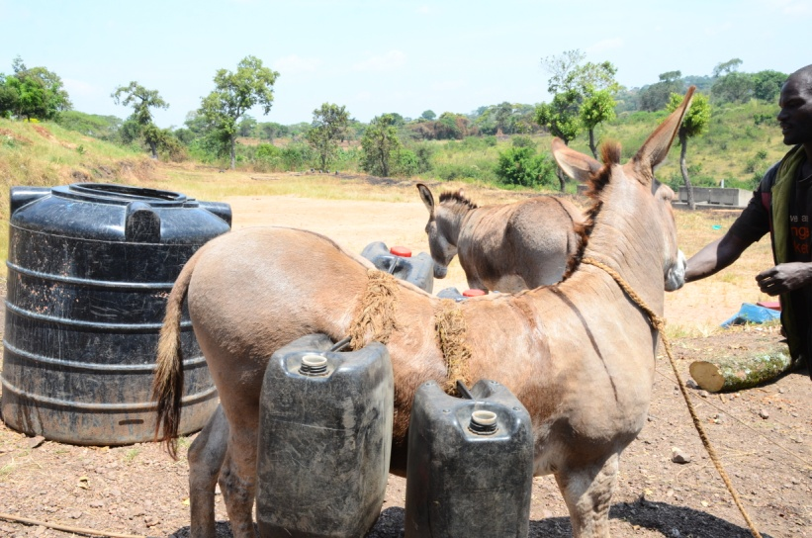
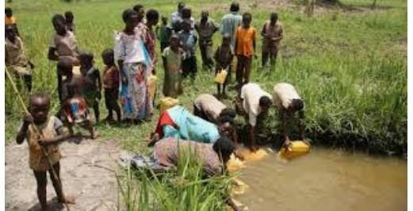
h
5. Situations before project implementation
The condition of Water Supply, Sanitation and Hygiene of the project area was very poor. The school used to fetch water while using camels and to make matters worse, the fetched water was also dirty.
In addition, pupils used to line up while accessing latrine and bath room services making the Sanitation and Hygiene poor at school.
The Kijooha households could fetch water from unprotected seasonal springs. They need around 1hour and 30 minutes to fetch round trip water. The Kijooha Communities were not aware on health and hygiene.
Community people fetching water from unprotected well before the implementation of the project.
Joy’s Center previously used this way to get water for the school.

Slide 5
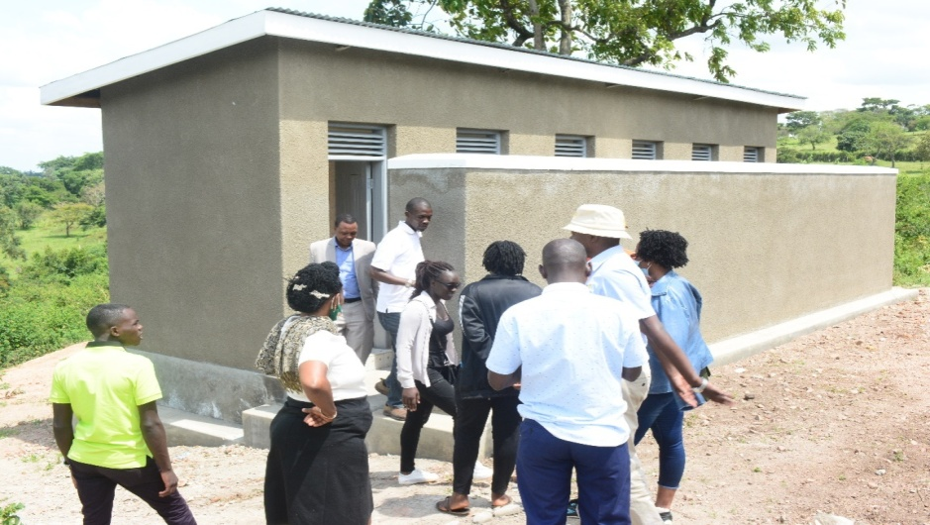
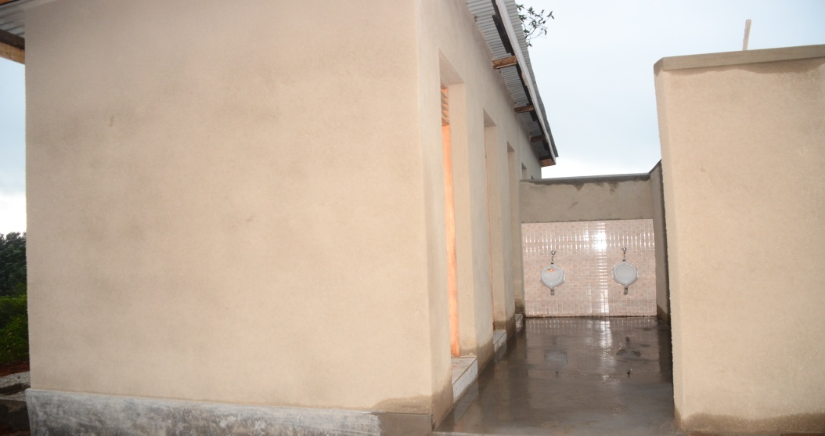
h
6. Achievement of the Project:
(i). Construction of Bathrooms and Toilets
The school is now fully equipped with bathrooms and toilets for teachers and pupils.
The bathroom and toilet facilities have shutters, tiles, are plastered and the walls are well painted.
In addition, septic tank excavation and blinding was done under the project.
Construction of a 2,000-liter toilet reserve tank and hand washing facilities constructed at both the teachers and pupils’ toilets was well done and appreciated by the project beneficiaries.
Completed toilets and bath rooms at the school.

Slide 6
(ii) Drilling and Installation of Solar Water Pumps
The water project serves at least 2500 people both the school community and Kijooha population from at least 200 households.
Households now need only 15 minute to fetch water from the tap instead of 1hour and 30 minutes before this project.
A solar powered, submersible, deep water well pump with a maximum head height of 250m has been done under the project.
A set of photovoltaic Solar panels of 5pcs, each 250watt peak is now installed on a ground mounted metallic frame near the borehole.
A wire mesh fence constructed at the water source to secure the water pump and the solar panels. A manhole chamber of 1.5 x 1.5m was constructed to further safeguard the water pump. In addition, a reserve plastic water tank of 10,000 Litres installed at the school premises.
In general, the condition of Water Supply, Sanitation and Hygiene of the project area is now good as people can now access to good water, pupils and teachers at Joy’s Centre have enough toilet and bathrooms.

Slide 7
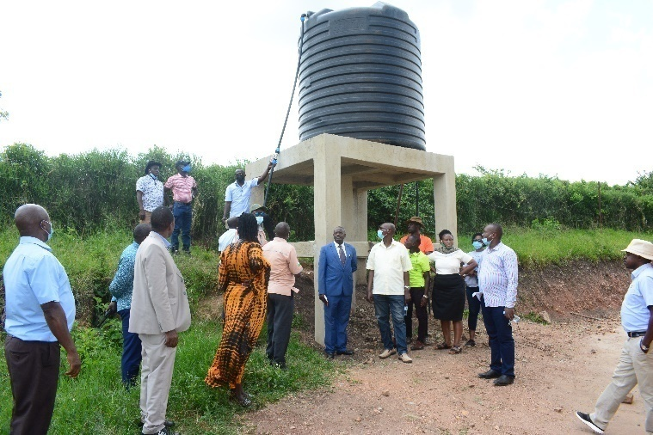
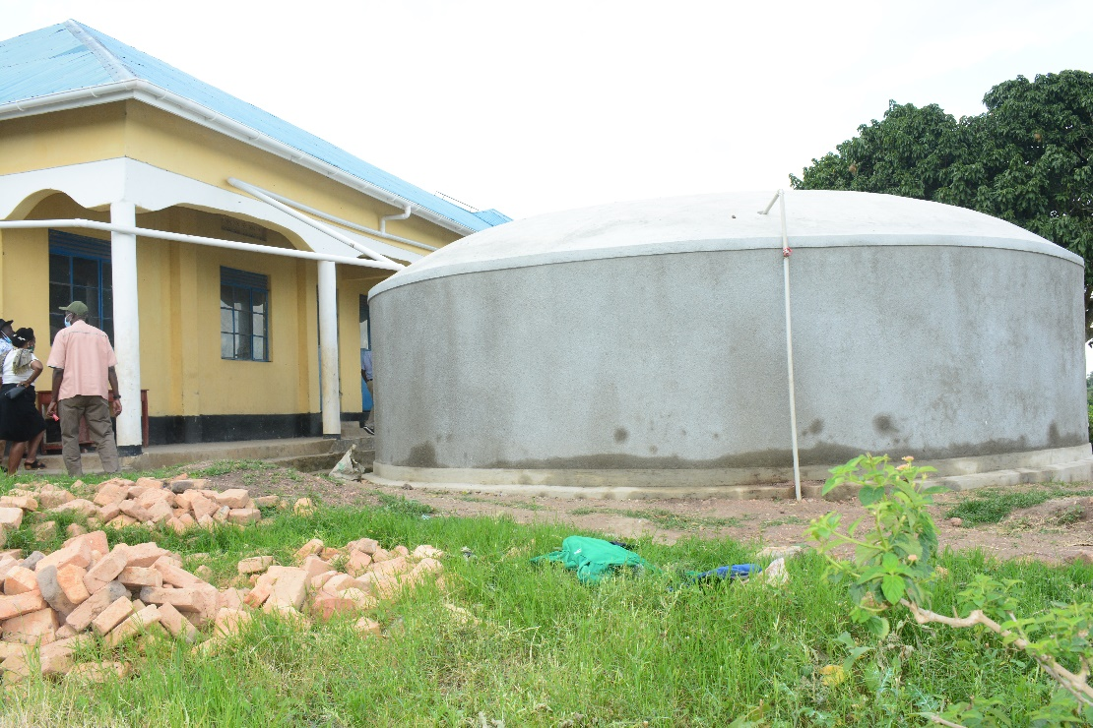
The hand wash stations have been fixed at both teachers and pupils toilets.
The 10,000-Liter tank installed at school and the community is very much involved
The 100,000-Liter tank installed at school
Water taps ready for use

Slide 8
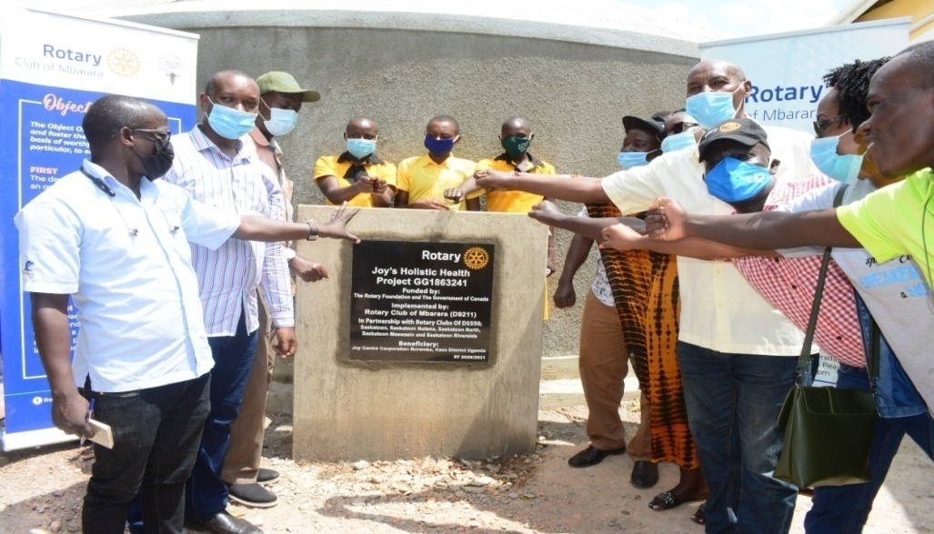
(iii) Establishment of Water & Sanitation User committee
Water supply and Sanitation User Committee (WUSC) has been formed with representation of the women and other discriminated groups in proportion to populations in the project areas.
User committee consists of 9 members comprising 44% (4 members) female, 56% (5 members) male from school and the surrounding community to keep overseeing the project.
The users committee already registered in District Water Resource Committee (DWRC).
During the implementation of the project, committee has been capacitated in institutional and technical aspect through different meetings.
Officials’ handover of the fully complete project infrastructures to the beneficiaries.

Slide 9
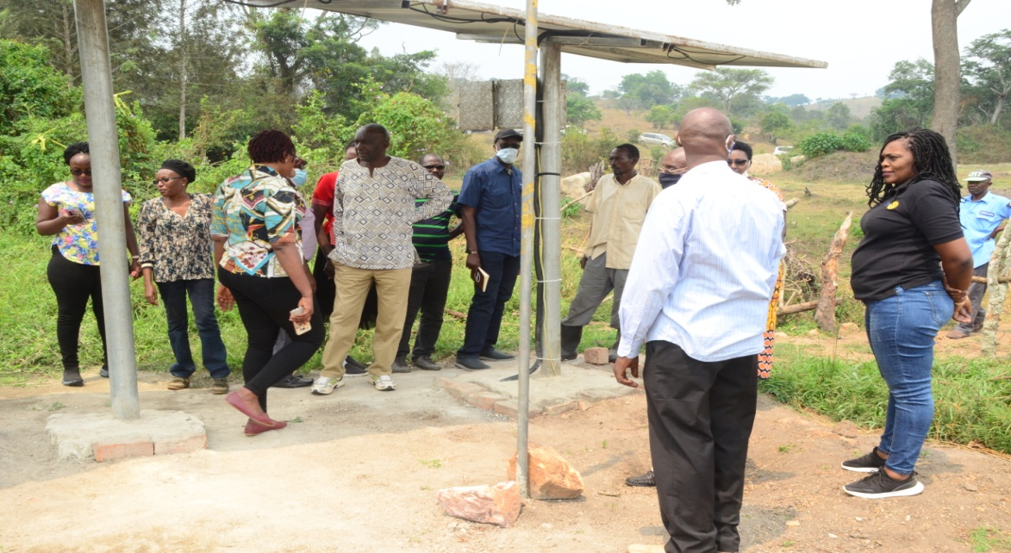
Opportunity President Phillip (Left with Rotary Cap) and PAG James Nkooka sample the water pressure from the source.
photovoltaic Solar panels

Slide 10
1.
We need more volunteers
80 more kids still need sponsors
($35 per month or $420 per year) with a tax receipt.
For more details:
Find us on:
Facebook:
Joy’s Centre corporation
Tel:306251-2272
Email: joyhomeofhope@gmail.com
THANK YOU ALL FOR THE SUPPORT

