Slide 1
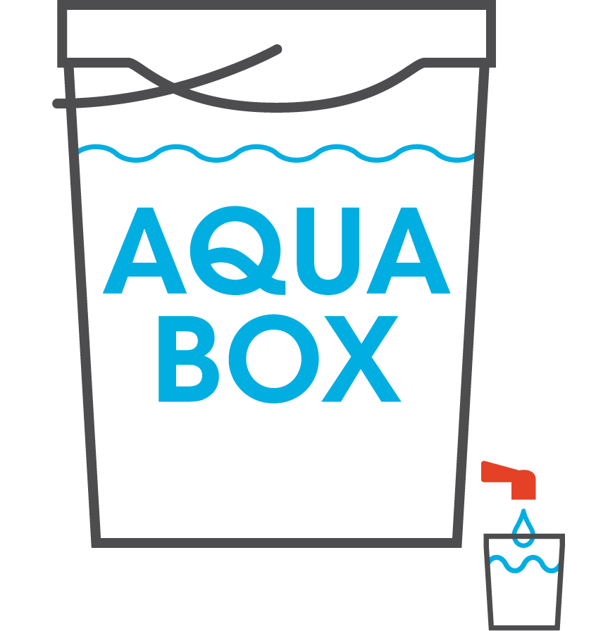
Aquabox

Slide 2
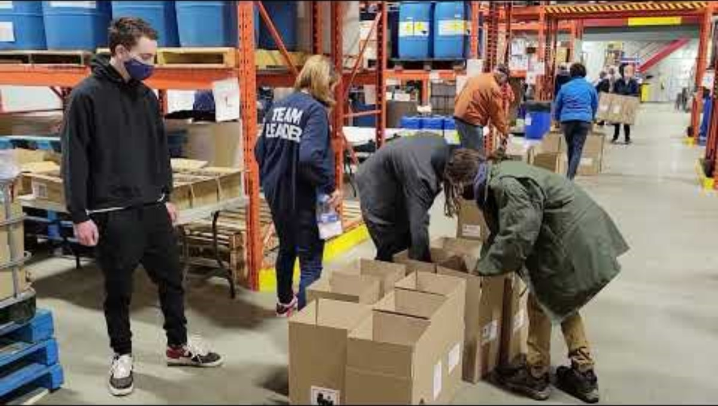
Aquabox
Notes:
Thank you for the invitation to speak to you this evening about the Aquabox.
I want to start out with a quick video showing Our Aquaboxes being distributed in Syria.

Slide 3
Aquabox
Notes:
The Aquabox project provides safe, clean drinking water to those affected by earthquakes, flooding and hurricanes around the world.
Often in these disasters the exiting water supplies are taken offline.
The greatest need in a disaster is for Safe, Clean Water
Ahead of Food and Shelter water is the greatest gift we can give

Slide 4
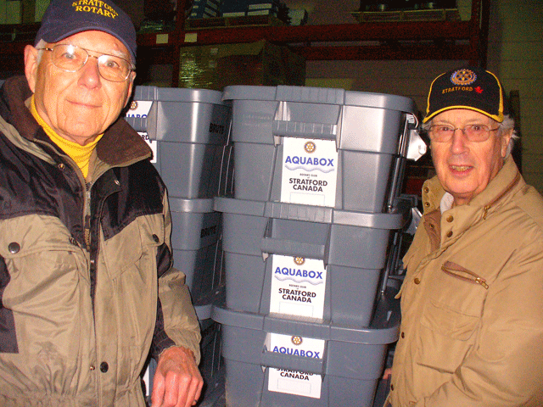
Aquabox
Originally launched in1992 by the Rotary Club of Wirksworth in Derbyshire UK
Jim Scott brought the program to us in 2005
The original “box” used chlorine tablets and had a cost of $125 per unit
Notes:
Pictured here are Jim Scott, on the right and Gary Morris
Gary is our technical expert. The latest designs are his handy work
The Aquabox was initiated in the United Kingdom and brought to us by Jim Scott, who some you may have known as a past District Governor
Since 2006 our club has produced and shipped over 16,000 units to 23 countries this represents close to 70 million liters of potable water

Slide 5
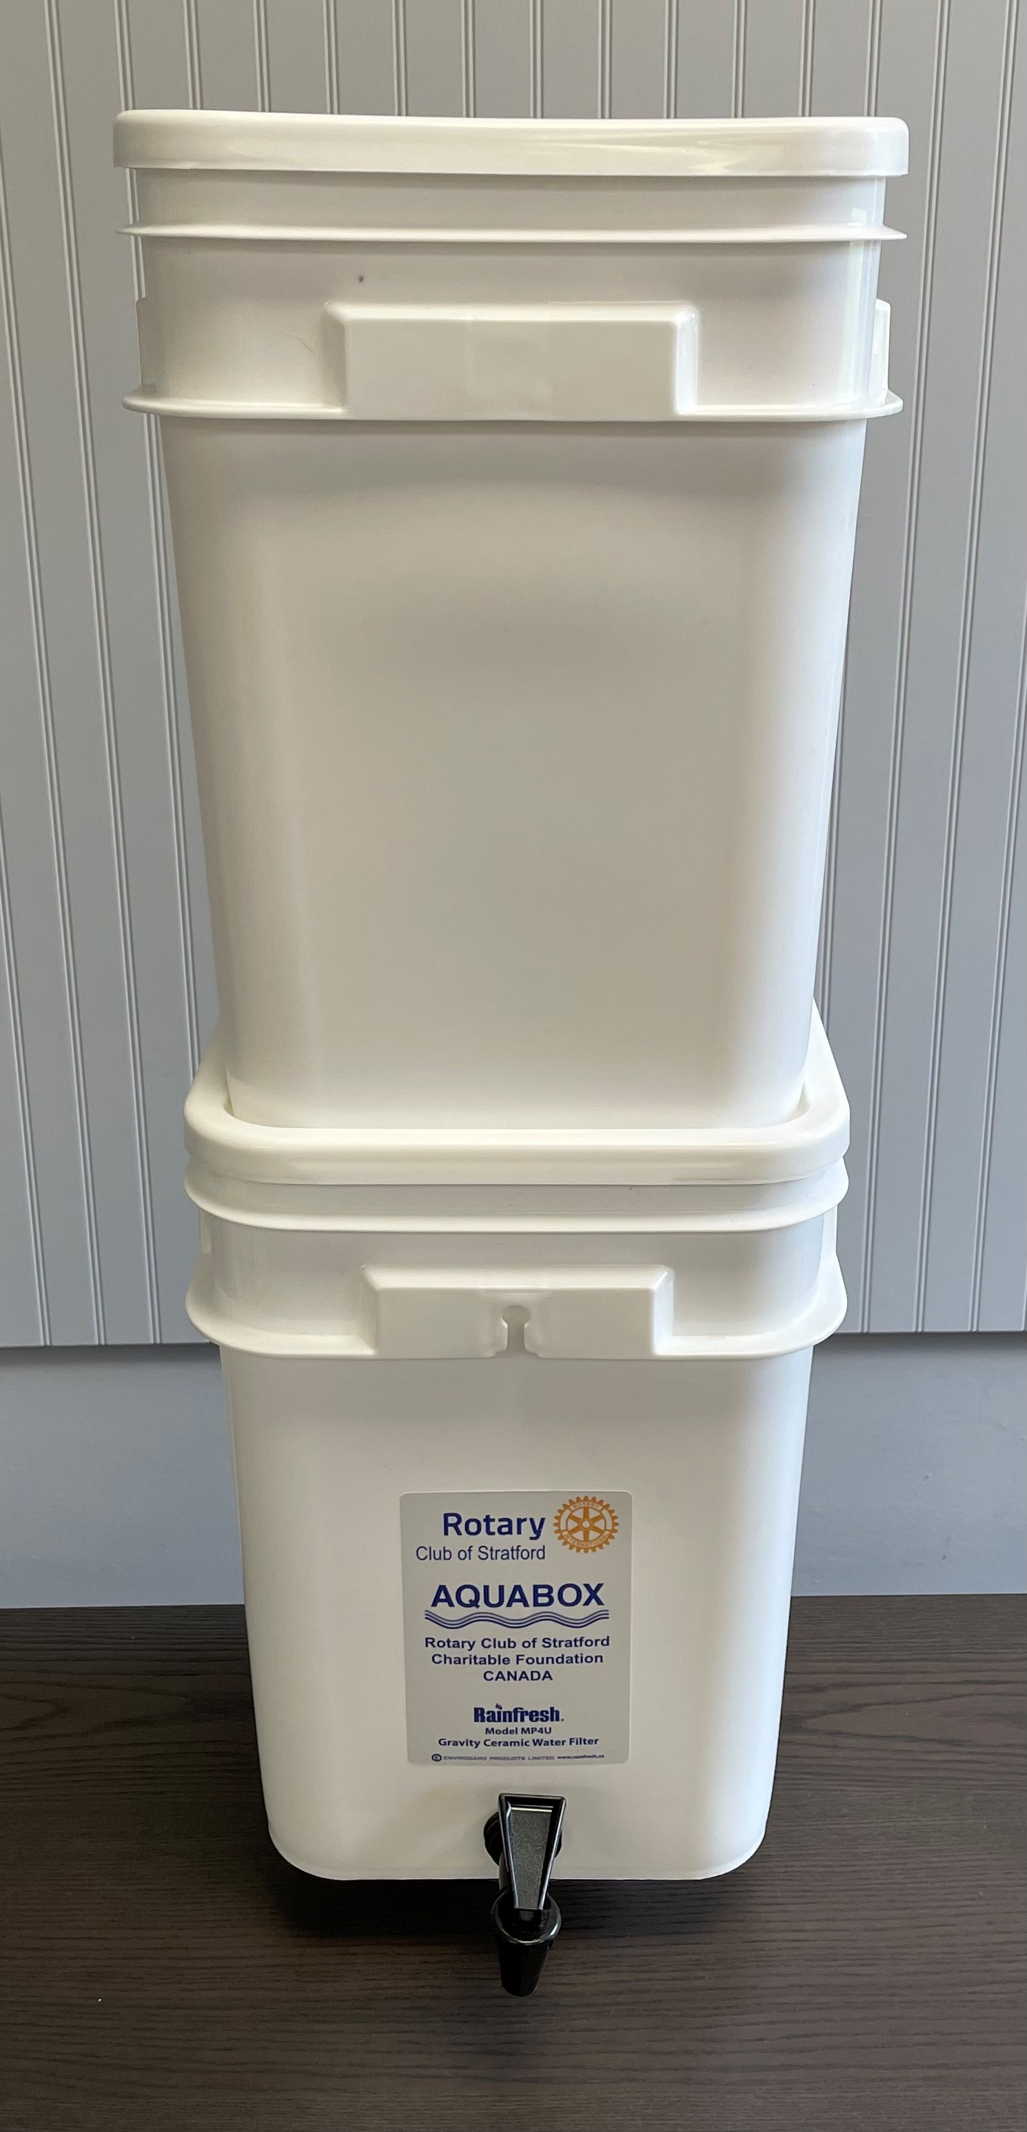
Aquabox
The Aqua “box” has evolved
an Aquabox includes 2 buckets, a spigot, 2 ceramic filters, a scrubbing pad, a cartridge gauge
dirty water goes in the top bucket, is filtered and sits in the bottom bucket until needed
it will provide a family of 5 with safe water for up to a year
Notes:
Our Aquabox quickly evolved and is now our own design.
We moved away from the chlorine tablets and have moved to ceramic filters.
An Aquabox is a two-pail system. The top pail is fitted with two ceramic filters that remove 99% of contaminants. The dirty water goes it the top.
The system is gravity fed. There are no pumps, no moving parts.
The lower pail has spigot to serve the potable water

Slide 6
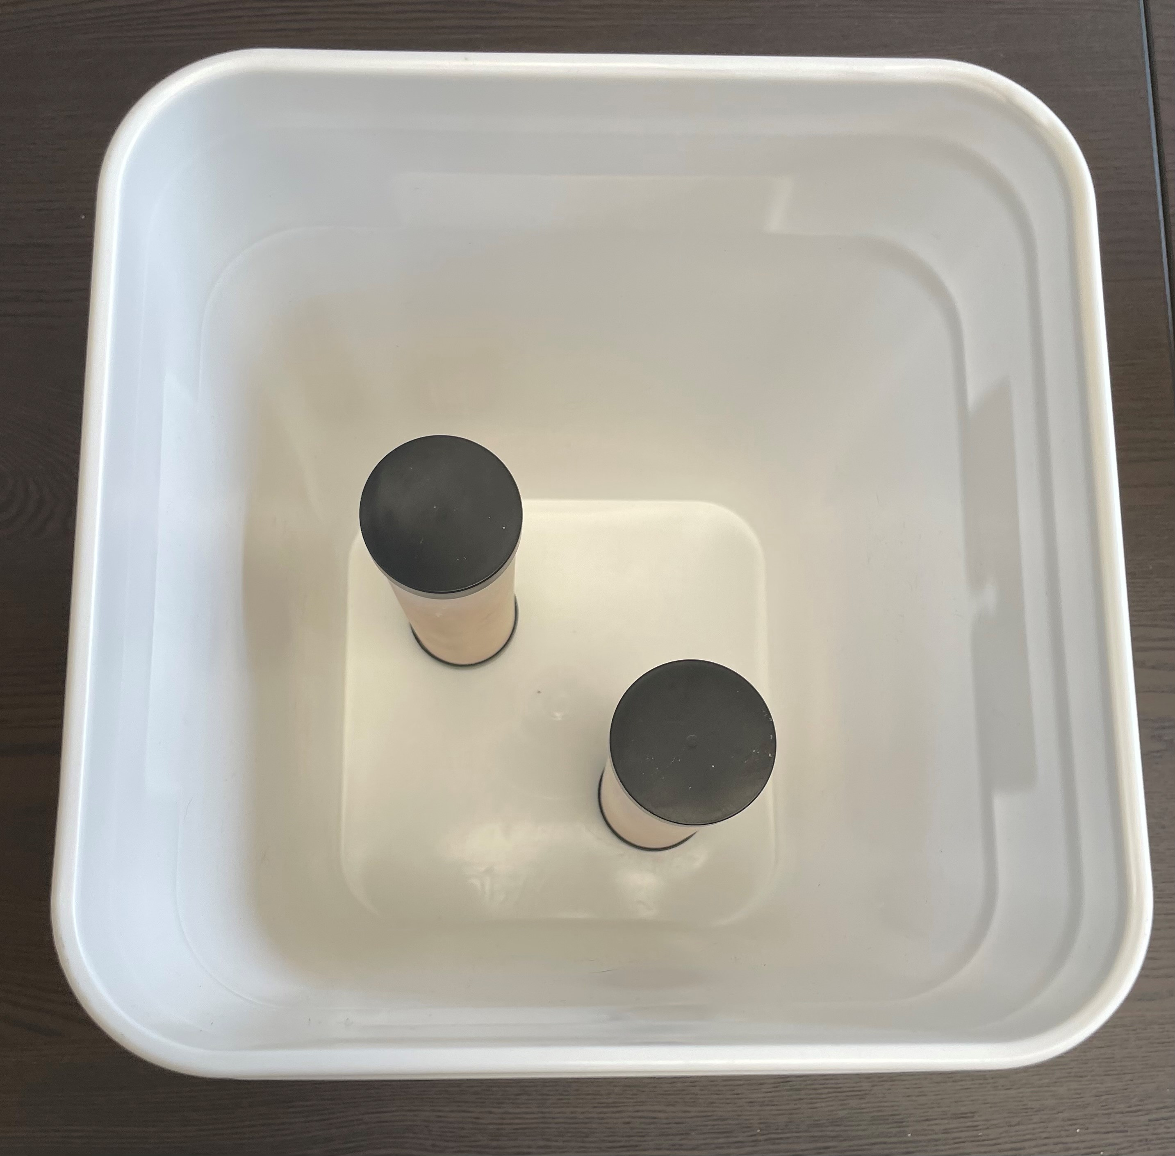
Aquabox
the ceramic filters are designed to trap and kill harmful bacteria
the filters are cleanable and reusable
the filters have a 99.9% rate of efficiency

Slide 7
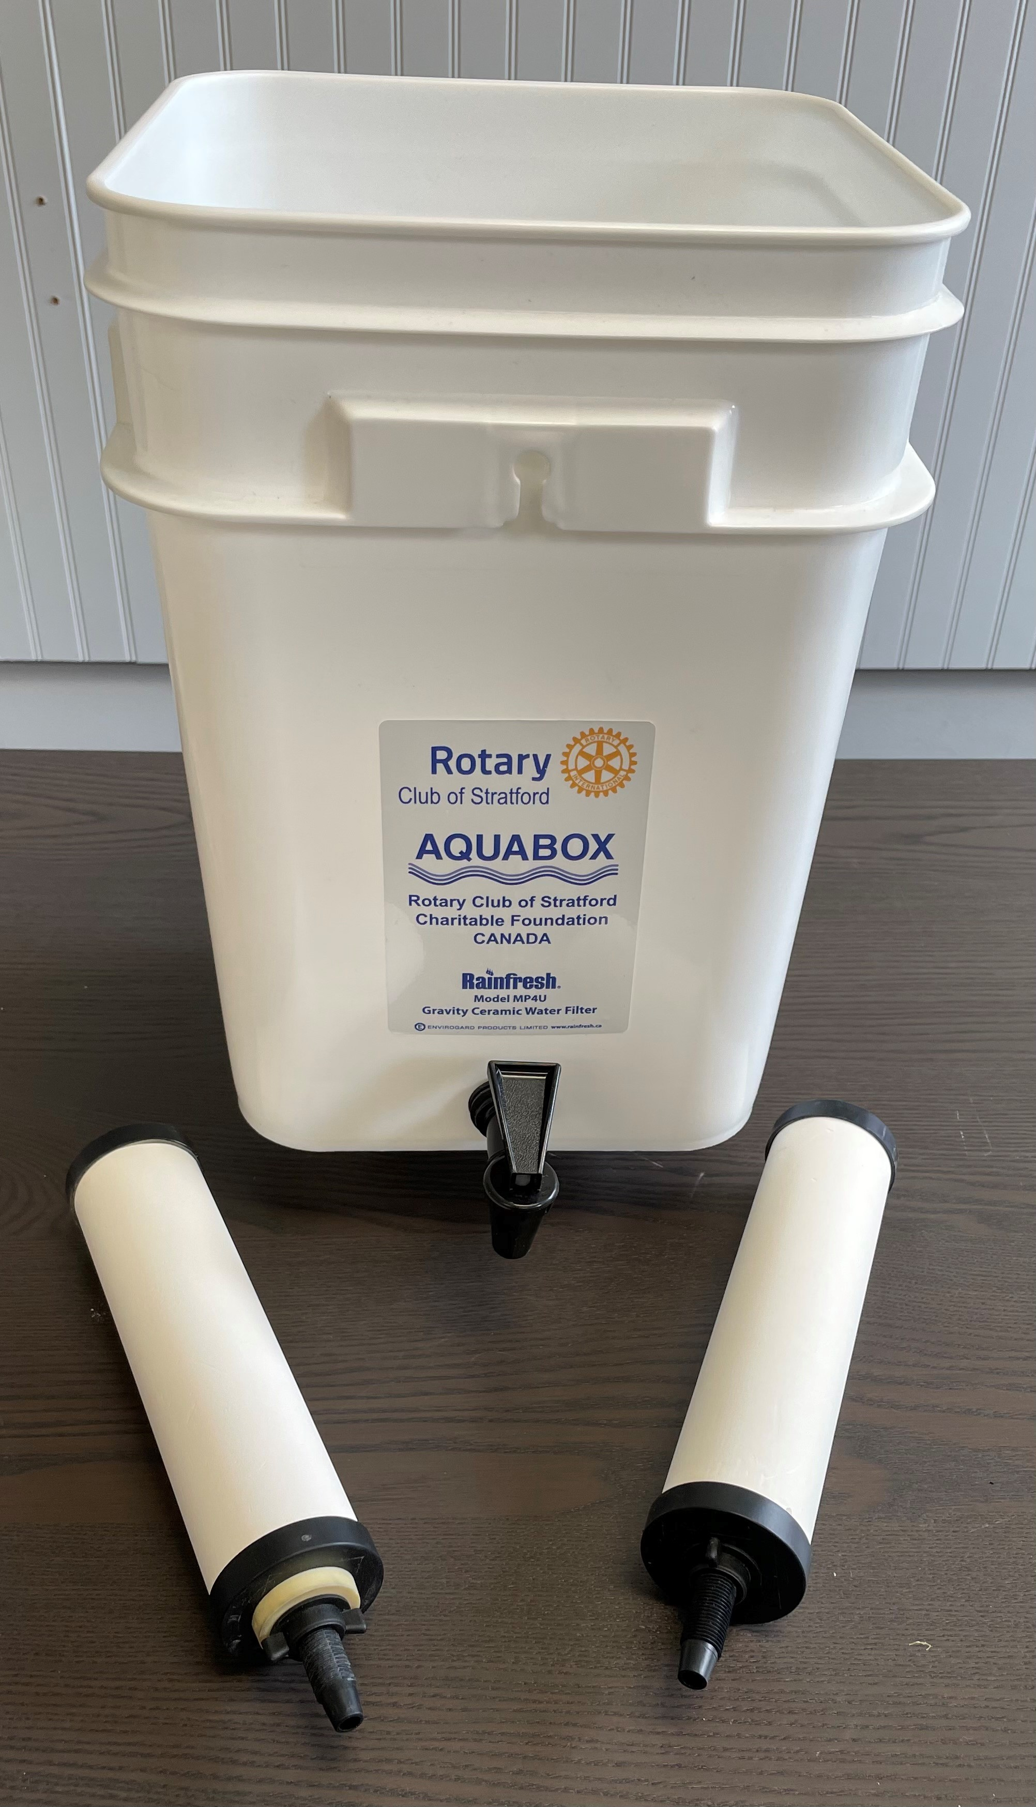
Aquabox
the 2 bucket system is designed to prevent contamination of the filtered water
the Aquabox is light, portable and easy to use until a more permanent source is available
Notes:
This 2 pail system keeps the clean water away from the contaminated.

Slide 8
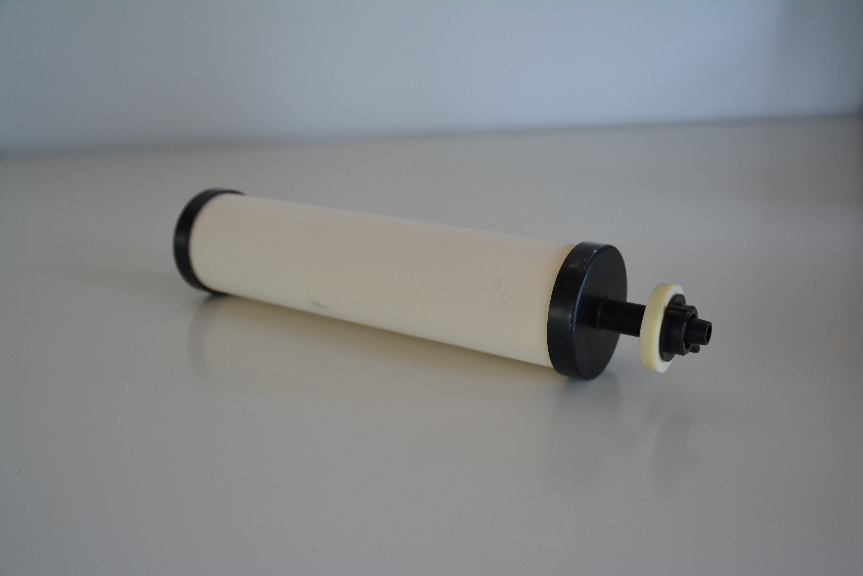
Aquabox
these filters have a life span of up to 1 year life depending on the condition of the water

Slide 9

Aquabox
Global Medic in Toronto handles the distribution of our Aquaboxes
Provide onsite aid and training
Notes:
Since there is a bit of open space in the box we also send a hygiene kit which contains toothpaste, toothbrushes and soap for the family
Our kits are distributed through Global Medic in Etobicoke. They are a nonprofit organization, many of their volunteers are EMS trained. Global Medic handles the logistics of getting the Aquaboxes on site and distributed to those in need. They also provide training making sure the Aquaboxes are used properly.
We have been working with Global Medic for over 10 years
Often the global medic team is on site within 48 hours of a disaster
Global Medics motto Right Aid, Right People, Right Time sums up the group perfectly.

Slide 10
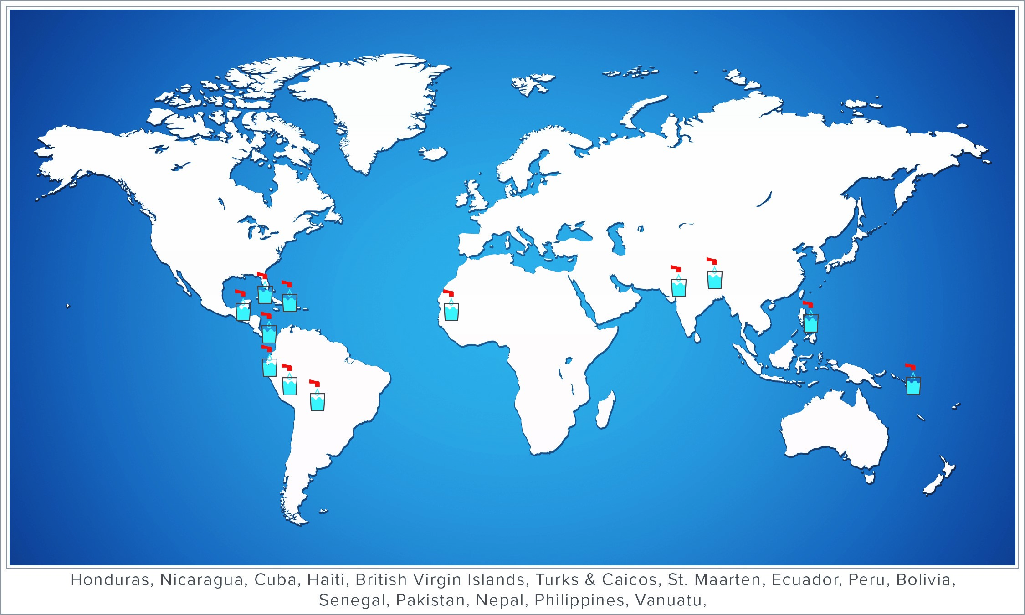
Aquabox

Slide 11
Aquabox
Notes:
One of the rewarding attributes of this program is the involvement of 40 to 50 volunteers that come together for our builds.
We get the chance to touch and hold the filters that will literally be saving lives on the other side of the planet
It is also a fun event where we work side by side with other volunteers on a common goal.
Often when we give there is a disconnect between the donations and the good they do.

Slide 12
Aquabox
An Aquabox cost $30 CDN
$15,000 for a build of 504 boxes
Notes:
Recently we built 1,000 units that were sent to Pakistan to aid their flooded regions.
We were aided in that effort by a local group of Pakistani Canadians from the London Health Science center.
Their donation of $12,500 plus the 25 volunteers they provided made this possible
Our financial requirements to build 1000 units per year are just over $30,000
These funds are mostly from community groups, individual donations as well as other Rotary clubs in our district
We have received donations from as far away as Vancouver from a Rotaract group, which is the Rotary club geared towards high school students.
All donations over $20 are eligible for a tax receipt.
All of the donations received go directly to the materials required to assemble the units

Slide 13
Aquabox
How can I help?
The fastest and easiest way would be to support our club financially.
With extra funding we could build and store many more boxes, and have then available immediately for the next disaster.
You could also act as a volunteer in our building process.

Slide 14
Aquabox
Questions?

