Slide 1
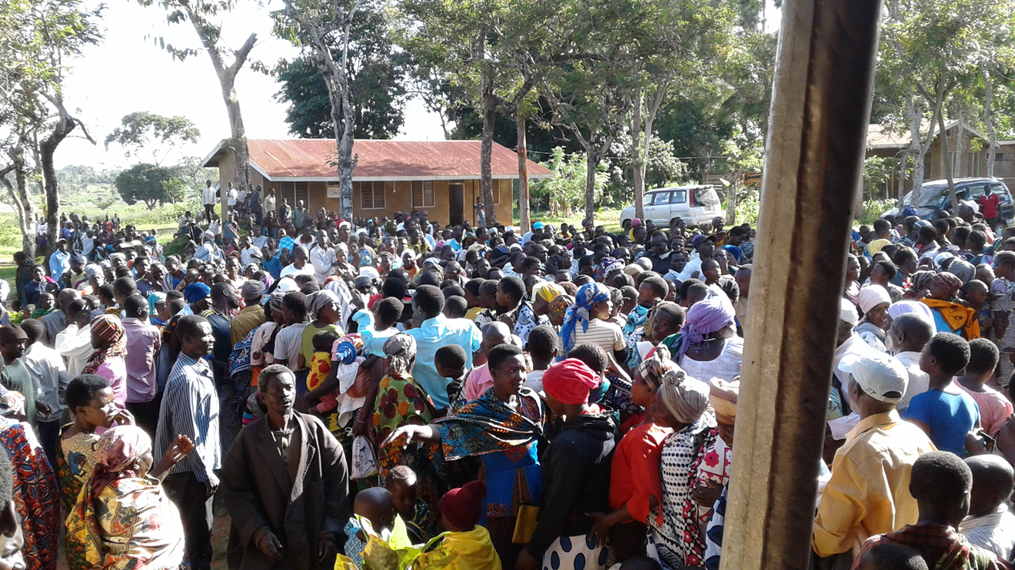

Slide 2
Project Impact
↓ Less time spent gathering water
↓ Gastrointestinal Diseases
↓ Drop-out rates for the girls
↓ Violence against women
↓ Unwanted pregnancies

Slide 3
A quote from Gordon McInally:
“How do we go about designing service projects with known outcomes and grounded in evidence?”

Slide 4
Outcomes

Slide 5
Informed by numbers

Slide 6
London South
Charter Date June 20th, 1989
Goals for the year?
All time TRF giving = $135,013 USD
Paul Harris Fellows 13 (84)
Major Donors (1)
Benefactors (4)
Bequest Society (4)
Paul Harris Society (4)
Polio Plus Society (2)

Slide 7
District 6330
Thank You
Total giving this year is:
$502,496

Slide 8
District 6330 Strategic Plan 2023-24
Strategic Direction | Goals | Metrics | 2023-24 | 2024-25 | 2025-26
Increase our Impact | Assist clubs to shift their attrition/attraction rates into the “green zone” | Move clubs into the “green zone” | Monitor
 |  | Move clubs out of the “red zone” | Monitor
 |  | Increase percentage of clubs that have a membership chair | ↑ to 60%
 | Maintain the generous support we give to the Rotary Foundation | Increase the number of clubs with a foundation chair | ↑ to 60%
 |  | Increase the percentage of clubs that participate in annual giving | ↑to 85%
 |  | Increase the number of Paul Harris Society members | Monitor
 |  | Increase the number of Polio Plus Society members | Monitor
 | Increase our engagement in youth programs | Increase the number of clubs that are engaged in the RYE program | Monitor
Expand our Reach | Strengthen district committee’s Develop and support new clubs Engage our communities | Committees have more than 1 member, a succession plan and terms of reference | 100% of committees have Terms of Reference
 |  | Add additional clubs | Monitor
 |  | Increase the percentage of women in D6330 | ↑ to 40%
 |  | Increase the number of service projects documented in Rotary Club Central | Monitor
Enhance Participant Engagement | Establish the Visioning Program as a club resource | Complete Visioning Facilitator Orientation | 5 clubs will go through visioning
 | Increase number of members who participate in service projects | Increase the percentage of clubs that have set goals in Rotary Club Central | Monitor
 | Establish monitoring system for club youth protection requirements (YVM) | Percentage compliance with reporting | Documentation in YVM will be completed
Increase our Ability to Adapt | Increase club member engagement with the district | Number of members who participate | Facilitation sessions for new secretaries, treasurers and foundation chairs
 | Provide District leadership opportunities to Rotaractors | Rotaractors are invited to join district committees | Monitor
 |  | Increased number of members on District Facebook page | Monitor
 |  | Increased open rates for District newsletter emails | Monitor
 |  | Increased percentage of clubs with a Public Image Chair | ↑ to 60%
 | Reduce the risk of software failure | There are multiple gatekeepers for district software programs | Monitor

Slide 9
Women in Rotary
Public Image Chairs
Foundation chairs
Visioning
Membership chairs
Youth Volunteer Management
Annual Giving
Facilitation groups including DEI and environment

Slide 11
Community Safety and Wellbeing

Slide 12
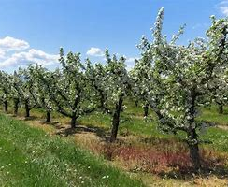
Plant a Seed
District Conference
June 21-23rd, 2024
Owen Sound

Slide 13
Thanks for creating hope in the world

