Slide 1
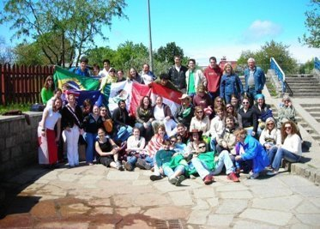
Connected by Exchange: How Rotary Shaped My Life
Kylie Michele Wood (Hilliard) • Poland 2005 • Sponsored by St. Thomas Rotary Club
Notes:
Thank you so much for having me here today. It really means a lot to be in a Rotary space again, sharing a story that began almost twenty years ago, but still feels very present in my life.
I grew up in West Lorne, Ontario — a small town of about 1,200 people — so going on exchange wasn’t just travel for me. It was my first real step into a much bigger world.
In 2005, I was sponsored by the St. Thomas Rotary Club to go on Rotary Youth Exchange to Poland. At the time, I thought I was signing up for an adventure — a new country, a new culture, new experiences.
What I didn’t realize was that Rotary was shaping something much deeper: the way I communicate, the way I learn, the way I relate to other people, and eventually, the way I think about service and community.
So today, I want to do two things. First, I’ll share a few small moments from my exchange year — moments that might sound simple, but genuinely changed me. And second, I’ll connect those moments to what came next, and how Rotary’s values kept showing up in my life long after that exchange year ended.
Because when I think about Rotary Youth Exchange, I don’t think about a single year. I think about a lifelong ripple effect.

Slide 2

Rotary as a Pathway
Exchange
Interact
Rotex
Rotaract
Notes:
My relationship with Rotary didn’t start with exchange. I was first introduced to Rotary through Interact in high school. I’m also what you could call a Rotary legacy—my mom was an exchange student too.
Looking back, I realize Rotary wasn’t just offering programs. It was offering a pathway—a way to grow into leadership and service over time. Interact gave me an early sense of what it means to show up for community. Exchange deepened my world understanding in the most immersive way possible. And then later, Rotaract gave me a space to practice leadership as a young adult.
What I love about Rotary is that it doesn’t end when you age out of one program. It evolves with you. It keeps inviting you back into service and connection—just with different responsibilities and a wider lens.
And that lens started sharpening for me the moment I arrived in Poland. I’m sharing these stories not because they’re unique, but because they’re exactly the kind of long‑term impact Rotary hopes for.

Slide 3
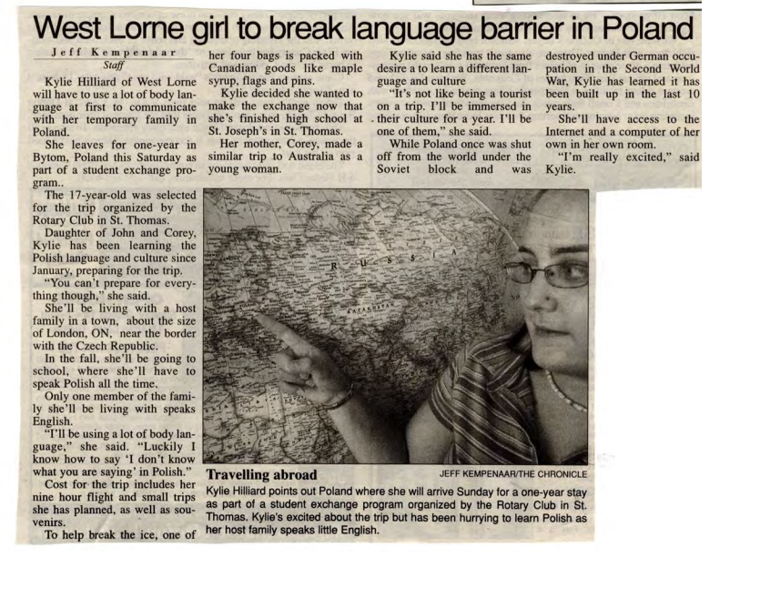
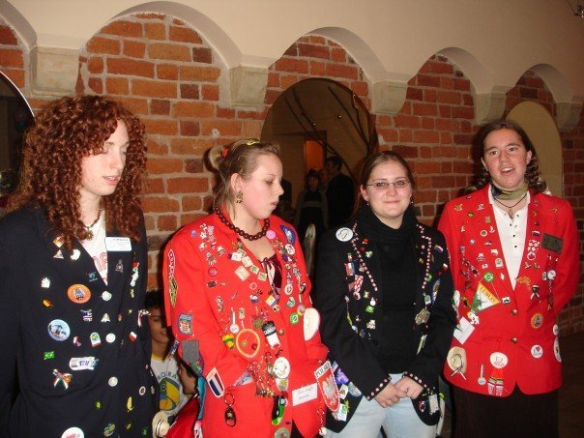

Arrival: Learning Without Language
Notes:
When I arrived in Poland, I quickly learned that my host family didn’t speak English—at all. And I didn’t speak Polish.
At first, that feels like a practical problem. How do you ask for what you need? How do you understand what’s happening around you? But very quickly it becomes something deeper than logistics—it becomes identity. You realize how much of your confidence and competence depends on being able to express yourself easily.
It’s amazing how far you can get with facial expressions, hand gestures, and a tiny English-to-Polish dictionary. But it’s also incredibly humbling. You’re vulnerable all the time. You have to be prepared to make mistakes. And not the quiet kind of mistakes—mistakes that happen in front of people, where you can’t explain yourself properly afterward.
That was hard for me, because I was used to being a high achiever. I was used to knowing the rules. Suddenly, I didn’t even know how to ask the question. This was my first real lesson in world understanding — not as an idea, but as a lived experience.

Slide 4
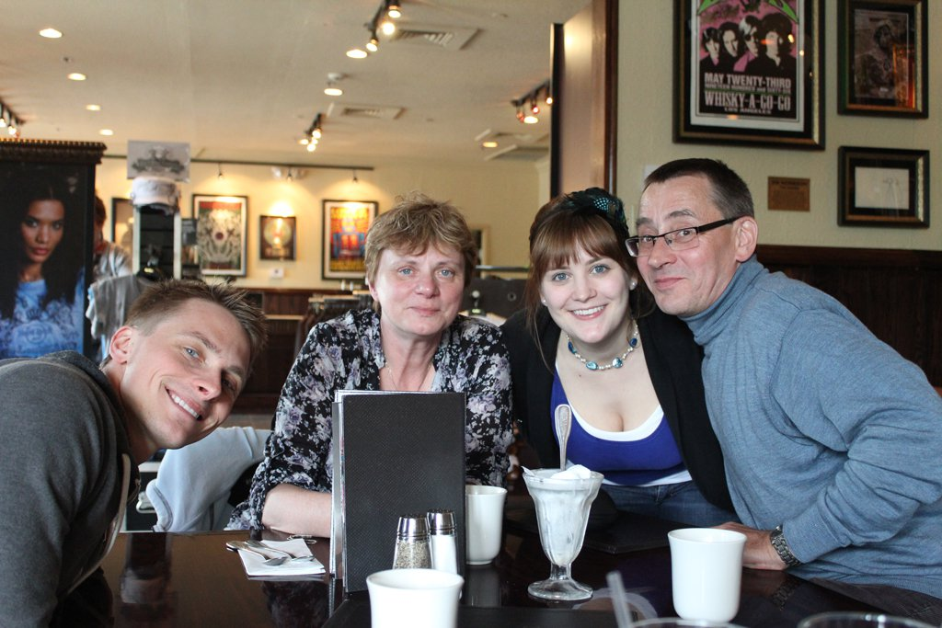
The Laundry Moment
A milestone we achieved together
Notes:
About three-quarters of the way through my exchange, I was sitting at the kitchen table with my host mom, folding laundry.
And for the first time, we actually had a real conversation. It wasn’t perfect. It was slow. But it was real. And what I remember most is her emotional response—because it made it clear that this wasn’t just a milestone for me.
It was something we had achieved together.
That moment taught me something I still carry: communication isn’t only about fluency. It’s about effort. It’s about patience. It’s about the willingness to keep trying, even when it’s uncomfortable.
Being understood is a gift. And when you can’t rely on words, you become a better listener. You watch people differently. You notice tone and body language and context. You become more careful—and more compassionate.
That skill shows up in my life constantly now, especially in my work and how I build community.

Slide 5


The Glass Bottle
Small Moments.
Big Lessons.
Notes:
Exchange also gave me many moments where I became more aware of my own assumptions — and how deeply everyday behaviours are shaped by culture.
One of my favourite examples is a simple glass bottle of water. My host parents took me on a mining tour — not a tourist experience, but something meaningful to them. At the end, we were given bottles of water. I didn’t realize the bottle was meant to be returned.
So we’re walking through the parking lot, and there I am — still drinking my water, bottle in hand, completely unaware.
They thought it was hilarious. This little Canadian girl had walked off with a bottle. And they loved telling that story — to family, to friends, to anyone who would listen.
What stayed with me wasn’t just the humour. It was the realization that I was operating on assumptions I didn’t even know I had — about resources, systems, and “how things work.”
It’s also why Rotary’s emphasis on exchange makes so much sense to me now — you don’t learn empathy by being told about it.

Slide 6
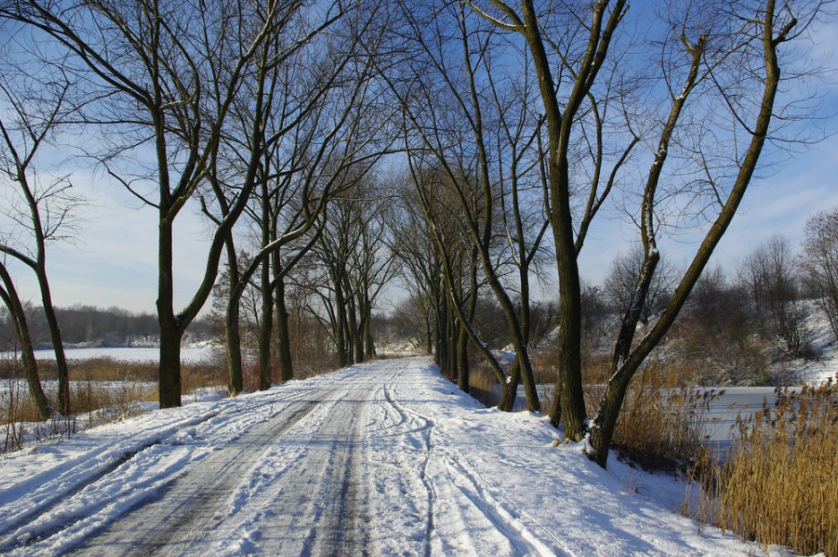
“Camp” Expectations
Notes:
Another moment that still makes me laugh—and also genuinely shaped me—was when I went to what I was told was “camp” with a friend.
I was excited. I pictured arts and crafts, maybe a campfire, some team-building. You know—classic camp.
That is not what happened.
The weekend began by jumping off a slow-moving train—in the dark—with barked commands like “jump left,” “jump right,” “duck,” and “climb.”
All in Polish.
Here’s what I remember most: everyone else responded instantly. They moved. They reacted. They followed instructions like it was second nature.
And there I was… standing. Watching. Processing. Always a few seconds behind.
By the time I figured out what the command meant, everyone else was already on the next one.
And I wasn’t unsafe—but I was extremely aware that I didn’t have the same context as everyone else. I couldn’t rely on language. I had to rely on tone, urgency, body language, and what everyone else was doing.
By the end of the weekend, I learned how to shoot a pellet gun, and I absolutely understood “lewo i prawo.” But the bigger lesson was this: words don’t carry meaning on their own—context does.
And that lesson has followed me into adulthood. It’s why I slow down when I’m explaining something. It’s why I check for understanding. It’s why I try not to assume that everyone in the room has the same background, the same context, or the same comfort with the language we’re using.
Exchange didn’t just teach me vocabulary. It taught me empathy in real time.

Slide 7
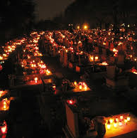
All Saint's Day
Different Customs.
Shared Values.
Notes:
One of the cultural moments that’s stayed with me most deeply is All Saints’ Day.
In Poland, families gather on November 1st to honour loved ones who have passed, and cemeteries are lit with thousands of candles. It’s one of the most beautiful things I’ve ever seen.
What stayed with me wasn’t just the image, but the reminder that even when customs differ, the values underneath are often the same — remembrance, respect, connection, family.
I still think about that day, because it taught me that world understanding isn’t abstract. It shows up in real, human moments like this.

Slide 8
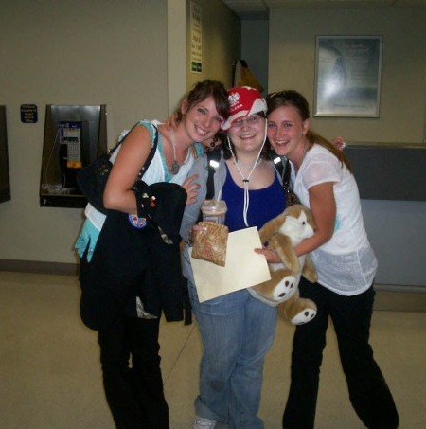
Returning Home:
Same Place
Different Person
Notes:
When my exchange ended and I returned home, something unexpected happened.
I came back to the same place I had left — same family, same routines — but I didn’t feel the same. I had changed in ways that were hard to explain.
There was a sense of loss. Not because home was wrong, but because a chapter that had deeply shaped me had closed.
And I want to be clear — this wasn’t a “travel bug.” What exchange gave me was a deeper awareness of how interconnected our world is, and a growing desire to understand where I fit within it.

Slide 9
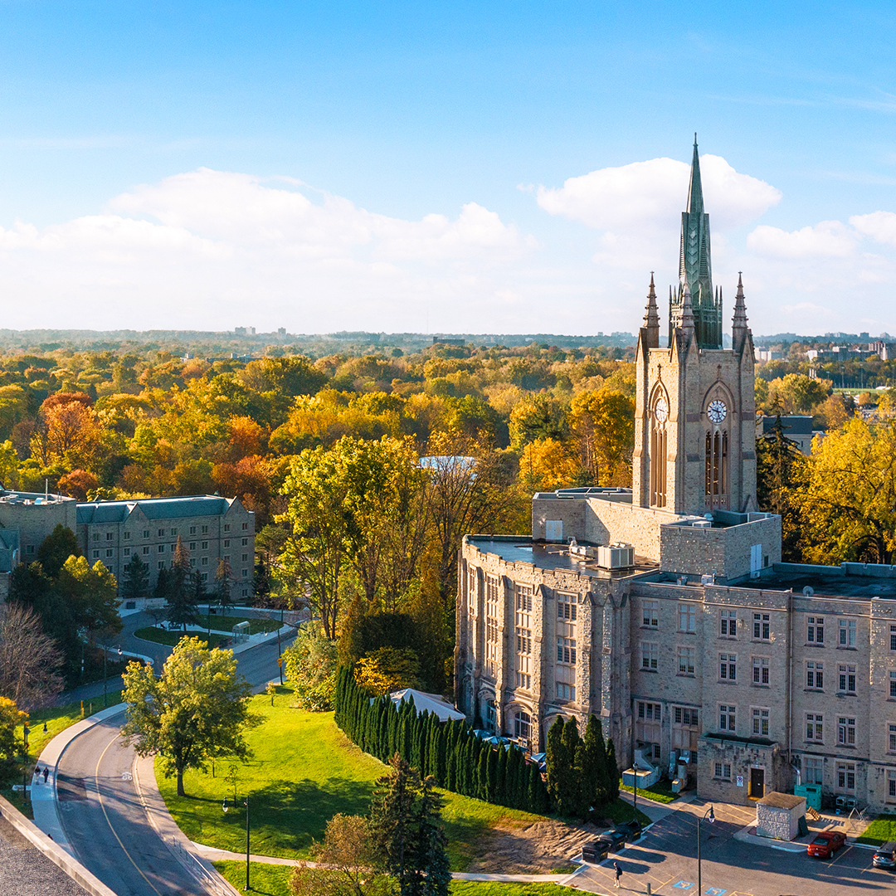
The Search for Understanding
Globalization
Intercultural Competence
Reflection
Notes:
That feeling of being changed but not yet having language for it sparked a search.
I wanted language for what Rotary had already shown me.
That’s what led me to study globalization at Huron — to better understand how systems, cultures, and people are interconnected.
Later, during my Master’s in International Education, I focused on intercultural competence — not as a theory, but as a lived skill.
Exchange taught me how to live across difference. Education helped me understand why it mattered — and how to be intentional about it.

Slide 10
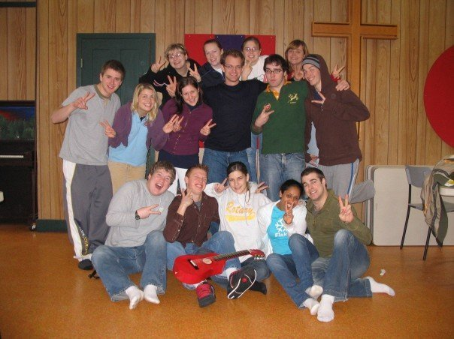
Staying Connected After Exchange
Notes:
After my exchange, Rotary stayed in my life in different ways — not always loudly or formally, but meaningfully.
One of the most important spaces for me was Rotex. And that matters — because Rotary doesn’t just send students out, it makes sure they’re supported when they come back changed.
It gave me a place to reflect alongside other students who had also gone on exchange and returned home changed. It supported the outgoing students, to be connected to peers with the lived experiences.
I know everyone feels they had a great exchange group, but I genuinely believe I did
I was also involved in Rotaract while at Fanshawe. I wasn’t leading the charge, but Rotaract offered continuity — a reminder that Rotary didn’t end with exchange, even during a busy and transitional stage of life.

Slide 11

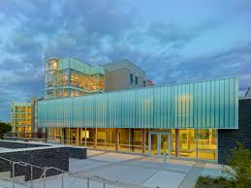
Career: Building Community
Notes:
Professionally, I started working in Housing at Western University in 2014, and over the years I’ve worked in various areas supporting students as they embark on their academic journeys.
So much of student success, especially early on, comes down to belonging—feeling seen, feeling supported, knowing how to navigate an environment that can be unfamiliar and overwhelming.
And what I realized is that exchange had prepared me for this work in a very real way. Because I recognized that feeling—the feeling of not knowing the rules, of trying to interpret social cues, of being a little behind the conversation sometimes.
Exchange made me more patient, more curious, and more intentional about building community.
When I work with students navigating new environments and expectations, I recognize that feeling immediately — because exchange taught me how to sit in uncertainty and learn my way forward.

Slide 12
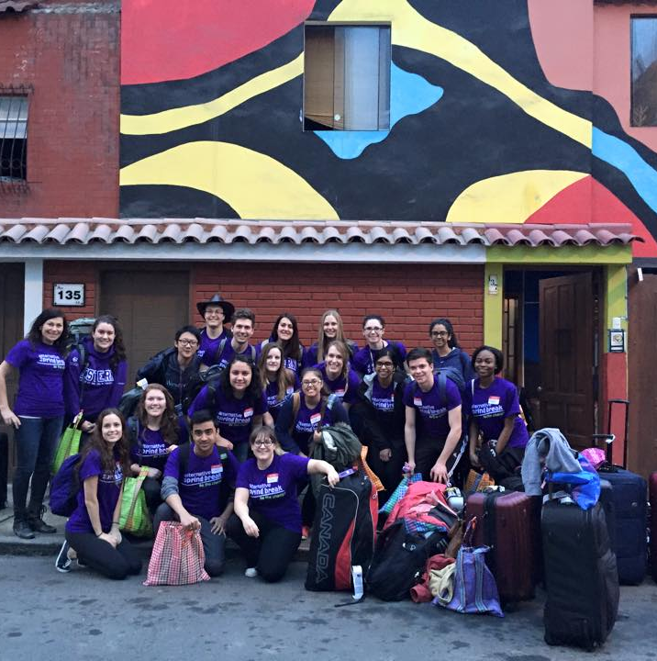
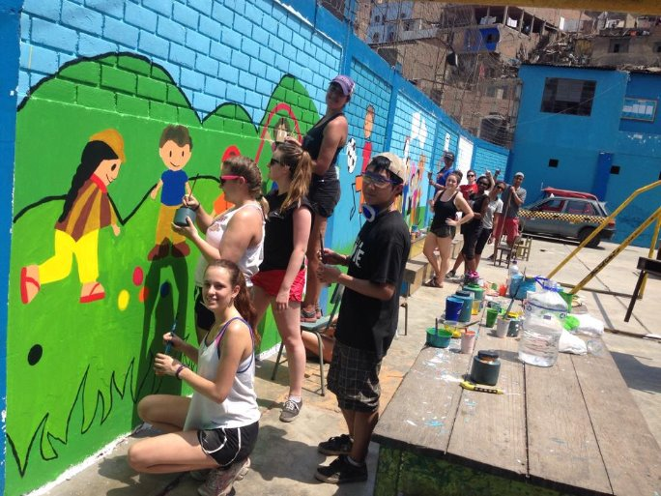
Service Beyond Exchange
Notes:
Early in my career, I had the opportunity to serve as a staff leader with Western University’s Alternative Spring Break, which took us to Peru for a week of community‑focused service learning.
That experience was eye‑opening — because it echoed lessons I had already learned through exchange.
Being immersed in a different culture again, adjusting quickly, and working alongside communities reminded me how important humility, listening, and relationship‑building are in any service context.
ASB reinforced that exchange hadn’t been a single, isolated experience.

Slide 13
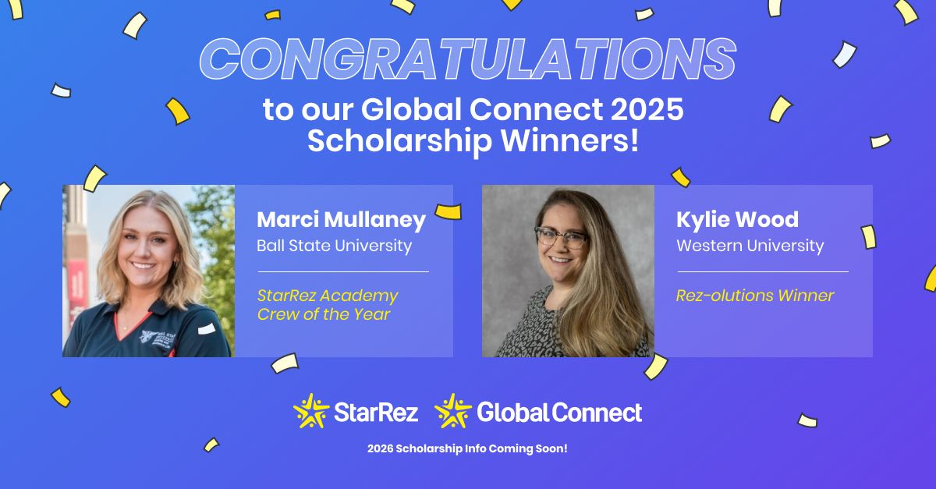
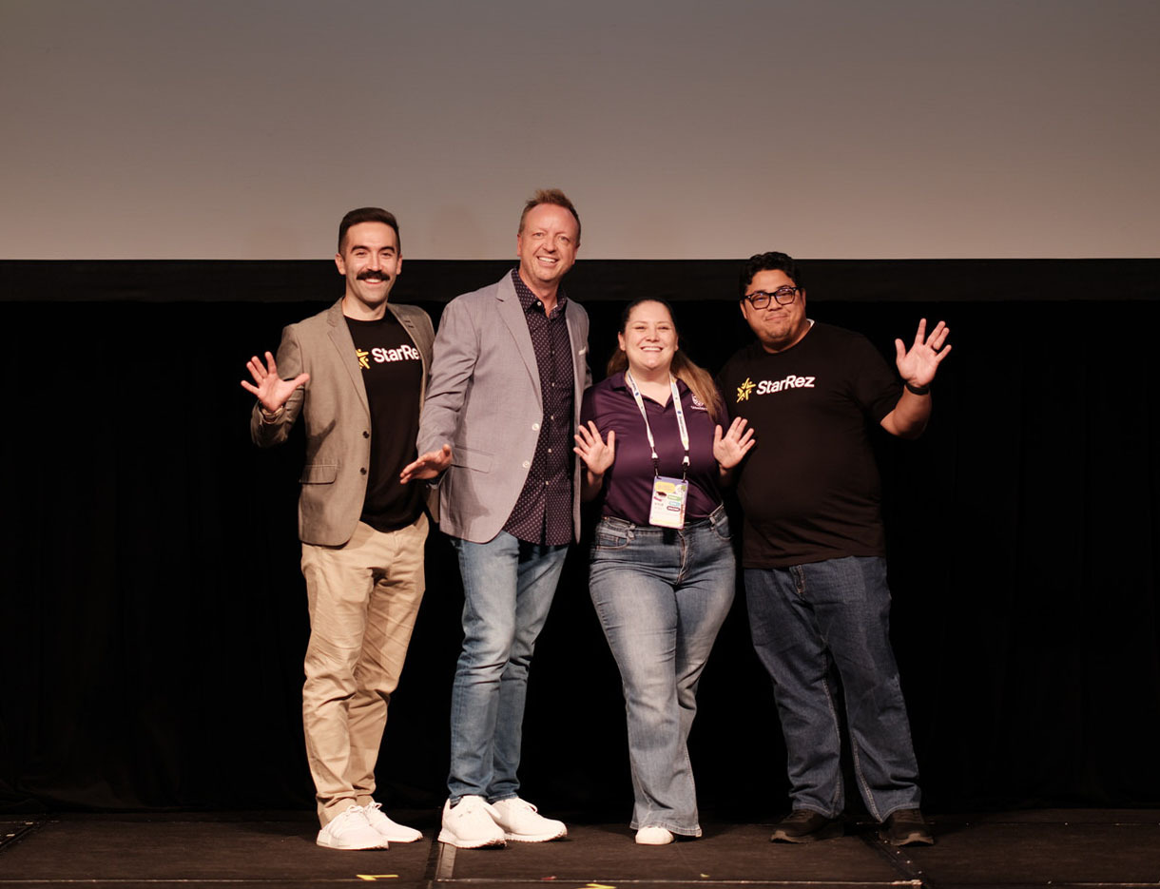
Leadership Today
Notes:
Over time, my work has evolved to include more data‑driven and project‑focused responsibilities. I am the Business Intelligence Coordinator for the Divison of Housing and Ancillary Services at Western University.
I spend a lot of time building systems, improving processes, and supporting both our students and our teams through technology.
Last year, I shared a process I developed for our housing management software at a global user conference in Denver, Colorodo. That work was recognized as best in show, and it is allowing me to return this year on a scholarship.
This isn't something that exchange caused, but rather something exchange prepared me for — by strengthening habits like curiosity, adaptability, and learning alongside others early in my personal journey.
I’m also midway through my Executive MBA, because another thing instilled early was the idea that learning is ongoing, not something you complete.

Slide 14
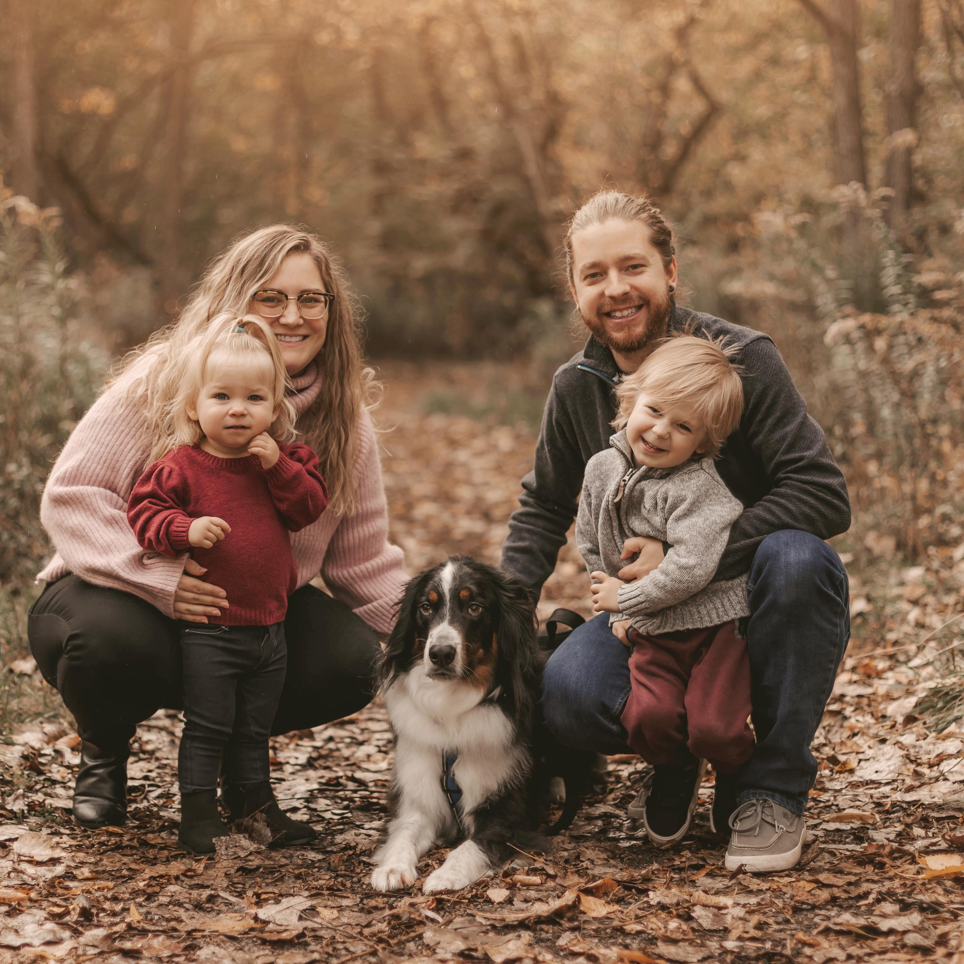
What Exchange Gives Me Today
Notes:
When I think about the last twenty years, I don’t see exchange as the reason for everything that followed. I see it as the beginning of a way of approaching the world.
Exchange gave me comfort with uncertainty, a habit of reflection, and the ability to sit with difference without needing to resolve it immediately.
Those qualities have supported me through professional growth, ongoing learning, and a full and sometimes complex personal life.
Exchange didn’t define my life — but it definitely helped shape how I live it.

Slide 15
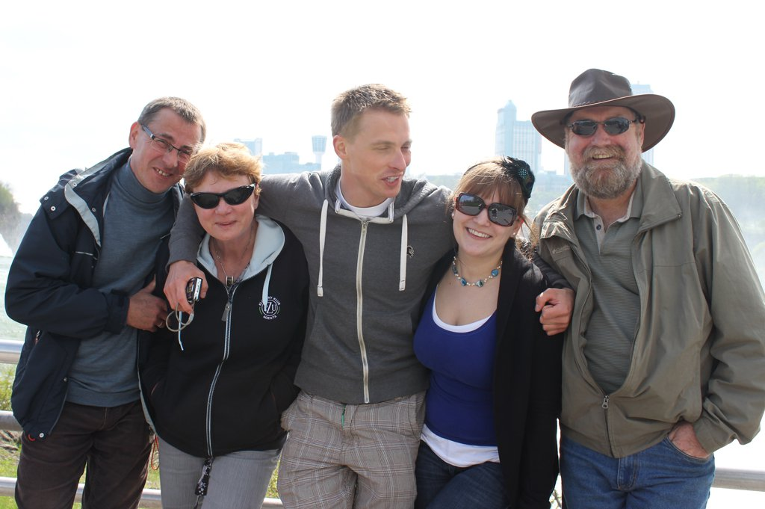
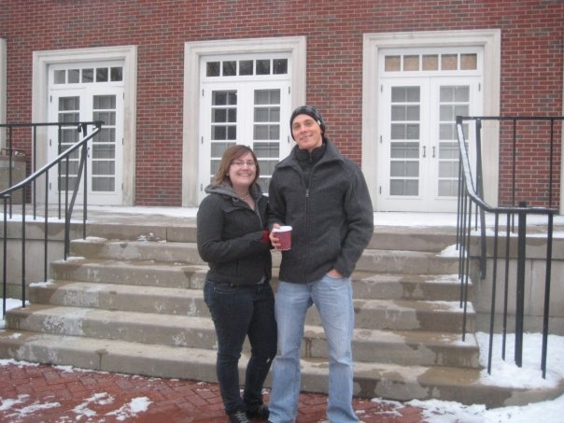
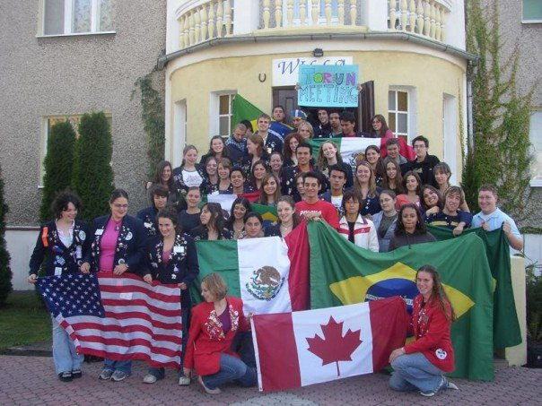
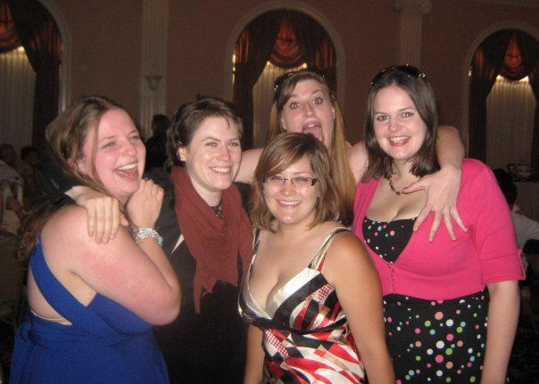
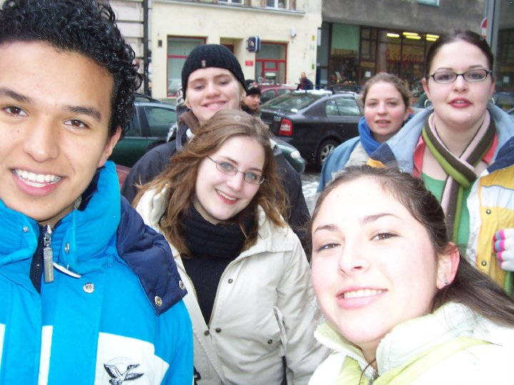
Lifelong connections
Notes:
One of the most tangible impacts of my exchange is the network of relationships that still exists today.
Social media has changed how we stay connected, but the connections themselves have lasted. I’m still part of a close group of exchange students who lived in Poland, and we’ve had a WhatsApp group going for years.
Every few months, messages pop up — life updates, photos, stories from around the world. And when major world events happen, we check in on one another.
I’m also still connected with my host brother. He’s since moved to Australia, and he went on exchange himself to the U.S., to Indiana — this incredible ripple effect of understanding continuing through different lives.
Exchange friends even travelled in for my wedding in 2018. And that was the moment it really clicked for me: this wasn’t a chapter that ended.
Exchange didn’t just give me memories. It gave me people.

Slide 16
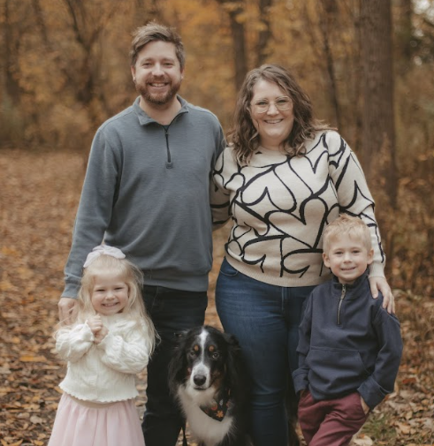
Life Today: Rooted Locally, Connected Globally
Notes:
Today, I live in London, Ontario with my husband and our two kiddos. Our life is full and busy in the ways many of you can probably relate to.
More recently, our family has started serving as ambassadors with Children’s Health Foundation — which feels like a very natural extension of the values Rotary reinforced for me early on.
Yes—I am curling in a recreational league with some colleagues, which I love because it’s such a community activity... our team is "Sweeping Sloths".
Exchange shaped my global lens, but it also shaped how I live locally—with curiosity, connection, and a commitment to building community wherever I am.

Slide 17
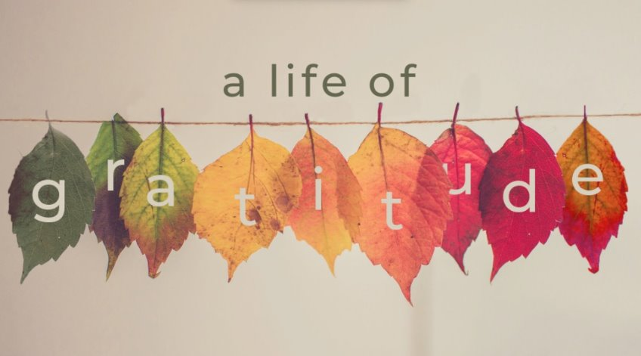
Thank you
Kylie Wood (Hilliard)
Kylie.wood@uwo.ca
Notes:
Rotary’s vision is about people uniting to create lasting change—across the globe, in our communities, and in ourselves.
When I look at my own life, I can honestly say that Rotary Youth Exchange helped create lasting change in me. It shaped how I communicate. It shaped how I learn.
I’m deeply grateful—not only for what Rotary gave me during my exchange year, but for how that investment has continued to echo forward in my education, my career, my relationships, and my understanding of the world.
Thank you.

