Slide 1
A Brief Overview about Me
Akhil Antony

Slide 2
Agenda
About me
Career
SWOT Analysis
Experiences and Learnings

Slide 3
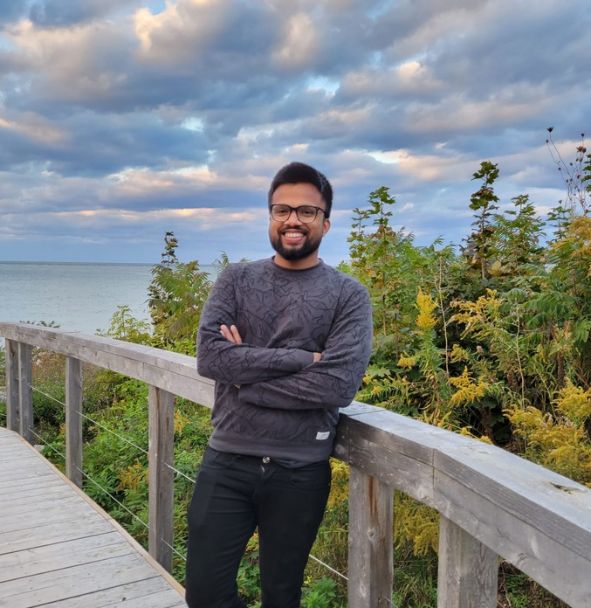
About Me
Personal Profile
A problem solver who loves taking up challenges to bring out efficient and reasonable solutions
Work Experience
Currently an insurance broker with 5 years of past experience in Design Engineering
Achievement
A Dean Honor Roll Awardee in Business Management who helped implement a strategy to reduce production waste and increase efficiency helping Bosco & Roxy save budget
Hobbies
As a critical thinker, playing chess gives me a sense of accomplishment for the day with an added workout regime for my physical health
Akhil Antony
Education
Bachelor in Mechanical Engineering with an interest in Design Engineering

Slide 4
Career
Gorani Industries Ltd. Indore (India)
I have worked in a product development team to develop sheet metal assembly for kitchen appliances such as Kitchen stoves, exhaust hoods & natural gas geysers.
Produced results in a cross-functional team for design and manufacturing.
2016 Mechanical Engineer
Ashirwad Technocrats, Bangalore (India
Designed modular metal wardrobe units which reduced onsite assembly time by 66%.
Developed lab furniture, lab equipment, commercial & domestic steel kitchens and equipment
2017 Design Engineer
Cyient Ltd, Bangalore (India)
Developed prototypes & performed simulations, design validations, and calculations for central heating appliances.
Developed HMI for the premium-segment heating appliance and designed front fascia, mounting brackets, and electronic housings.
2020
Design Engineer
Sutherland Elliot Insurance Brokers Customise insurance solutions to fit the client’s lifestyle and protect their asset. Networks for new sales leads and being a trusted advisor in the community to build relationships for future sales.
2022
Insurance Broker

Slide 5
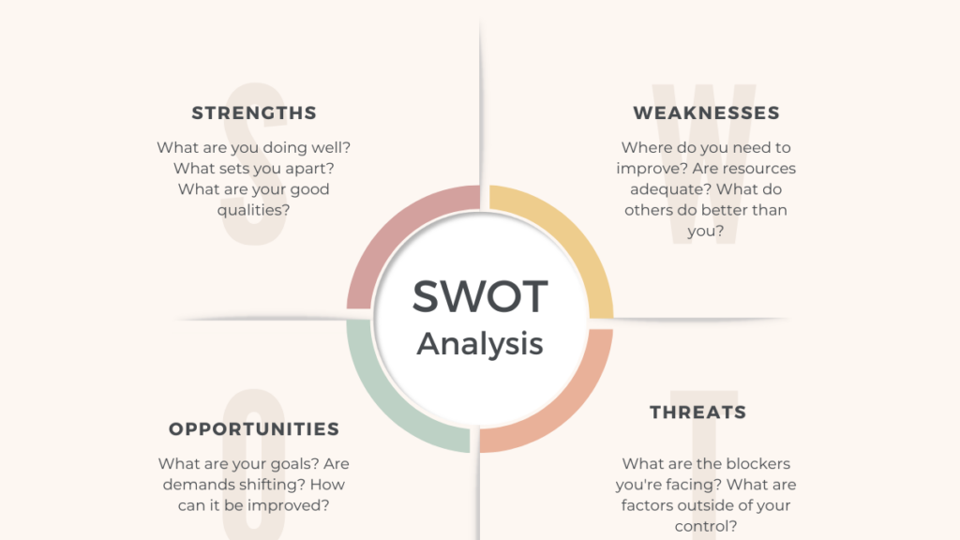
Able to think on my feet
Accepts challenges as a stepping stone for personal growth and development
Adapts to situations easily in terms of facing changes in life
Introverted in Nature, has stage fright
Takes time to make decisions often resulting in a one-time consideration
Reflects upon situations and pro-actively interprets the surrounding
Factors outside my control are the decision-making powers of people around me and their thought processes in interpreting scenarios
Fear of Public Speaking which makes me have second thoughts
The goal is to never be comfortable and always channel my critical thinking aspect
To build connections in the community in order to be articulate and presentable in front of a large crowd

Slide 6
Rotary
Experiences and
Learnings
Making food for parents staying in Ronald McDonald’s home which is non- profit organization provides shelter for parents who otherwise wouldn’t be able to stay with kids in the hospital
Helped in preparing pancakes for school students who are from the immigrant community
Youth exchange coordinator helping outbound students with their documentation and rotary application for processing visa to go to their chosen destination
Seeking to learn dedication and how individuals put efforts into groundwork to run Rotary as an organization
Being a part of Rotary puts me in a spot and makes me accountable for examples, with this interview you are held responsible and accountable for your work
Learning from a crowd of experienced individuals who have great presence of mind, helping me elevate my general conscious

Slide 7
Thank you for taking the time to Read a chapter of my life

