Slide 1
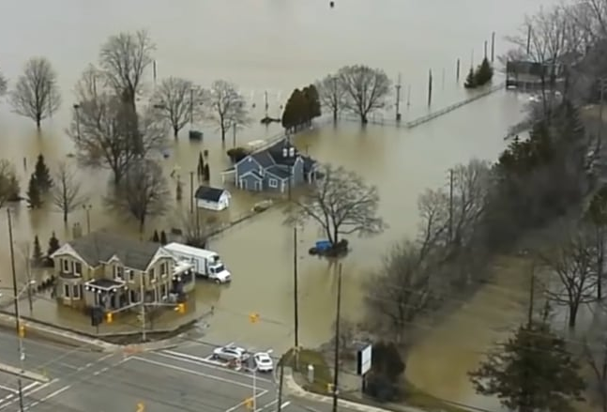
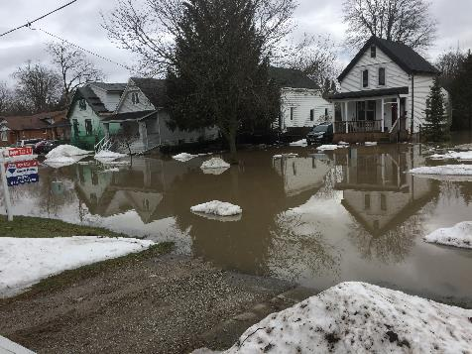


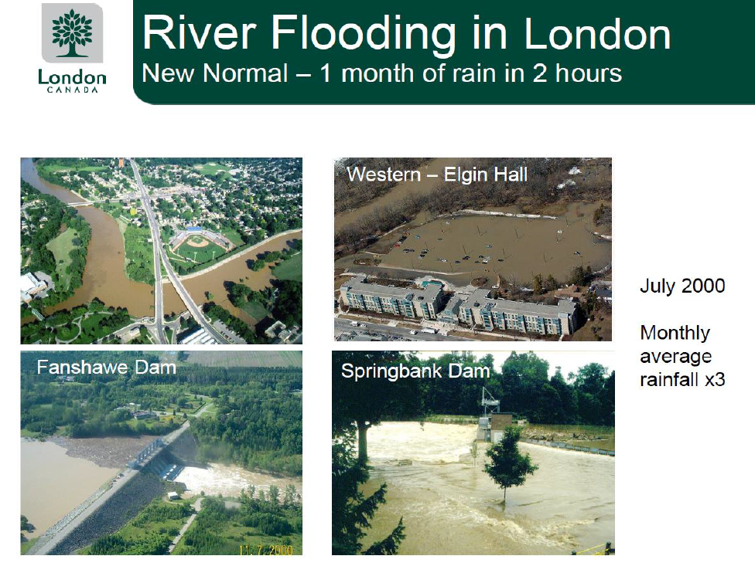
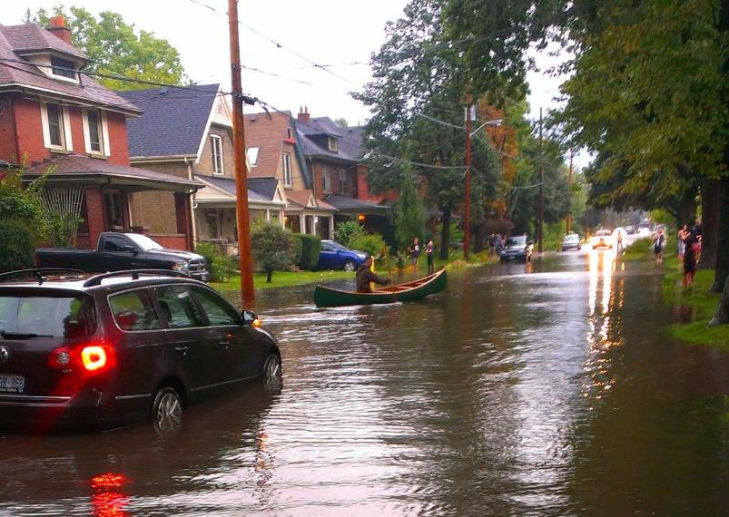
River Flooding - Winter-February 2018
Climate Change and Building Climate Resilient Communities
Walnut Street, just west of Wharncliffe & Riverside
Adelaide & Windermere
Gordon McBean CM, OOnt, PhD, FRSC
Institute for Catastrophic Loss Reduction
Professor Emeritus, Department of Geography and Environment
Western University
Presentation to
Rotary Club of London South Meeting November 26, 2021
Queens Ave, 2014

Slide 2
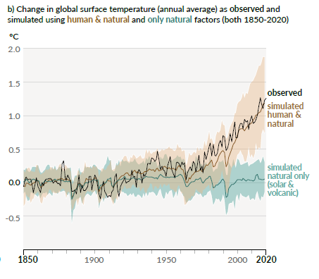
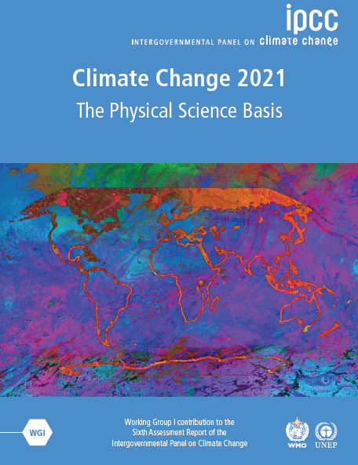
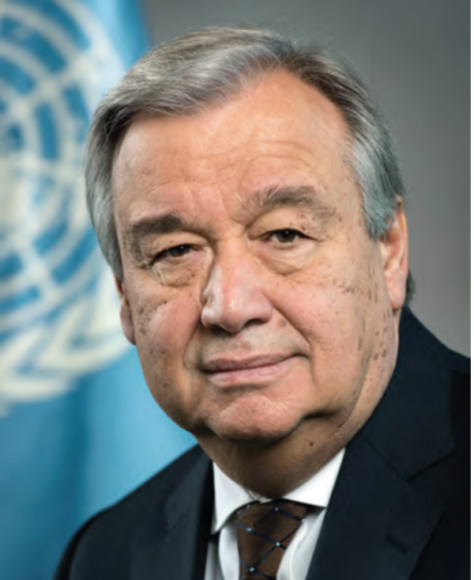
9 August 2021
Global surface temperature has increased faster since 1970 than in any other 50-year period.
In 2011–2020, annual average Arctic sea ice area reached its lowest level since at least 1850.
Late summer Arctic sea ice area was smaller than at any time in at least the past 1000 years.
CO_{2,} CH_{4,} N₂O concentrations - higher than at any time in at least 800,000 years.
0.2ºC/decade
It is unequivocal that human influence has warmed the atmosphere, ocean and land. Widespread + rapid changes in atmosphere, ocean, cryosphere and biosphere have occurred.
Human-induced climate change is already affecting many weather and climate extremes.
Heatwaves, heavy precipitation, droughts, and tropical cyclones.
Climate Change Warming
Code Red for Humanity
August 2021

Slide 3
By 2100, economic cost of climate change could be six times higher than previously thought
  A. Guterres, United Nations Secretary-General
“Climate change is the defining challenge of our time.”
“If I had to select one sentence to describe the state of the world, I would say we are in a world in which global challenges are more and more integrated, and the responses are more and more fragmented, and if this is not reversed, it’s a recipe for disaster.”
"Each person's emissions could quite well result in a cost to humanity of over $1,300 per year, rising to over $15,000 once the impacts of climate change on economic growth are included," G. Brierly +, University College London, Environmental Research Letters

Slide 4
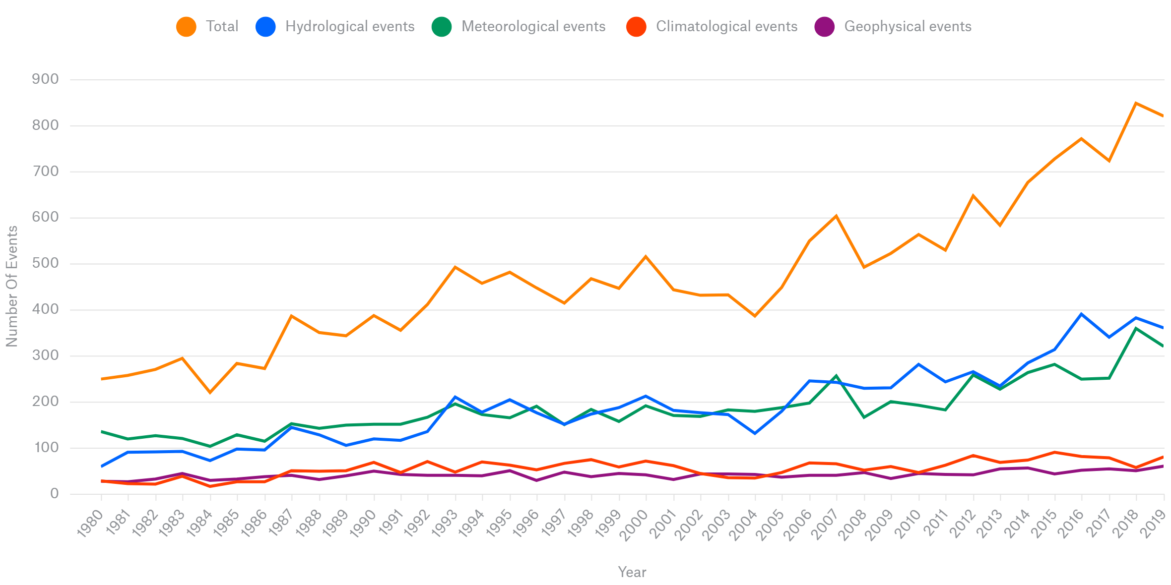
Impacts Globally
the Number of Natural hazards disasters is increasing
Heat, drought, wildfire
Floods
Storms
Geophysical
Climate Change
NatCatSERVICE, Munich Re, 2020

Slide 5
Impacts in Canada
the Number of “Natural” Catastrophes is increasing
Canada is warming at nearly twice the global rate with parts of western and northern Canada warming three or four times the global average.
Sea ice in the North is thinning and shrinking, and our unique ice shelves are crumbling into pieces.
$15B
$10B
Canadians are experiencing more and more extreme weather, from intense and lengthy heat waves, to suffocating smoke and haze from wildfires, to extreme flooding.
Canadian scientists - clear link between climate change and extreme weather events. … much of what we are seeing is driven by human-induced climate change.
projected to intensify in future.
Fort McMurray Fire
Alberta, Toronto Floods
Eastern Canada
ice storm
Ontario
Wind + rain
Calgary Hail
Heat, Floods, storms, …
2030
2021

Slide 6
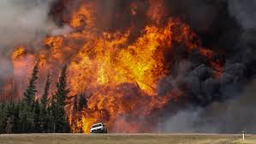
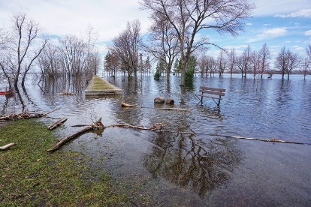
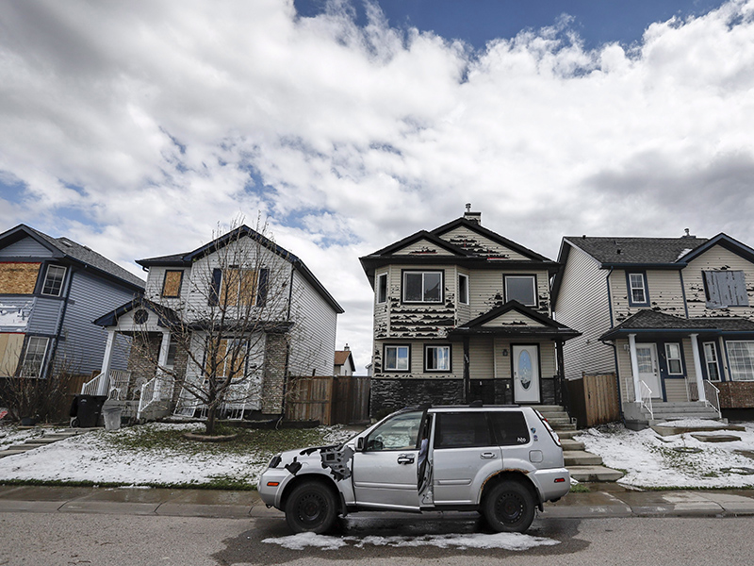
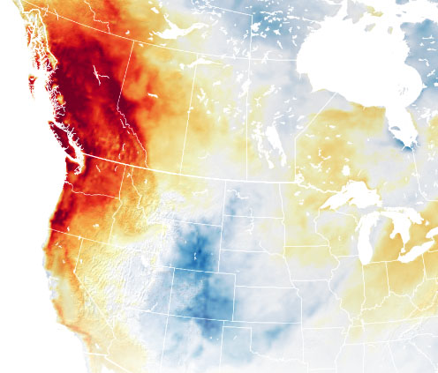
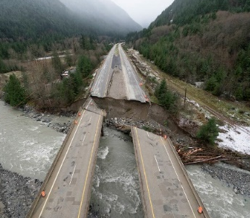
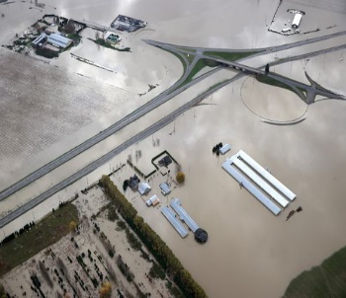
Recent Extreme Weather Hazardous events in Canada
May 2016 Fort McMurray Wildfires
The May fires forced almost 90,000 residents out of the Regional Municipality of Wood Buffalo and destroyed about 2,400 homes and other buildings.
April 2019 Ottawa River flood - Another record-setting – exceeding the 2017 flood more than 6,000 dwellings were flooded or at risk. Roads - streets –bridges - closed, Flooded farmlands - delaying fieldwork and planting. At least two lives lost: one each in Ontario and Quebec.
June 2020 Calgary Hail Storm - Calgary hailstorm that caused $1.2B in damage. Much damage to homes, vehicles – no deaths
BC Floods –
November 2021
Heat Dome of 2021 – 49.6ºC in Lytton BC

Slide 7
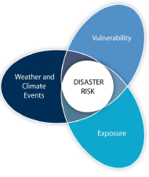
Reducing Disaster risk
Impacts from hazard events depend on:
Vulnerability: predisposition of a person or group to be adversely affected
How to reduce exposure
and vulnerability?
Changing Climate
Changing Hazards
Exposure and vulnerability are key determinants of disaster risk
HAZARD EVENT
Nature and severity of event
Exposure
Government policies and actions – better homes, not in flood plains, …
Disaster Risk: the likelihood of severe alterations in the normal functioning of a community or society due to hazard events interacting with vulnerable social conditions

Slide 8

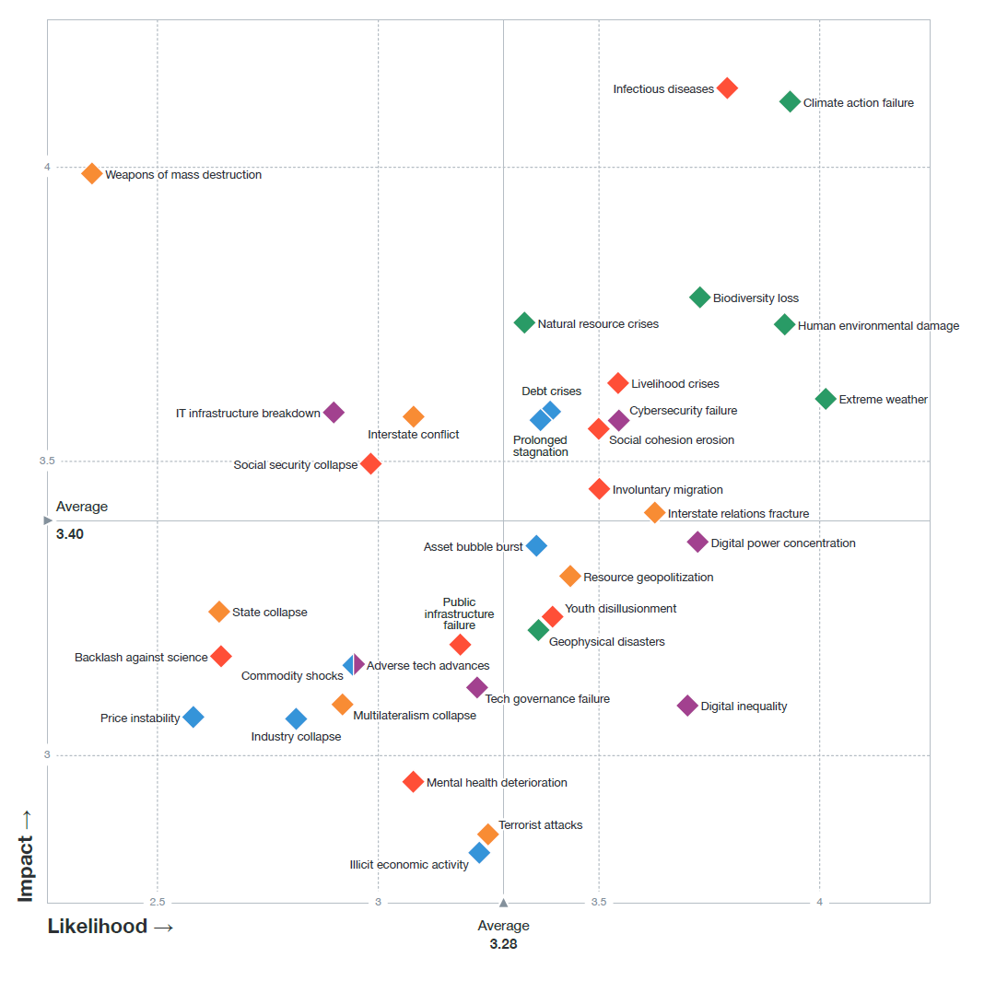


World Economic Forum - Global Risk Assessments
Global Risk Report 2021
Infectious Diseases (2021)
Climate Action Failure
Weapons of Mass Destruction
HIGH
Biodiversity Loss
Human
Environmental Damage
food, water Crises
Extreme Weather
Impact
Livelihood crises
Social cohesion erosion
Involuntary migration
Public infrastructure failure
Climate, Environmental and Societal Risks Connected
Likelihood
HIGH
A global risk - significant negative impact for several countries or industries within the next 10 years – to 2030.

Slide 9

Climate Convention CoP21 Paris, 2015
GLOBAL AGENDA 2030
Article 2 1. This Agreement, .. aims to strengthen the global response to .. threat of climate change, .. context of sustainable development and efforts to eradicate poverty:
(a) Holding the increase .. global average temperature to well below 2 °C, above pre-industrial levels.. Limit .. to 1.5 °C .., significantly reduce the risks and impacts of climate change; MITIGATION
(b) Increasing the ability to adapt to the adverse impacts of climate change and foster climate resilience and low greenhouse gas emissions development, in a manner that does not threaten food production; ADAPTATION
Article 4 Each Party shall prepare, communicate and maintain successive nationally determined contributions (NDC) … public registry.
Article 7 Parties hereby establish the global goal on adaptation of enhancing adaptive capacity, strengthening resilience and reducing vulnerability to climate change, … early warning systems,
The process to formulate and implement national adaptation plans;
Conference of Parties 26 – CoP 26
Glasgow – Nov 1-12, 202121

Slide 10

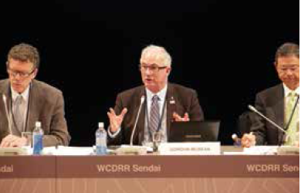

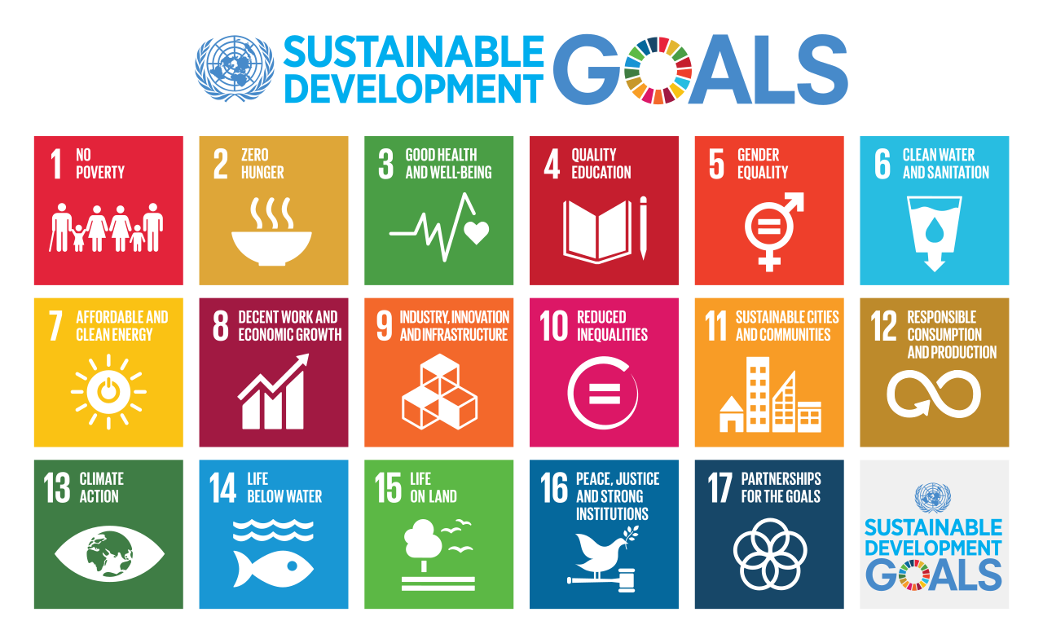
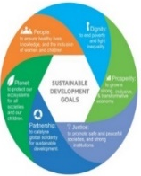
Sendai Framework for Disaster
Risk Reduction 2015-2030
2015 Policy
Agenda - 2030
Four priority areas for Disaster Risk Reduction
Understanding disaster risk;
Strengthening disaster risk governance to
manage disaster risk;
Investing in disaster risk reduction for resilience;
Enhancing disaster preparedness for effective response, and to “Build Back Better” in recovery, rehabilitation and reconstruction.
Lead - S&T
Major Grp
Need an integrated approach across Global Agenda 2030 -Climate – Disasters – Sustainable Development - issues and disciplines – and levels of governance and private sectors – to address these issues together.
Global Agenda - 2030
Sustainable Development Goals – 17 Goals -169 Targets
Interconnections
Sustainable
Development
Goals
9. Build resilient infrastructure
10. Reduced Inequalities
11. cities+human settlements… safe, resilient
16. Peace, Justice + Strong Institutions
Global Partnerships - Multi-disciplinary Science

Slide 11
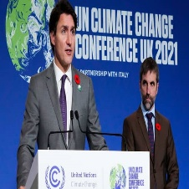
UN Climate Change
Conference UK 2021
Canada: end: public financing - fossil fuel projects, deforestation by 2030; global carbon tax; methane; zero-emissions vehicles
----------------------------------------------------------------------------------
Glasgow Climate Pact -
I. Science and urgency
Recognizes the importance of the best available science …;
3. Expresses alarm and utmost concern…;
4. …urgency of enhancing ambition and action - mitigation, adaptation
II. Adaptation
5. … serious concern … climate+weather extremes…impacts;
6. … urgency - scaling up action and support, … enhance adaptive capacity, strengthen resilience and reduce vulnerability to climate change … best available science, … needs of developing country
7. Welcomes the national adaptation plans, …
8. … further integrate adaptation into local, national and regional planning;
III. Adaptation finance
10. … current provision of climate finance for adaptation remains insufficient to respond to worsening climate change impacts in developing countries

Slide 12
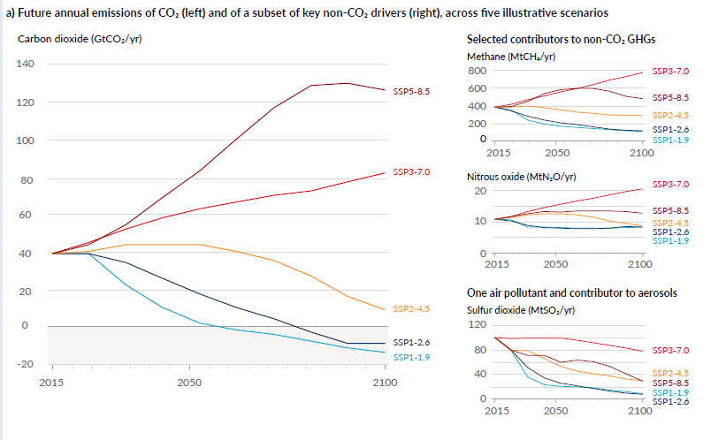
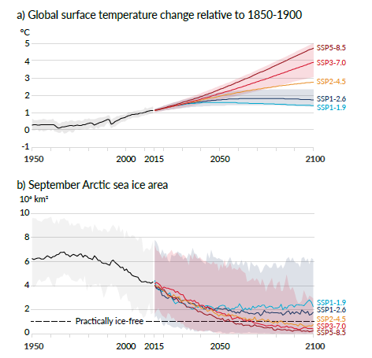
Global warming of 1.5°C and 2°C will likely be exceeded during the 21st century
Climate Futures – Emissions Scenarios – Warming
Carbon dioxide (GtCO₂/yr)
Global Temp
(relative to 1850-1900)
Greenhouse effect warming:
Earth % warming lifetime
Water Vapor 65% 10 days
Carbon Dioxide 25% 100 years
Methane 10% 10 years
Warming +33C
Global, decadal-century problem
0.2ºC/decade

Slide 13
Glasgow Climate Pact
IV. Mitigation
17. … 1.5 °C requires rapid, deep and sustained reductions …
18. … accelerated action in this critical decade, …;
19. … include methane;
21. … protecting, conserving and restoring nature and ecosystems, including forests, terrestrial and marine …
VI. Loss and damage
44. … importance of coherent action to respond to the scale of needs caused by the adverse impacts of climate change;
45. … strengthen partnerships between developing and developed countries, funds, technical agencies, civil society and communities to enhance understanding of how approaches to averting, minimizing and addressing loss and damage can be improved;
Climate resilience is defined as the ability to anticipate, prepare for, and respond to hazardous events, trends, or disturbances related to climate. With climate change happening now, it has never been more important to understand its global and local impacts.

Slide 14



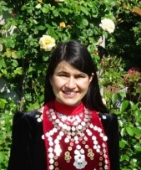




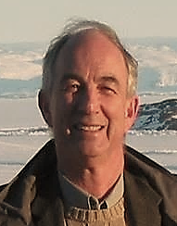








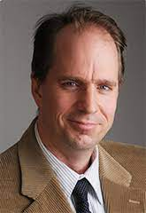


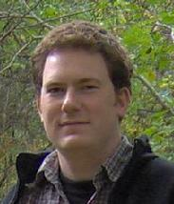
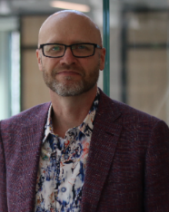
Building Climate Resilient Communities
SSHRC Knowledge Synthesis Grant – 2020-1
How can communities across Canada proactively advance climate- resilience to effectively reduce the risk of adverse climate impacts, loss and damage? https://ir.lib.uwo.ca/geographypub/369
The Team
Focus
Topics
Impacts and Adaptation-Resilience Strategies
Heat environments of Canadian communities
Construction Codes - Disaster Risk Reduction for Severe Wind, Hail, Wildfire, and Urban Flooding
Building Climate Resilience in Indigenous Communities
Climate Change Impacts on Human Health
Economics and Climate Adaptation
Barriers to Adaptation
Cities Adapt – wildfires
PIs

Slide 15
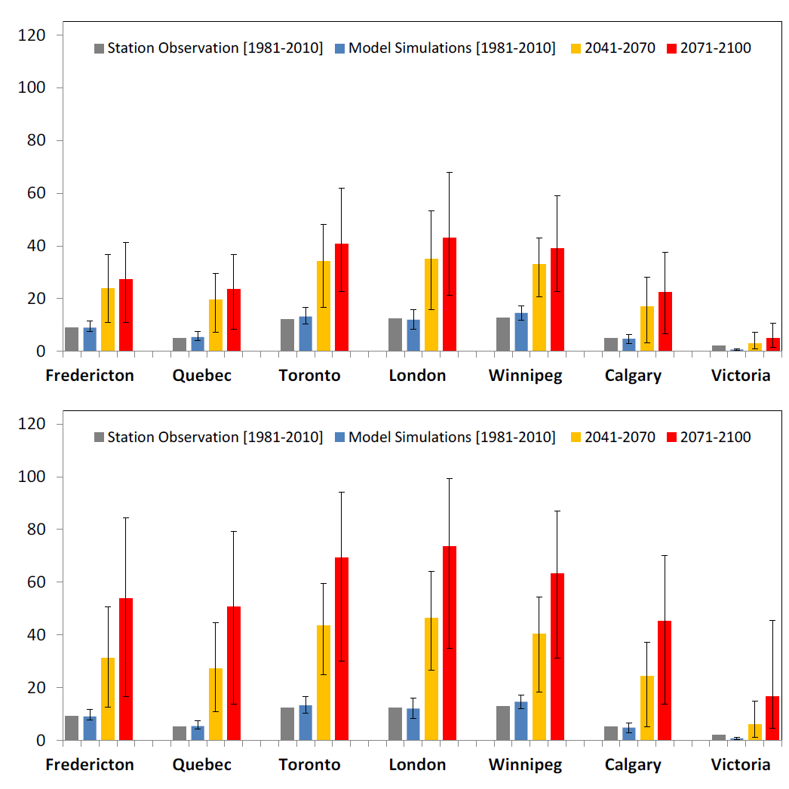
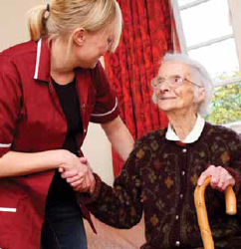
4. Canadian Climate Resilience Agenda
A Healthy Environment and Healthy Economy (HE-HE) Plan (Dec. 2020)
  Pillars: Power of Nature to Support Healthier Families and More Resilient Communities.
Develop Canada’s first-ever National Adaptation Strategy,
Supreme Court (2021): global warming - beyond provincial boundaries.
Multi-level governance arrangements to address climate-related events.
National Issues Report 2021 – Summary comments
  Large gaps remain in our preparedness for climate change, as demonstrated by recent impacts of extreme weather events.
  Lessons on good practices are emerging
  Climate change adaptation deficit in Canada
Key Messages - Building Climate Resilient Communities
Climate change is impacting communities, health, and the entire society. Local-scale warming due to urbanization adds to heat burden and
social, health and
economic impacts.
40

Slide 16
Key Messages - Building Climate Resilient Communities
Severe weather events - infrastructure characteristics and disaster risk affects.
Warming - severe weather - Northern Tornadoes Project (NTP)
The expert community has developed proven tools to develop and implement plans. Some communities in Canada have prepared high-level adaptation plans, but few have a detailed implementation strategy with established funding frameworks. Local communities need funding and guidence from senior governments to be resilient.
Indigenous communities - leading climate change adaptation.
Adaptation without Borders - between countries and provinces, across multi-level governance and sectors of society. Flooding with impacts – across borders and levels of governance.
Good examples: London Climate Emergency Action Plan
  Nova Scotia Municipal Climate Change Action Plan (MCCAP)
  Pacific Climate Impacts Consortium; Pacific Institute for Climate Solutions; City of Vancouver – municipal adaptation plan
The National Adaptation Strategy needs to address these and to assist in addressing the significant financial, other issues.
  to go to Action

Slide 17
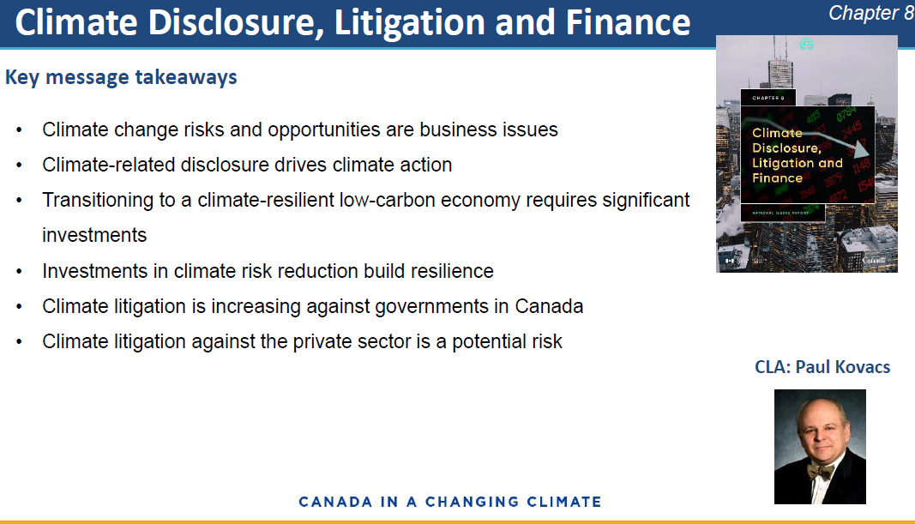

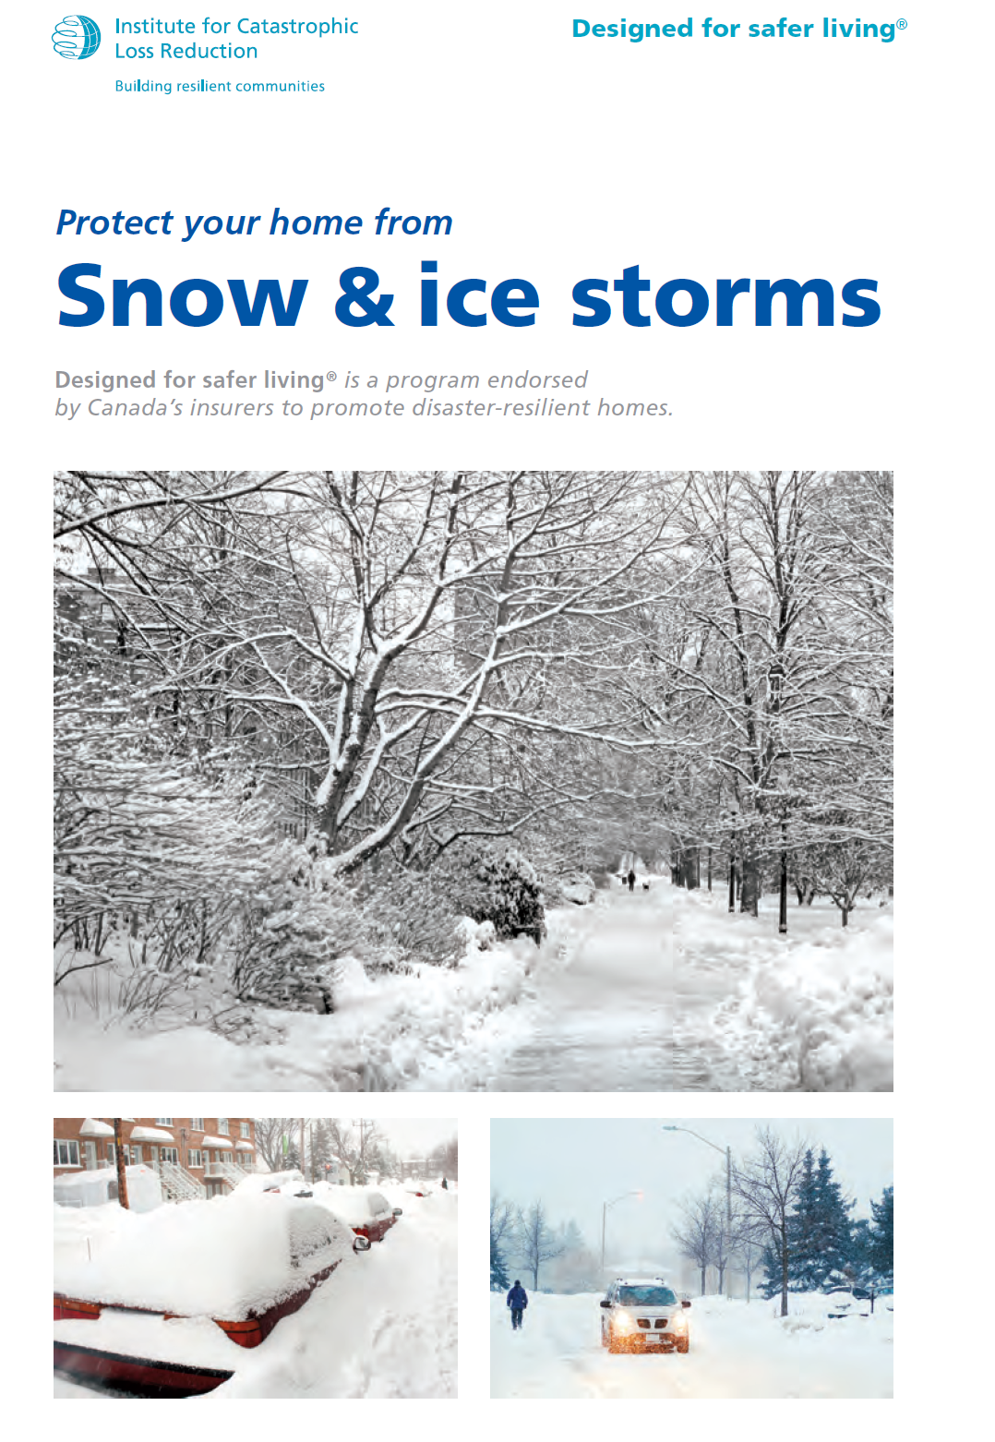
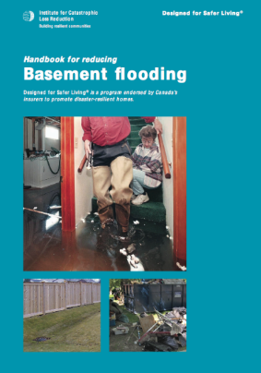
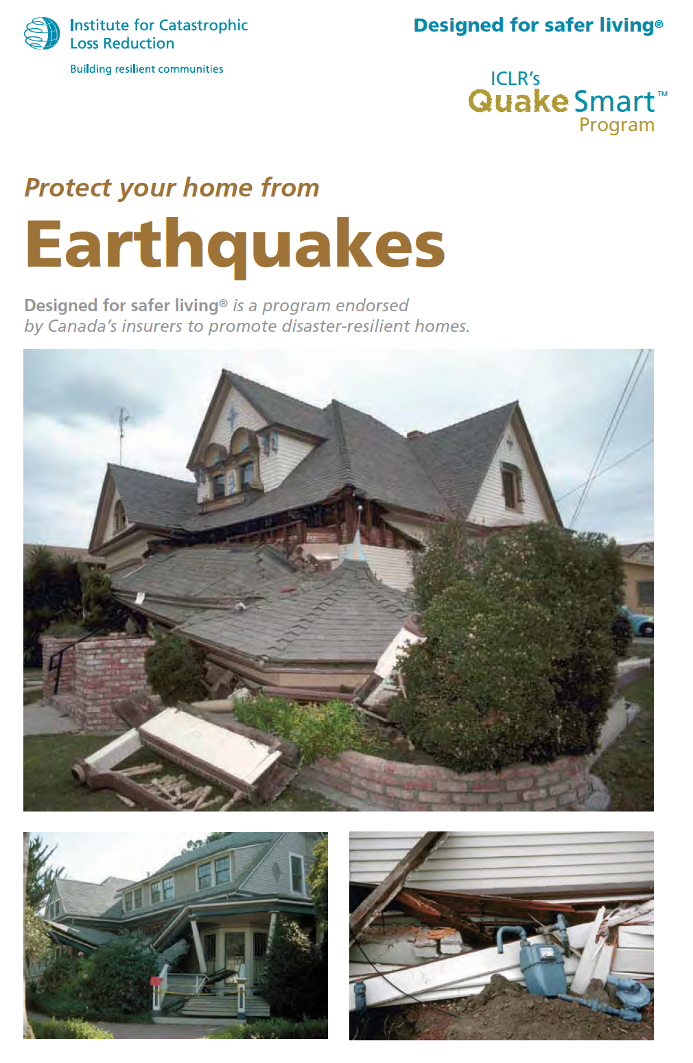

National Issues – 2021 Report
Protecting homes from heat, water, wind and wildfire
Correcting ageing infrastructure
Water damage - finished basements
Guidebooks for homeowners
Risk self assessment tool + advice

Slide 18
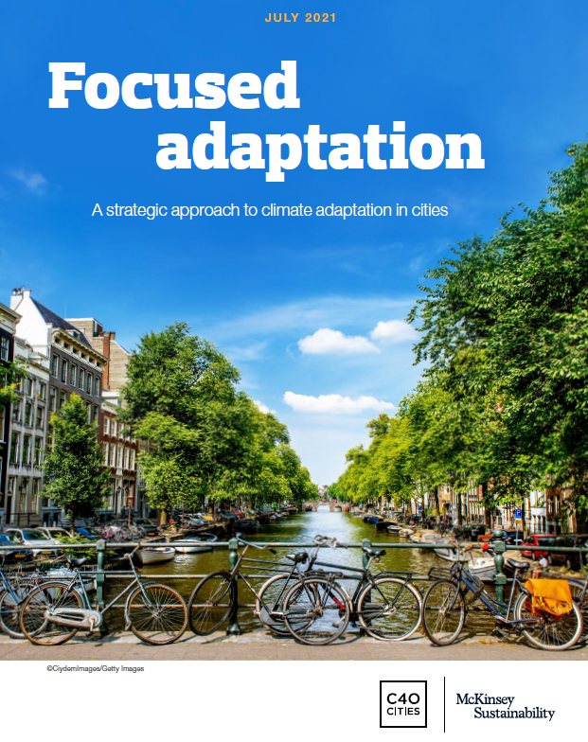
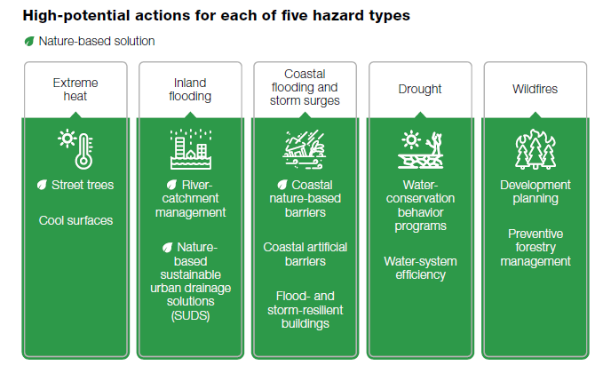
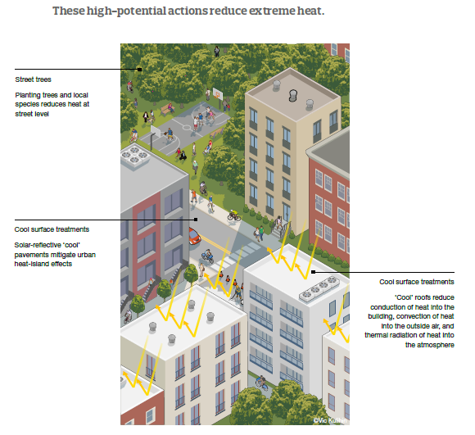
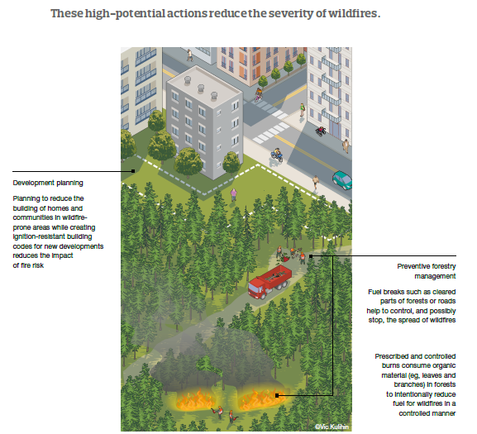
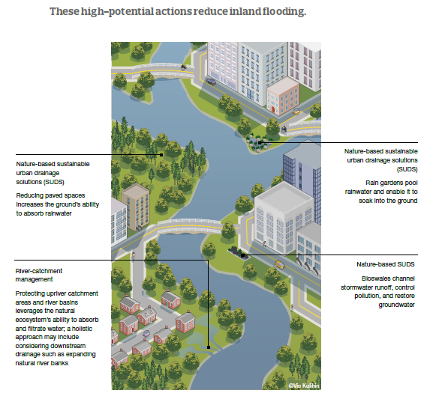
How cities can adapt to climate change
Report (McKinsey + C40 Cities Climate Leadership, a network of large cities (Toronto, Montreal, Vancouver, ++) that are committed to addressing climate change) to help leaders set priorities and choose courses of action.
(July 20, 2021, released Sept 18)
Nature-based solutions
Trees
Nature-based sustainable urban drainage solutions
Development Planning
Cool surfaces
River-catchment management
Preventive Forestry Management

Slide 19
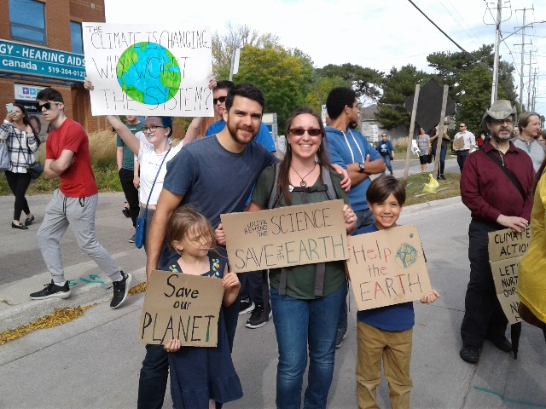
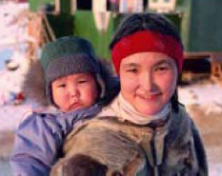

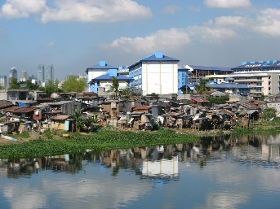
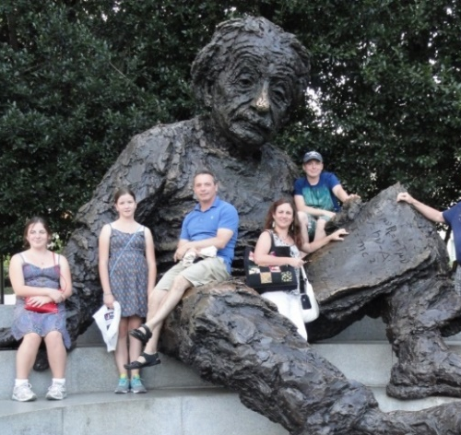

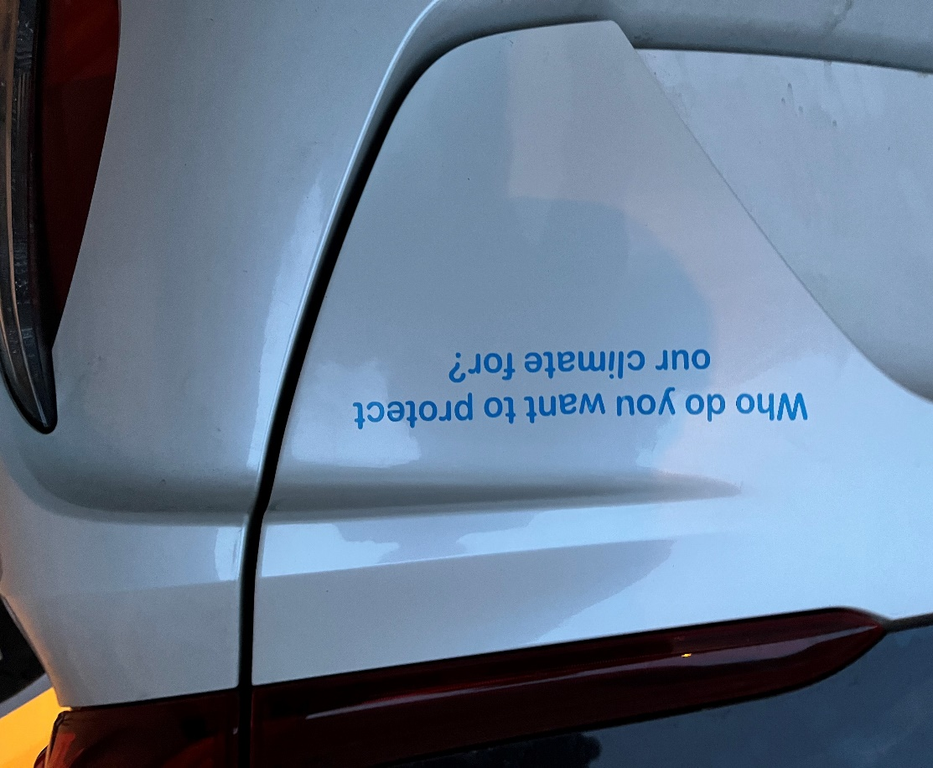
Climate change is an issue of intergenerational, national and international equity and ethics –
Reduce Emissions and Adapt - for All – now + future
ACTION
Unite Behind the SCIENCE
SAVE THE EARTH
Thank you for your attention and actions

