Slide 1
London South Rotary Club
&
Little Footprints,
Big Steps
March 17th, 2023

Slide 2
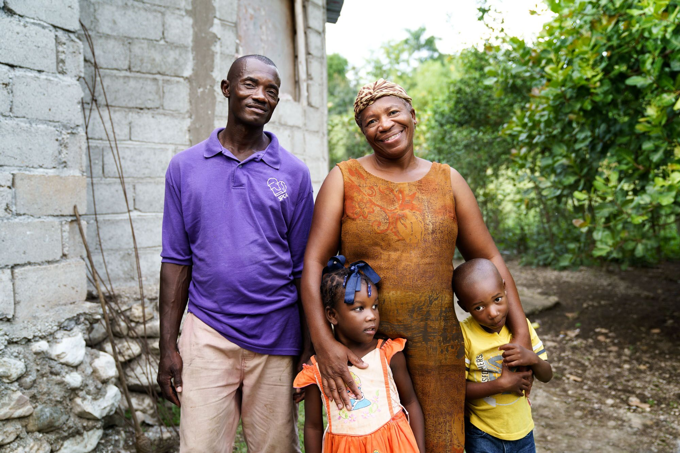
About us

Slide 3
About Us
Little Footprints Big Steps is a non-profit organization, founded in 2011, that works to reduce family separation in Haiti, caused largely by child trafficking.

Slide 4
About Us
1 in 4 children do not live with their families due to child trafficking (U.S. Department of State 2020 Trafficking in Persons Report: Haiti).
We work to protect vulnerable children in Haiti by reuniting families and empowering them with resources and opportunities to build a self-sufficient future.

Slide 5
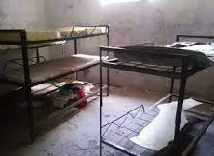
Child Trafficking
There are 4 prevalent causes of child trafficking in Haiti.
Fraudulent orphanages – For-profit orphanages which seek children from low-income families, promising a high quality of care and access to education. The children are used as a means to seek international donations.
There are approximately 32,000 children living in Haitian orphanages. A 2018 audit found that:
only 4.6% of orphanages met minimum standards
only 15% were officially registered.
Over 80% of children in orphanages have a living parent and almost all have family members (2021 Trafficking in Persons Report: Haiti).

Slide 6
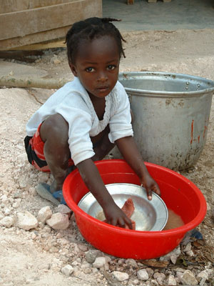
Child Trafficking
Restavek system (child slavery) – Children are sought from low-income families to work for wealthier families, with the perception that they will be provided with healthy meals and education.
This impacts an estimated 300,000 children.
The children are often physically abused and receive little access to education (2021 Trafficking in Persons Report: Haiti).

Slide 7
Child Trafficking
Street children – Street children in Haiti are vulnerable to different types of trafficking and are often fleeing prior trafficking (2021 Trafficking in Persons Report: Haiti).
Street children are currently being recruited by gangs to commit crimes.

Slide 8
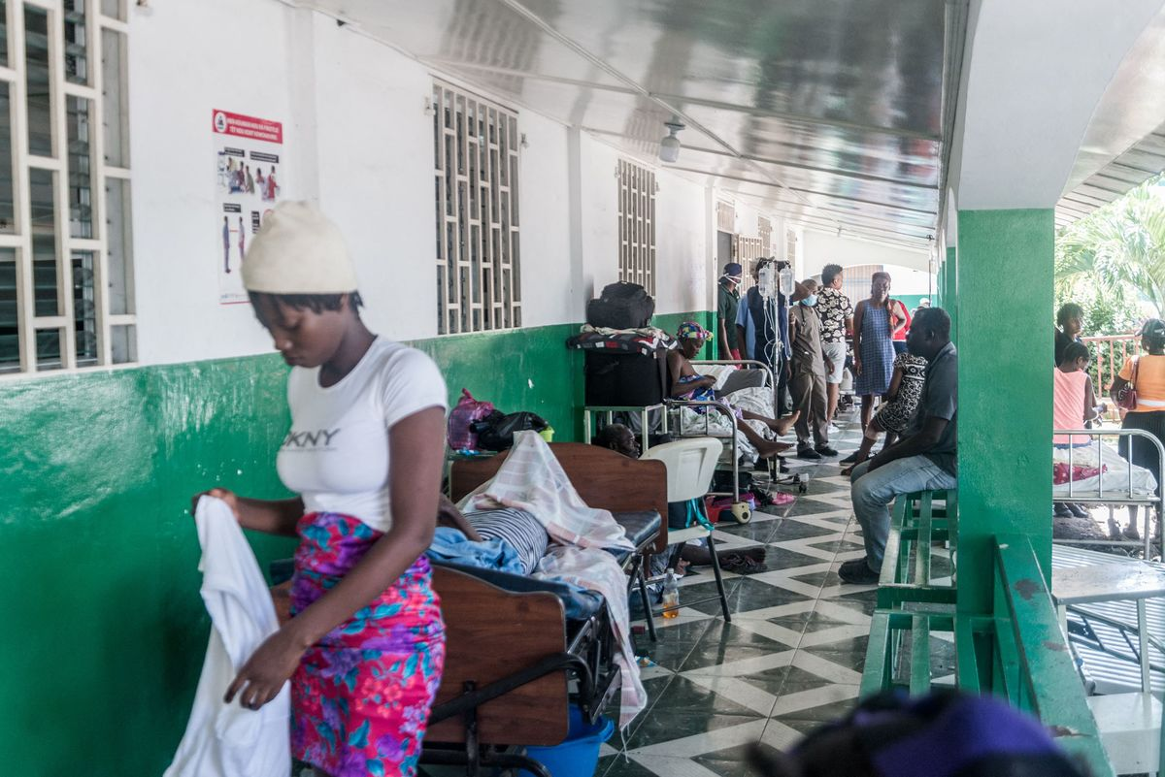
Child Trafficking
Emergencies – Due to Haiti’s fragile infrastructure, there is a high risk of children becoming separated from their families post emergencies (e.g., earthquakes) and falling risk to traffickers.
For example, following the 2021 major earthquake, there was a high rate of children being abandoned and trafficked at the hospital.
Little Footprints was asked to have staff monitor the hospitals to support vulnerable children and prevent trafficking.
*Currently, authorities have noted an increase in children separated from their families due to the crisis.

Slide 9
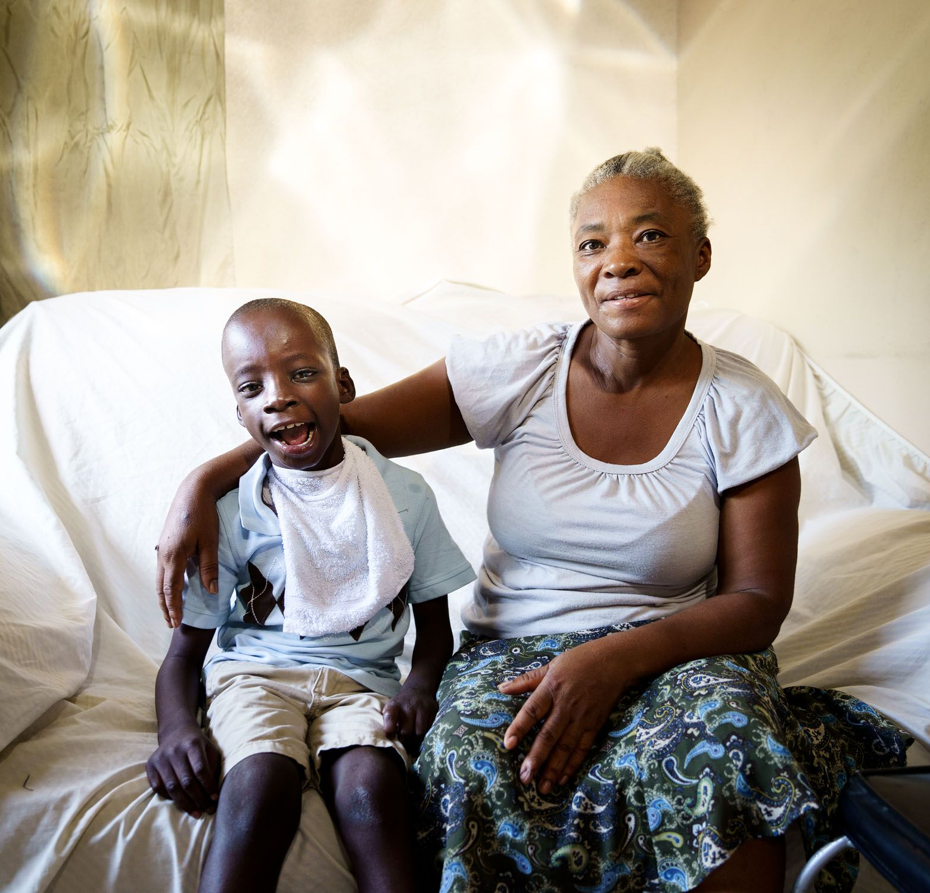
Empowering Families
Little Footprints Big Steps empowers vulnerable families who have been separated, or who are at risk of separation, by:
Empowering family self sufficiency through income generating activities such as business start up or agriculture
Supporting children’s access to healthcare
Supporting children’s access to education
Building a stronger child protection network in partnership with local authorities
Responding to urgent/ critical needs of highly vulnerable children and families.

Slide 10
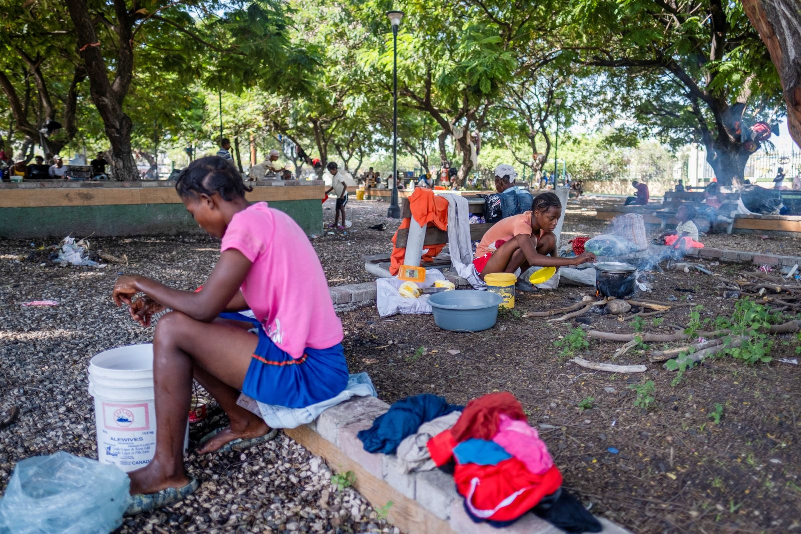
Key Needs & Projects: Haiti in Crisis

Slide 11
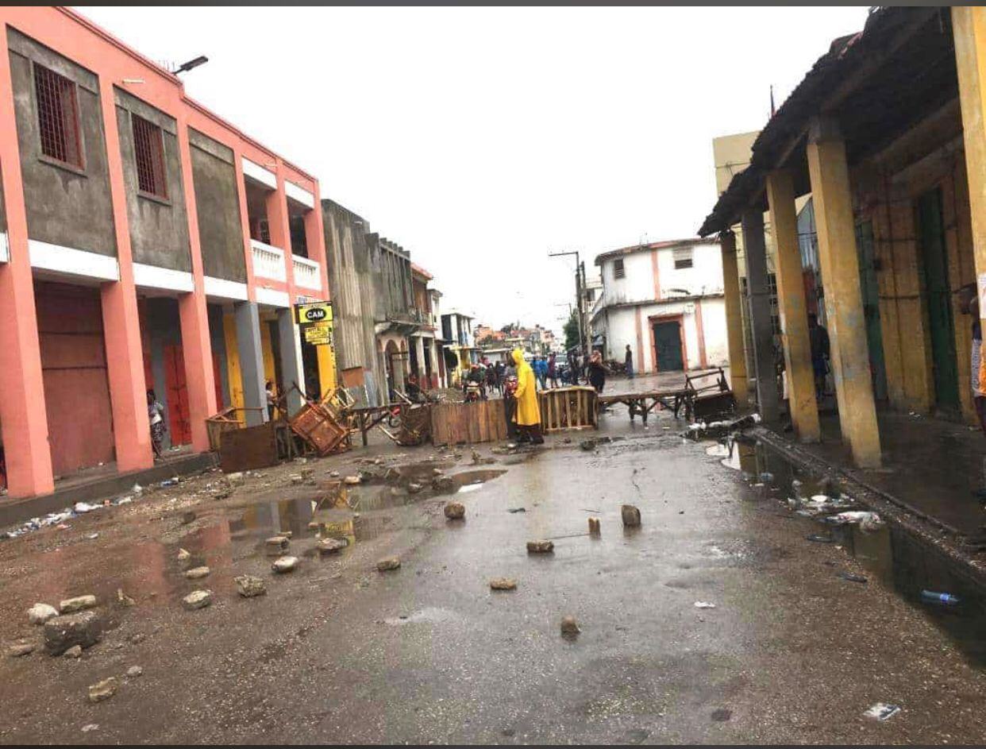
Escalating Needs
Within the current environment in Haiti, needs are increasing:
Extreme inflation
Continuing unrest
Increased insecurity
Ongoing lockdowns
Reduced functioning of hospitals due to lack of power
Increase in cholera and other illness
Limited access to emergency supplies or support due to: lack of circulation of goods (lack of fuel, gang activity)
Many families homeless either post-earthquake (2021) or due to violence

Slide 12
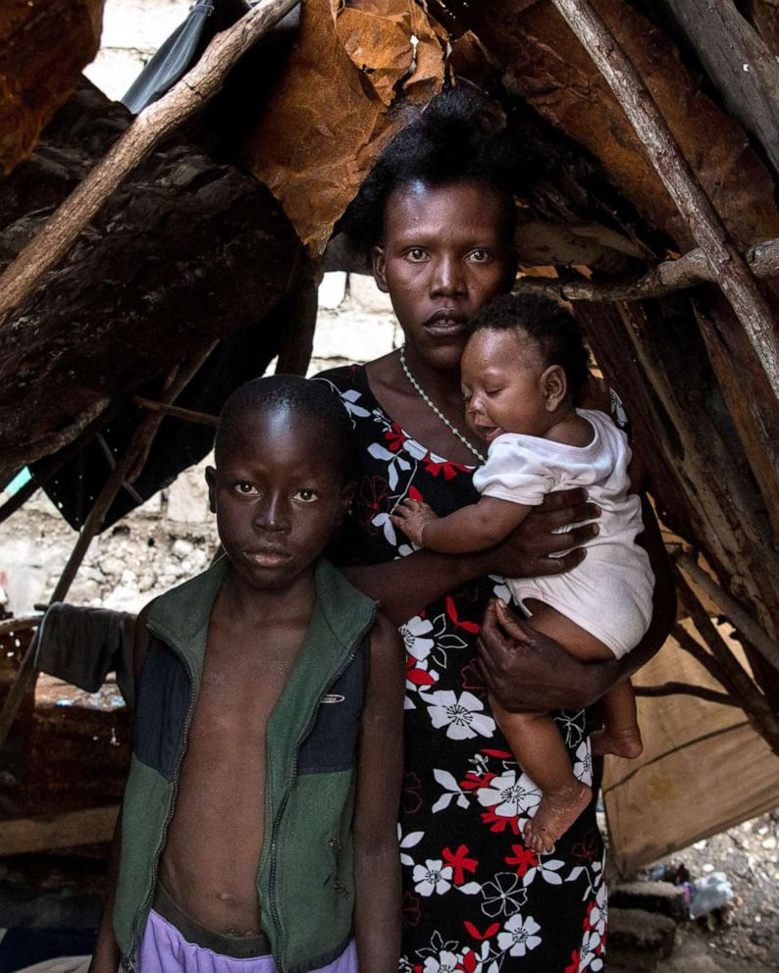
Increasing Human Rights Violations
Examples Morgan shared with the House of Commons Subcommittee on International Human Rights in November 2022:
Over 100,000 people are currently displaced in Haiti.
Prevalence of malnutrition is increasing.
Over 700 orphanages are operating illegally in Haiti. During crisis, children are more severely neglected.
Authorities have reported a spike in separated and unaccompanied children.
Street children are being recruited into armed gangs, forced to commit crimes.
Prisoners are dying of famine. Child prisoners, often arrested below the minimum age, frequently suffer sexual and physical abuse.

Slide 13
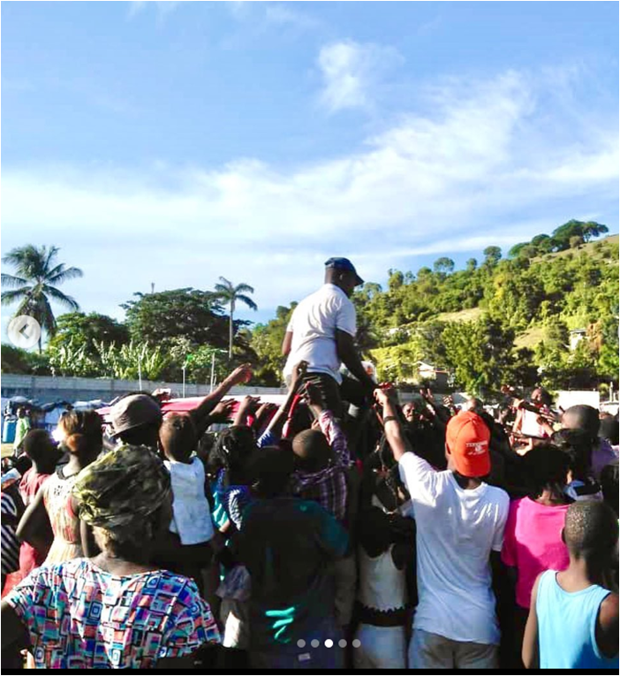
Ongoing Supports
Little Footprints Big Steps has been a consistent support provider through this and past periods of urgency
Post the 2021 major earthquake, over 3,000 families in rural, highly vulnerable communities across Southern Haiti were supported by Little Footprints Big Steps
During the current crisis, our 20+ staff have continued to be supporting families and the work of child protection authorities despite extreme challenges.

Slide 14
Example
Example: Our lead nurse, Mauna, receives referrals from authorities of:
families experiencing malnutrition
or in need of hospital care
She provides assessments, treatments and coordinates medical care at Haiti’s functioning hospitals. She offers follow-up and education with the families to ensure long-term health improvement.

Slide 15
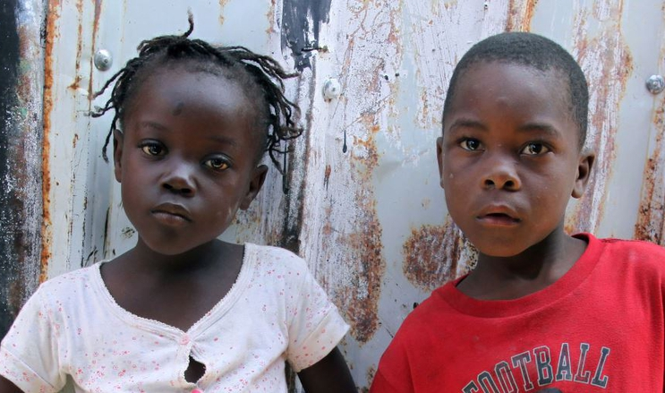
5 Key Initiatives Seeking Partnership
Urgent needs:
Retrieving 520 children from situations of trafficking
Providing nursing for children with medical vulnerabilities
Accessing truck to provide urgent supports (nursing, coaching, food, etc.)
Rebuilding:
Funding education for 125 children in low-income families
Offering 200 micro loans or agricultural support (seedlings and livestock) to be managed by communities for long-term

Slide 16
Urgent Need #1: Child Trafficking
Haitian authorities wish to work with Little Footprints Big Steps on removing 520 children from 14 fraudulent orphanages, where abuse or neglect have been documented. Children have been trafficked from their families, to be used in the seeking of lucrative international aid.
These orphanages have been deemed the “red” level of risk (highest level) by Haitian authorities.
Example: Little Footprints assisted in the closing of a small orphanage. Children were found locked in a room, unattended. Over half were gravely ill with Typhoid fever.

Slide 17
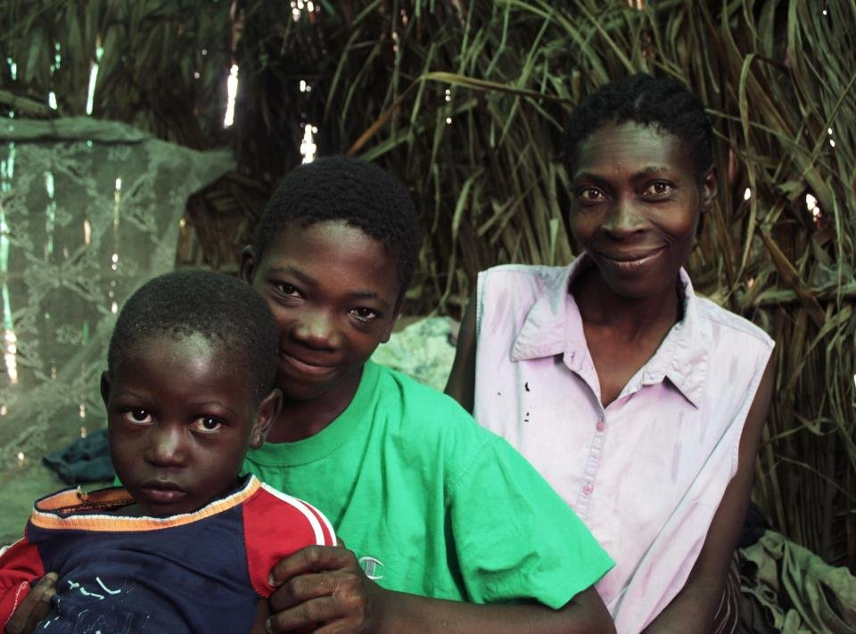
Urgent Need #1: Child Trafficking
Within the current environment, authorities are concerned that the levels of neglect or abuse in these red-level orphanages will have likely increased.
Action plan: Little Footprints will partner with authorities in a 3-year initiative to remove the 520 children, provide short-term shelter and reunite children with their parents and families.
Staff will provide follow-up support, to empower families to be successful.
Such as: self-sufficiency coaching, support to resolve conflict within family or community, strategies to enhance access to clean water and increase family revenue, etc.

Slide 18
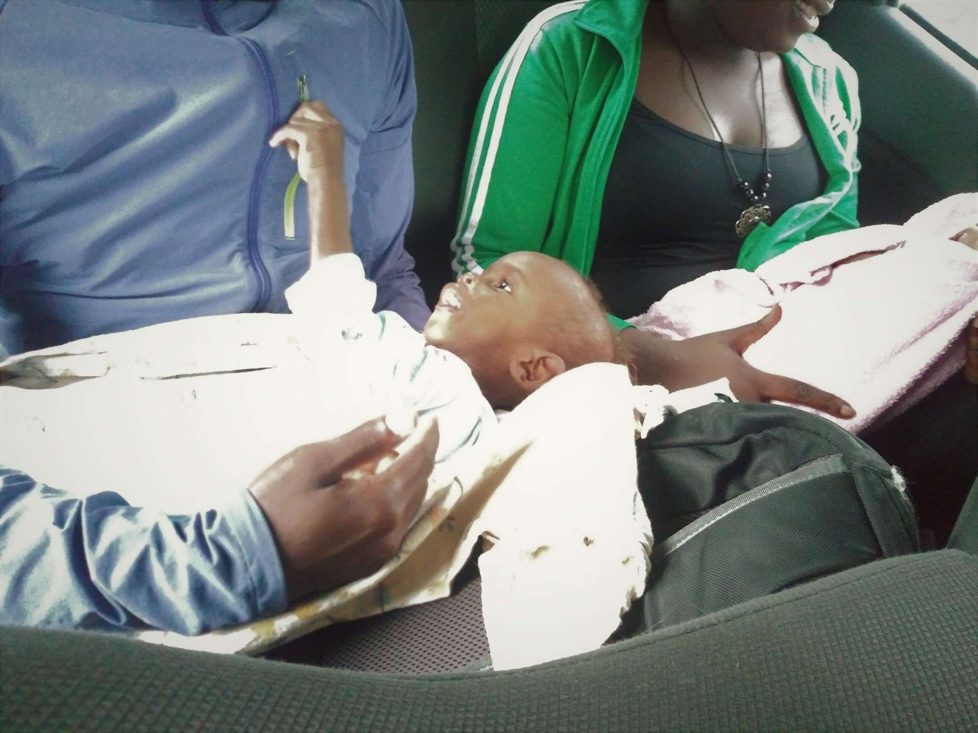
Urgent Need #2: Children’s Nursing
Local authorities are referring a significant number of children with malnutrition – as well as families in critical condition – for our emergency nursing services.
Families in the communities we intervene in have requested nursing check-in’s for 74 children with medical vulnerabilities.
Lead nurse Mauna supports over 250 children per year in enhancing their health and teaches families skills to enhance their family’s health (e.g., cholera prevention skills)

Slide 19
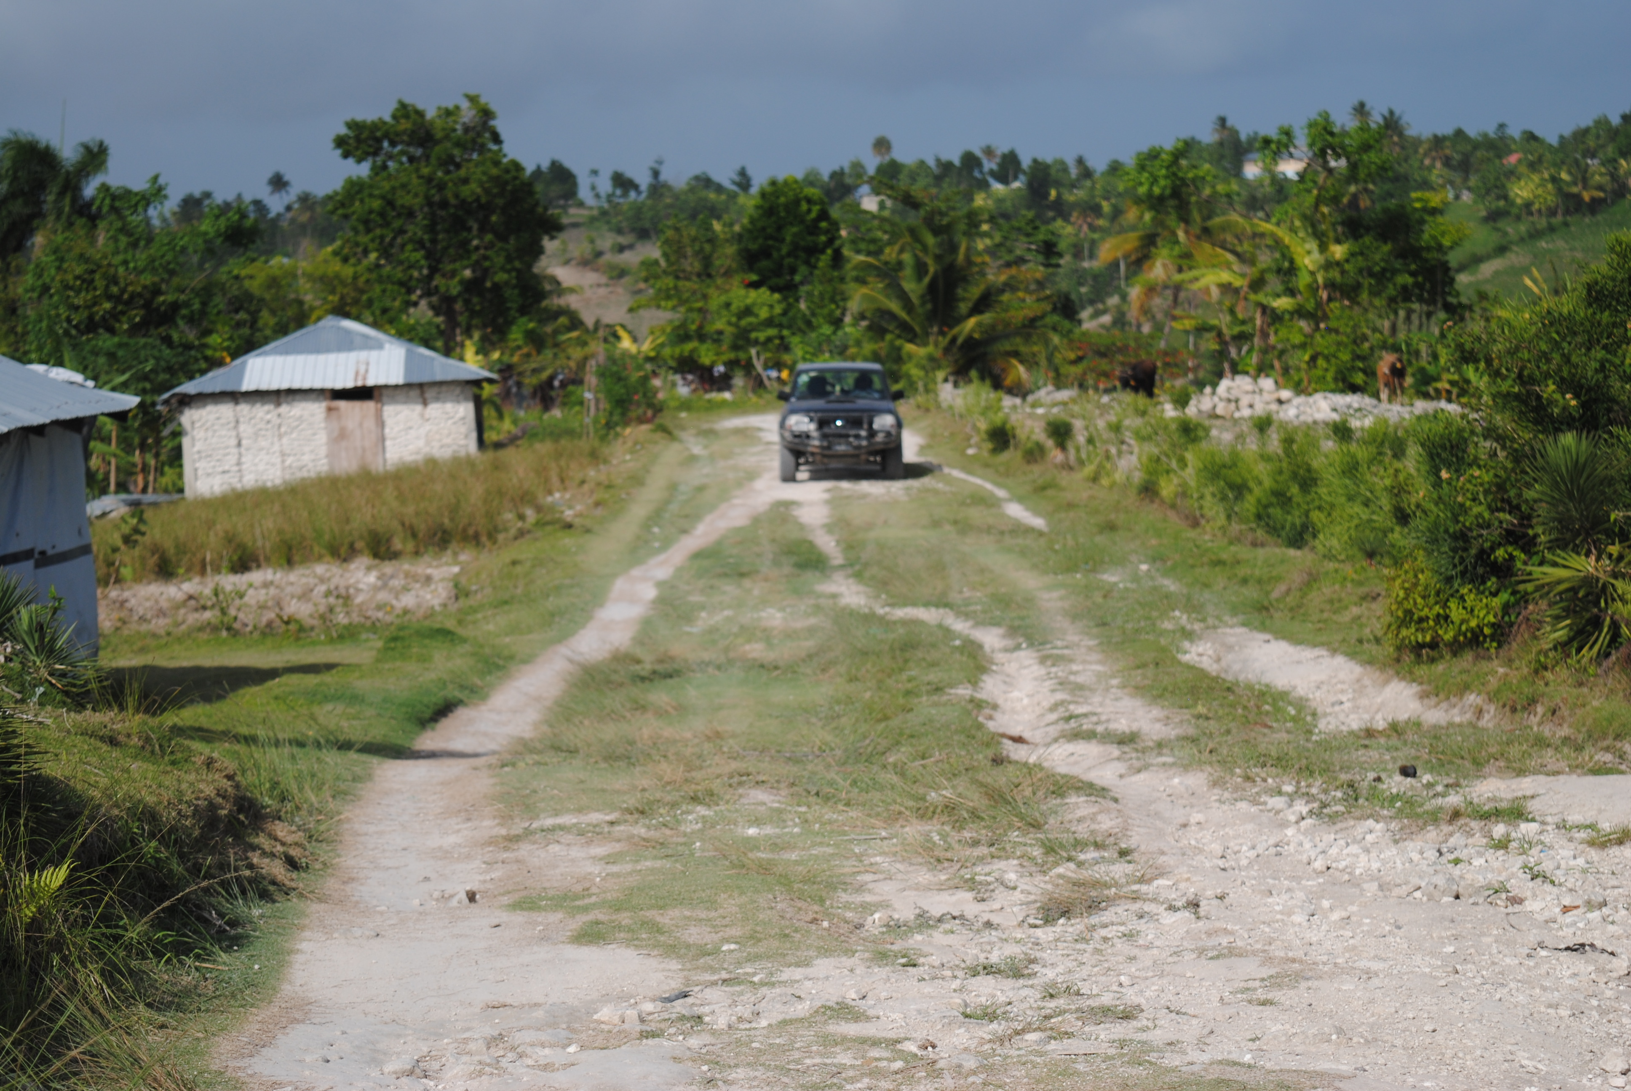
Urgent Need #3: Access to Truck
Timely, urgent supports must be provided by truck.
Paved roads are limited in Haiti.
Example: In order to reach rural and remote communities with services or emergency supplies (for example, to provide Aquatab water purification tablets), one must cross rivers and streams with no bridges, and use roads which have limited gravel or traction.
2 of Little Footprints Big Steps’ existing trucks are no longer in working condition due to extensive use and regular wear and tear, leaving 20 staff with 1 solid vehicle to support all timely work.

Slide 20
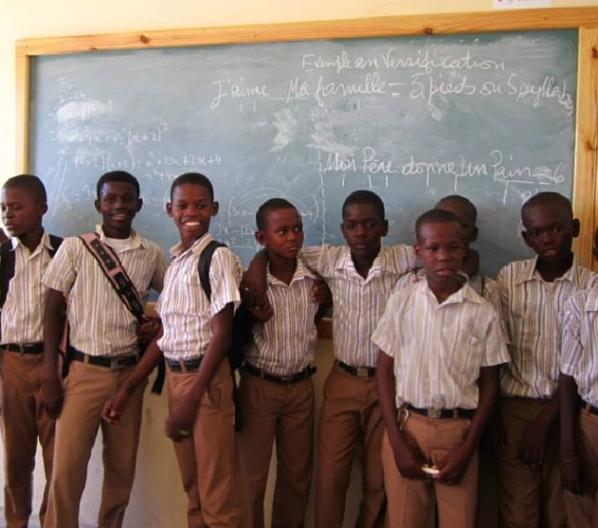
Rebuilding Project #1: Education
Access to Education:
Have supported hundreds of children in accessing education for the past 11 years.
In the current time, with inflation and loss of jobs, families are even more compromised in their ability to fund children’s education.
125 children and youth are currently in need of education support for primary or secondary education.
100% of these students have successfully completed their funded schooling to date, greatly appreciating the opportunity to learn.
These students come from vulnerable families, otherwise unable to afford education

Slide 21
Impact Made: Education
Benefits
Education can significantly reduce poverty and income inequality.
Education funding supports children to attend school while living at home.
A community-based program that costs a fraction of supporting children with an institutional setting such as an orphanage.
Strengthens communities for long-term progress, ensuring sustainable and locally-led change that will benefit many generations.
Supports employment readiness for students.

Slide 22
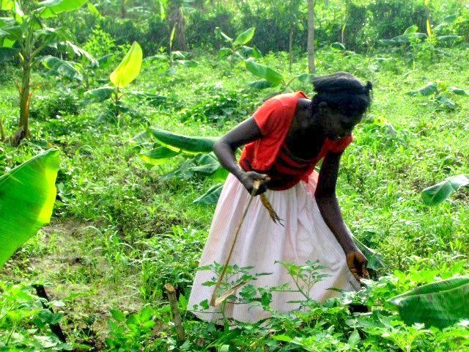
Rebuilding Project #2: “Agro-Starter Kits” & Micro Loans
We have over 300 families seeking access to our self-sufficiency coaching and micro loans.
This waiting list reflects the increased level of need and the success of this program in assisting vulnerable families in becoming more self-sufficient (increased access to food, water, family revenue, etc.).
After month-long lockdown in September, many families are left with no means of generating an income – meanwhile the cost of living continues to escalate.

Slide 23
Impact Made: Micro Loans & Agro-Starter Kits
Families access “agro-starter kits” (livestock and agricultural training) to ensure long-term food security and sources of revenue.
Families receive micro loans and small business start-up training, to operate small businesses in their local markets (each neighbouring town has a market day).
212 families have successfully enhanced their self-sufficiency through these strategies.
These loans or starter kits are returned and re-used by other members in the community.

Slide 24
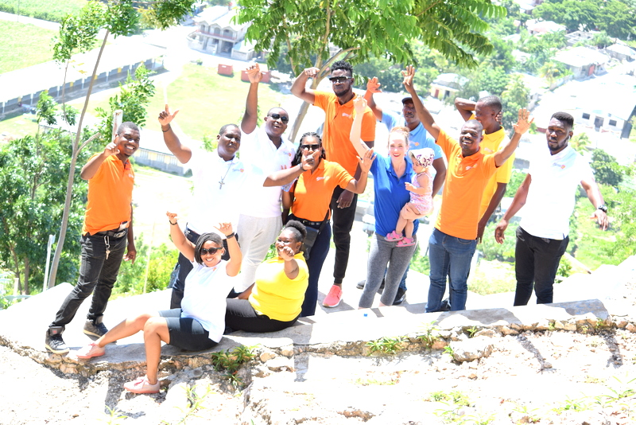
THANK YOU!

Slide 25
Questions

