Slide 1
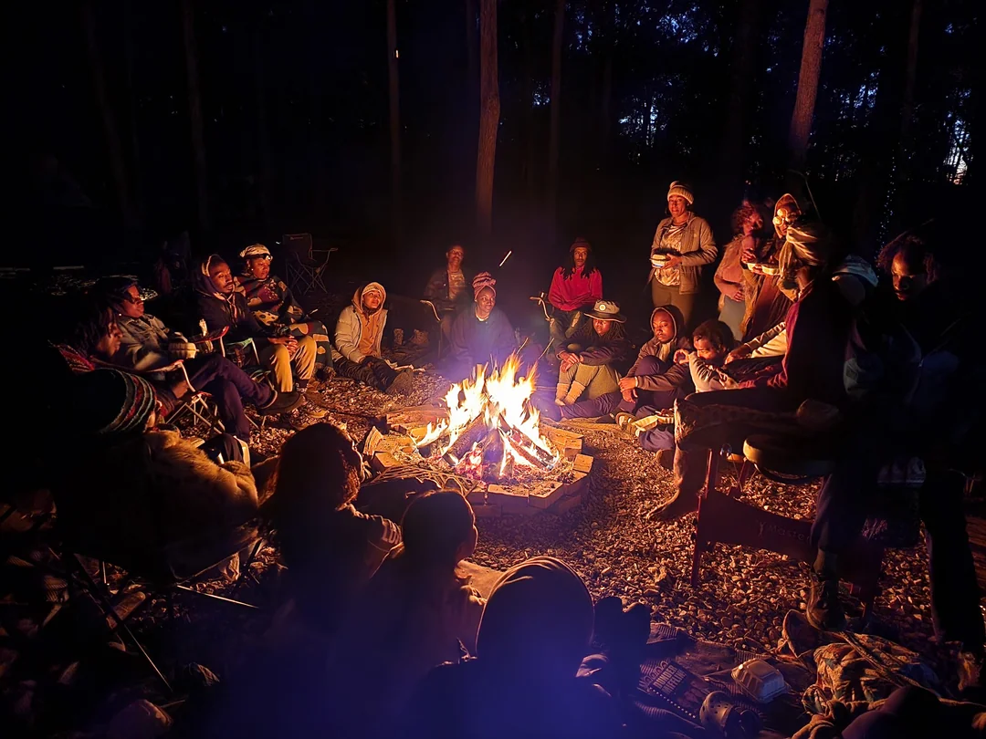
How it all started
Notes:
Today I am going to tell you a story, a true story…I think storytelling is important for at least 7 reasons:
1. They Help Us Understand the World
Stories provide context, meaning, and structure to human experiences. They help us make sense of complex ideas, emotions, and historical events.
2. They Build Connections
Stories create emotional bonds between people. Whether through books, movies, or personal experiences, they allow us to see life from different perspectives and foster empathy.
3. They Preserve Culture and History
Many cultures pass down knowledge and traditions through storytelling. Myths, legends, and folktales keep the past alive and shape cultural identities.
4. They Inspire and Teach
Stories teach moral lessons, share wisdom, and inspire action. Whether it’s a fable with a lesson or a biography of someone who changed the world, stories influence behavior and values.
5. They Entertain and Provide Escape
Good stories transport us to different worlds, offering a break from reality and sparking imagination.
6. They Shape Our Identities
The stories we tell ourselves and the ones we believe about our past shape our self-image and influence our future decisions.
7. They Drive Change
Powerful storytelling has led to social movements, policy changes, and revolutions. A well-told story can change minds and inspire action.
Stories are, at their core, how humans communicate, learn, and evolve. They make life richer and more meaningful. What kind of stories do you love?

Slide 2
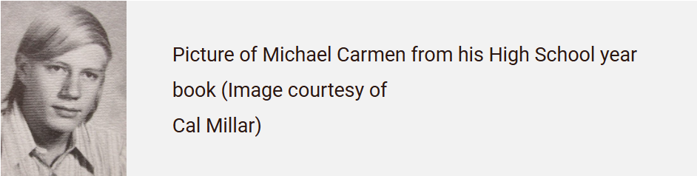

1976: Albuquerque, New Mexico
Notes:
It’s July of 1976.
This is Michael Carmin. His mom and dad: Connie, and Chester, are very excited, as their son’s wedding is just two weeks away.
At 20 years old, Michael is a college student when he offered to take his friend’s shift at the gas station, they both worked at.
When Michael arrived for that overnight shift, little did he know how that early morning would unfold.
Michael was shot during a robbery, point blank in the stomach by a 12-gage shotgun.
When police responded to the emergency call, they found Michael gravely wounded.
For the next four agonizing hours, the doctors and nurses did all they could,
and Michael struggled to tell detectives who was responsible,
but he lacked the strength to form the words before he passed away.

Slide 3
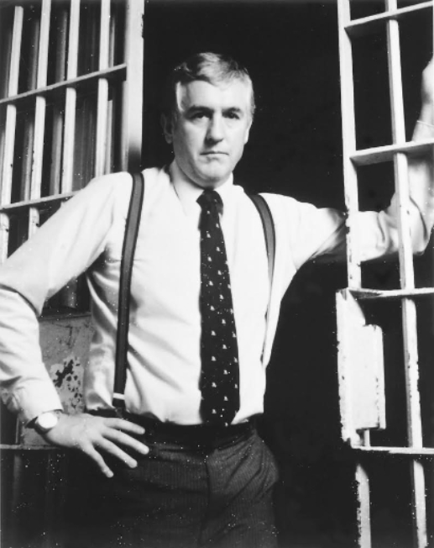

1976: Albuquerque, New Mexico
Notes:
The case was handed to Detective Greg MacAleese.
At the time, Albuquerque had one of the highest per capita crime rates in the country, and people were too afraid to assist the police.
Six weeks passed with no leads. It looked as if NO ONE KNEW ANYTHING.
Determined, Detective MacAleese knew that this just couldn’t be the case. He knew that someone saw something, someone knows something.
He then came up with a bold idea: he would create a video reenactment of the murder. Back in 1976, this was unheard of.
He promised anonymity for anyone willing to call in with information, and even offered a reward of $300 from his own pocket to encourage someone to come forward.
It almost seemed unnecessary to take such drastic steps for a case like Michael’s. This was a crime that should have stirred the community, drawing in multiple witnesses.
But Greg's plan worked. Within hours of the reenactment airing on television, he received a call.
The video had triggered a memory in someone who had heard a loud bang near the gas station and then saw a car speeding away. The caller told Greg the car belonged to a resident of a nearby apartment complex.
Through further investigation, Greg and his team arrested two men within 72 hours. They were charged with the murder of Michael Carmin, as well as a string of armed robberies. They had caught the men that had murdered Michael Carmen. While that would not ease the pain his family was dealing with, it did prevent them from being further burdened with the lack of closure.

Slide 4
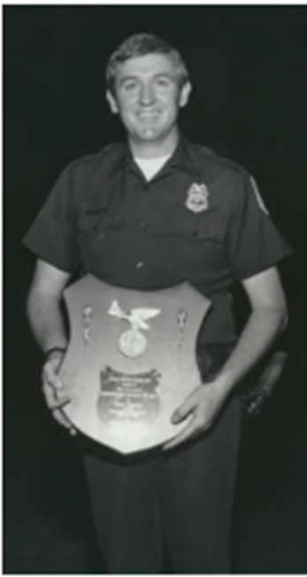
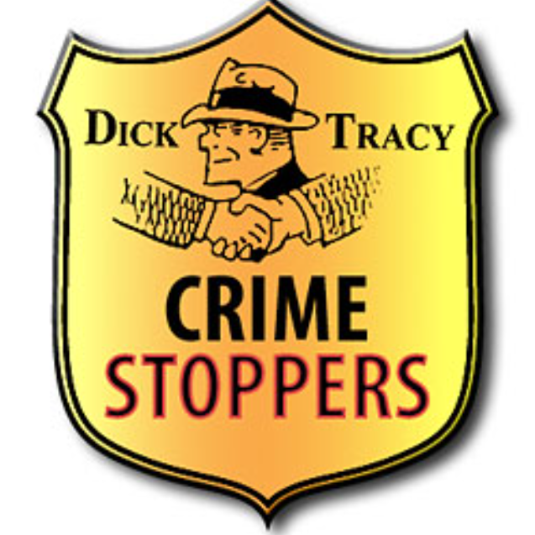
1976: Albuquerque, New Mexico
Notes:
Greg received other calls following the reenactment, including one that allowed police to solve the rape of a young woman. Realizing that this type of program might be useful in fighting crime, Greg convinced the Albuquerque Police Department to allow a group of citizens to establish the first Crime Stoppers program.
An interesting fact: the term “Crime Stoppers” was first seen in the Dick Tracy comic strip. Greg approached the artist: Chester Gould for permission to adopt the name. This was the beginning of a well-recognized term today.
The result was the beginning of one of the most effective citizen-law enforcement, anti-crime iniatives in existence.

Slide 5

Today: Crime Stoppers is a Global Movement
1,200+ local programs worldwide
25 countries represented by Crime Stoppers International (CSI)
87 programs in Canadian Crime Stoppers Association (CCSA)
37 local programs under Ontario Association of Crime Stoppers (OACS)
Notes:
Today we are a GLOBAL movement
more than 1,200 programs worldwide, spanning 25 countries represented by Crime Stoppers International
there are 87 programs in the Canadian Crime Stoppers Association
here in our province we have 37 programs under the Ontario Association of Crime Stoppers
Bringing us to the London-Middlesex Crime Stoppers.

Slide 6
Notes:
Our local program started in 1987.
There are 12 members.
We meet every 2nd Tuesday of each month, and determine how we might connect with our communities, review and approve tip payouts,
And then we try to figure out how we might fundraise to support the program.
My name is Lloyd Stacey, I am the President of London Middlesex Crime Stoppers, I have been on the volunteer board for just over 2 years.
I am a miliary veteran, and my paid job is Director of Operations for Corporate Investigation Services – a private investigations/labour dispute management company based her in London.
I sometimes am asked why I choose to volunteer in this way. When I was in college in Ottawa, I worked at a corner store and one night working the graveyard shift, I was robbed at gun point. 3 men came in with a shotgun and two handguns. But for the grace of God, I could have been Michael Carmen.

Slide 7

Our program saw a 29% increase in TIPS over last year,
Those TIPS resulted in nearly $300,000 in recoveries of property, cash, and drugs.
Notes:
Its been a busy year, as our metrics show….

Slide 8

Why Does Crime Stoppers Work?
Tipsters don’t have to share their identity
Volunteer-led!
Local training/seminars aimed at sharing information to vulnerable communities
Working independently from, but in partnership
with, the local police service
Somebody saw or knows something
People want to do the right thing
Sometimes people need an incentive or a sense of safety
“Say It Here"
Notes:
So, why does Crime Stoppers Work?
Tipsters can make a positive impact on the community without revealing their identity.
Volunteer-led initiatives focus on community safety and address local concerns.
Local training and seminars provide valuable information to vulnerable communities.
These efforts work independently but in partnership with the local police service.
Often, someone has seen or knows something important.
People generally want to do the right thing.
Sometimes, an incentive or a sense of safety is needed to encourage action.
"Say It Here" provides a safe platform for sharing information.
At the end of the day, we all deserve to live in a safe community.

Slide 9
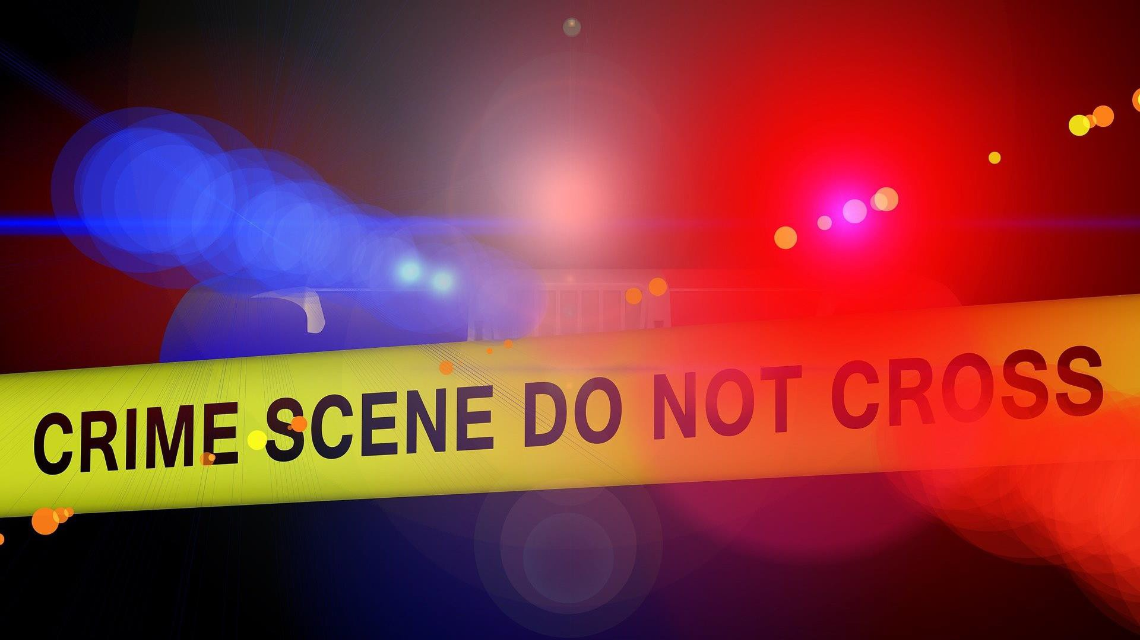
What Crime Stoppers Does
Notes:
I’ve explained how Crime Stoppers came to be, and why it works…let’s talk about just what Crime Stoppers does.

Slide 10
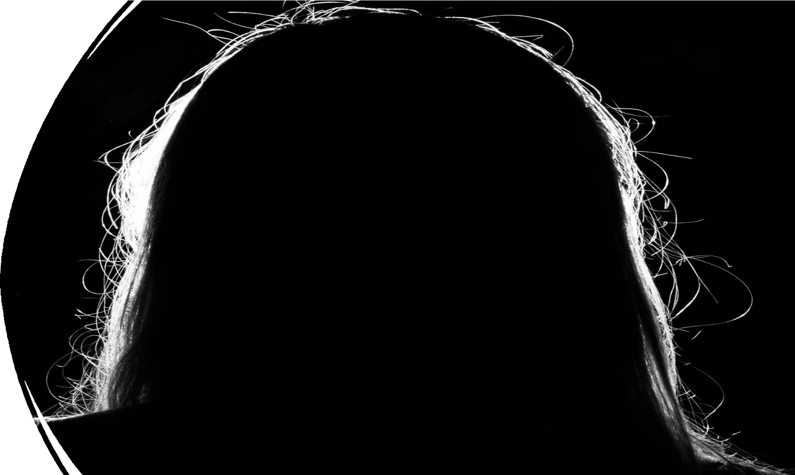
Crime Stoppers- anonymous and confidential method of reporting crime
Intermediary between Tipster and Investigator
Crime Stoppers is protected by Case Law (R vs Leipert 1997/R vs Durham CS 2017)
Guided by a volunteer Board of Directors in partnership with a Program Coordinator
Charitable organization, registered with Canada Revenue Agency (CRA)
Crime Stoppers are NOT the police.
Notes:
To understand just what Crime Stoppers does, it’s important to know
Crime Stoppers are NOT the police.
Crime Stoppers is an anonymous and confidential method of reporting crime
It is an Intermediary between Tipster and Investigator when a member of the public wants to report crime
Crime Stoppers is protected by Case Law (R vs Leipert 1997/R vs Durham CS 2017). The Tipster’s identify is protected by law.
A Crime Stoppers tip is the exclusive property of the Crime Stoppers program and not the property of the Crown Attorney or the police.
There is case law protecting the sanctity of Crime Stoppers tip information (R v Leipert 1997) and, as such, efforts by defense counsel, the Crown Attorney or a police agency to obtain disclosure of a Tip are met with refusal and the matter is referred to OACS Legal Counsel.
Designed to be guided by a volunteer Board of Directors in partnership with a Program Coordinator
Charitable organization, registered with Canada Revenue Agency (CRA)

Slide 11

While police are not the only investigators Crime Stoppers submits Tips to, most Tips do go to police
Have good working relationships with investigative partners.
We have strong communication with partnering police services who support Crime Stoppers
They support us by helping us by providing staff (Coordinators), vehicle/vehicle maintenance
They attend community events with us, helping to share our message.
Notes:
I’ve mentioned “partnership” several times already, so wo do we partner with?
-we don’t just partner with the police
-Canadian Border Security Agency
-Ministry of Natural Resources
-Ministry of the Environment
So, we may partner with several agencies, but we are NOT the police. No one on our board is a sworn member of any police force, or agency mentioned above.
We do have however, strong relationship with our partners. They can investigate matters that the rest of us are not equipped or authorized to do.
Partnership isn’t simply Crime Stoppers sending tips to the police either. These agencies can support us as well through helping to provide a vehicle, maintain that vehicle, they can provide staff to act as a Coordinator. They assist us with local events, such as information booths, parades, community events.

Slide 12

The Process
Tips are submitted via 1-800-222-TIPS or digitally via website
Tips received are sanitized by Program Coordinator
Tips are forwarded through P3 software to investigator
Dispositions are required from investigator
Determines rewards
Ensures accountability
Tips are NOT the property of police – but of Crime Stoppers program
Once an arrest is made, disposition is used to determine reward value for Board
approval
Tipster qualifies for cash reward
Tipster must always follow up with Crime Stoppers as there’s no way for the Tipster
to be contacted
AT NO TIME WILL A BOARD MEMBER HAVE ACCESS TO TIPS.
Notes:
You now know how Crime Stoppers came to be, who we are – what we do…I want to explain HOW we do it.
Here’s a clearer version of the steps:
Tips are submitted either by calling 1-800-222-TIPS or through the website.
A Program Coordinator reviews and sanitizes the received tips.
The sanitized tips are then sent to an investigator via P3 software.
The investigator is required to provide updates (dispositions) on the tip.
The investigator determines whether the tipster qualifies for a reward.
The investigator ensures accountability throughout the process.
Tips are not considered the property of the police; they belong to the Crime Stoppers program.
Once an arrest is made, the investigator’s disposition helps determine the reward value, which must be approved by the Board.
If the tipster qualifies, they are eligible for a cash reward.
Tipsters must follow up with Crime Stoppers, as there is no way for Crime Stoppers to contact them directly.
AT NO TIME DOES A BOARD MEMBER HAVE ACCESS TO THE TIPS, OR THE TIPSTER INFORMATION.

Slide 13

Role of the Board member
FUNDRAISE!
Notes:
I want to discuss with you the role of the board.

Slide 14

Role of the Board
Administer the local community program
Establish policy and follow Bylaws
Protect integrity of anonymity
Fundraise (including events and sponsorships)
Responsible for financial accountability
Approve rewards for successful tips
Work closely with law enforcement and the media
Awareness activities about Crime Stoppers
Don’t forget to FUNDRAISE!
Notes:
While it is a volunteer position, we have to apply just like anyone would to a “regular job”.
We complete an application, we consent to a CR check and Social Media review
We are interviewed by 1 or 2 existing members of the board
Then we are provided with information on what the board does and a copy of the bylaws
If we pass the interview, the board will review our application and a vote is taken
The final stage is we take an oath of Confidentiality and are given a Board Handbook.
Once on the board, what do we do? The work of the board is largely fundraising…but there are tasks required outside of that:
Administer the local community program
Establish policy and follow Bylaws
Protect integrity of anonymity
Fundraise (including events and sponsorships)
Responsible for financial accountability
Approve rewards for successful tips
Awareness activities about Crime Stoppers
Ensure a close working relationship with Program Coordinator(s)

Slide 15

“They also raise the reward fund and meet monthly to
determine what reward amounts callers should receive.”
Greg MacAleese
Notes:
This mandate alone compels Crime Stoppers to fundraise. As the program developed, so did the need for funds to support community awareness and education, administrative and operational matters and training for Boards, Coordinators, police personnel.
Middlesex London Crime Stoppers is solely supported by donations from corporations, businesses, and individuals. We get no government funding.
We have no paid staff, we “borrow” office space from supporting businesses for our meetings and to store equipment/supplies in. We have one vehicle, donated to Crime Stoppers by Ray Cullen Chevrolet.
Our Board must focus nearly all our energy to raising donations.
Appeal to Corporations and Businesses
We hold community events like the Pizza Hut Day of Heroes
We participate in 50/50 draws at local sporting events
We hold a charity golf tournament each summer
And we are still figuring it out… What works and what doesn’t

Slide 16

Role of the Program Coordinator
Notes:
Each program has 1 or 2 Coordinators. Here in London Middlesex, we are fortunate to have 2 – one with the OPP and one with the London Police Service.

Slide 17
Role of the Program Coordinator
Each program’s staffing is different, based on the agreements with local participating police service(s), the role of the Program Coordinator includes:
Tip Management
Media Relations
Program Promotion
Administrative Responsibilities
Notes:
Tip Management
Receive, assess, and process information received on the Crime Stoppers “TIPS” telephone line, web-tips, or text tips.
Media Relations
Maintain strong relationships with Media contacts, including social media as appropriate.
Program Promotion
Promote the Crime Stoppers program through public awareness initiatives including presentations, and special events.
Encourage promotion of OACS special initiatives.
Administrative Responsibilities
Provide administrative and operational support to the Board of Directors & recommend reward amount for approval.

Slide 18

Conclusion
We are here
We are active
We are successful
We need help
Executive Board Members
Networking
Fundraising

Slide 19


