Slide 2
Supporting Local Causes
Platform that allows charities and groups to raise money and at the same time support local business
Would you give your favorite cause $100, if they gave you $100 back?

Slide 3
Supporting Local Business
Small Businesses needs to market themselves
Marketing normally requires an up-front investment and no way to measure results
FunRayZR is a commission based program
Business only pays when they make a sale!

Slide 4
The Math
Consumer buys $100 gift card and receives $100 in goods or services
80% goes to a local business
10% goes to the cause
3.5% goes to Visa + MasterCard
1.5% for administration costs
2.5% sales rep commission
2.5% FunRayZr profit margin

Slide 5
Sample Campaign
Original Kids Theatre wants to raise money to send kids to their summer camp

Slide 6
They send an Email to their Supporter List
We’re Raising Money to send kids to our summer camp!
Buy a Gift Card to a local business!
Click Here!

Slide 7
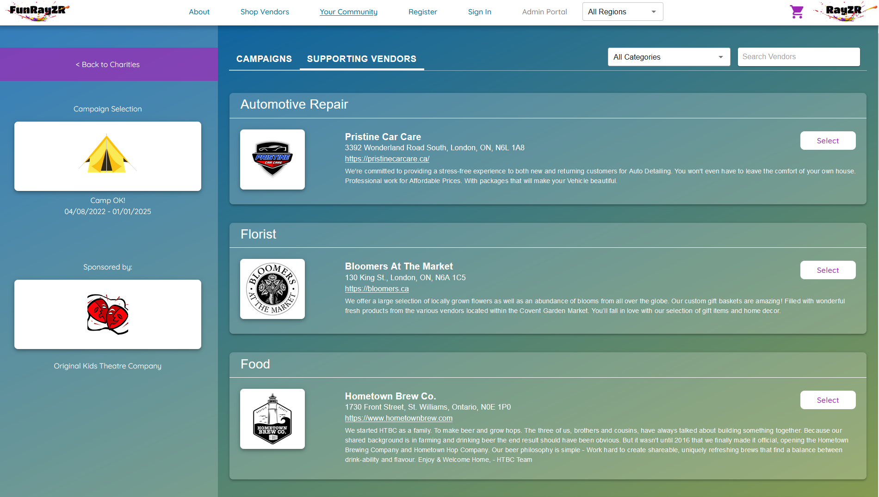

Slide 8
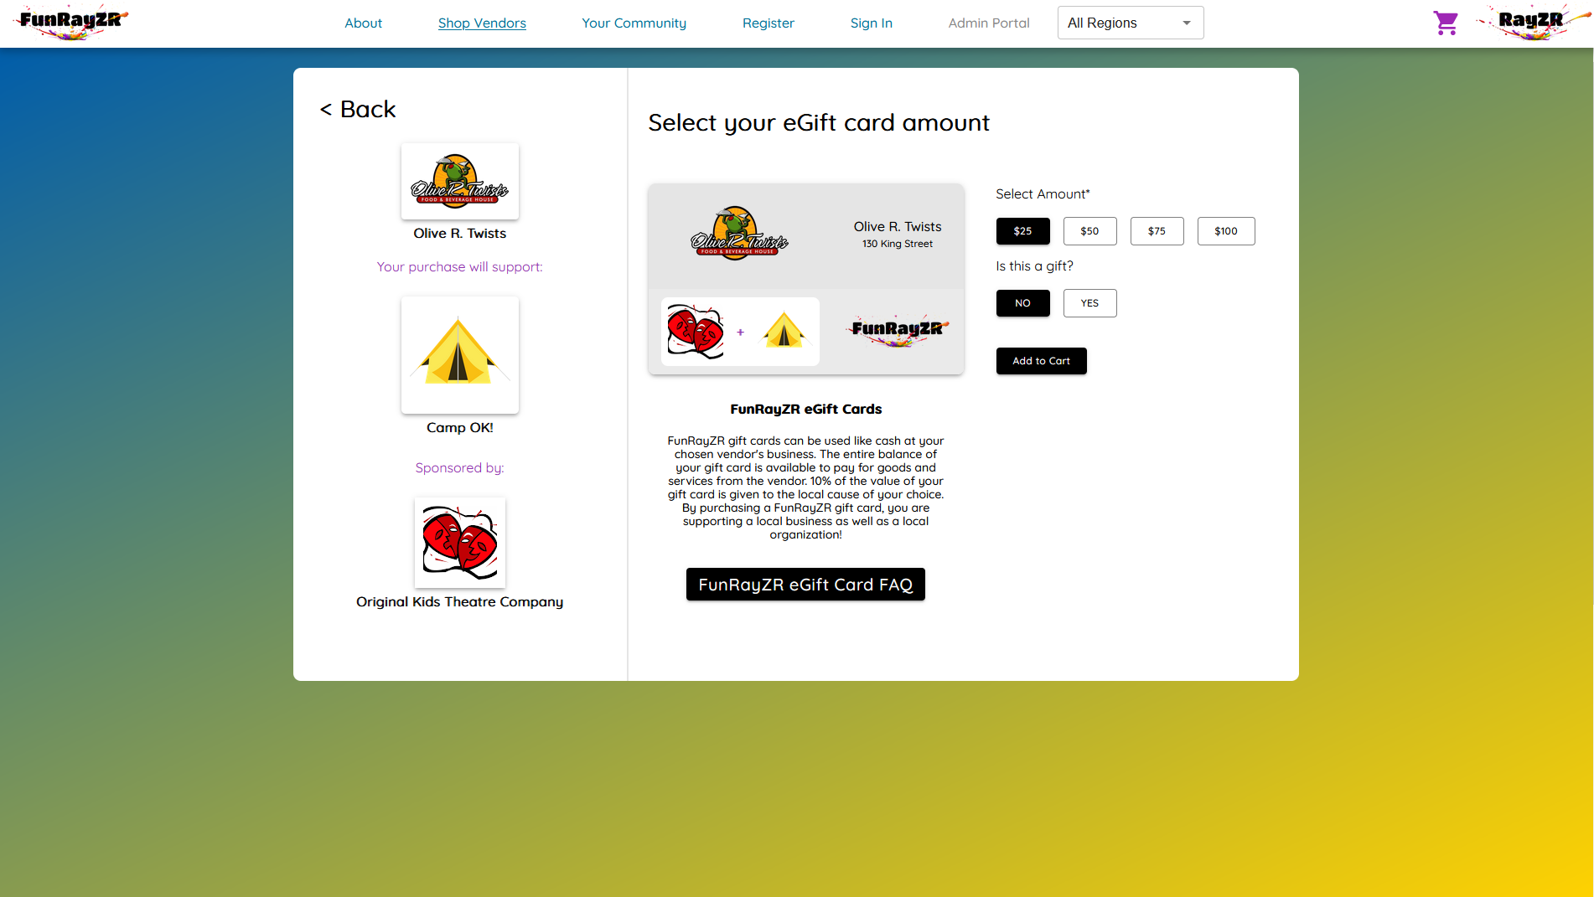

Slide 9
Can be a gift or for yourself
If it’s a gift, you can also add a personal message

Slide 10
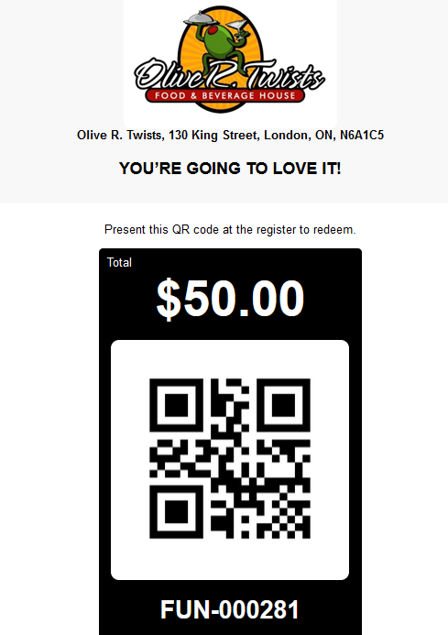

Slide 11
Everybody Wins!
Consumer Gives $100 and Gets $100 Back
Easy for the Charity, they just send an email to their supporters
Local Business gets free promotion on the FunRayZR platform
Local Business only pays when they make a sale
Local Business gets a new customer for $20 or less depending on the value of the Gift Card

