Slide 1
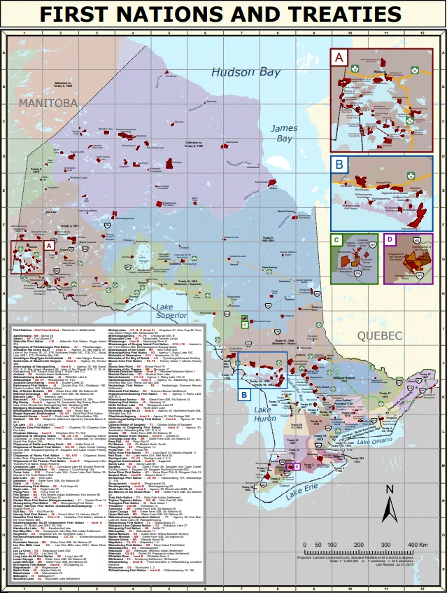
Land Acknowledgements
More Than Just Words

Slide 2
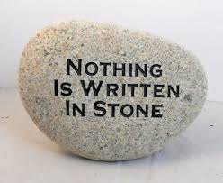
Developing a Land Acknowledgment is not a one time exercise
It should evolve as your Club’s knowledge of and relationships with First Nations develop and grow

Slide 3
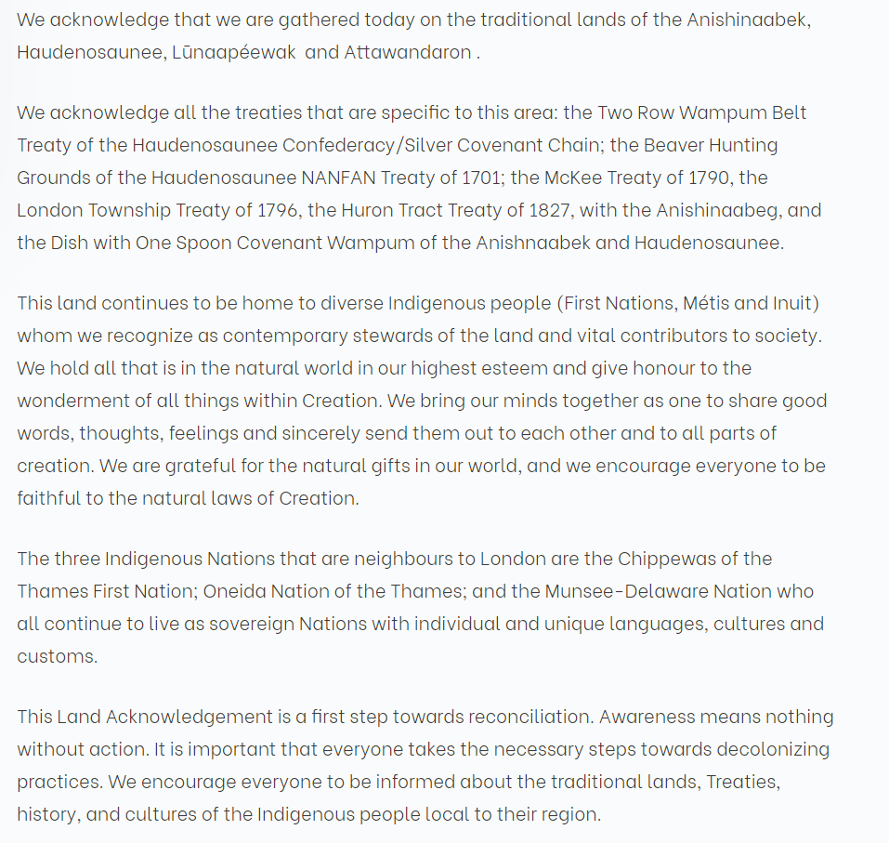
Land
Acknowledgement
Video

Slide 4
We want to
Accurately and historically recognize the territories of First nations, Inuit and Metis peoples, and acknowledge un-ceded and treaties that were signed by the government on our behalf and are still in place today.
Honour Indigenous Peoples’ principle kinship to the land and water and recognize our shared responsibilities
Provide a personal reflection

Slide 5
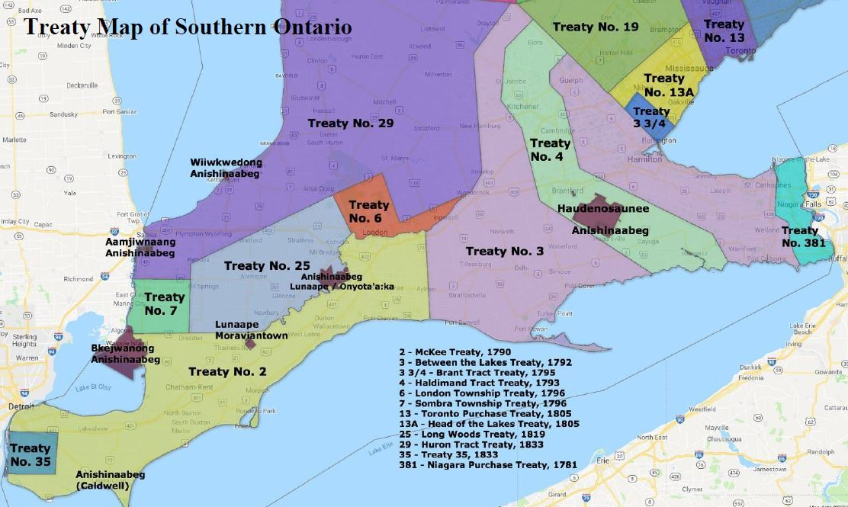
Recognize the First Nations, the Territories and Treaties
We should officially acknowledge that we are on the traditional territorial land of a specific First Nation(s) and identify if the land is unceded or if there is a Treaty.
How do we make this personal and interesting?
Research and share the boundaries of the traditional territorial lands and waters
Learn and share some of the indigenous names for landmarks and bodies of water
Get a copy of the relevant Treaty(ies) and read it. Share a detail of two

Slide 6
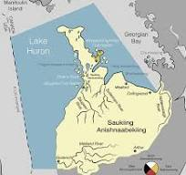
This is what I come up with for our District Conference
We acknowledge that we are meeting on Saukiing Anishnaabekiing the traditional lands and treaty territory of the Saugeen Ojibway Nation, which consists of the Chippewas of Saugeen and the Chippewas of Nawash Unceded First Nation.
The traditional lands run east from Lake Huron to the Nottawasaga River (near Wasaga beach) and south from the tip of the Bruce Peninsula to the Maitland River system (south of Goderich) and include portions of Lake Huron and Georgian Bay.

Slide 7
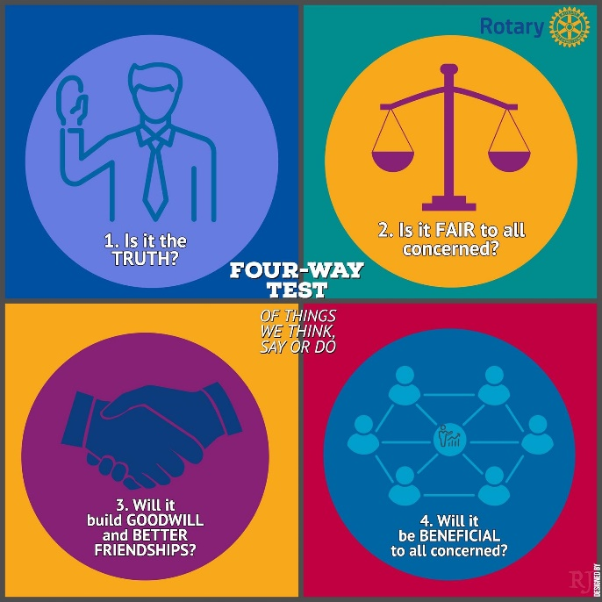
2. Honour Indigenous Peoples’ Kinship to the Land and Our Shared Responsibilities
This section should indicate how you and your group are going to honour our shared responsibilities. This should be unique to your organization/club/event. It shouldn’t be borrowed or copied from some other organization.
How to make this unique and meaningful :
As Rotarians we could reference the 4 Way Test or the 7 Areas of Focus
Does your club have a special focus ?
Do one or two of the 95 recommendations in the TRC Report speak to your Club?
Where is your Club on the Truth and Reconciliation path? Are you at the learning/unlearning stage, at the building relationships stage? ….

Slide 8
What I came up with for our Conference
We take this time to acknowledge the treaties and territories because it’s a reminder of the communities of our indigenous neighbours, their history, and their connection to the land and waters.
As Rotarians we’ll be guided by the 4 Way Test as we work to increase our knowledge and understanding of the past and present and as we look to the future to build relationships with our Indigenous neighbours.

Slide 9
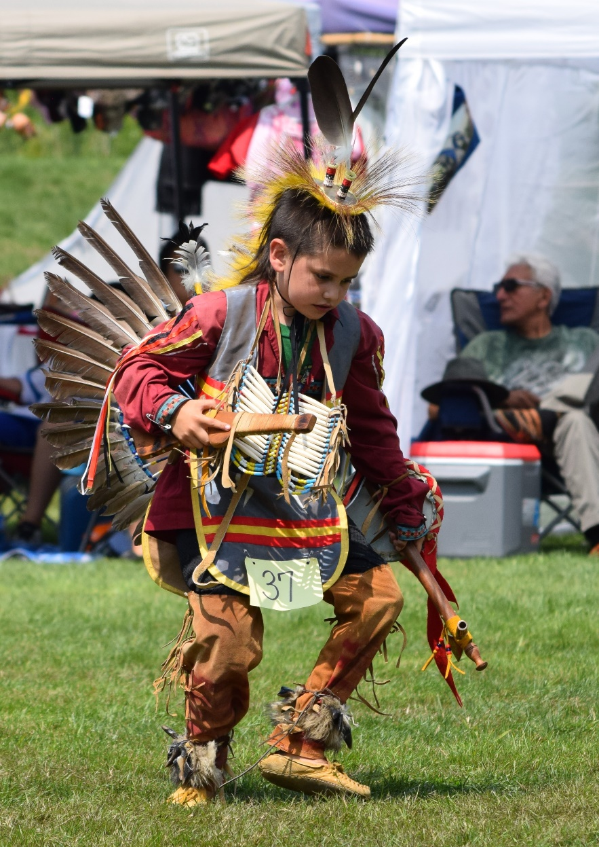
3. Provide a Personal Reflection
This is a time of learning, of sharing something you’ve learned
An article or book you’ve read or a resource (share a link)
The indigenous name of a local landmark
The date and time of an indigenous event – A Pow Wow (research and share the “Do’s and Don’t’s “ of attending a Pow Wow).
Research and share one of the Seven Grandfather teachings, how does it relate to your Rotary Club?

Slide 10
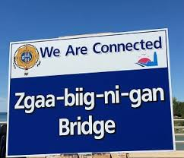
My Personal Antidote for the District Conference
6 years ago as an act of Reconciliation, the bridge between Saugeen Shores (Southampton and Port Elgin) and the Saugeen First Nation was renamed zgaa-beeg-ni-gun, which translates to “We are Connected”
This resonates with me because my favourite Rotary year theme is still Rotary Connects the World. Each year on Truth and Reconciliation Day the two communities have a celebration on the bridge rededicating our connection. Every time I drive over the bridge I’m reminded of our connection.

Slide 11
Remember
It’s not a one time exercise, it’s not cast in stone, the person giving the Land Acknowledgement should add something personal
Make it unique to your organization
Eash time it is given is an opportunity to learn something new
It’s
MORE THAN JUST WORDS
it’s
A COMMITMENT TO ACTION

