Slide 1
Kenyan Water & Girl Empowerment Project

Slide 2
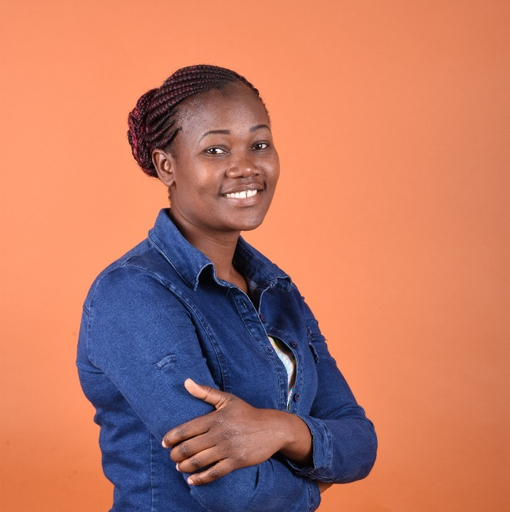
Background – Smart Girlhood
Deurence Onyango – a very active fellow Kenyan Rotarian in her district and beyond to empower girls.
Nominee for the 2021-22 Rotary People of Action: Champions of Girls’ Empowerment
Founder of Smart Girlhood – mentoring girls by providing Menstrual Health Management information and sanitary pads while encouraging them to avoid missing school during the “Period of Shame.”
On average, girls miss 5 days/ month of schools while they are menstruating.

Slide 3
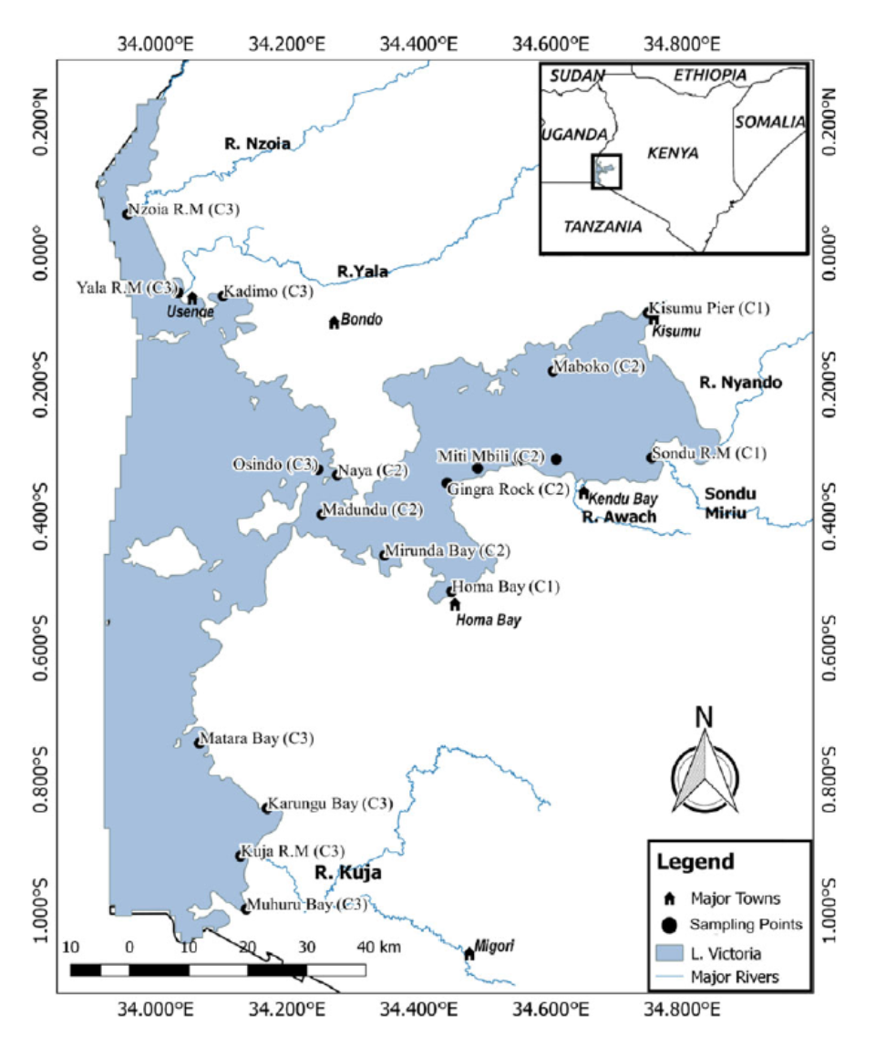
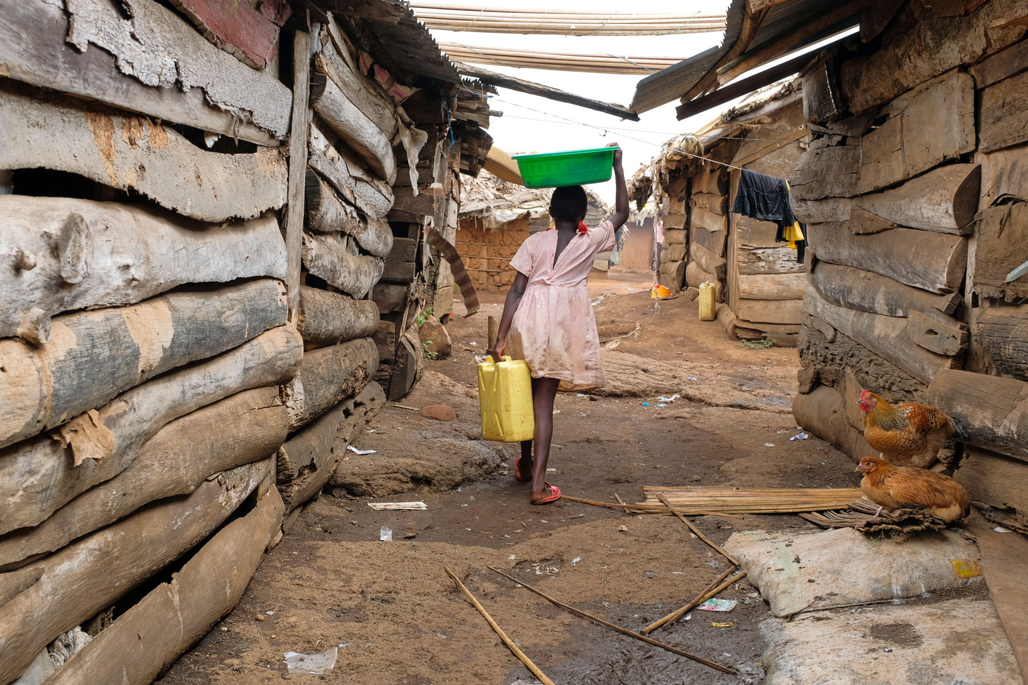
Komenya Village
Located in Homabay County, Kenya.
6 - 10, 000 residents including children
Poor infrastructure: no clean water, roads or health centre
Village depends on small hand dug shallow wells in the riverbed
Girls & women wake up at 3 AM to make the trek of over 10Km for potable water. They say… “The early bird catches the worm…” but there no guarantee you will succeed.
Study by Kundy et al., 2017 published the study on pollution indicators in Lake Victoria, Kenya. One of the clusters where water samples were collected was the region of Homabay, Kenya. High total and fecal coliforms due to urban sewage and industrial efﬂuents exceeded WHO standards.

Slide 4
Learnings from Rapid Assessment
Assessment (60 girls; 10-19 yrs. old)
The type of materials girls used during menstruation?
The source of the materials used
Who bought/gave them the materials used?
Findings
57% of girls use archaic materials (e.g. tissue paper, old newspaper, old rugs/mattresses, leaves) instead of sanitary pads during menses
43% use disposable sanitary pads
Only 14% can afford sanitary pads
Those who use disposable sanitary pads, 58% are given to them.

Slide 5
Who buys/gives sanitary pads ?
65% of girls rely on NGO’s for sanitary pads
24% bought for by friends (boys, and mostly in exchange for sex)
Results in-
Early Pregnancy
Sexually Transmitted Disease (e.g. HIV)
School Drop-out
Conclusion
Need to reach more girls with sanitary products
Introduce reusable sanitary pads will be sustainable
Establishment of local enterprises to boost local skills and production of re-usable sanitary pads is key to sustainability

Slide 6
The Cycle and Dilemma
No resources to purchase sanitary pads
“Days of Shame”
Breaking The Cycle-
Education
Menstrual Management Education
Resources for sanitary pads
Establishment of local enterprises to boost local skills and production of re-usable sanitary pads is key to sustainability
Sex for Sanitary Pads and Money
GIRLS MISS SCHOOL
OBSTACLE ---> Reusable sanitary pads from Days for Girls require clean water to wash them….
-Sexually Transmitted Disease
-Early Pregnancy

Slide 7
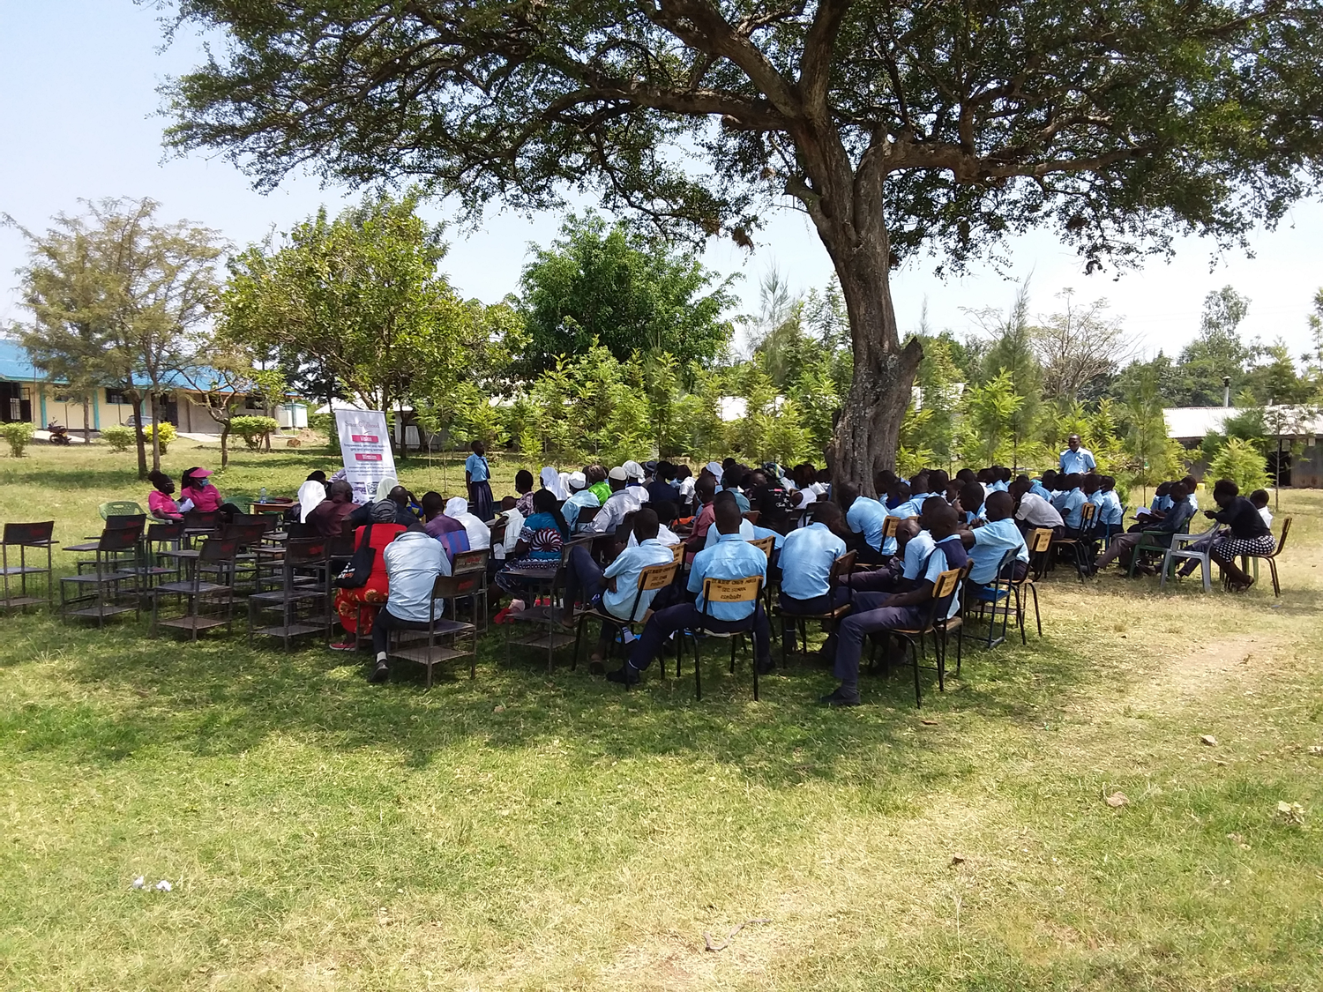
Community Sensitization - July 2021
Deurence and team including the club’s president met 143 parents, teachers and students at an introductory meeting.
Provided information about the project and how parents can support the girls.
Parents were impressed with the project, more aware of the support that the girls need and welcome the project roll out.
Six students volunteered to start Rotary Interact activities in the school.

Slide 8
Kenyan Water & Girl Empowerment Project
$20K
2 Phase Project
$5K
Phase I Pilot Project -
Phase II Extending to Village -
$15K

Slide 9
Kenyan Water & Girl Empowerment Project
Phase I - Pilot Project - $5,000
Construction of water tables at selected family homes and schools
Provide bottles for water treatment and storage
Educate girls, parents and teachers on how to disinfect and test the water
Educate all on basic personal hygiene practices to save lives and Menstrual Hygiene
Phase II Extending to the village - $15,000
Solar Disinfection of Water
Menstrual Hygiene Kits = School Attendance
Establish a Local a Sustainable Enterprise
Sewing Skills Training & Micro Financing
$20K

Slide 10
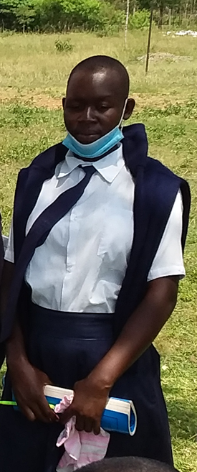
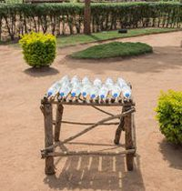
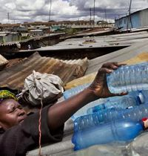
Phase I Progress Report - August 30, 2021
Pre-water sample were collected and sent to be analysed.
PET bottles, tabletops material and aluminum sulphate was purchased.
Local carpenter was contracted to build the tabletops.
Post-water treatment testing currently being conducted

Slide 11
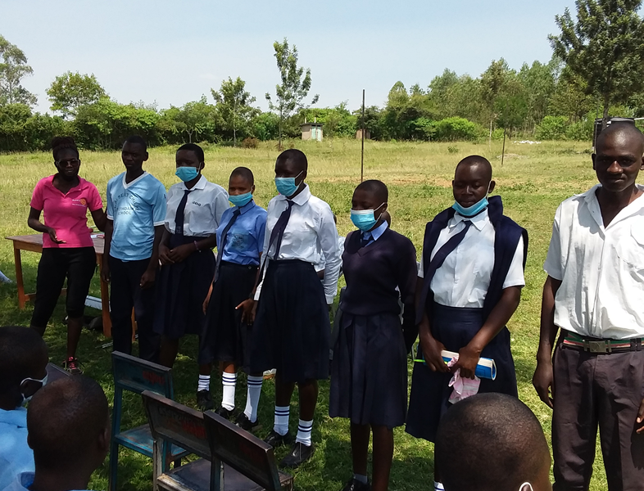
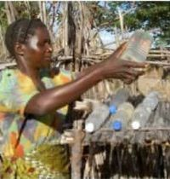
Phase I- Progress Report September 04, 2021
Bottles were distributed to 48 girls and 28 parents.
Instructed how the water treatment Solar Disinfection (SODIS) should occur.
decanting the water
using the aluminium sulphate (cannot be turbid water)
Bottling
Placing bottles over tabletop in the sun
23 tabletops ready to be distributed:
1 for the school
22 for households
The ultraviolet power of the sun rays can kill up to 99.9% of bacteria

Slide 12
Rotary Club London South
Phase I – $5,000 Pilot Project with regular reporting and updates of a control group
Pilot Project will be evaluated, and success will be determined prior to sending additional funds.
Phase II - Funds Needed $15,000.
Phase II- Water purification and Menstrual Management Education and skills building extended to the village.
Phase II - Complete project will result in a local enterprise supplying re-usable sanitary pads.

Slide 13
We Need Your Help
Phase I Phase II Extending to Village
Solar Disinfection of Water
Menstrual Hygiene Kits = School Attendance
Establish a Local a Sustainable Enterprise
Sewing Skills Training & Micro Financing
Become a Club Partner:
Bronze up to $ 500
Silver $1,000
Gold $2,000
Platinum $2,500+
GOAL $15K

Slide 14
We Need Your Help
Make a Personal Donation
A donation of $50 Cdn will give ONE household clean water to cook, drink and wash their re-usable sanitary pads.
$50 = Gift of Clean WATER = Gift of LIFE
Help us - Empower Girls to have a brighter future and enable them to attend school every day!

Slide 15
Ways to Donate
E-transfer to Rotary Club of London South Treasurer dramsdale@gmail.com
noting “Kenya Project” in the Message section
Make cheque payable to:
Rotary Club of London South (Kenya Project)
and mail to PO Box 25602, London, ON N6C 6B3
Donate via www.CanadaHelps.org
Search Rotary Club of London South Foundation
Select Campaign “Kenya Project”

Slide 16
www.canadahelps.org/en/charities/rotary/rotary-club-of-london-south-foundation/campaign/rcls-kenya-clean-h2O/

Slide 17
Kenyan Water & Girl Empowerment Project

Slide 18
Topics
Background
Project
Budget
Timeline & Progress
Rotary Club of London South involvement as of September 2021
How can you get involved?

Slide 19
Empowering Girls For A Brighter Future
$50 CAD provides one girl and her family with a tabletop water purifying system.
Personal Hygiene and Menstrual Management education to prepare girls for a brighter future.
Empower
Enable
Educate
Progress

