Slide 2
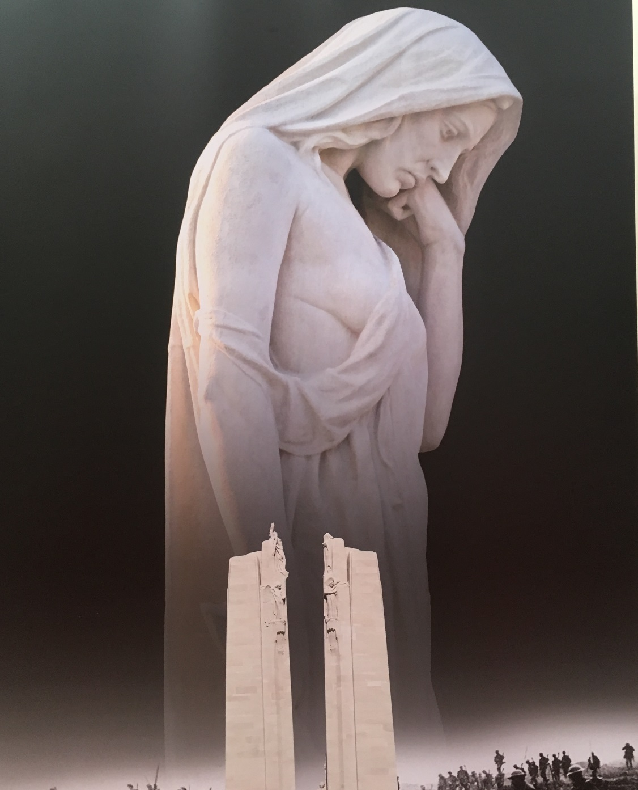
Bereft Canada

Slide 3
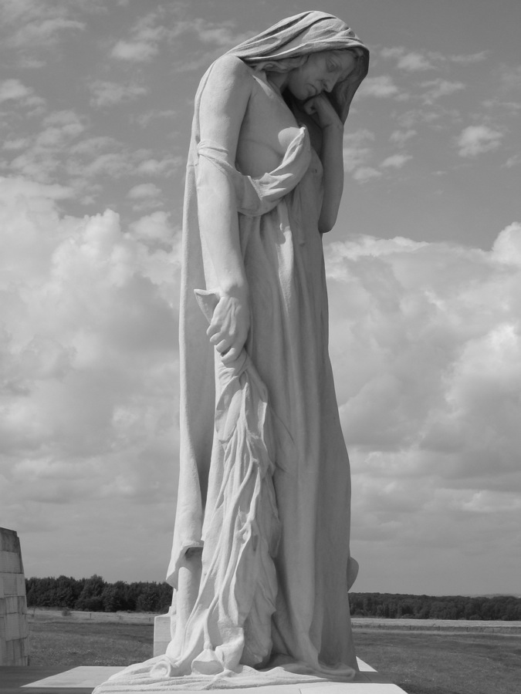

Slide 4
Twenty sculpted, symbolic figures grace the monument, each carved where they now stand from huge blocks of limestone. The largest, a mourning figure known as Canada Bereft, was carved from a single 30-tonne block. Head bowed in sorrow, she provides a powerful representation of Canada, a young nation grieving her dead. Overlooking the Douai Plain, she gazes down upon a symbolic tomb draped in laurel branches and bearing a helmet and sword.

Slide 5
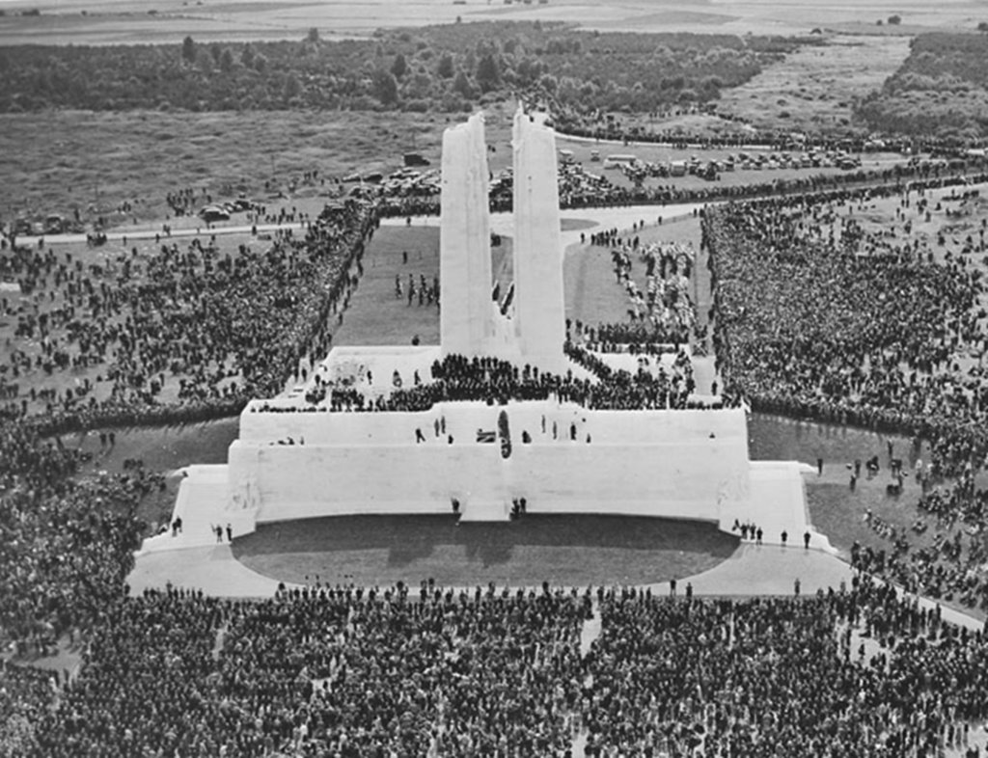
Vimy Memorial Opened: July 26, 1936 Designer: Walter Seymour Allward

Slide 6
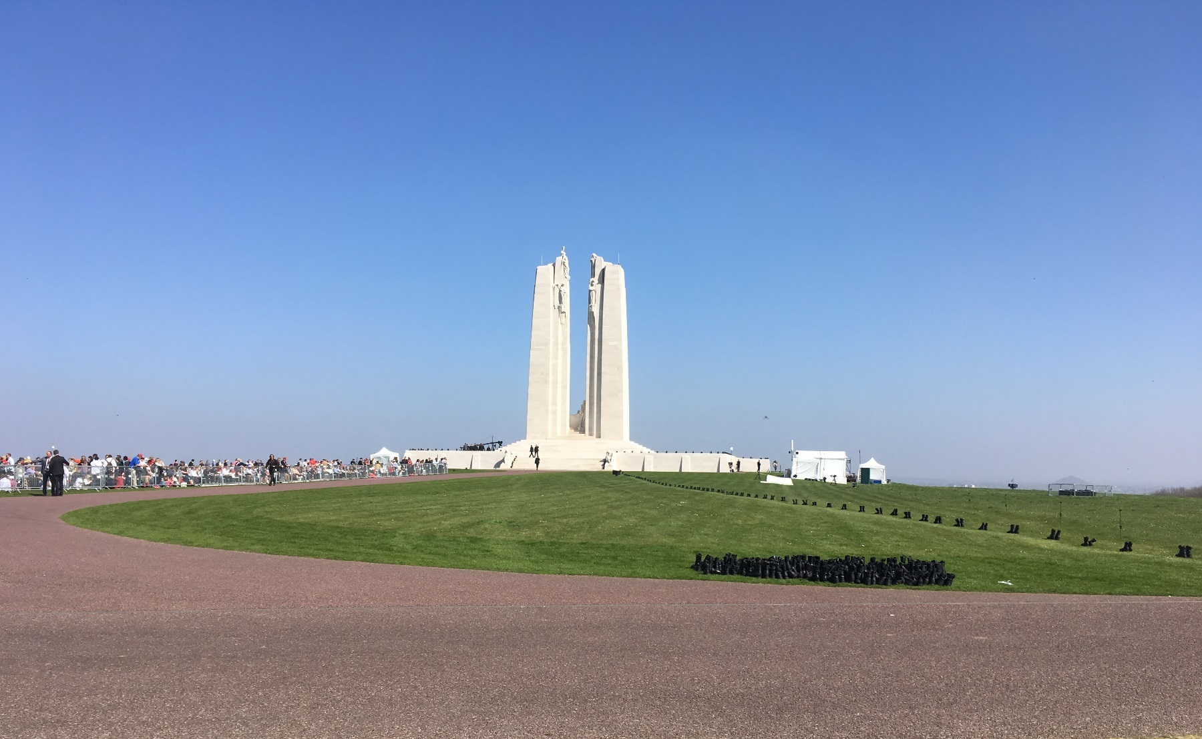
HISTORY Carved on the walls of the monument are the names of 11,285 Canadian soldiers who were killed in France and whose final resting place was then unknown.

Slide 7
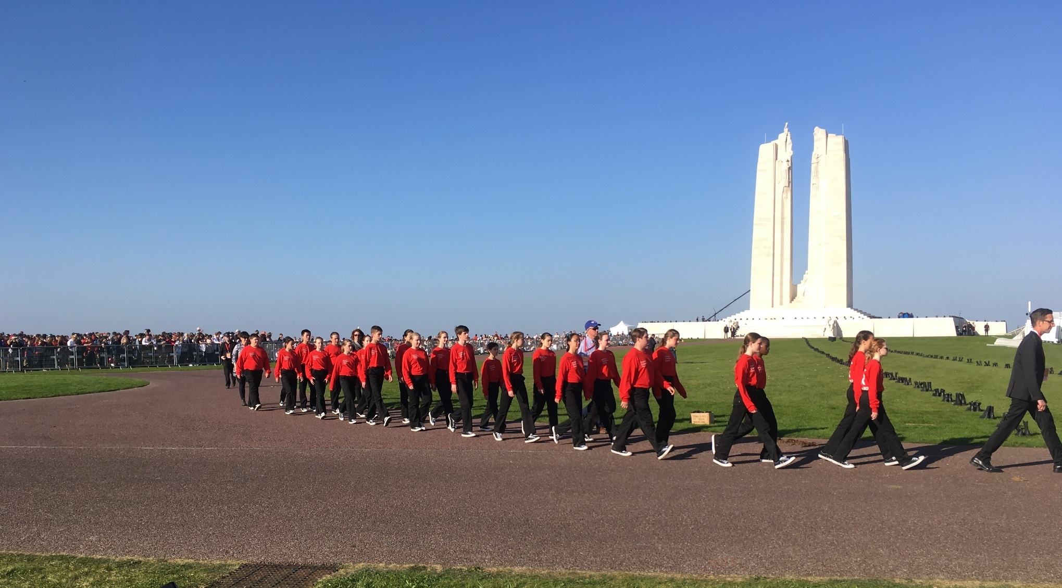

Slide 8
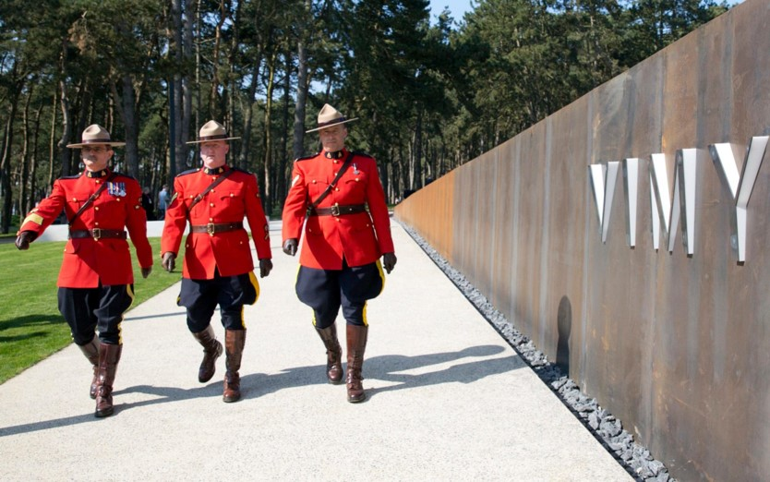

Slide 9
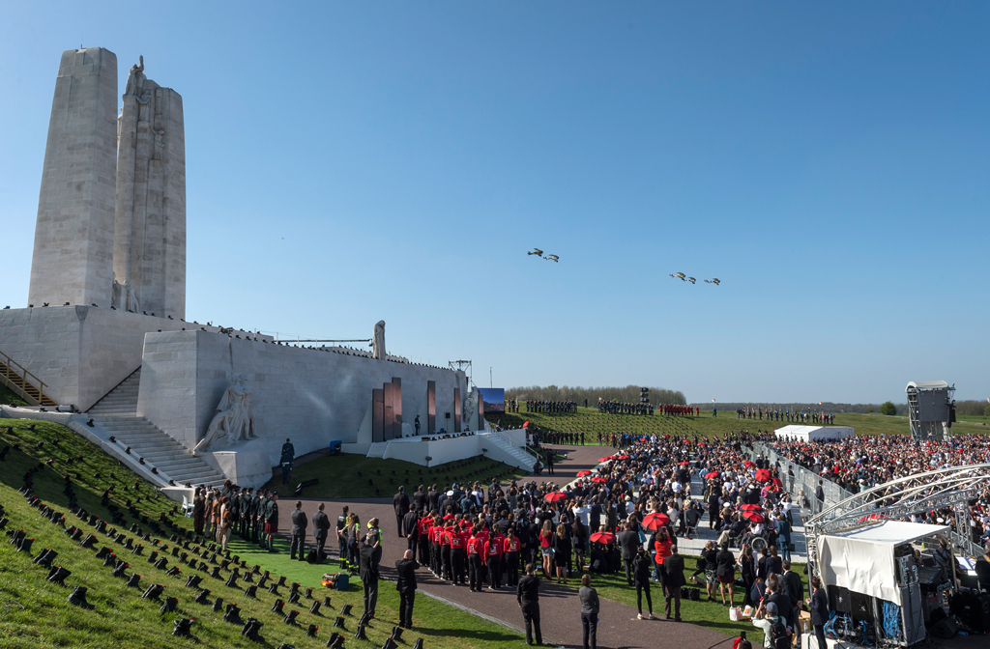
FLY PAST

Slide 10
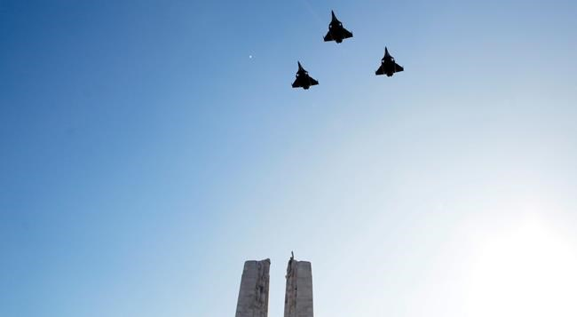
FRENCH SALUTE

Slide 11
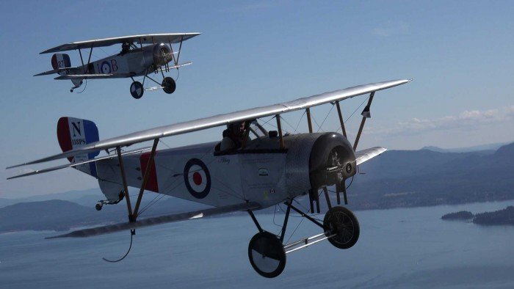
ROYAL FLYING CORPS

Slide 12
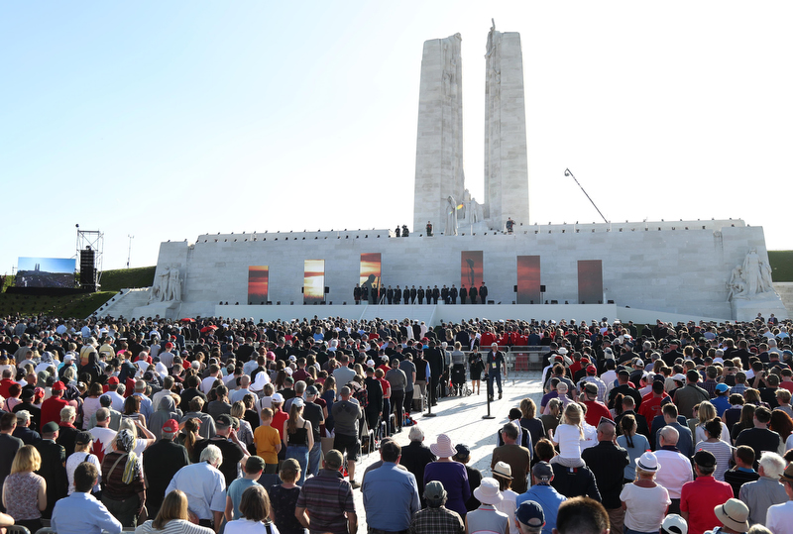
LAST POST

Slide 13
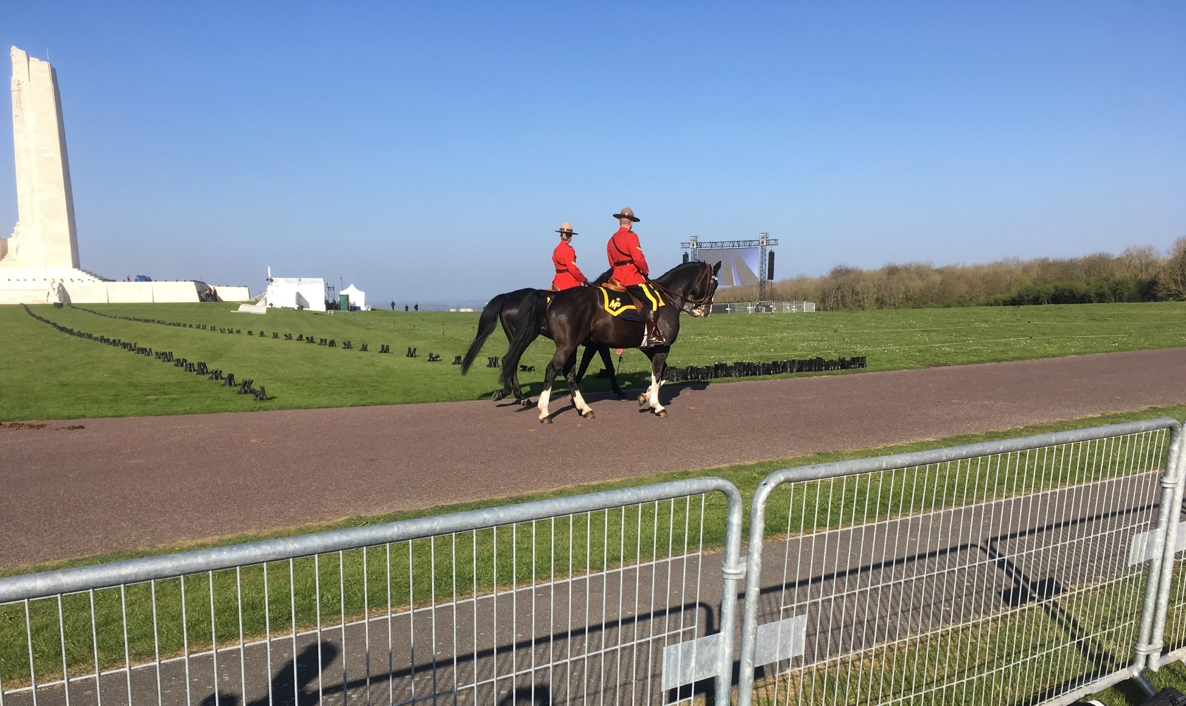

Slide 15
SAD BUT REAL

Slide 17
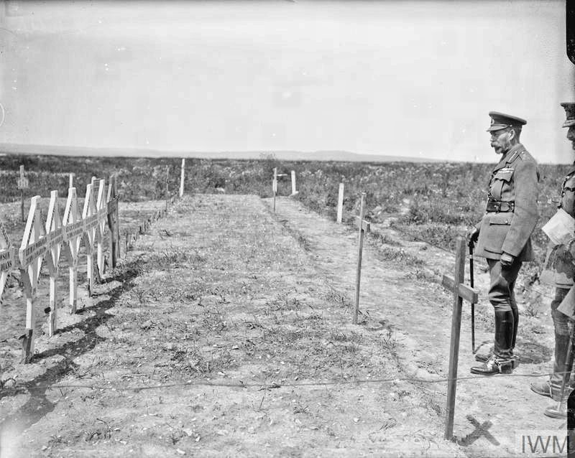
11th July 1917: King George V visiting the graves of Canadian soldiers on Vimy Ridge. Identified graves include servicemen of the 75th Battalion, Canadian Expeditionary Force all of whom were killed in action on 9 April 1917 and are now buried in Canadian Cemetery No.2.

Slide 18
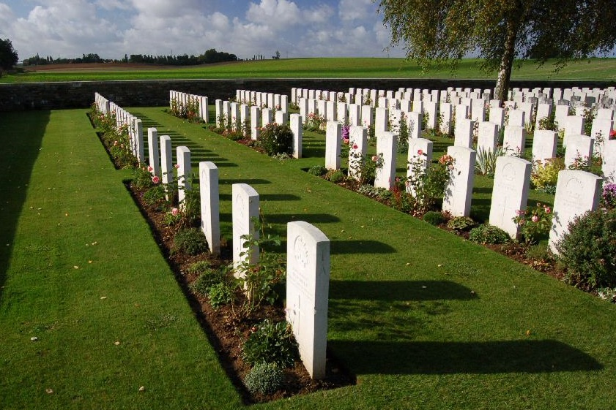

Slide 19
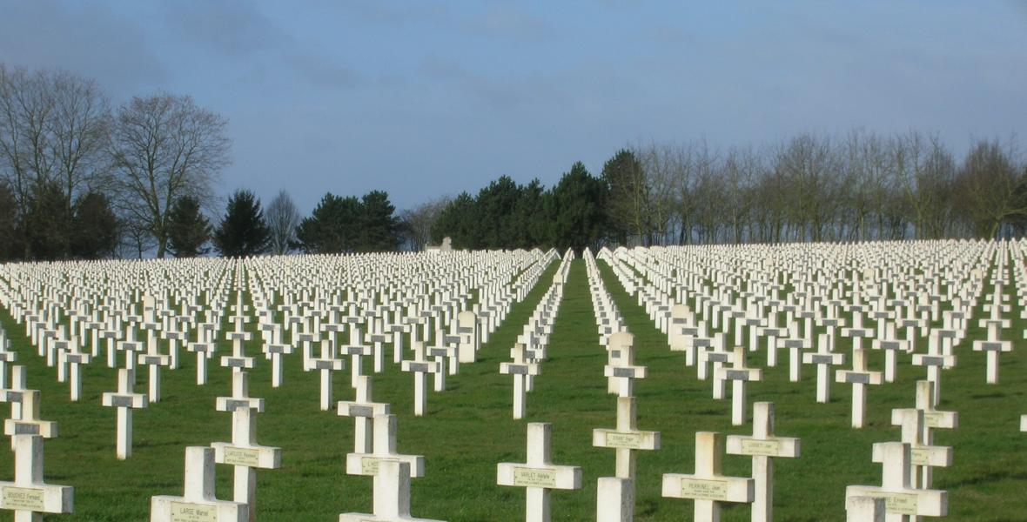
This is Tyne Cot, the Commonwealth war cemetery at Ypres in Belgium and this level of caring devotion is repeated at 23,000 cemeteries and memorials in 154 countries around the world.

Slide 20
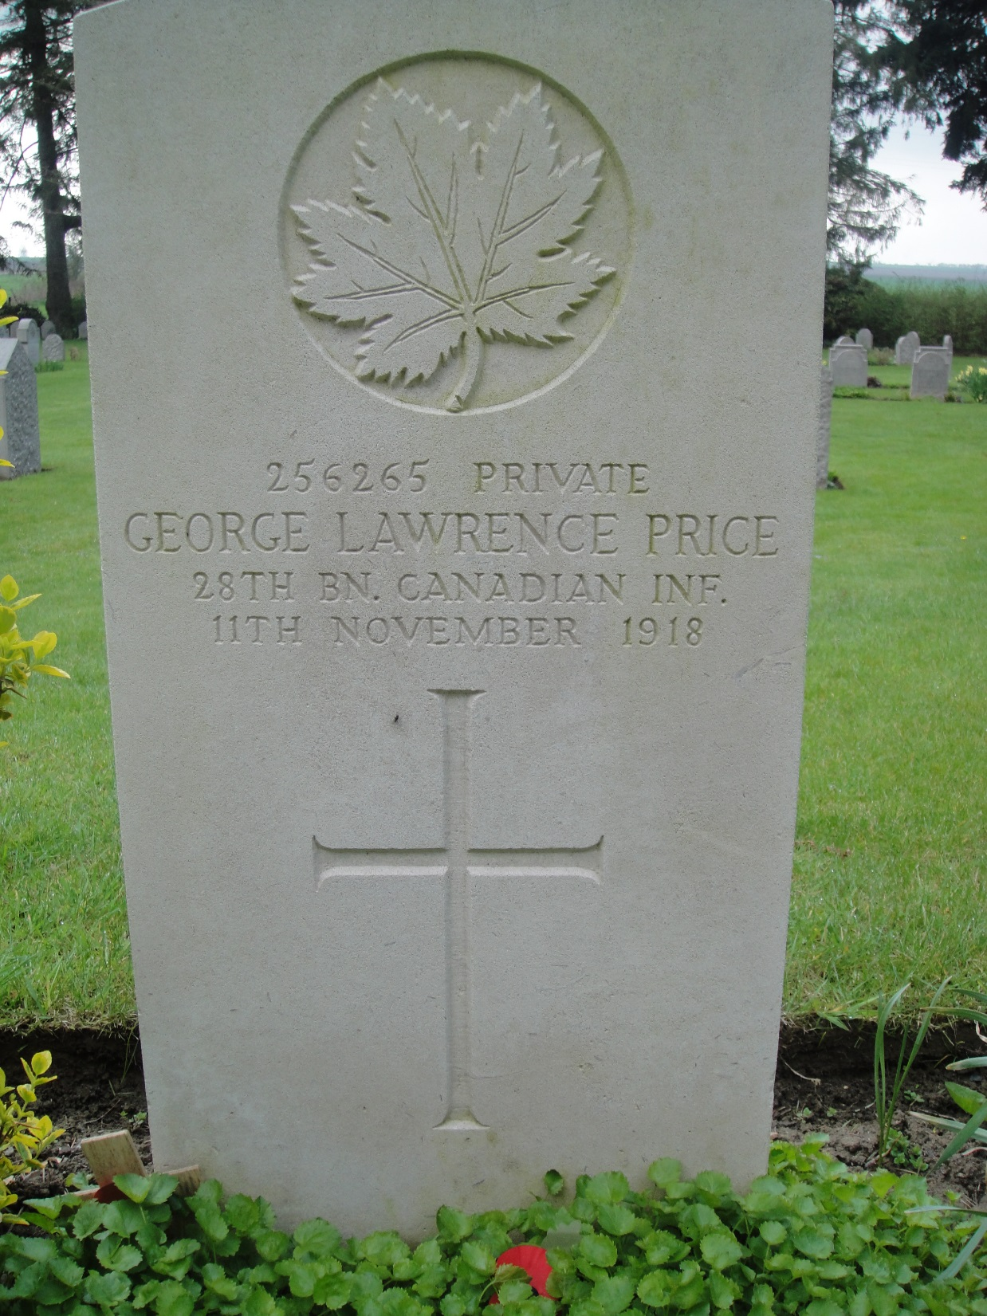
LAST TO DIE 1918-11-11
This is Tyne Cot, the Commonwealth war cemetery at Ypres in Belgium and this level of caring devotion is repeated at 23,000 cemeteries and memorials in 154 countries around the world

Slide 21
