Slide 2
A PERSONAL STORY, BUT NOT UNCOMMON

Slide 3
1915 Eng’g Student U of T

Slide 4
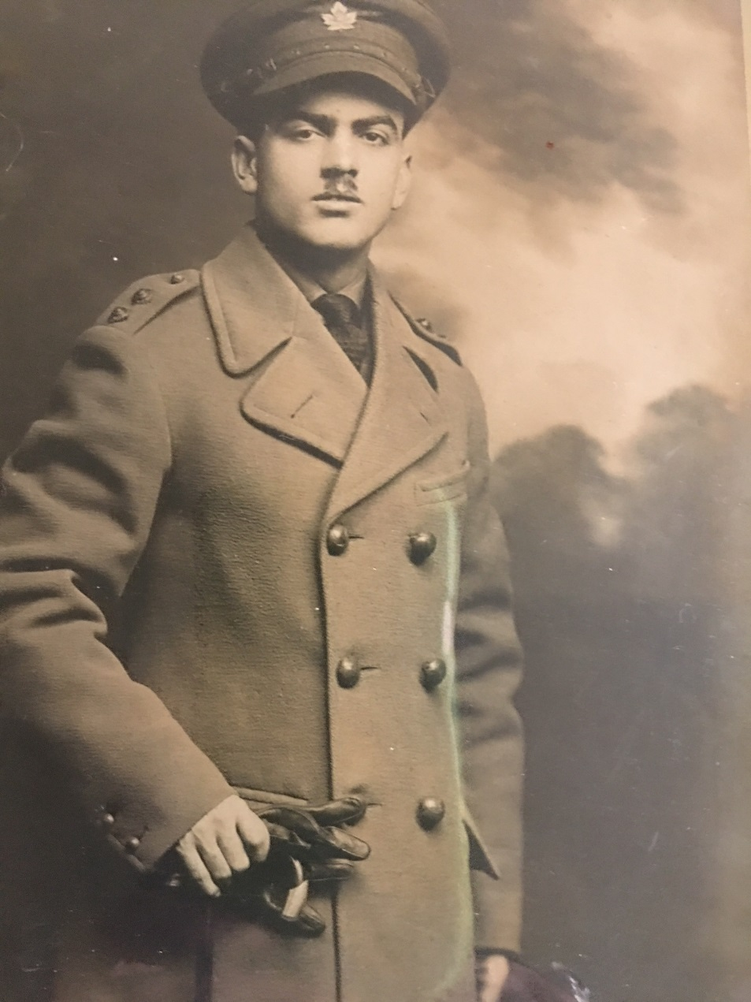
Lt. Franklin Roy Malcolm 1916

Slide 5
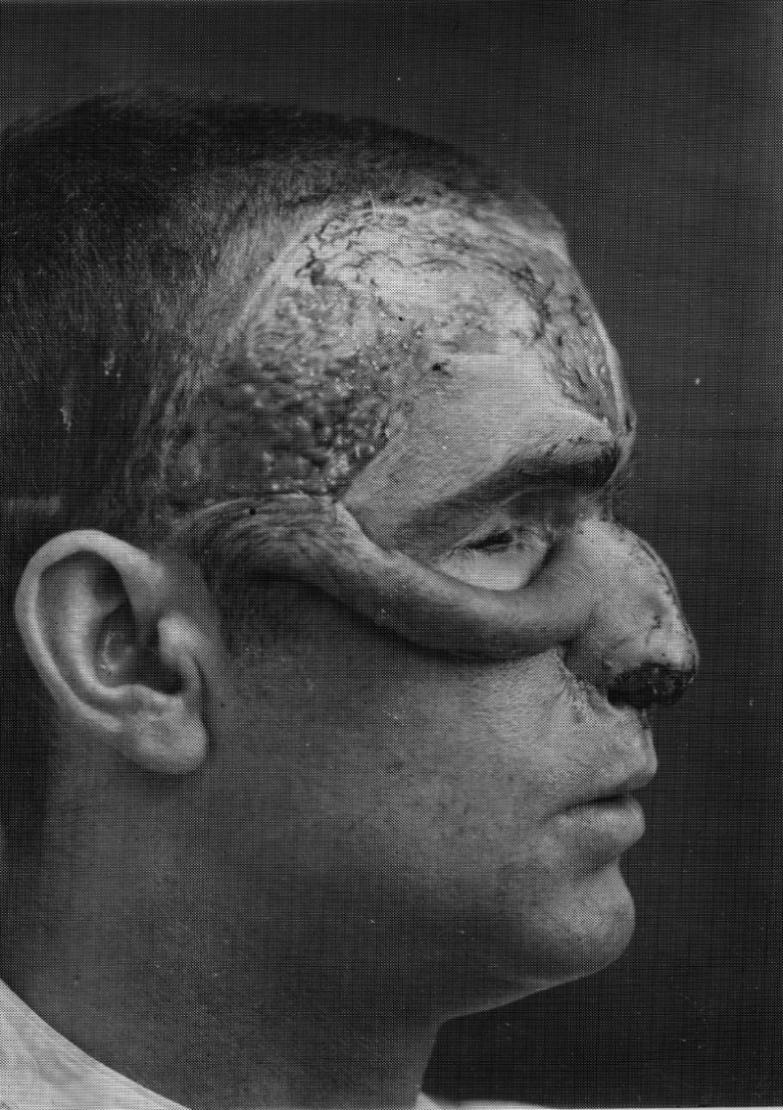
Medical History and Psychiatric Rehabilitation from April 9, 1917 to October 20, 1920

Slide 6
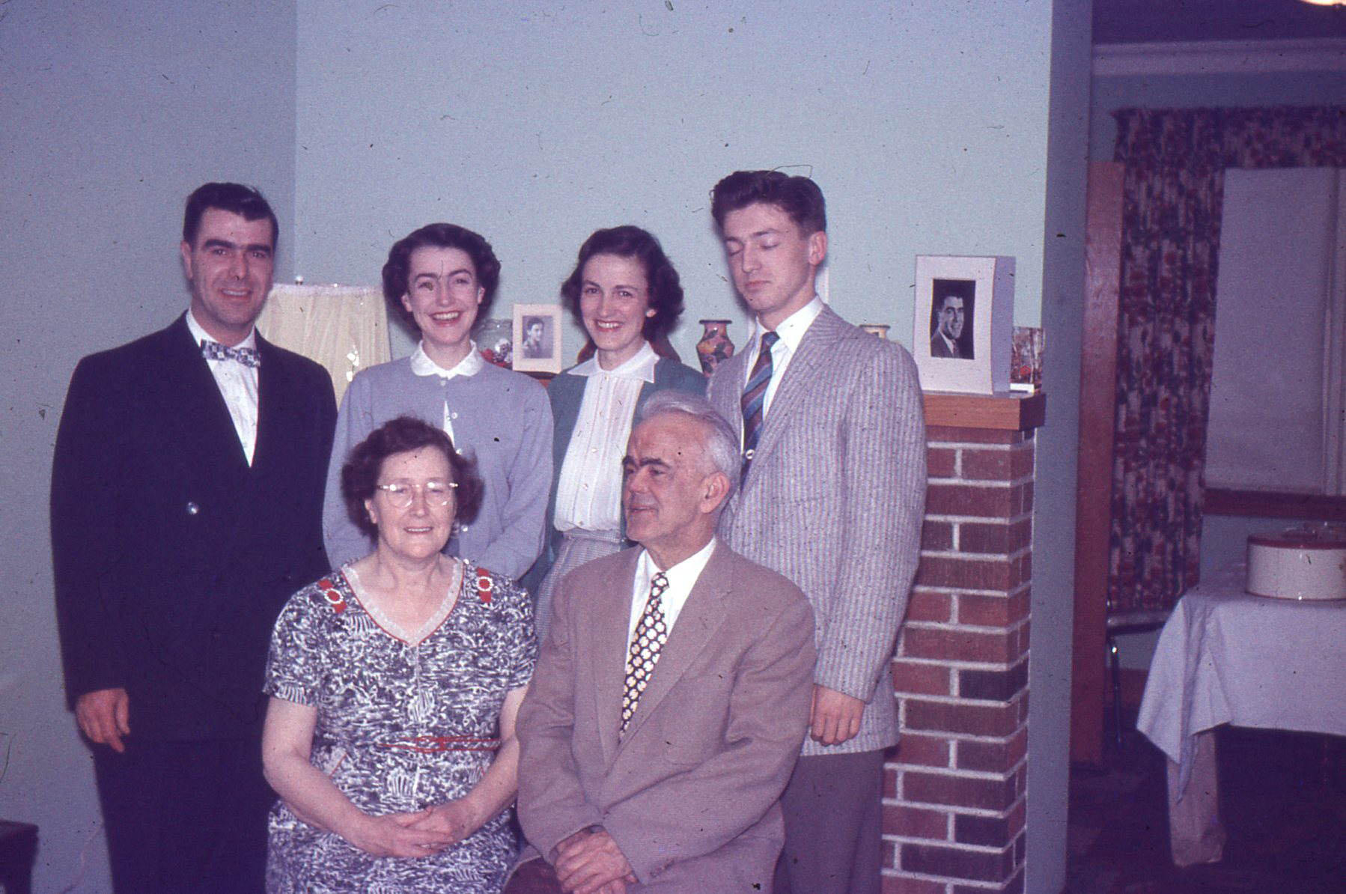

Slide 7
