Slide 1
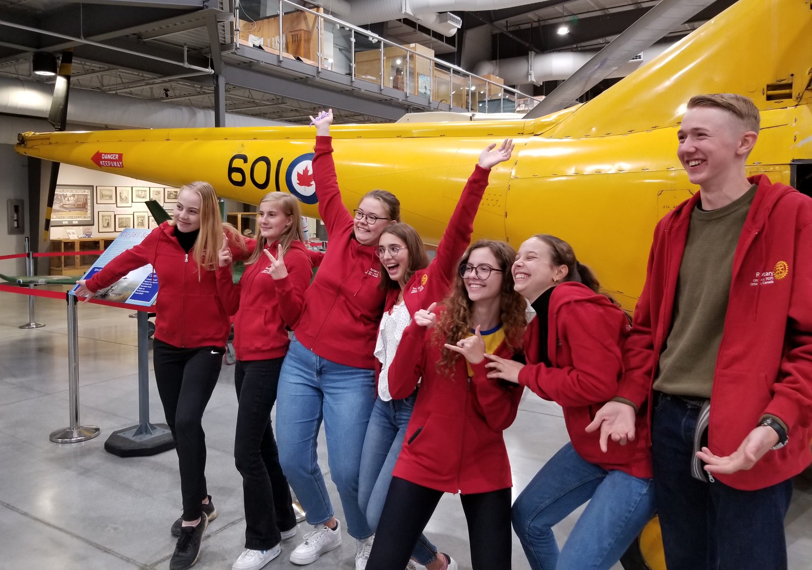
District 7070 Youth Exchange Re-imagine our world
Notes:
Deb Murray - RC of Trenton
Trevor & Shelley Hagerman - RC of Stirling
Grant Southwell - RC of Trenton
Rob Pope - RC of Campbellford
Joyce Cassin - RC of Brighton
Janet Thorstenstein - RC of Whitby Sunrise
Beth Selby - RC of Cobourg
Maddy - ROTEX
Patti Wright - District Youth ServicesDirector
We are looking for new members.
For us Youth Exchange is largely responsible for opening our eyes to the true scope of Rotary and its role in the world. It also has brought that same knowledge & understanding to our club AND led our club to get involved in an international project in 2019, thanks to an outstanding presentation by Eloise.
NEXT SLIDE

Slide 2
What is Rotary Youth Exchange (RYE)
An 11 month long exchange:
Rotary Clubs participate and choose an outbound student
Selected District 7070 Rotary Club students live abroad
In exchange, students from abroad live here
Students attend high school
Students are hosted in local families (Rotarians or other)
Students experience the culture of another country
Notes:
This 11 month long program sees Rotary partnering countries exchanging students to live abroad, attend high school and live with host families for 3-4 months which can be Rotarians or qualified community partners. During this time, students are immersed in a culture different than their own and learn another language, bringing back to Canada an understanding of the differences that make us all unique!
NEXT SLIDE

Slide 3
Long-Term Exchange Program Goals
Deeper Cultural Understanding
Notes:
NEXT SLIDE

Slide 4
Long-Term Exchange Program Goals
Foster Global Citizens
Notes:
NEXT SLIDE

Slide 5
Long-Term Exchange Program Goals
Bridging differences through Friendships and Bonds
Notes:
NEXT SLIDE

Slide 6
Long-Term Exchange Program Goals
Broader View of the World
Notes:
NEXT SLIDE

Slide 7
Long-Term Exchange Program Goals
Generating leaders, givers and Rotarians
Notes:
NEXT SLIDE

Slide 8
Long-Term Exchange Program Goals
Tolerance and Understanding of others
Notes:
NEXT SLIDE

Slide 9
Rotary District 7070 Youth Exchange
BC Wildfire fighter
Heather Murray
RYE Student 2010/2011
The Plan
August 2022
Outbound/Inbounds
Notes:
The Plan is that by August 2022, the world will be in a safe situation to allow for student exchange again.
NEXT SLIDE

Slide 10
Help Us Reach Our Goal! Get your club involved in RYE
Notes:
Your Club is critical to the Rotary Youth Exchange Program
NEXT SLIDE

Slide 11
What will it take?
Your Club says YES by August 30th and has a
Youth Exchange Officer
Youth Counselor
A Club plan to recruit an outbound student by Nov 30
2-4 host families ready to host for 3-4 months
Club budget of about $6,000 (IB & OB)
Notes:
In any given year, this slide shows you what needs to happen. If you’re interested, just say, YES and reach out to any one of us on the RYE Committee
Committee members are going to follow-up with all clubs in the coming weeks
NEXT SLIDE

Slide 12
Rotary District 7070 Youth Exchange Alumni
Ultimate Value – Building World Peace!
Notes:
By getting to know one another, respecting our differences while understanding our common goals, we can lay a foundation of World Peace for future generations!
NEXT SLIDE

Slide 13
Need to know more?
Register for
March 30^{th, 2021}
Youth Exchange – The inside Scoop
An information session for curious clubs.
www.rotary7070.org
Notes:
We’re here to help you establish a Youth Exchange in your Club. Please join us on March 30th for an information session via Zoom. Swatch for the email and then register!
NEXT SLIDE

Slide 14
We are here to help! rye.d7070@gmail.com www.yepd7070.org
Notes:
You & your Club are vital to maintaining this vibrant, energetic and rewarding program! We’re so excited to work with you! Thank you ALL!

