Slide 1
Community & Family Services

Slide 2
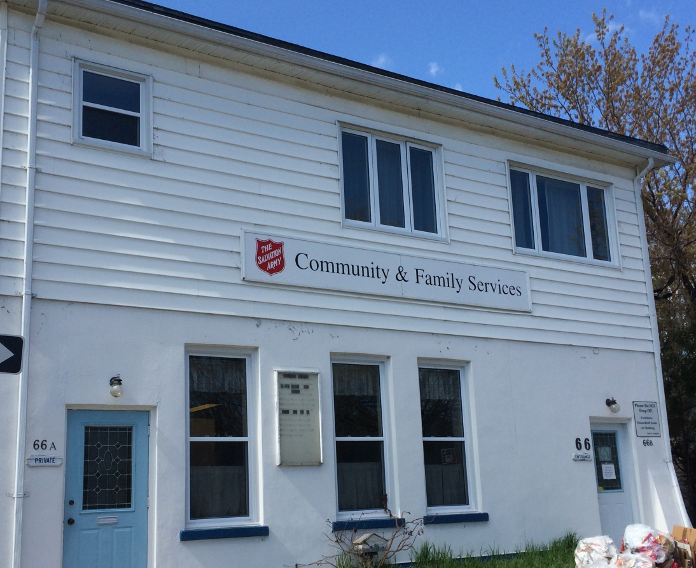
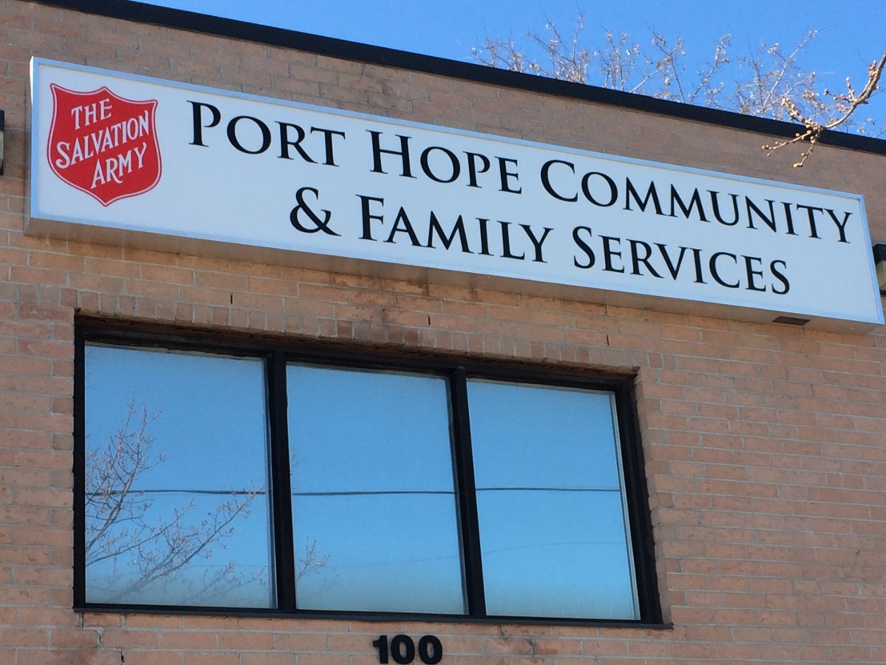
Community & Family Services
Cobourg & Port Hope Offices
Director: Edward Nkyi
Manager: Lisa Graham

Slide 3
Services and Programs
that we offer:

Slide 4
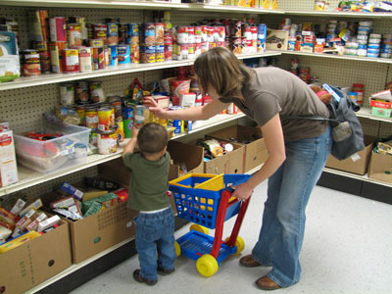
Food Cupboard
The Food Cupboard provides, food, refreshments, snacks and a social time for everyone who is interested. Those who come bring their own bags and fill them up with food.

Slide 5
Health
Bank
Low income households who need emergency prescriptions, dental and optical needs which are not covered by government programs can receive assistance through the Health Bank Program.

Slide 6
Rent, Utility Assistance
and Household Repairs

Slide 7
Christmas Assistance
In conjunction with The Giving Tree, toys and gift cards for food are distributed to low income households.

Slide 8
Homeless Supports
For at risk and homeless
Pay utility bills
Assist with rent arrears
Transportation
Household supplies – diapers, cleaning products
Food – food vouchers
Clothing
Blankets/sleeping bags
Backpacks with personal hygiene products

Slide 9
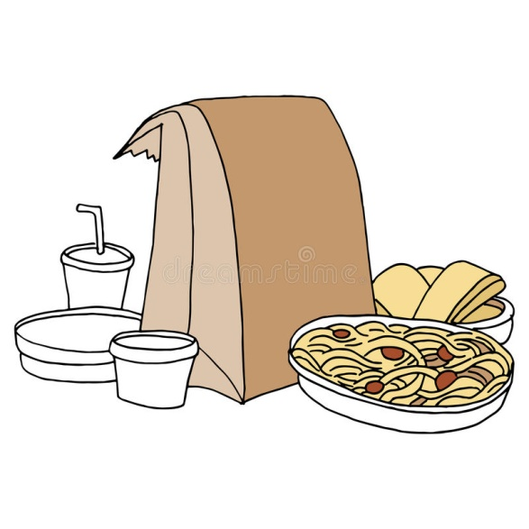
Community Mobile
Outreach Program
This program works in partnership with community agencies and services to respond to people in need in Northumberland County. Take-out meals are provided at various locations in Cobourg and Port Hope on Tuesdays evenings.

Slide 10
The Salvation Army works together with various community partners to make sure children stay warm in the winter.

Slide 11
Baby Formula Program
Nurture Our Future program assists families with children ages 0 – 1 year of age, assisting to support formula needs every week.

Slide 13
We provide a safe place for people to be real about things they struggle with in order to experience the life changing power of Jesus Christ.

Slide 14
Coffee With Friends
The Salvation Army
Mondays & Fridays 9:00am – 12:00pm
Available in the Port Hope CFS office
January - October

Slide 15
Community Meals/Lunch Program
A bowl of hot soup and/or a sandwich are offered to those who come but there are those only come for a coffee and to chat in a warm and friendly environment.

Slide 16
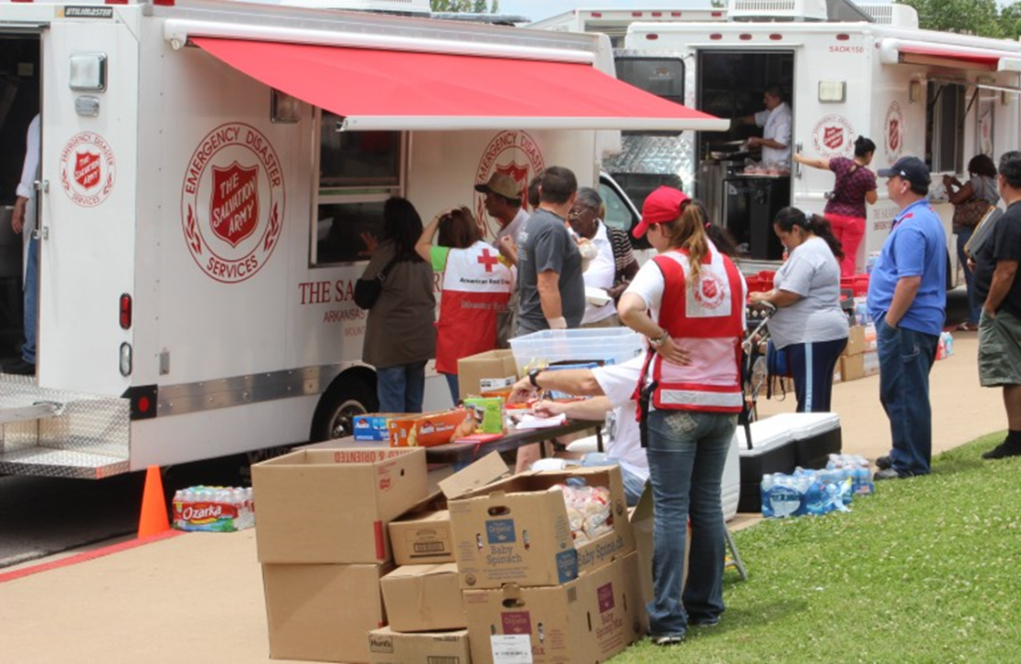
For victims of small-scale disasters i.e. fire & motor vehicle accidents. We provide services that include food, accommodations, personal needs items, housing, clothing, appliances & household items.

Slide 17
Emergency Housing
Moving people from the streets into temporary shelter. The Salvation Army works with local shelters, Police services, motels and out of the area shelters.

Slide 18
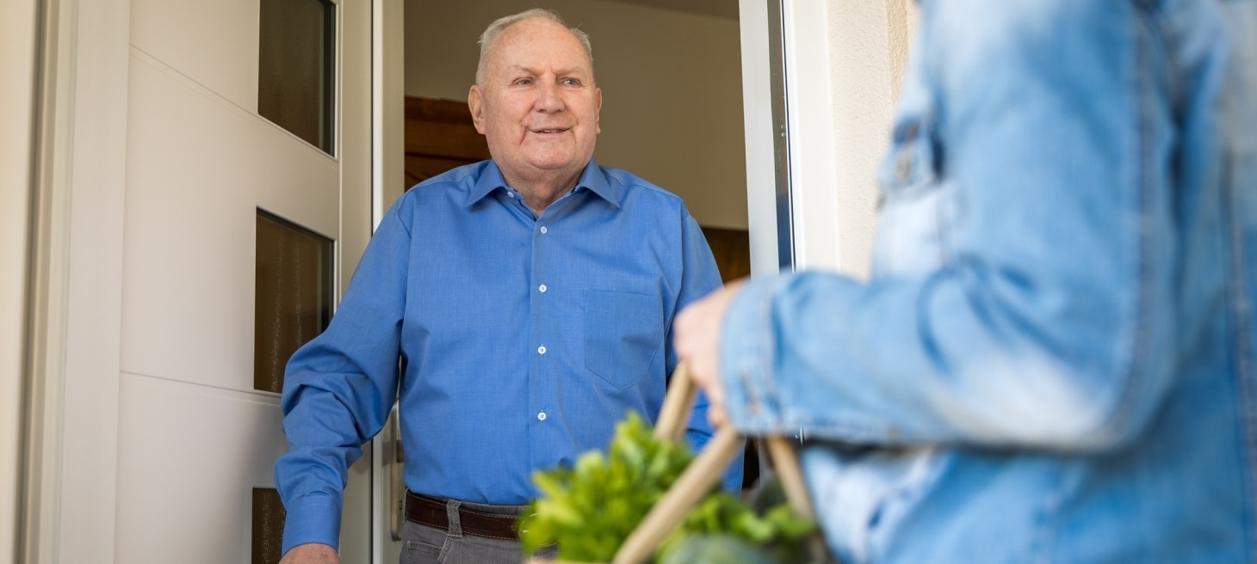
SENIORS
sdjj
Wellness Check-In Program

Slide 19
Summer Camping Programs

Slide 20
WE ARE STILL HERE
Serving Cobourg & Port Hope
The Salvation Army is re-imagining what church and practical support looks like during these times of isolation and social-distancing.
We may not be operating as usual, but we are available and able to assist you. Please
contact us if you need support at this time.
Contact Us:
Community & Family Services Offices
Cobourg (905) 373-9440 safamser@cogeco.net
Cell: (905) 375-7682
Port Hope (905) 885-2323 saporthope@gmail.com
Cell: (289) 251-5758
Cobourg Community Church (905) 372-3832

Slide 21
Giving Hope Today

