Slide 1
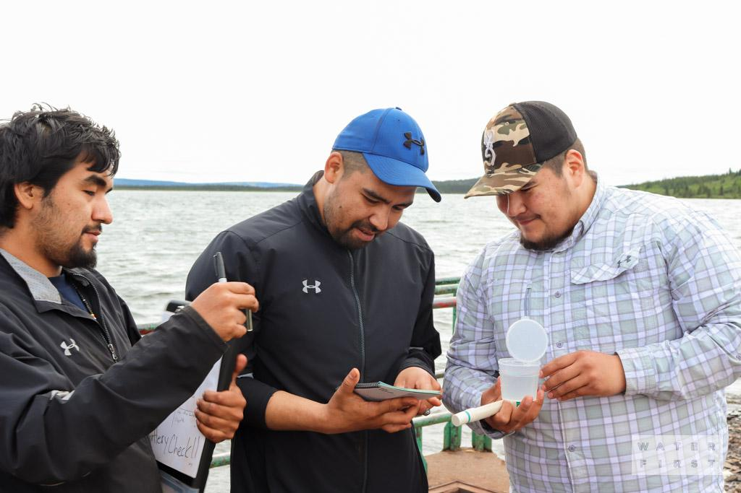
District 7010 Indigenous Project - Water First
STRONG COMMUNITIES. SAFE, CLEAN WATER

Slide 2
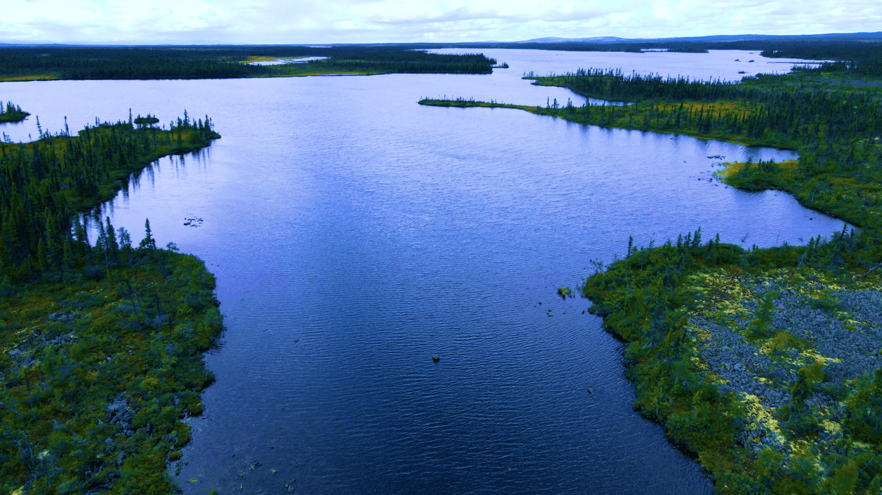
Through water, sanitation, and hygiene programs, Rotary’s people of action mobilize resources, form partnerships, and invest in training that
yields long-term change.
The Water First mission is to help address local water challenges in Indigenous communities through education, training
and meaningful collaboration.

Slide 3
A problem close to home
13.5% of First Nation communities are under a boil water advisory.
40% of First Nation communities are under a boil water advisory.
Water First partners with Indigenous communities in Canada to address critical drinking water challenges.
“Before this job, I didn't care where the water came from. I turned on the tap and that's it. I came in for a job and came out with a career. Because of this, my son and I are set.”
Amy Waboose, Whitefish River First Nation
Notes:
Why we focus on communities in Canada/Ontario

Slide 4
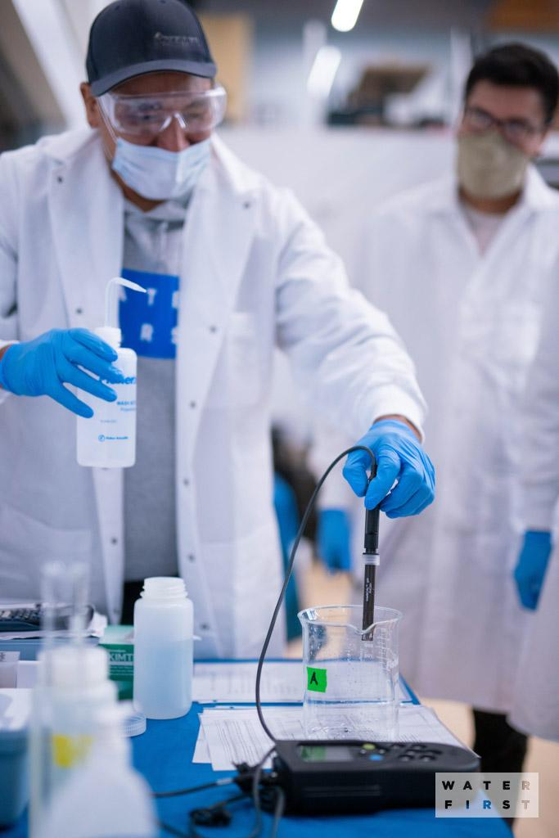
ROTARY takes action to empower educators
to inspire learning at all ages
Technology alone does not provide clean and reliable drinking water; the people who run the systems are critical.
Many First Nations have identified the need for young, qualified, and local personnel to support solving water issues, independently and for the long term.

Slide 5
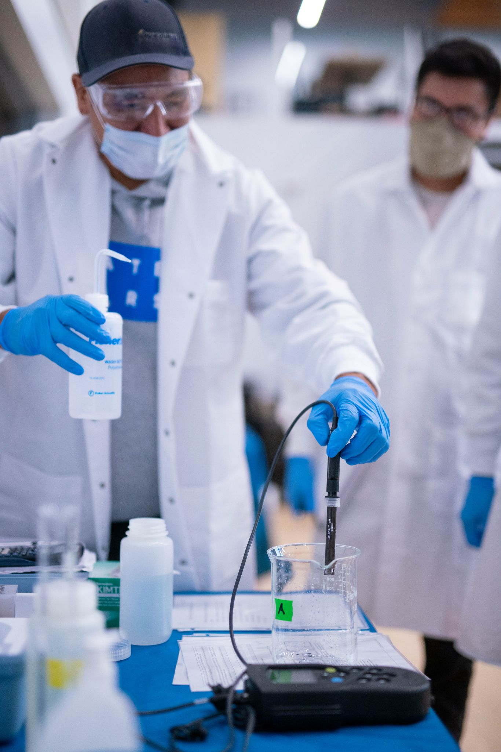
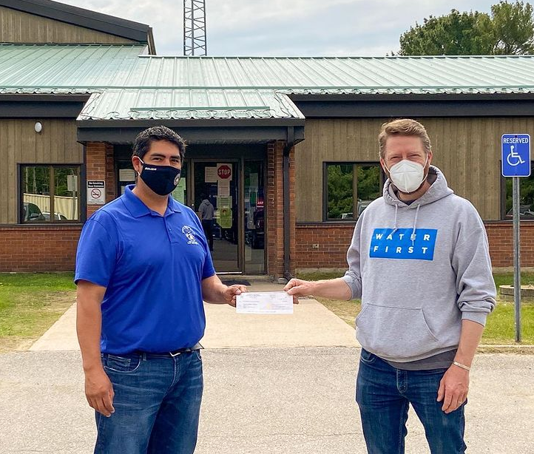
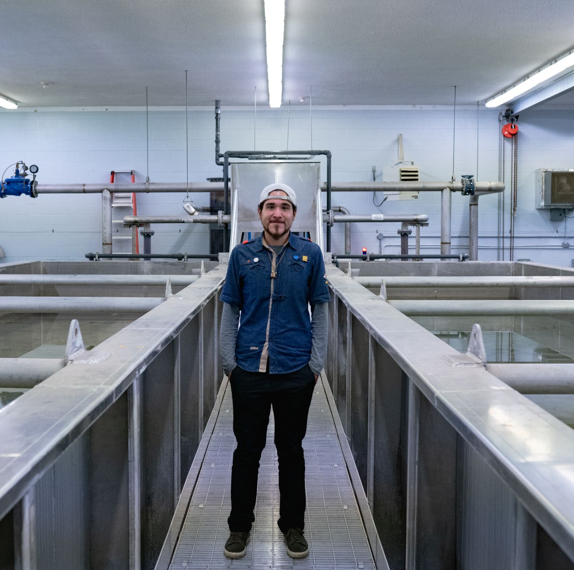
When Rotary partners with Water First, we help amplify their impact, advance this
important cause to improve communities, and create local connections for the program.
1st Internship on Manitoulin Island
2nd Internship with the Bimose Tribal Council (Kenora)
3rd Internship - Georgian Bay
10 Interns graduated
Within 8 weeks, 90% of interns were working in the field or pursuing further study
11 Interns will graduate in August 2021
Started June 2021 with 16 Interns in partnership with 8 First Nations communities

Slide 6
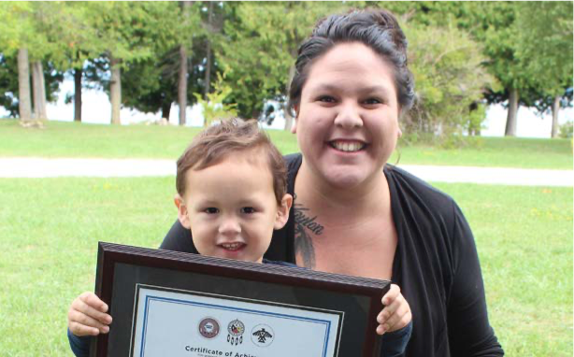
Well Planned Rotary Service Projects Require:
A project aligned with Rotary's areas of focus (FOUND !)
Assistance with project design/planning and implementation (ongoing)
Access to global grants (upcoming)
Conduct a community assessment (completed by Water First)
Identify international partners (District 4130 Mexico)
Secure funding (on going)
Ensure the sustainability of the project (Partnering with Water First)
Establish measurement and evaluation benchmarks (ongoing)

Slide 7
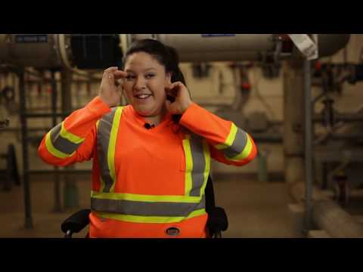
Notes:
VIDEO. CLICK TO PLAY. ONCE DONE CLICK SLIDE ARROW AT BOTTOM TO ADVANCE TO NEXT SLIDE.

Slide 8
Funding breakdown
The costs:
Staffing
Intern wages
Travel
Equipment and materials
Alumni network
Average cost per student is $100,000 with shared funding from the Federal, Provincial, and corporate sources.
Funding sources:
Government (grants are available)
Indigenous community partners 40%
Corporate partners 6%
Foundations 18%
Individual supporters & donors 24%
Community supporters (like Rotary) 12%

Slide 9
D7010 Proposed Budget
To Support 4th Internship
District 7010
Host Club $5,000
Rotary Clubs Other $50,000
District DDF $12,500
Other Districts
D7040/D7080/D7090 $20,000
International Partner- D4130 Mexico
Sponsor Club $5,000
Other Rotary Clubs $2,000
District DDF $6,250
TRF World Fund (District 7010 + International = 18,750)
DDF Match 80% $15,000
Proposed Total Funding: $115,750

Slide 10
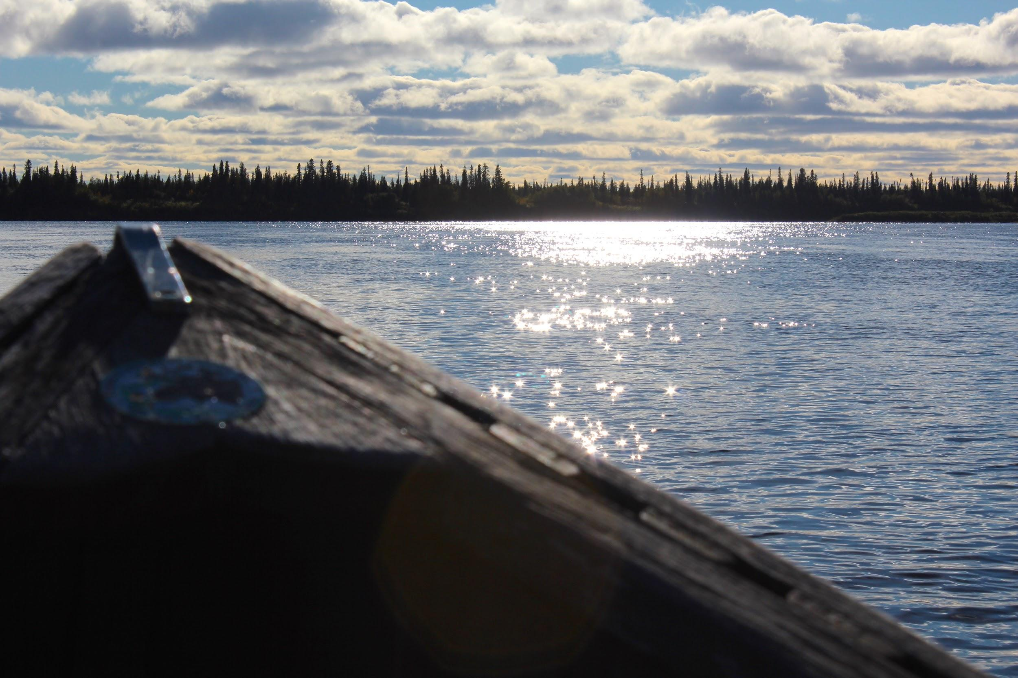
We hope that your Club or Rotarians
will support this project !
Individuals requiring an income tax receipt or clubs paying by credit card: Canada Helps. https://www.canadahelps.org/en/dn/63546
Clubs can contribute by:
E-transfer to rotarydistrict7010@hotmail.com
or by sending cheques payable to :
District 7010
c/o Office Works 12B-195 WELLINGTON ST
BRACEBRIDGE ON
P1L 1C2

