Slide 1
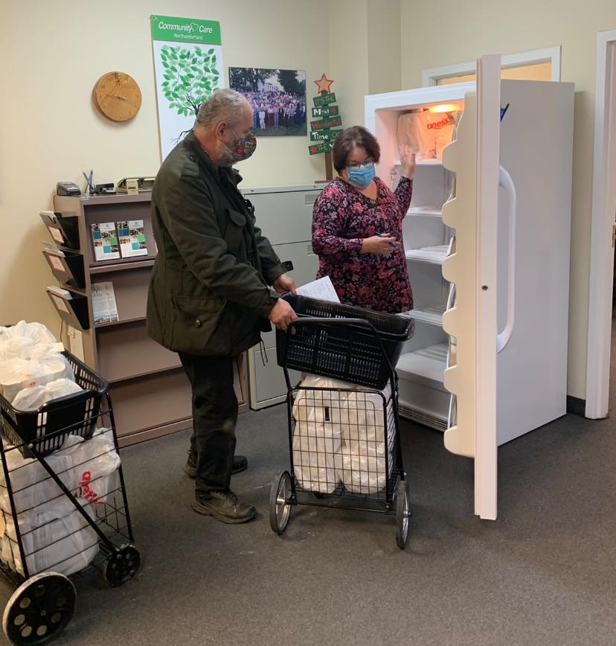
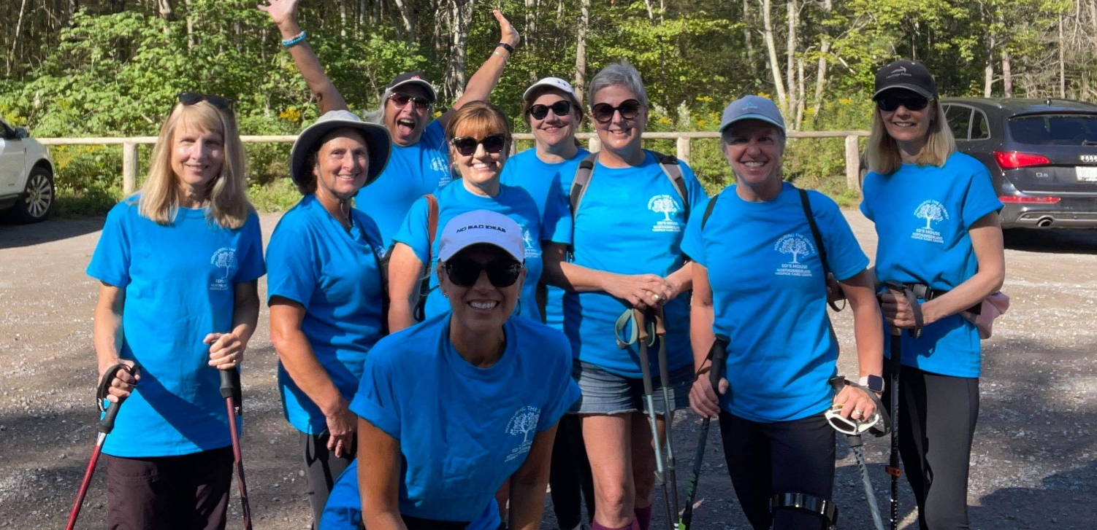
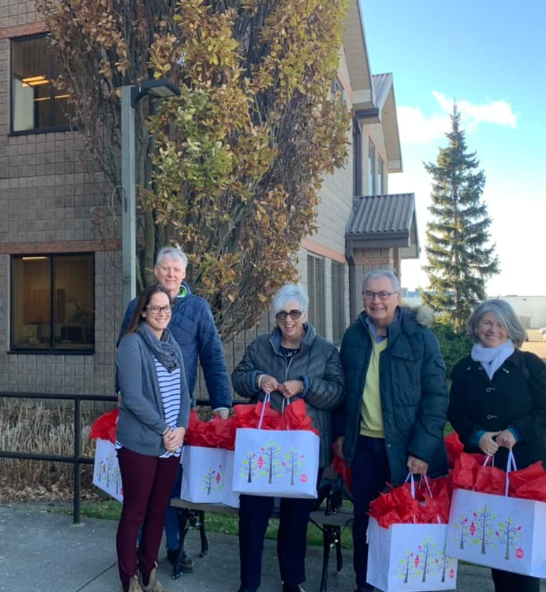
Community Care Northumberland Presenting:
Northumberland’s Volunteer Peer Support Initiative
WrapAround for Older Adults
SUPPORTED BY
Community Care Programs and Volunteer Recruitment

Slide 2
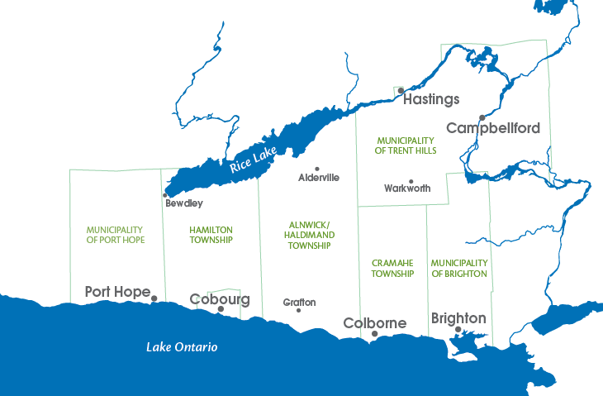
About Community Care Northumberland
Established in 1988, Community Care Northumberland (CCN) is a not-for-profit community support organization in Northumberland County.
CCN staff and volunteers work out of three local offices (Campbellford, Brighton and Cobourg) and two satellite offices (Port Hope and Colborne), plus Ed’s House Northumberland Hospice Care Centre (1301 Ontario Street, Hamilton Township).
Clients can phone their local CCN office to request service or information.
We offer programs and services geared towards seniors, adults with disabilities, hospice clients and their families and caregivers, and those recovering from illness or injury.
Campbellford
Ed’s House
Cobourg
Brighton
MISSION
VISION
VALUES
To improve the health and wellbeing of our community through the creation, coordination and delivery of relevant community-based programs.
Improving the quality of life for individuals in our communities
Accountability; Collaboration; Generosity; Inclusivity; Innovation; Respect; Creating opportunities for staff and volunteers to contribute to their own and CCN’s success

Slide 3
About the Ontario Health Team of Northumberland (OHT-N)
Drawing on a strong history of collaboration, patients, caregivers, health and community care providers from across Northumberland County are working together to improve patient and caregiver experience with local health and community care services, as well as provider work-life experience, through the Ontario Health Team (OHT) model.
On December 6, 2019, Deputy Premier and Minister of Health Christine Elliott visited the Colborne Emergency Services Base to announce the Ontario Health Team of Northumberland (OHT-N) as one of the first 24 OHT candidates in the province. The OHT-N has moved forward with implementing this new model of organizing and delivering care, better connecting local patients and caregivers with providers in order to:
Improve patient and caregiver experience
Improve health outcomes
Improve provider work life experience
Improve value to the community

Slide 4
Ontario Health Team of Northumberland (OHT-N) Projects
Volunteer Peer Support - This initiative will match trained volunteers with people in our community who require informal support, broadening their social network and assisting them to navigate and access the health care services they need.
Community Paramedicine Program- The OHT-N has partnered with Northumberland Paramedics to expand the reach of the Community Paramedicine program, supporting more people who are frail/elderly, live in rural areas, are experiencing mental health and addictions challenges, or are experiencing homelessness. Leveraging the skills and training of Northumberland Paramedics, the Community Paramedicine program provides proactive services for patients who use 9-1-1 services due to system gaps/challenges/ access to community care, such as onsite assessments and remote patient monitoring.
Rural Outreach Clinics - Multiple OHT-N partners will bring services to rural community locations to reduce barriers to care experienced by patients in small, rural areas, such as access, transportation and outreach challenges. The Colborne Rural Outreach Clinic, opened April 6, 2021. Located at 34 Victoria St. in Colborne
The population served, as well as the scope of services provided, will expand over time.

Slide 5
Introduction to WrapAround
The Volunteer Peer Support (VPS) program is one of the priority projects in our community as part of the Year 1 activities of the Ontario Health Team of Northumberland (OHT-N).
It will see well-trained peer volunteer facilitators support Northumberland older adults and their caregivers experiencing persistent complex problems and conditions with an innovative new High Fidelity WrapAround model.
Currently 8+ volunteers have been trained during our first WrapAround facilitator training held in October 2021.

Slide 6
Goal of the VPS Initiative
The OHT-N Volunteer Peer Support initiative will match skilled volunteers with vulnerable older adults experiencing persistent complex problems and conditions.
The volunteers will be trained (4-Day Comprehensive Training Sessions) to deliver a consistent and prescribed method of support, known as WrapAround.
The older adult and the volunteers will work together, using the High Fidelity WrapAround method, to form a team of support around the older adult. These teams will support the older adult to battle social isolation and build on their strengths to find ways to address their needs and goals.
It is expected that older adults who participate in a WrapAround process will have developed greater capacity to navigate the service systems and be less reliant on the service systems, due to their larger, informal, social support circle.

Slide 7
Expected Impact of the Volunteer Peer Support Program
Increased capacity of patients/families/caregivers to participate in their own care planning and self-care to complement services provided by formal health and social service teams
Improved experience of vulnerable individuals and families by providing volunteer-based supports to contribute to timely access and more effective transitions
A new referral option for primary care providers/health care teams to refer to
Community and inter-personal connections that mitigate social isolation and loneliness which can contribute to system delays through unnecessary, repeat and frequent use of primary care/ED/EMS services and can prolong hospital stays
Increased capacity of both health and social service systems to offer a more seamless experience for patients/families/caregivers by contributing to early referral/connection/access and providing support for patients/families/caregivers during service changes and health transitions
Increased rich volunteer opportunities across the County
Support provincial objective of increasing timely access to services including primary care

Slide 8
The WrapAround Process
An older adults/family driven, team based and holistic planning process that develops one individualized and integrated plan.
Builds on the strengths of the older adult and their team members
Develops strategies that the entire team takes on to effectively address the needs identified by the older adult on a daily basis.
This process blends the older adult’s formal services and natural supports into one team that work together to support the implementation of the older adults plan.

Slide 9
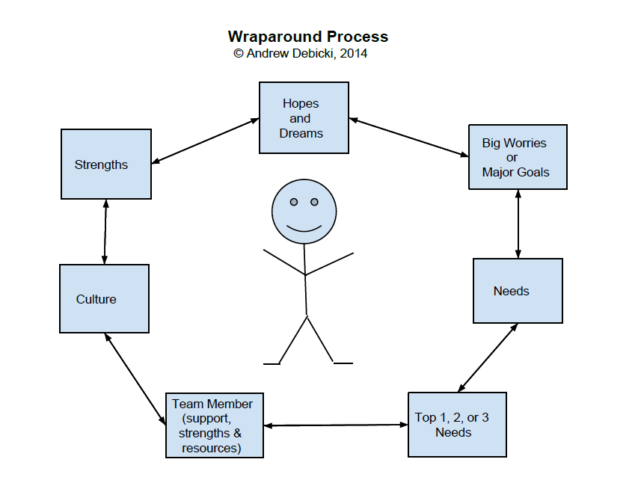
How Does The WrapAround Process Work?
THE FACILITATOR ASSISTS THE OLDER ADULT IN IDENTIFYING THEIR:
Hopes and Dreams or their vision of a better life
Strengths and Older Adult Culture
Long Term Goals and the key needs that must be addressed to achieve them
People whom they want to be on their WrapAround Team; they can choose to include their friends, extended family, community support people and professional services providers with whom they are involved.

Slide 10
How Does The WrapAround Process Work?
The team brainstorms strategies or options that build on the strengths and resources of the older adult and their team
Key to the success of WrapAround is that the older adult pick who will be on their team, what they want to work on, the strategies that they want in their Action Plan and how fast they want to work on that plan.
The older adult’s team meets on average at least once a month to both develop and then review their Action Plan.
It is important to track success with respect to the plan put in place to address the needs that the older adult has identified.
One of the primary reasons that the WrapAround process has been so successful is that it makes the necessary shift from collaboration to integration
Another reason for its success is that the service system supports the local community and the neighborhood that the older adult lives in to get involved and take charge of this initiative

Slide 11
The Guiding Principles of WrapAround
1. Family/Senior Voice and Choice This affirms that the senior is the expert of their own situations and should be integral to the process. | 6. Culturally Competent The process respects and builds on the values, preferences, beliefs and culture of the senior.
2. Team Based Process is undertaken by a team and should involve individuals who are committed to the senior’s wellbeing. | 7. Individualized All plans are uniquely tailored to fit the senior.
3. Natural Supports The model encourages the full participation of individuals drawn from the senior’s natural supports and networks. | 8. Strengths Based The process is built on the strengths, skills, expertise and assets of each senior and family.
4. Collaboration Team members work together and share the responsibility of implementing the plan. | 9. Persistence The team is committed to implementing a plan that reflects the WrapAround principles even in the face of limited system capacity.
5. Community Based The plan strives to implement service and support that is accessible to family. | 10. Outcome Based The team ties goals and objectives to measurable indicators and outcomes. The team is accountable for achieving the goals laid out in the plan.
LIFE DOMAINS
Housing
Safety
Financial
Spiritual
Family
Social
Health
Legal
Recreation

Slide 12
WrapAround Core Values
WrapAround helps people to articulate their hopes and dreams, puts them in charge of their own life-planning process and gives them hope.
Be respectful and to be respected | Person or Family Directed
2. The right to be listened to and to truly be heard and understood | 6. The right to care and support even when the person is dealing with multiple and ongoing complex needs
3. “No blame, No shame”- what happens in the past stays in the past, we focus on now and the future | 7. The right to be part of and contribute to their community
4. Know that you are a sacred part of creation and recognize that you have purpose | 8. Truth and honesty

Slide 13
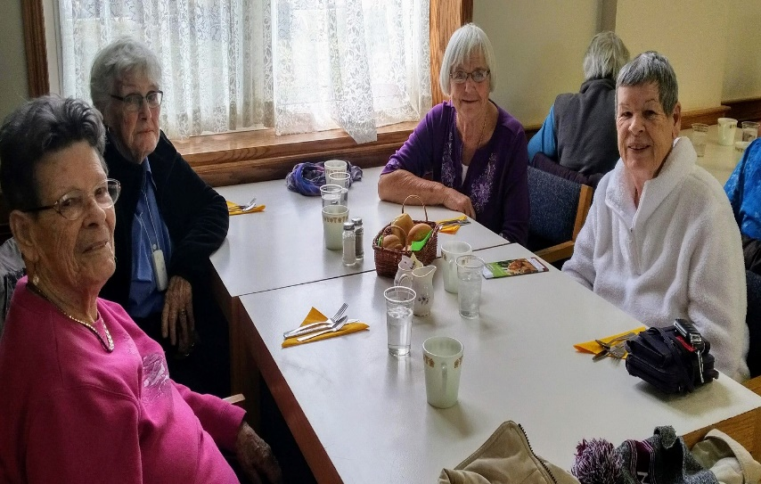
The Four Phases of WrapAround
Four Phases of WrapAround
Engagement: referral made by organization, family member, etc.
Listen to their story and reflect it back
2 to 4 meetings to complete the “Strengths/Needs/Culture Discovery”, a list of the participants strengths, culture, hopes and dreams, needs and the people they want on their WrapAround team.
Team-Based Planning
2nd and subsequent team meetings held (monthly or as needed)
Implementation
Follow up with the participant and each team member after the first team meeting at least once and more often as necessary
Continuously reviewing the plan and making changes as needed
Transition
When goals have been achieved, start 6 week or 3 month countdown to assist the participant to transition out of WrapAround.
Summarize success, do anticipatory planning for future challenges with participant and, in some case, their team members
Follow up as necessary and as agreed upon

Slide 14
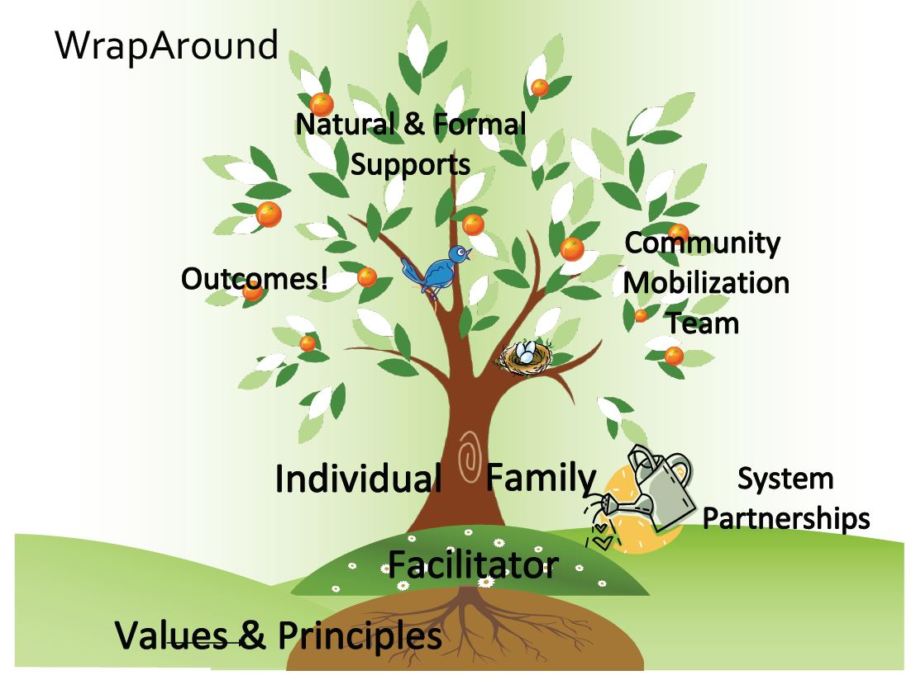
STEPS IN THE WRAPAROUND PROCESS
A facilitator will be assigned and will call to set a time to meet with the entire family
The facilitator will assist your family to recognize the strengths of all members
The facilitator will assist your family to arrange a time for all family team members to meet
4. You and your family will identify the goals you would like to achieve
5. The family team will help you plan and figure out how to reach those goals
6. The family team will meet regularly to assess the success in moving toward reaching the goals, to re-think any parts of the plan that aren't working and to celebrate successes

Slide 15
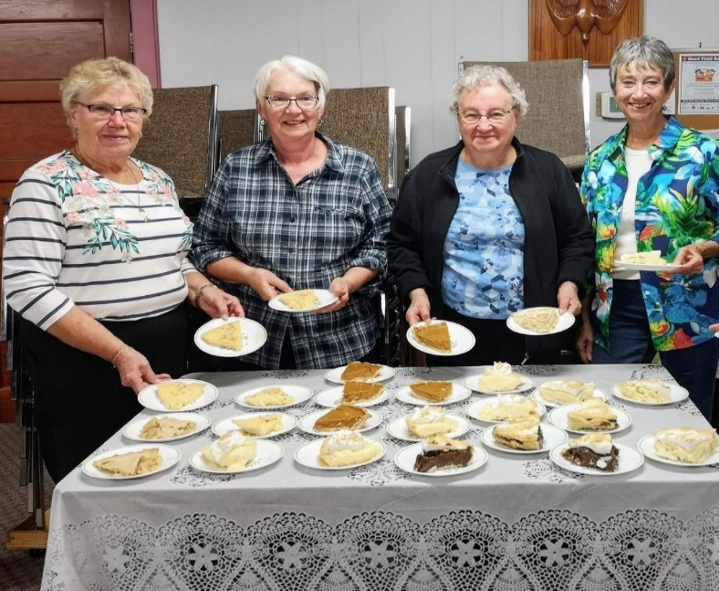
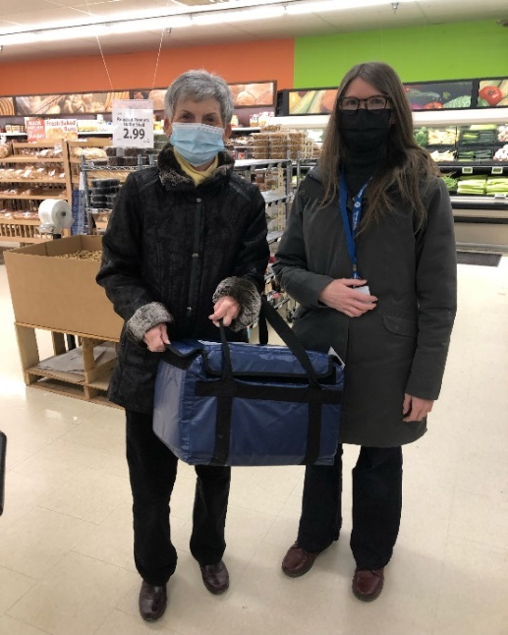
Our Core Programs
Nutrition
CCN volunteers deliver meals to clients who find it difficult to go grocery shopping and/or cook for themselves
These also serve as a safety check for some of our isolated clients
Our popular dining programs have started to resume, where clients can meet and share a meal with others in their community
In-Home Support
Home Help and Maintenance aide clients by completing household tasks they may not be able to easily perform themselves
Our Home First and Home at Last programs help clients transition from hospital to their homes with the help of our Personal Support Worker staff
While these are paid programs, Home Help and Maintenance are often looking for new workers to take on clients from their waitlist

Slide 16
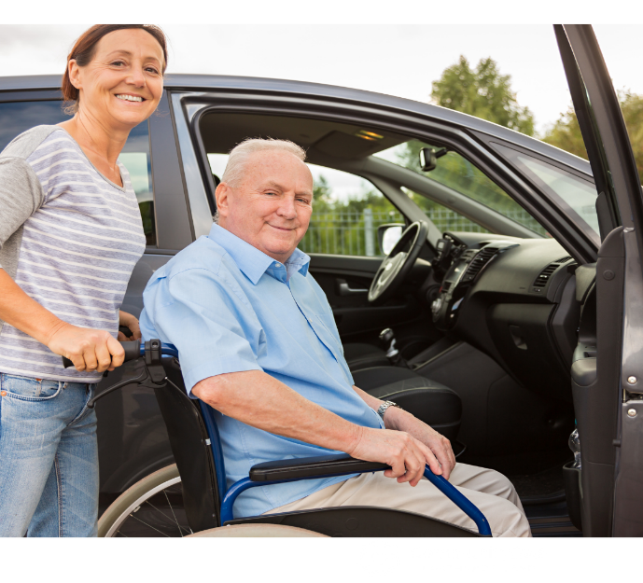
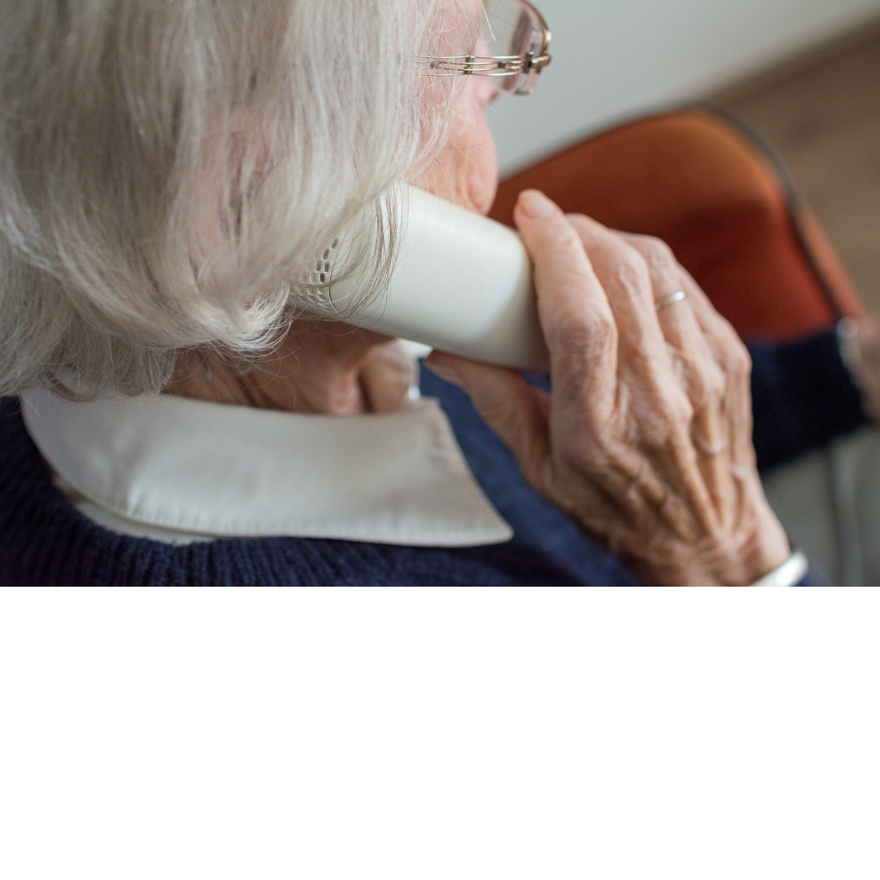
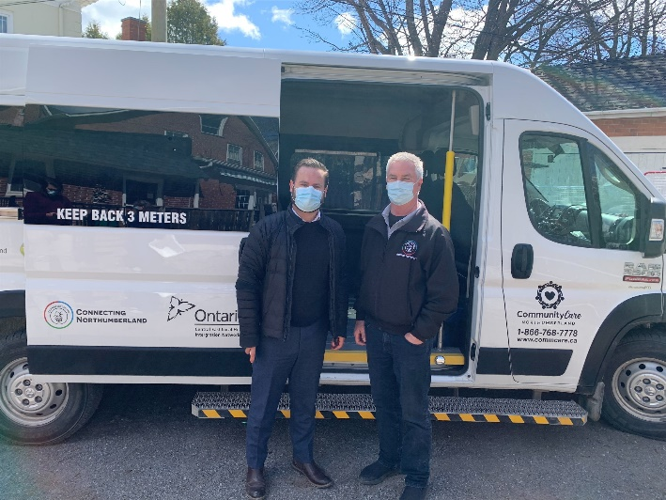
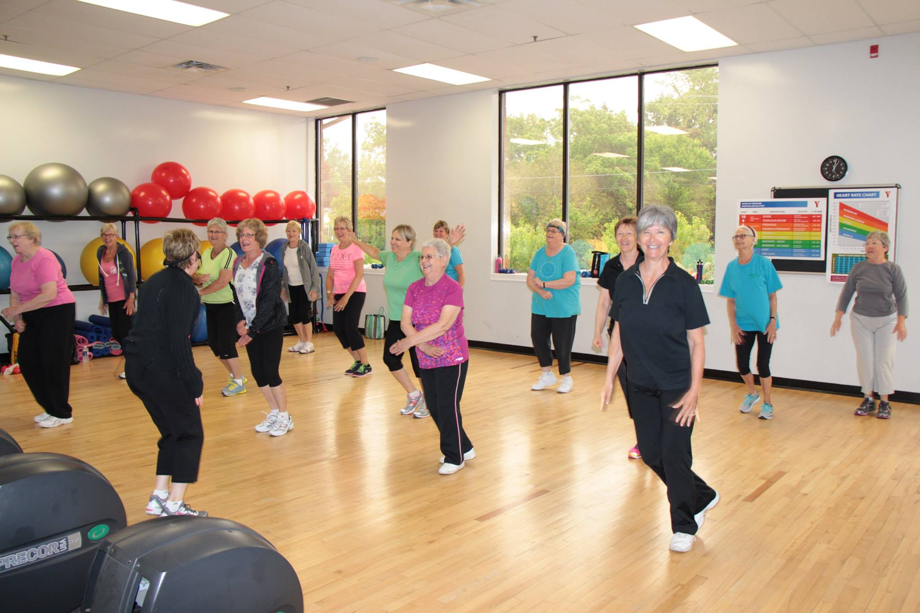
Our Core Programs
Transportation
We continue to support the mobility needs of our clients by offering transportation to essential appointments such as chemotherapy, dialysis, COVID-19 vaccine clinics, and medical appointments
Volunteers pick up clients in their own vehicles and drive them to appointments and drop them off back home. Volunteer drives are reimbursed some gas mileage (50 cents/km)
Wellness
Our wellness volunteers support our clients through:
personal distress alarm installation
reassurance calls
friendly visiting

Slide 17
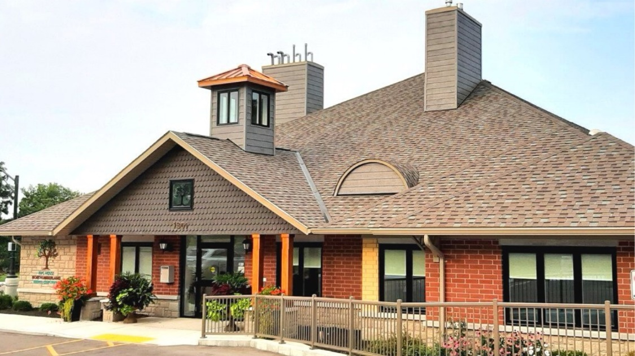
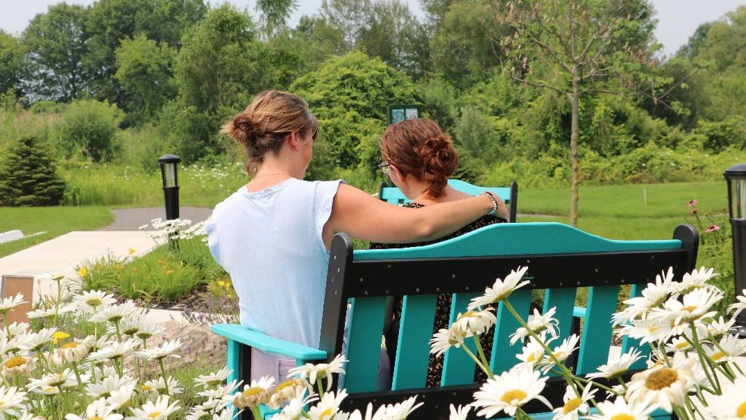
Hospice Volunteering
Hospice volunteers assist in two areas:
Ed’s House
Community Hospice
Ed’s House volunteers help support the day to day operations at Ed’s House including reception, and kitchen.
Community Hospice volunteers provide support and respite to individuals in our community and their families in their homes
*Hospice Services offered at Ed’s House are offered at no cost to clients, families and loved ones
www.edshouse.northumberlandhospice.ca

Slide 18
Our Impact Serving Almost 5000 Residents In the County
37,620
Meals on Wheels delivered
26,241
essential drives completed
470
home help & maintenance clients supported
17,517
social and safety visits provided by staff and volunteers
222
virtual exercise class participants
231
Home at Last (HAL) clients supported
431
community hospice clients supported
109 plus
residents and their families supported at Ed’s House
*Based on 2021-22 actuals

Slide 19
Volunteer Recruitment & Training Opportunities
For volunteers interested in becoming WrapAround facilitators, some of the skills and experience the program would consider as helpful for applicants, include:
Experience supporting seniors (e.g. as friend/family caregiver)
Other volunteering and volunteer training
Excellent communication and listening skills
Ability to form professional and comfortable working relationships with a wide range of people
Empathetic and caring
General knowledge of:
Community support groups (may include faith communities, senior’s programs and centres, service clubs); and
Health care services and social services available throughout Northumberland County.
Stay tuned for more information on the next facilitator training hosted by Wrap Canada in the Fall 2022

Slide 20
How to Access the Volunteer Peer Support Service
REFERRALS
Individuals can:
Self-refer
Be referred by a family, friend or caregiver
Be referred by a doctor, primary care provider or another community service provider
ELIGIBILITY CRITERIA
Older adults residing in Northumberland County, and
Are experiencing complex and persistent problems/conditions or are caring for someone with multiple complex and persistent problems/conditions, and
Are agreeable to a WrapAround process, and
Efforts by service providers have not been able to help the adult to effectively address their needs.
FEES
There is no fee for the services we provide in the Volunteer Peer Support Program

Slide 21
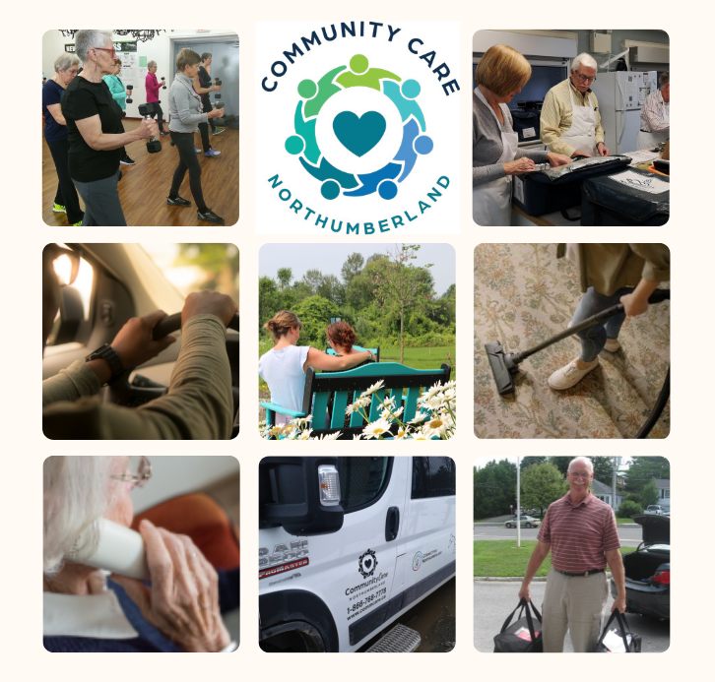
CONTACT
RECOGNIZING CONTRIBUTIONS TO CCN:
CCN wants to recognize Brighton Rotary as being approachable and willing to work with local not-for-profits
CONTACT:
Colleen Williams,
Volunteer Recruitment Coordinator
905-885-7224 x 108
c.williams@commcare.ca
volunteer@commcare.ca
Kelly Peterson,
Volunteer Peer Support Coordinator
905-373-2998
k.peterson@commcare.ca
www.commcare.ca
You can follow us on Facebook and Instagram to keep up to date with special events, fundraising, and open positions. Please let us know if you’d like to be added to our monthly newsletter!
@commcarenorthumberland Community Care Northumberland

