Slide 1
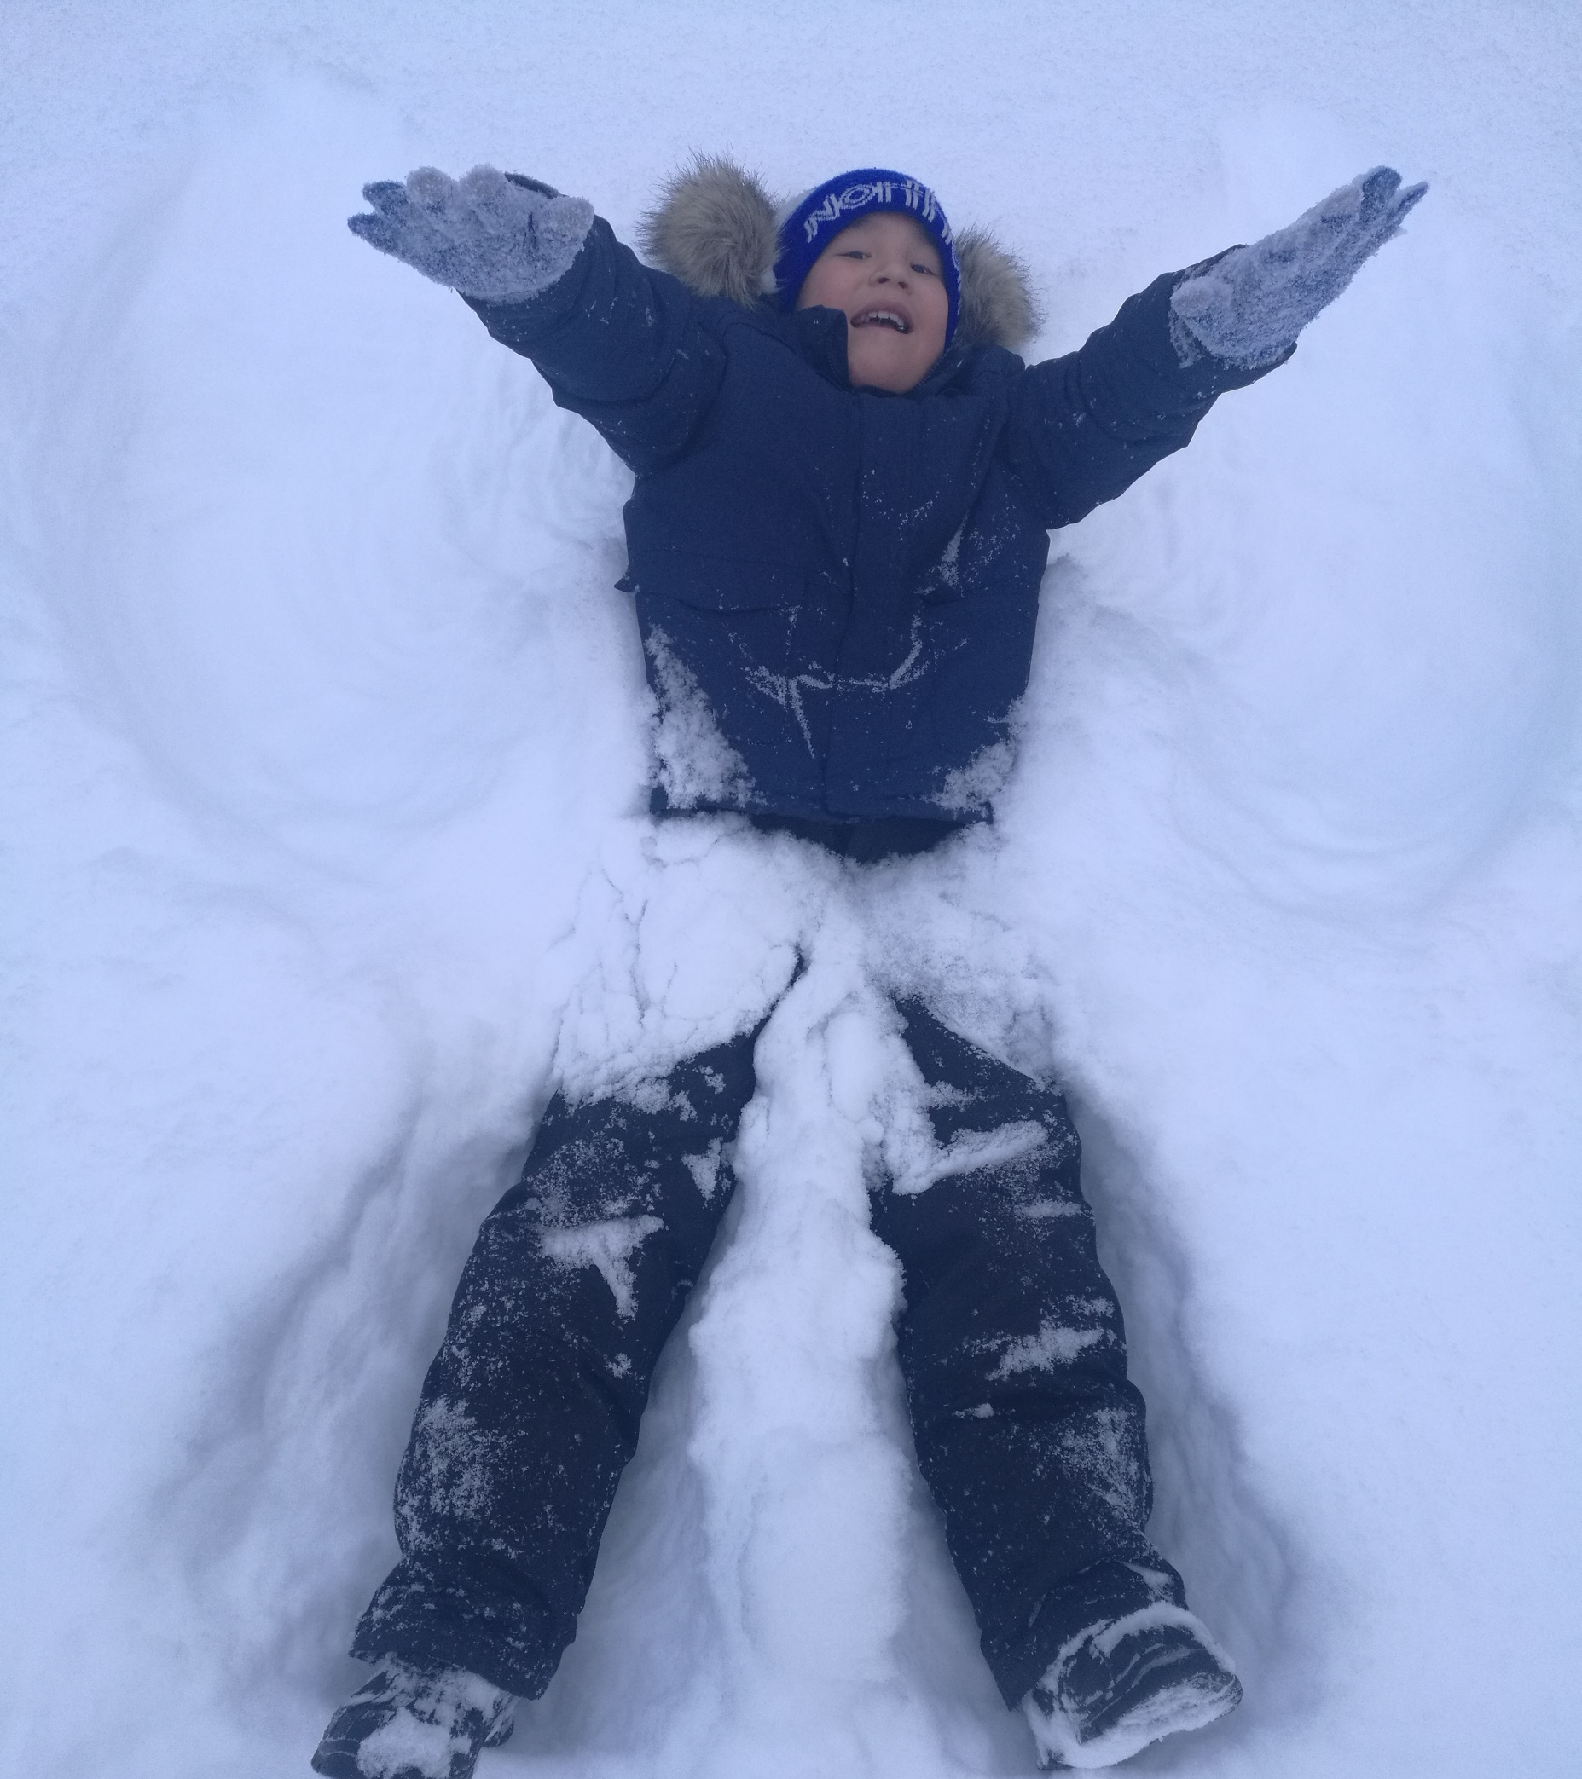
Sachigo Lake FN Community
Notes:
Located 500 km north of Sioux Lookout this community is a fly-in FN community
On winter roads it is possible to travel to Souix Lookout in 13-15 hours and then to Winnipeg in 5 hours;
Population of approximately 600 people;
Unemployment is a significant problem. The school, health centre, Northern grocery store and band office are the only possibilities for employment, which leaves many without an occupation;
Although this is a dry community there is a significant drug addiction issue. The number of clients at the suboxone clinic across the street from the school is a testimony to this problem.
Many students come to school hungry.

Slide 2
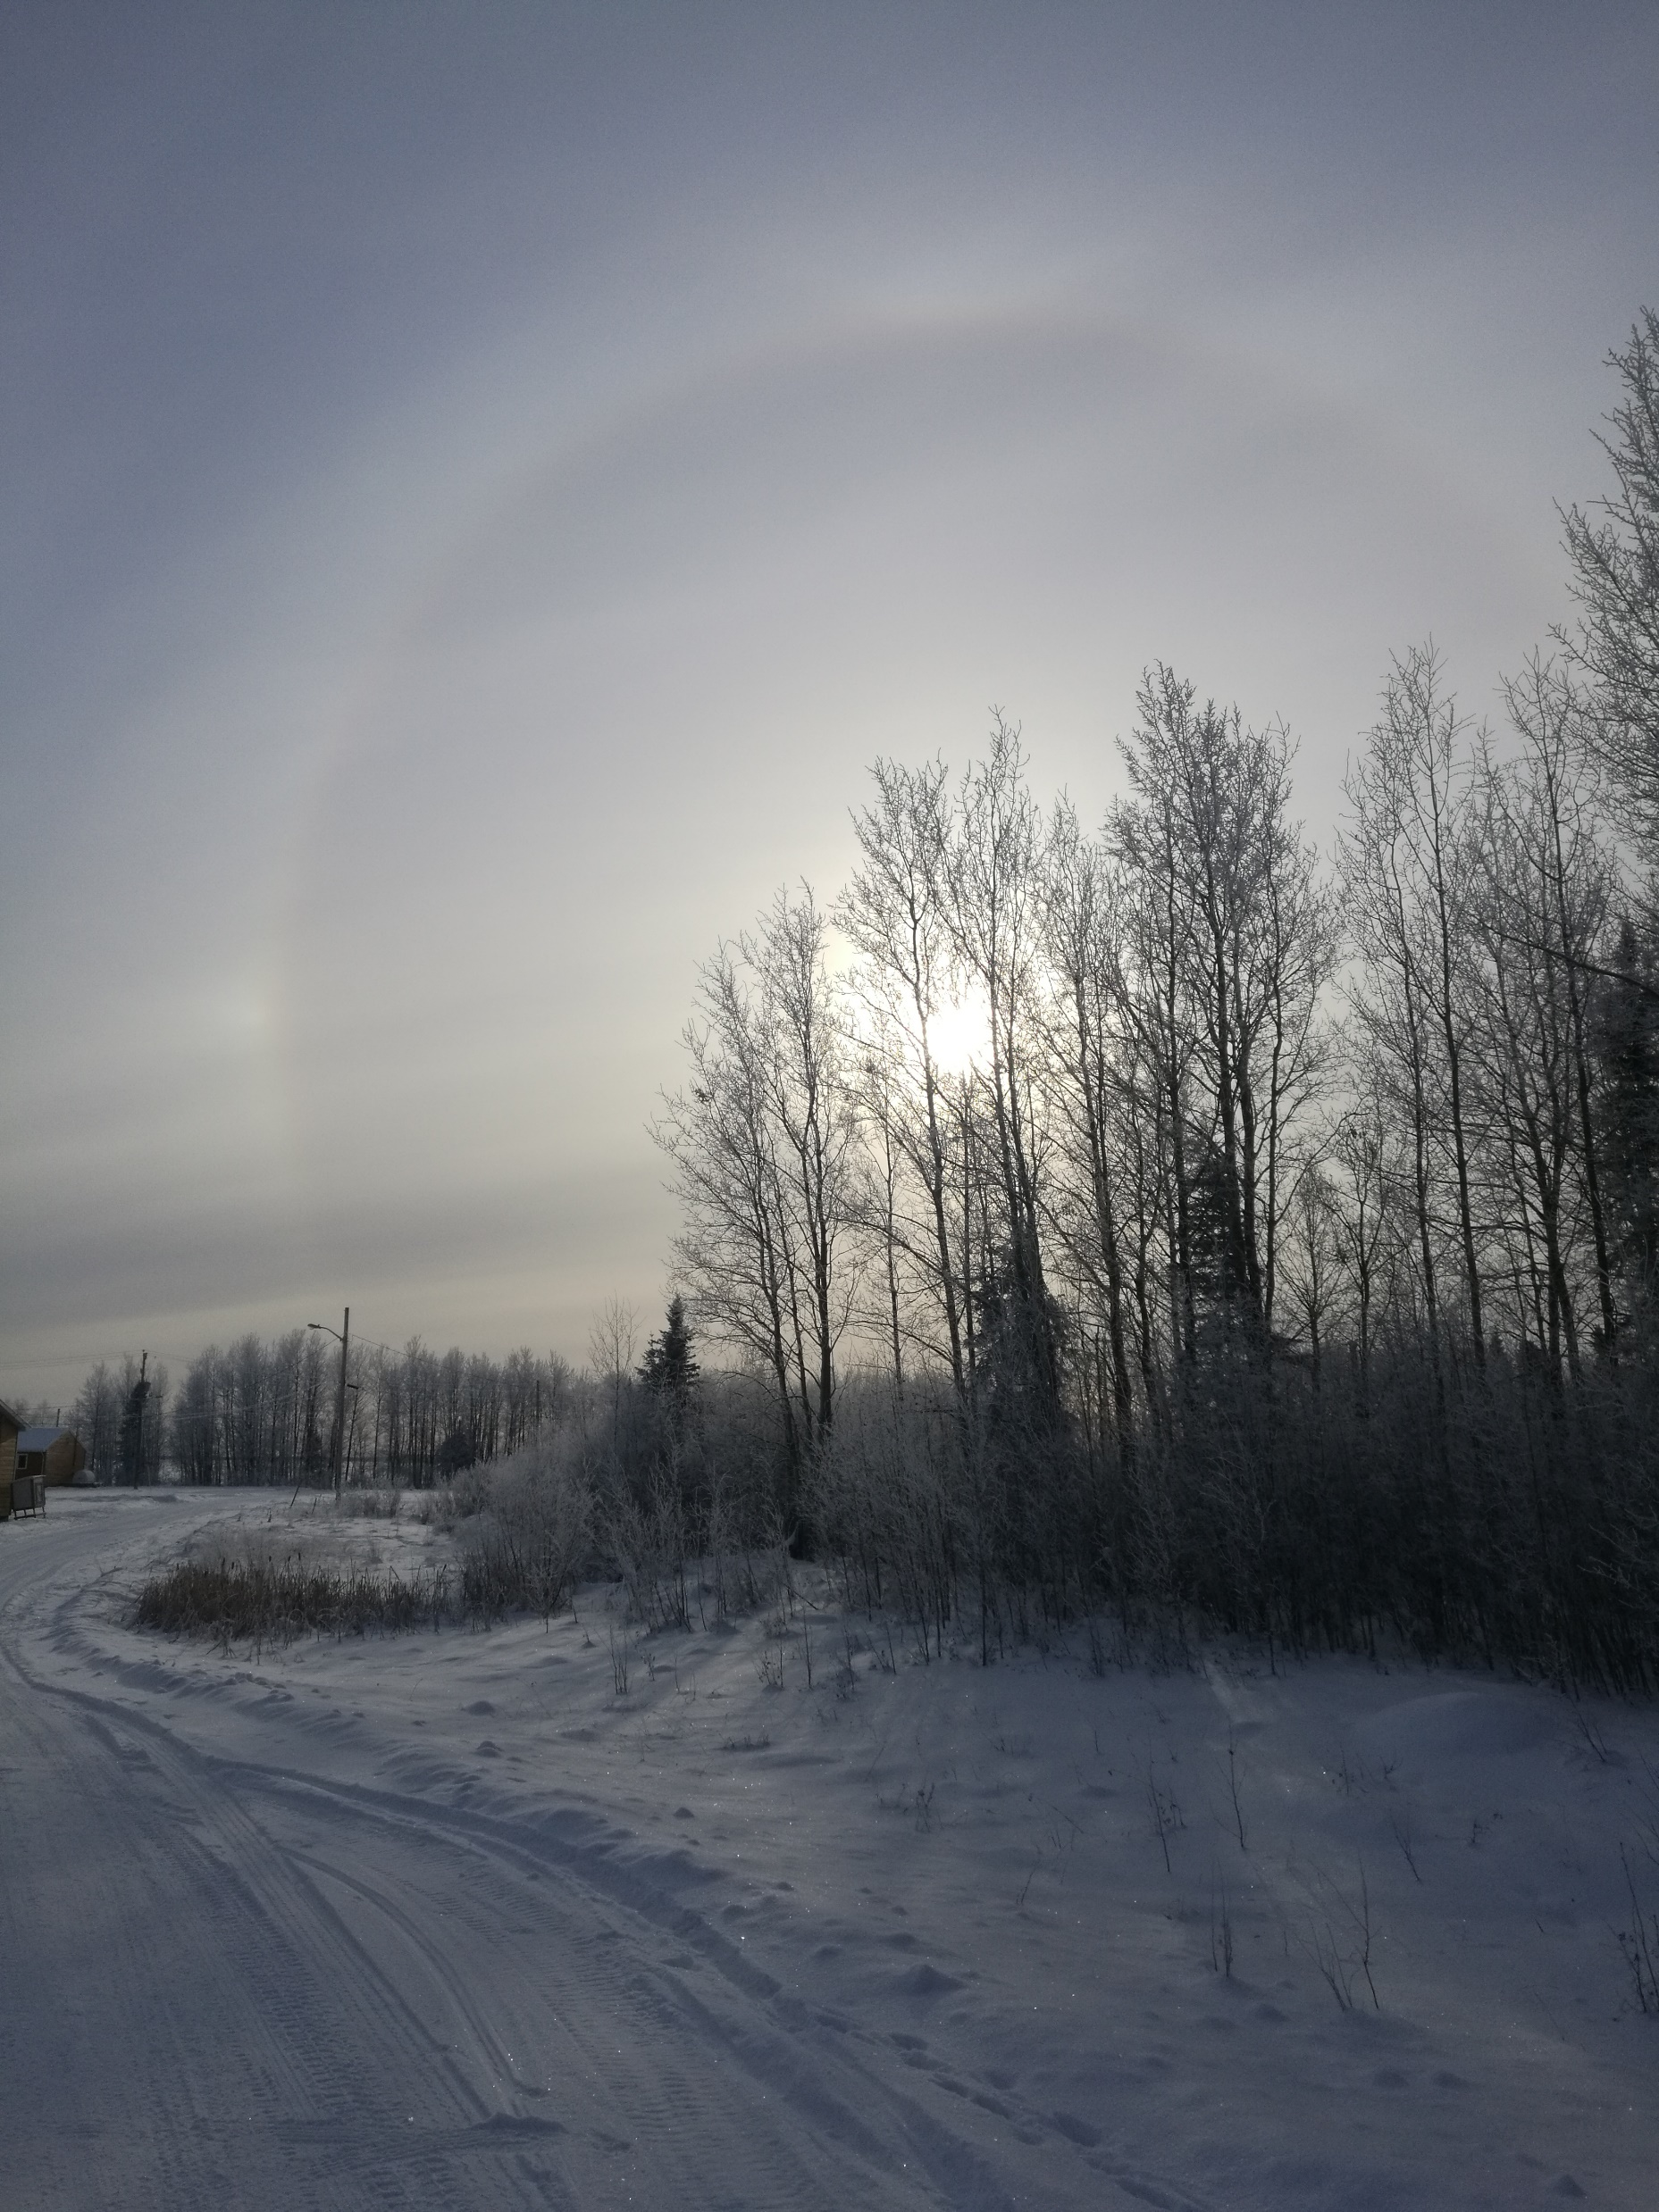
Introduction to
Martin McKay Memorial School
Notes:
Sachigo held many beauties, including Sachigo Lake. Whether, it was summer or winter there was so much happening in and on the lake. Of course, during the winter, temperatures would fall to -45 degrees Celsius for at least a couple of weeks.

Slide 3
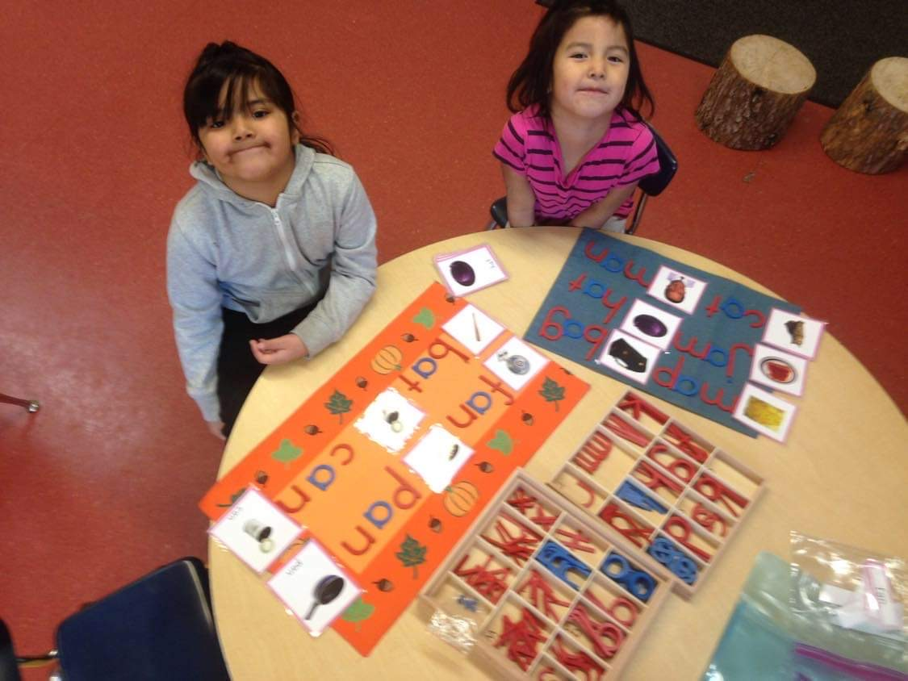
Notes:
These girls like many of the K4/5s demonstrate that they like many of their peers across the province are quite capable of learning. Sadly, their aspirations of future careers dwindle quickly through the elementary school years. The girl in the pink wanted to become a doctor when she was in K4.

Slide 4
Notes:
Rosemary the cook, prepares Bannock, which everyone loves. It is a very simple recipe of flour and water, but not easy to make. Small portions are fried in a pan. The majority of the food is flown in. The school provides a breakfast and lunch program, which is sorely needed. The food pickup from the airport for the school every couple weeks is a big effort requiring many hands.
Prices for some fresh goods are subsidized at the local Northern grocery store but sadly the majority of the quick carbs are the cheapest.

Slide 5
A good plan for Brighton, not Sachigo… but fun.
Notes:
In an attempt to introduce raising chickens, we hatched eggs and built a hen house and coop. Sadly the chickens did not survive which is no surprise given the local temperatures.

Slide 6
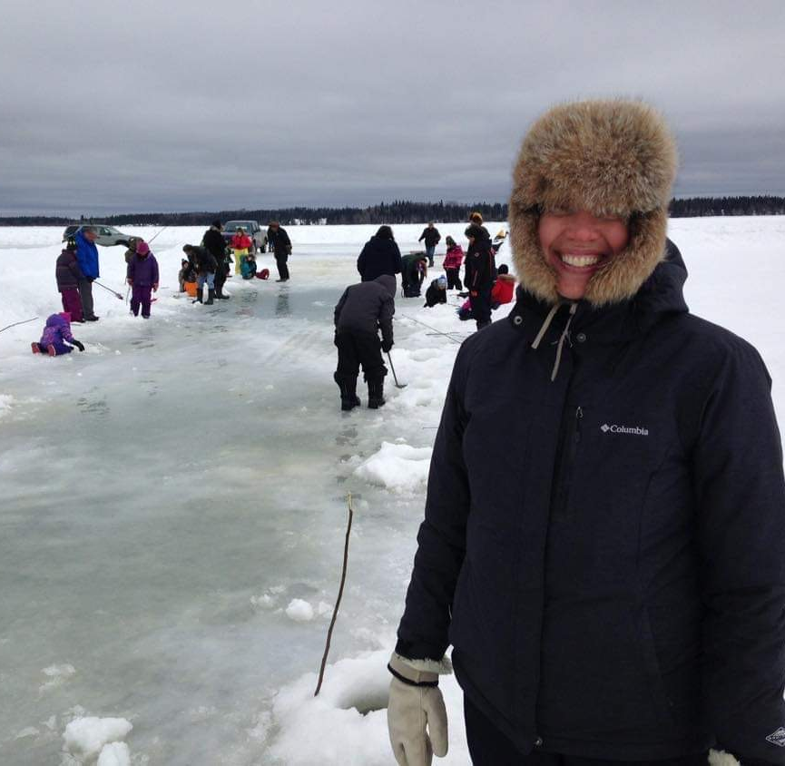
Cultural FN Learning – Place-based
Martin McKay Memorial School
Notes:
Everyone gets involved with fishing. When there is a derby, one learns to whisper.

Slide 7
Notes:
These two were my constant companions. Highway was the husky’s name. He refused to come inside and loved life. On one occasion when I attempted to tie him outside the school when there was a culling of stray dogs. He chewed the rope not once but into many noodles. He was there for the three years I was there and I very much appreciated his companionship as I walked to school and throughout the community.

Slide 8
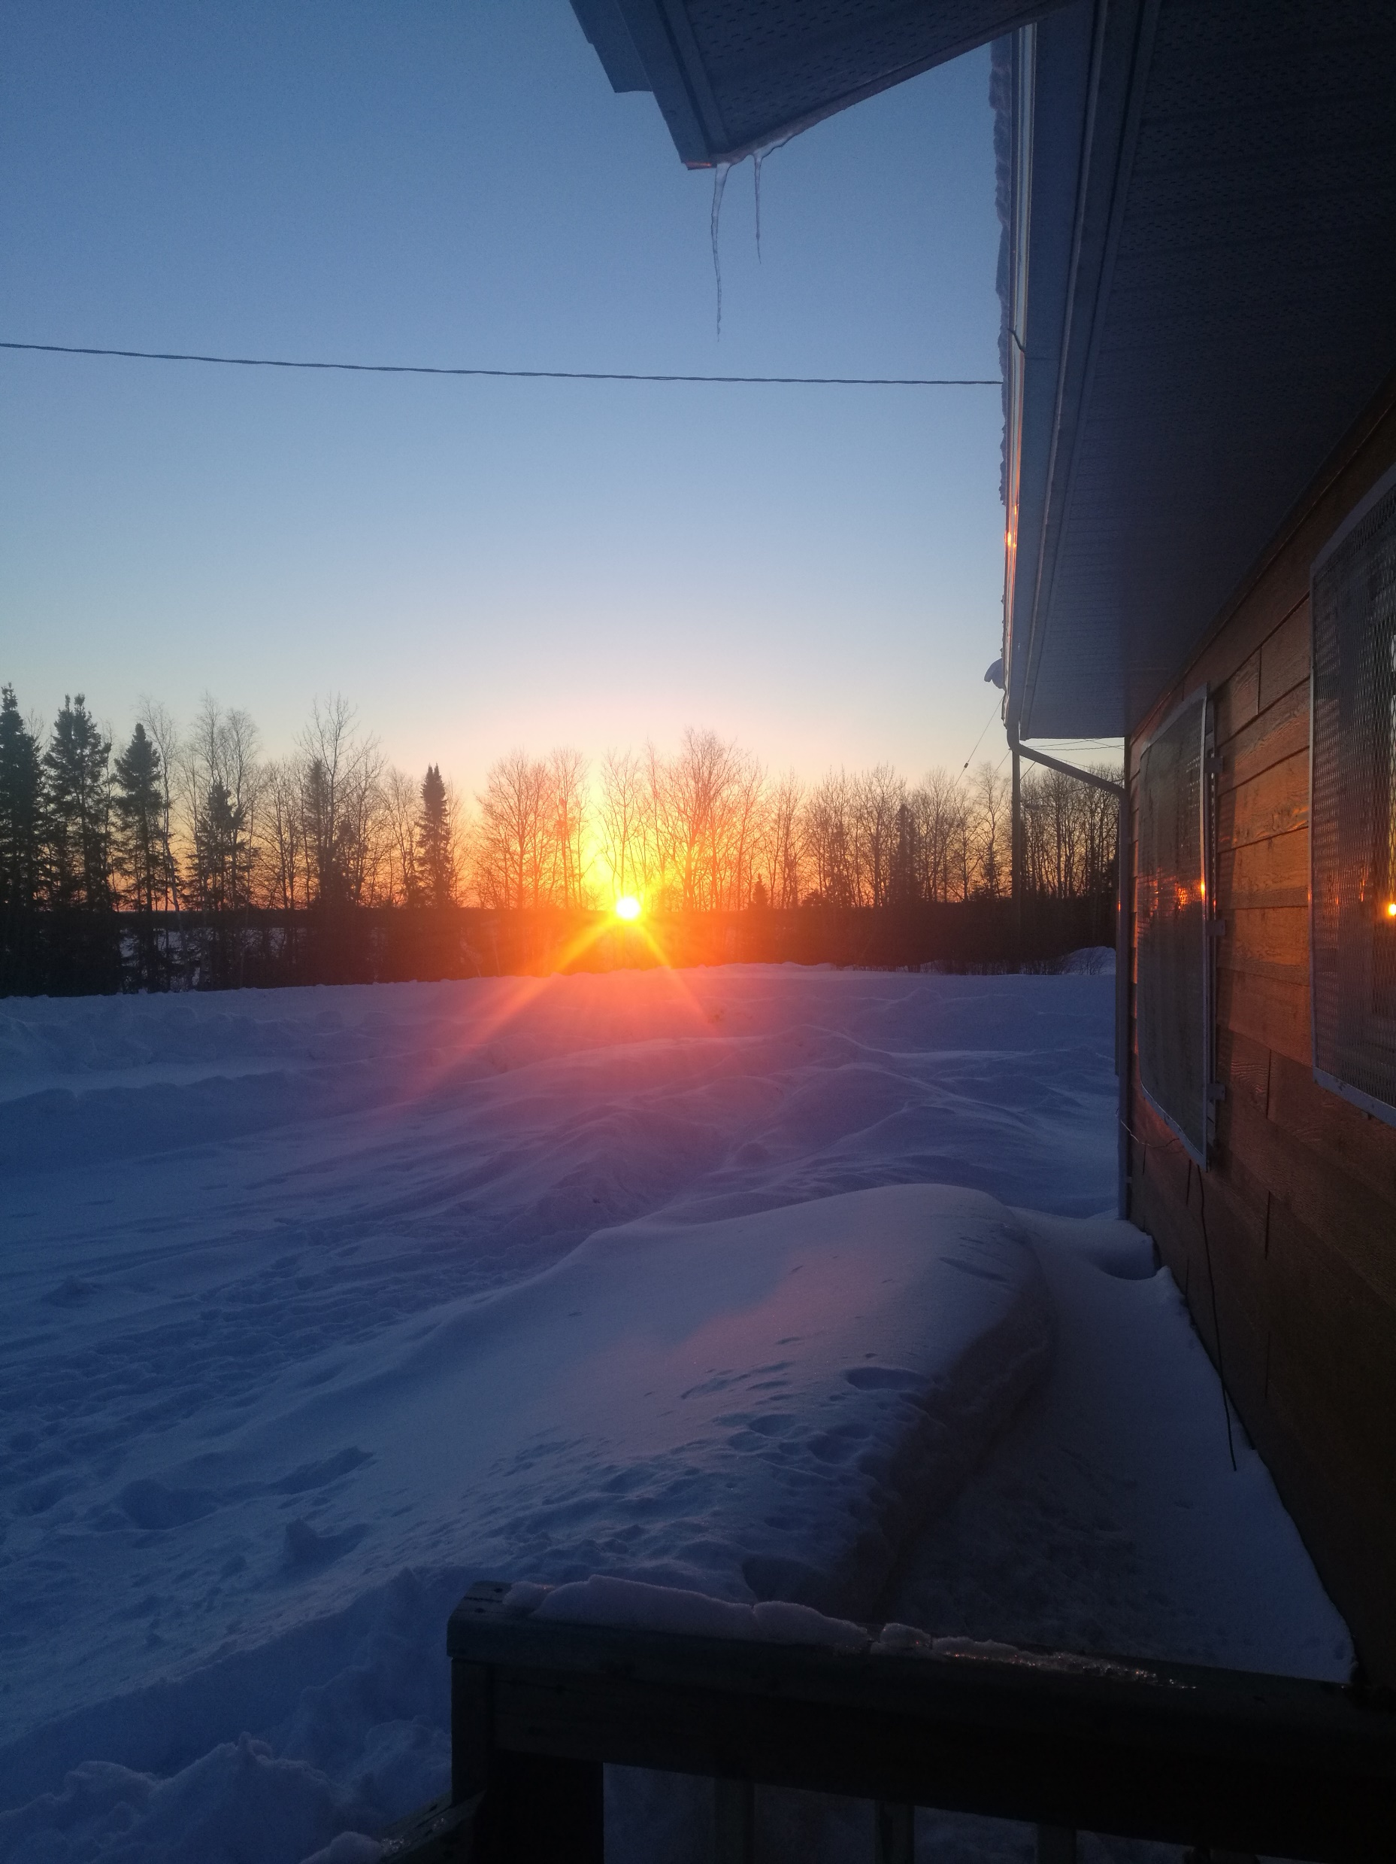
Notes:
This young lady like many youth, suffered too much. Her parents would separate in her third grade of schooling. Like many other students she would come to school hungry.

Slide 9
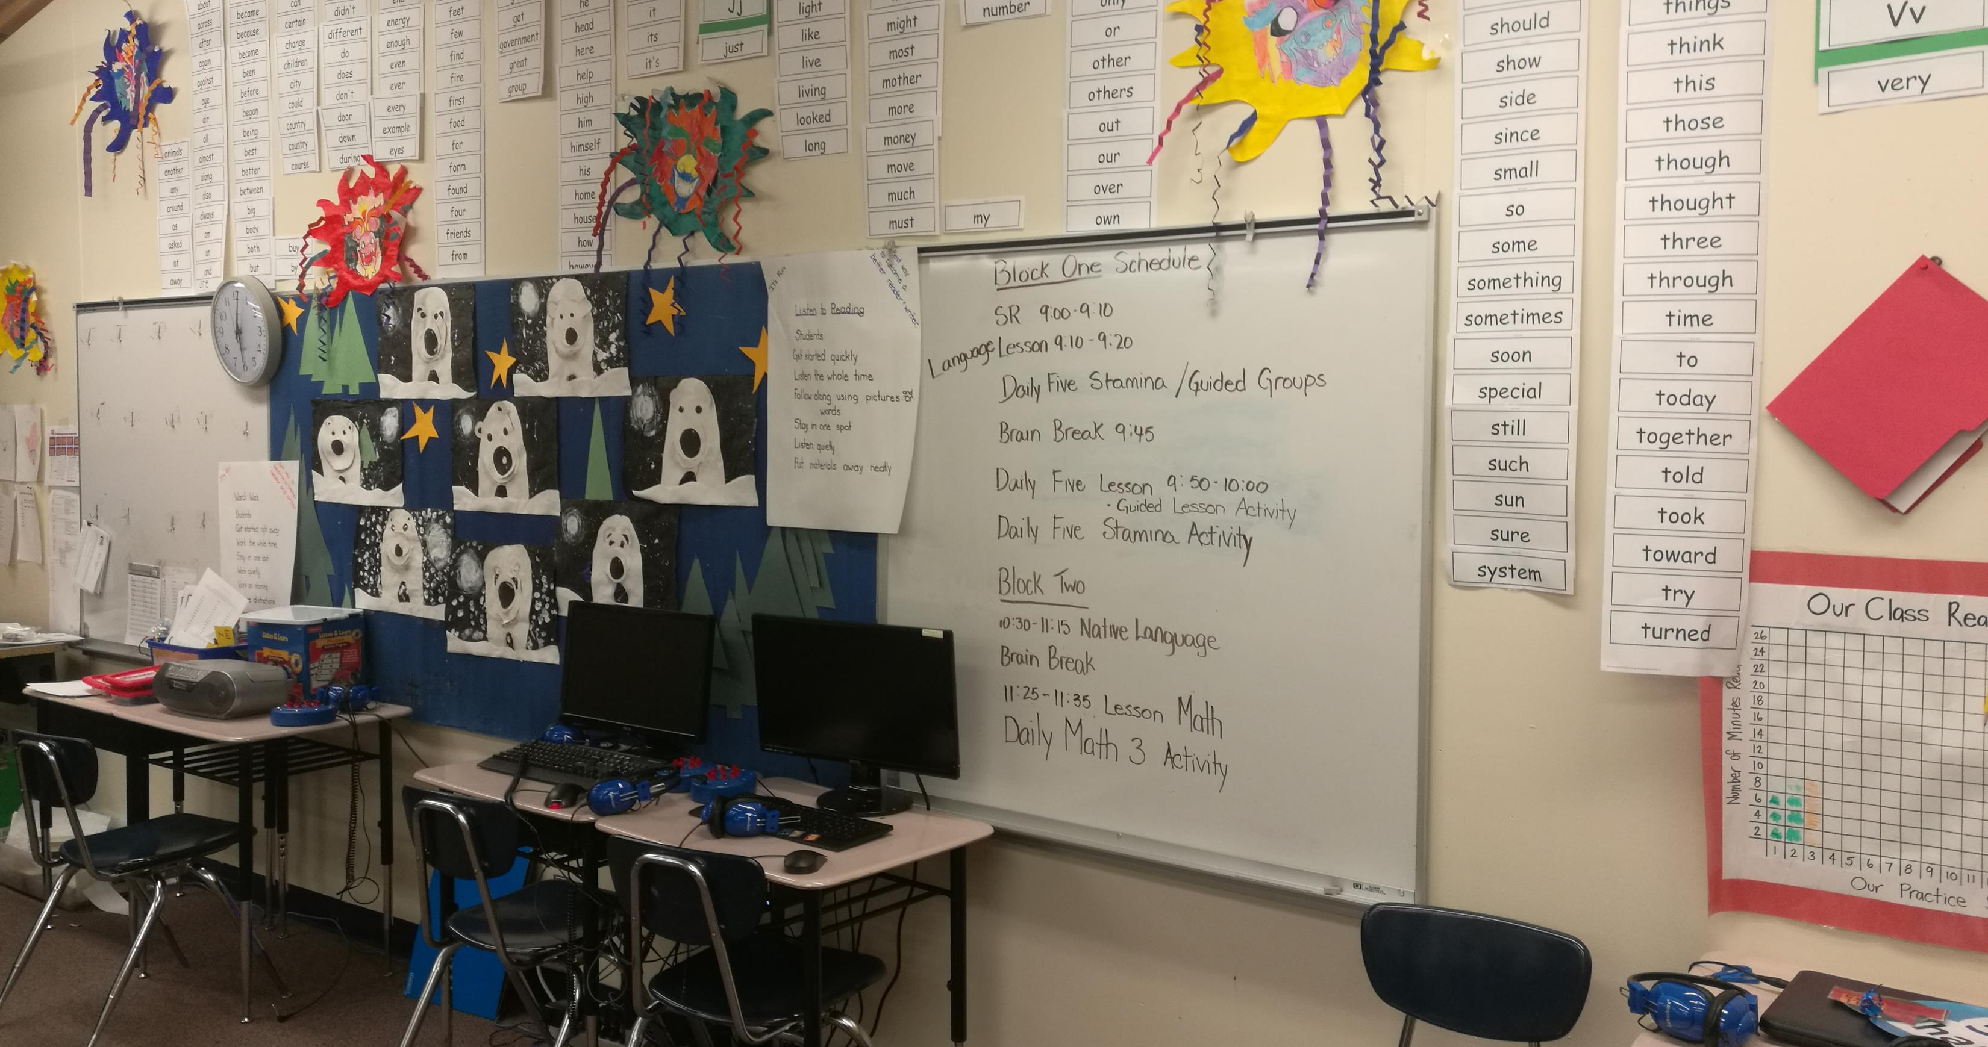
Notes:
The school was a safe haven for all and was well-equipped. Sadly, the technology required the know-how to fix it when necessary and that was not always available. In fact, skilled labour was often lacking.

Slide 10
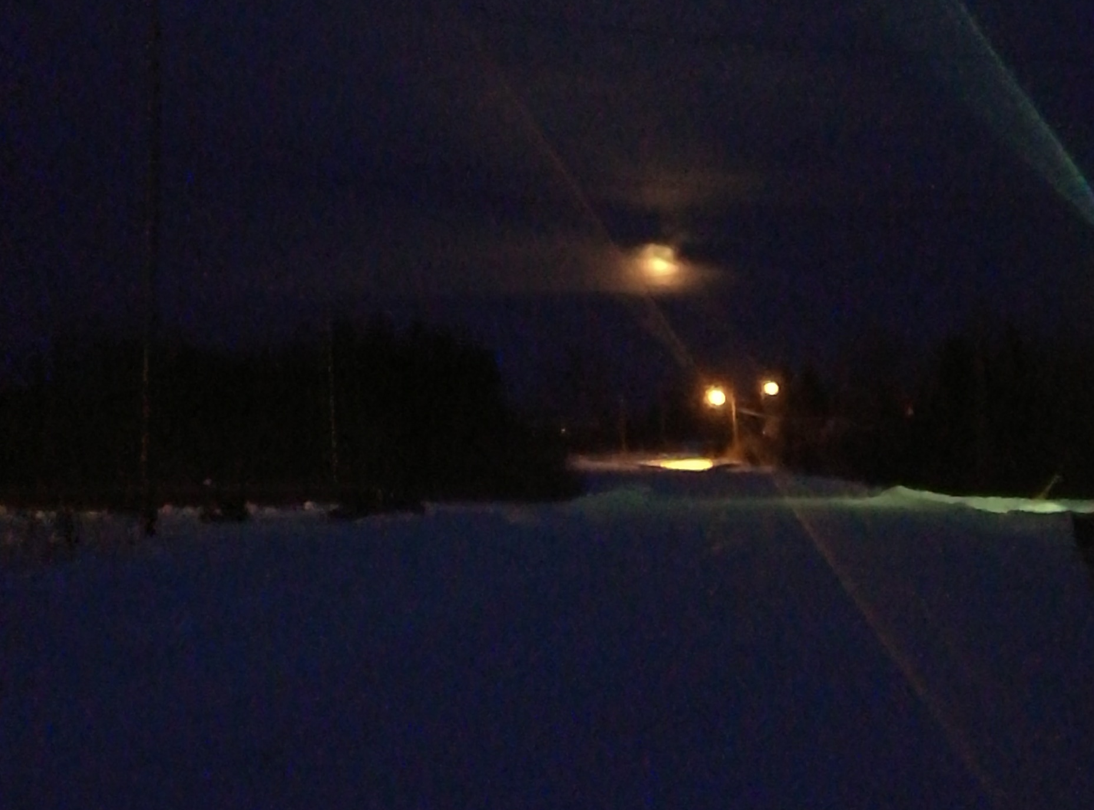
Notes:
In the winter months, following the after school program, it was dark by 5:00 pm. Walking home was always a special quiet time.

Slide 11
Notes:
Early morning sunrise across Sachigo Lake.

Slide 12
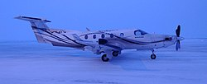
Highschool in ThunderBay
This Photo by Unknown Author is licensed under CC BY-NC-ND
This Photo by Unknown Author is licensed under CC BY-SA
Notes:
Highschool in ThunderBay had become a deadly gamble……………………………See book “Seven Fallen Feathers”

Slide 13
In memory of…….
Theodore
Notes:
There were so many funerals and memorials in the community. Life is hard and so no surprise, the life expectancy for an indigenous male is significantly less than that for a Caucasian male. This man was both a friend and social worker at Martin McKay Memorial School who passed away from lung cancer in the summer of 2022.

Slide 14
